Slide 1
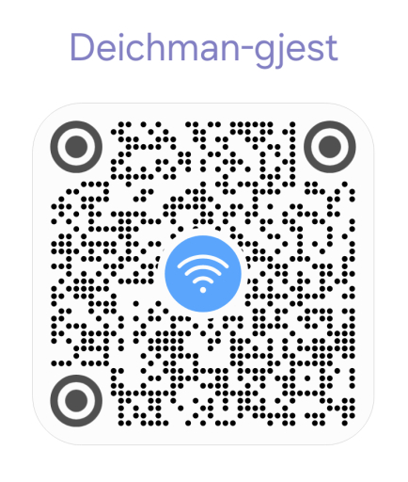
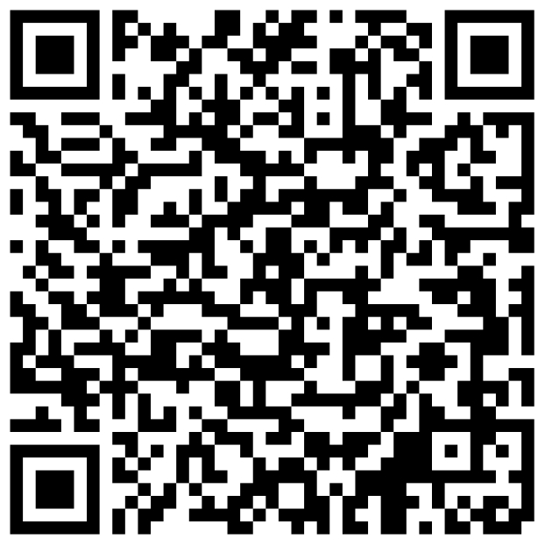
Free Wifi Network
Guest are requested to register

Slide 2
Time | Activity
1745 | Gathering and Networking
1800 | President starts and welcome guests
1805 | Toastmaster of the Evening introduces the theme and the team
1818 | Prepared speeches
1850 | Break
1900 | Table Topics
1930 | Evaluations
1950 | Reports, Awards and Thanks
{{meeting_theme}}

Slide 3
Oslo Toastmasters Club
{{meeting_date}}

Slide 4

{{President_Presenter}} President’s Welcome

Slide 5
{{Toastmaster_Presenter}} Toastmaster of the Evening

Slide 6
Timer
Grammarian
Ah and Vote Counter
General Evaluator
TAGG Team
of Today’s Meeting

Slide 7
(1:00 min)
Timer
{{Timer_Presenter}}
The Timer makes sure the meeting runs on time and helps speakers develop discipline with timing.

Slide 8
(1:00 min)
Ah and Vote Counter
{{AhVoteCounter_Presenter}}
Ah-Counter = listens for filler words. Vote Counter = ensures fair voting and recognition & has tie breaker vote

Slide 9
Word of the Day
(1:00 min)
{{word_of_the_day}}
Grammarian
{{GrammarianWordoftheDay_Presenter}}
The Grammarian supports members in building better English speaking habits through vocabulary and grammar awareness.

Slide 10
(1:00 min)
General Evaluator
{{GeneralEvaluator_Presenter}}
The General Evaluator is like a quality checker of the entire meeting, ensuring everyone learns not just from their own roles, but also from how the meeting is conducted overall and gives feedback on it.

Slide 11
{{Toastmaster_Presenter}} Toastmaster of the Evening

Slide 12
Prepared Speech Contest

Slide 13
{{Speaker1_Project}}
{{Speaker1_Description}}
({{Speaker1_Min}}-{{Speaker1_Max}})
Evaluator:
{{1stEvaluator_Presenter}}
{{Speaker1_Name}}
“{{Speaker1_Title}}”

Slide 14
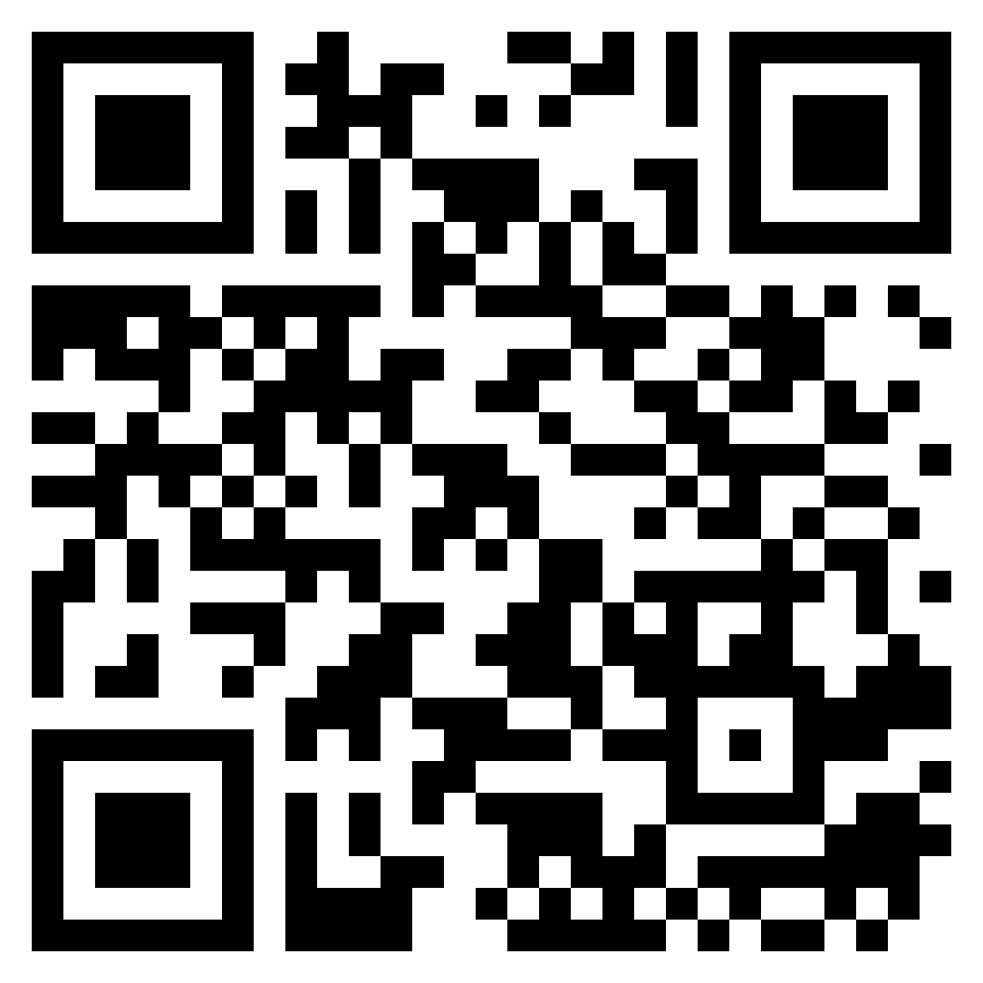
https://bit.ly/OTM-fb
Notes:
Feedback for each speaker

Slide 15
{{Speaker2_Project}}
{{Speaker2_Description}}
({{Speaker2_Min}}-{{Speaker2_Max}})
Evaluator:
{{2ndEvaluator_Presenter}}
{{Speaker2_Name}}
“{{Speaker2_Title}}”

Slide 16
https://bit.ly/OTM-fb
Notes:
Feedback for each speaker

Slide 17
{{Speaker3_Project}}
{{Speaker3_Description}}
({{Speaker3_Min}}-{{Speaker3_Max}})
Evaluator:
{{3rdEvaluator_Presenter}}
{{Speaker3_Name}}
“{{Speaker3_Title}}”

Slide 18
https://bit.ly/OTM-fb
Notes:
Feedback for each speaker

Slide 19
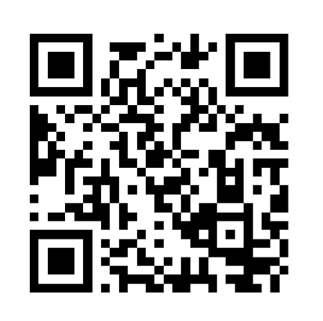
Best Speaker Voting [Timer’s report]
https://bit.ly/OTMspeech
Notes:
Best Speaker

Slide 20
BREAK

Slide 21
Free Wifi Network
Guest are requested to register

Slide 22
Table Topics Contest
Table Topics Master
{{TableTopicMaster_Presenter}}

Slide 23
Rules 📋
Max. 30 seconds for thinking
Introduction of the participant name - topic - topic - name
Green Card 🟩 1:00 minimum qualified time
Yellow card 🟨 1:30
Red card 🟥 2:00
After red card: 30 seconds left to wrap up
Guests are encouraged to participate 🙋‍♀️🙋‍♂️
Evaluation Criterias
Content & Structure
Delivery
Language Use
Engagement
Timing

Slide 24
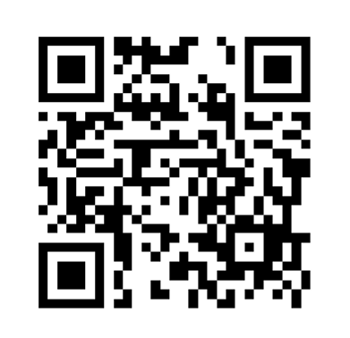
Best Table Topic Speaker Voting [Timer’s report]
https://bit.ly/OTM-tt
Notes:
Best Table Topic

Slide 25
Speech Evaluations Contest

Slide 26
(2:00-3:00 min)
{{1stEvaluator_Presenter}}
Evaluating Speech of {{1stSpeaker_Presenter}}

Slide 27
(2:00-3:00 min)
{{2ndEvaluator_Presenter}}
Evaluating Speech of {{2ndSpeaker_Presenter}}

Slide 28
(2:00-3:00 min)
{{3rdEvaluator_Presenter}}
Evaluating Speech of {{3rdSpeaker_Presenter}}

Slide 29
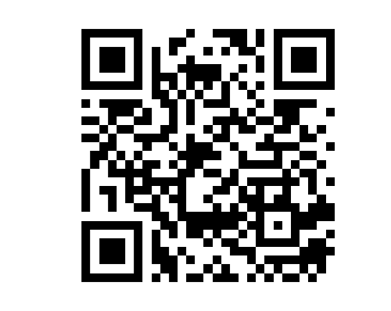
Best Evaluation Speech [Timer’s report]
https://bit.ly/OTMeval
Notes:
Best Evaluator

Slide 30
(2:00-3:00 min)
{{TableTopicsEvaluator_Presenter}}
Evaluating the Table Topics Speakers

Slide 31
TAGG Team’s Report

Slide 32
(1:00-2:00 min)
Timer Report
{{Timer_Presenter}}

Slide 33
(1:00-2:00 min)
Ah Counter Report
{{AhVoteCounter_Presenter}}

Slide 34
Word of the Day
(2:00-3:00 min)
{{word_of_the_day}}
Grammarian Report
{{GrammarianWordoftheDay_Presenter}}
The Grammarian supports members in building better English speaking habits through vocabulary and grammar awareness.

Slide 35
(5:00-7:00 min)
General Evaluation
{{GeneralEvaluator_Presenter}}
The General Evaluator is like a quality checker of the entire meeting, ensuring everyone learns not just from their own roles, but also from how the meeting is conducted overall and gives feedback on it.

Slide 36
Club Business & Awards

Slide 37
Oslo Toastmasters Club
Next Meeting {{next_meeting_date}}

Slide 38
Oslo Toastmasters Club

