Slide 1
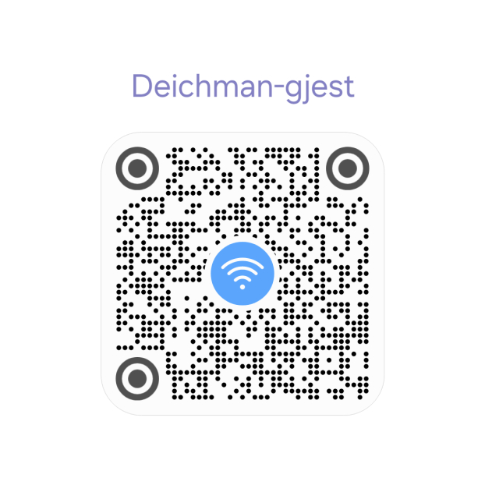
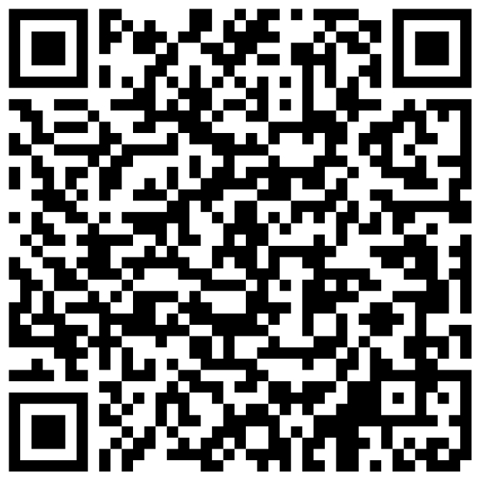
Guest Registration

Slide 2
Oslo Toastmasters Club
Tuesday, 8th July , 2025
Notes:
Presidents Welcome

Slide 3
{{President_Presenter}}
President’s Welcome
Notes:
Introduce yourself and the agenda

Slide 4
{{Toastmaster.Presenter}}
Toastmaster of the Evening
Notes:
Introduce your self and the agenda

Slide 5
Time | Activity
1745 | Gathering and Networking
1800 | President starts and welcome guests
1803 | Toastmaster of the Evening takes charge
 | Prepared speeches
1850 | Break
1900 | Table Topics
 | Evaluations
1945 | Reports, Awards and Thanks
Introduction TAGG Team
Introduction Audience
Prepared Speeches
Break
Table Topics
Evaluations
TAGG Team Report
Club Business & Awards
Inspiration

Slide 6
({{1stSpeaker_min}}-{{1stSpeaker_max}})
{{1stSpeaker_Presenter}}
"Internal Power"
Notes:
MORNING PERSON who do not drink COFFEE. ”;
MENTORED PPL who now TEACH ME things I didn’t know—BEST PLOT TWIST EVER

Slide 7
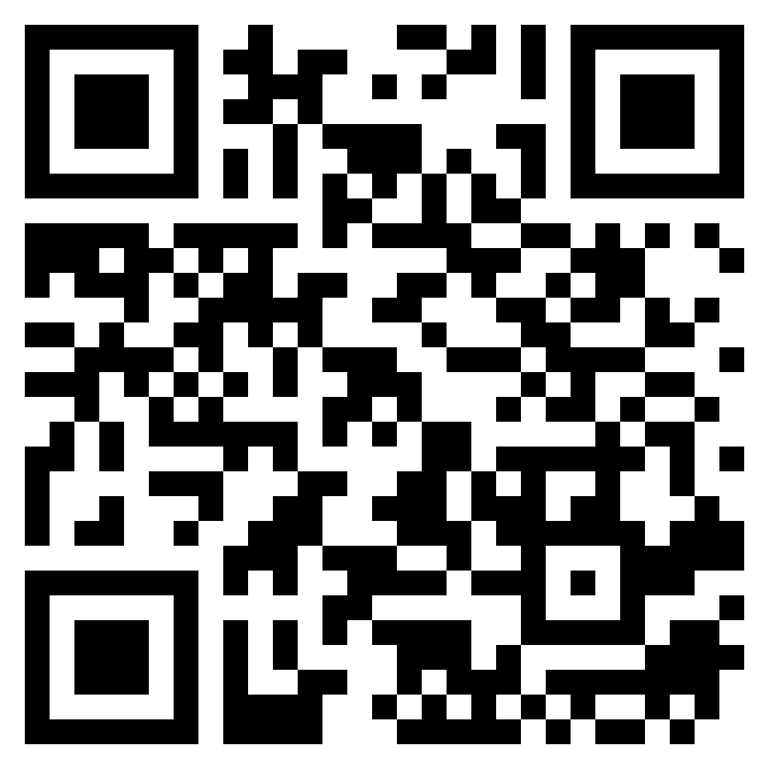
https://bit.ly/OTM-fb
Notes:
Feedback for each speaker

Slide 8
({{2ndSpeaker_min}}-{{2ndSpeaker_max}})
{{2ndSpeaker_Presenter}}
"Internal Power"
Notes:
MORNING PERSON who do not drink COFFEE. ”;
MENTORED PPL who now TEACH ME things I didn’t know—BEST PLOT TWIST EVER

Slide 9
https://bit.ly/OTM-fb
Notes:
Feedback for each speaker

Slide 10
({{3rdSpeaker_min}}-{{3rdSpeaker_max}})
{{3rdSpeaker_Presenter}}
"Internal Power"
Notes:
MORNING PERSON who do not drink COFFEE. ”;
MENTORED PPL who now TEACH ME things I didn’t know—BEST PLOT TWIST EVER

Slide 11
https://bit.ly/OTM-fb
Notes:
Feedback for each speaker

Slide 12
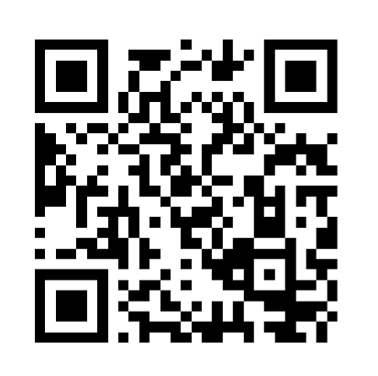
Best Speaker
[Timer’s report]
https://bit.ly/OTMspeech
Notes:
Best Speaker

Slide 13
Guest Registration

Slide 14
BREAK

Slide 15
Table Topics Master
Rules 📋
  Max. 30 seconds for thinking
  Introduction of the participant name - topic - topic - name
    Green Card 🟩 1:00 minimum qualified time
    Yellow card 🟨 1:30
    Red card 🟥 2:00
  After red card: 30 seconds left to wrap up
  Guests are encouraged to participate 🙋‍♀️🙋‍♂️
Evaluation Criterias
Content & Structure
Delivery
Language Use
Engagement
Timing

Slide 16
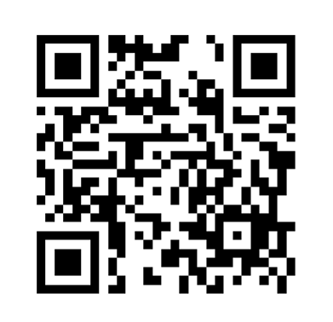
Best Table Topic
[Timer’s report]
https://bit.ly/OTM-tt
Notes:
Best Table Topic

Slide 17
Evaluator
Speech Evaluations
Evaluations

Slide 18
{{1stEvaluator_Presenter}}:
({{1stSpeaker_Presenter}})

Slide 19
{{2ndEvaluator_Presenter}}:
({{2ndSpeaker_Presenter}})

Slide 20
{{3rdEvaluator_Presenter}}:
({{3rdSpeaker_Presenter}})

Slide 21
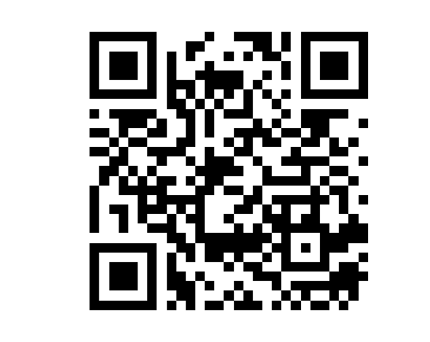
Best Evaluator
[Timer’s report]
https://bit.ly/OTMeval
Notes:
Best Evaluator

Slide 22
TAGG Team
Report

Slide 23
Club Business & Awards

Slide 24
Oslo Toastmasters Club
Next Meeting
Tuesday, July 15 , 2025
Notes:
Presidents Welcome

Slide 25
Oslo Toastmasters Club

