Slide 1
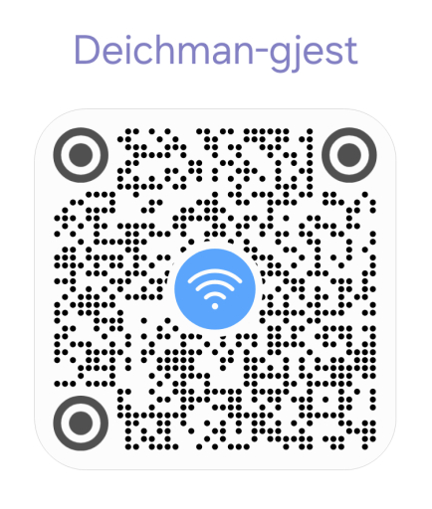
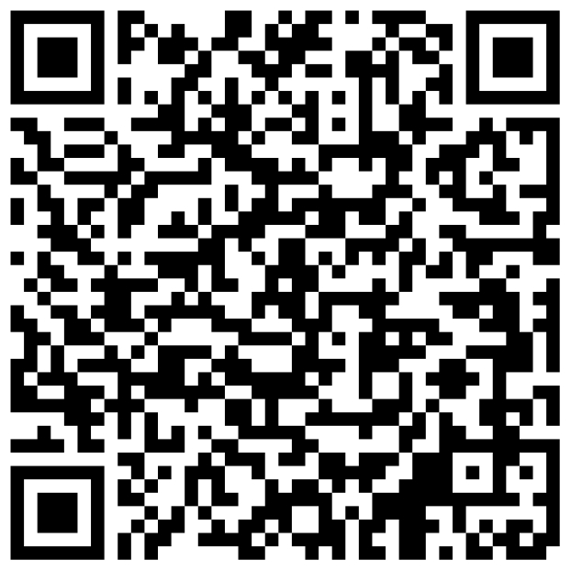
Free Wifi Network
Guest are requested to register

Slide 2
Time | Activity
1745 | Gathering and Networking
1800 | President starts and welcome guests
1805 | Toastmaster of the Evening introduces the theme and the team
1818 | Prepared speeches
1850 | Break
1900 | Table Topics
1930 | Evaluations
1950 | Reports, Awards and Thanks
{{meeting_theme}}

Slide 3
Time | Activity
1745 | Gathering and Networking
1800 | President starts and welcome guests
1803 | Toastmaster of the Evening takes charge
 | Prepared speeches
1850 | Break
1900 | Table Topics
 | Evaluations
1945 | Reports, Awards and Thanks
Introduction TAGG Team
Introduction Audience
Prepared Speeches
Break
Table topics
Evaluations
TAGG Team Report
Club Business & Awards
TBA

Slide 4
Oslo Toastmasters Club
{{meeting_date}}

Slide 5

{{President_Presenter}} President’s Welcome

Slide 6
{{Toastmaster_Presenter}} Toastmaster of the Evening

Slide 7
Time | Activity
1745 | Gathering and Networking
1800 | President starts and welcome guests
1803 | Toastmaster of the Evening takes charge
 | Prepared speeches
1850 | Break
1900 | Table Topics
 | Evaluations
1945 | Reports, Awards and Thanks
Introduction TAGG Team
Introduction Audience
Prepared Speeches
Break
Table Topics
Evaluations
TAGG Team Report
Club Business & Awards
Inspiration

Slide 8
Time | Activity
1745 | Gathering and Networking
1800 | President starts and welcome guests
1803 | Toastmaster of the Evening Round Robin
 | Prepared speeches
1850 | Break
1900 | Table Topics
 | Evaluations
1945 | Reports, Awards and Thanks
2000 | end of meeting +/- 10 minutes
Travel & Vacation

Slide 9
Timer
Grammarian
Ah and Vote Counter
General Evaluator
TAGG Team
of Today’s Meeting

Slide 10
(1:00 min)
Timer
{{Timer_Presenter}}
The Timer makes sure the meeting runs on time and helps speakers develop discipline with timing.

Slide 11
(1:00 min)
Ah and Vote Counter
{{AhVoteCounter_Presenter}}
Ah-Counter = listens for filler words. Vote Counter = ensures fair voting and recognition & has tie breaker vote

Slide 12
Word of the Day
(1:00 min)
{{word_of_the_day}}
Grammarian
{{GrammarianWordoftheDay_Presenter}}
The Grammarian supports members in building better English speaking habits through vocabulary and grammar awareness.

Slide 13
(1:00 min)
General Evaluator
{{GeneralEvaluator_Presenter}}
The General Evaluator is like a quality checker of the entire meeting, ensuring everyone learns not just from their own roles, but also from how the meeting is conducted overall and gives feedback on it.

Slide 14
{{Toastmaster_Presenter}} Toastmaster of the Evening

Slide 15
Prepared Speech Contest

Slide 16
{{Speaker1_Project}}
{{Speaker1_Description}}
({{Speaker1_Min}}-{{Speaker1_Max}})
Evaluator:
{{1stEvaluator_Presenter}}
{{Speaker1_Name}}
“{{Speaker1_Title}}”

Slide 17
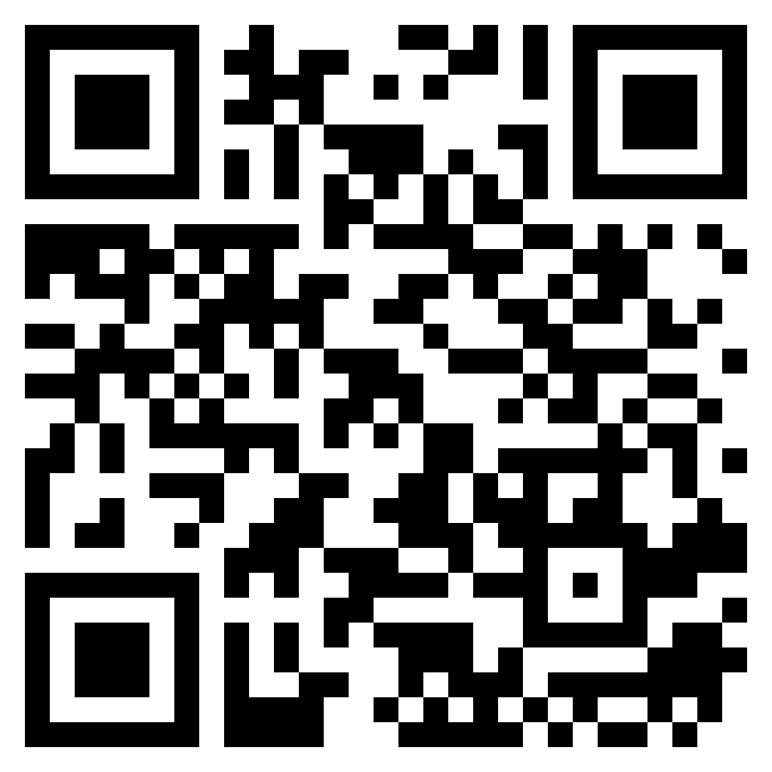
https://bit.ly/OTM-fb
Notes:
Feedback for each speaker

Slide 18
{{Speaker2_Project}}
{{Speaker2_Description}}
({{Speaker2_Min}}-{{Speaker2_Max}})
Evaluator:
{{2ndEvaluator_Presenter}}
{{Speaker2_Name}}
“{{Speaker2_Title}}”

Slide 19
https://bit.ly/OTM-fb
Notes:
Feedback for each speaker

Slide 20
{{Speaker3_Project}}
{{Speaker3_Description}}
({{Speaker3_Min}}-{{Speaker3_Max}})
Evaluator:
{{3rdEvaluator_Presenter}}
{{Speaker3_Name}}
“{{Speaker3_Title}}”

Slide 21
https://bit.ly/OTM-fb
Notes:
Feedback for each speaker

Slide 22
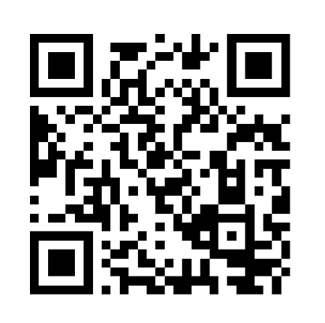
Best Speaker Voting [Timer’s report]
https://bit.ly/OTMspeech
Notes:
Best Speaker

Slide 23
BREAK

Slide 24
Free Wifi Network
Guest are requested to register

Slide 25
Table Topics Contest
Table Topics Master
{{TableTopicMaster_Presenter}}

Slide 26
Rules 📋
Max. 30 seconds for thinking
Introduction of the participant name - topic - topic - name
Green Card 🟩 1:00 minimum qualified time
Yellow card 🟨 1:30
Red card 🟥 2:00
After red card: 30 seconds left to wrap up
Guests are encouraged to participate 🙋‍♀️🙋‍♂️
Evaluation Criterias
Content & Structure
Delivery
Language Use
Engagement
Timing

Slide 27
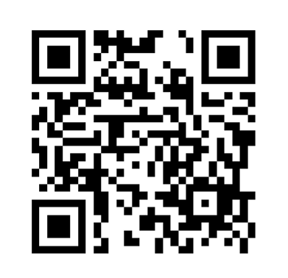
Best Table Topic Speaker Voting [Timer’s report]
https://bit.ly/OTM-tt
Notes:
Best Table Topic

Slide 28
Speech Evaluations Contest

Slide 29
(2:00-3:00 min)
{{1stEvaluator_Presenter}}
Evaluating Speech of {{1stSpeaker_Presenter}}

Slide 30
(2:00-3:00 min)
{{2ndEvaluator_Presenter}}
Evaluating Speech of {{2ndSpeaker_Presenter}}

Slide 31
(2:00-3:00 min)
{{3rdEvaluator_Presenter}}
Evaluating Speech of {{3rdSpeaker_Presenter}}

Slide 32
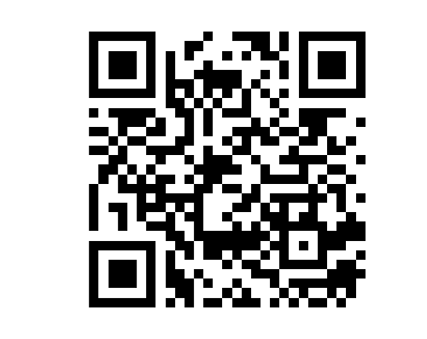
Best Evaluation Speech [Timer’s report]
https://bit.ly/OTMeval
Notes:
Best Evaluator

Slide 33
(2:00-3:00 min)
{{TableTopicsEvaluator_Presenter}}
Evaluating the Table Topics Speakers

Slide 34
TAGG Team’s Report

Slide 35
(1:00-2:00 min)
Timer Report
{{Timer_Presenter}}

Slide 36
(1:00-2:00 min)
Ah Counter Report
{{AhVoteCounter_Presenter}}

Slide 37
Word of the Day
(2:00-3:00 min)
{{word_of_the_day}}
Grammarian Report
{{GrammarianWordoftheDay_Presenter}}
The Grammarian supports members in building better English speaking habits through vocabulary and grammar awareness.

Slide 38
(5:00-7:00 min)
General Evaluation
{{GeneralEvaluator_Presenter}}
The General Evaluator is like a quality checker of the entire meeting, ensuring everyone learns not just from their own roles, but also from how the meeting is conducted overall and gives feedback on it.

Slide 39
Club Business & Awards

Slide 40
Oslo Toastmasters Club
Next Meeting {{next_meeting_date}}

Slide 41
Oslo Toastmasters Club

