Slide 1

Data bootcamp Final Project:
Airbnb in New York City, Paris, and Sydney
Christian Sarkis, Haanbi Kim, Jennifer Zhang

Slide 2

Agenda
Airbnb Listings: Prices and Superhosts
Airbnb Vs. Hotel Prices
Covid-19 Policy Impact on Airbnb

Slide 3
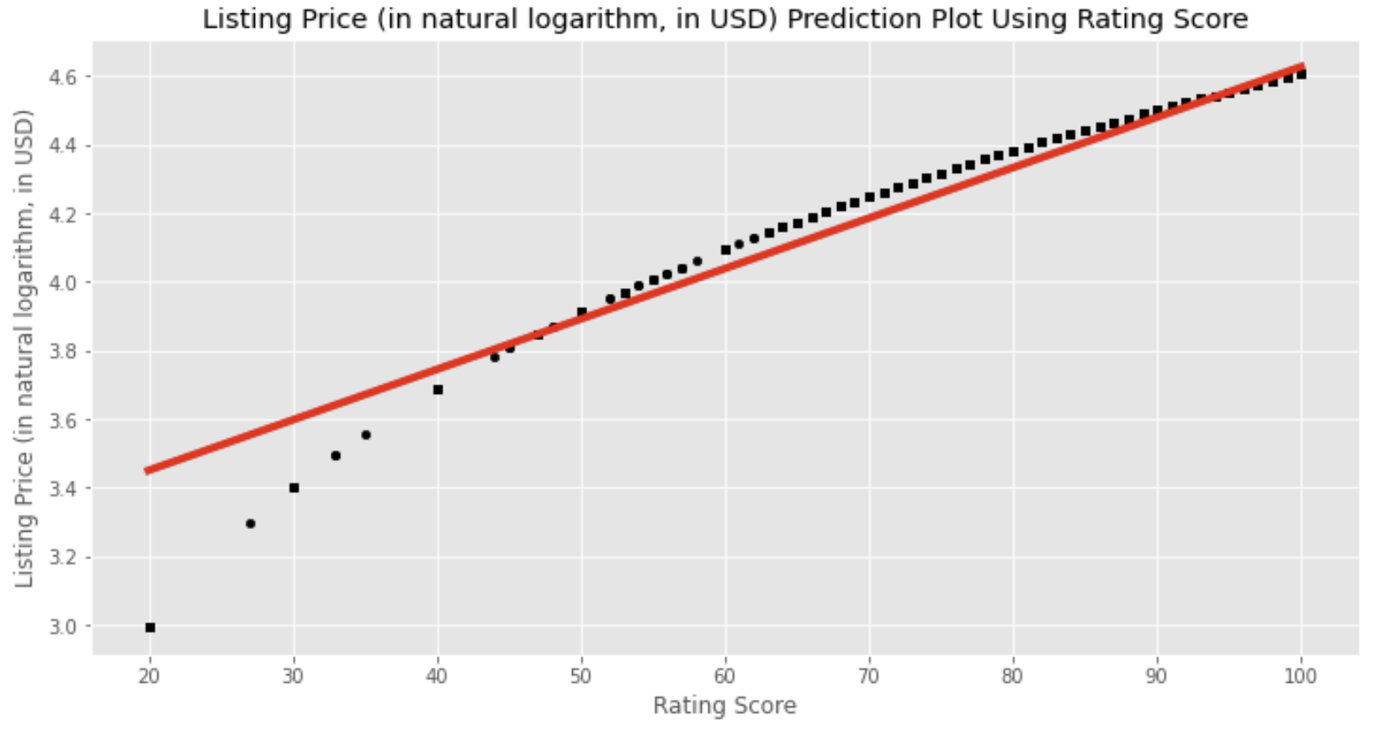
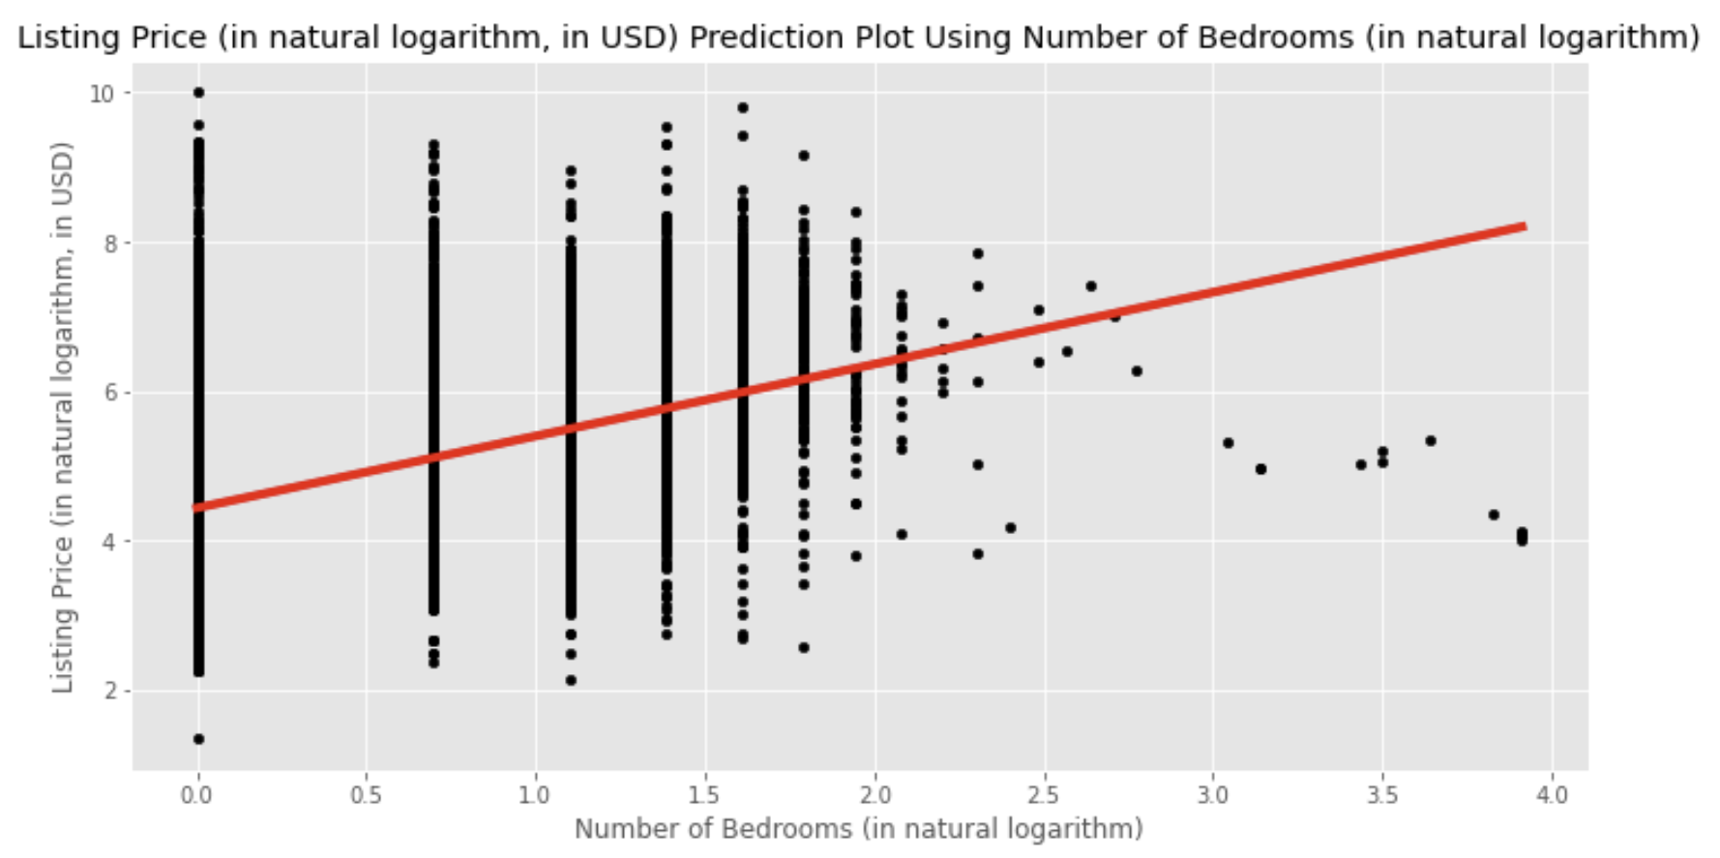
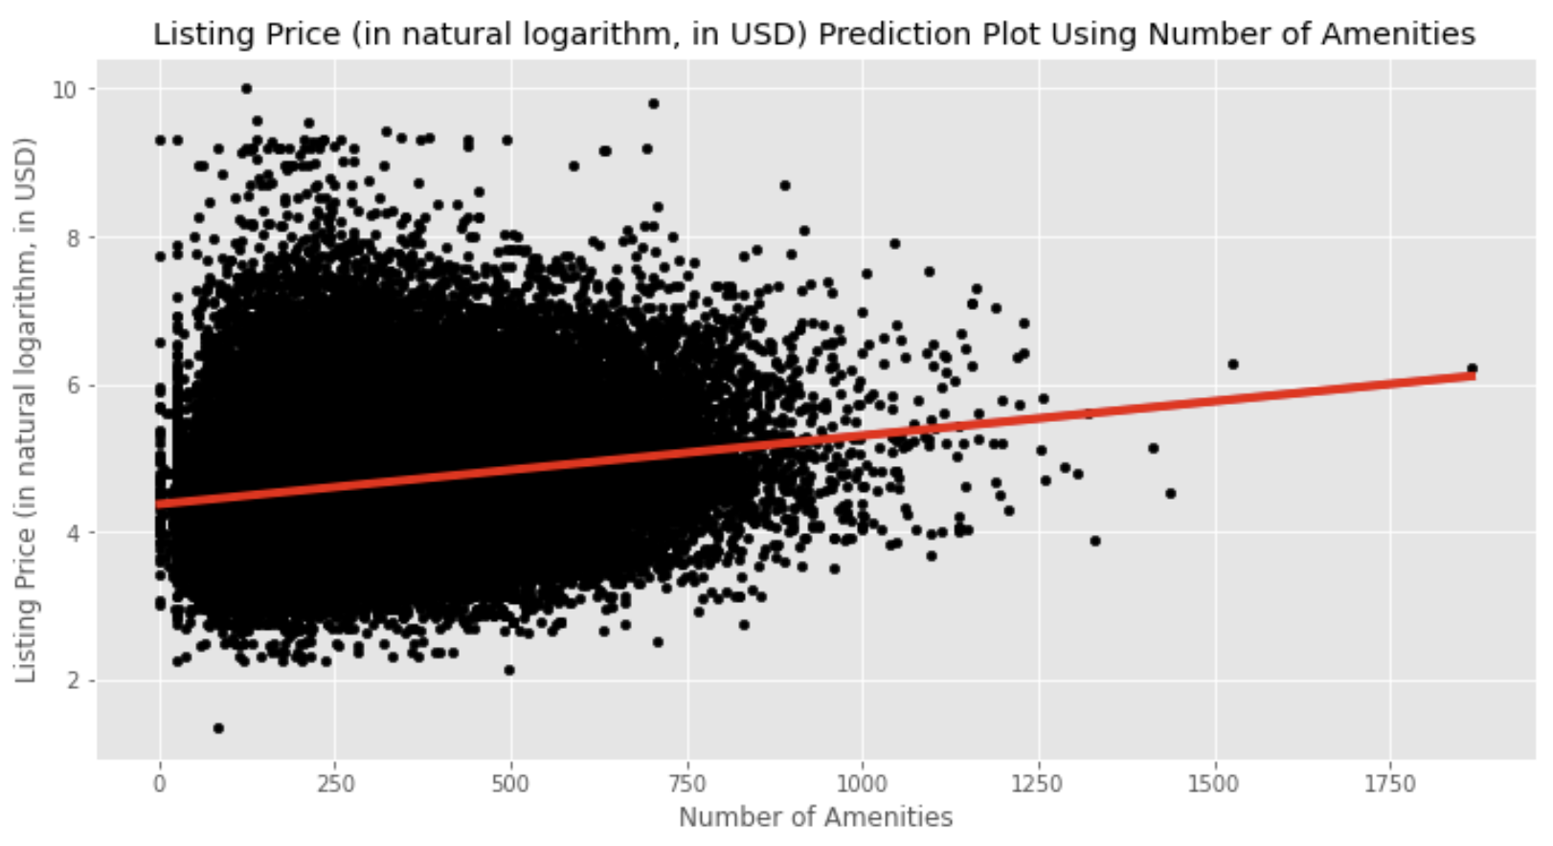
Listings and Prices
Regression Models (Predicting Listing Prices):
Listing Price and Rating Score
Listing Price and Number of Bedrooms
Listing Price and Number of Amenities
Characteristics of a stay that intuitively influence its price show positive correlations, but don’t necessarily show strong correlations (e.g. Number of Bedrooms and Number of Amenities)
Listing Price shows a positive correlation with all three variables observed, yet the accuracy of these relationships are varied.

Slide 4
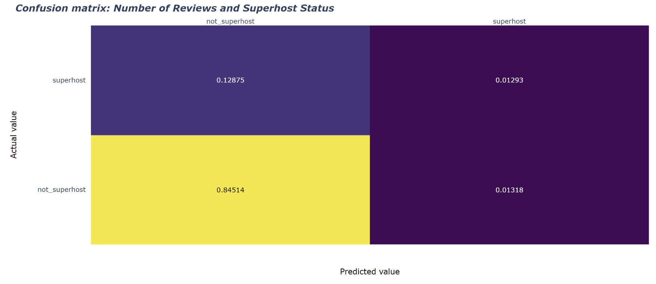
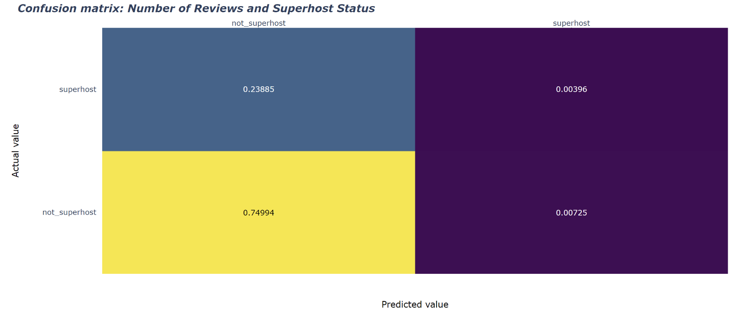
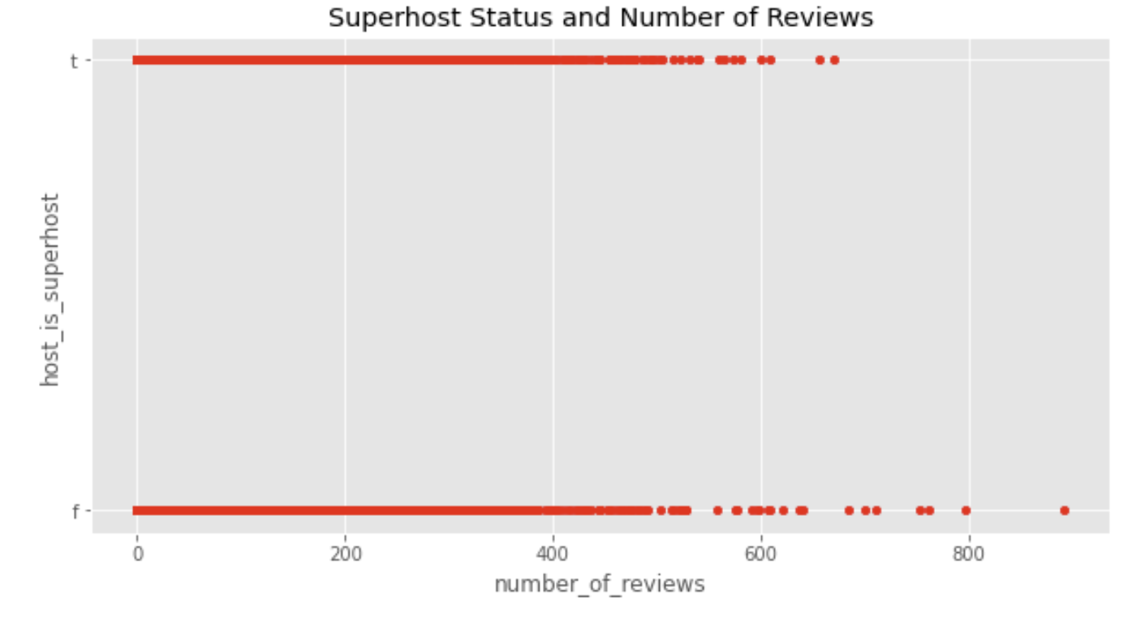
Superhost Status
Classification Models (Predicting Superhost Status):
Superhost Status and Number of Reviews
Superhost Status and Host Response Rate
Constructed the models and used a confusion matrix as visualization to show how the models performed
Both models showed better performance in predicting one side of the data than the other
Higher rates of accuracy when predicting that the host is not a superhost than the host is a superhost
Overall high R-squared values (~ 0.85 and 0.75, respectively), but the issue we described previously may render these numbers misleading
Problems may arise from the composition of the data points themselves
E.g. At 200 reviews, there is an abundance of both superhosts and non-superhosts, which can give rise to inaccuracies

Slide 5
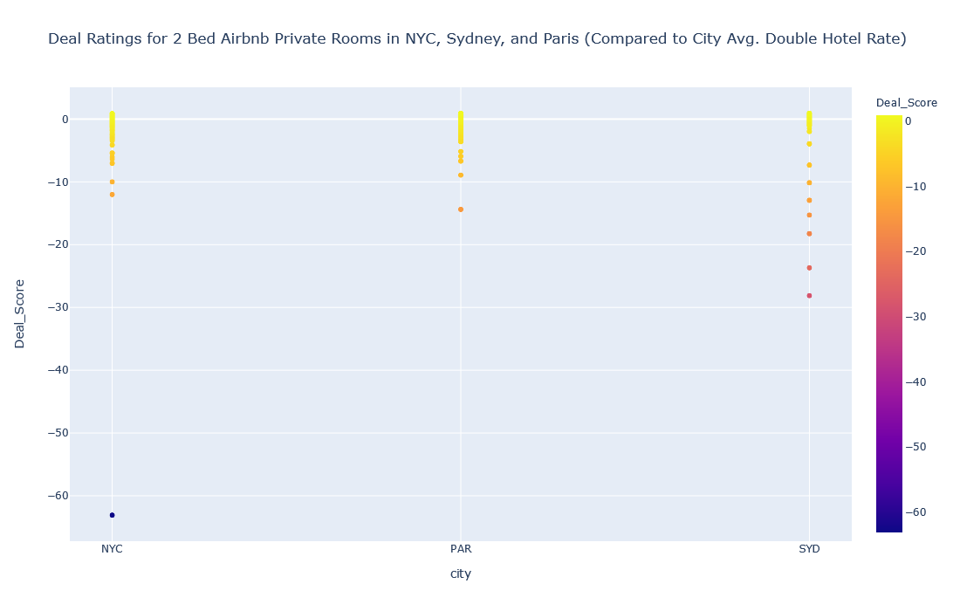
Airbnb vs. Hotels - Across Cities
In all three cities, we can see the following in listings:
A small amount at a bargain.
A majority at a significant upcharge.
A few at a massive upcharge (>1000x the average rate).
Distributions were relatively similar; Sydney had noticeably more massive upcharges; possibly due to the availability of seaside listings.

Slide 6
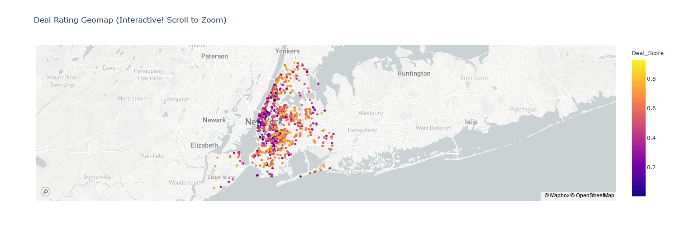
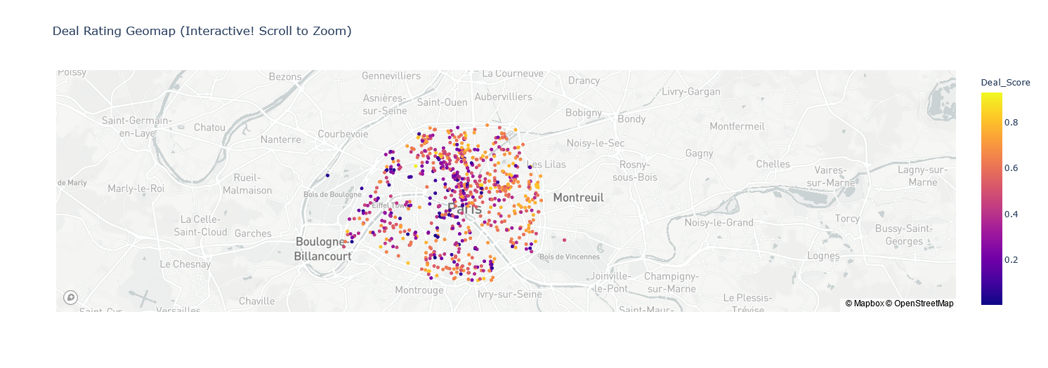
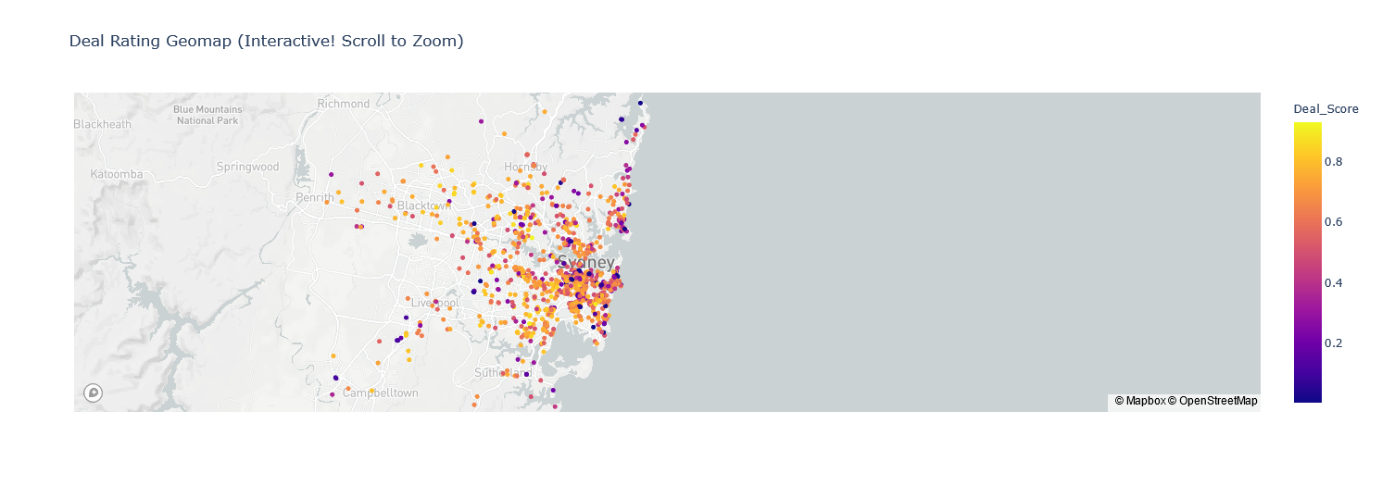
Airbnb vs. Hotels -
Where to Find Deals in Cities
NEW YORK
While there are deals everywhere, the best deals are unsurprisingly found far away from city centers.
That being said, it is also possible that hotels in these locations are also cheaper than the average, meaning the empirical deal score may be lower than we think.
Regardless, there are deals over hotels on Airbnb in these major cities, but due diligence must be taken to make sure that you are actually getting a deal.
PARIS
SYDNEY

Slide 7
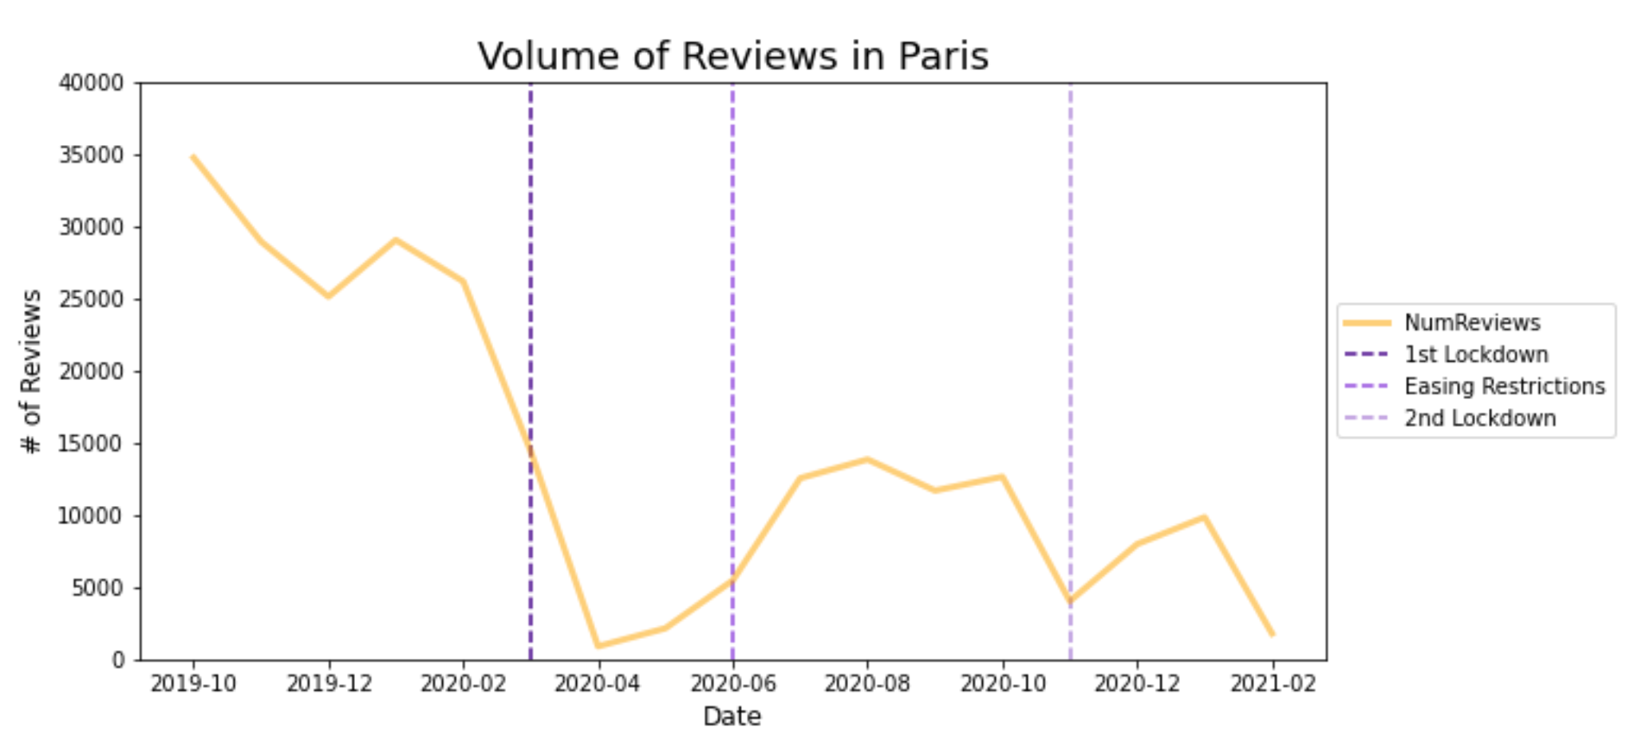
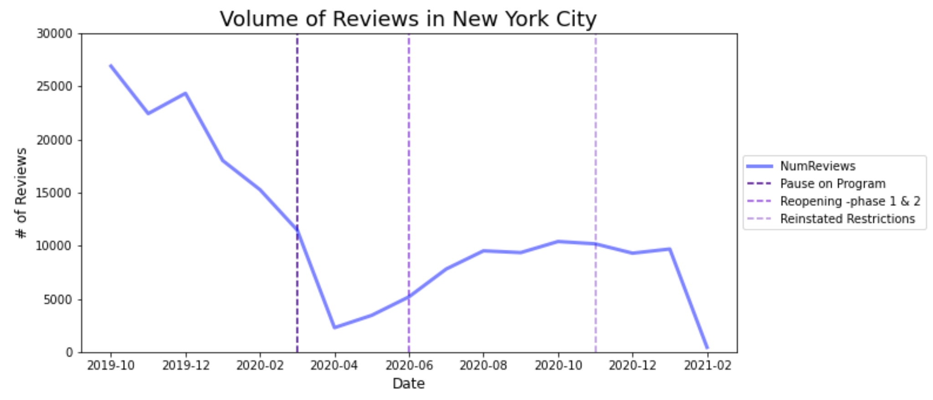
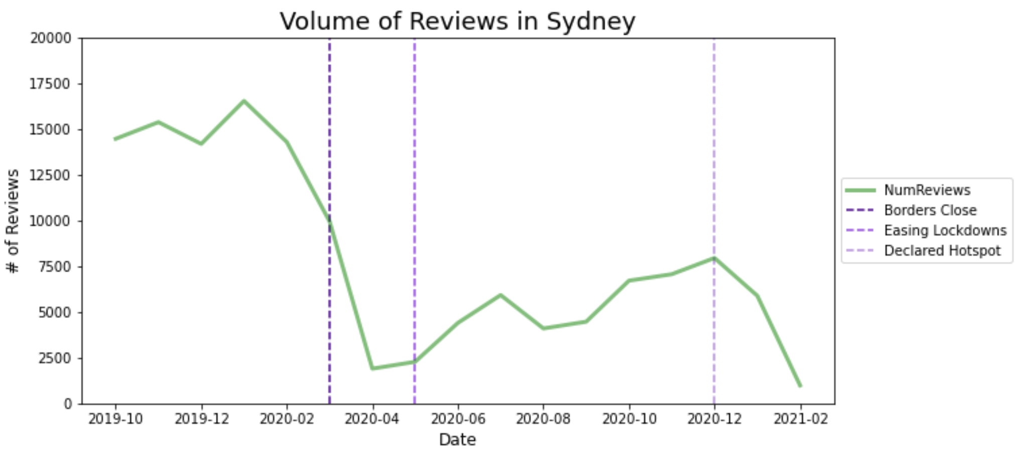
Covid-19 Impact on Airbnb
Unsurprisingly, stricter Covid-19 policies that were legally enforced had a greater impact on Airbnb
Paris was most impacted by its lockdown policies
New York City’s did not see as much of a percentage in response to its policy: policy did not have as much of an impact on NYC Airbnb stays

