Slide 1

Operating Systems
Jinghui Zhong （钟竞辉）
Office：B3-515
Email ：jinghuizhong@scut.edu.cn

Slide 2

单选题
1分
The opening, closing, reading and writing operations of the device are completed by () 。
A
User program
B
Compiler
C
Device allocator
D
Device driver
提交

Slide 3
主观题
1分
The designers of a computer system expected that the mouse could be moved at a maximum rate of 20 cm/sec. If a mickey is 0.1 mm and each mouse message is 3 bytes, what is the maximum data rate of the mouse assuming that each mickey is reported separately?
正常使用主观题需2.0以上版本雨课堂
作答

Slide 4
The designers of a computer system expected that the mouse could be moved at a maximum rate of 20 cm/sec. If a mickey is 0.1 mm and each mouse message is 3 bytes, what is the maximum data rate of the mouse assuming that each mickey is reported separately?
Answer：
（20cm /s ）/ 0.1mm * 3Byte = 6000Byte/s

Slide 5
Power Management
Device | Li et al. (1994) | Lorch and Smith (1998)
Display | 68% | 39%
CPU | 12% | 18%
Hard disk | 20% | 12%
Modem |  | 6%
Sound |  | 2%
Memory | 0.5% | 1%
Other |  | 22%
Power consumption of various parts of a notebook computer.
The most common method to save battery is to design the devices to have multiple states:
On, Sleep, and Off.

Slide 6
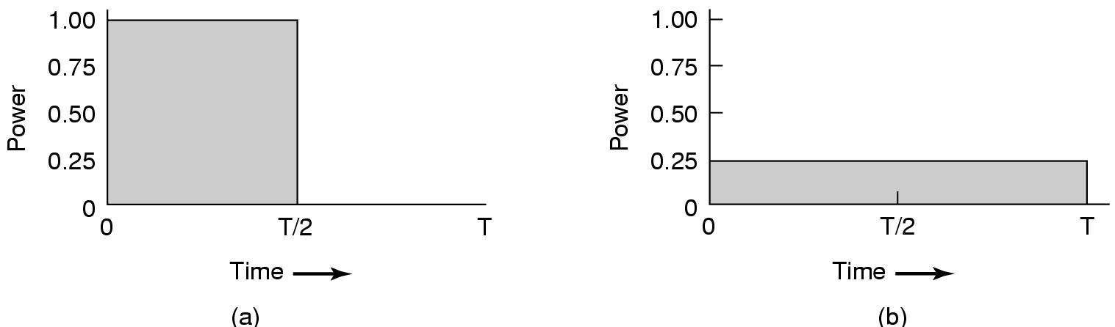
Power Management
Running at full clock speed.
Cutting voltage by two cuts clock speed by two and power consumption by four.

Slide 7
Power Management
The user can run longer on a given battery by accepting some quality degradation.
Abandon the color information and display the video in black and white.
Use radio link to send task to other devices.
Trading image quality to reduce the transmission overload.

Slide 8
主观题
1分
If a CPU’s maximum voltage, V, is cut to V/n, its power consumption drops to 1/n^2 of its original value and its clock speed drops to 1/n of its original value. Suppose that a user is typing at 1 char/sec, but the CPU time required to process each character is 100 msec. (1)What is the optimal value of n; (2) what is the corresponding energy saving in percent compared to not cutting the voltage? Assume that an idle CPU consumes no energy at all.
正常使用主观题需2.0以上版本雨课堂
作答

Slide 9
Answer：
In order to reduce energy consumption, the speed can be slowed down to 100ms/1s =10 times，
So, n = 10。
(2) Assuming that the energy consumption of CPU at full speed is E, the CPU spends 100ms to process characters in 1 second, and the total energy consumption in 1 second is 0.1E;
If the speed is slowed down 10 times, the energy consumption is: E / 100; therefore, the energy saved is: 0.1E – 0.001E = 0.09E; that is, 90% energy consumption is saved 。

Slide 10
File Management

Slide 11
Long-term information storage
Must store large amounts of data
Gigabytes -> terabytes -> petabytes
Stored information must survive the termination of the process using it
Lifetime can be seconds to years
Must have some way of finding it
Multiple processes must be able to access the information concurrently
Solution: Store information on disk or other external media in units called files.
11

Slide 12
Naming files
Important to be able to find files after they’re created
Every file has at least one name
Name can be
“foo.c”, “my photo”,
“4502”,
Case may or may not matter (Depends on the file system)
Name may include information about the file’s contents, e.g.,
The name should make it easy to figure out what’s in it;
Computer may use part of the name to determine the file type

Slide 13
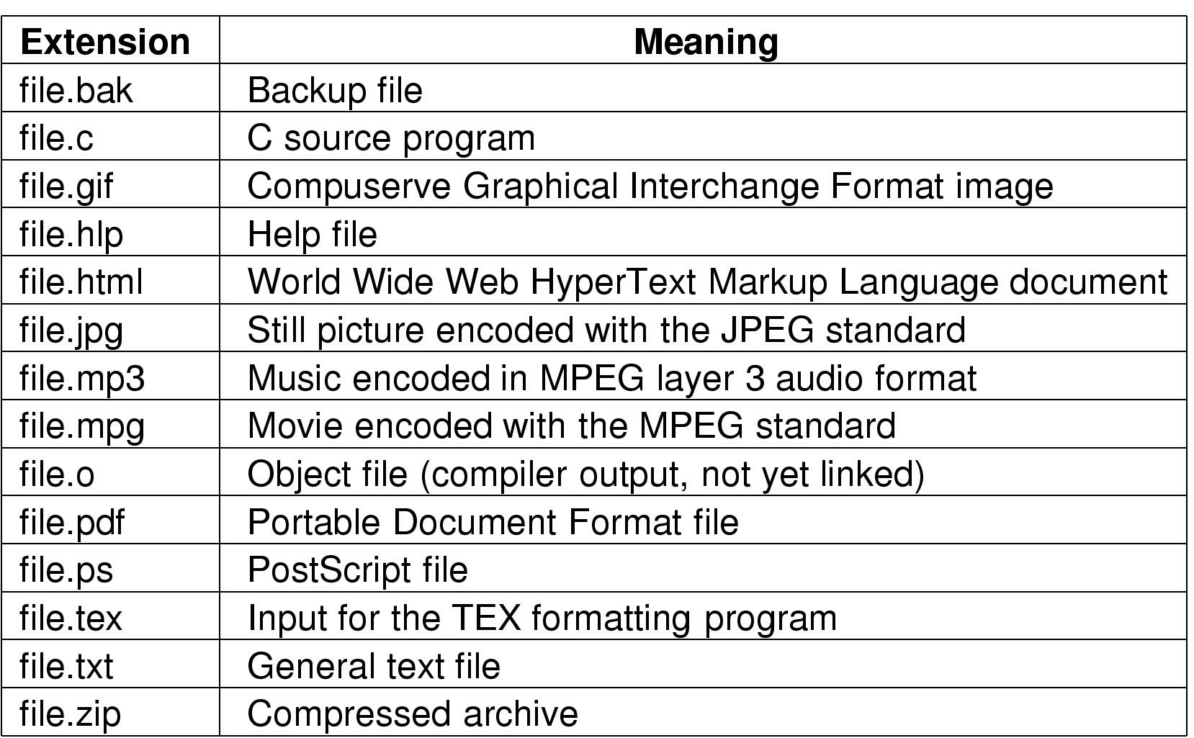
File Naming
Typical file extensions.
13

Slide 14
File Structure
1 record
1 byte
12A
101
111
sab
wm
cm
avg
ejw
sab
elm
br
Sequence of bytes
(Windows & UNIX)
Sequence of records
(common in old days)
S02
F01
W02
Tree
(large mainframe computers)
14

Slide 15
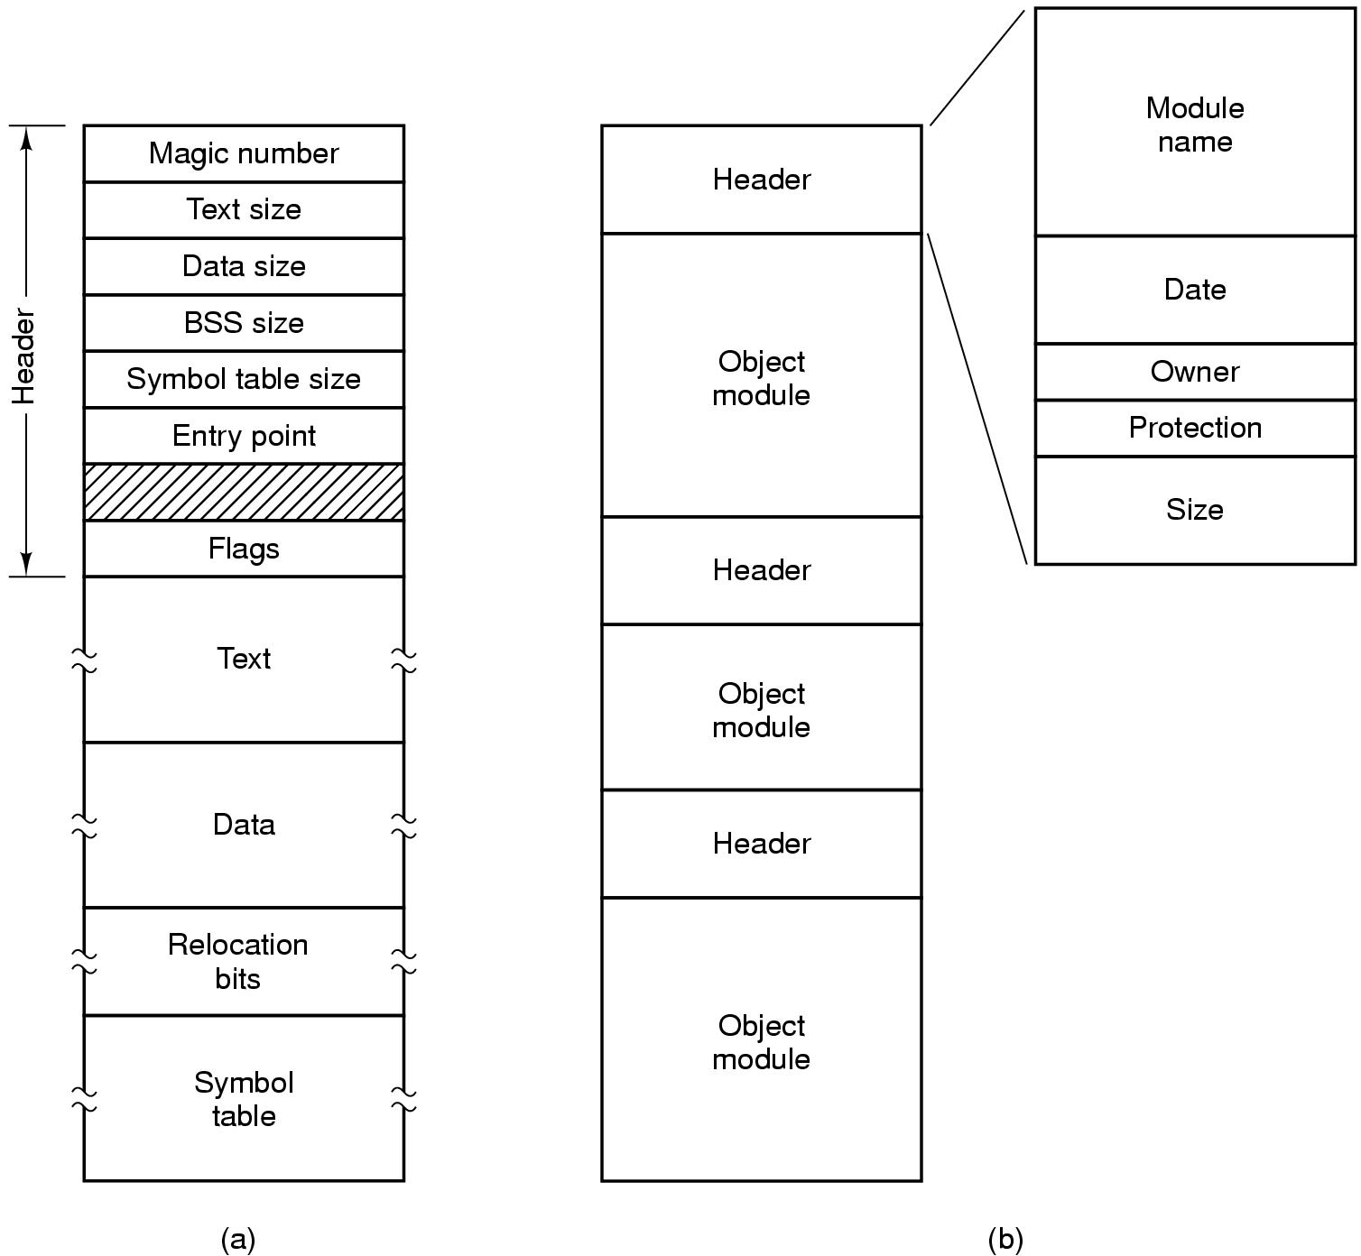
File Types
(a) An executable file (b) An archive
15

Slide 16
Case Study: Reading a BMP file

Slide 17
BMP File Format
Content | Normal | Kernel
File Header | 14B
Info Header | 40B | 12B
[Color Table] | n*4B (BGR0) | n*3B (BGR)
Pixel Infos | The high position comes first, the line 4B is aligned (0 is added if it is insufficient), and the line is arranged from bottom to top
File Head Format
Content | size | Values
Flag | 2B | ”BM”
File size | 4B | Number of bytes
Reserved1 | 2B | 0
Reserved2 | 2B | 0
Offset of pixel array | 4B | Number of bytes

Slide 18
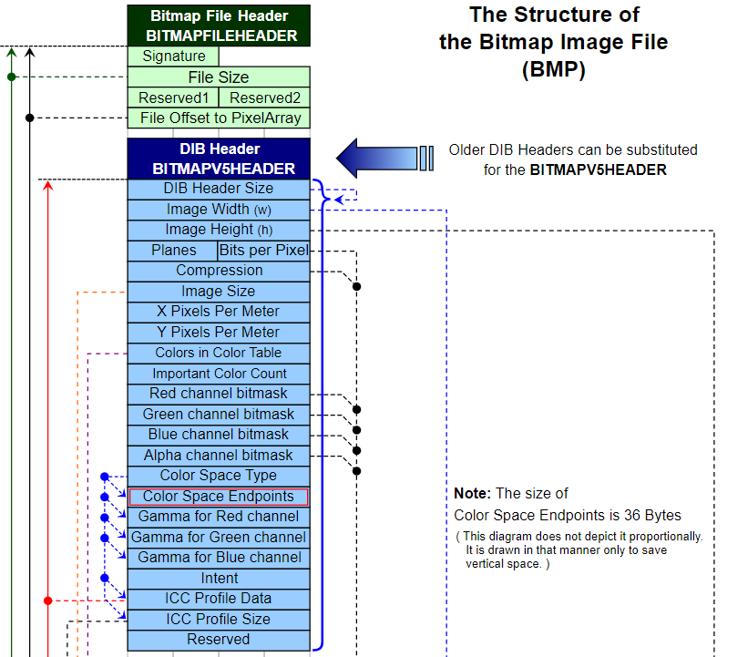

Slide 19
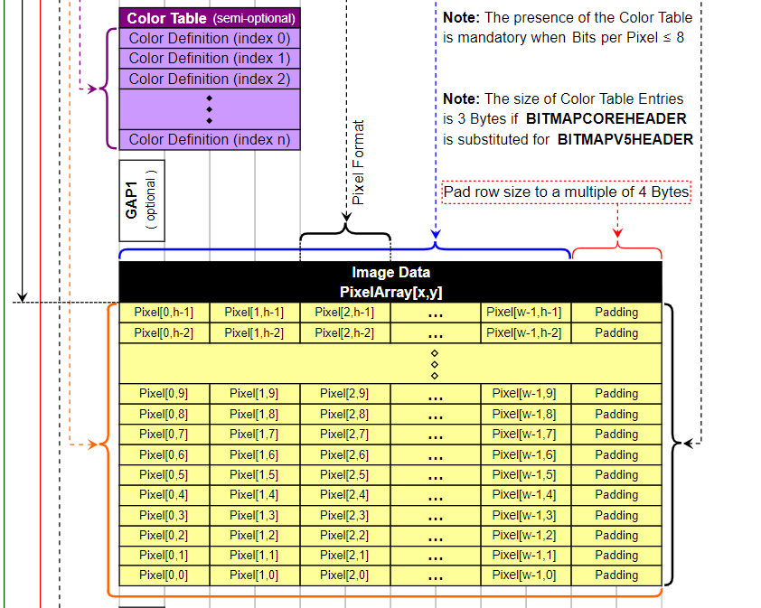

Slide 20
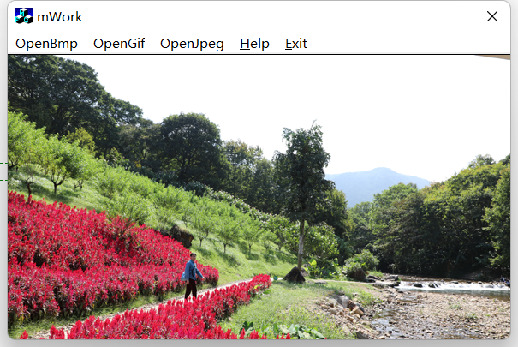
DEMO

Slide 21
File Access
Sequential access
read all bytes/records from the beginning
cannot jump around
convenient when medium was magnetic tape
Random access
bytes/records read in any order
essential for database systems
21

Slide 22
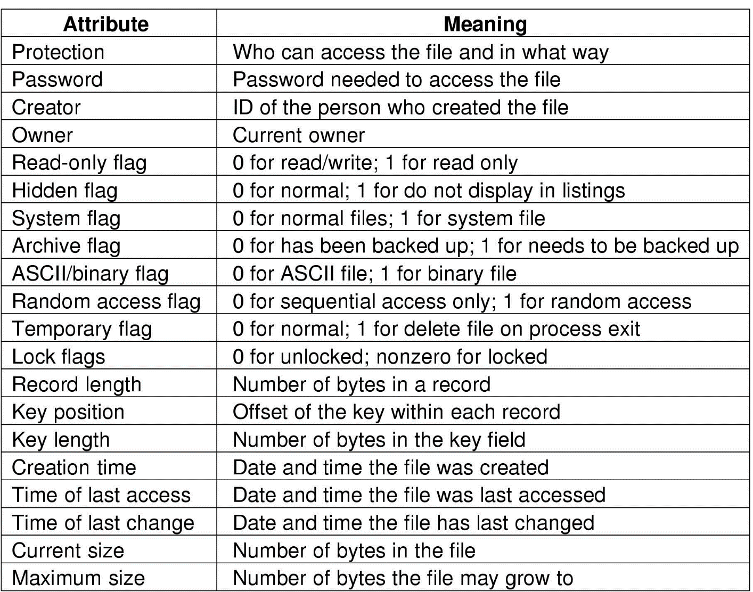
File Attributes
Operating systems associate extra information with each file, called file attributes.
Possible file attributes
22

Slide 23
File Operations
Create
Delete
Open
Close
Read
Write
Append
Seek
Get attributes
Set Attributes
Rename
23

Slide 24
Case Study:
Using File system Calls to Copy a File

Slide 25
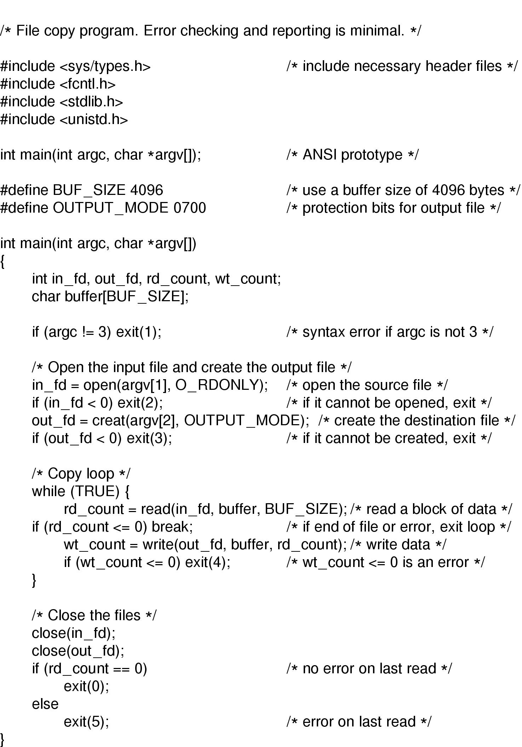
An Example Program Using File System Calls
25

Slide 26
An Example Program Using File System Calls
26

Slide 27
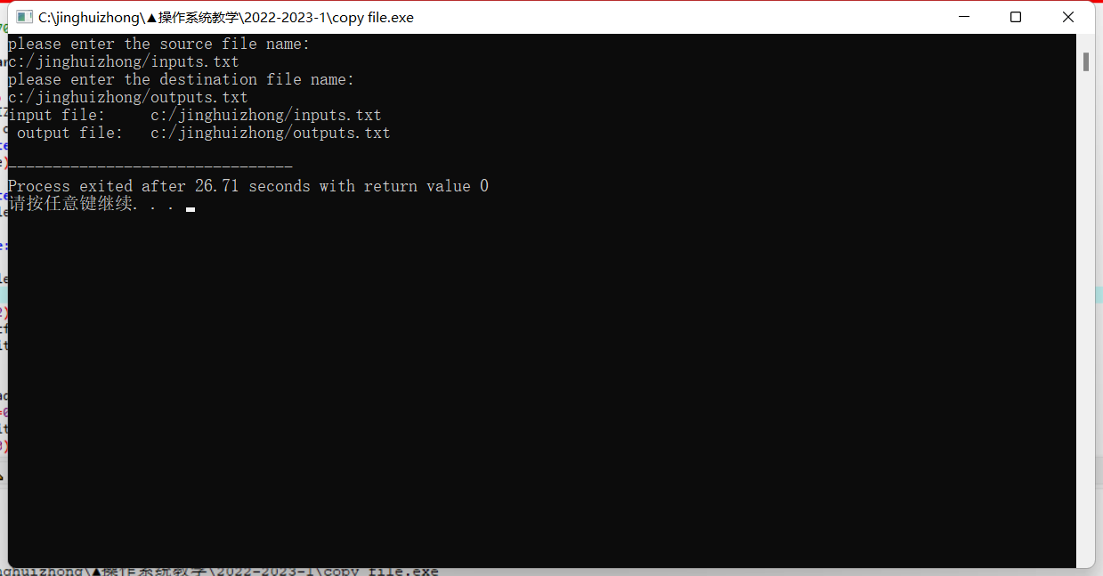
DEMO
https://baike.baidu.com/item/gcc/17570?fr=aladdin
https://baike.baidu.com/item/Dev-C%2B%2B/4461658?fromtitle=devc%2B%2B&fromid=10668389&fr=aladdin

Slide 28
Directories
File systems have directories or folders to keep track of files.
A single-level directory has one directory (root) containing all the files.
A two-level directory has a root directory and user directories.
A hierarchical directory has a root directory and arbitrary number of subdirectories.
28

Slide 29
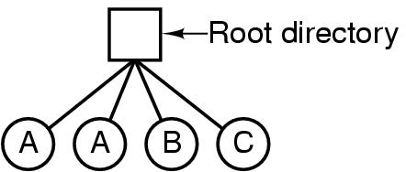
Directories - A single level directory system
A single level directory system
contains 4 files
owned by 3 different people, A, B, and C
Common in early personal computers.
29

Slide 30
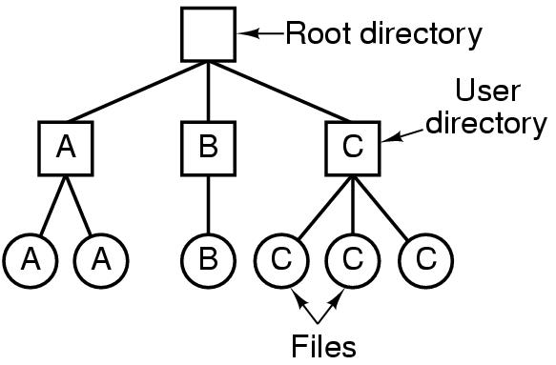
Two-level Directory Systems
Letters indicate owners of the directories and files
30

Slide 31
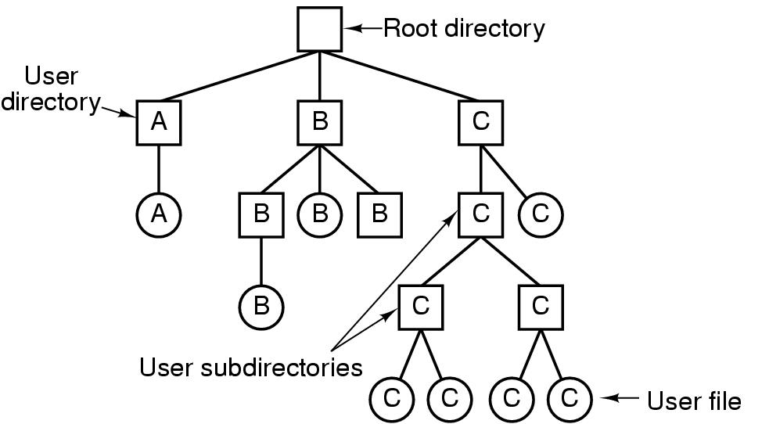
Hierarchical Directory Systems
All modern file systems are organized in this manner.
31

Slide 32
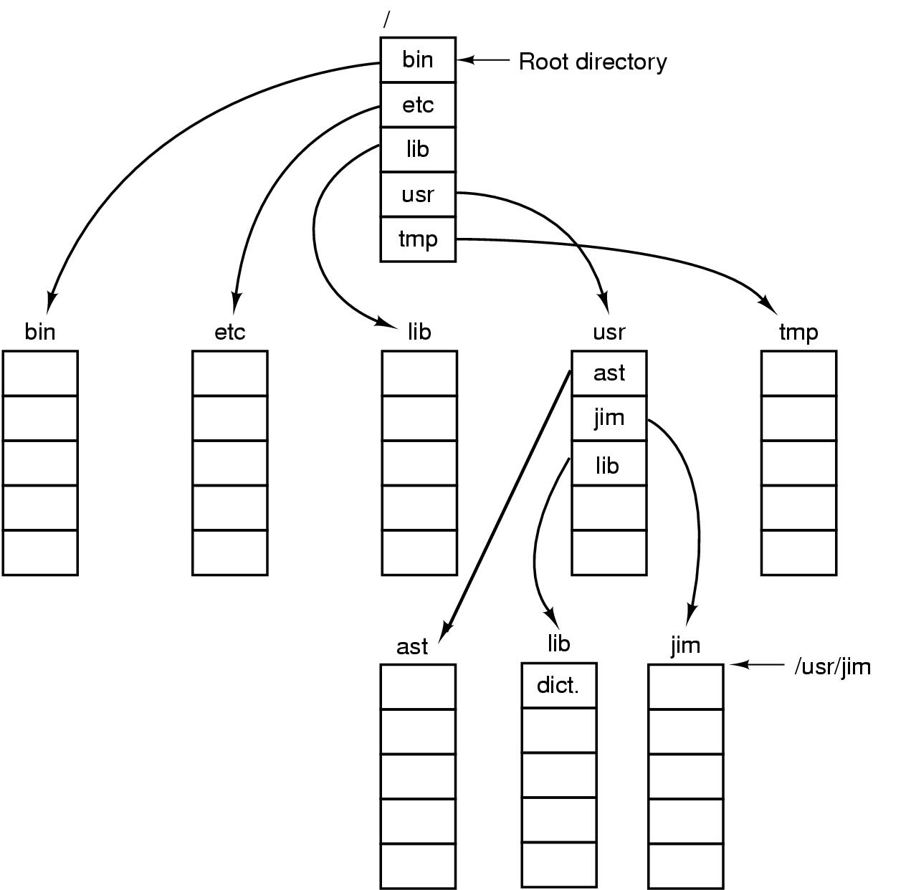
A UNIX directory tree
32

Slide 33
Directories
Two different methods are used to specify file names in a directory tree:
Absolute path name consists of the path from the root directory to the file. e.g., cp /usr/ast/mailbox /usr/ast/mailbox.bak
Relative path name consists of the path from the current directory (working directory). e.g, cp ../lib/dictionary ➔ cp /usr/lib/dictionary
33

Slide 34
Directories
The path name are different in different systems:
Winodws: \usr\ast\mailbox
UNIX: /usr/ast/mailbox
MULTICS: >usr>ast>mailbox
“.” and “..” are two special entries in the file system.
Dot (.) refers to the current directory (working directory).
Dot dot (..) refers to its parent.
34

Slide 35
Directory Operations
Create
Delete
Opendir
Closedir
Readdir
Rename
Link
Unlink
35

Slide 36
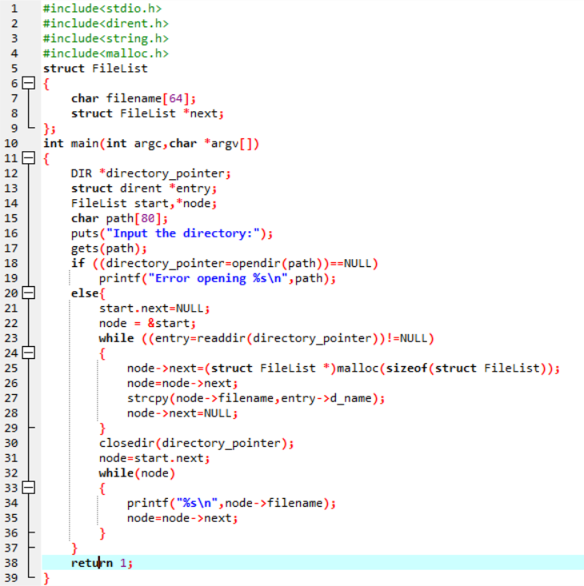
Case Study: Display all files in a directory

Slide 37
单选题
1分
Which description is wrong? ( )
A
The close operation tells the system that the specified file is no longer needed and can be discarded ；
B
The open operation tells the system to start using the specified file
C
The file must be opened before using it
D
The directory must be opened before using it
提交

Slide 38
单选题
1分
The purpose of using multi-level directory in file system is to （）
A
Resolve naming conflicts
B
Save storage space
C
Reduce system overhead
D
Reduce transmission time
提交

Slide 39
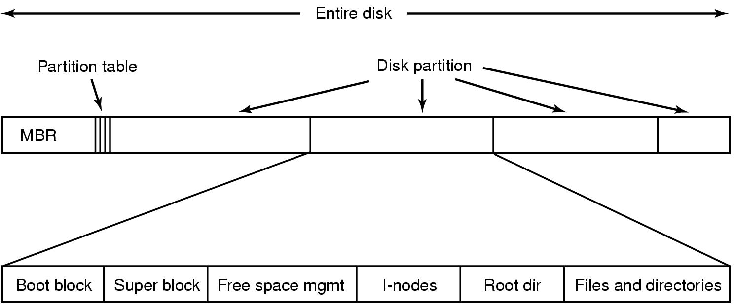
File System Layout
File system layout:
MBR (Master Boot Record) is used to boot the computer.
The partition table gives the starting and ending addresses of each partition.
39

Slide 40
File System Layout
Boot block: read in by the MBR program when the system is booted.
Superblock: contains the key parameters about the file system.
Free blocks information
I-nodes tells all about the file.
Root directory
Directories and files
Load OS
40

Slide 41
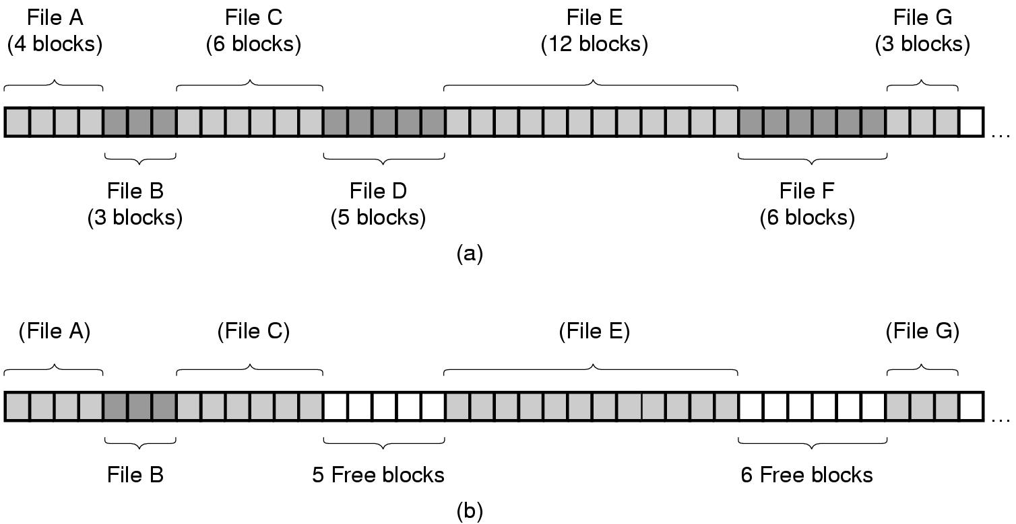
File Allocation
Contiguous Allocation:
store each file as contiguous block of data.
41

Slide 42
File Allocation
Contiguous Allocation
Advantages:
Simple to implement;
Read performance is excellent.
Disadvantages:
Disk fragmentation
The maximum file size must be known when file is created.
Example: CD-ROMs, DVDs
42

Slide 43
File Control Block
A file is composed of File Control Block（FCB) and File body。
FCB stores the property information of the file
e.g., name, path, access control information。
In Unix， FCB is implemented by i-node
43

Slide 44
单选题
1分
In the process of opening a file for the first time by a user process, what the operating system needs to do is （）
A
Read the contents of the file into memory
B
Read the file control block into memory
C
Modify the read and write permissions of file control block
D
Returns the first pointer of the file's data buffer to the user process
提交

Slide 45
多选题
1分
Select the wrong descriptions（）
A
The file system is responsible for the management of file storage space, but it can not realize the conversion from file name to physical address
B
In the multi-level directory structure, the access to the file is through the path name and the user directory name
C
The main purpose of open system call in file system is to read the control information of file from secondary memory to memory
D
File path includes absolute path and relative path
提交

Slide 46
Check points
List three reasons for long-term information storage;
What is sequence of bytes file structure?
Please list at least five common file attributes.
What is relative path name and why do we need relative path name?
46

