Slide 1
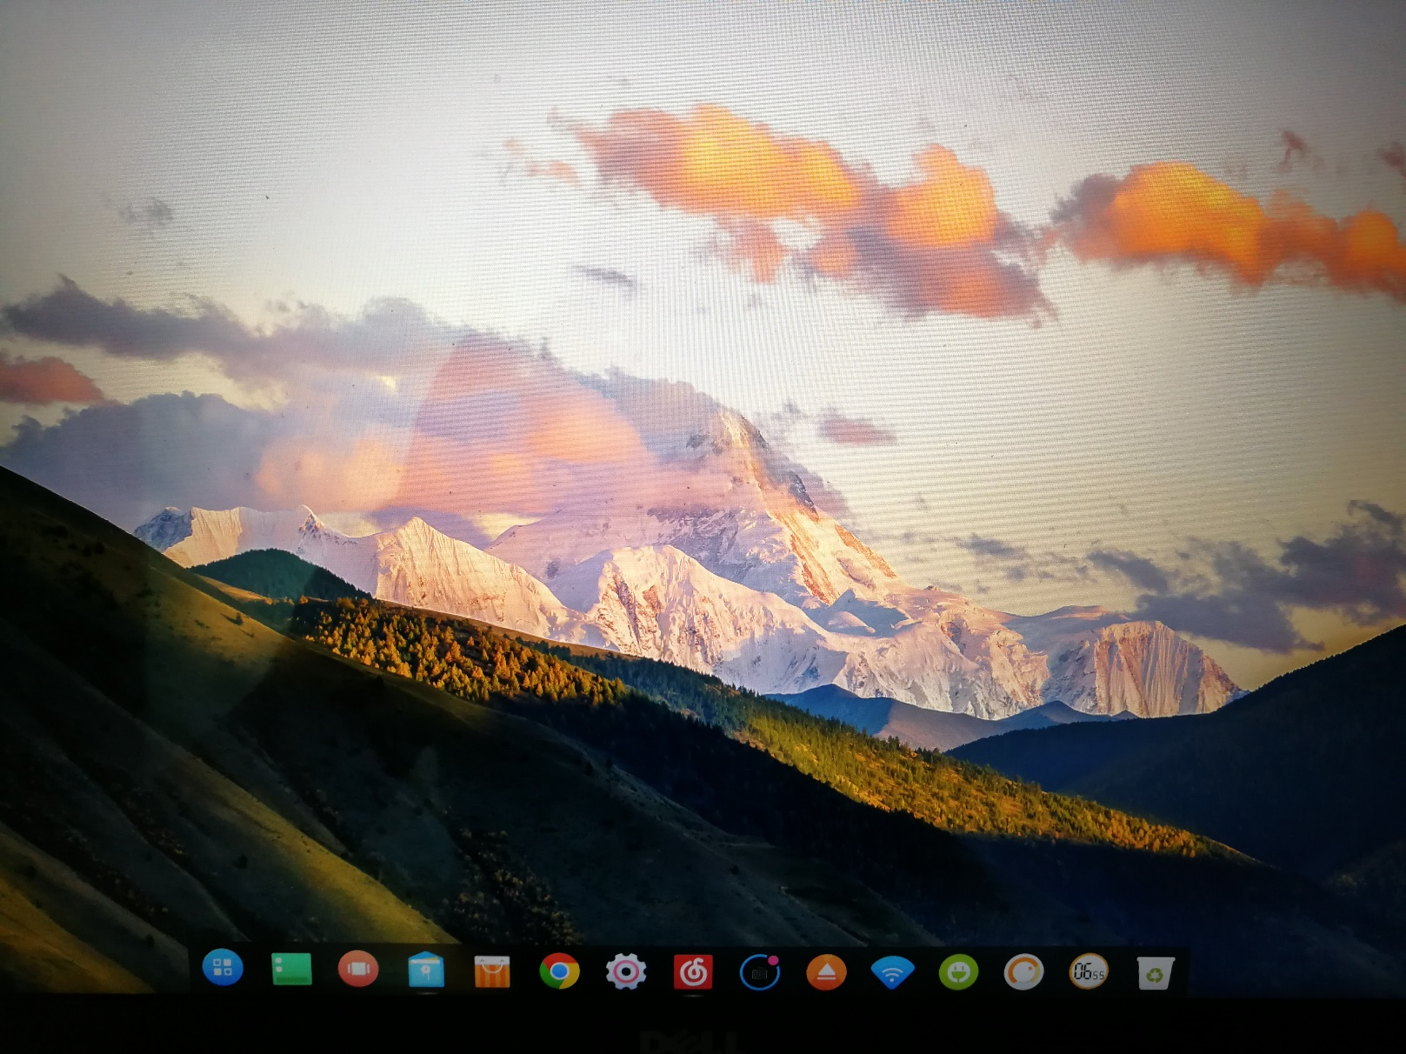
Operating Systems
Jinghui Zhong （钟竞辉）
Office：B3-515
Email ：jinghuizhong@scut.edu.cn

Slide 2

主观题
1分
In this problem you are to compare reading a file using a single-threaded file server and a multithreaded server. It takes 12 msec to get a request for work, dispatch it, and do the rest of the necessary processing, assuming that the data needed are in the block cache. If a disk operation is needed, as is the case one-third of the time, an additional 75 msec is required, during which time the thread sleeps. How many requests/sec can the server handle if it is single threaded? If it is multithreaded?
作答

Slide 3
Chapter 2, p.17
In this problem you are to compare reading a file using a single-threaded file server and a multithreaded server. It takes 12 msec to get a request for work, dispatch it, and do the rest of the necessary processing, assuming that the data needed are in the block cache. If a disk operation is needed, as is the case one-third of the time, an additional 75 msec is required, during which time the thread sleeps. How many requests/sec can the server handle if it is single threaded? If it is multithreaded?
For a single threaded server: When there is no disk operation needed, it takes 12ms to handle a request. While for the cases when a disk operation is needed, 12 + 75 = 87ms is needed. Since there are 1/3 cases that involve a disk operation, an average time of 1/3 * 87 + 2/3 * 12 = 37ms is needed to handle one request. Therefore the server can handle 1000/37 ≈ 27 requests per second.
For a multiple threaded server: When a disk operation is needed for a request, the threads that don’t sleep can still handle the requests that don’t require a disk operation. So a non-sleep thread is then loaded to CPU and handle another request. So the time to handle a request is 12ms. Therefore the server can handle 1000/12 ≈ 83.3 requests per second.
(all the waiting for the disk is overlapped )

Slide 4
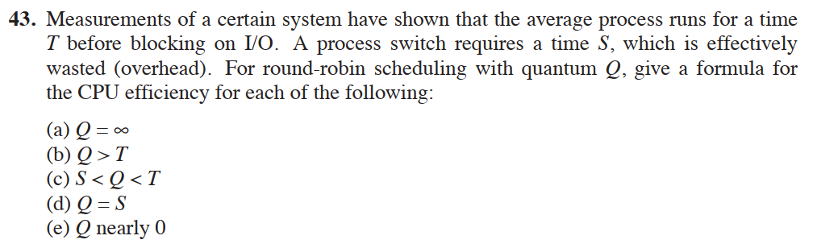
主观题
1分
请您编辑题干
作答

Slide 5
Chapter 2, p.43
Answer:
For Q = infinity and Q > T, a certain process will never be preempted until it terminates. So the efficiency of CPU is T/(S+T).
For S < Q < T, after every Q time, S time is needed for context switch. So the efficiency is Q/(Q+S).
For Q = S, it is Q/(Q+S)=0.5.
For Q -> 0, Q/(Q+S) -> 0, so the efficiency approaches to 0.

Slide 6
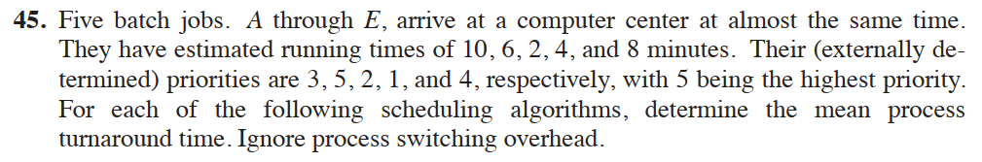
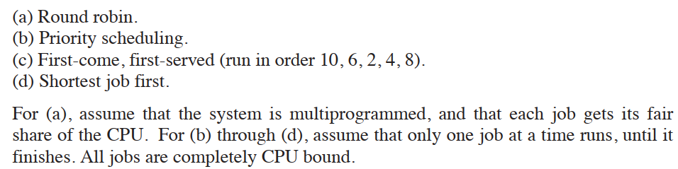
主观题
2分
请您编辑题干
作答

Slide 7
Answer:
C process terminates at 2*5 = 10 min. D terminates at 10+2*4=18 min. B terminates at 18+2*3=24 min. E terminates at 24+2*2=28 min. A terminates at 28+2=30 min. The average turnaround time for each process is (10+18+24+28+30)/5=22min.
According to the priority, B is the first one to be executed and it terminates at 6min. And then E terminates at 6+8=14 min. A terminates at 14+10=24 min. C terminates at 24+2=26 min. Finally D terminates at 26+4=30 min. The average turnaround time for each process is (6+14+24+26+30)/5=20 min.
If jobs are executed A-E. A terminates at 10 min. B terminates at 10+6=16 min. C terminates at 16+2=18 min. D terminates at 18+4=22 min. E terminates at 22+8=30 min. The average turnaround time is (10+16+18+22+30)/5=19.2 min.
The jobs are executed according to the running time. So the average time is (2*5 + 4*4 + 6*3 + 8*2 + 10*1)/5 = 14 min.

Slide 8
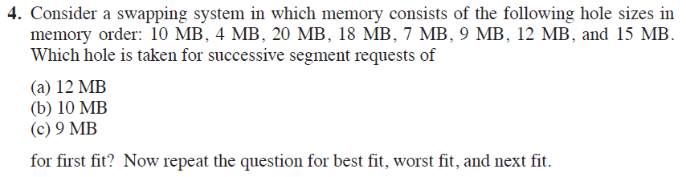
主观题
10分
请您编辑题干
作答

Slide 9
Answer： Suppose a，b，c requests are subsequent：
First fit：（a）20MB，（b）10MB，（c）18MB
Best fit：（a）12MB， （b）10MB， （c）9MB
Worst fit：（a）20MB， （b）18MB， （c）15MB
Next fit：（a）20MB， （b）18MB， （c）9MB

Slide 10
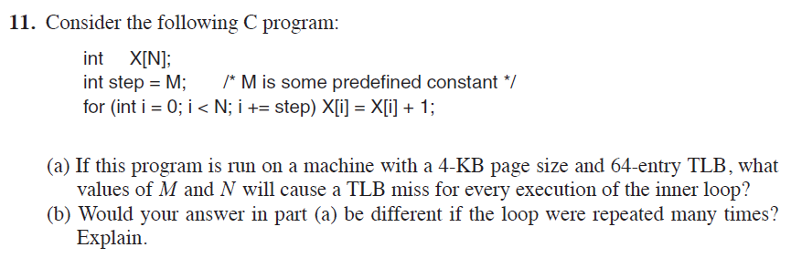
主观题
10分
请您编辑题干
作答

Slide 11
Chapter 3
Answer：
Suppose sizeof(int) = 4B
(a) M has to be at least 1K to ensure a TLB miss for every access to an element of X. Since N affects only how many times X is accessed, any value of N is OK. (b) M should still be at least 1K to ensure a TLB miss for every access to an element of X. But now N should be greater than 64*M to thrash the TLB.

Slide 13
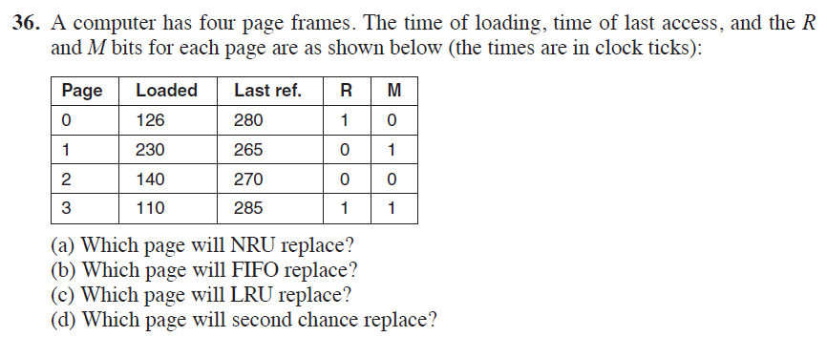
主观题
10分
请您编辑题干
作答

Slide 14
Chapter 3
Answer:
Page 2, because both R and M bit are 0
Page 3, because it loaded at 110 time, which is the earliest.
Page 1, because its last reference at 265, which is the earliest.
Page 2

Slide 15
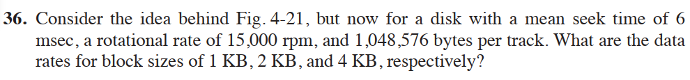
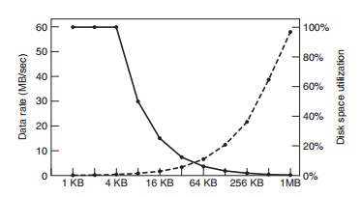
主观题
10分
请您编辑题干
作答

Slide 16
Chapter 4
Answer:
At 15,000 rpm, the disk takes 4 msec to go around once. The average access time (in msec) to read k bytes is then 6 + 2 + (k/1, 048, 576) ⋅ 4.
For blocks of 1 KB, 2 KB, and 4 KB, the access times are about 8.0039 msec, 8.0078 msec, and 8.0156 msec, respectively.
These give rates of about 124.939 KB/sec, 255.751 KB/sec, and 511.004 KB/sec, respectively

Slide 17
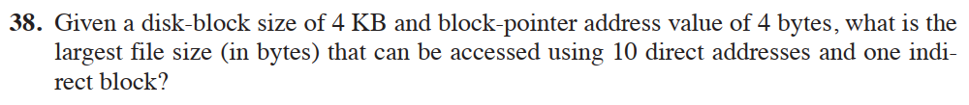
主观题
10分
请您编辑题干
作答

Slide 18
Chapter 4
The indirect block can hold 1024 addresses. Added to the 10 direct addresses, there are 1034 addresses in all. Since each one points to a 4-KB disk block, the largest file is 4136KB.

Slide 19
主观题
10分
请您编辑题干
作答

Slide 20
Chapter 5
It rotates 7200/60 = 120 times per second. So it require 1/120*1000=8.33ms for one rotation. So reading a sector needs 8.33/500 = 0.0167ms.

Slide 21
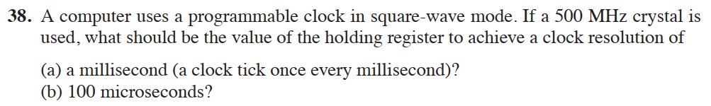
主观题
10分
请您编辑题干
作答

Slide 22
Chapter 5
Answer:
(1) 500MHz/1ms = 500,000. So the register needs holding 500,000.
500MHz/100us = 50,000. The register needs holding 50,000.

Slide 23
Session 1
【Objective and Requirement】
Objective： Be familiar with the creation of process and thread.
Requirement：
Task 1: Create a console application, “child”, which keeps printing out “The child is talking at [system time]” (in a loop, one per 1s).
Task 2: Create another console application, “parent”. It create a child process to execute “child”. At the same time, the “parent” process keeps printing out “The parent is talking at [system time]”. (one per 1s). Execute “parent” and explain the output you see.
Task 3: Create a child thread in the “mainThread” program. Both the main thread and the child thread keep printing out “[ThreadID] + [System time]”.
Task 4: Create a console application, which contains a shared integer shared_var. The initial value of shared_var is 0. The application will create a child thread after it starts. The main thread keeps increasing the value of shared_var by 1, while the child thread keeps decreasing the value of shared_var by 1. Explain the observed results.
【Environment】
Operating System：Linux;

