Slide 1

Operating Systems
Jinghui Zhong （钟竞辉）
Office：B3-515
Email ：jinghuizhong@scut.edu.cn

Slide 2

主观题
答案解析
1分
答案解析
What are the three states of a process？
Running, ready, blocked;
正常使用主观题需2.0以上版本雨课堂
作答
可为此题添加文本、图片、公式等解析，且需将内容全部放在本区域内。正常使用需3.0以上版本

Slide 3
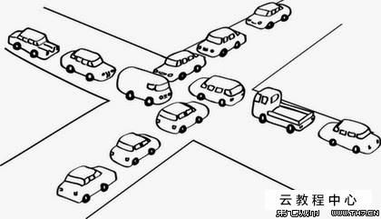
Inter Process Communication (IPC)
How to pass information among processes?
How to make sure two or more processes do not get into each other’s way when engaging in critical activities.
Proper sequencing when dependencies are present.
B
A
D
C
3

Slide 4
Race Conditions
Race conditions: situations in which several processes access shared data and the final result depends on the order of operations.
With increasing parallelism due to increasing number of cores, race condition are becoming more common.
4

Slide 5
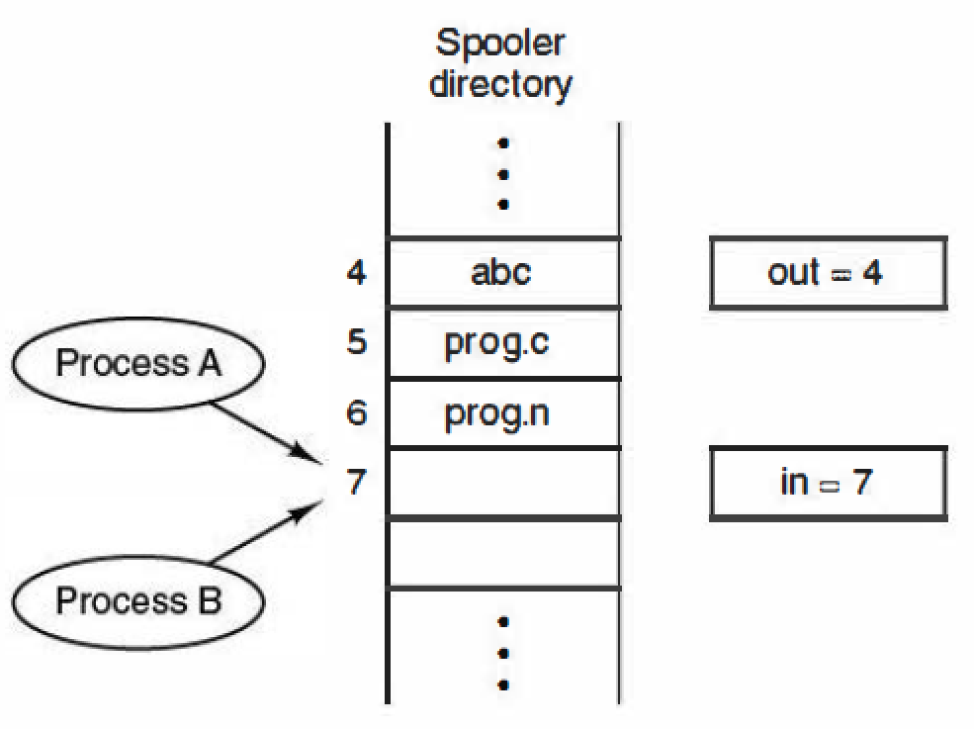
Example of Race Condition
How to implement the printing procedure?
Introduce two share variables:
(1) out: points to the next file to be printed
(2) in: points to the next free slot in the directory.
5

Slide 6
Example of Race Condition
out: points to the next file to be printed
in: points to the next free slot in the directory.
in =7
The file name in slot 7 was determined by who finished last. A race condition occurs.
(1): Process A reads in and stores the value 7 in a local variable. A switch to process B happens.
(2): Process B reads in, stores the file name in slot 7 and updates in to be an 8.
(3): Process A stores the file name in slot 7 and updates in to be an 8.
6

Slide 7
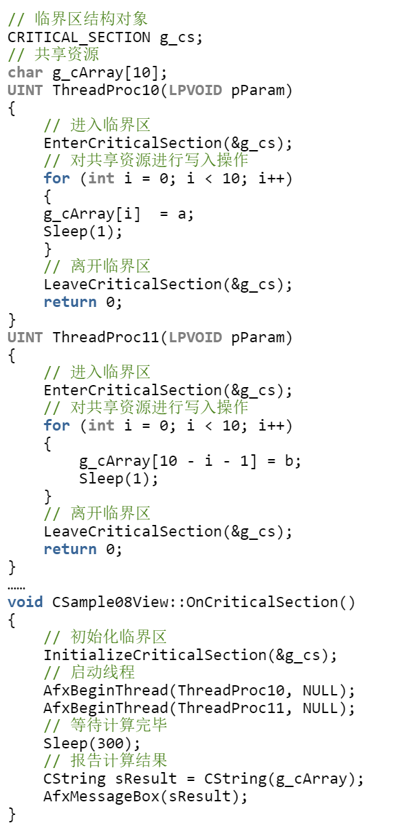
Critical Regions
Key idea to avoid race condition：prohibit more than one process from reading and writing the shared data at the same time.
Critical Region: part of the program where the share memory is accessed。
7

Slide 8
Critical Regions
Four conditions to support a good solution
No two processes may be simultaneously in critical region
No assumption made about speeds or numbers of CPUs
No process running outside its critical region may block another process
No process must wait forever to enter its critical region
8

Slide 9
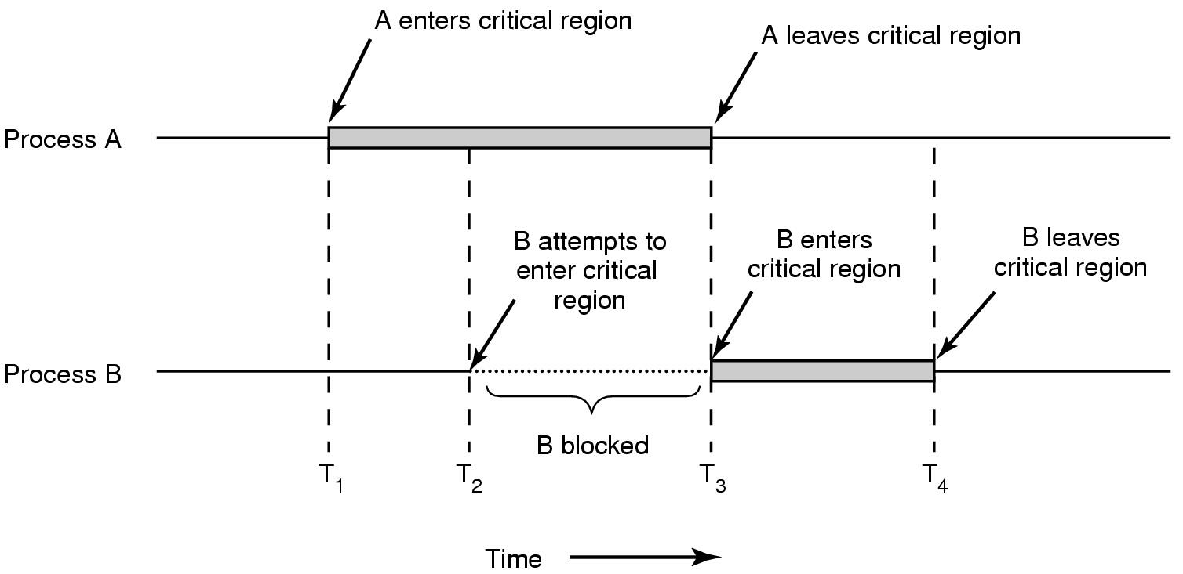
Mutual Exclusion using Critical Regions
9

Slide 10
Mutual Exclusion Solution - Disabling Interrupts
The CPU is only switch from process to process when clock or other interrupts happen; Hence, by disabling all interrupts, the CPU will not be switched to another process.
However, it is unwise to allow user processes to disable interrupts.
One thread may never turn on interrupt;
Problem still exist for multiprocessor systems.
10

Slide 11
Mutual Exclusion Solution - Lock Variable
shared int lock = 0;
/* entry_code: execute before entering critical section */
while (lock != 0) ; // do nothing
lock = 1;
- critical section -
/* exit_code: execute after leaving critical section */
lock = 0;
Problem?
If a context switch occurs after one process executes the while statement, but before setting lock = 1, then two (or more) processes may be able to enter their critical sections at the same time.
11

Slide 12
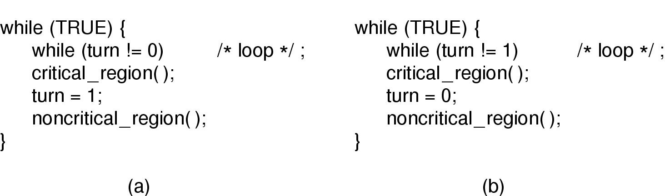
Mutual Exclusion Solution – Strict Alternation
Process 0.
Process 1.
Since the processes must strictly alternate entering their critical sections, a process wanting to enter its critical section twice will be blocked until the other process decides to enter (and leave) its critical section.
12

Slide 13
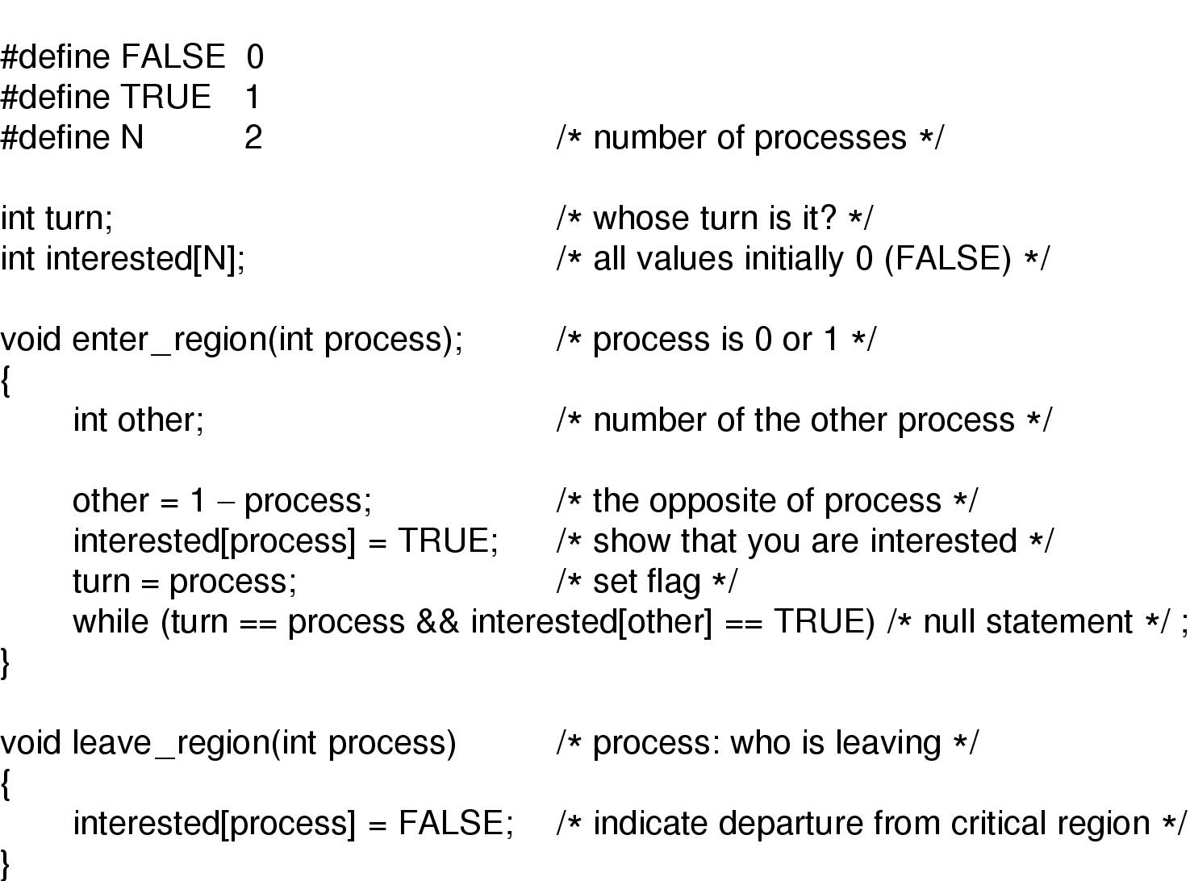
Mutual Exclusion – Peterson’s Solution
This solution satisfies all 4 properties of a good solution. Unfortunately, this solution involves busy waiting in the while loop.
13

Slide 14
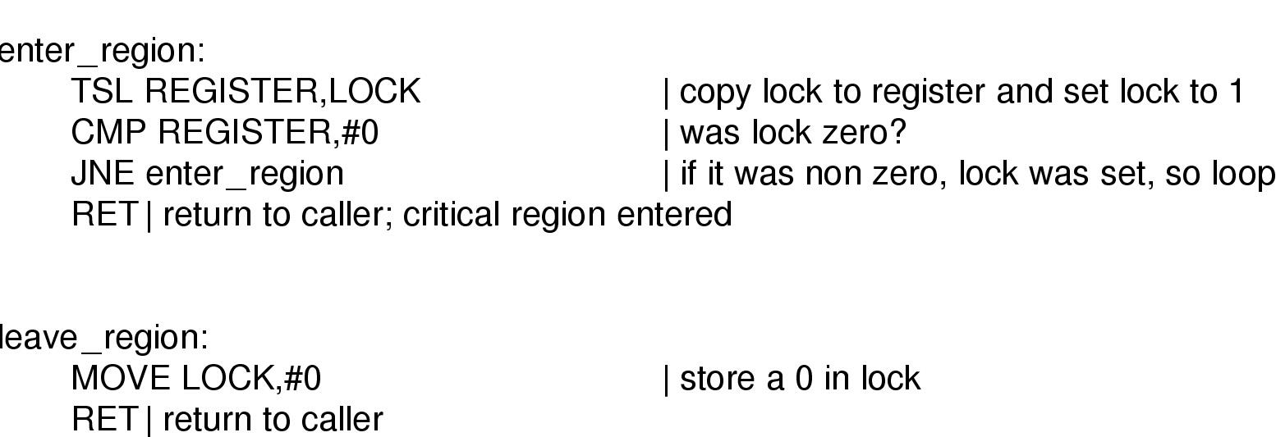
Hardware solution: Test-and-Set Locks (TSL)
The hardware must support a special instruction, TSL, which does two things in a single atomic action:
copy a value in memory (flag) to a CPU register
set flag to 1.
14

Slide 15
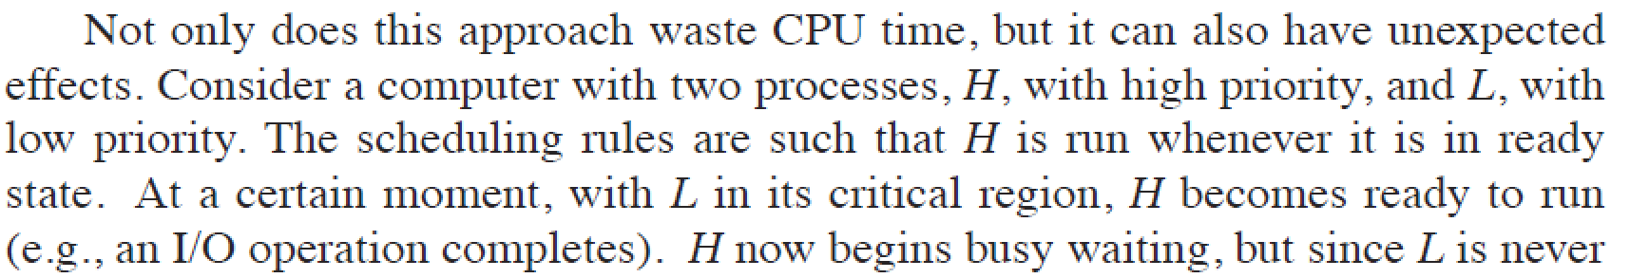
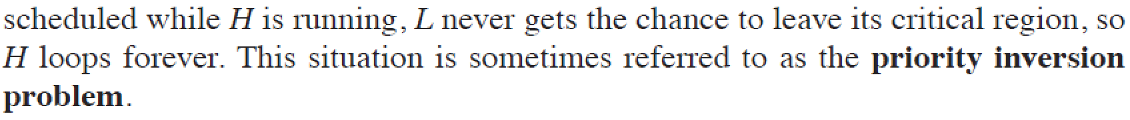
Mutual Exclusion with Busy Waiting
BUSY-WAITING：a process executing the entry code will sit in a tight loop using up CPU cycles, testing some condition over and over, until it becomes true.
Busy-waiting may lead to the priority-inversion problem .
15

Slide 16
Priority-inversion Problem
16

Slide 17
单选题
1分
When a process in critical region A is interrupted due to a request waiting for IO operations ，（ ）
A
Allow other processes to enter critical region A
B
Other processes are not allowed to enter their critical regions
C
Other processes are allowed to preempt the processor, but cannot enter the critical region A
D
No process is allowed to preempt the processor
提交

Slide 18
Sleep and Wakeup
From busy waiting to blocking...
Sleep: is a system call that causes the caller to block, that is, be suspended until another process wakes it up.
Wakeup: has one parameter, the process to be awakened.
18

Slide 19
Producer-Consumer Problem
Producer-Consumer Problem: Consider a circular buffer that can hold N items. Producers add items to the buffer and Consumers remove items from the buffer. The Producer-Consumer Problem is to restrict access to the buffer.
Producer 1
Consumer 1
Producer 2
rN
…
r2
r1
Consumer 2
…
…
buffer
Producer X
Consumer Y
19

Slide 20
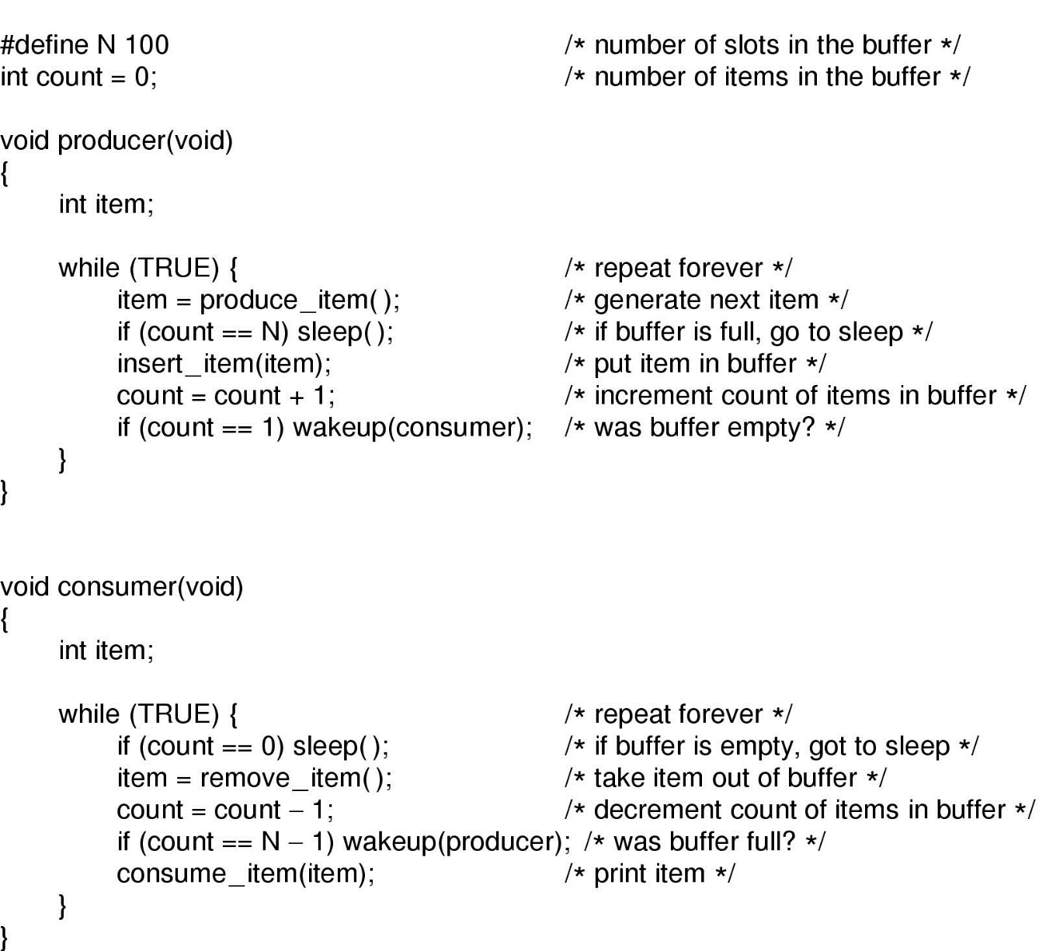
Producer-Consumer Problem
Producer-consumer problem with fatal race condition
20

Slide 21
Semaphores [E.W. Dijkstra, 1965]
A SEMAPHORE, S, is a structure consisting of two parts:
(a) an integer counter, COUNT
(b) a queue of pids of blocked processes, Q
That is,
struct sem_struct {
int count;
queue Q;
} semaphore;
semaphore S;
21

Slide 22
Semaphores [E.W. Dijkstra, 1965]
There are two operations on semaphores, UP and DOWN (PV). These operations must be executed atomically (that is in mutual exclusion). Suppose that P is the process making the system call. The operations are defined as follows:
DOWN(S):
if (S.count > 0)
S.count = S.count - 1;
else
block(P); that is,
(a) enqueue the pid of P in S.Q,
(b) block process P (remove the pid from the ready queue)
(c) pass control to the scheduler.
22

Slide 23
Semaphores [E.W. Dijkstra, 1965]
UP(S):
if (S.Q is nonempty)
wakeup(P) for some process P in S.Q; that is,
(a) remove a pid from S.Q (the pid of P),
(b) put the pid in the ready queue, and
(c) pass control to the scheduler.
else
S.count = S.count + 1;
23

Slide 24
Semaphores
Semaphores do not require busy-waiting, instead they involve BLOCKING.
semaphore full = 10; // set full.count = 10
DOWN(full);
- critical section -
UP(full);
24

Slide 25
Mutexes：Mutual Exclusion Solution
A mutex is a semaphore that can be in one of two states: unlocked (0) or locked (1).
semaphore mutex = 1; // set mutex.count = 1
DOWN(mutex);
- critical section -
UP(mutex);
25

Slide 26
Previous Solution
Producer-consumer problem with fatal race condition
26

Slide 27
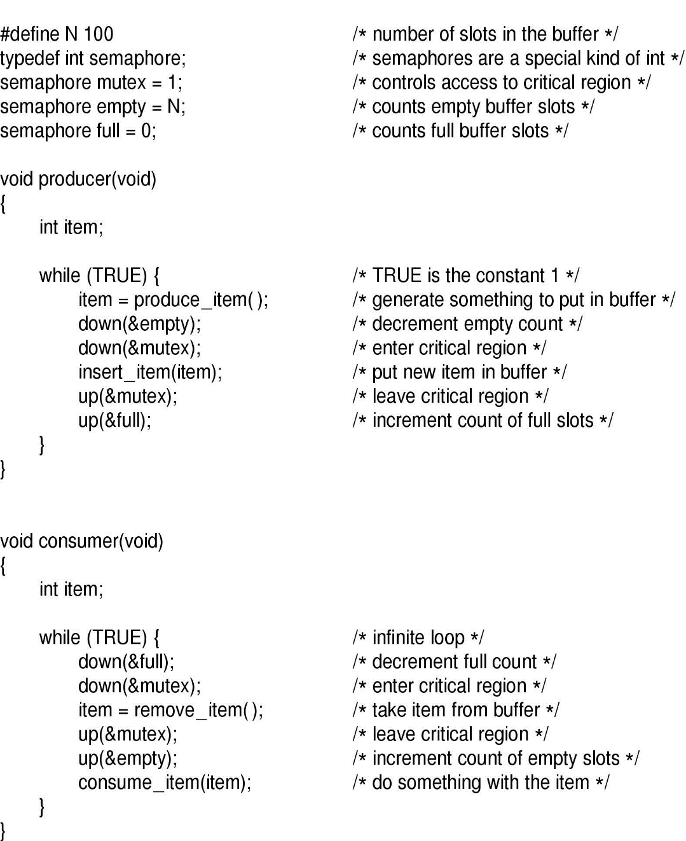
Semaphore Based Solution
The producer-consumer problem using semaphores
27

Slide 28
Using Semaphores
Process Synchronization:
Suppose we have 4 processes: A, B, C, and D. A must finish executing before B start. B and C must finish executing before D starts.
How many semaphores should be used to achieve the above goal?
B
A
D
C
28

Slide 29
Using Semaphores
Process Synchronization:
Process A:
- do work of A
UP(S1); /* Let B or C start */
Process B:
DOWN(S1); /* Block until A is finished */
- do work of B
UP(S2);
Process C: - do work of C
UP(S3);
Process D:
DOWN(S2);
DOWN(S3);
- do work of D
B
A
D
C
29

Slide 30
单选题
1分
When the semaphore is used to realize mutual exclusion, the initial value of the mutex semaphore is usually set to ();
When the semaphore is used to realize synchronization, the initial value of the synchronized semaphore is usually set to （）。
A
0；1
B
1；0
C
uncertain ；1
D
1； uncertain
提交

Slide 31
单选题
1分
Let the initial value of semaphore associated with a resource is 3 and the current value is 1. If M is the number of available resources and N is the number of processes waiting for the resource, then M and N are respectively （ ）
A
0，1
B
1，0
C
1，2
D
2，0
提交

Slide 32
主观题
2分
In a box, a mixture of equal number of white and black particles. Now we have to use an automatic sorting system to separate the white and black particles. Suppose the system has two processes P1 and P2, in which P1 picks white particles and P2 picks black particles. Each process is specified to pick only one particle at a time. When a process is picking, another process is not allowed to pick at the same time; when a process picks a particle, another process must be allowed to pick. Try to write the program that these two concurrent processes can execute correctly 。
正常使用主观题需2.0以上版本雨课堂
作答

Slide 33
Semaphore S₁=0; Semaphore S₂=1; main () { Cobegin { 进程P₁ { while (true) { P (S₁); // 申请拣白子 拣一白子； V (S₂); // 允许拣黑子 } } 进程P₂ { while (true) { P (S₂); // 申请拣黑子 拣一黑子； V (S₁); // 允许拣白子 } } } Coend }

Slide 34
Classical IPC Problems
Readers and Writers Problem
Sleeping Barber Problem
Dining Philosophers Problem
34

Slide 35
Readers and Writers Problem
Reader
Writer
Multiple readers can read simultaneously
Only one writer is allowed to write at a time
When reading, writing is not allowed.
When writing, reading is not allowed.
Data
35

Slide 36
主观题
1分
Solution 1
Reader
Down(mutex)
Read data
Up(mutex)
Writer
Down(mutex)
Write data
Up(mutex)
Is there any problem in this solution?
正常使用主观题需2.0以上版本雨课堂
作答

Slide 37
Solution 1
Reader
Down(mutex)
Read data
Up(mutex)
Writer
Down(mutex)
Write data
Up(mutex)
Problem
Only one reader can read the data at a time.
37

Slide 38
主观题
1分
Solution 2
Initial: reader = 0; wmutex = 1;
Reader
reader ++;
If(reader == 1) Down(wmutex);
Read data
reader--;
If(reader == 0) Up(wmutex);
Writer
Down(wmutex)
Write data
Up(wmutex)
Is this solution OK?
正常使用主观题需2.0以上版本雨课堂
作答

Slide 39
Solution 2
Initial: reader = 0; wmutex = 1;
Reader
reader ++;
If(reader == 1) Down(wmutex);
Read data
reader--;
If(reader == 0) Up(wmutex);
Writer
Down(wmutex)
Write data
Up(wmutex)
Problem
Will cause race condition.
39

Slide 40
Solution 3
Reader
Down(mutex);
reader ++;
If(reader == 1) Down(wmutex);
Up(mutex);
Read data
Down(mutex);
reader--;
If(reader == 0) Up(wmutex);
Up(mutex);
Writer
Down(wmutex)
Write data
Up(wmutex)
40

Slide 41
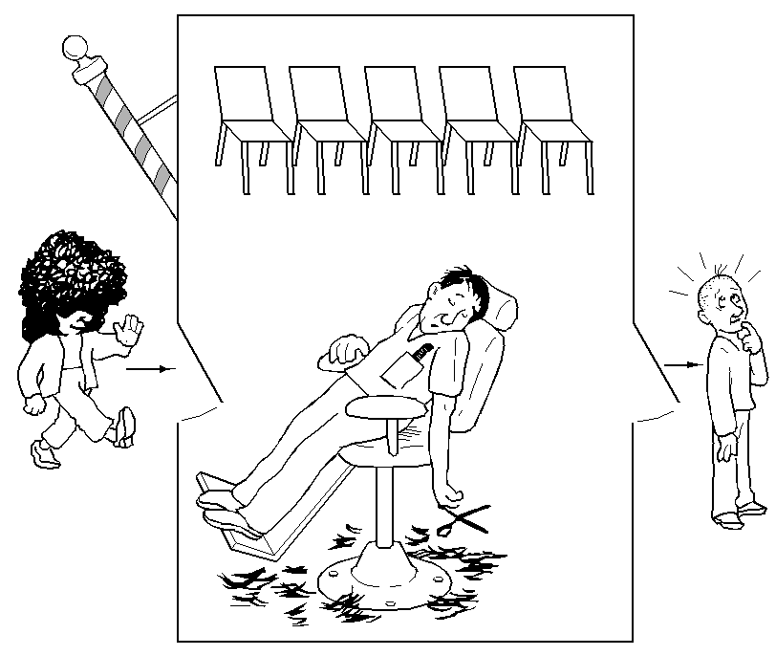
The Sleeping Barber Problem
Problem: one barber, one barber chair, and n chairs.
If there is no customer, the barber will fall asleep.
The first customer arrived will wake up the barber.
If additional customers arrive , sit down or leave the shop.

Slide 42
Solution
barber_ready
cust_ready
Semaphores
mutex
Initial:
barber_ready = 0;
cust_ready = 0;
mutex = 1;
seat_num
42

Slide 43
Barber
Customer
While (True) do {
Down(cust_ready);
Down(mutex);
seat_num++;
Up(barber_ready);
Up(mutex);
# cut hair here
}
Down(mutex);
If(seat_num > 0){
seat_num--;
Up(cust_ready);
Up(mutex);
Down(barber_ready)
}else Up(mutex);
}
43

Slide 44
主观题
1分
At a one-way intersection, several cars are waiting to pass through the intersection from east to west and from south to north. For safety reasons, only one vehicle can be passed at a time (East to west or south to North). When there are vehicles passing by, other vehicles should wait. When there is no traffic at the intersection, a vehicle (from east to west or from south to North) can pass through the intersection. Write pseudo code for both processes using semaphore variables and PV operations (one for East to West vehicles and one for South to North vehicles) 。
正常使用主观题需2.0以上版本雨课堂
作答

Slide 45
Semaphore s = 1;
Process for vehicles from east to west:
Void main()
{
Down(s);
Pass the intersection;
Up(s);
}
Process for vehicles from south to north:
void main()
{
Down(s);
Pass the intersection;
Up(s);
}

Slide 46
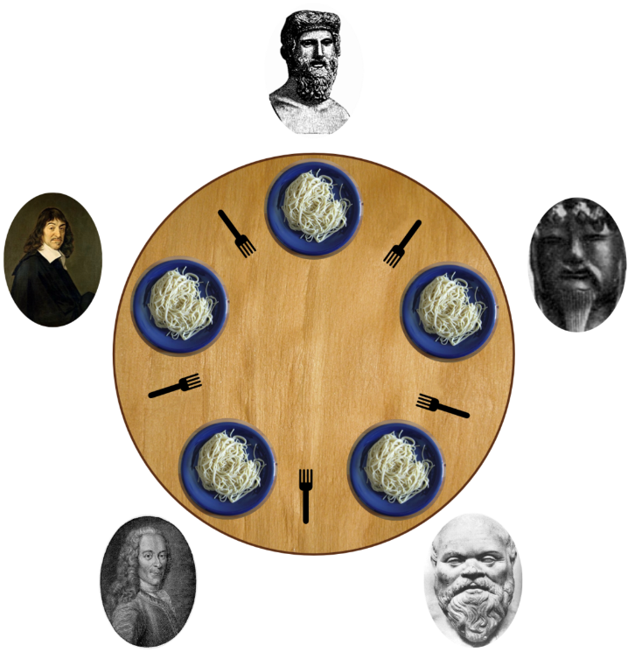
Dining Philosophers Problem
Five silent philosophers sit at a round table with bowls of spaghetti. Forks are placed between each pair of adjacent philosophers. Each philosopher must alternately think and eat. However, a philosopher can only eat when they have both left and right forks. Each fork can be held by only one philosopher and so a philosopher can use the fork only if it is not being used by another philosopher. After an individual philosopher finishes eating, they need to put down both forks so that the forks become available to others. A philosopher cannot start eating before getting both forks.
46

Slide 47
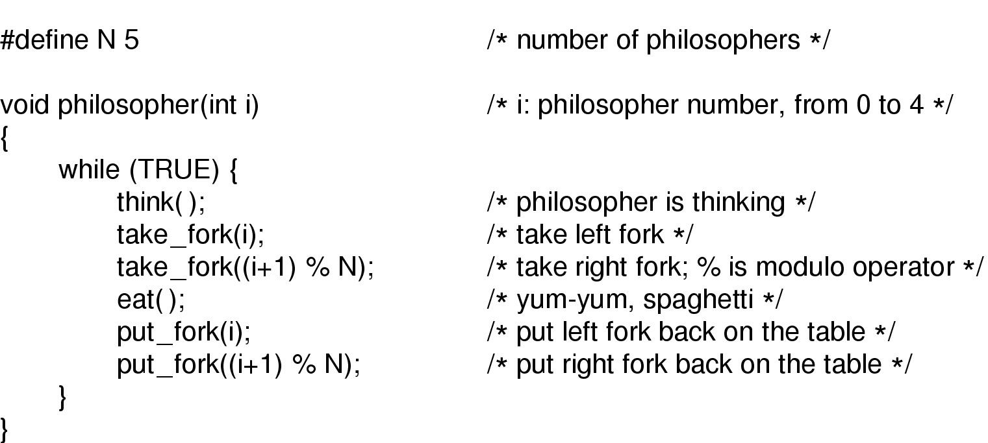
主观题
1分
Solution 1
The procedure take-fork waits until the specified fork is available and then seizes it.
Is there any problem in this solution?
正常使用主观题需2.0以上版本雨课堂
作答

Slide 48
Solution 1
The procedure take-fork waits until the specified fork is available and then seizes it.
Problem?
If five philosophers become hungry at the same time, they will pick their left forks first, this will make them keep waiting for their right forks.
48

Slide 49
主观题
1分
Solution 2
Down(mutex)
Critical Region
Up(mutex)
Is there any problem in this solution?
正常使用主观题需2.0以上版本雨课堂
作答

Slide 50
Solution 2
Down(mutex)
Critical Region
Up(mutex)
Problem?
If a philosopher is eating and one of his neighbors is requesting the forks, all other philosophers must wait until this request has been fulfilled.
50

Slide 51
Solution 3（Tanenbaum’s Solution）
Hungry
Thinking
State of philosopher
Eating
S[5]
Semaphore, all set to 0
mutex
Semaphore, set to 1
51

Slide 52
Void philosopher(int i)
{
While (True) do {
Thinking;
take_forks(i);
Eating;
put_forks(i);
}
}
Void take_forks(int i){
down(mutex);
state[i] = Hungry;
test(i);
up(mutex);
down(s[i]);
}
Void put_forks(int i){
down(mutex);
state[i] = Thinking;
test(LEFT);
test(RIGHT);
up(mutex);
}
52

Slide 53
Void test(int i)
{
if(state[i] == Hungry &&
state[LEFT] != Eating &&
state[Right] != Eating ){
state[i] = Eating;
up(s[i]);
}
}
If i want to eat and the condition is satisfied,
then give i a ticket
Objective: To check whether (i) can start eating. If (i) can start eating, then update (i)’s state and allow (i) to eat. Otherwise, (i) will be blocked when executing the next down operation.
53

Slide 54
主观题
1分
There is an empty dish on the table. Dad put apples or oranges in the dish. The son eats oranges and the daughter apples. When the dish is empty, only one fruit can be put at a time. Please use PV primitive to realize the synchronization of father, son and daughter.
正常使用主观题需2.0以上版本雨课堂
作答

Slide 55
Semaphore s0 = 1, s1 = 0, s2 = 0;
Father{
while(true){
P(s0);
Put a fruit accordingly/randomly;
if(is orange）{
V（s1）
}else{
V（s2）
}
}
}
Son{
While（true）{ P（s1）； eat orange； V（s0）； }
}
Daughter{
While（true）{ P（s2）； eat apple； V（s0）； }
}

Slide 56
Check Points
What is Race Condition?
What is Critical Region?
What is Busy Waiting?
What is Semaphore?
What is Mutex?
56

