Slide 1

Operating Systems
Jinghui Zhong （钟竞辉）
Office：B3-515
Email ：jinghuizhong@scut.edu.cn

Slide 2

单选题
1分
A mutex semaphore is used to achieve mutual exclusion between two processes. The mutex is 0，indicating that（ ）
A
No process entered critical region
B
There is a process entered critical region
C
One process has entered the critical region and another is waiting
D
Both processes are in the critical region
提交

Slide 3
单选题
1分
Processes A and B share the same critical resource, and A is in the critical region, which description is correct? （ ）
A
The execution of A cannot be interrupted, and the code of critical region is atomic.
B
The execution of A can be interrupted, but after A is interrupted, the CPU cannot be dispatched to B process.
C
The execution of A can be interrupted. When B is ready, the CPU can be scheduled to B.
D
The execution of A can be interrupted. When B is ready, the CPU must be scheduled to B.
提交

Slide 4
主观题
10分
A museum can accommodate up to 500 people to visit at the same time. There is only one door which is used as entrance and exit. The door allows only one person to pass at a time. The activity description of visitors is as follows:
cobegin
Visitor process i:
{
...
Come in.
...
Visit;
...
Go out;
...
}
coend
Please add necessary semaphores and Down, UP operations to realize mutual exclusion and synchronization in the above process. It is required to explain the meaning of semaphores and assign their initial values.
正常使用主观题需2.0以上版本雨课堂
作答

Slide 5
A museum can accommodate up to 500 people to visit at the same time. There is only one door which is used as entrance and exit. The door allows only one person to pass at a time.
Semaphore empty = 500;
Semaphore mutex = 1;
Visitor process i:
{
P(empty);
P(mutex);
Come in.
V(mutex);
Visit;
P(mutex);
Go out;
V(mutex);
V(empty);
}

Slide 6
Monitors
A monitor is a collection of procedures, variables, and data structures that can only be accessed by one process at a time (for the purpose of mutual exclusion).
To allow a process to wait within the monitor, a condition variable must be declared, as condition x, y;
Condition variable can only be used with the operations wait and signal (for the purpose of synchronization).
The operation
x.wait(); means that the process invoking this operation is suspended until another process invokes
x.signal();
The x.signal operation resumes exactly one suspended process. If no process is suspended, then the signal operation has no effect.
6

Slide 7
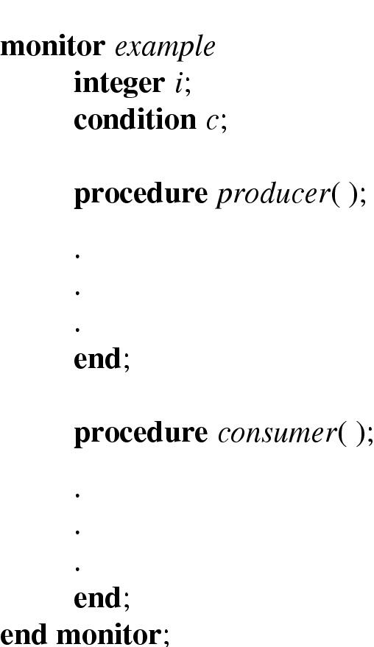
Monitors
Example of a monitor
7

Slide 8
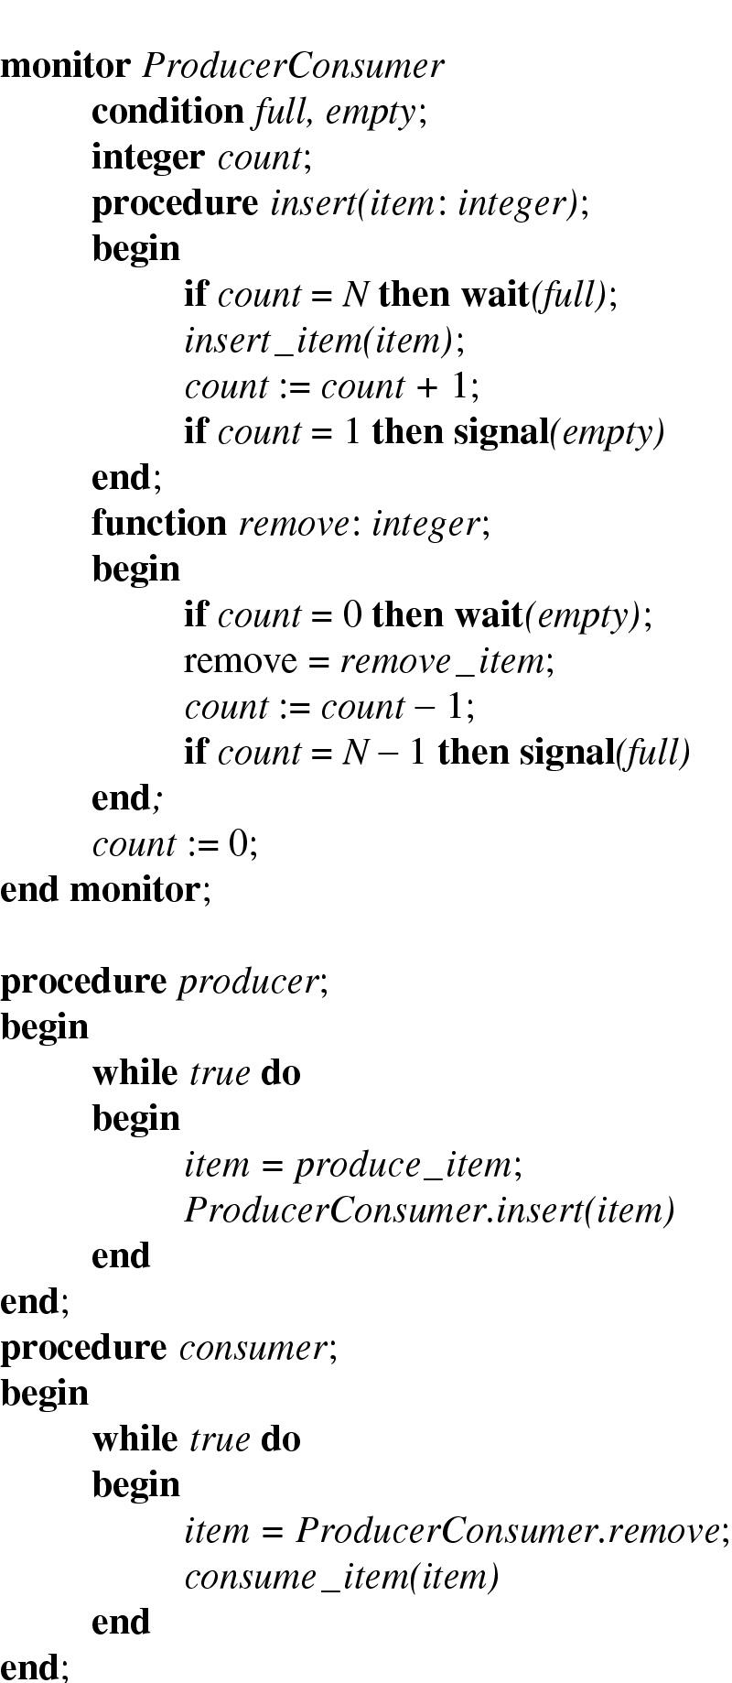
Monitors
Producer-consumer problem with monitors
only one monitor procedure active at one time
8

Slide 9
Monitors
Monitors in Java
supports user-level threads and methods (procedures) to be grouped together into classes.
By adding the keyword synchronized to a method, Java guarantees that once any thread has started executing that method, no other thread can execute that method.
Advantages: Ease of programming.
Disadvantages:
Monitors are a programming language concept, so they are difficult to add to an existing language; e.g., how can a compiler know which procedures were in monitor?
Monitors are too expensive to implement.
9

Slide 10
Comparing monitor with Semaphores
The wait and signal operations on condition variables in a monitor are similar to P and V operations on counting semaphores. A wait statement can block a process's execution, while a signal statement can cause another process to be unblocked. However, there are some differences between them.
What are the differences between monitor and Semaphores？

Slide 11
Comparing monitor with Semaphores
Differences：
When a process executes a P operation, it does not necessarily block that process because the counting semaphore may be greater than zero. In contrast, when a wait statement is executed, it always blocks the process.
When a task executes a V operation on a semaphore, it either unblocks a task waiting on that semaphore or increments the semaphore counter if there is no task to unlock. On the other hand, if a process executes a signal statement when there is no other process to unblock, there is no effect on the condition variable.
Another difference between semaphores and monitors is that users awaken by a V operation can resume execution without delay. Contrarily, users awaken by a signal operation are restarted only when the monitor is unlocked.
http://courses.cs.vt.edu/~cs5204/fall00/monitor.html

Slide 12
Message Passing
Possible Approaches:
Assign each process a unique address such as addr. Then, send messages directly to the process, e.g., signals in UNIX.
send(addr, msg);
recv(addr, msg);
Message passing is commonly used in parallel programming systems.
e.g., MPI (Message-Passing Interface).
12

Slide 13
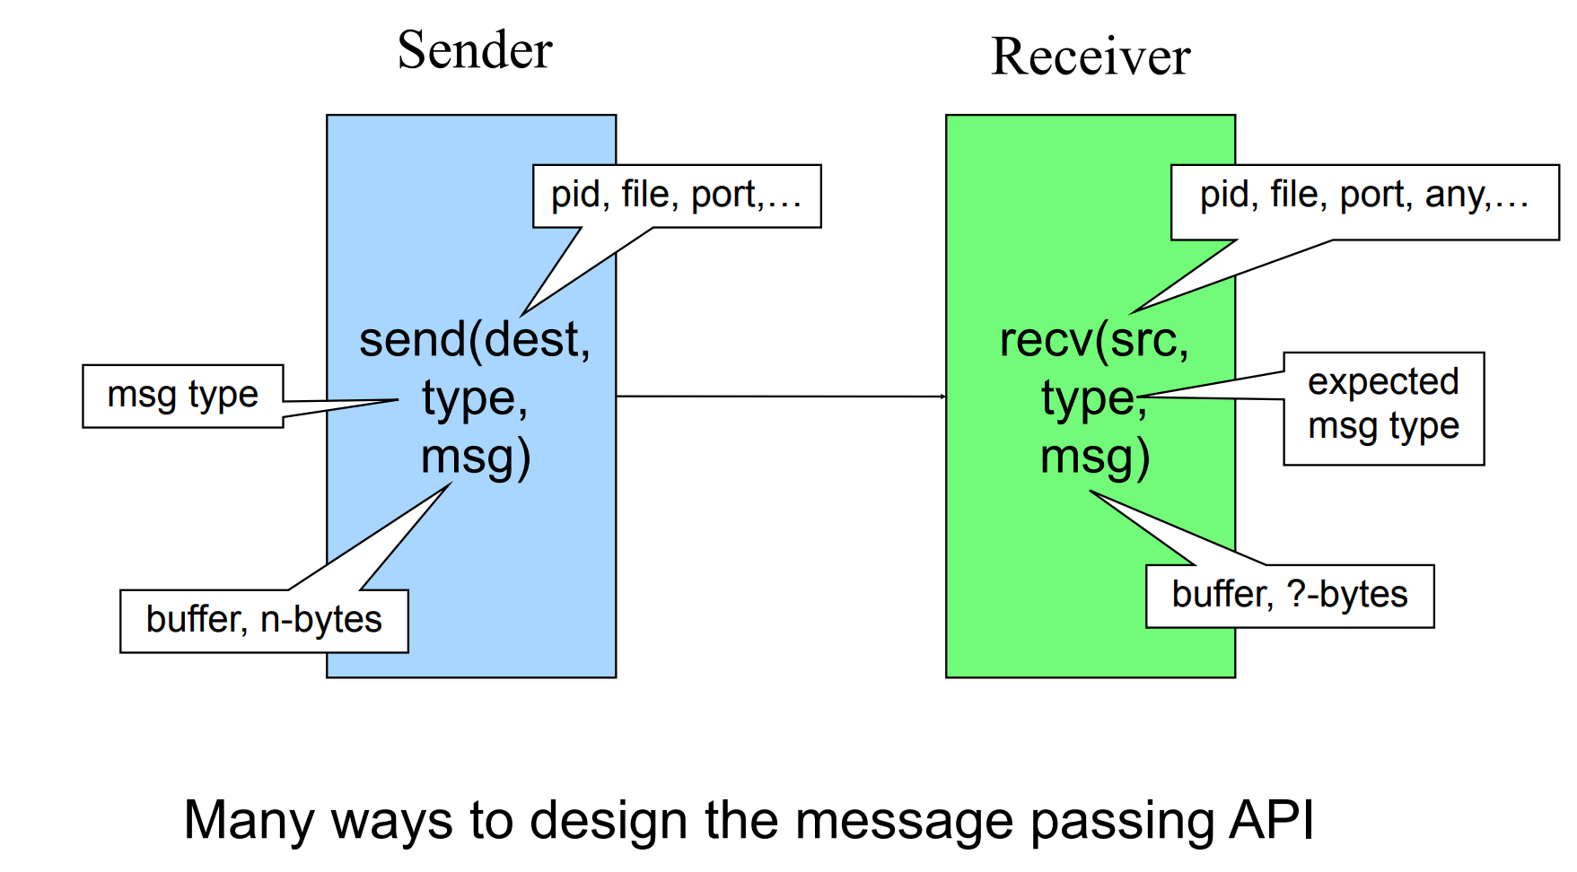
Message Passing API
Message passing is applicable for:
processes inside the same computer.
processes in a networked/distributed system.

Slide 14
Synchronization in message passing (1)
Message passing may be blocking or non-blocking.
Blocking is considered synchronous
Blocking send has the sender block until the message is received
Blocking receive has the receiver block until a message is available
Non-blocking is considered asynchronous
Non-blocking send has the sender send the message and continue
Non-blocking receive has the receiver receive a valid message or null

Slide 15
Synchronization in message passing (2)
Sender: it is more natural not to be blocked after issuing send:
can send several messages to multiple destinations.
but sender usually expect acknowledgment of message receipt (in case receiver fails).
Receiver: it is more natural to be blocked after issuing receive:
the receiver usually needs the information before proceeding.
but could be blocked indefinitely if sender process fails to send.

Slide 16
Synchronization in message passing (3)
Other methods are offered, e.g., blocking send, blocking receive:
both are blocked until the message is received.
provides tight synchronization (rendezvous).
So, there are three combinations that make sense:
(1) Blocking send, Blocking receive;
(2) Nonblocking send, Nonblocking receive;
(3) Nonblocking send, Blocking receive – most popular .

Slide 17
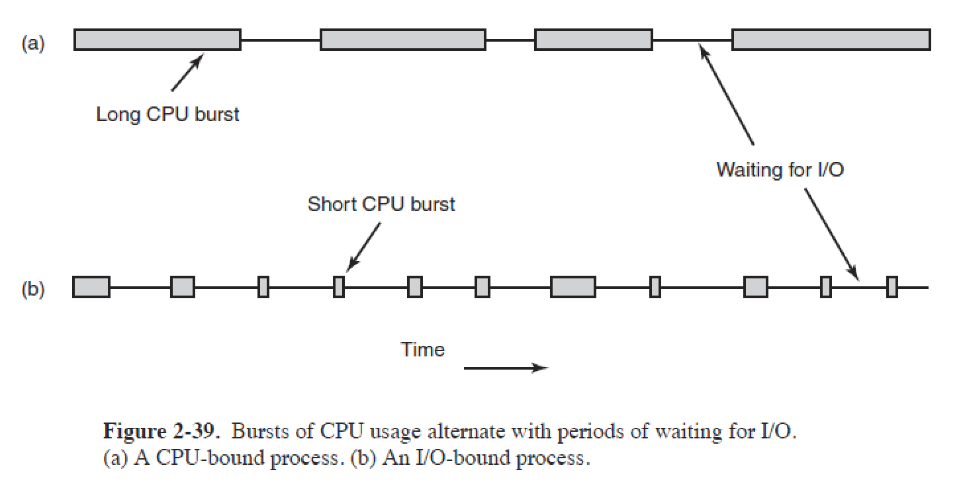
Process Behavior
Nearly all processes alternate bursts of computing with I/O requests.
CPU-bound: Spend most of the time computing.
IO-bound: Spend most of the time waiting for I/O.
17

Slide 18
Process Scheduling
Scheduler: A part of the operating system that decides which process is to be run next.
Scheduling Algorithm: a policy used by the scheduler to make that decision.
To make sure that no process runs too long, a clock is used to cause a periodic interrupt (usually around 50-60 Hz); that is, about every 20 msec.
Preemptive Scheduling: allows processes that are runnable to be temporarily suspended so that other processes can have a chance to use the CPU.
18

Slide 19
When to Schedule
When a new process is created;
When a process exist;
When a process blocks on I/O;
When an I/O interrupt occurs (e.g., clock interrupt).
19

Slide 20
Scheduling Algorithm Goals
Fairness - each process gets its fair share of time with the CPU.
Efficiency - keep the CPU busy doing productive work.
Response Time - minimize the response time for interactive users.
Turnaround Time - minimize the average time from a batch job being submitted until it is completed.
Throughput - maximize the number of jobs processed per hour.
20

Slide 21
First-Come, First-Served (FCFS) Scheduling
Process Burst Time
P₁ 24
P₂ 3
P₃ 3
Suppose that the processes arrive in the order: P₁ , P₂ , P₃
Waiting time for P₁, P₂, and P₃ = 0，24，27
Average waiting time = (0+24+27)/3 = 17
21

Slide 22
主观题
1分
Suppose that the processes arrive in the order P₂ , P₃ , P₁ .
What is the average waiting time?
P₂
P₃
P₁
0
3
6
30
正常使用主观题需2.0以上版本雨课堂
作答

Slide 23
FCFS Scheduling
Suppose that the processes arrive in the order P₂ , P₃ , P₁ .
Waiting time：P₁ = 6； P₂ = 0； P₃ = 3
Average waiting time： (6 + 0 + 3)/3 = 3
Much better than previous case.
P₂
P₃
P₁
0
3
6
30
23

Slide 24
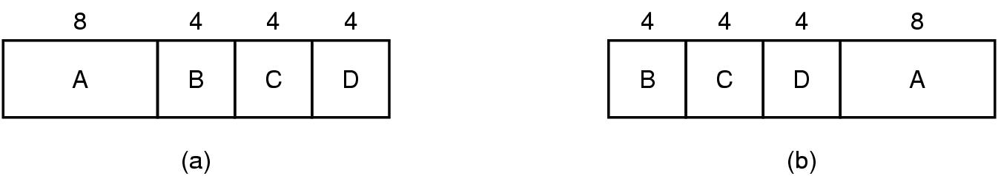
Shortest-Job-First (SJF) Scheduling
Associate with each process the length of its next CPU burst. Use these lengths to schedule the process with the shortest time.
An example of shortest job first scheduling
Drawback?
The real difficulty with the SJF algorithm is knowing the length of the next CPU request.
24

Slide 25
Shortest-Job-First (SJR) Scheduling
Two schemes:
nonpreemptive – once CPU given to the process it cannot be preempted until it completes its CPU burst.
preemptive – if a new process arrives with CPU burst length less than remaining time of current executing process, preempt. This scheme is know as the Shortest-Remaining-Time-First (SRTF).
SJF is optimal – gives minimum average waiting time for a given set of processes.
25

Slide 26
主观题
10分
Example of Non-Preemptive SJF
Process Arrival Time Burst Time
P₁ 0.0 7
P₂ 2.0 4
P₃ 4.0 1
P₄ 5.0 4
SJF (non-preemptive)
Average waiting time = ?
正常使用主观题需2.0以上版本雨课堂
作答

Slide 27
Example of Non-Preemptive SJF
Process Arrival Time Burst Time
P₁ 0.0 7
P₂ 2.0 4
P₃ 4.0 1
P₄ 5.0 4
SJF (non-preemptive)
Average waiting time = (0 + 6 + 3 + 7)/4 = 4
P₁
P₃
P₂
P₄
0
3
7
8
12
16
27

Slide 28
主观题
10分
Example of Preemptive SJF
Process Arrival Time Burst Time
P₁ 0.0 7
P₂ 2.0 4
P₃ 4.0 1
P₄ 5.0 4
SJF (preemptive)
Average waiting time = ?
正常使用主观题需2.0以上版本雨课堂
作答

Slide 29
Example of Preemptive SJF
Process Arrival Time Burst Time
P₁ 0.0 7
P₂ 2.0 4
P₃ 4.0 1
P₄ 5.0 4
SJF (preemptive)
Average waiting time = (9 + 1 + 0 +2)/4 = 3
P₁
P₂
P₃
P₂
P₄
P₁
0
2
4
5
7
11
16
29

Slide 30
Round Robin (RR) Scheduling
Each process gets a small unit of CPU time (time quantum), usually 10-100 milliseconds. After this time has elapsed, the process is preempted and added to the end of the ready queue.
If there are n processes in the ready queue and the time quantum is q, then each process gets 1/n of the CPU time in chunks of at most q time units at once. No process waits more than (n-1)q time units.
Performance
q large ⇒ FIFO
q small ⇒ q must be large with respect to context switch, otherwise overhead is too high.
30

Slide 31
Example of RR with Time Quantum = 20
Process Burst Time
P₁ 53
P₂ 17
P₃ 68
P₄ 24
The Gantt chart is:
Typically, higher average turnaround than SJF, but better response.
P₁
P₂
P₃
P₄
P₁
P₃
P₄
P₁
P₃
P₃
0
20
37
57
77
97
117
121
134
154
162
31

Slide 32
单选题
1分
The CPU is scheduled using RR strategy. When the time slice of a process is run out, its state will change to （ ）
A
blocked
B
running
C
ready
D
vanishing
提交

Slide 33
Priority Scheduling
A priority number (integer) is associated with each process
The CPU is allocated to the process with the highest priority (smallest integer ≡ highest priority).
Preemptive
nonpreemptive
SJF is a priority scheduling where priority is the predicted next CPU burst time.
Problem: Starvation – low priority processes may never execute.
Solution: Aging – as time progresses increase the priority of the process.
33

Slide 34
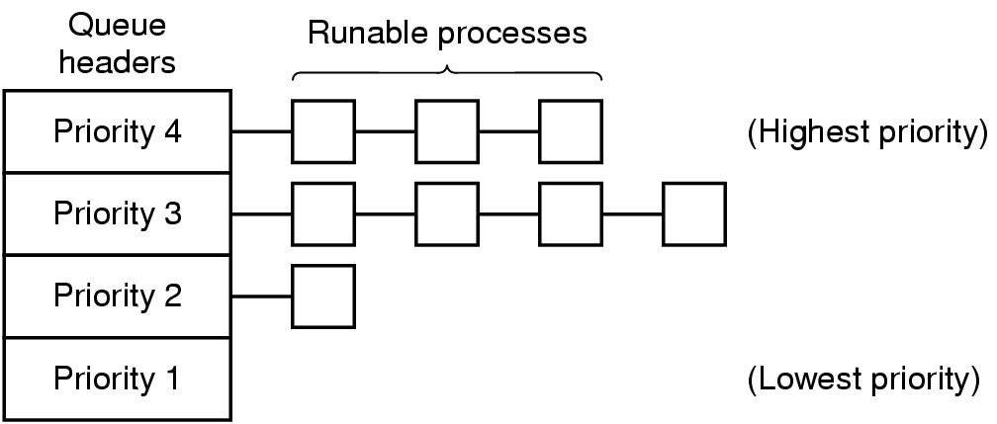
Scheduling in Interactive Systems
A scheduling algorithm with four priority classes
34

Slide 35
单选题
1分
Which of the followings strategies would not cause starvation （ ）
A
RR
B
Static priority scheduling
C
Non-preemptive SJF
D
Preemptive SJF
提交

Slide 36
单选题
1分
答案解析
Which of the following process scheduling algorithms considers both the process waiting time and execution time ( ）
Response Ratio = (W + S)/S
Here, W is the waiting time of the process so far and S is the Burst time of the process.
A
RR
B
SJF
C
FCFS
High response ratio Next scheduling
D
提交
可为此题添加文本、图片、公式等解析，且需将内容全部放在本区域内。正常使用需3.0以上版本

Slide 37
Highest Response Ratio Next Scheduling is a non-preemptive CPU Scheduling algorithm.
Response Ratio = (W + S)/S
Here, W is the waiting time of the process so far and S is the Burst time of the process.

Slide 38
单选题
1分
In a system with a single processor, when and how long the process can use CPU depends on （ ）
A
The length of the code of the process
B
How long does the process need to run
C
Process itself and process scheduling strategy
D
What function does the process accomplish
提交

Slide 39
单选题
1分
There are three jobs A, B and C, which run for 2 h, 5 h and 3 h respectively. Assuming that they arrive at the same time and run in a system with one processor, the execution sequence with the shortest average turnaround time is （）
A
A B C
B
C B A
C
A C B
D
B C A
提交

Slide 40
More Scheduling
Shortest Process Next
SJF can be used in an interactive environment by estimating the runtime based on past behavior. Aging is a method used to estimate runtime by taking a weighted average of the current runtime and the previous estimate.
Example: Let a = estimate weight, then the current estimate is: a *T₀ + (1-a) * T₁
where T₀ is the previous estimate and T₁ is the current runtime.
Guaranteed Scheduling
Suppose 1/n of the CPU cycles.
Compute ratio = actual CPU time consumed / CPU time entitled
Run the process with the lowest ratio
40
Notes:
b

Slide 41
More Scheduling
Lottery Scheduling
Give processes lottery tickets for various system resources
When a scheduling decision is made, a lottery ticket is chosen, and the process holding that ticket gets the resource.
Fair-Share Scheduling
Take into account how many processes a user owns.
Example: User 1 – A, B, C, D and Use 2 – E
Round-robin: ABCDEABCDE...
Fair-Share: if use 1 is entitled to the same CPU time as user 2
AEBECEDEAEBECEDE….
41

Slide 42
Thread Scheduling
The process scheduling algorithms can also be used in thread scheduling. In practice, round-robin and priority scheduling are commonly used.
User-level and kernel-level threads
A major difference between user-level threads and kernel-level threads is the performance.
User-level threads can employ an application-specific thread scheduler.
42

Slide 43
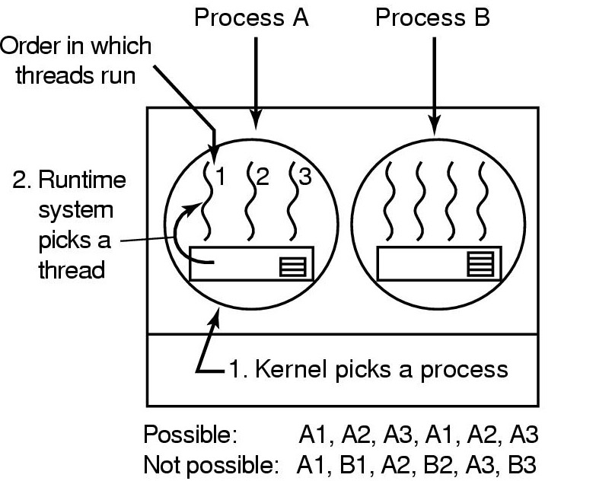
Thread Scheduling
Possible scheduling of user-level threads
50-msec process quantum
Threads run 5 msec/CPU burst
43

Slide 44
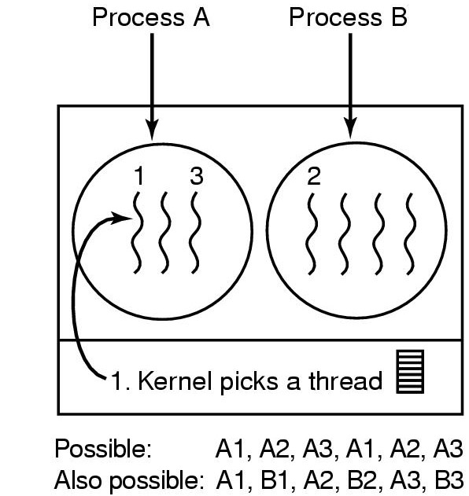
Thread Scheduling
Possible scheduling of kernel-level threads
50-msec process quantum
Threads run 5 msec/CPU burst
44

Slide 45
主观题
2分
There are five batch jobs A-E, and they arrive at a computing center almost at the same time. Their running times are estimated to be 10, 6, 2, 4, and 8 minutes, respectively. For each of the following scheduling algorithms, please calculate the average process turnaround time （the overhead of process switching is ignored）.
The SJF;
The RR method;
Assuming that the system has multiprogramming capability, each job shares CPU time fairly, and all jobs are CPU-bound.
正常使用主观题需2.0以上版本雨课堂
作答

Slide 46
SJF：
Running time（minute）：A=10、B=6、C=2、D=4、E=8
The completed time of the 5 jobs are:
C：2m；
D：2+4 = 6m；
B：6+6 = 12m；
E：12 + 8 = 20m；
A：20 + 10 = 30m;
average turnaround time =
（2 + 6 + 12 + 20+30）/ 5 = 14 m

Slide 47
RR：
Running time（minute） ：
A=10、B=6、C=2、D=4、E=8
（1）C finish，time： 2*5 = 10分钟；
（2）D finish，time： 10 +（4-2）*4=18分钟；
（3）B finish，time：18 +（6-4）*3=24分钟；
（4）E finish，time：24 + （8 – 6）*2 = 28分钟；
（5）A finish，time：28 + （10-8）*1=30分钟；
average turnaround time =
（10 + 18 + 24 + 28+30）/ 5 = 22 分钟

Slide 48
Check points
What is monitors and message passing IPC techniques?
What is IO-bound process?
When to schedule processes?
What are the goals of Scheduling algorithms?
What is the drawback of the SJF algorithm?
What is RR scheduling?
48

