Slide 1

Operating Systems
Jinghui Zhong （钟竞辉）
Office：B3-515
Email ：jinghuizhong@scut.edu.cn

Slide 2
Presentation
Example topics
Process Scheduling
The Banker’s Algorithm
Virtual Memory Paging
Page Replacement Algorithm
Memory Management (Link List)
Disk space Management
Interrupt/DMA
Disk Arm Scheduling Algorithm
Files: Link List Allocation
…
2

Slide 3

多选题
1分
What may cause the state of a process changing from running to blocking （ ）
A
The running process performs the P operation
B
Scheduling of process scheduler
C
Run out of time slices of the process
D
The running process performs the V operation
提交

Slide 4
单选题
1分
What may cause the state of a process changing from running to ready （ ）
A
Perform the P operation
B
Failed to apply for memory
C
Start the IO device
D
Preempted by high priority process
提交

Slide 5
Computer Deadlock:
What it is and how to model it

Slide 6
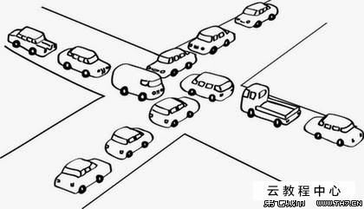
What is deadlock?
Examples
You can't get a job without experience;
You can't get experience without a job.
6

Slide 7


What is deadlock?
Definition
A set of processes(e.g., ) is in a deadlock state when every process in the set is waiting for a resource that can only be released by another process in the set.
Not enough resource
Deadlock
7

Slide 8

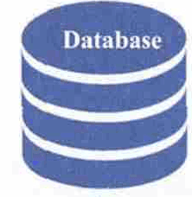

Resources
A resource is anything that can be acquired, used, and released over the course of time.
Resource
……
8

Slide 9
Two types of Resources
Preemptable resources
can be taken away from a process with no ill effects (e.g. memory)
Nonpreemptable resources
will cause the process to fail if taken away (e.g. CD recorder)
Potential deadlocks that involve Preemptable resources can usually be resolved by reallocating resources from one process to another.
9

Slide 10
Resource Usage
Sequence of events required to use a resource
request the resource
use the resource
release the resource
Must wait if request is denied
requesting process may be blocked
may fail with error code
10

Slide 11
Resource Acquisition
Associate a semaphore with each resource :
typedef int semaphore;
semaphore resource_1;
semaphore resource_2;
void process_A(void) { void process_B(void) {
down(resource_1); down(resource_1);
down(resource_2); down(resource_2);
use_both_resources(); use_both_resources();
up(resource_2); up(resource_2);
up(resource_1); up(resource_1);
} }
All semaphores are initialized to 1.
11

Slide 12
Resource Acquisition
Code with a potential deadlock :
typedef int semaphore;
semaphore resource_1;
semaphore resource_2;
void process_A(void) { void process_B(void) {
down(resource_1); down(resource_2);
down(resource_2); down(resource_1);
use_both_resources(); use_both_resources();
up(resource_2); up(resource_1);
up(resource_1); up(resource_2);
} }
12

Slide 13
多选题
1分
Select the correct descriptions （ ）
A
There are at least two processes involved in a deadlock ；
B
Each process involved in the deadlock waits for resources ；
C
At least two of the processes involved in the deadlock occupy resources ；
D
Deadlock process is a subset of the current process set in the system;
提交

Slide 14
Conditions for Deadlocks
Mutual exclusion
Resources are held by processes in a non-sharable (exclusive) mode.
Hold and Wait
A process holds a resource while waiting for another resource.
No Preemption
There is only voluntary release of a resource - nobody else can make a process give up a resource.
Circular Wait
Process A waits for Process B waits for Process C .... waits for Process A.
ALL of these four conditions must happen simultaneously for a deadlock to occur.
14

Slide 15

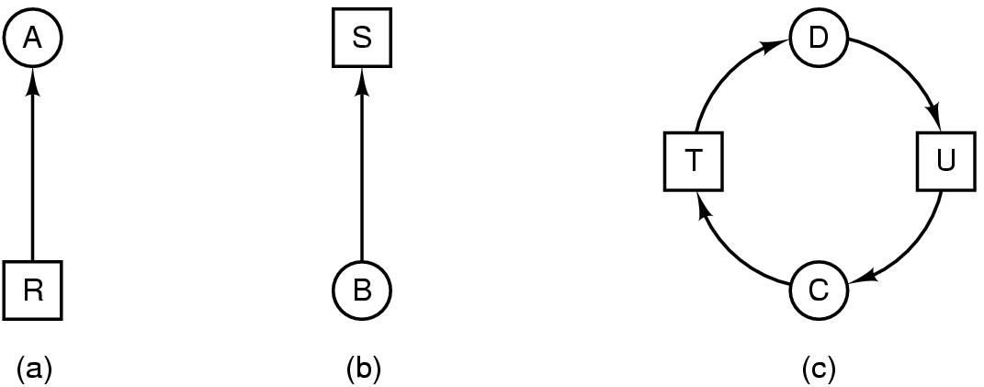
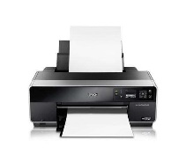
Deadlock Modeling (Resource with single instance)
Modeled with directed graphs
(a) resource R assigned to process A
(b) process B is requesting/waiting for resource S
Process
Resource
15

Slide 16

Deadlock Modeling (Resource with single instance)
Modeled with directed graphs
Process C and D are in deadlock over resources T and U
Process
Resource
16

Slide 17
Resource-Allocation Graph
A set of vertices V and a set of edges E.
V is partitioned into two types:
P = {P₁, P₂, …, P_{n}}, the processes in the system.
R = {R₁, R₂, …, R_{m}}, the resource types.
Request edge: directed edge P₁ → R_{j}
Assignment edge: directed edge R_{j} → P_{i}
17

Slide 18
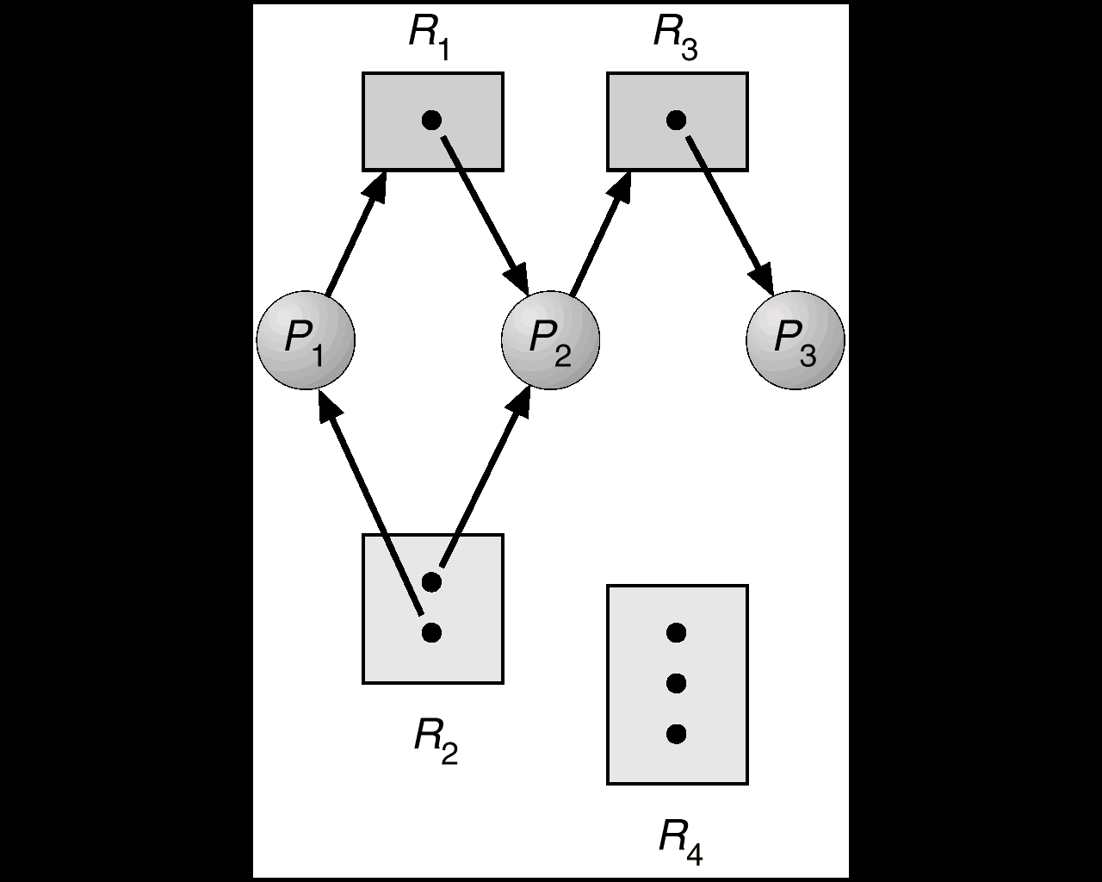
Deadlock Modeling (Resource with multiple instances)
Resource Type with 3 instances
P_{i} requests an instance of R_{j}
P_{i} is holding an instance of R_{j}
P_{i}
P_{i}
18

Slide 19
Example (1)
19

Slide 20
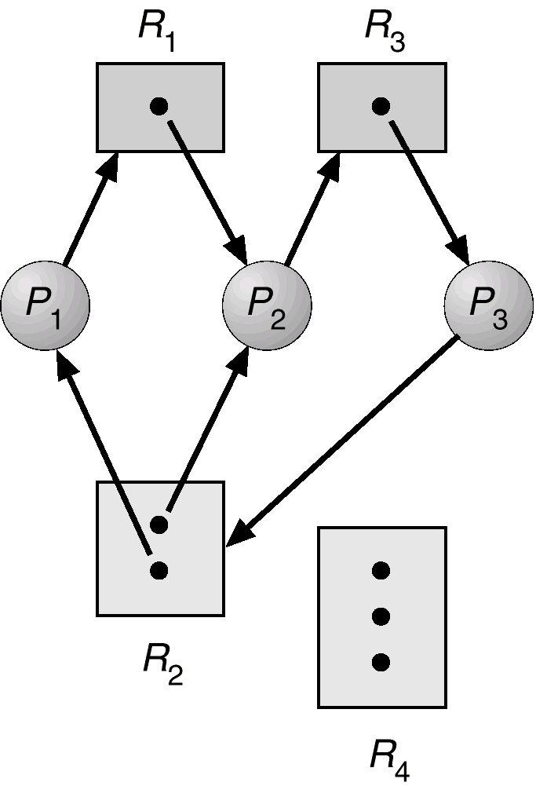
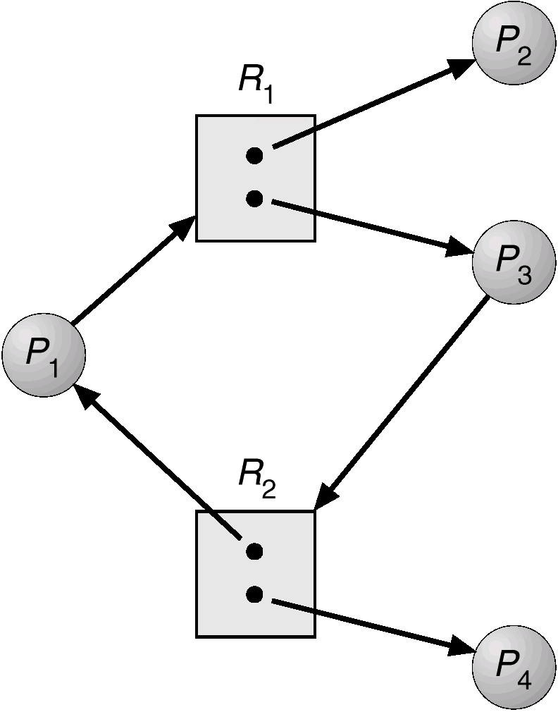
Examples (2)
20

Slide 21
Basic Fact
21
If graph contains no cycles ⇒ no deadlock.
If graph contains a cycle ⇒
if only one instance per resource type, then deadlock.
if several instances per resource type, possibility of deadlock.

Slide 22

The Ostrich Algorithm
Pretend that there is no problem
Reasonable if
deadlocks occur very rarely
cost of prevention is high
Deadlock
22

Slide 23
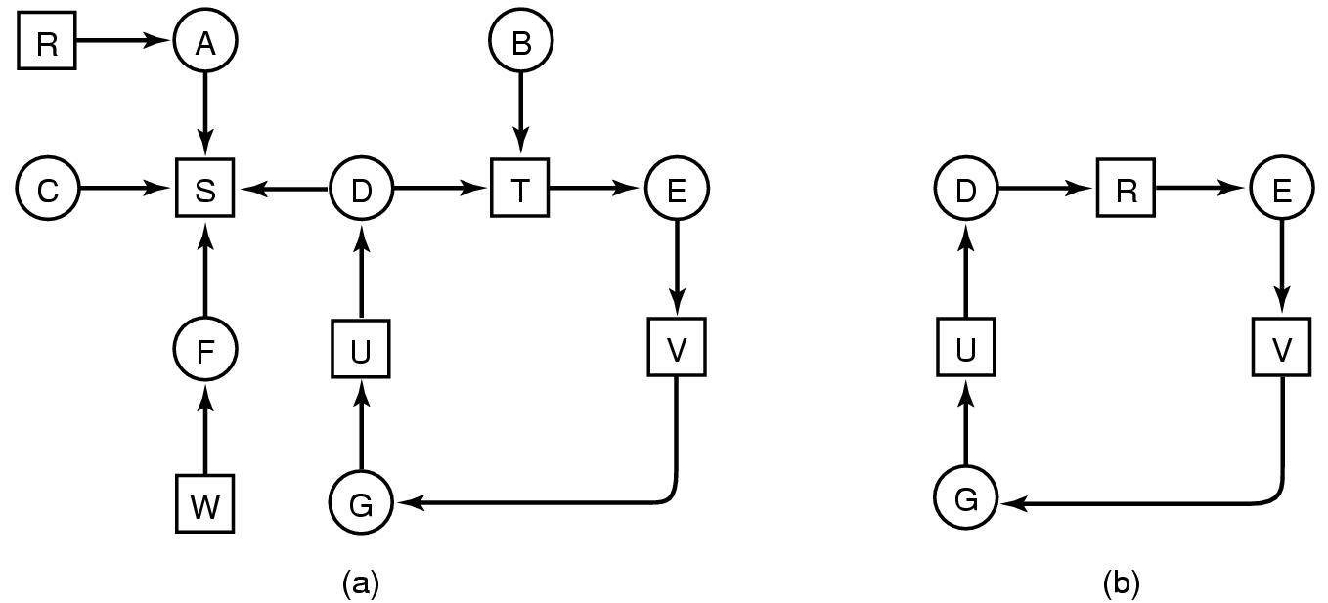
Detection with One Resource of Each Type
Note the resource ownership and requests
A cycle can be found within the graph, denoting deadlock
Many algorithms for detecting cycles in directed graphs.
23

Slide 24
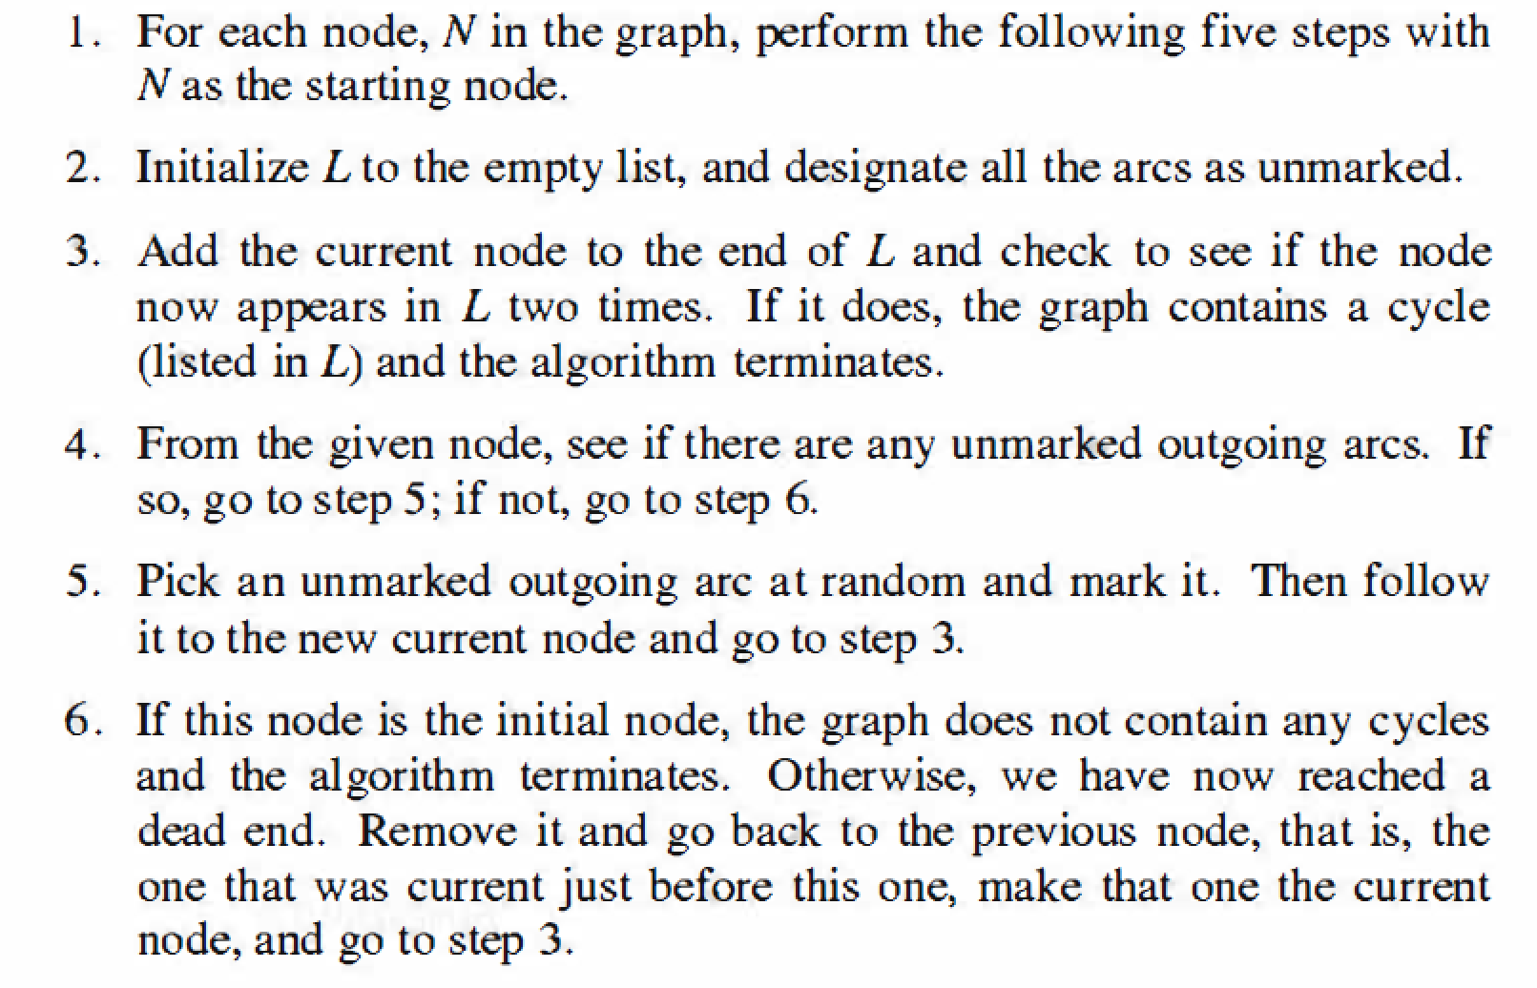
Detecting Cycles in Directed Graphs

Slide 25
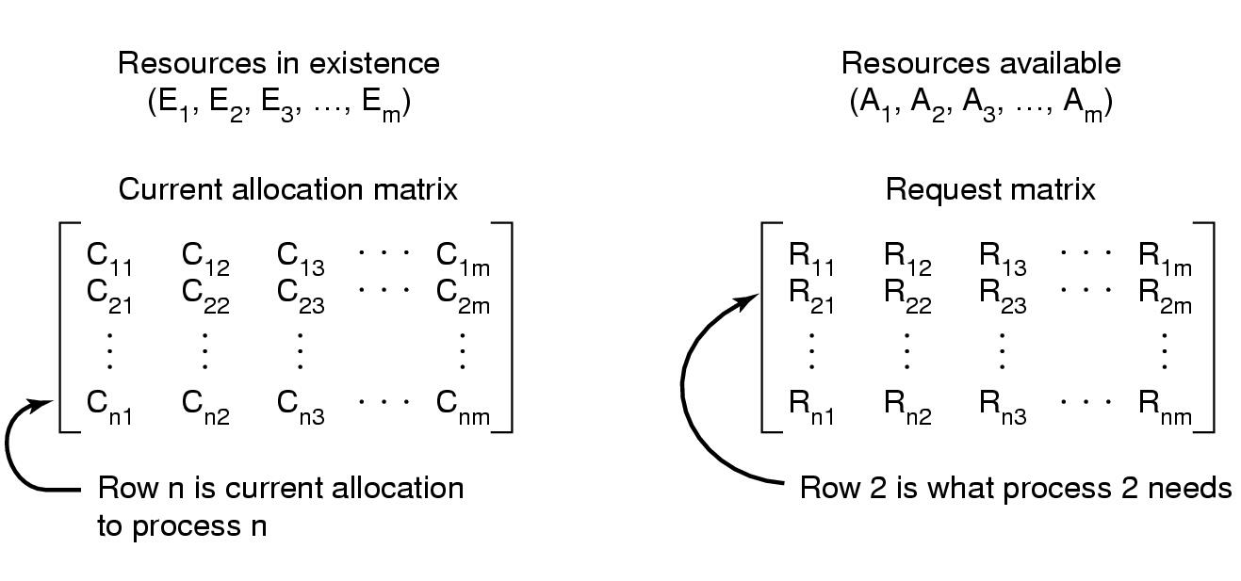
Detection with Multiple Resources of Each Type
Data structures needed by deadlock detection algorithm
Σ C_{ij} + A_{j} = E_{j}
25

Slide 26
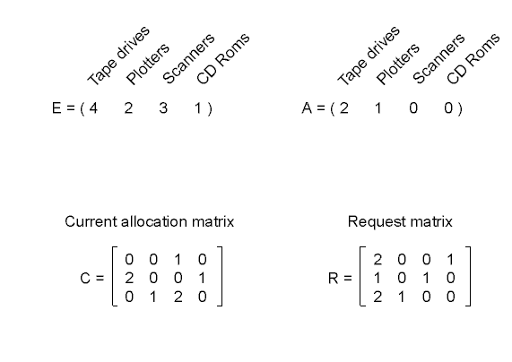
Detection with Multiple Resources of Each Type
26

Slide 27
Deadlock Detection Algorithm
Recovery look for an unmark process P_{i} s.t. the i-th row of R is less than A. (P_{i} 's request can be satisfied )
If such a process is found, add the i-th row of C to A, mark the process and go back to step 1. ( When Pi completes, its resources will become available ).
If no such process exist, the algorithm terminates. The unmarked process, if any, are deadlock.
27

Slide 28
Deadlock Detection Algorithm
Add all nodes to Unfinished;
Do{
done = true
foreach node in Unfinished{
if([R_{node}] <= [A]){
remove node from Unifished;
[A] = [A] + [C_{node}]
done = false;
}
}
}until(done)
Current Request Resources of node
Available Resources
Resources held by node
28

Slide 29
Deadlock Detection: An Example
A = (2 2 2 0)
A = (4 2 2 1)

Slide 30
Recovery from Deadlock
Recovery through preemption
take a resource from some other processes
depends on the nature of the resource
Recovery through rollback
checkpoint a process periodically
use this saved state
restart the process if it is found deadlocked
30

Slide 31
Recovery from Deadlock
Recovery through killing processes
crudest but simplest way to break a deadlock
kill one of the processes in the deadlock cycle
the other processes get its resources
choose process that can be rerun from the beginning
31

Slide 32
单选题
1分
Which method can be used to remove deadlock（ ）。
A
Perform parallel operations
B
Kill process
C
Refuse to allocate new resources
D
Modify semaphore
提交

Slide 33
单选题
1分
Deadlock can be prevent by allocating all resources at a time. Which of the four necessary conditions for deadlock is destroyed by this method（）
A
Mutual exclusion
B
Hold and wait
C
No Preemption
D
Circular wait
提交

Slide 34
单选题
1分
There are 11 printers in a system, N processes share printer resources, and each process requires 3 printers. What is the maximum value of N (), that can ensure there will be no deadlock in the system.
A
4
B
5
C
6
D
7
提交

Slide 35
Can we avoid deadlock?
Motivation: In most systems, resources are requested one at a time. It is desirable that the system can decide whether granting a resource is safe or not.
Question: Is there an algorithm to make the correct decision?
Answer: Yes, we can avoid deadlock, but only if certain information is available in advance.
35

Slide 36
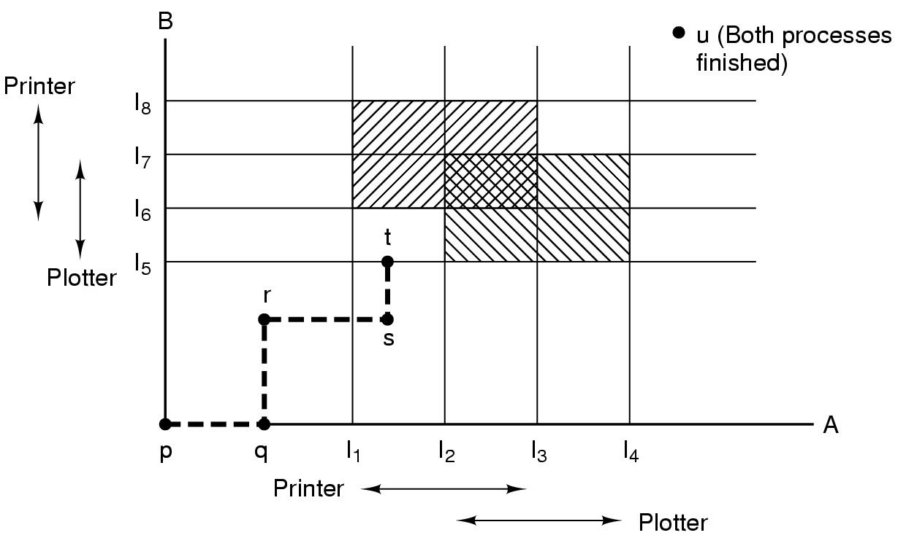
Resource Trajectories
If the system enters the box bounded by[I₁, I₂, I₅,I₆],
it will eventually deadlock. Why?
36

Slide 37
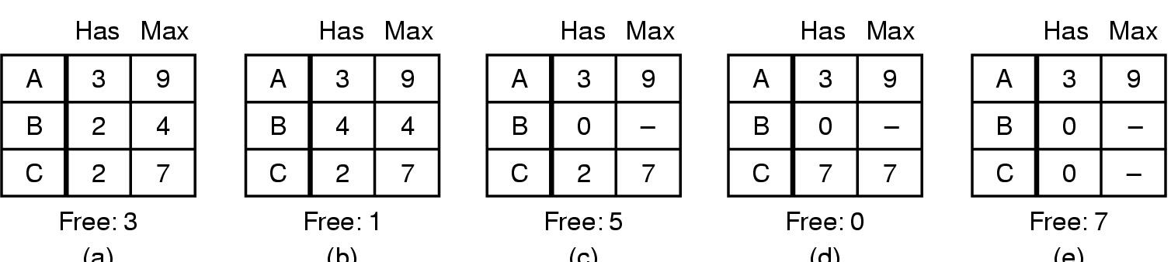
Safe and Unsafe States
A state is safe if there is some scheduling order in which every process can run to completion even if all of them suddenly request their maximum number of resources.
(a) (b) (c) (d) (e)
Demonstration that the state in (a) is safe
37

Slide 38
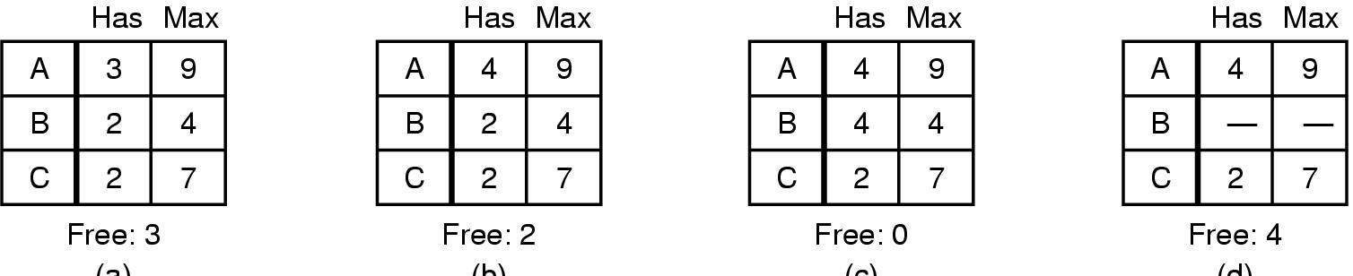
Safe and Unsafe States
(a) (b) (c) (d)
Demonstration that the state in (b) is not safe
38

Slide 39
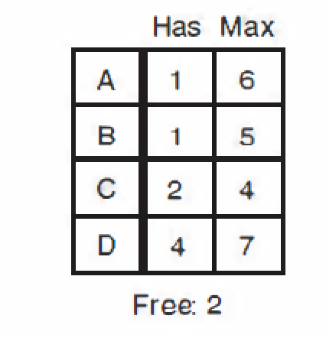
主观题
1分
If D asks for one more unit, does this lead to a safe state or an unsafe one? What if the request came from C instead of D?
正常使用主观题需2.0以上版本雨课堂
作答

Slide 40
单选题
1分
Which description is correct?( ）
A
Deadlock state may be a safe state
B
The safe state will become a deadlock state
C
Unsafe state is deadlock state
D
The deadlock state must be unsafe state
提交

Slide 41
Safe and Unsafe States
The difference between a safe state and an unsafe state is that:
from a safe state the system can guarantee that all processes will finish; But from an unsafe state, no such guarantee can be given.
41

Slide 42
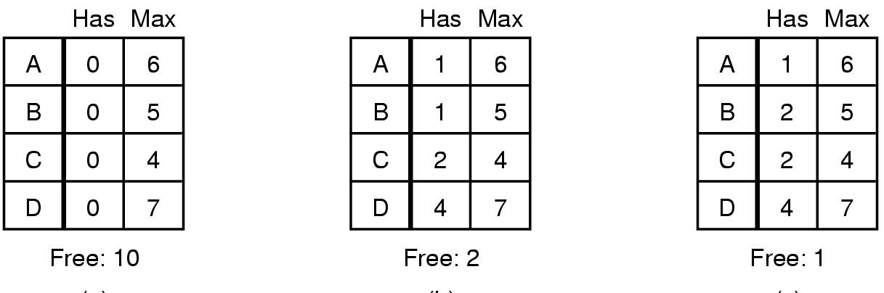
The Banker's Algorithm for a Single Resource
(a) safe; (b) safe; (c) unsafe.
Check to see if granting the request leads to an unsafe state. If it does, the request is denied. If granting the request leads to a safe state, it is carried out.
42

Slide 43
Banker’s Algorithm
Step 1: Look for a new row in R which is smaller than A. If no such row exists the system will eventually deadlock ==> not safe.
Step 2: If such a row exists, the process may finish. mark that process (row) as terminate and add all of its resources to A.
Step 3: Repeat Steps 1 and 2 until all rows are marked == > safe state
or not marked == > not safe.
43

Slide 44
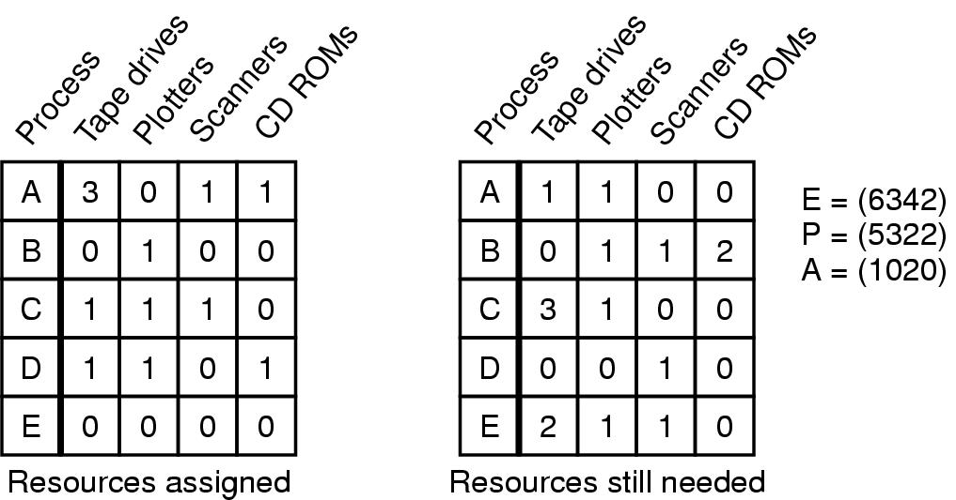
Banker's Algorithm for Multiple Resources
Example of banker's algorithm with multiple resources
44

Slide 45
单选题
1分
The resource usage of a process at a certain time is shown in the following table. At this time, the safe sequence is（）
 | allocated |  |  | require |  |  | available
 | r1 | r2 | r3 | r1 | r2 | r3 | r1 | r2 | r3
p1 | 2 | 0 | 0 | 0 | 0 | 1 | 0 | 2 | 1
p2 | 1 | 2 | 0 | 1 | 3 | 2
p3 | 0 | 1 | 1 | 1 | 3 | 1
p4 | 0 | 0 | 1 | 2 | 0 | 0
p1,p2,p3,p4
A
B
p1,p3,p2,p4
p1,p4,p3,p2
C
D
N/A
提交

Slide 46
主观题
10分
In the banker algorithm, the resource allocation occurs is shown in the following table, and the number of remaining resources in the system is (3,2,2). (1) Is the state safe? Why? (2)If the processes request the following resources, how to allocate the resource to avoid deadlock?
P1: request(1,0,2);P4:requrest(3,3,0);P0:request(0,1,0).
 | Maximum requirement | allocated
p0 | 7,5,3 | 0,1,0
p1 | 3,2,2 | 2,1,0
p2 | 9,0,2 | 3,0,2
p3 | 2,2,2 | 2,1,1
p4 | 4,3,3 | 0,0,2
作答

Slide 47
In the banker algorithm, the resource allocation occurs is shown in the following table, and the number of remaining resources in the system is (3,2,2). (1) Is the state safe? Why?
Answer: requirement
P0=(7,4,3), p1 = (1,1,2), p2 = (6,0,0);
p3=(0,1,1) p4 = (4,3,1)
Safe order: P1→P3→P0→P2→P4
 | Maximum requirement | allocated
p0 | 7,5,3→(7,4,3) | 0,1,0
p1 | 3,2,2→(1,1,2) | 2,1,0
p2 | 9,0,2→(6,0,0) | 3,0,2
p3 | 2,2,2→(0,1,1) | 2,1,1
p4 | 4,3,3→(4,3,1) | 0,0,2

Slide 48
The number of remaining resources in the system is (3,2,2). (2)requests:
P1: request(1,0,2);P4:requrest(3,3,0);P0:request(0,1,0).
 | Maximum requirement | allocated
p0 | 7,5,3→(7,4,3) | 0,1,0
p1 | 3,2,2→(1,1,2) | 2,1,0
p2 | 9,0,2→(6,0,0) | 3,0,2
p3 | 2,2,2→(0,1,1) | 2,1,1
p4 | 4,3,3→(4,3,1) | 0,0,2
Answer:
P1: Available =(2,2,0) , safe order: P1,P3,P2,P0,P4
P4: reject
P0: available = (2,1,0), safe order: P1,P3, P0, P2,P4

Slide 49
Banker's Algorithm Summary
In theory : the algorithm is wonderful.
In practice: it is essentially useless because processes rarely know in advance what their maximum resource needs will be.
Thus, in practice, few systems use the banker’s algorithm for avoiding deadlocks.
49

Slide 50
Check points
What is deadlock?
What is resource in computer?
What are the four conditions for a deadlock to occur?
How to detect deadlock?
How to recovery from deadlock?
50

