Slide 1

Operating Systems
Jinghui Zhong （钟竞辉）
Office：B3-515
Email ：jinghuizhong@scut.edu.cn

Slide 2

单选题
1分
There are n mutually exclusive devices of the same kind in a system. Three concurrent processes need 3, 4 and 5 devices respectively. What is the minimum number of devices that can ensure that the system is deadlock free?（ ）
A
9
B
10
C
11
D
12
提交

Slide 3
单选题
1分
Which description is correct?（ ）
A
The banker's algorithm can prevent deadlock
B
When the system is in a safe state, there must be no deadlock process in the system
C
When the system is in an unsafe state, deadlock process will appear in the system
D
The banker's algorithm destroys the “hold and wait" condition for deadlock
提交

Slide 4
Starvation
Definition: a process is perpetually denied necessary resources to process its work.
Example: A system always chooses the process with the shortest file to execute. If there is a constant stream of processes with short files, the process with long file will never be executed.
4

Slide 5
Starvation vs Deadlock
Starvation: thread waits indefinitely
Deadlock: circular waiting for resource.
What are the differences between them?
Deadlock ➔ starvation but not vice versa.
Starvation may end，but deadlock can’t end without external intervention.
5

Slide 6
Some notes of Deadlock
Deadlock is not always deterministic.
void process_A(void) { void process_B(void) {
down(resource_1); down(resource_2);
down(resource_2); down(resource_1);
use_both_resources(); use_both_resources();
up(resource_2); up(resource_1);
up(resource_1); up(resource_2);
} }
Deadlock won’t always happen with this code.
Have to have exactly the right time;
6

Slide 7
Deadlock Detection, Deadlock Avoidance, and Deadlock Prevention
Deadlock Detection: To make sure whether there is a deadlock now.
Deadlock Avoidance: to ensure the system won’t enter an unsafe state. The system dynamically considers every request and decides whether it is safe to grant it at this point.
Deadlock Prevention: to ensure that at least one of the necessary conditions for deadlock can never hold.
7

Slide 8
Necessary Conditions for Deadlock
Mutual exclusion
Resources are held by processes in a non-sharable (exclusive) mode.
Hold and Wait
A process holds a resource while waiting for another resource.
No Preemption
There is only voluntary release of a resource - nobody else can make a process give up a resource.
Circular Wait
Process A waits for Process B waits for Process C .... waits for Process A.
ALL of these four must happen simultaneously for a deadlock to occur.
8

Slide 9
Attacking the Mutual Exclusion Condition
No resource were assigned exclusively to a single process.
Problem?
This method is generally impossible, because the mutual-exclusion condition must hold for non-sharable resources. e.g., a printer can not be shared by multiple processes simultaneously.
9

Slide 10
Attacking the Hold and Wait Condition
Require processes to request resources before starting
a process never has to wait for what it needs
e.g. In the dining philosophers’ problem, each philosopher is required to pick up both forks at the same time. If he fails, he has to release the fork(s) (if any) he has acquired.
Problems?
It is difficult to know required resources at start of run
10

Slide 11
Attacking the No Preemption Condition
If a process is holding some resources and requests another resource that cannot be allocated to it, then all resources are released.
Problem?
The method can be applied to resources whose state can be save and restored later, e.g., memory.
It cannot be applied to resources such as printers.
11

Slide 12
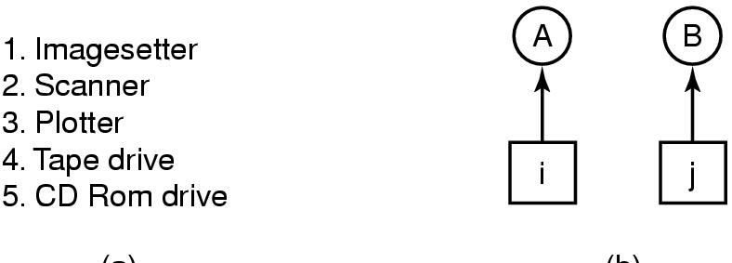
Attacking the Circular Wait Condition
A process is entitled only to a single resource at any moment.
Impose a total ordering of all resource types and to require that each process requests resources in an increasing order of enumeration.
(a) (b)
12

Slide 13
多选题
1分
If system S1 adopts deadlock avoidance method, S2 adopts deadlock detection method ,which description is correct?( ）
A
S1 limits the order in which users request resources, while S2 does not
B
S1 needs the total amount of resources required for the process to run, while S2 does not
C
S1 does not allocate resources to processes that may cause deadlock, while S2 does
D
S1 and S2 will be in deadlock state
提交

Slide 14
Other Issues: Two-Phase Locking
Phase One
process tries to lock all records it needs, one at a time
if needed record found locked, restart
(no real work done in phase one)
If phase one succeeds, it starts second phase,
performing updates
releasing locks
Similar to requesting all resources at once
14

Slide 15
Non-resource Deadlocks
Communication Deadlock
E.g., each is waiting for the other to do some task
Can happen with semaphores
Request message was lost
A
B
Blocked, waiting reply from B
Waiting for request message.
void process_A(void) { void process_B(void) {
down(resource_1); down(resource_2);
down(resource_2); down(resource_1);
use_both_resources(); use_both_resources();
up(resource_2); up(resource_1);
up(resource_1); up(resource_2);
} }
15

Slide 16
主观题
1分
The banker’s algorithm is being run in a system with m resource classes and n processes? In the limit of large m and n, the number of operations that must be performed to check a state for safety is proportional to mªn^{b}. What are the values of a and b?
正常使用主观题需2.0以上版本雨课堂
作答

Slide 17
主观题
答案解析
1分
答案解析
Consider p processes each needing a maximum of m resources and a total of r resources available. What condition must hold to make the system deadlock free?
正常使用主观题需2.0以上版本雨课堂
作答
可为此题添加文本、图片、公式等解析，且需将内容全部放在本区域内。正常使用需3.0以上版本

Slide 18
主观题
答案解析
1分
答案解析
Consider a system consisting of m resources of the same type being shared by n processes. A process can request or release only one resource at a time. Show that the system is deadlock free if the following two conditions hold:
The maximum need of each process is between one resource and m resources.
The sum of all maximum needs is less than m + n.
此处添加答案解析
正常使用主观题需2.0以上版本雨课堂
作答
可为此题添加文本、图片、公式等解析，且需将内容全部放在本区域内。正常使用需3.0以上版本

Slide 19
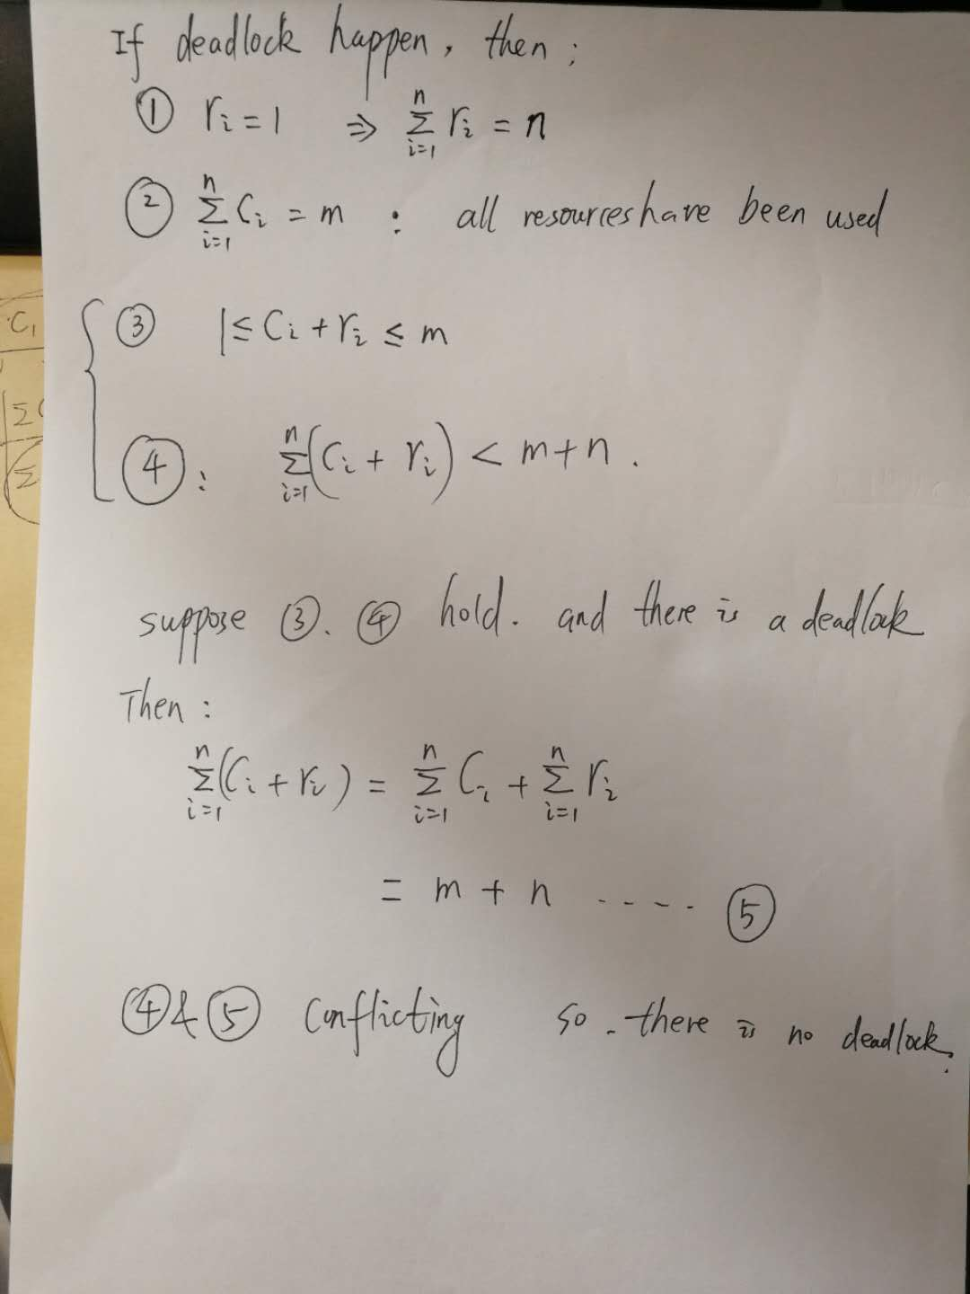

Slide 20
Memory Management
Ideally programmers want memory that is
large
fast
non volatile
Memory hierarchy
small amount of fast, expensive memory – cache
some medium-speed, medium price main memory
gigabytes of slow, cheap disk storage
Memory manager handles the memory hierarchy
20

Slide 21
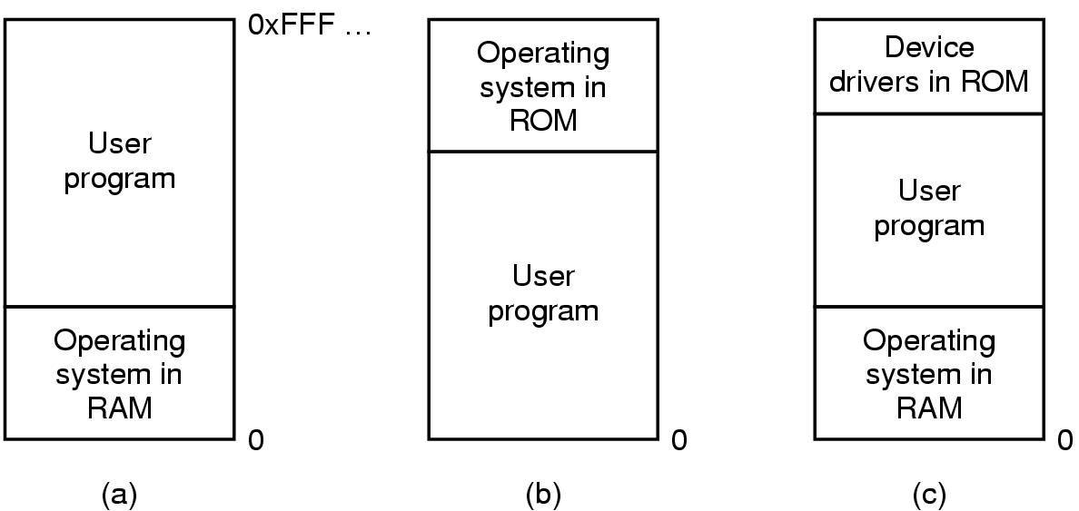
Basic Memory Management
Three simple ways of organizing memory
- an operating system with one user process
21

Slide 22
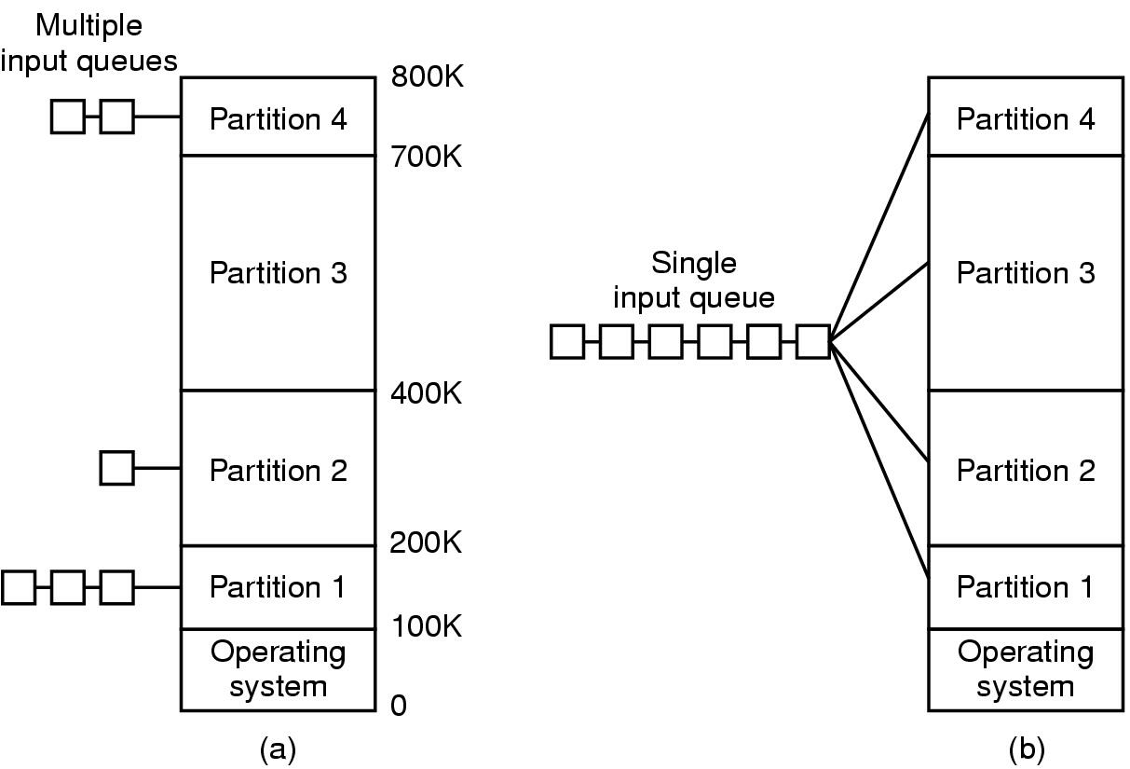
Multiprogramming with Fixed Partitions
Separate input queues for each partition
Single input queue
As the partition sizes are fixed, any space not used by a particular job is lost.
It may not be easy to state how big a partition a particular job needs.
22

Slide 23
Swapping & Virtual Memory
Two approaches to overcome the limitation of memory:
Swapping puts a process back and forth in memory and on the disk.
Virtual memory allows programs to run even when they are only partially in main memory.
23

Slide 24
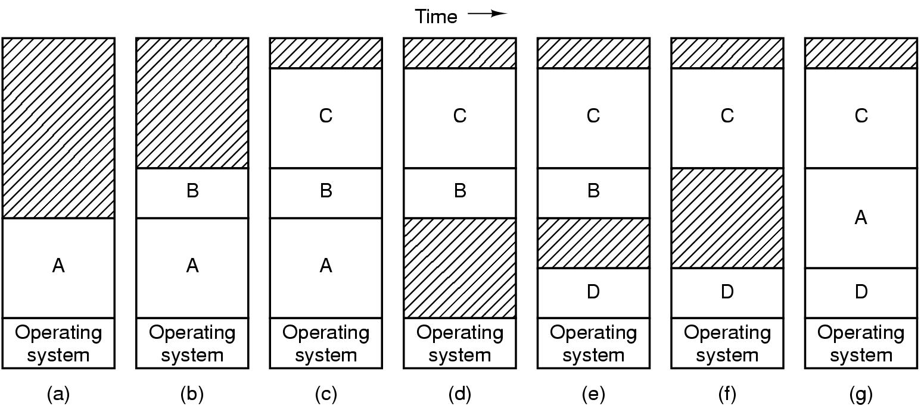
Swapping
Memory allocation changes as processes come into memory and leave memory.
When swapping creates multiple holes in memory, memory compaction can be used to combine them into a big one by moving all processes together.
24

Slide 25
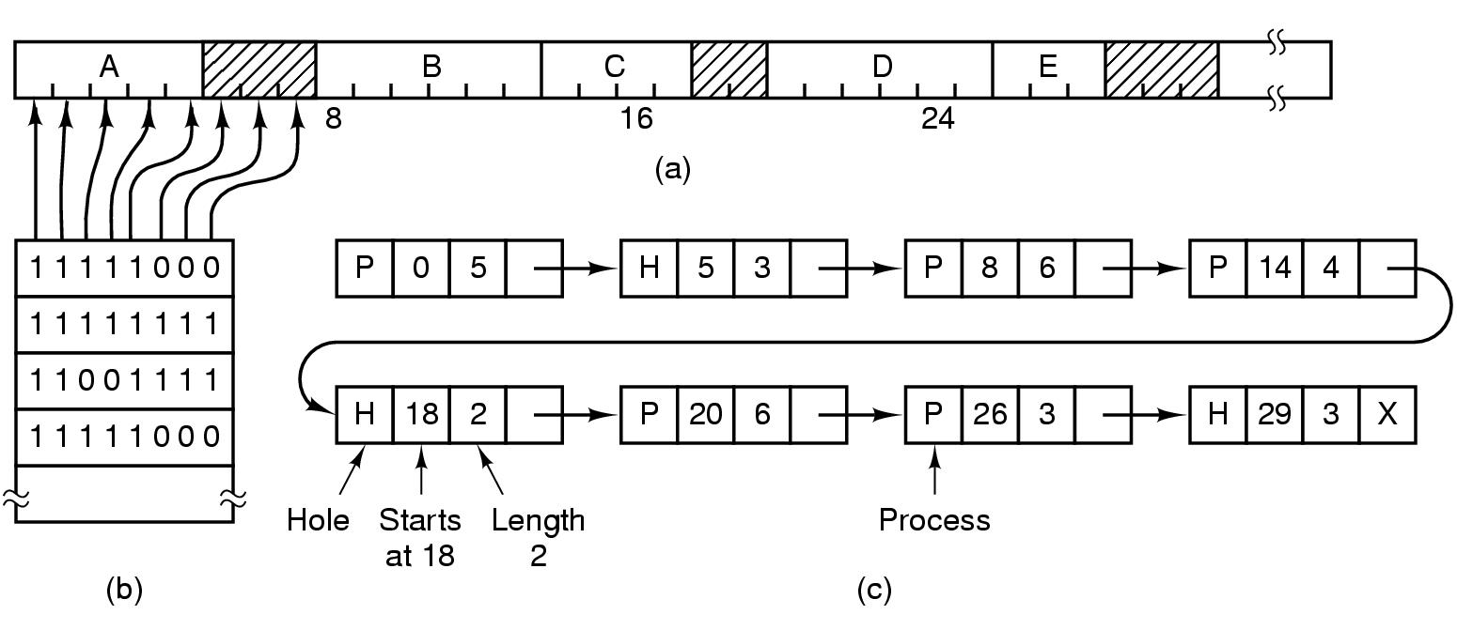
Memory Management with Bit Maps & List
Drawback of bitmaps: to find consecutive 0 bits in the map is time-consuming.
(a) Part of memory with 5 processes, 3 holes
tick marks show allocation units
shaded regions are free
(b) Corresponding bit map
(c) Same information as a list
25

Slide 26
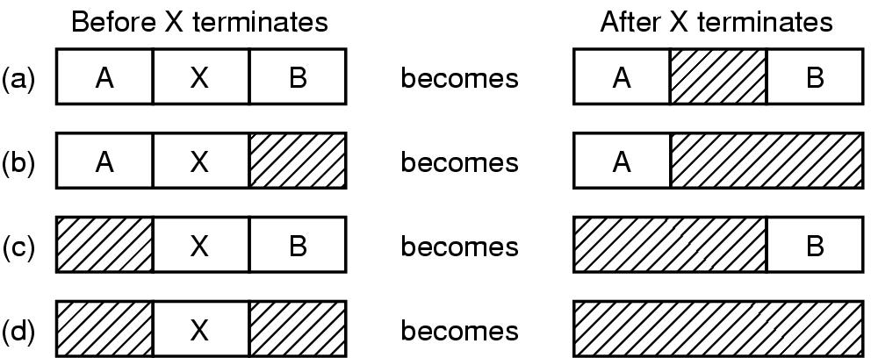
Memory Management with Linked Lists
Four neighbor combinations for the terminating process
Four algorithms for memory management:
First fit: Searches from the beginning for a hole that fits.
Next fit: Searches from the place where it left off last time for a hole that fits.
Best fit: Searches the entire list and takes the smallest hole that fits.
Worst fit: Searches the largest hole that fits.
26

Slide 27
Virtual Memory
Problem: Program too large to fit in memory
Solutions:
Virtual memory - OS keeps the part of the program currently in use in memory
Paging is a technique used to implement virtual memory.
Virtual Address is a program generated address.
The MMU (memory management unit) translates a virtual address into a physical address.
27

Slide 28
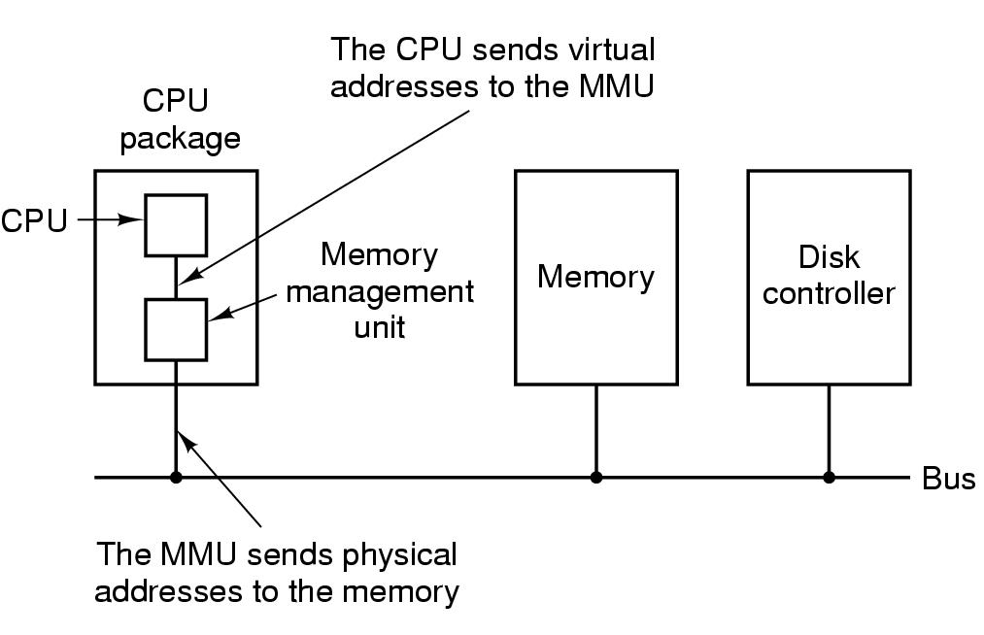
MMU
The position and function of the MMU
28

Slide 29
Virtual Memory
The virtual address space is divided into (virtual) pages and those in the physical memory are (page) frames.
A Present/Absent bit keeps track of whether or not the page is mapped.
Reference to an unmapped page causes the CPU to trap to the OS.
This trap is called a Page fault. The MMU selects a little used page frame, writes its contents back to disk, fetches the page just referenced, and restarts the trapped instruction.
29

Slide 30
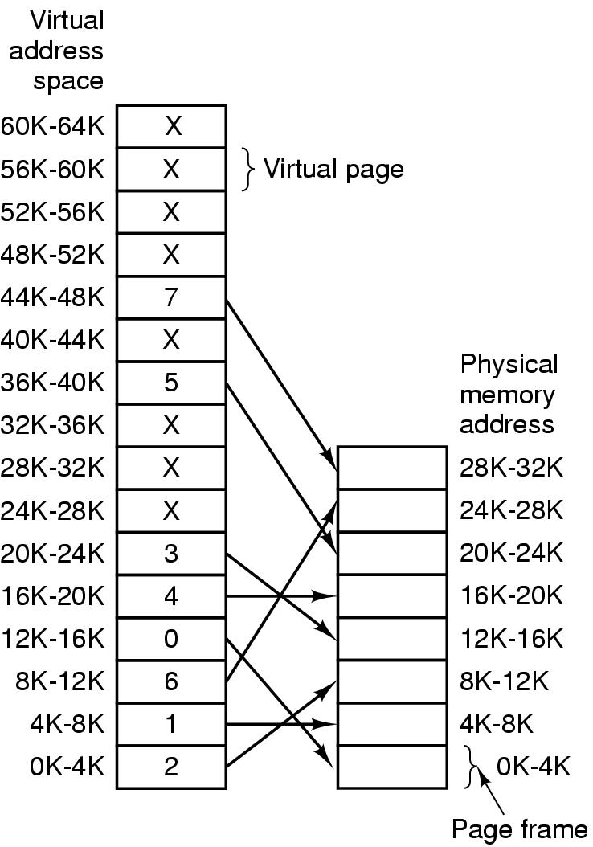
Page Table
The relation between virtual addresses and physical memory addresses given by page table
30

Slide 31
Page Tables
Example: Virtual address = 4097 = 0001 000000000001
Virtual page # 12-bit offset
The purpose of the page table is to map virtual pages into page frames. The page table is a function to map the virtual page to the page frame.
Two major issues :
Page tables may be extremely large (e.g. most computers use) 32-bit address with 4k page size, 12-bit offset
➔ 20 bits for virtual page number
➔1 million entries!
The mapping must be fast because it is done on every memory access!!
31

Slide 32
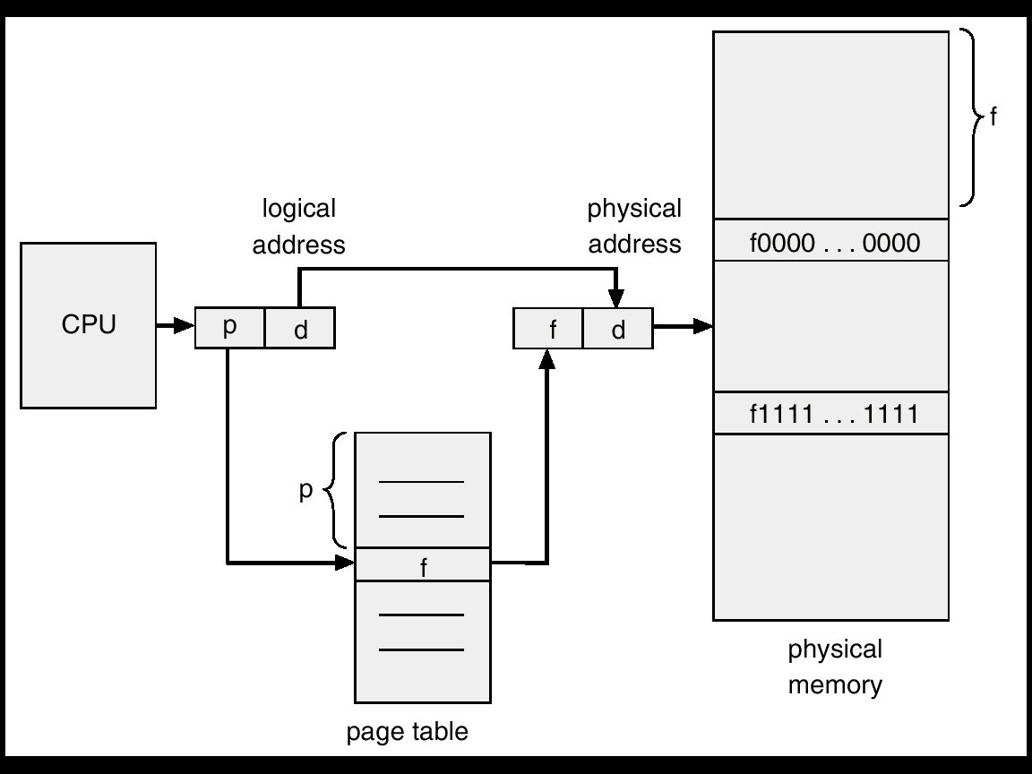
Pure paging
32

Slide 33
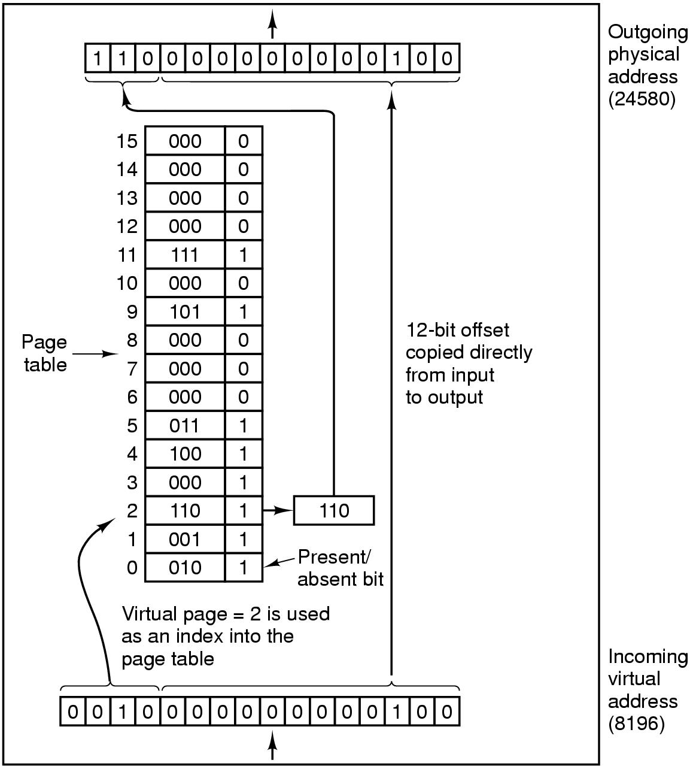
Page Table
Internal operation of MMU with 16 4 KB pages
33

Slide 34
单选题
1分
There is a one page storage management system. The maximum logical address space provided to users is 16 pages, each page is 2048B. There are 8 memory blocks in total. What is the smallest number of bits for logical address, and what is the size of the memory space（）？
A
12bits，32KB
B
12bits，16KB
C
15bits，32KB
D
15bits，16KB
提交

Slide 35
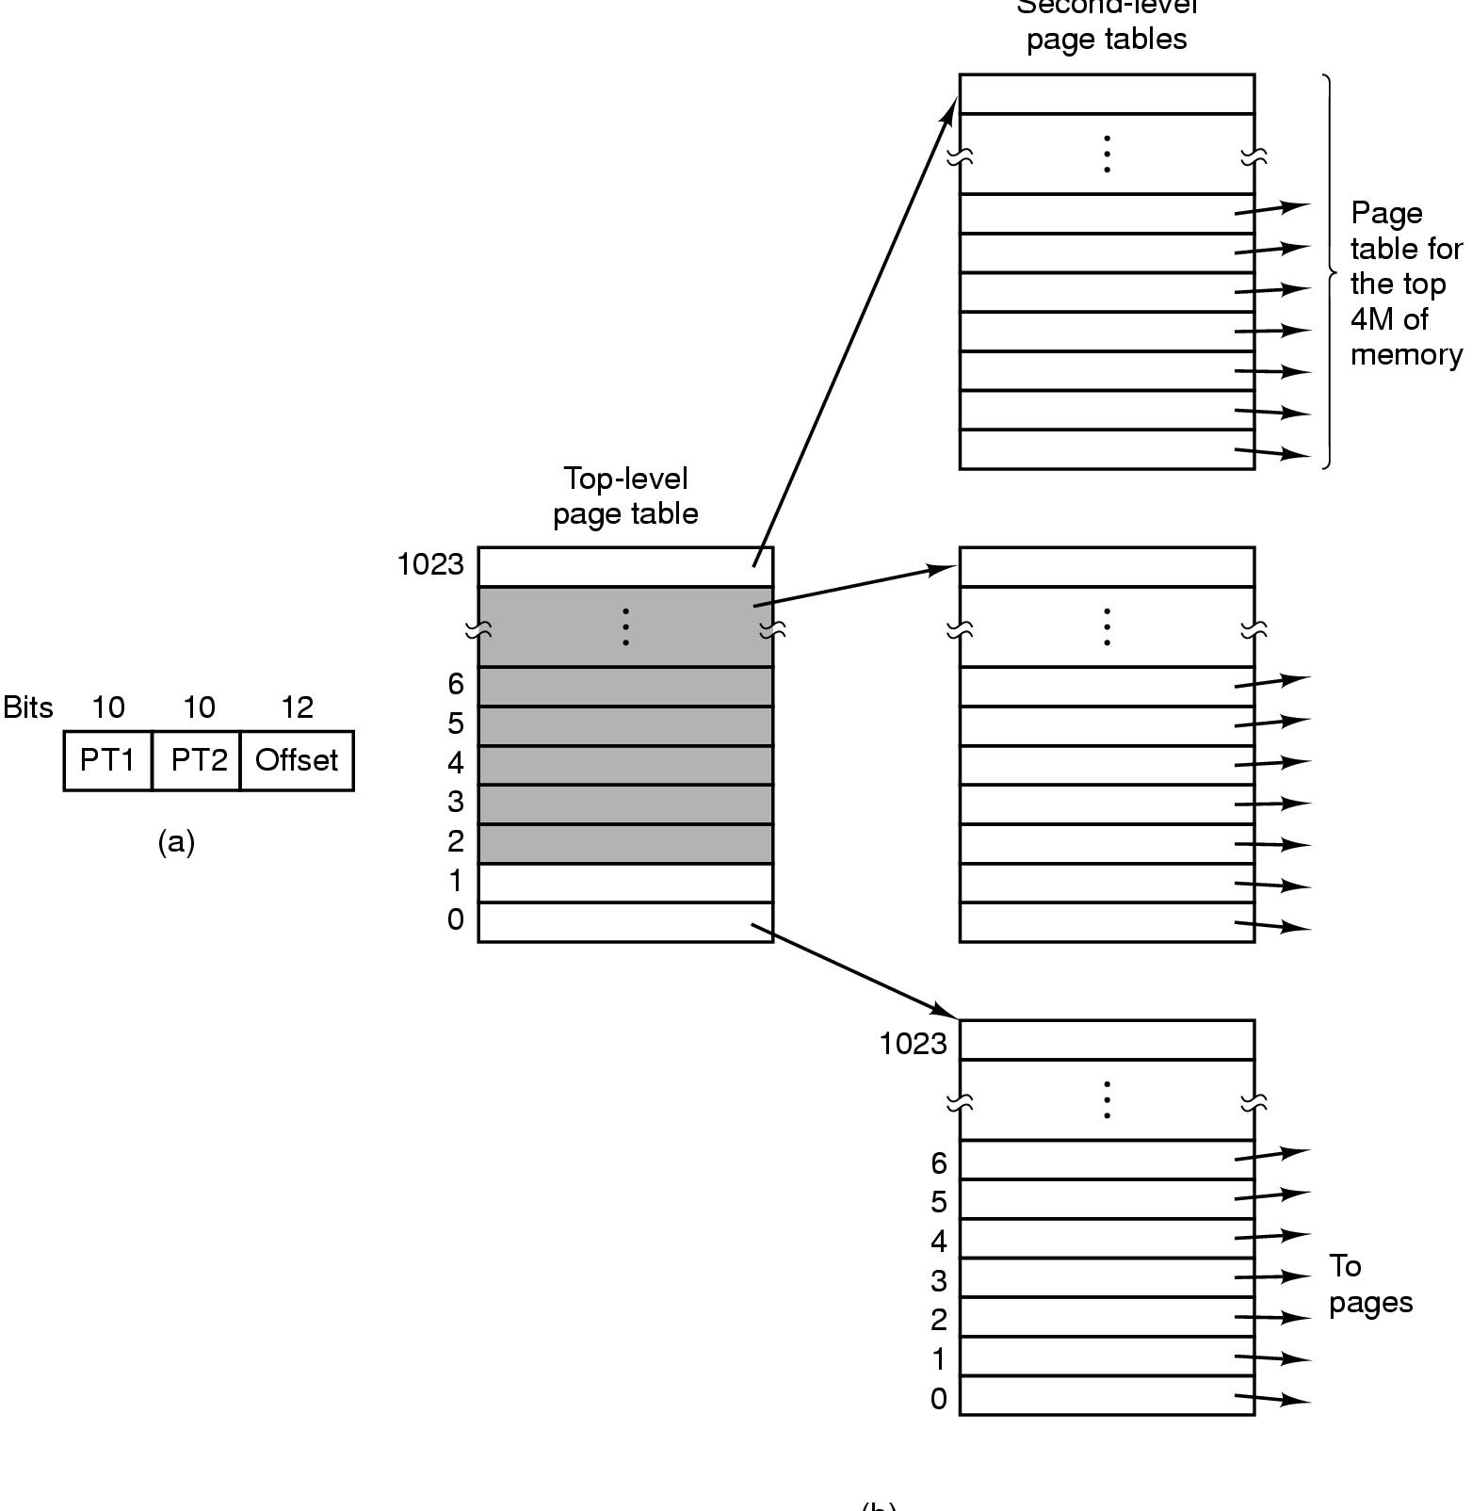
Multilevel Page Tables
Multilevel page tables - reduce the table size. Also, don't keep page tables in memory that are not needed.
32 bit address with 2 page table fields
35

Slide 36
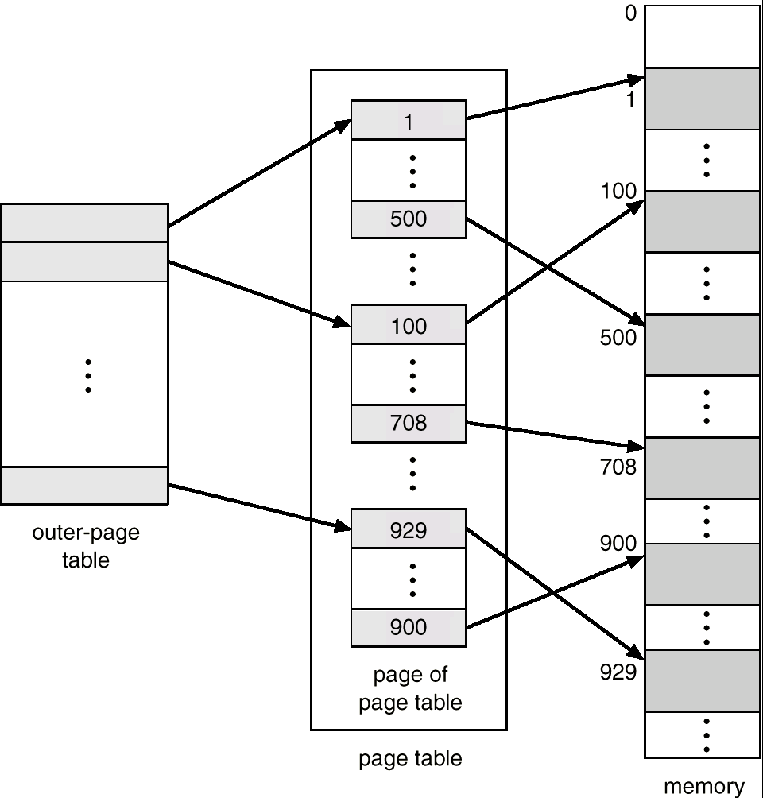
Two-Level Page-Table Scheme
36

Slide 37
Two-Level Paging Example
A logical address (on 32-bit machine with 4K page size) is divided into:
a page number consisting of 20 bits.
a page offset consisting of 12 bits.
Since the page table is paged, the page number is further divided into:
a 10-bit page number.
a 10-bit page offset.
Thus, a logical address is as follows:
where p₁ is an index into the outer page table, and p₂ is the displacement within the page of the outer page table.
page number
page offset
p₁
p₂
d
10
10
12
37

Slide 38
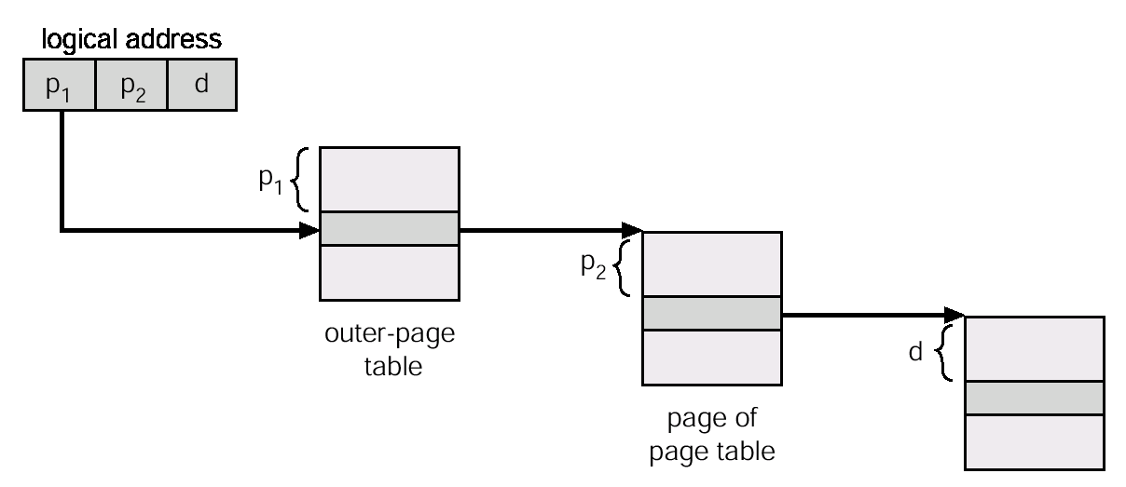
Address-Translation Scheme
Address-translation scheme for a two-level 32-bit paging architecture is shown as below.
38

Slide 39
Page Tables
Most OSs allocate a page table for each process.
Single page table consisting of an array of hardware registers. As a process is loaded, the registers are loaded with page table.
Advantage - simple
Disadvantage - expensive if table is large and loading the full page table at every context switch hurts performance.
Leave page table in memory - a single register points to the table
Advantage - context switch cheap
Disadvantage - one or more memory references to read table entries
39

Slide 40
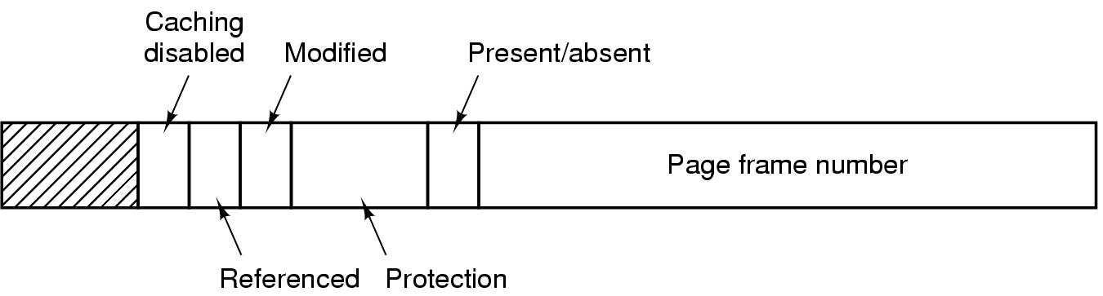
Page Tables
Typical page table entry
40

Slide 41
Structure of a Page Table Entry
Page frame number: map the frame number
Present/absent bit: 1/0 indicates valid/invalid entry
Protection bit: what kinds of access are permitted.
Modified – set when modified and writing to the disk occur
Referenced - Set when page is referenced (help decide which page to evict)
Caching disabled - used to keep data that logically belongs on the disk in memory to improve performance
41

Slide 42
单选题
1分
The operating system adopts paging storage management mode ，then（ ）
A
Each process has a page table, and the page table is in memory
B
Each process has a page table, and the page table is in memory only when the process is running
C
All processes share a page table, and the page table is in memory
D
All processes share a page table ， Only the pages currently in use are in memory
提交

Slide 43
TLB
Observation: Most programs make a large number of references to a small number of pages.
Solution: Equip computers with a small hardware device, called Translation Look-aside Buffer (TLB) or associative memory, to map virtual addresses to physical addresses without using the page table.
43

Slide 44
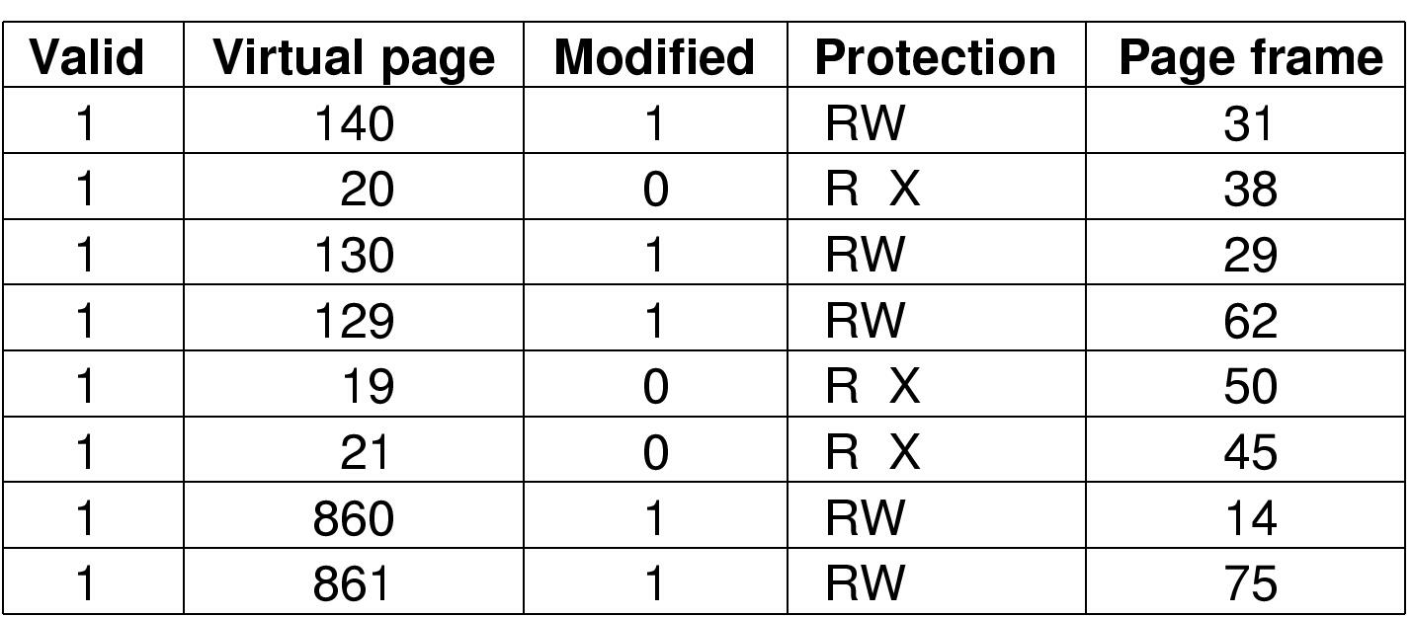
TLB – Translation Lookaside Buffer
A TLB to speed up paging
44

Slide 45
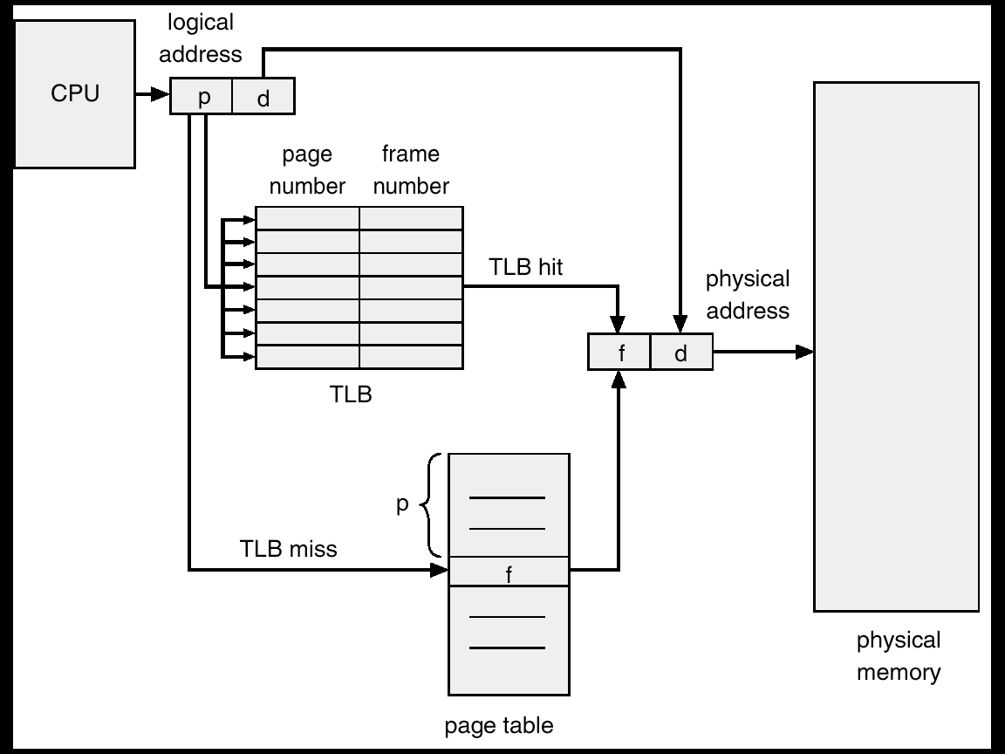
Paging Hardware With TLB
45

Slide 46
x = ?
TLB
页表
物理内存
Page id | Page frame id
x | 2
3 | x
x | 1
Page frame id | present
x | x
 | x
x | x
 | x
x | x
x | x
 | x
x | x
 | x
 | x
1
1
2
3
2
3
4
4
5
5
6
7
8
9
10
46

Slide 47
TLB
页表
物理内存
Page id | Page frame id
x | 2
3 | x
x | 1
Page frame id | present
x | 1
 | 0
x | 1
 | 0
x | 1
x | 1
 | 0
x | 1
 | 0
 | 0
1
1
2
3
2
3
4
4
5
5
6
7
8
9
10
47

Slide 48
TLB
页表
物理内存
Page id | Page frame id
x | 2
3 | x
x | 1
Page frame id | present
3 | 1
 | 0
5 | 1
 | 0
1 | 1
2 | 1
 | 0
4 | 1
 | 0
 | 0
1
1
2
3
2
3
4
4
5
5
6
7
8
9
10
48

Slide 49
TLB
页表
物理内存
Page id | Page frame id
6 | 2
3 | 5
5 | 1
Page frame id | present
3 | 1
 | 0
5 | 1
 | 0
1 | 1
2 | 1
 | 0
4 | 1
 | 0
 | 0
1
1
2
3
2
3
4
4
5
5
6
7
8
9
10
49

Slide 50
Inverted Page Table
Usually, each process has a page table associated with it. One of drawbacks of this method is that each page table may consist of millions of entries.
To solve this problem, an inverted page table can be used. There is one entry for each real page (frame) of memory.
Each entry consists of the virtual address of the page stored in that real memory location, with information about the process that owns that page.
50

Slide 51
Inverted Page Table
To illustrate this method, a simplified version of the implementation of the inverted page is described as:
<process-id, page-number, offset>
Each entry： <process-id, page-number>.
The inverted page table is then searched for a match. If a match i is found, then the physical address <i, offset> is generated. Otherwise, an illegal address access has been attempted.
Although it decreases memory needed to store each page table, but increases time needed to search the table when a page reference occurs.
51

Slide 52
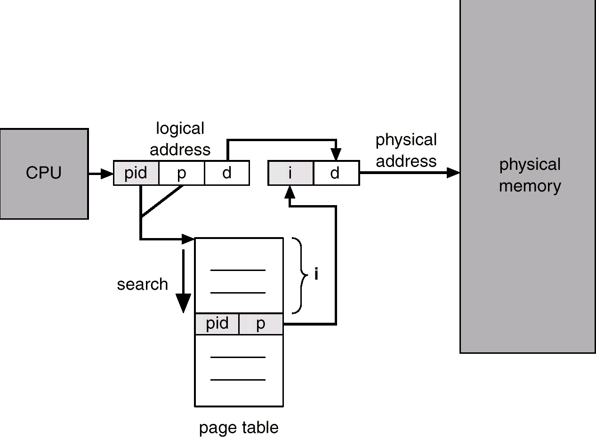
Inverted Page Table Architecture
52

Slide 53
单选题
1分
The algorithm of finding the free segment according to its length from small to large is called（ ）
A
Best fit
B
Worst fit
C
First fit
D
FIFO
提交

Slide 54
多选题
1分
Which description is correct?（ ）
A
VM technique is based on continuous allocation technology
B
VM technique is based on non-continuous allocation technology
C
The capacity of VM storage is only limited by the external storage capacity
D
The capacity of VM storage is only limited by the memory capacity
提交

Slide 55
Check Points
What is the drawback of the bitmap method for free memory management?
What is the purpose of virtual memory?
What is page table?
What is the purpose of using multi-level page table?
What is the purpose of using TLB？
What is invert page table?
55

