Slide 1
Software Engineering
-- overview
10.<number>

Slide 2

What is Software?
Program
☞ Data
☞ Document
executable
inexecutable
software
Data
program
doc
doc

Slide 3
Introduction
Software crisis(1968 at a conference)
  Introduction of new computer hardware
  Software become magnitude larger and more complex
  Software cost much more than predicted
  New techniques and methods were needed to control the complexity of large software systems

Slide 4
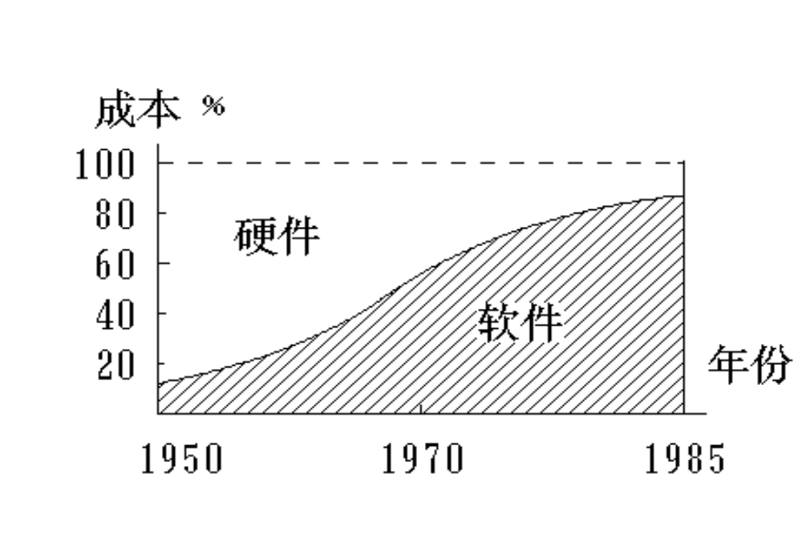
软件、硬件成本变化趋势
cost
hardware
software
year


Slide 5
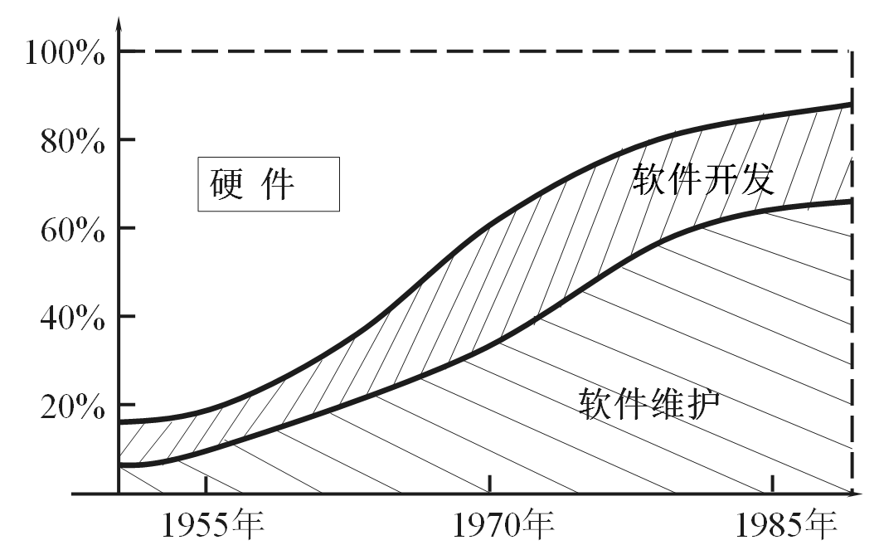
软件、硬件成本变化趋势
cost
hardware
develop
maintenance
software
year

Slide 6
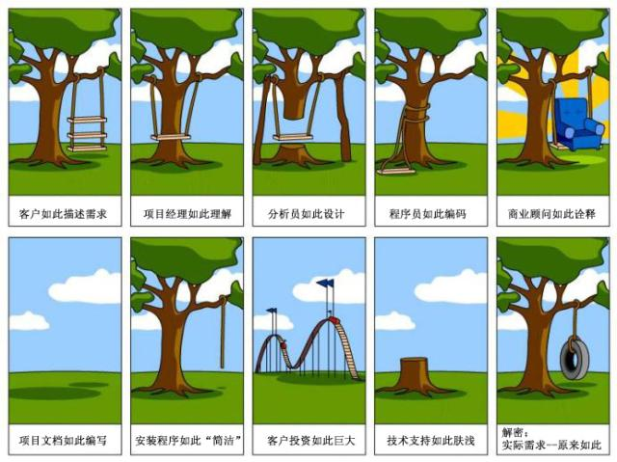
Difficulties in SE

Slide 7
What is Software Engineering?
“软件工程”
----Software Engineering
于1968年 在
德国召开的一次会议上提出
是把软件当作一种工业产品，要求 “采用工程化的
原理与方法对软件进行计划、开发和维护 ”。

Slide 8
Software Engineering – Def. 1
“The establishment and use of sound engineering principles in order to obtain economically software that is reliable and works on real machines.” [Fritz Bauer]
软件工程就是为了经济地获得可靠的且能在实际机器上高效运行的软件而建立和使用的完善的工程原理。

Slide 9
Software Engineering – Def. 2
“The application of a systematic, disciplined, quantifiable approach to the development, operation, and maintenance of software” [IEEE 1990]
软件工程是将系统的、规范的、可度量的方法应用于软件的开发、运行和维护的过程，即将工程化应用于软件中，并研究上述提到的途径。

Slide 10
Software Engineering – Def. 3
“Software engineering is that form of engineering that applies the principles of computer science and mathematics to achieving cost-effective solutions to software problems.” [CMU/SEI-90-TR-003]
软件工程就是应用计算机科学和数学的原理来经济有效的解决软件问题的一种工程。

Slide 11
What is software engineering
  Definition
    Software engineering is an engineering discipline that is concerned with all aspects of software production from early system specification to maintaining the system after it has gone into use
  Engineering discipline
    Theories, methods and tools (formal or less formal approach)

Slide 12
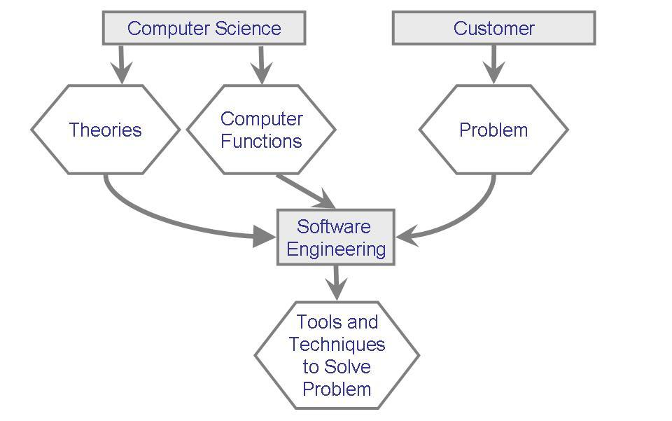
Relationship between computer science and software engineering

Slide 13
What is Software Engineering
Solving Problems
Method: refers to a formal procedure; a formal “recipe” for accomplishing a goal that is typically independent of the tools used
Tool: an instrument or automated system for accomplishing something in a better way
Procedure: a combination of tools and techniques to produce a product

Slide 14
软件工程三要素
方法
提供一系列软件开发技术。包括完成开发过程中各方面任务的方法并用某种特殊的语言或图形来描述。
软件工程
三个要素
工具
过程

Slide 15
软件工程三要素
方法
软件工具为软件方法提供了自动的或半自动的支撑环境。将多种工具集成在一起可构成计算机辅助软件工程（ Computer-Aided Software Engineering 即CASE）的软件开发支撑系统。
软件工程
三个要素
工具
过程

Slide 16
软件工程三要素
方法
软件工程
三个要素
工具
软件过程是将软件工程的方法和工具综合起来，进行软件开发活动。
过程

Slide 17
中国软件工程的发展
为了满足中国软件产业发展需求，中国自1980年启动软件工程研究与实践，其过程和成果与国际发展趋势一致
2000年以后
展开网构软件技术体系的研究
建设软件构件库体系
建立标准和培养人才
1990年代
以构件技术为主线开展前沿研究
建立较为全面的软件工程环境
1980年代
开展软件开发方法学研究
CASE工具和环境的研发
2000
软件企业开始尝试工业化生产技术
1990
软件企业开始使用软件工具
1980
软件产业起步
Notes:
目前的软件技术研究热点可归纳为从不同角度对Internet环境及其应用的不同理解。

Slide 18
中国软件工程代表性研究成果
XYZ系统 1990年国家自然科学一等奖
  中科院唐稚松院士领导的科研团队
  XYZ/E：第一个可执行的时序逻辑语言
  围绕该语言的一组软件工具
MLIRF系统
  中科院董韫美院士领导的科研团队
  形式化描述（上下文无关语言的递归函数描述问题和解之间的关系）
北京大学牵头的青鸟工程
  工业化生产技术和工程化开发方法
  支撑环境与工具标准规范体系
  基于构件／构架应用系统集成组装
10.<number>

Slide 19
Content of this Course
Procedure of SE
  Analysis (requirement specification)
  Design
  Implementation
  Testing
10.<number>

Slide 20
Content of this Course (cont'd)
Methods
  UML and other models
  Design Pattern
  Formal method
  Agile Development
10.<number>

Slide 21
Content of this Course (cont'd)
Environment and Tools
  Ruby + Rails
Other Topics
  Declarative Programming: Prolog
  Distributed Architecture: CORBA
10.<number>

Slide 22
Solving Problems
Software products are large and complex
Development requires analysis and synthesis
  Analysis: decompose a large problem into smaller, understandable pieces
    abstraction is the key
  Synthesis: build (compose) a software from smaller building blocks
    composition is challenging

Slide 23
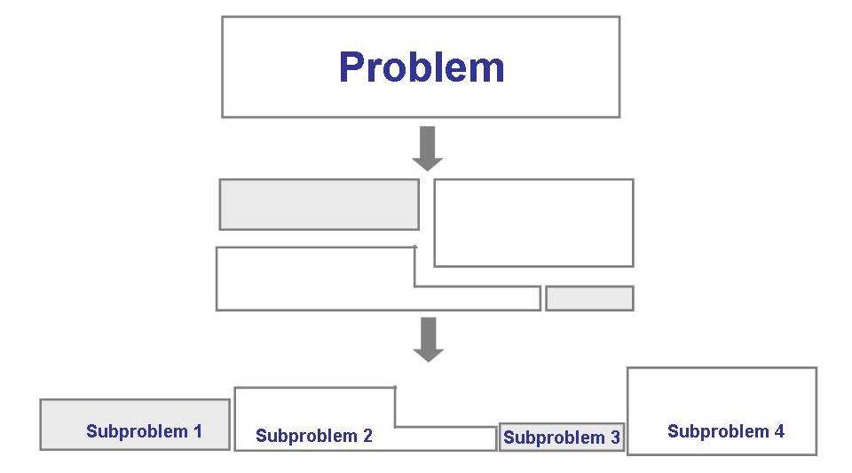
Solving Problems
The analysis process

Slide 24
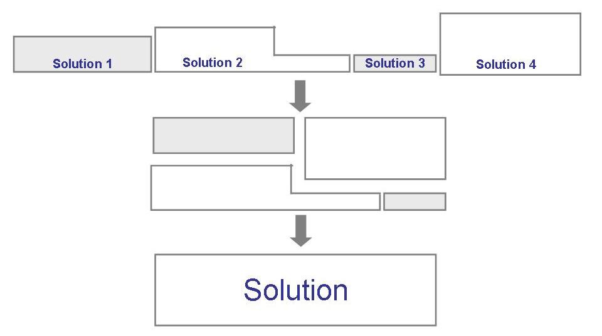
Solving Problems
The synthesis process

Slide 25
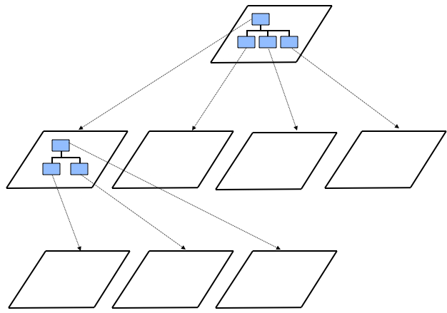
Decomposition and Views
High-level description of system’s key elements
Creating a hierarchy of information with increasing details
Top
level
First level of
decomposition
Second level of
decomposition

Slide 26
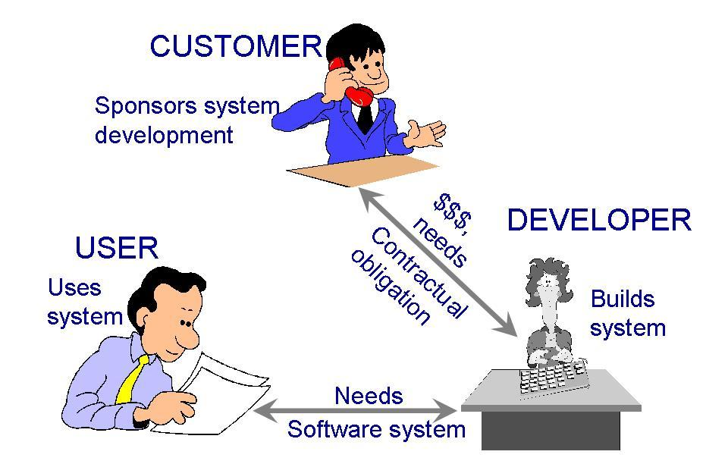
Who Does Software Engineering?
Participants (stakeholders) in a software development project

Slide 27
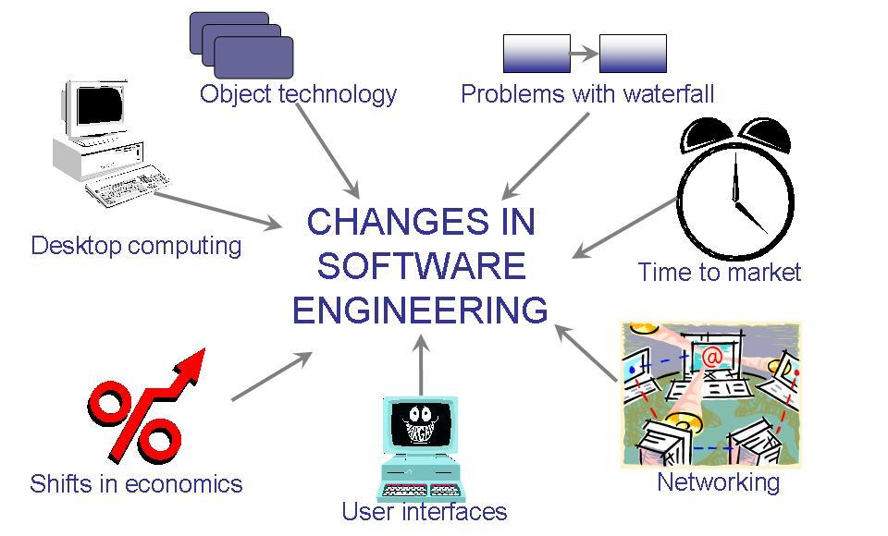
改变软件工程实践的七个关键因素

Slide 28
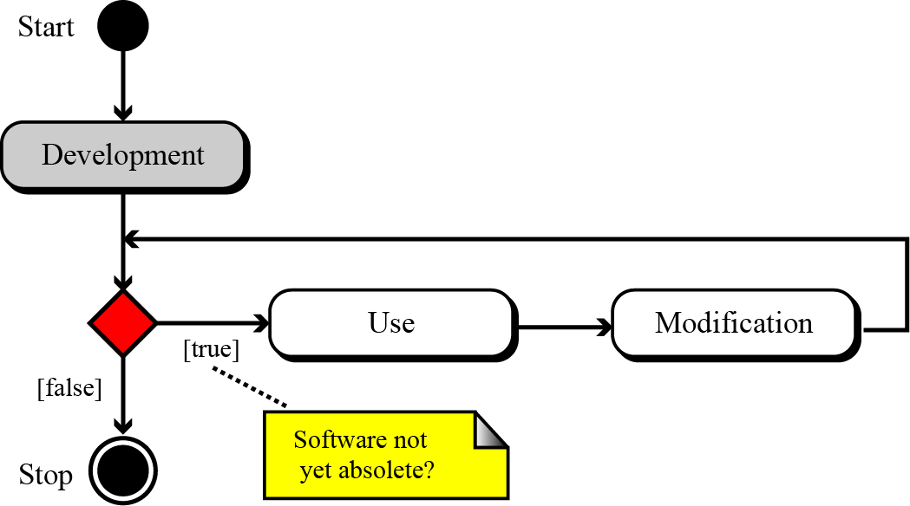
THE SOFTWARE LIFE CYCLE
A fundamental concept in software engineering is the software lifecycle. Software, like many other products, goes through a cycle of repeating phases .
10.<number>

Slide 29
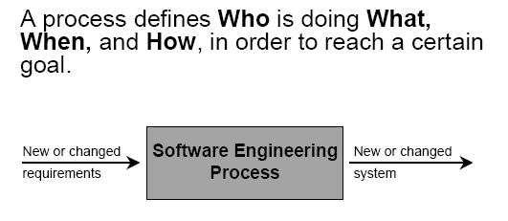
Software Process

Slide 30
What is software process model
    Is a simplified description of a software process, include activities of software process, software products and the role of people involved
  To model software development
    Waterfall approach
    Iterative development
    Component-based software engineering

Slide 31
Development process models
The development process in the software lifecycle involves four phases: analysis (requirement specificiation), design, implementation and testing. There are several models for the development process. We discuss the two most common here: the waterfall model and the iterative model.
10.<number>

Slide 32
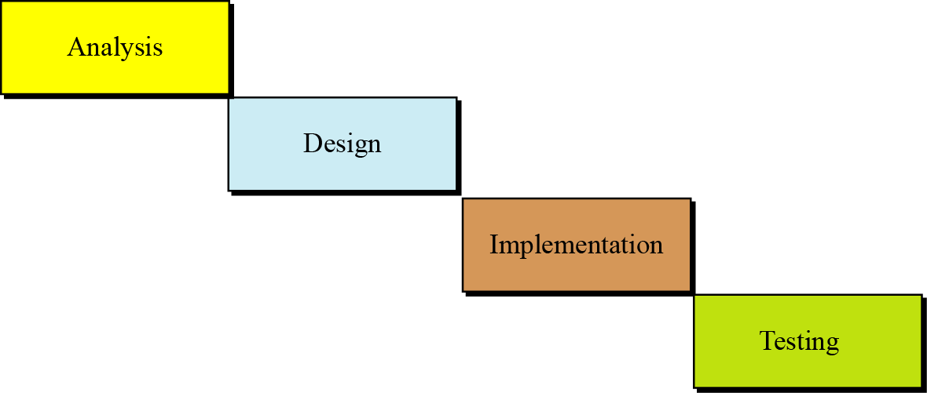
The waterfall model
In this model, the development process flows in only one direction. This means that a phase cannot be started until the previous phase is completed.
10.<number>

Slide 33
软件过程
可行性研究
软件定义
需求分析
概要设计
详细设计
软件开发
实 现
集成测试
接收测试
软件使用与维护
使用与维护
退役

Slide 34
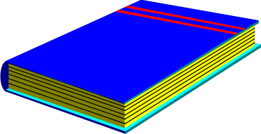

Software Process
SRS
需求分析
软件设计
软件设计文档
编码
源代码
测试
测试计划/报告
发布
软件系统

Slide 35
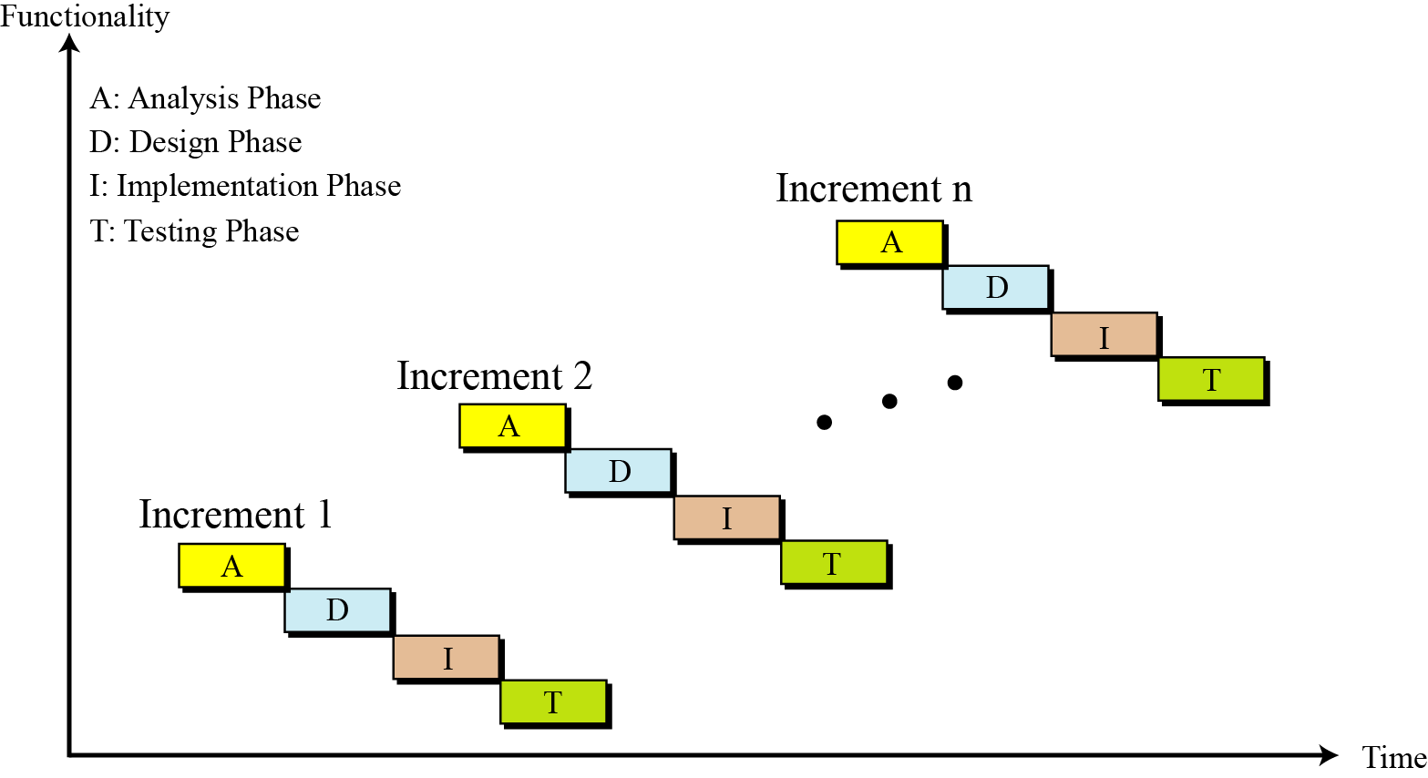
The iterative model
In the iterative model, software is developed in a series of steps.
10.<number>

Slide 36
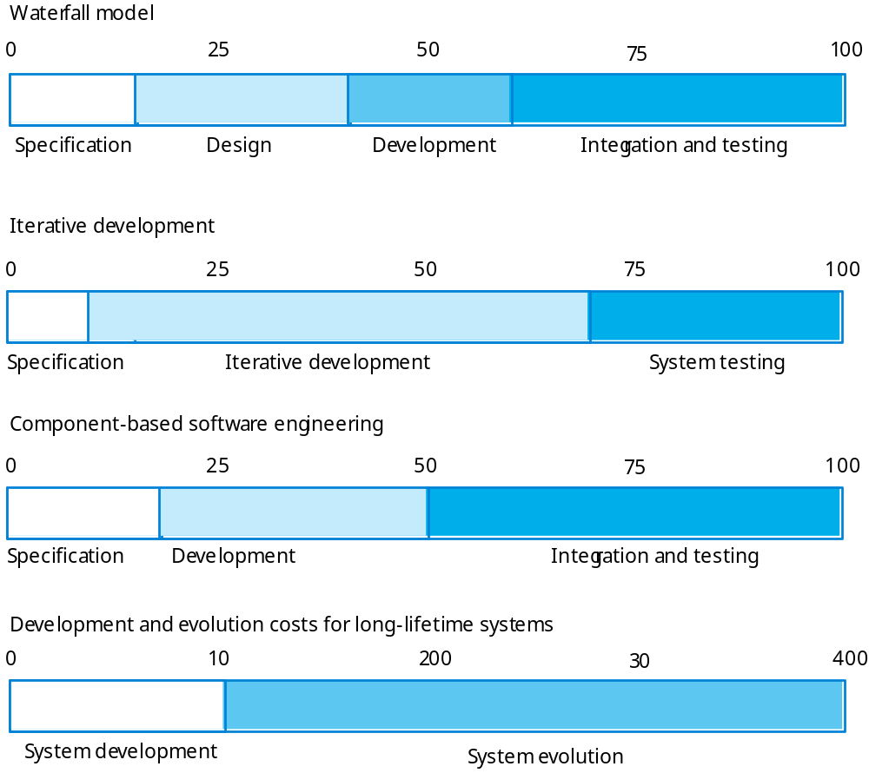
Waterfall model
Iterative development
Component-based development
Development vs Evolution

Slide 37
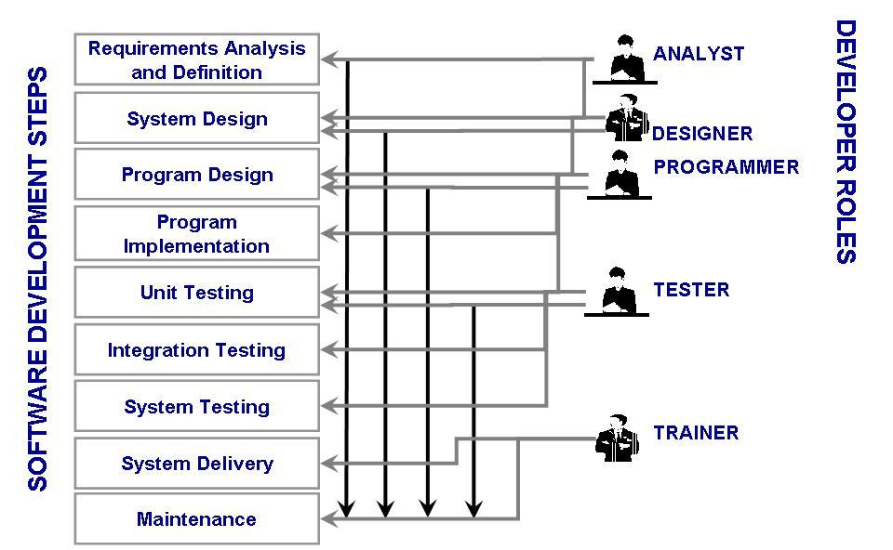

Slide 38
Members of Development Team
Software development steps | Developer
Analysis and definition | Analyst
System design | Designer
Program design
Program implementation | Programmer
Unit testing
Integration testing | Tester
System testing
System deliver | Trainer and all others
Maintenance

Slide 39
ANALYSIS PHASE
The development process starts with the analysis phase. This phase results in a specification document that shows what the software will do without specifying how it will be done. The analysis phase can use two separate approaches, depending on whether the implementation phase is done using a procedural programming language or an object-oriented language. We briefly discuss both in this section.
10.<number>

Slide 40
Procedure-oriented analysis
Procedure-oriented analysis—also called structured analysis or classical analysis—is the analysis process used if the system implementation phase will use a procedural language. The specification in this case may use several modeling tools, but we discuss only a few of them here.
10.<number>

Slide 41
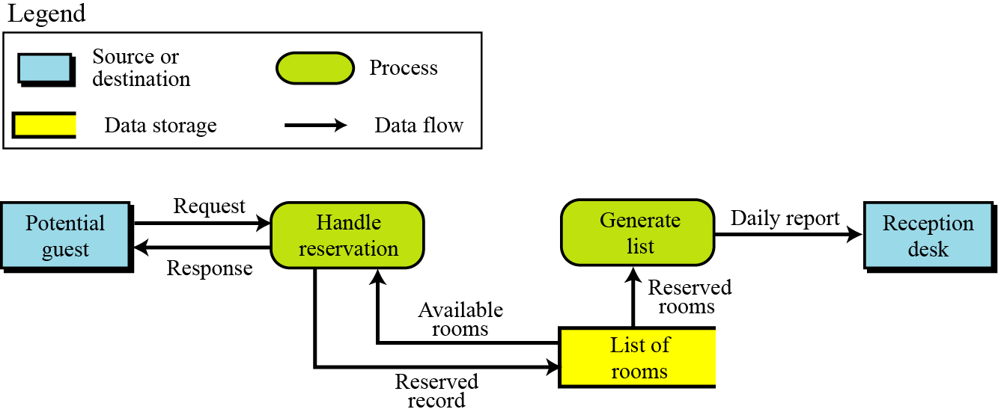
Data flow diagrams
Data flow diagrams show the movement of data in the system.
10.<number>

Slide 42
Entity-relationship diagrams
Another modeling tool used during the analysis phase is the entity-relationship diagram. Since this diagram is also used in database design.
State diagrams
State diagrams provide another useful tool that is normally used when the state of the entities in the system will change in response to events. As an example of a state diagram, we show the operation of a one-passenger elevator. When a floor button is pushed, the elevator moves in the requested direction. It does not respond to any other request until it reaches its destination.
10.<number>

Slide 43
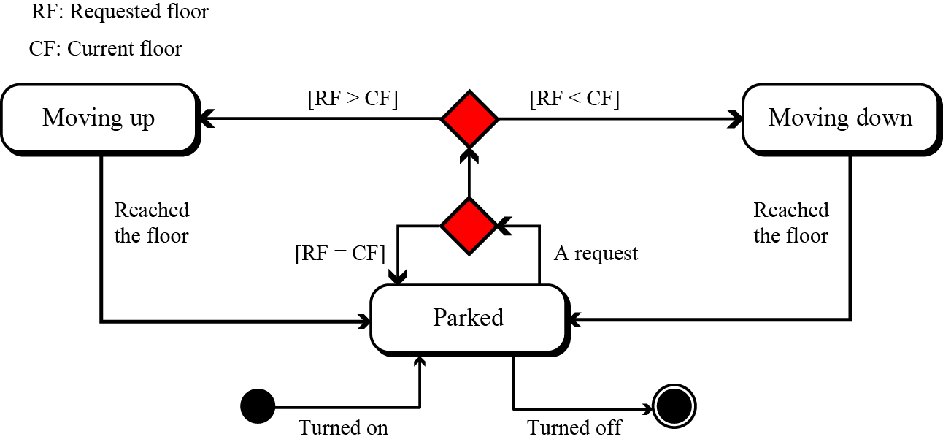
An example of a state diagram
10.<number>

Slide 44
Object-oriented analysis
Object-oriented analysis is the analysis process used if the implementation uses an object-oriented language. The specification document in this case may use several tools, but we discuss only a few of them here.
10.<number>

Slide 45
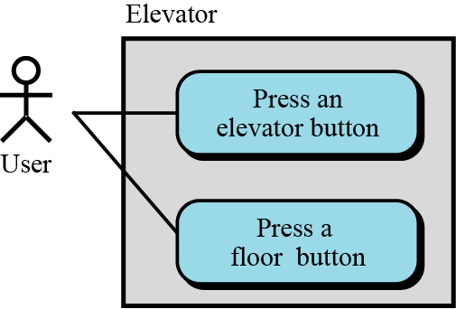
Use case diagrams
A use-case diagram gives the user’s view of a system: it shows how users communicate with the system. A use-case diagram uses four components: system, use cases, actors and relationships. A system, shown by a rectangle, performs a function.
An example of use case diagram
10.<number>

Slide 46
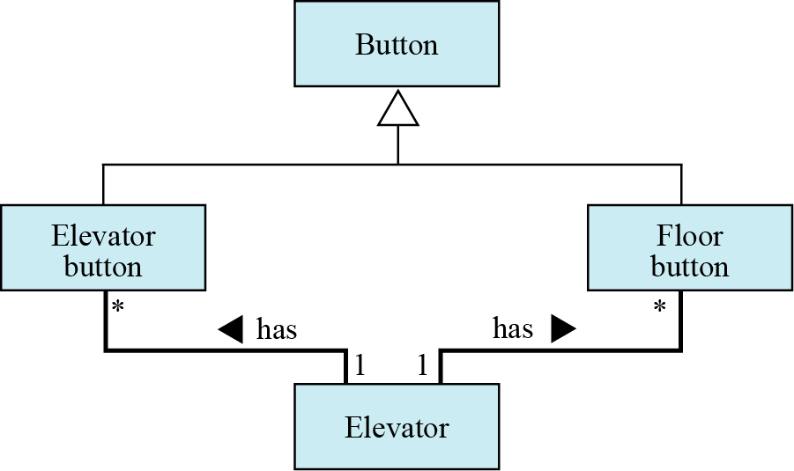
Class diagrams
The next step in analysis is to create a class diagram for the system. For example, we can create a class diagram for our old-style elevator. To do so, we need to think about the entities involved in the system.
An example of a class diagram
10.<number>

Slide 47
DESIGN PHASE
The design phase defines how the system will accomplish what was defined in the analysis phase. In the design phase, all components of the system are defined.
10.<number>

Slide 48
Procedure-oriented design
In procedure-oriented design we have both procedures and data to design. We discuss a category of design methods that concentrate on procedures. In procedure-oriented design, the whole system is divided into a set of procedures or modules.
10.<number>

Slide 49
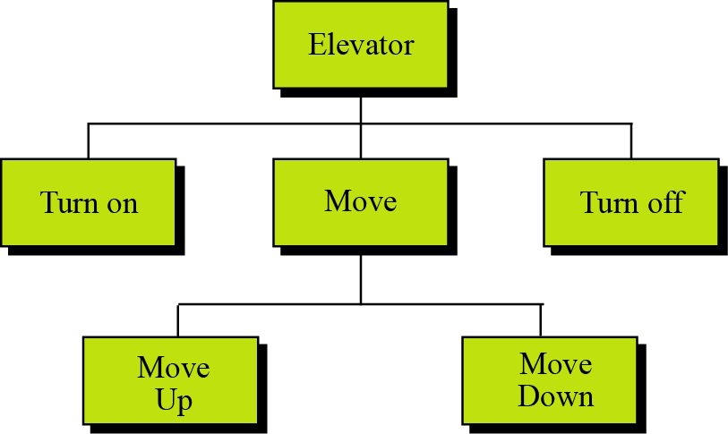
Structure charts
A common tool for illustrating the relations between modules in procedure-oriented design is a structure chart. For example, the elevator system whose state diagram is shown in Figure can be designed as a set of modules
A structure chart
10.<number>

Slide 50
Modularity：
经验1：E(P₁+P₂)>E(P₁)+E(P₂)
经验2：
Mini cost
cost
软件总成本
Interface
cost
最小成本区
接口成本
成本
module
cost
成本 / 模块
module number
模块数目

Slide 51

Modularity
Modularity means breaking a large project into smaller parts that can be understood and handled easily. In other words, modularity means dividing a large task into small tasks that can communicate with each other. The structure chart discussed in the previous section shows the modularity in the elevator system. There are two main concerns when a system is divided into modules: coupling and cohesion.
Coupling is a measure of how tightly two modules are bound to each other.
i
Coupling between modules in a software system
must be minimized.
10.<number>

Slide 52
Coupling
Two modules are tightly coupled when they depend a great deal on each other
Loosely coupled modules have some dependence, but their interconnections are weak
Uncoupled modules have no interconnections at all; they are completely unrelated
Uncoupled -
no dependencies
Loosely coupled -
some dependencies
Tightly coupled -
many dependencies

Slide 53
Another issue in modularity is cohesion. In computer programming, cohesion refers to the degree to which the elements inside a module belong together. In one sense, it is a measure of the strength of relationship between the methods and data of a class and some unifying purpose or concept served by that class.
Modules with high cohesion tend to be preferable, because high cohesion is associated with several desirable traits of software including robustness, reliability, reusability, and understandability.
i
Cohesion within modules in a software system
must be maximized.
10.<number>

Slide 54
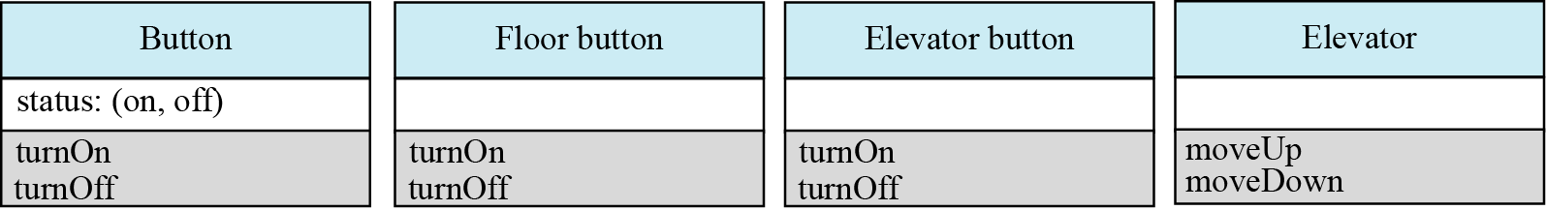
Object-oriented design
In object-oriented design the design phase continues by elaborating the details of classes. A class is made of a set of variables (attributes) and a set of methods. The object-oriented design phase lists details of these attributes and methods. Figure shows an example of the details of our four classes used in the design of the old-style elevator.
An example of classes with attributes and methods
10.<number>

Slide 55
IMPLEMENTATION PHASE
In the waterfall model, after the design phase is completed, the implementation phase can start. In this phase the programmers write the code for the modules in procedure-oriented design, or write the program units to implement classes in object-oriented design. There are several issues we need to mention in each case.
10.<number>

Slide 56
Choice of language
In a procedure-oriented development, the project team needs to choose a language or a set of languages from among the procedural languages. Although some languages like C++ are considered to be both a procedural and an object-oriented language—normally an implementation uses a purely procedural language such as C. In the object-oriented case, both C++ and Java are common.
10.<number>

Slide 57
Software quality
The quality of software created at the implementation phase is a very important issue. A software system of high quality is one that satisfies the user’s requirements, meets the operating standards of the organization, and runs efficiently on the hardware for which it was developed. However, if we want to achieve a software system of high quality, we must be able to define some attributes of quality.
10.<number>

Slide 58
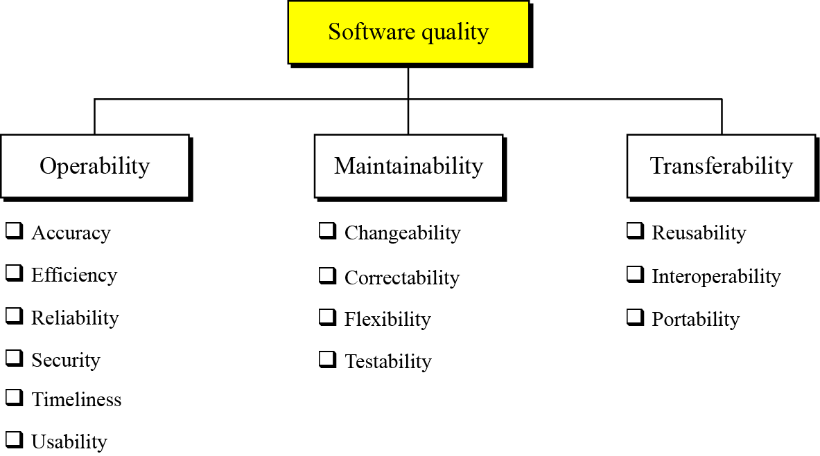
Software quality factors
10.<number>

Slide 59
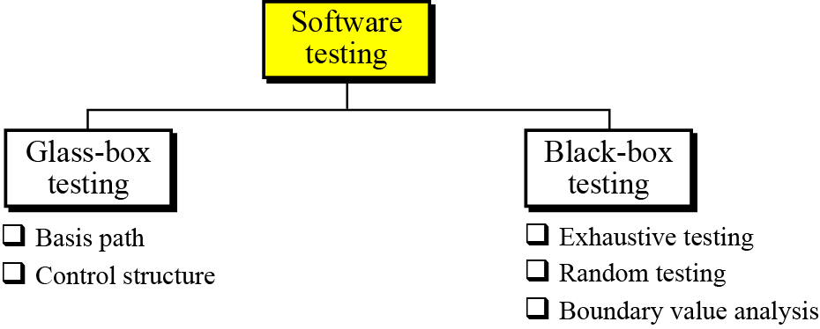
TESTING PHASE
The goal of the testing phase is to find errors, which means that a good testing strategy is the one that finds most errors. There are two types of testing: glass-box (white box) and black-box
10.<number>

Slide 60
Glass-box testing
Glass-box testing (or white-box testing) is based on knowing the internal structure of the software. The testing goal is to determine whether all components of the software do what they are designed for. Glass-box testing assumes that the tester knows everything about the software. In this case, the software is like a glass box in which everything inside the box is visible. Glass-box testing is done by the software engineer or a dedicated team.
Several testing methodologies have been designed in the past. We briefly discuss basis path testing .
10.<number>

Slide 61
Basis path testing
Basis path testing was proposed by Tom McCabe. This method creates a set of test cases that executes every statement in the software at least once.
i
Basis path testing is a method in which each statement in the software is executed at least once.
10.<number>

Slide 62
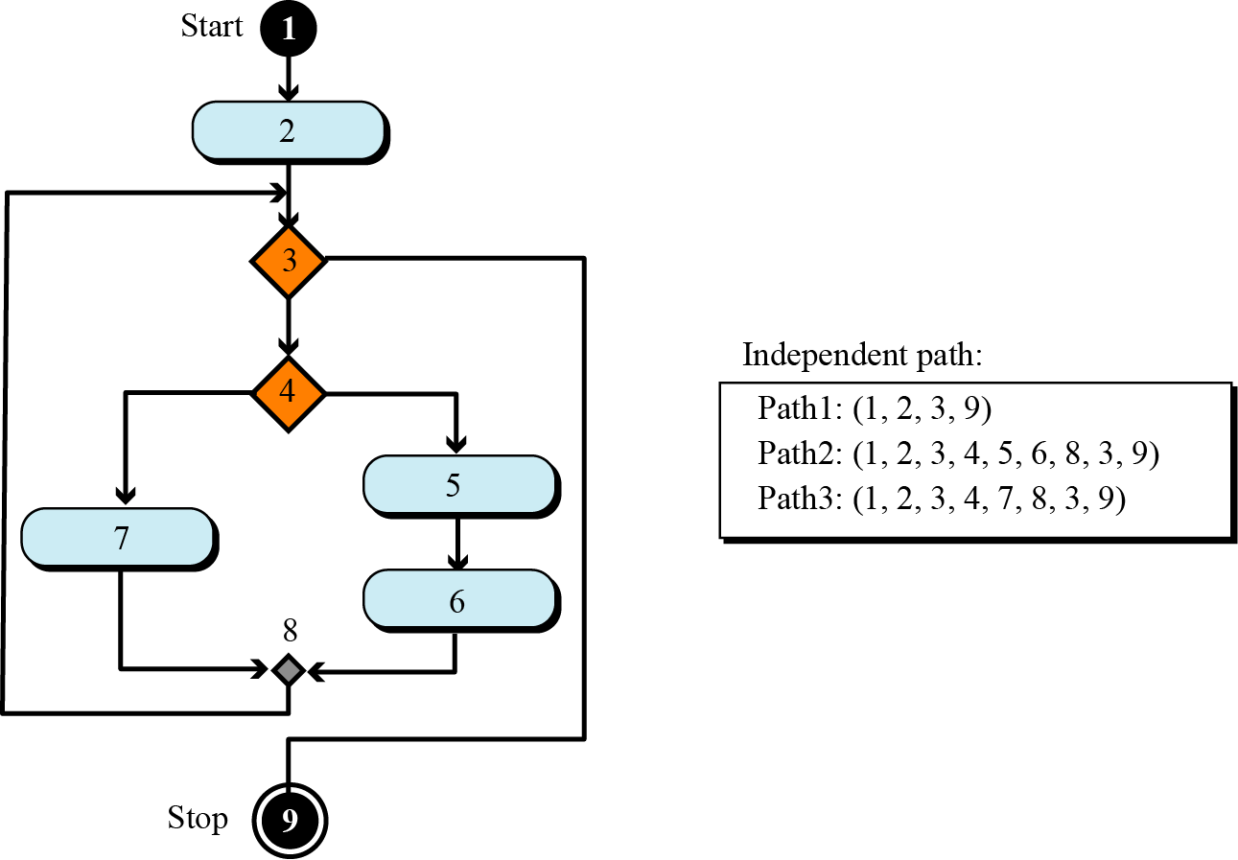
Example
To give the idea of basis path testing and finding the independent paths in part of a program, assume that a system is made up of only one program and that the program is only a single loop with the UML diagram shown in Figure.
10.<number>

Slide 63
Black-box testing
Black box testing gets its name from the concept of testing software without knowing what is inside it and without knowing how it works. In other words, the software is like a black box into which the tester cannot see. Black-box testing tests the functionality of the software in terms of what the software is supposed to accomplish, such as its inputs and outputs. Several methods are used in black-box testing, discussed below.
10.<number>

Slide 64
Exhaustive testing
The best black-box test method is to test the software for all possible values in the input domain. However, in complex software the input domain is so huge that it is often impractical to do so.
Random testing
In random testing, a subset of values in the input domain is selected for testing. It is very important that the subset be chosen in such a way that the values are distributed over the domain input. The use of random number generators can be very helpful in this case.
10.<number>

Slide 65
Boundary-value testing
Errors often happen when boundary values are encountered. For example, if a module defines that one of its inputs must be greater than or equal to 100, it is very important that module be tested for the boundary value 100. If the module fails at this boundary value, it is possible that some condition in the module’s code such as x ≥ 100 is written as x > 100.
10.<number>

Slide 66
DOCUMENTATION
For software to be used properly and maintained efficiently, documentation is needed. Usually, three separate sets of documentation are prepared for software: user documentation, system documentation and technical documentation.
i
Documentation is an ongoing process.
10.<number>

Slide 67
User documentation
To run the software system properly, the users need documentation, traditionally called a user guide, that shows how to use the software step by step. User guides usually contains a tutorial section to guide the user through each feature of the software.
A good user guide can be a very powerful marketing tool: the importance of user documentation in marketing cannot be over-emphasized. User guides should be written for both the novice and the expert users, and a software system with good user documentation will definitely increase sales.
10.<number>

Slide 68
System documentation
System documentation defines the software itself. It should be written so that the software can be maintained and modified by people other than the original developers. System documentation should exist for all four phases of system development.
10.<number>

Slide 69
Technical documentation
Technical documentation describes the installation and the servicing of the software system. Installation documentation defines how the software should be installed on each computer, for example, servers and clients. Service documentation defines how the system should be maintained and updated if necessary.
10.<number>

Slide 70
Thank You

