Slide 1
COMPUTER NETWORKS
- Chapter 2. The Physical Layer 1
王昊翔
WANG Haoxiang
hxwang@scut.edu.cn
School of Computer Science & Engineering
国家双语教学试点项目 广东省精品课

Slide 2
Contents
Theoretical basis for data communication
  Fourier analysis
  Bandwidth-Limited Signals
  The Maximum data rate of a channel
Guided transmission media
  Magnetic media
  Twisted pair
  Coaxial cable
Wireless Transmission
  Electromagnetic spectrum
  Radio transmission
  Microwave transmission
  Infrared and millimeter waves
  Light wave transmission

Slide 3
The physical layer
defines the mechanical, electrical, and timing interfaces to the network, provides the means to transmit bits from sender to receiver, that is, involves a lot on how to use (analog) signals for digital information.

Slide 4
Theoretical Basis
Information can be transmitted on wires by varying some physical property such as voltage or current. By representing the value of this voltage or current as a single-valued function of time, f(t), we can model the behavior of the signal and analyze it mathematically. This analysis is the subject of the following sections.

Slide 5
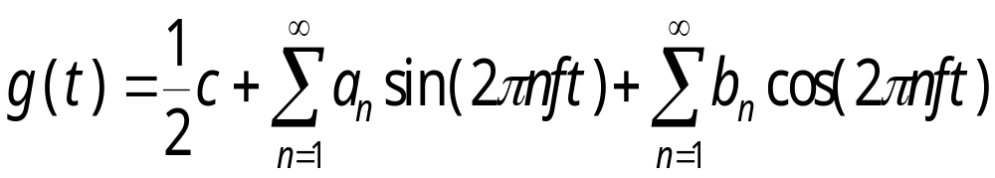
Fourier Series
Any reasonably behaved periodic function, g(t), with period T can be constructed by summing a (possibly infinite) number of sines and cosines:
where f=1/T is the fundamental frequency and a_{n} and b_{n} are the sine and cosine amplitudes of the nth harmonics (terms).

Slide 6
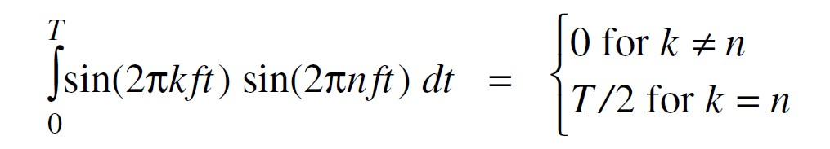
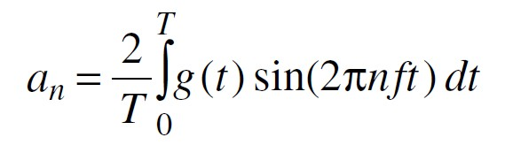
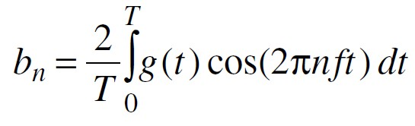
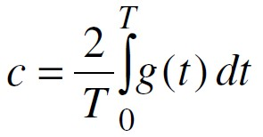
Fourier Series

Slide 7

An example
Consider 01100010, 8 bit for ASCII character 'b':
  a_{n} =1/πn[cos(πn/4) -cos(3πn/4) + cos(6πn/4) -cos(7πn/4)]
  b_{n} = 1/πn[sin(3πn/4) -sin(πn/4) + sin(7πn/4) -sin(6πn/4)]
  c_{n} = ¾
  The root mean square amplitudes is

Slide 8
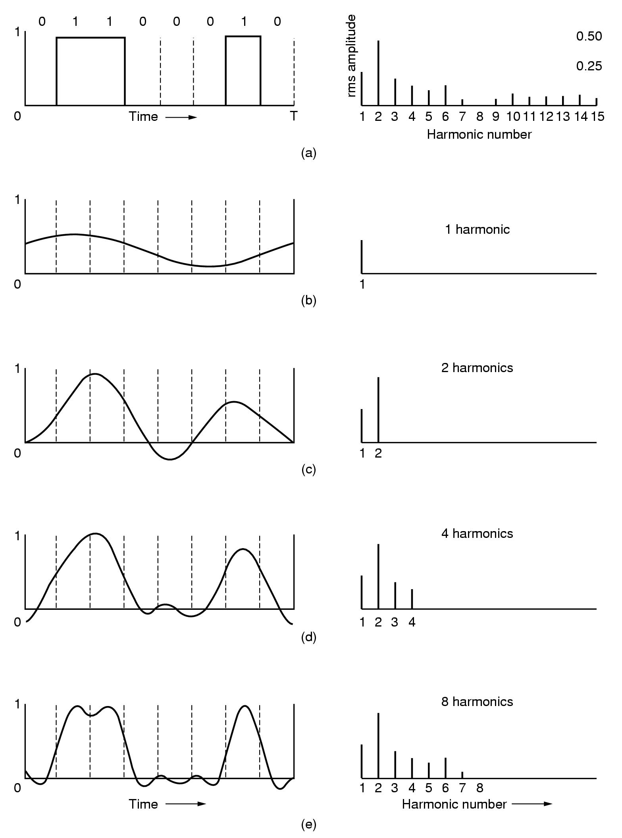
Note: root mean squares (on the right) reflect the dispersed
energy at the given frequency.

Slide 9
Bandwidth
Digital signal transmission is subject to attenuation, distortion, etc. This is partly caused by disallowing high-frequency components to pass through.
The range of frequency or the number of bits of a transmission medium is called bandwidth.

Slide 10
Bandwidth-Limited Signals
The larger n is, the higher the frequency nf of the nth harmonic.
All transmission facilities diminish different Fourier components by different amounts, thus introducing distortion.
Usually, the amplitudes are transmitted undiminished from 0 up to some frequency f_{c} (in Hertz, Hz) with all frequencies above this cutoff frequency截止频率 strongly attenuated.

Slide 11
Bandwidth
Hz
bps
？

Slide 12
Bit Rate vs. Harmonics
Given a bit rate of b bits/sec, the time T required to send 8 bits (for example) is 8/b sec, so the frequency f of the first (i.e., n=1) harmonic is b/8 Hz.
0
8 bits
b bits
0
T
1 sec.

Slide 13
Bit Rate vs. Harmonics (cont.)
N
1
2
:
n
Frequency (Hz)
b/8
2b/8
:
nb/8
nb/8≤ f_{c}
⇒ n ≤ f_{c}/ (b/8)
The number of the highest harmonic passed through is f_{c}/(b/8) or 8f_{c}/b, roughly. That is, the 1st, 2nd, 3rd, ..., and (8f_{c}/b)-th harmonics could pass through without diminution.

Slide 14
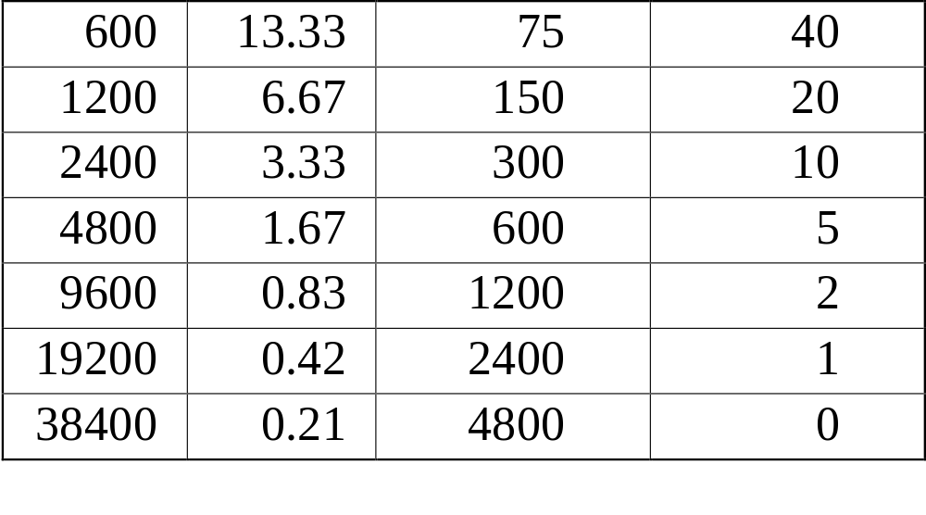
Telephone Line with f_{c}=3000 Hz
Bit Rate
(bps)
T
(msec)
First Harmonic
(Hz)
# Harmonics
sent

Slide 15
Signal-to-Noise Ratio
S/N
  S: signal power
  N: noise power
dB
  10 log₁₀ S/N
  an S/N ratio of 1000 is 30 dB

Slide 16
Max. Data Rate of a Channel
Nyquist’s Theorem (noiseless channel)
  H: bandwidth
  V: discrete levels
  Maximum data rate: 2H log₂ V bits/sec
Shannon’s Theorem (noise channel)
  H: bandwidth
  S/N: signal to noise ratio
  Maximum number of bits/sec: H log₂ (1 + S/N)

Slide 17
Exercise
Suppose that the bandwidth of a channel is between 3MHz and 4MHz and SN = 24dB.
  (1) what is the capacity of this channel?
  (2) Being able to achieve capacity, how many signaling levels are required?

Slide 18
Exercise solution
Suppose that the bandwidth of a channel is between 3MHz and 4MHz and SN = 24dB.
  (1) what is the maximum data rate?
    H = 1MHz
    S/N = 251
    C = 10⁶xlog₂(1+251)=8Mbps
  (2) Being able to achieve capacity, how many signaling levels are required?
    C=2H log₂ V
    V=16

Slide 19
Presentations
Guided transmission media/wires
Wireless Transmission

