Slide 1
COMPUTER NETWORKS
- Chapter 2. The Physical Layer 4
王昊翔
WANG Haoxiang
hxwang@scut.edu.cn
School of Computer Science & Engineering
国家双语教学试点项目 广东省精品课

Slide 2
Outline
Communication Satellites
  Overview
  Types
  Frequencies
  Major problems
  Comparing to fibres, and
  The future

Slide 3
Communication Satellites
Satellites are like big microwave repeaters in the sky:
  contain transponders: listen to some portion of the spectrum, amplify the signal and then rebroadcast at another frequency (to avoid interference with incoming signals)
The higher the satellite, the longer the orbital period (time it takes to rotate around the earth)
  near the surface of the earth, period approx 90 min
  at 35 800km, the period is 24 hours (therefore stationary with respect to the earth’s surface)
  at 384 000km (where the moon is) the period is 1 month

Slide 4
Types of satellites
GEO (Geostationary Earth Orbit) satellites:
  each satellite typically has multiple downward beams focused on small geographical areas (such as South Africa) called spot beams. Used for TV (e.g. DSTV)
MEO (Medium Earth Orbit) satellites:
  24 satellites used for GPS (Global Positioning System). Not used for telecommunications.
LEO (Low Earth Orbit) satellites:
  Iridium & Globalstar: systems of satellites used for global satellite telephones (ships, rural areas, etc).
  Teledesic: used for Internet users, completely bypasses telephone system (packet switching in space)

Slide 5
GEOs
Originally proposed by Arthur C. Clarke
Circular orbits above the equator
Angular separation about 2 degrees - allows 180 satellites
Orbital height above the earth about 23000 miles/35000km
Round trip time to satellite about 0.24 seconds

Slide 6
GEOs (2)
GEO satellites require more power for communications
The signal to noise ratio for GEOs is worse because of the distances involved
A few GEOs can cover most of the surface of the earth
Note that polar regions cannot be “seen” by GEOs

Slide 7
GEOs (3)
Since they appear stationary, GEOs do not require tracking
GEOs are good for broadcasting to wide areas

Slide 8
Major problems for satellites
Positioning in orbit
Stability
Power
Communications
Harsh environment

Slide 9
Positioning
This can be achieved by several methods
One method is to use small rocket motors
These use fuel - over half of the weight of most satellites is made up of fuel
Often it is the fuel availability which determines the lifetime of a satellite
Commercial life of a satellite typically 10-15 years

Slide 10
Stability
It is vital that satellites are stabilised
  to ensure that solar panels are aligned properly
  to ensure that communications antennae are aligned properly
Early satellites used spin stabilisation
  Either this required an inefficient omni-directional aerial
  Or antennae were precisely counter-rotated in order to provide stable communications
Modern satellites use reaction wheel stabilization - a form of gyroscopic stabilization

Slide 11
Reaction wheel stabilisation
Heavy wheels which rotate at high speed - often in groups of 4.
3 are orthogonal, and the 4th (spare) is a backup at an angle to the others
Driven by electric motors - as they speed up or slow down the satellite rotates
If the speed of the wheels is inappropriate, rocket motors must be used to stabilise the satellite - which uses fuel

Slide 12
Power
Modern satellites use a variety of power means
Solar panels are now quite efficient, so solar power is used to generate electricity
Batteries are needed as sometimes the satellites are behind the earth - this happens about half the time for a LEO satellite
Nuclear power has been used

Slide 13
Harsh Environment
Satellite components need to be specially “hardened”
Circuits which work on the ground will fail very rapidly in space
Temperature is also a problem - so satellites use electric heaters to keep circuits and other vital parts warmed up - they also need to control the temperature carefully

Slide 14
Alignment
There are a number of components which need alignment
  Solar panels
  Antennae
These have to point at different parts of the sky at different times, so the problem is not trivial

Slide 15
Antennae alignment
A parabolic dish can be used which is pointing in the correct general direction
Different feeder “horns” can be used to direct outgoing beams more precisely
Similarly for incoming beams
A modern satellite should be capable of at least 50 differently directed beams

Slide 16
Satellite - satellite communication
It is also possible for satellites to communicate with other satellites
Communication can be by microwave or by optical laser

Slide 17
LEOs
Low earth orbit satellites - say between 100 - 1500 miles
Signal to noise should be better with LEOs
Shorter delays - between 1 - 10 ms typical
Because LEOs move relative to the earth, they require tracking

Slide 18
Orbits
Circular orbits are simplest
Inclined orbits are useful for coverage of equatorial regions
Elliptical orbits can be used to give quasi stationary behaviour viewed from earth

Slide 19
Communication frequencies
Microwave band terminology
  L band 800 MHz - 2 GHz
  S band 2-3 GHz
  C band 3-6 GHz
  X band 7-9 GHz
  Ku band 10-17 GHz
  Ka band 18-22 GHz

Slide 20
Early satellite communications
Used C band in the range 3.7-4.2 GHz
Could interfere with terrestrial communications
Beamwidth is narrower with higher frequencies

Slide 21
More recent communications
Greater use made of Ku band
Use is now being made of Ka band

Slide 22
Satellite management
Satellites do not just “stay” in their orbits
They are pushed around by various forces
They require active management

Slide 23
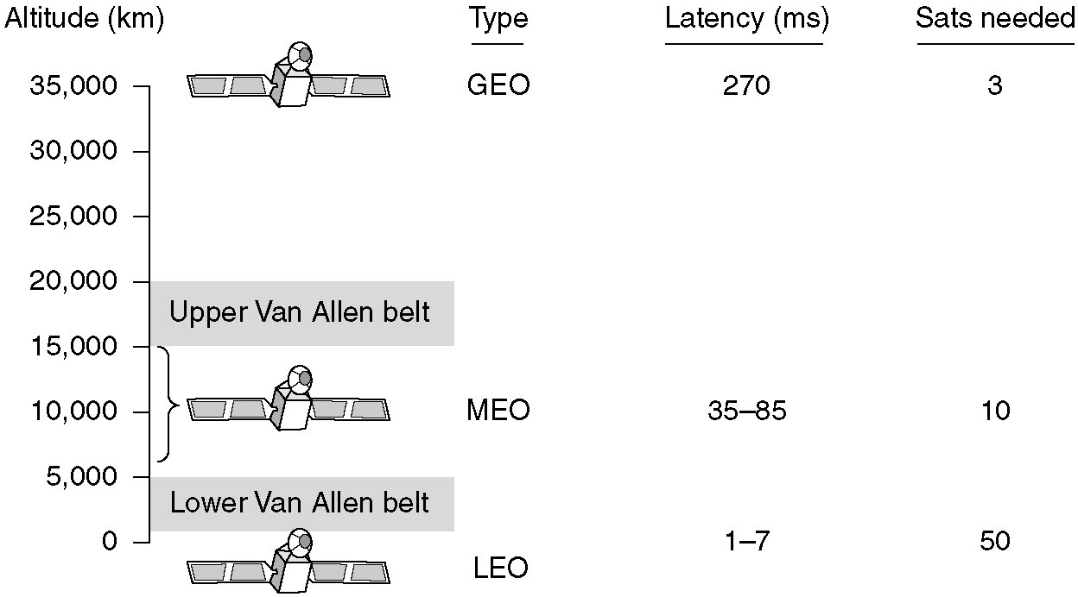
Communication Satellites
Communication satellites and some of their properties, including altitude above the earth, round-trip delay time and number of satellites needed for global coverage.

Slide 24
Satellites vs. Fiber
Satellites give users more bandwidth in practice:
  A single fiber has (in principle) more bandwidth than all the satellites.
  But in reality, this bandwidth is not available to all users (fiber used by telephone companies to share many calls)
  A single user can put up a dish and have high bandwidth using Teledesic.
Satellites have particular specialist uses:
  mobile communication: where there is no cell phone reception, can use satellites
  broadcasting: a message sent by satellite can be sent (cheaply) and received by thousands of ground stations at once.
  other areas: hostile terrain, rapid deployment, etc.

Slide 25
The future
Because Iridium has not been a commercial success the future of satellites is uncertain.
Satellites still have major advantages for wide area distribution of data.

Slide 26
Summary
Communication satellites have many advantages over other transmission media.
Communication satellites have three types: GEO, MEO and LEO, each deployed with different goal .
Different bands are divided and utilized in a variety occasions.

