Slide 1
COMPUTER NETWORKS
- Chapter 3. Data Link Layer 1
王昊翔
WANG Haoxiang
hxwang@scut.edu.cn
School of Computer Science & Engineering
国家双语教学试点项目 广东省精品课

Slide 2
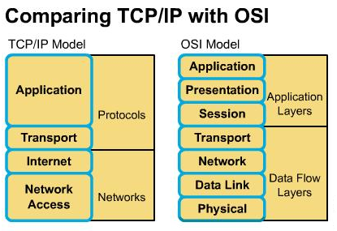
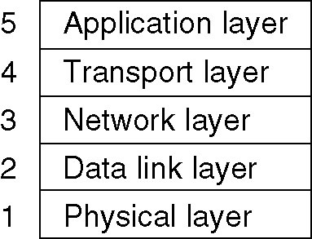
Contents presented in Chap1&2
Chapter 1
  Services vs. Protocols
  Reference Models(Encapsulation)
  Example Networks
  Networks Standardization
Chapter 2
  Theoretical Basis
  Three transmission media
    Guided transmission
    Wireless transmission
    Communication satellites
  Three communication system
    Public Switched Telephone Network

Slide 3
Main object of the chapter3
The DLL is responsible for taking the packets of information that it receives from the Network Layer and putting them into frames for transmission.
Each frame holds the payload plus a header and a trailer (overhead).
It is the frames that are transmitted over the physical layer.
Achieving reliable, efficient communication between two adjacent machines.

Slide 4
Main Functions of DLL
Provide a well-defined service interface to the network layer.
Deal with transmission errors.
Regulate the flow of data , so that slow receivers are not swamped.

Slide 5
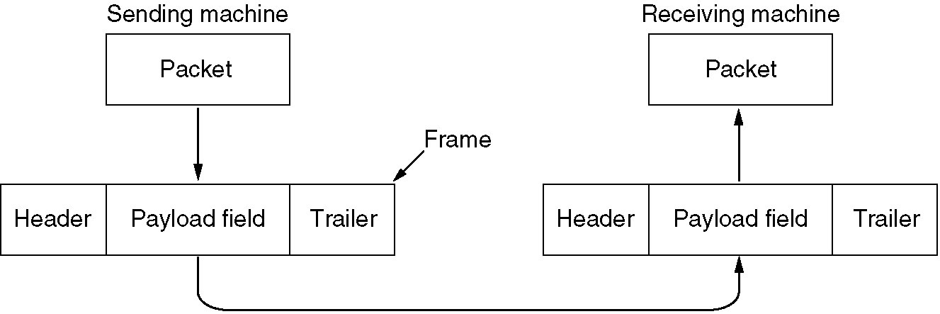
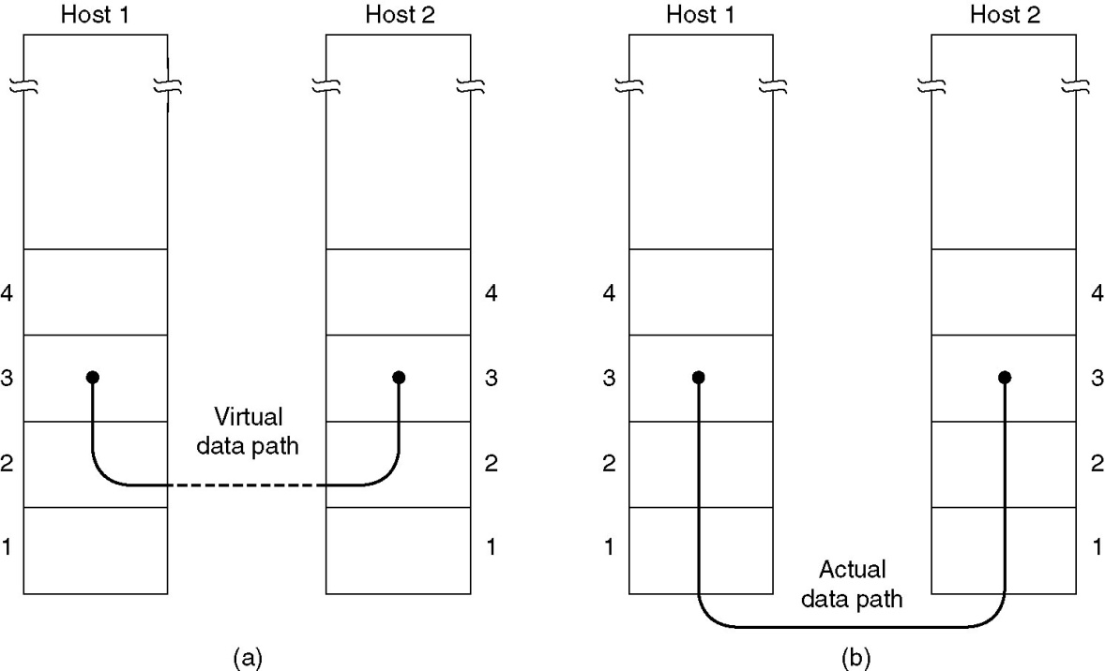
Relationship between packets and frames

Slide 6
Outline
Data Link Layer Design Issues
Error Detection and Correction
Elementary Data Link Protocols
Sliding Window Protocols
Example Data Link Protocols

Slide 7

Contents of this lecture
Overview of data link layer
Learn Framing methods
Learn error-detection and error-control
  Hamming code（海明码）
  Cyclic Redundancy Check（循环冗余码CRC）

Slide 8

Service provided by DLL
The data link layer can offer many kinds of service.
The actual offered services can vary from system to system.
Three common services:
  Unacknowledged connectionless service.
    无确认的无连接服务
  Acknowledged connectionless service.
    有确认的无连接服务
  Acknowledged connection-oriented service.
    有确认的面向连接服务

Slide 9
Unacknowledged connectionless service
The source machine send independent frames to the destination machine, and there is no acknowledgement from the destination machine.
No logical connection is established beforehand or released afterward.
The DLL will make no attempt to detect the loss of or recover a lost frame.
This service is useful for low error rate networks and for real-time traffic where late data is worse than no data.

Slide 10
Acknowledged Connectionless Service
The receiver acknowledges the arrival of each frame.
  If it hasn’t arrived correctly (or within a specified time interval), it can be resent.
This is a useful service when the connection is unreliable (such as wireless systems)
There is no requirement for such an acknowledgement service to be implemented by the data link layer.

Slide 11
Acknowledged Connection-Oriented Service
A connection is established between the two machines, and the frames are then transmitted.
Each frame sent over the connection is numbered and each frame is acknowledged.
The frames are guaranteed to arrive only once and in order.
The connection is released once the communication is complete.
This is the same as a “reliable” bit stream.

Slide 12
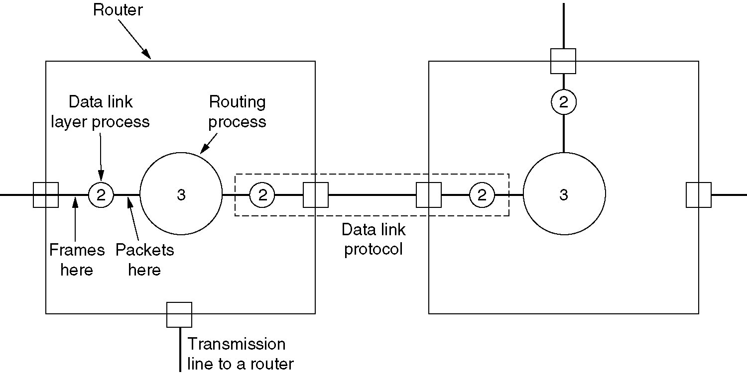
Data Flow Over Two Routers

Slide 13
Framing
The data link layer must use the service provided by the physical layer in order to provide service to the network layer.
The Physical Layer is only able to put a raw bit stream on the transmission media.
Bit stream is not guaranteed to be error free.
It is up to the data link layer to detect and, if necessary, correct errors.

Slide 14
Framing(cont’d)
The DDL can be able to break up the bit stream into discrete frames.
Compute the checksum for each frame and the checksum is recomputed when a frame arrives at the destination.
Breaking the bit stream up into frames is somewhat difficult.
  Time gaps
We need to look at other methods of denoting the start and finish of a frame.

Slide 15
Four framing method
Character count（字符计数法）
Flag bytes with byte stuffing（带字节/字符填充的分界符法）
Starting and ending flags, with bit stuffing（带位填充的分界标志法）
Physical layer coding violations（物理层编码违例法）

Slide 16
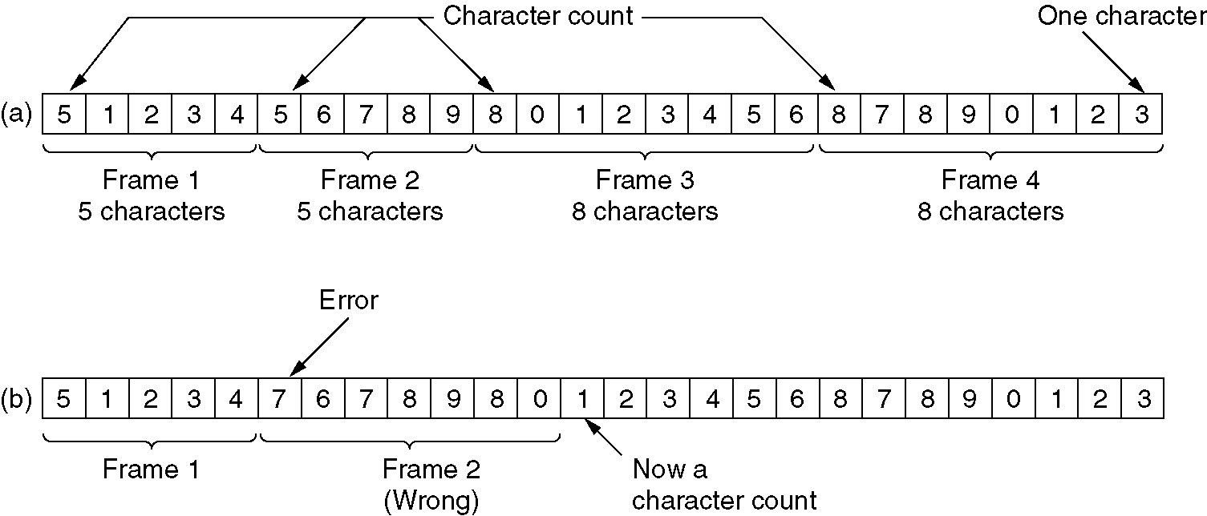
Character count
Insert time gaps between frames,impossible
Uses a field in the header to specify the number of characters in the frame
Problem

Slide 17
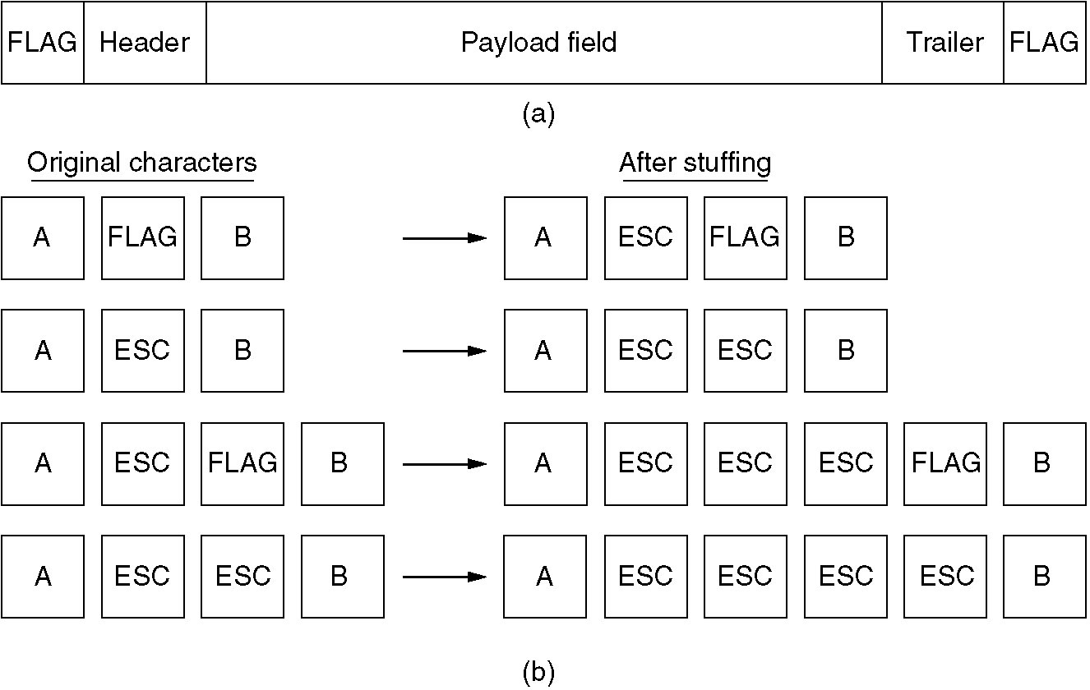
Flag Bytes with byte stuffing

Slide 18
Flag Bytes with bit stuffing
Allows data frames to contain an arbitrary number of bits and allows character codes with an arbitrary number of bits per character.
Each frame begins and ends with a special bit pattern, 01111110 (in fact, a flag byte).
Whenever the sender's data link layer encounters five consecutive 1s in the data, it automatically stuffs a 0 bit into the outgoing bit stream.
With bit stuffing, the boundary between two frames can be unambiguously recognized by the flag pattern.

Slide 19
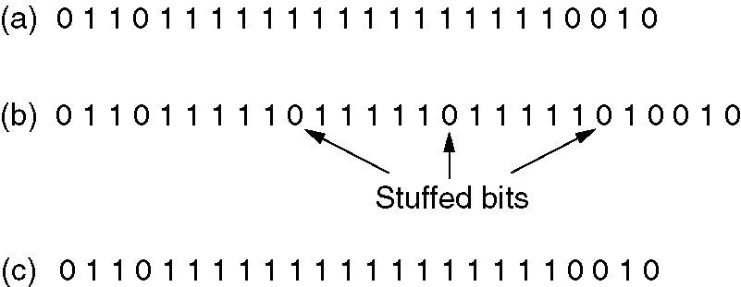
Example

Slide 20
Physical layer coding violations
物理层编码违例法
Only applicable to networks in which the encoding on the physical medium contains some redundancy.
For example, some LANs encode 1 bit of data by using 2 physical bits. Normally, a 1 bit is a high-low pair and a 0 bit is a low-high pair.
Most DLL protocols use a combination of character count with another method for extra safety. This increases the chances of catching an error.

Slide 21
Error Control
We use byte stuffing, bit stuffing and checksum as a method for detecting and determining errors in the data that we send.
We also have to deal with making sure that the frames make it to their destination.
The receiver sends back a control frame acknowledging the received frame and the condition of the frame.
A timeout can occur if the acknowledgement doesn’t arrive, resulting in the frame being resent.
  Timeout interval

Slide 22
Error Control (cont’d)
Resending the frame can also cause problems – what happens when the same frame is received twice or more times?
We can also sequentially number the frames to prevent this problem.
There are many different ways to do this type of error control (and it can be done at different levels as well).
Managing the timers and sequence numbers are important parts of the data link layer's duties.

Slide 23
Flow Control
We must deal with the issue where the sender is sending data at a higher rate than the receiver can receive the data.
There are two approaches to this problem:
  feedback-based flow control
    feedback is used to tell the sender how the receiver is doing or to send another frame
  rate-based flow control
    the transfer rate is fixed by the sender
    this is never used in the DLL

Slide 24
Why do we need
Error Detection And Correction?
The local loops are still analog twisted copper pairs and errors are still common.
Wireless communication is becoming more common, and the error rates are orders of magnitude worse than on the interoffice fiber trunks.
Transmission errors are going to be with us for many years to come.

Slide 25
Types of Error
Errors come in bursts
Independent single-bit errors
Example
  block size is 1000 bits
  error rate is 0.001 per bit
Burst errors are much harder to correct than isolated errors

Slide 26
Error Processing
Error-correcting codes
  Include enough redundant information along with each block of data sent.
  The receiver can deduce the transmitted data
  The use of error-correcting codes is often referred to as forward error correction(前向纠错).
Error-detecting codes
  Include only enough redundancy
  Allow the receiver to deduce that an error occurred, but not correct error, and just have it request a retransmission.

Slide 27
Error Processing (cont’d)
Each of the two techniques is applicable to different circumstances.
Error-correcting code
  The overhead is high but it reduces the need to resend frames.
  best suited for networks with high error (wireless).
Error-detecting code
  suite for highly reliable channel, such as fiber
  just retransmit when errors are found

Slide 28
Presentation
Error correction
Hamming encoding
detect d bits errors
correct d bits errors

Slide 29
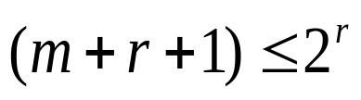
Do exercise（1/2）
Original data: 10101111,even-parity Hamming code, if hope to correct one single error, What is the Hamming code for it?
Solution：m=8，According ：
  r=4， ??1?010?1111
  P1=B1⊕B3⊕B5⊕B7⊕B9⊕B11 =∑(0,1,0,0,1,1)=1 P2=B2⊕B3⊕B6⊕B7⊕B10⊕B11=∑(0,1,1,0,1,1)=0
  P3=B4⊕B5⊕B6⊕B7 ⊕B12 =∑(0,0,1,0,1)=0
P4=B8⊕B9⊕B10⊕B11⊕B12 =∑(0,1,1,1,1)=0
So, Hamming code is: 101001001111

Slide 30
Do exercise（2/2）
All conditions is as above, if receiver has received a codeword like：1 0 0 1 1 0 0 0 1 1 0 0 (m=8,r=4），Question: Is the codeword is correct or not? What is the corresponding correct one if wrong?
Solution：
  P1=B1⊕B3⊕B5⊕B7⊕B9⊕B11 =∑(1,0,1,0,1,0)=1 P2=B2⊕B3⊕B6⊕B7⊕B10⊕B11=∑(0,0,0,0,1,0)=1
  P3=B4⊕B5⊕B6⊕B7 ⊕B12 =∑(1,1,0,0,0)=0 P4=B8⊕B9⊕B10⊕B11⊕B12 =∑(0,1,1,0,0)=0
  So, Counter=1+2=3，the 3rd bit is wrong, correct one is：
  1 0 1 1 1 0 0 0 1 1 0 0

Slide 31
Error Detection
Error-detecting codes only include enough data to let the receiver determine whether the data is faulty.
If the error rate of physical link is much lower, error detection and retransmission is usually more efficient.
  copper wire or fiber

Slide 32
How efficient, an example
For comparison, consider a channel with error rate of 10⁻⁶ per bit. Let block size be 1000 bits.
  To correct a single error (by Hamming code), 10 check bits per block are needed. To transmit 1000 blocks, 10,000 check bits (overhead) are required.
  To detect a single error, a single parity bit per block will suffice. To transmit 1000 blocks, only one extra block (due to the error rate of 10-⁶ per bit) will have to be retransmitted, giving the overhead（开销） of only 2001 (= 1000*1 + 1001) bits.
Notes:
这个1000*1应该指的是有1000个single parity bit，这个1001应该指的是重发的那个block的1000个本来的bit+1个single parity bit

Slide 33
Polynomial Code(多项式编码)
Also known as a CRC (Cyclic Redundancy Check，循环冗余校验码).
Based upon treating bit strings as representations of polynomials with coefficients of 0 and 1
  Example: 110001
  five-degree six-term polynomial（6项5阶多项式）
  1*x⁵ + 1*x⁴+0*x³+0*x²+0*x¹+1*x⁰=x⁵+x⁴+1
Polynomial arithmetic is done modulo 2. Both addition and subtraction are identical to EXCLUSIVE OR（等同于异或）:
    10011011 01010101
    + 11001010 - 10101111
    --------------- ---------------
    01010001 11111010

Slide 34
What is modulo 2？
Modulo 2 addition & substraction: XOR logic
  0⊕0=0; 0⊕1=1;
  1⊕0=1; 1⊕1=0.
Modulo 2 mltiplication: -- Modulo 2 division:
  1 0 1 0 1 0 1/ 1 0 0 0 0
  × 1 0 1 1 0 1
  1 0 1 0 0 1 0
  0 0 0 0 0 0 0
  1 0 1 0 1 0 0
  1 0 0 0 1 0 1 0 1
  0 1
1 0 1

Slide 35
Polynomial Code (cont’d)
The basic idea of the CRC method:
  The sender and receiver agree upon a generator polynomial（生成多项式）, G(x), in advance.
  The sender appends a checksum to the end of the frame in such a way that the polynomial represented by the checksummed frame is divisible by G(x).
  When the receiver gets the frame, it tries dividing it by the same G(x). If there is a remainder, there must have been an error and a retransmission will be requested.

Slide 36
Algorithm For Computing Checksum
Let r be the degree of G(x). Append r zero bits to the low-order end of the frame so it now contains m + r bits and corresponds to the polynomial x^{r}M(x).
Divide the bit string corresponding to G(x) into the bit string corresponding to x^{r}M(x), using modulo 2 division.
Subtract the remainder (which is always r or fewer bits) from the bit string corresponding to x^{r}M(x) using modulo 2 subtraction. The result is the checksummed frame to be transmitted. Call its polynomial T(x).

Slide 37
An example of CRC
Frame: 1101011011（m=10）
M(x)= x⁹+x⁸+x⁶+x⁴+x³+x+1
G(x)=x⁴+x+1 （r=4阶）
x⁴M(x) （相当于在原码字后加r个0）=x⁴(x⁹+x⁸+x⁶+x⁴+x³+x+1) =x¹³+x¹²+x¹⁰+x⁸+x⁷+x⁵+x⁴
x⁴M(x)- reminder(x⁴M(x)/ G(x))=?

Slide 38
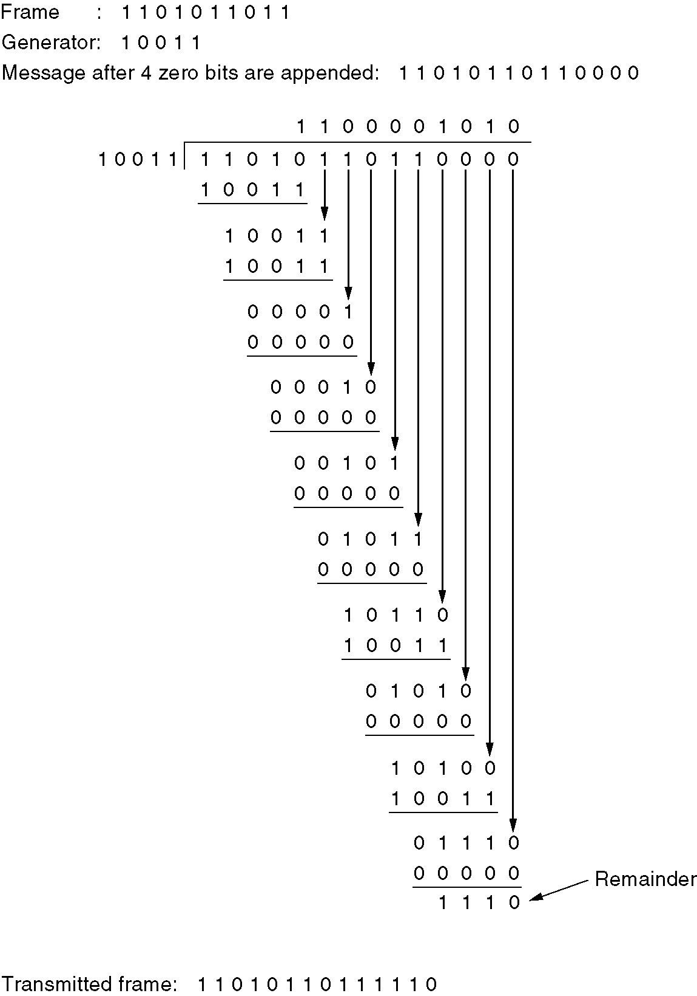
An example of CRC（cont’d）

Slide 39

Summary of this lecture
Learn functions of DLL
Learn and Master framing method
Master error detection and correction methods
  Hamming code海明码
  Polynomial code(CRC)

