Slide 1
COMPUTER NETWORKS
- Chapter 3. Data Link Layer 2
王昊翔
WANG Haoxiang
hxwang@scut.edu.cn
School of Computer Science & Engineering
国家双语教学试点项目 广东省精品课

Slide 2
Contents of this lecture
Learn 6 elementary DLL protocol
Learn & master sliding-window
Learn & master ARQ（自动重复请求）/PAR
Learn & master piggybacking(捎带确认)
Other: pipeline, NAK

Slide 3
Elementary DLL protocol
Assumptions:
  The physical layer, data link layer, and network layer are independent processes.
  Machine A wants to send a long stream of data to machine B, using a reliable, connection-oriented service.
  A's data link layer asks for data, the network layer is always able to comply immediately.
  These protocols deal with communication errors, but not the problems caused by computers crashing and rebooting.
  As far as the data link layer is concerned, the packet passed across the interface to it from the network layer is pure data.

Slide 4
Elementary DLL protocol（cont’d）
3 simplex(单工) protocol：
  An unrestricted simplex protocol
    无限制的单工协议
  A simplex stop-and-wait protocol
    单工的仃—等协议
  A simplex protocol for a noisy channel
    有噪声信道的单工协议

Slide 5
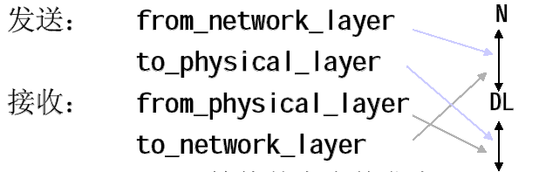
Protocol Declaration （1/2）
All common data-type、functions are defined as （protocol.h）
Data transmission between NL、PL
PL

Slide 6
Protocol Declaration （2/2）
Wait_for_event (&event): wait for something to happen
  fram_arrive,
  cksum_err,
  timeout
Timer
  start_timer, stop_timer
  start_ack_timer，stop_ack_timer

Slide 7
Frame structure
typedef struct{
frame_kind kind;
seq_nr seq;
seq_nr ack;
packet info;
}frame;
Frame header
Frame header
Frame header

Slide 8
Unrestricted Simplex Protocol (protocol 1)
Protocol 1 (utopia, 乌托邦)
Data are transmitted in one direction only
Both the transmitting and receiving network layers are always ready （随时待命）
Processing time can be ignored （瞬间完成）
Infinite buffer space is available （无限空间）
The communication channel between the data link layer never damages or loses of frames（完美通道）

Slide 9
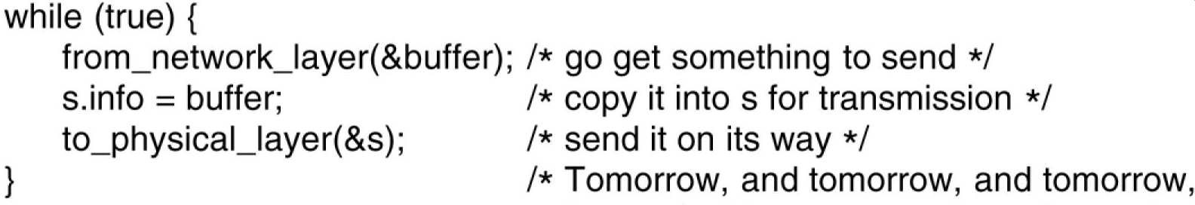
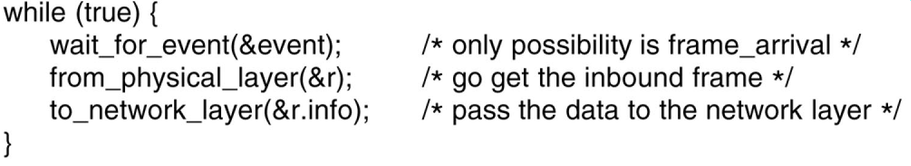
Unrestricted Simplex Protocol
Both the sender and the receiver are in an infinite while loop(无限的while循环)
The sender:
The receiver

Slide 10
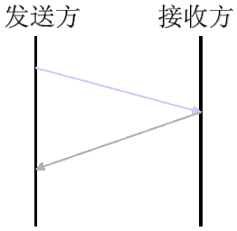
Simplex Stop-and-Wait Protocol
Protocol2 ：Drop the unrealistic restriction
  Process abilities in receiver is limited: the receiver has only a finite buffer capacity and a finite processing speed.
How to prevent the sender from flooding the receiver with data? 发得太快导致淹没
  simply insert a delay into protocol 1
  the receiver provide feedback to the sender
Protocols in which the sender sends one frame and then waits for an acknowledgement before proceeding are called stop-and-wait
a dummy frame

Slide 11
Pay attentions
Data traffic is simplex（单工）, but frames do travel in both directions.
The communication channel between the two data link layers needs to be capable of bidirectional information transfer.
  A half- duplex（半双工） physical channel is enough
Data flow
  first the sender sends a frame, then the receiver sends a frame, then the sender sends another frame, then the receiver sends another one, and so on.

Slide 12
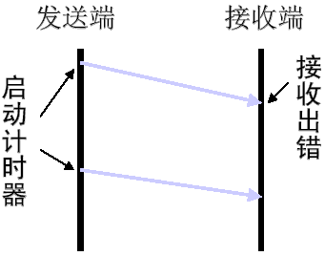
Simplex Protocol for a Noisy Channel
Let us consider the normal situation: a communication channel may make errors.
A scheme using timer and acknowledgement:
  The sender starts a timer after sending a frame.
  The receiver sends back an acknowledgement only when the incoming frame were correctly received.
  The sender will retransmit the frame if the timer expired before
Positive Acknowledgement with Retrasmission
Automatic Repeat reQuest

Slide 13
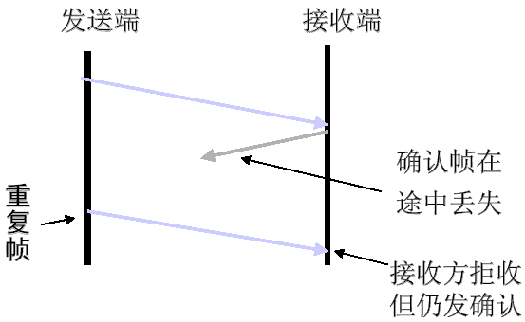
PAR(主动确认重传)
What is the fatal flaw in the above scheme ?
  Loss of an acknowledgement
  duplicated frame
How to distinguish a frame being seen for the first time from a retransmission ?
  Use a sequence number in the header of each frame.

Slide 14
Sliding window protocol
How to improve efficiency of transmission?
  full-duplex （全双工）
  piggybacking （捎带确认）
  sliding window （滑动窗口）（flow control）
Sliding window protocol
  Protocol 4：n=1——basic idea of sliding window
  Protocol 5： Go Back n （回退n帧）
  Protocol 6： Select Repeat （选择性重传）

Slide 15

Sliding window protocol
How to achieve full-duplex data transmission ?
  Two separate simplex data channels
  One circuit for data in both directions
Piggybacking(捎带确认)
  temporarily delay outgoing acknowledgements so that they can get a free ride on the next outgoing data frame
How long should the receiver wait for piggybacking?
  An ad hoc scheme: waiting a fixed number of milliseconds. （ACK-TIMER）

Slide 16
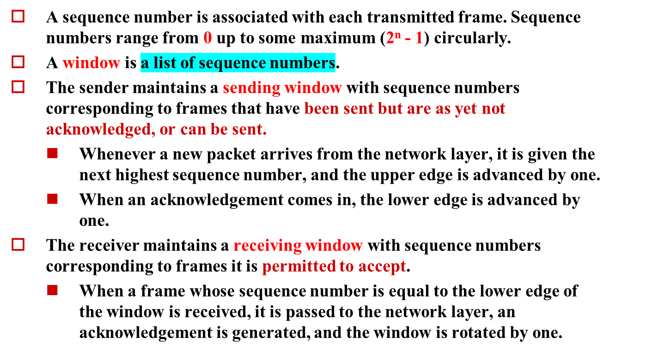
Sliding window protocol

Slide 17
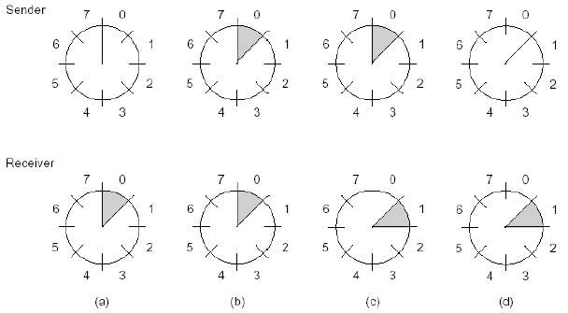
A sliding window of size 1, with a 3-bit sequence number
初始时 发送了第一帧 接收了第一帧 收到第一个确认帧

Slide 18
Explain
Receiver: after receive frame，check if the sequence number is frame_expected(预期帧号) or not，if it is，receive it and frame_expected+1，that’s sliding receiving-window（接收窗口）。
Sender：When receive acknowledge frame，check if ack_number is next_frame_to_send or not，if it is, get packet from network_layer, and next_frame_to_send+1，that’s sliding sending_window

Slide 19
Principle of protocol 4
1-bit sliding window protocol （w=1）
Window setting
  Sliding window maximum：MAX_SEQ = 1
  Initial value：seq =0, ack=1（期待接收seq=0）
Window sliding scheme
  A send frame firstly（seq=0, ack=1, A0）
  B receive A0，send back piggyback-acknowledge （seq=0, ack=0, B0）
  A receive acknowledge （to A0），sliding window，send next frame（seq=1, ack=0, A1）
characteristic
  序列号seq和确认值ack“0”“1”交替
  滑动窗口长度W=1，收到确认才移动窗口
  保证按顺序将接收到的正确帧只一次上交网络层

Slide 20
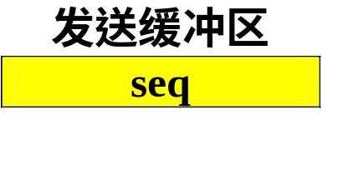
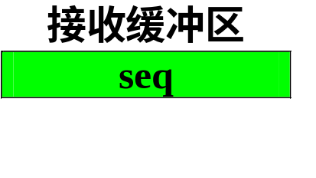
Normal case of protocol 4
A
B
(0, 1, A0)
(0, 1, A0)*
(0, 0, B0)
(0, 0, B0)*
(1, 0, A1)
(1, 0, A1)*
(1, 1, B1)
(1, 1, B1)*
(0, 1, A2)
(0, 1, A2)*
(0, 0, B2)
(0, 0, B2)*
(1, 0, A3)
(1, 0, A3)*
（seq，ack，data）
(1, 1, B3)

Slide 21
Abnormal case 1：duplicated
A
B
期望
seq
B
=
0
(0, 1, A0)
期望
seq
A
=
0
超时重传
(0, 1, A0)
(0, 1, A0)
*
交网络层
(0, 0, B0)
期望
seq
A
=1
期望
acq
A
=0
超时重传
(0, 1, A0)
(0, 1, A0)
seq

acq

seq

acq

(0, 0, B0)*
(0, 0, B0)
期望
seq
A
=1
期望
seq
B
=
1
(1, 0, A1)
(0, 1, A0)
seq

acq

seq

acq

(0, 0,B0)
(0, 0, B0)
期望
seq
A
=1
期望
seq
B
=
1
(1, 0, A1)
(1, 0, A1)*
seq

acq

(1, 1, B
1
)
期望
seq
A
=
0

Slide 22
Abnormal case 1：error control
A
B
期望
(0,0)
(0, 1, A0)
(0, 1, B0)
期望
(0,0)
(0, 1, A0)*
seq

ack

(0, 0, B0)
期望
(1,0)
seq

ack

(0, 1, B0)*
期望
(1,0)
(0, 0, A0)
丢弃
(0,
0
, B0)
(
0,
0
, A0)
丢弃
期望
(1,1)
(1, 0, A1)
(1, 0, B1)
期望
(1,1)
(1, 0, A1)
*
seq

ack

(1,
1, B1)
期望
(0,1)
seq

ack

(1, 0, B1)
*
期望
(0,1)
(1, 1, A1)
丢弃
(1,
1
, B1)
(1,
1
, A1)
丢弃
期望
(0,0)
(0, 1, A2)
(0, 1, B2)
期望
(
0,0)
(0, 1, A2)
seq

ack

(
0
,
0
, B
2
)
期望
(
1,0)

Slide 23
Line utilization rate of protocol4（信道利用率）

Slide 24
Line utilization rate of protocol 4（信道利用率）
An assumption in protocol 4: the time is negligible.
  The transmission time forward or back
  The processing time for the receiver to handle the incoming frame
In fact, the round-trip time can be very large in low rate channel, and the sender is blocked during the period.
Line utilization rate:
  channel capacity is b bps
  frame size k bits
  round-trip propagation time R sec

Slide 25
Example
Assumption：
  channel capacity b = 50 kbps
  round-trip propagation R = 500 ms
  frame size k = 1000 bit
  Receiver immediately send back acknowledge frame when it receives a frame
Question: how much is line utilization rate?

Slide 26
Reference key
Time for sending frame
T_{f} =k/b = 20 ms
Round Trip Time
R = 500 ms
Time from very-beginning to acknowledgement-back
(T_{f} +R) = 20 + 500 = 520 ms
Line utilization rate
T_{f} /(T_{f} +R) = 20/520 = 3.85 %

Slide 27

Less than 4%
接收方
W = 1
在发送缓冲区只存储1个待确认帧。
发送方
T_{f}
R
T_{f} + R

Slide 28
How to improve line utilization？
Increase maximum sliding-window size W:
  Line utilization = W*T_{f} / (T_{f} +R)
  = W* k / (k + bR)
Utopian case: line utilization rate is up to 100%，then maximum sliding-window size is:
W = (T_{f} +R) / T_{f} = 520 / 20 =26

Slide 29
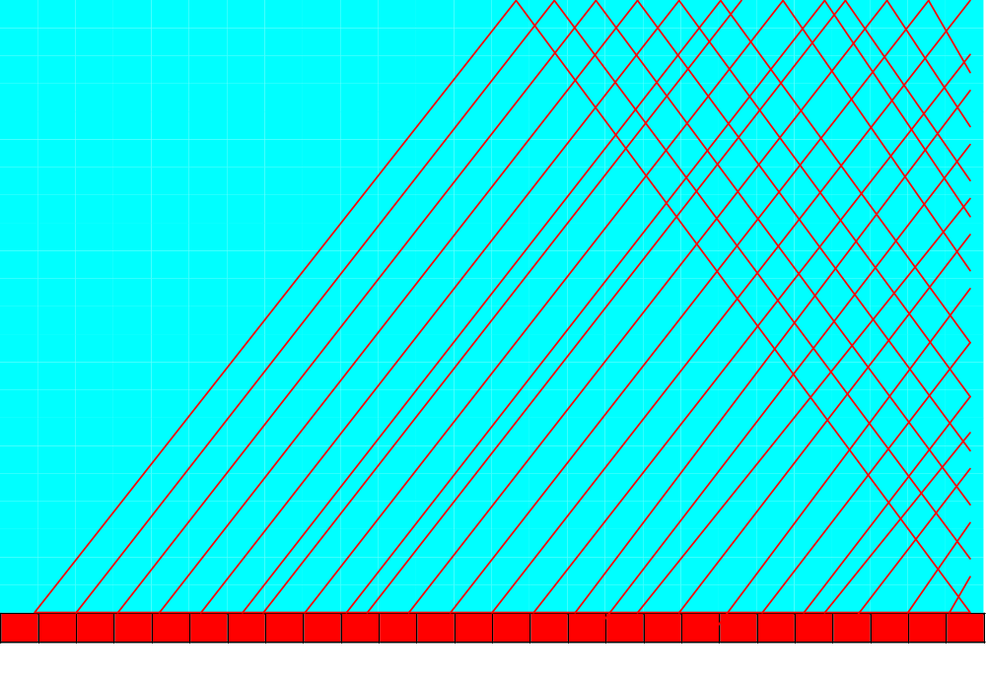
Line utilization rate is 100%
接收方
W = 26
连续发送、并在发送缓冲区存储26个待确认帧。
发送方
T_{f} + R
T_{f}
管道化（pipeling）

Slide 30
Pipeline
Allowing the sender to transmit up to w frames before blocking.
Whenever the product of bandwidth and round-trip-delay is large, a large window on the sending side is needed.
What to do if a frame in the middle of a long stream is damaged or lost?
  Go back n
  Selective repeat

Slide 31
Protocol 5：go back n
receiver：
  Just discard wrong frame and latter frames(后续帧) （receiving-window is 1）
Sender：
  Resend wrong frame and latter frames

Slide 32
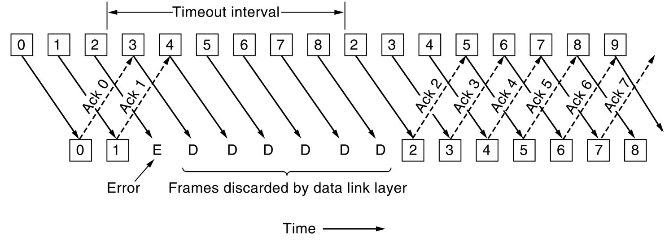
Basic idea of protocol 5
The receiver's window size is 1, that is to say, the receiver only accepts frames in order.
The receiver discards all frames following an error, sending no acknowledgements.
After time out, the sender retransmits all unacknowledged frames in order, starting with the damaged or lost one.

Slide 33
Construct a data frame
s.kind=data
s.info=buffer[frame_nr]
s.seq=frame_nr
s.ack=(frame_expected+Max_seq)%(Max_seq+1)
F
A
C
N(S)
P/F
N(R)
Info.
FCS
F

Slide 34
While (between(ack_expected ,r.ack, next_frame_to_send ))
{
nbuffered= nbuffered-1 （发送窗口上边界）
stop_timer(ack_expected )
inc(ack_expected ) （发送窗口下边界）
}

Slide 35
ack_expected
ack
4
5
6
7
0
1
2
3
4
5
6
7
对方已正常收到
已发送对方还未确认
入重发缓冲区
MAX_SEQ
窗口大小

Slide 36
Protocol 6：selective repeat
Receiver：
just discard wrong frame，and store all latter
correct frames
Sender：
Just resend wrong one

Slide 37
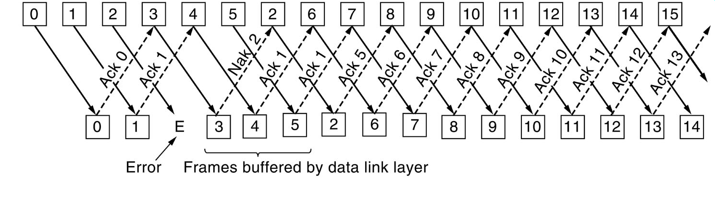
Basic idea of protocol 6
Protocol 6 accepts frames out of order but passed packets to the network layer in order.
  Receives all frames whose sequence number fall within the receiving window
  Doesn’t pass the frame to the network layer until all the lower-numbered frames have already been delivered to the network layer in the correct order.

Slide 38
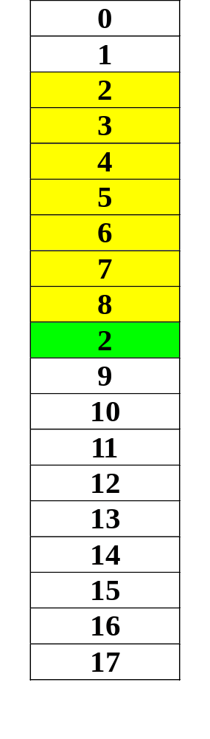
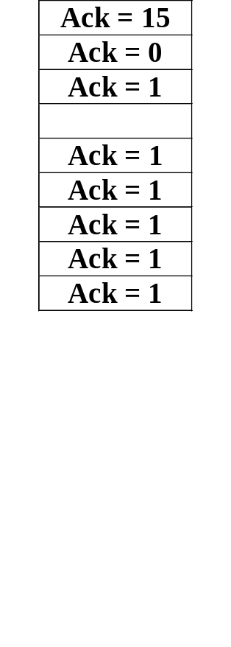
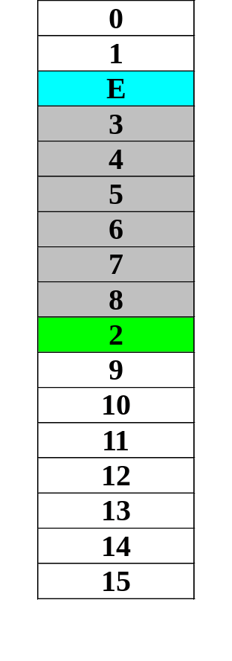
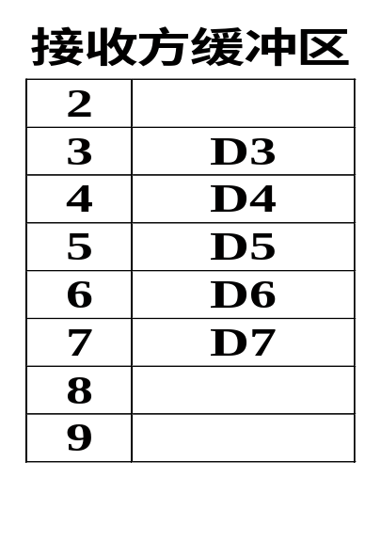
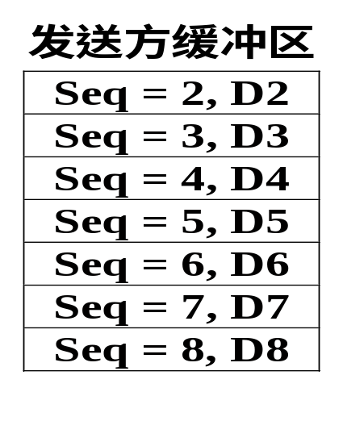
An example：
接收方收到非期望的正确帧－缓存
发送
接收方期望接收seq2，缓存其后的正确帧。
确认

Slide 39
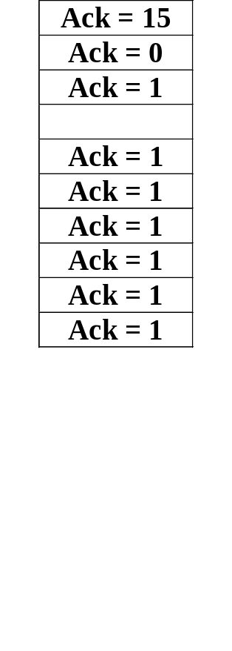
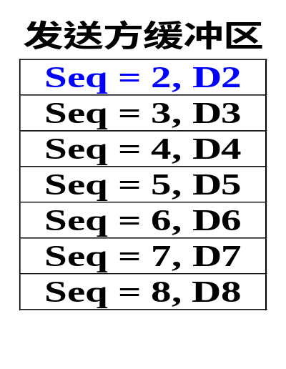
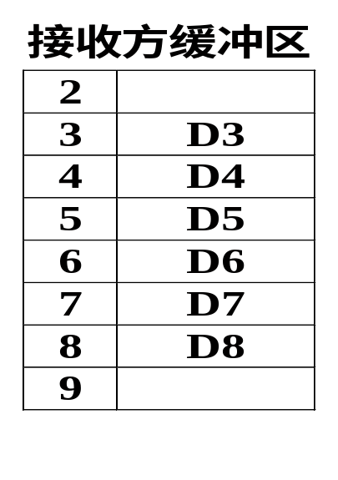
An example：
发送方选择帧seq2重传
发送
确认

Slide 40
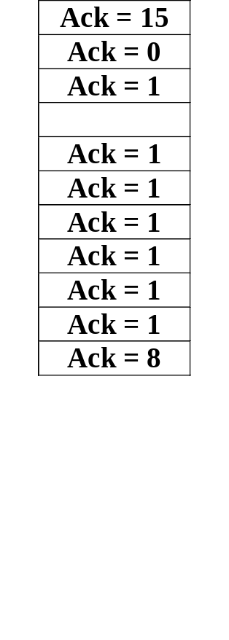
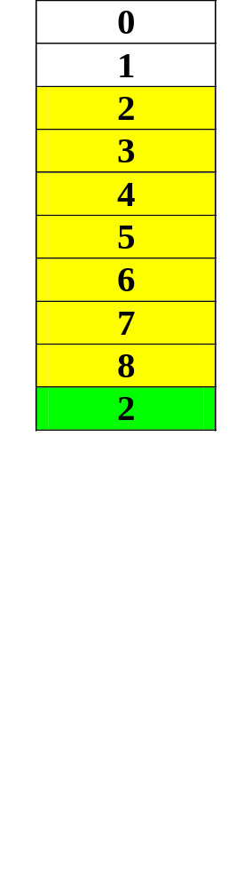
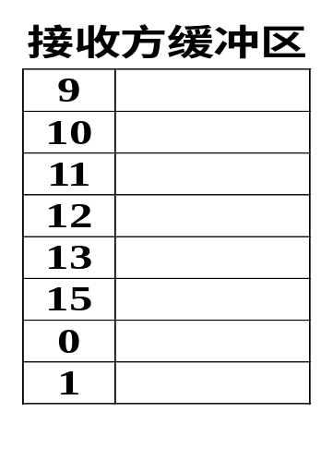
An example：
接收方收到重传帧seq2－排序上交
发送
将帧seq2和接收方缓冲区中的帧正确排序，提交网络层，回送ack=8，滑动接收窗口。
确认

Slide 41
Function of NAK
Negative acknowledgement (否定确认)
More efficient than protocol 5
  Send back NAK for wrong frame to sender，force sender resend the frame immediately instead of timeout

Slide 42

Comparison of error control policy and decision of sliding-window size

Slide 43
Comparison of protocol 5&6
Go back n (protocol 5)
  Sender needs large buffer
  Repeat rate is large (waste bandwidth)，suit for low-error rate environment
Selective repeat (protocol 6)
  Receiver needs large buffer
  Repeat rate is small，suit for bad-quality channel

Slide 44
Decision of sliding-window size
Protocol 5（回退n帧）
  MAX_SEQ = 7（ Seq=0～ MAX_SEQ ）
  W = 7
  W = MAX_SEQ (sending-window)
Protocol 6（选择重传）
  MAX_SEQ =7（ Seq=0～ MAX_SEQ ）
  W = 4
  W= (MAX_SEQ + 1) / 2 (receiving-window)

Slide 45
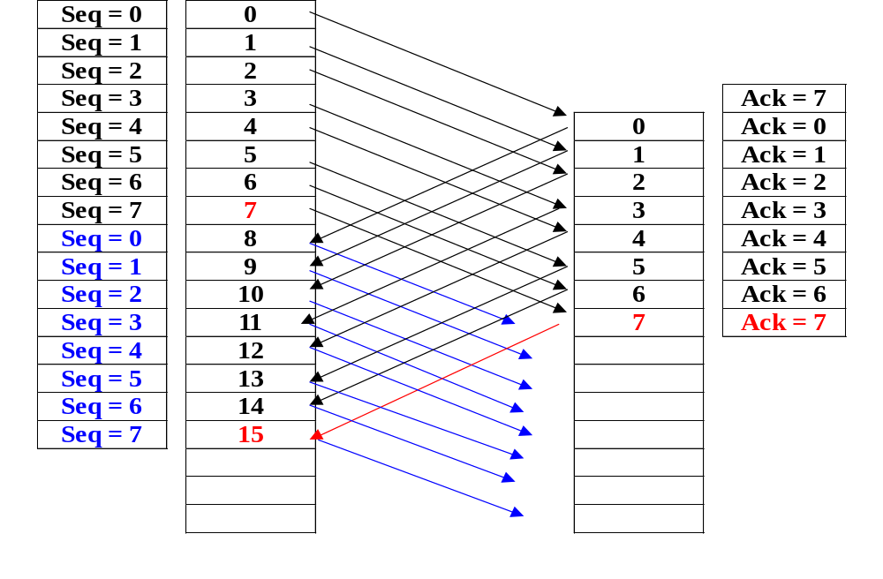
Protocol 5：W = 8，abnormal
接收方有可能不立即确认接收帧，捎带确认ack=n，意味着n-1, n-2也被确认。
收到ack=7，本是帧7的确认，被判定为帧15的确认，误认为第二窗口发送成功，开始发送后续帧。
第二个窗口发送的数据帧全部丢失。

Slide 46
Protocol 5：W = 7，abnormal
Seq = 0
0
Seq = 1
1
Seq = 2
2
连续发送帧0~6
Seq = 3
3
Ack = 7
Seq = 4
4
0
Ack = 0
Seq = 5
5
1
Ack = 1
Seq = 6
6
2
Ack = 2
Seq = 7
7
3
Ack = 3
Seq = 0
8
4
Ack = 4
Seq = 1
9
5
Ack = 5
连续发送帧7~13
Seq = 2
10
6
Ack = 6
Seq = 3
11
Seq = 4
12
Seq = 5
13
14
收到ack=6，从seq=7开始重传第二窗口的数据帧，不会误认为第二窗口发送成功。
第二个窗口发送的数据帧全部重发。

Slide 47
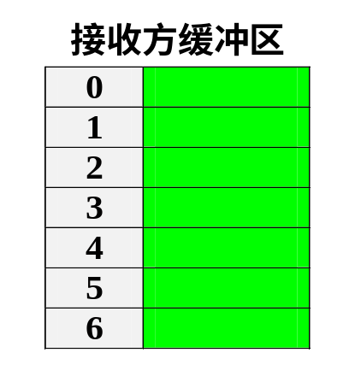
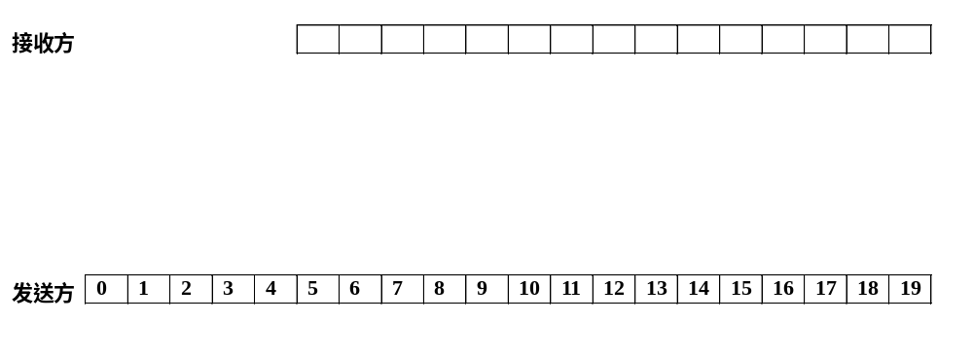
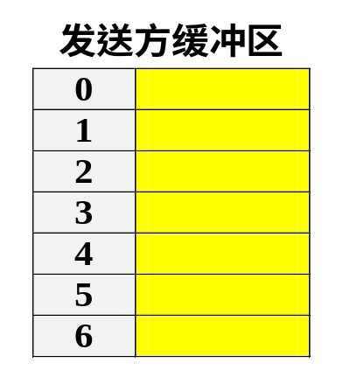
Protocol 6：W=7，初始缓冲区空

Slide 48
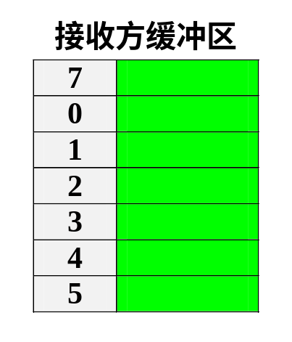
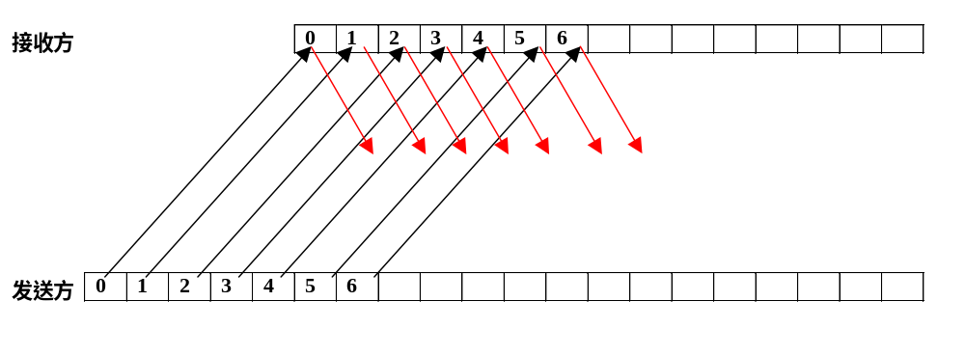
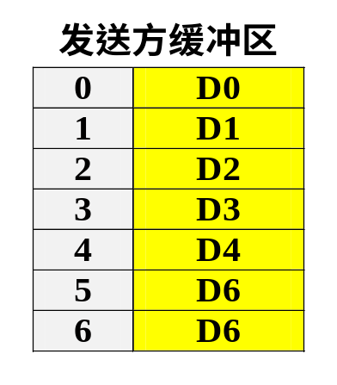
协议6：帧0~6发送成功、正确接收
帧0~6上交网络层，回送确认，接收窗口滑动。
帧0~6的确认丢失！
发送帧0~6等待确认。

Slide 49

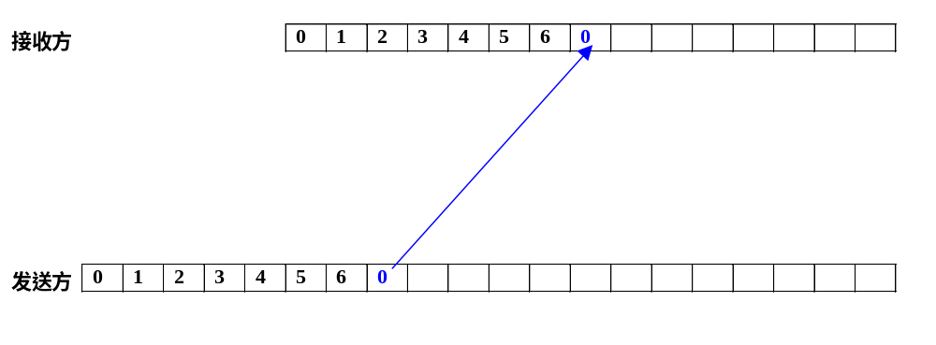

协议6：帧0超时重传并被正确接收
重传帧0正确到达，seq=0在可接收范围，被接收在缓冲区内，回送ack=6。
帧0超时，被重传。

Slide 50
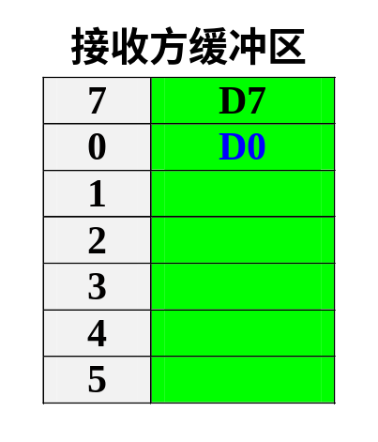
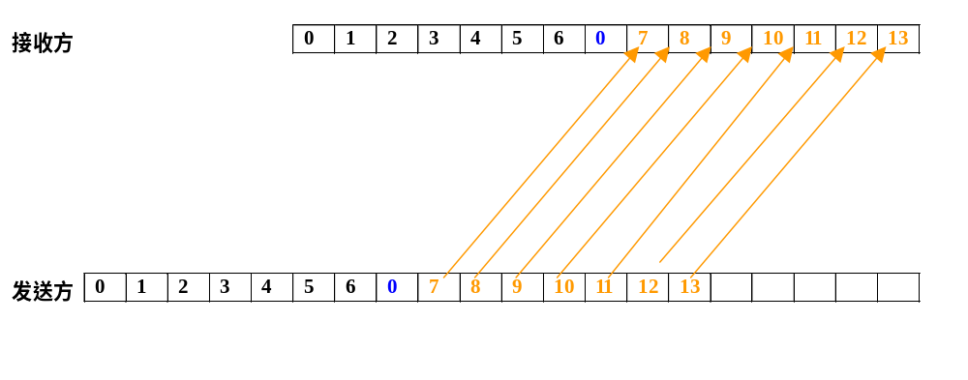
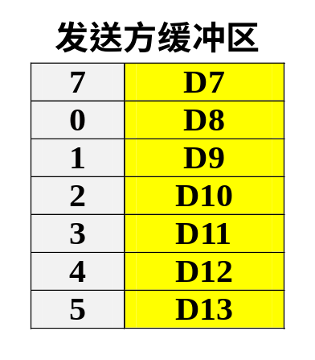
协议6：帧0被重复提交
第7帧正确提交，重传帧0被认为是正确帧提交，出现重复提交错误。
收到第6帧的确认，认为0～6被正确接收，发送第7～13帧。

Slide 51
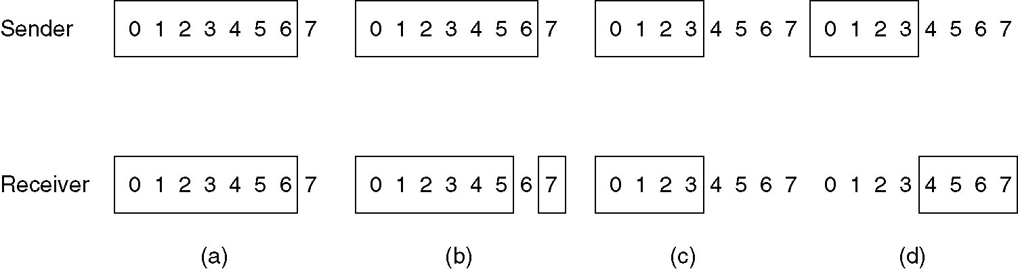
解决办法：保证新老窗口不重叠
MAX_SEQ=7
W = 7
W = 4
新老窗口重叠
新老窗口不重叠

Slide 52
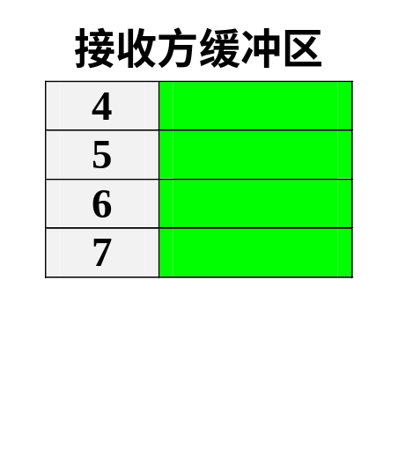
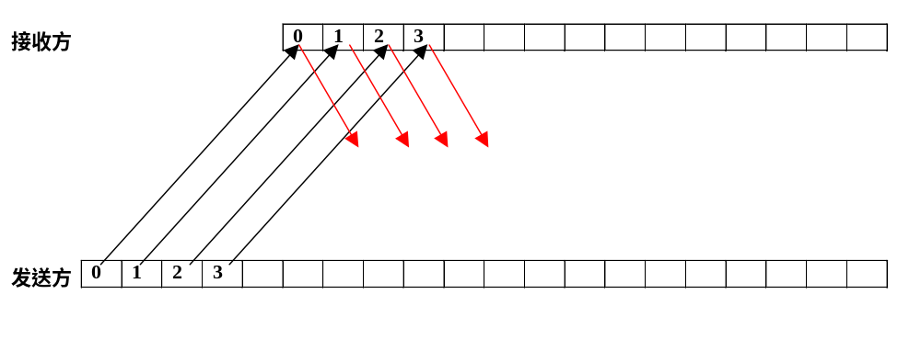
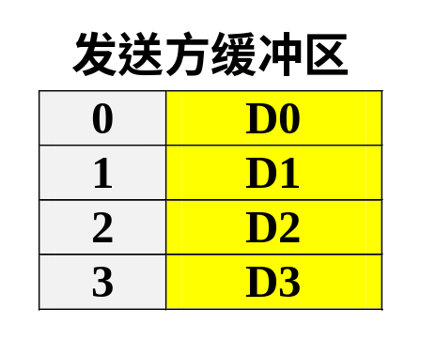
Protocol 6：W=(MAX_SEQ+1)/2
帧0～3的重传帧落在接收窗口外，被拒绝，不会出现重复提交错误。
帧0~3上交网络层，回送确认，接收窗口滑动。
帧0~3的确认丢失！
发送帧0~3等待确认。

Slide 53
W-Size difference of 3 protocol
One-Bit sliding window (protocol 4):
  0 <= size of Sending window<=1
  size of receiving window=1
Go-back-N (protocol 5)：
  0 <=size of Sending window<=MAX_SEQ
  size of receiving window=1
Selective Repeat (protocol 6)：
  0 <= size of Sending window<= (MAX_SEQ+1)/2
  size of receiving window= (MAX_SEQ+1)/2

Slide 54
Summary of this lecture
Learn 6 elementary DLL protocol
Learn & master sliding-window
Learn & master ARQ（自动重复请求）/PAR
Learn & master piggybacking(捎带确认)
Learn pipeline
Go back n & selective repeat

