Slide 1
COMPUTER NETWORKS
- Chapter4 Medium Access Control Sublayer 1
王昊翔
WANG Haoxiang
hxwang@scut.edu.cn
School of Computer Science & Engineering
国家双语教学试点项目 广东省精品课

Slide 2
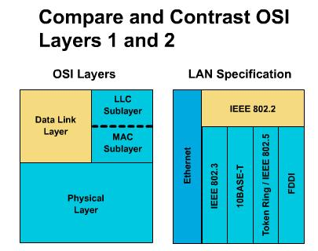
Position of MAC sublayer
Medium Access Control

Slide 3
Main content of this chapter
Multiple access protocol
A real system(LAN): Ethernet
IEEE802.3
Data Link Layer Switching
Bridge
switch

Slide 4
Contents of this lecture
Learn random access protocol(随机访问协议)
Master pure ALOHA and slotted ALOHA
Master the characteristics of each type of CSMA
1-P CSMA
CSMA/CD
Learn collision-free protocol (无冲突的协议)
Bit-Map
Binary Countdown

Slide 5
The problem of Broadcast network
Data communication
Unicast（单播）：One - to - One
Broadcast（广播）：One - to - Everyone
Multicast（组播）：One - to - A group
In any broadcast network, the key issue is how to allocate a single broadcast channel among multiple competing users.
Broadcast channels are sometimes referred to as multiaccess channels or random access channels.

Slide 6
What is MAC?
The protocol used to determine who goes next on a multiaccess channel belong to sublayer of the data link layer called the MAC(Medium Access Control) sublayer
The MAC sublayer is especially important in LANs, many of which use a multiaccess channel as the basis for communication.

Slide 7
Allocating channel
There are two methods of allocating channels:
static allocation
the channel is like a circuit – only one person is allowed to use it.
unused bandwidth will be lost （wasted）
dynamic allocation
the channel is open, with some computers being able to access unused bandwidth from others.
there is no dedicated bandwidth

Slide 8
Static allocation
FDM（频分多路复用Frequency Division Multiplexing）
TDM（时分多路复用 Time Division Multiplexing）

Slide 9
Problem of Static Channel Allocation
Under what circumstances FDM is efficient ?
When there is only a small and fixed number of users, and each of which has a heavy (buffered) load of traffic
What's the problem with FDM ?
If fewer than N users are currently interested in communication, some portions of spectrum will be wasted.
If more than N users want to communicate, some of them will be denied permission
Even the number of users is N and constant, when some users are quiescent, no one else can use their bandwidth so it is simply wasted.
For bursty data traffic (peak traffic to mean traffic ratio of 1000:1), the allocated small subchannel will be idle most of the time but unable to handle the peak traffic.

Slide 10
Poor Performance Of Static FDM
Without FDM
channel capacity C bps
arrive rate λframes/sec
mean frame length 1/μbit/frame
mean time delay T
With FDM
divide into N subchannels
each subchannel capacity C/N bps
Mean input rate λ/N
Precisely the same arguments that apply to FDM also apply to time division multiplexing (TDM).

Slide 11
Dynamic Channel Allocation
Before we get to dynamic allocation, we have to consider 5 key assumptions:
Station Model
Single Channel Assumption
Collision Assumption
Continuous/Slotted Time
Carrier/No Carrier Sense

Slide 12
1 – Station Model
The model consists of N independent stations (also called terminals).
Each station generates frames for transmission.
Once a frame has been generated, the station is blocked and does nothing until the frame has been successfully transmitted.

Slide 13
2 – Single Channel Assumption
It is the heart of the model.
A single channel is available for all communication.
As far as the hardware is concerned, all stations are equivalent.
But protocol software may assign priorities to different stations.

Slide 14
3 – Collision Assumption
If two frames are transmitted at the same time, they will “collide”.
In a collision, both frames are completely lost.
A collided frame must be retransmitted again later.
All stations can detect collisions.
There are no errors other than collisions.

Slide 15
4 – Continuous/Slotted Time
Continuous Time
Time is treated as a continuum.
Time is not divided into discrete intervals.
Frame transmission can begin at any instant.
Slotted Time
Time is divided into discrete intervals (slots).
Frame transmissions always begin at the start of a slot.
A slot may contain 0, 1, or more frames.
0 frames = idle slot
1 frame = successful transmission
2+ frames = collision
Some systems use one and some systems use the other. But for a given system, only one of them holds.

Slide 16
5 – Carrier/No Carrier Sense
Carrier sense（载波侦听）
Stations can tell if the channel is in use before sending
If the channel is sensed as busy, no station will attempt to use it until it goes idle.
No carrier sense （非载波侦听）
Stations do not sense the channel before trying to use it.
Only later can they determine whether the transmission was successful.
LANs generally have carrier sense.
Note that the word ''carrier'' in this sense refers to an electrical signal on the cable.

Slide 17
Multiple access protocol
Random Access Protocol（随机访问协议）
Characteristic：compete using channel, maybe result in collision
Typical random access protocol
ALOHA
Pure ALOHA；slotted (分隙,分槽）ALOHA
CSMA
CSMA/CD（Ethernet）
受控访问协议（ Controlled Access ）
Characteristic：is allocated channel, no collision

Slide 18
ALOHA Protocol
Norman Abramson and his colleagues at the university of Hawaii devised in the 1970s
Two version
Pure ALOHA
Slotted ALOHA (分隙ALOHA协议)

Slide 19
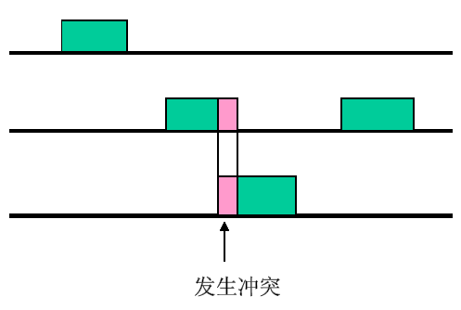
Basic idea of Pure ALOHA（1/2）
Let users transmit whenever they have data to be sent. （想发就发）
A sender can always find out whether or not its frame was destroyed by listening to the channel output .（冲突检测）
If the frame was destroyed, the sender just waits a random amount of time and sends it again.（重发）

Slide 20
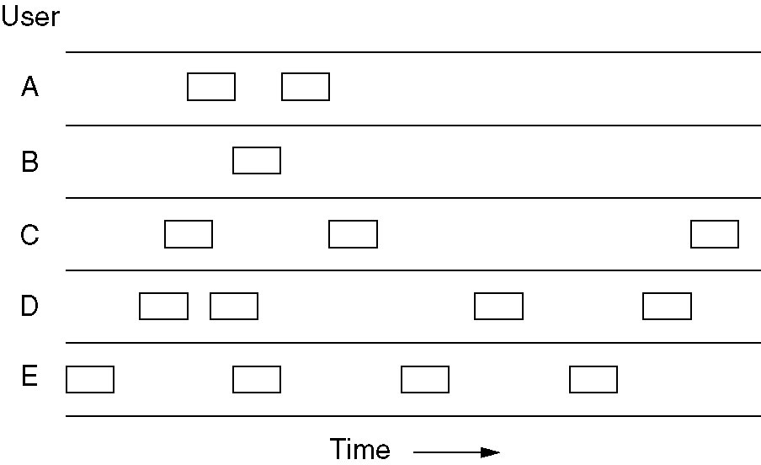
Basic idea of Pure ALOHA（2/2）
标准帧（固定长度）
帧时 t
Frame time
冲突，帧被损坏
Can send data whenever
Collision is unavoidable if ≥2 staions send data at the same time

Slide 21
Mathematical description of pure ALOHA
Frame time(T): the amount of time needed to transmit the standard, fixed length frame(标准帧).
Assume: new frame is generated according to Poisson distribution (服从泊松分布)
New frame per frame-time (users generate)： N (mean value)
New frame per frame-time（Channel generate）：G (mean value)
Analysis：
0< N < 1; low-load N~0; heavy-load N~1
G >= N; low-load G=N（no collision），heavy-load G>N（retransmit）
Probability
Pr[k] = G^{k}e^{-G} / k! (一个帧时内信道中产生k个帧，泊松分布)
Pr[k=0] = e^{-G} （一个帧时内信道中产生0个帧）

Slide 22
How is the efficiency?
Throughout(吞吐率) is S
Is just offered load, 0<S<1
If S = 1, frame is sent one by one, there is no slot between sent-frame.
S value shows line-utility

Slide 23
How is the efficiency? (cont’d)
Carried load(运载负载,网络负载) G
The number of the frame generated by all stations (including retransmitted frame )
Apparently，G≧S，
G=S, only if no collision
G>>1，collision is occurred frequently
P₀：P₀ is the probability which frame sent successfully (no collision).

Slide 24
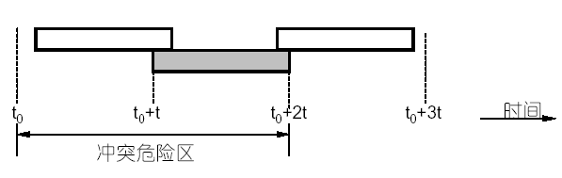
How to get P₀ ?
Dangerous period of collision ：2t
Generated frame(mean)：2G
Probability of no collision：
P₀ = e^{-2G}（why？）

Slide 25
Performance of pure ALOHA
Put P₀= e^{-2G} into S = GP₀：
S = Ge^{-2G}
Calculate the maximum of S：
S′= e^{-2G}–2Ge^{-2G}= 0
When G = 0.5，S ≌0.184
That is: the maximum line-utility is 18.4%

Slide 26
Slotted ALOHA(时隙ALOHA)
Time is divided up into discrete intervals, each interval corresponding to one frame-time.
An interval is the time which is used to transmit a frame
A terminal (station) is not permitted to send until the beginning of the next slot (interval)
Collision can only be occurred at the very beginning of interval (slot)
Once a station compete successfully, and then no collision during this slot(interval)

Slide 27
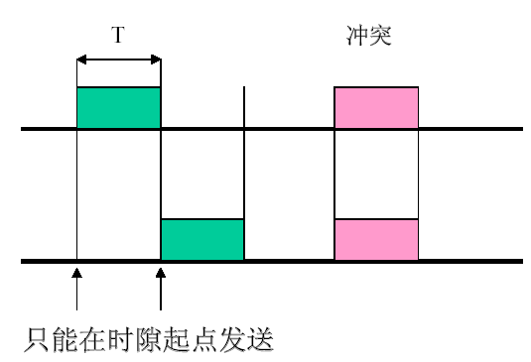
Slotted ALOHA

Slide 28
Performance of slotted ALOHA
P[0] = e^{-G}
P₀ = P[0] = e^{-G}（why？）
S = Ge^{-G}
When G = 1, S can get maximum：
S_{max}= 1/e ≌0.368
So, the efficiency double the pure ALOHA

Slide 29
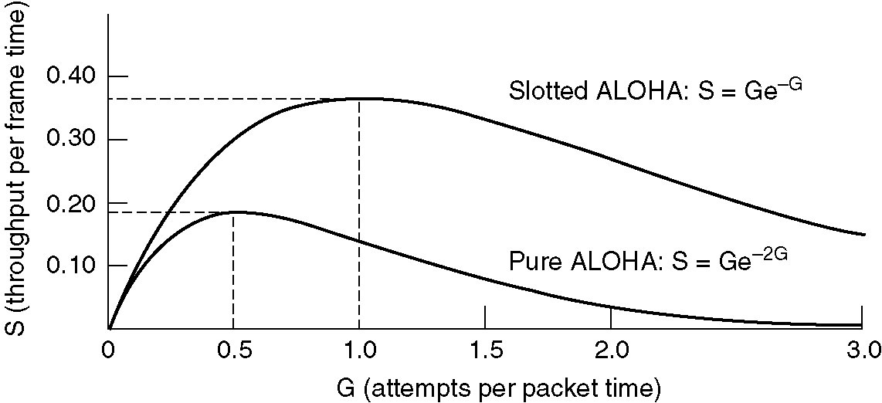
The relation between S and G
1/e = 37%
1/2e = 18%

Slide 30
Brief summary
Pure ALOHA
Dangerous period of collision
Time length：2t
Generated frame (mean)：2G
Probability of no collision：P₀ = e^{-2G}
Throughput：S = G P₀ = G e^{-2G}
Slotted ALOHA
Frame-time T is discrete interval
Dangerous period of collision ：t
Throughput ：S = G P₀ = G e^{-G}

Slide 31
Comparation of pure ALOHA and slotted ALOHA
Pure ALOHA:
A Frame is sent at once when it is generated
Collision may be occurred all the time
Slotted ALOHA
Frame is sent only at the very beginning of interval
Frame is sent successfully once no collision is occurred at the beginning of interval (slot)

Slide 32
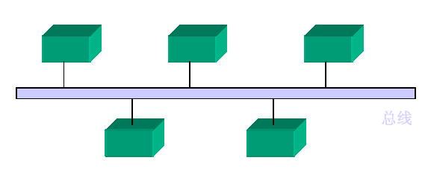
Carrier Sense Protocols
CSMA：Carrier Sense Multiple Access
Characteristic：“先听后发”
Improve ALOHA
Types
Non-persistent CSMA
Persistent CSMA
1-persistent CSMA
P-persistent CSMA

Slide 33
Non-persistent CSMA
Basic idea：
①A station sense channel, if no one else is sending, then it begin sending
②If the channel is already in use, it doesn’t sense it ,instead, it waits a random time and repeats①。
Advantage: Waiting a random time can reduce the probability of collision
Disadvantage: longer delay (random time, maybe no data is transmitted )

Slide 34
Persistent CSMA (1-persistent)
Basic idea：
① A station sense channel, if no one else is sending, then it begin sending
②If channel is busy, the station waits and sense it continually, once the channel becomes idle, it begin transmitting
③If collision is occurred, waits a random time and repeats①。
Advantage: shorter delay than non-persistent
problem：if 2 or more stations are wait at the same time, once the channel becomes idle, the collision is unavoidable.

Slide 35
P-persistent CSMA
Basic idea:
① A station sense channel, if no one else is sending, then it transmits with probability p, and delay one unit-time to transmit with probability (1–p)
② If channel is busy, the station waits and sense it continually, once the channel becomes idle, repeats①。
③If a station has delayed its transmission 1 unit time, repeat①。
So, 1-persistent is a special example of p-persistent

Slide 36
Question
For 1-persistent CSMA, if a station send its data after sensing the channel is idle, can a collision be occurred?
Key: yes!
Cause：
2 or more stations send data at the same time
Propagation (传播延迟时间)
Propagation-speed is 0.65C, about 200m/μs

Slide 37
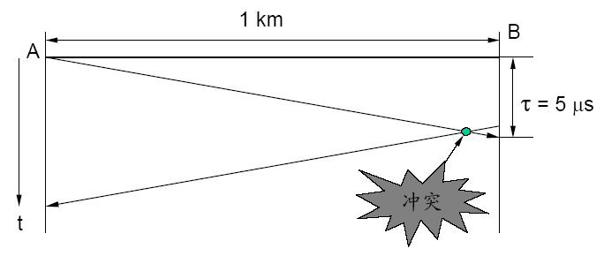
Influence of propagation
这里A的最大窗口是10μs

Slide 38
How to compute collision window
Assume：signal’s propagation speed v is about: v = 200m /µs，NIC delay is t_{PHY}，then：
t= S/v，
Collision window (slot time)= 2t + 2t_{PHY}，
If repeater is used, assume delay caused by repeater is t_{中继器}, then:
Collision window (slot time)= 2*(t + t_{PHY}+ N×t_{中继}）

Slide 39
CSMA/CD
CSMA with Collision Detection (Carrier Sense Multiple Access with Collision Detection)
“先听后发、边发边听”
Basic idea：
① A station sense channel, if no one else is sending, then it begin sending.
② If channel is busy, the station waits and sense it continually, once the channel becomes idle, send data at once.
③If collision is occurred, aborts its transmission, and waits a random time and repeat①。

Slide 40
Characteristic of CSMA/CD
All station receive signal of itself while sending, so, the station detects a collision if signals are different.
Aborts its transmission at once it detect a collision, and send a jam signal in order to notify other stations when there is a collision; All stations need a random time to retransmit again.
Be widely used on LANs in the MAC sublayer

Slide 41
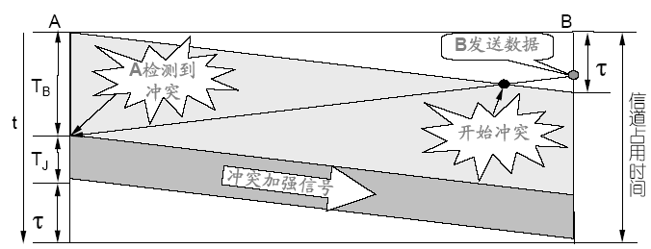
Principle show of CSMA/CD

Slide 42
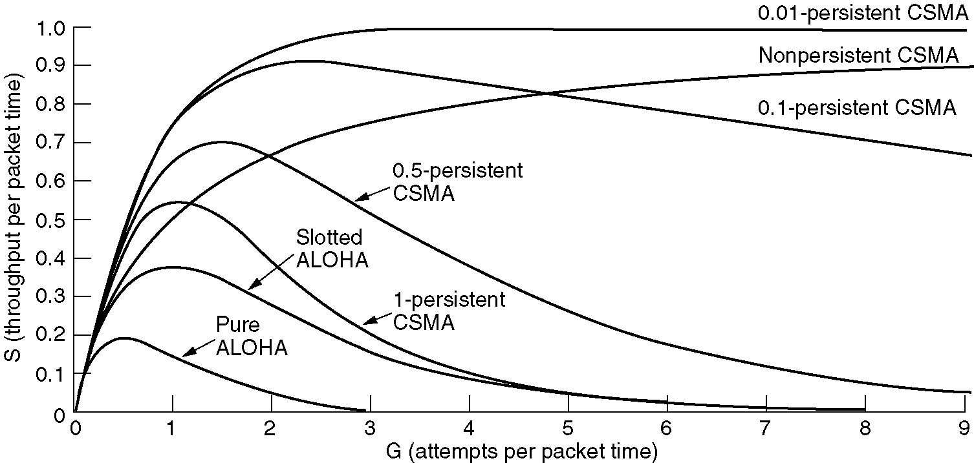
Comparison of performance

Slide 43
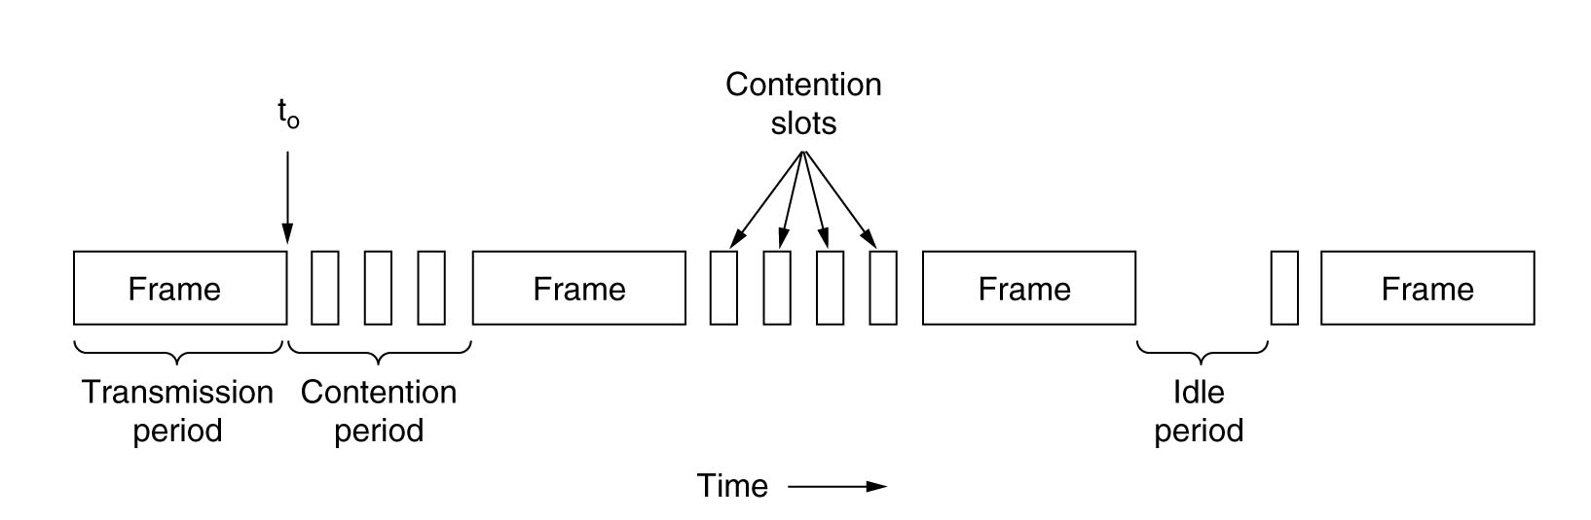
Conceptual model of CSMA/CD
CSMA/CD channel can be in one of three states
Contention
Transmission
idle

Slide 44
Collision detection and processing
Assume the length of time for data to propagate between the two furthest terminals is τ.
If a second terminal begins to transmit at τ – ε, then the maximum amount of time it will take for the sender to notice the collision is 2τ – ε.
The minimum amount of time is when both start transmitting at the same time, making the minimum amount simply τ.

Slide 45
Other Multiple Access Protocol
Collision-Free protocol (无冲突的协议) 考试不用考
A Bit-Map protocol(位图协议,预留协议)
Binary Countdown protocol (二进制倒计数协议)
Limited-Contention protocol (有限竞争协议)
WDMA（波分多路访问协议）
MACAW（无线局域网协议）
MACA：Multiple Access with Collision Avoidance
MACAW ：MACA for wirless

Slide 46
A Bit-Map Protocol
One assumption: there are N stations, each with a unique address from 0 to N –1 ``wired'' into it.
Which station gets the channel after a successful transmission ?
A basic bit-map protocol:
Each contention period consists of exactly N slots, with one slot time being at least 2τ.
If station i (0<= i <= N -1) has a frame to send, it transmits 1 bit during the ith slot; otherwise, it transmits 0 bit during the ith slot.
After all slots have passed by, stations begin transmitting in numerical order.
After the last ready station has transmitted its frame, another N-bit contention period is begun.

Slide 47
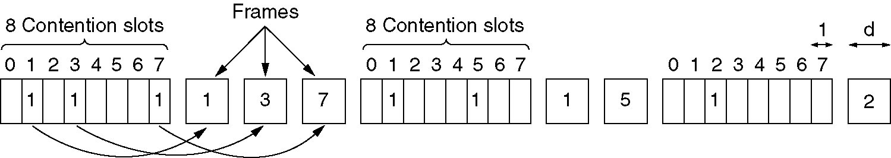
A Bit-Map Protocol (cont’d)

Slide 48
Performance analysis
Assume: time unit is contention bit slot, data frames consisting of d time units and N is the number of stations or slots.
low load: d/(N+d)
high load: d/(d+1)
Mean frame delay (high load): N(d+1)/2
Disadvantage：no priority

Slide 49
Binary Countdown (二进制倒数)
Each station has a binary address. All addresses are the same length.
To transmit, a station broadcasts its address as a binary bit string, starting with high-order bit.
The bits in each address position from different stations are BOOLEAN ORed together (so called Binary countdown).
As soon as a station sees that a high-order bit position that is 0 in its address has been overwritten with a 1, it gives up.
After the winning station has transmitted its frame, there is no information available telling how many other stations to send, so the algorithm begins all over with the next frame.

Slide 50
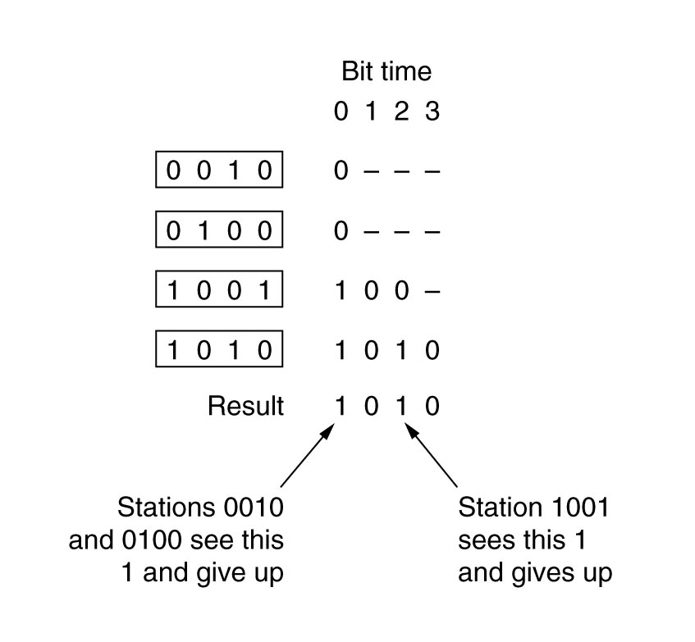
Binary Countdown (cont’d)
Improvement：prevent lower-station from silence long

Slide 51
Efficiency analysis
Bits which N stations address need is log₂N
Efficiency is：d/(d+log₂N)
If first field of frame is address, then efficiency is 100%

Slide 52
Summary
Learn random access protocol(随机访问协议)
Master pure ALOHA and slotted ALOHA
Master the characteristics of each CSMA
1-P CSMA
CSMA/CD
Learn collision-free protocol (无冲突的协议)
A Bit-Map protocol
Binary Countdown
other

Slide 53
Thanks！

