Slide 1
COMPUTER NETWORKS
- Chapter4 Medium Access Control Sublayer 2
王昊翔
WANG Haoxiang
hxwang@scut.edu.cn
School of Computer Science & Engineering
国家双语教学试点项目 广东省精品课

Slide 2
Contents of this lecture
Learn IEEE802 standard
Master Ethernet/IEEE802.3 principle
Master Ethernet/IEEE802.3 frame format
Learn characteristics of Ethernet
*

Slide 3
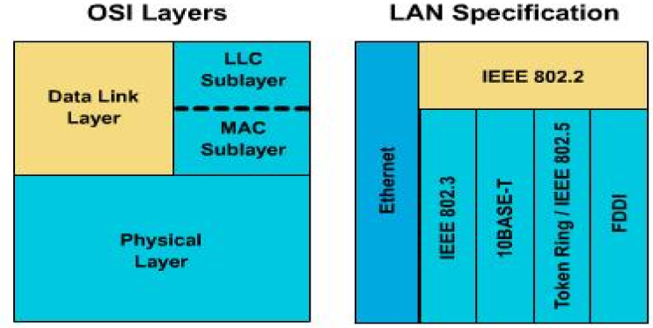
IEEE802.3/Ethernet & OSI RM
*

Slide 4
IEEE Ethernet naming rule
10Base2（IEEE 802.3a）
  –10：baseband（unit: Mbps）
  –Base：baseband transmission (基带传输)
  –2（或5）：support segment （100米为单位，四舍五入）
10Base-TX（IEEE 802.3X）
  –T：copper UTP
  –F：fiber
*

Slide 5
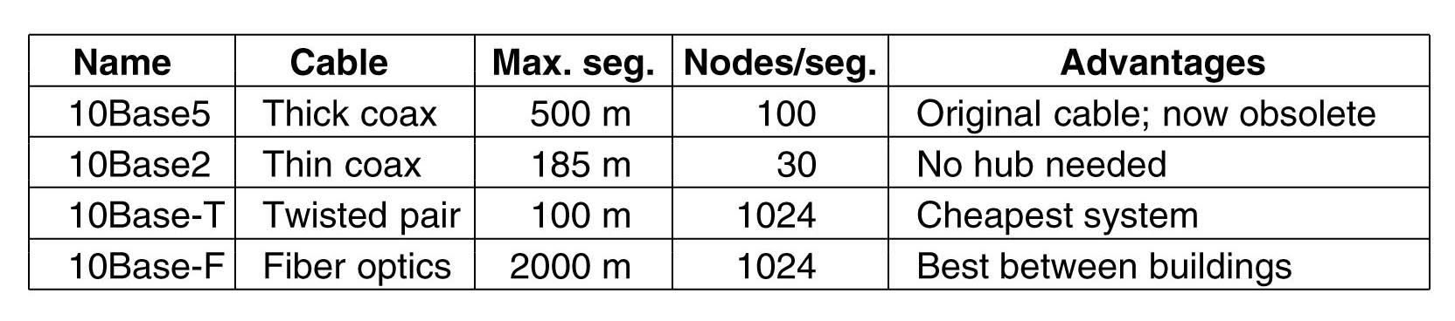
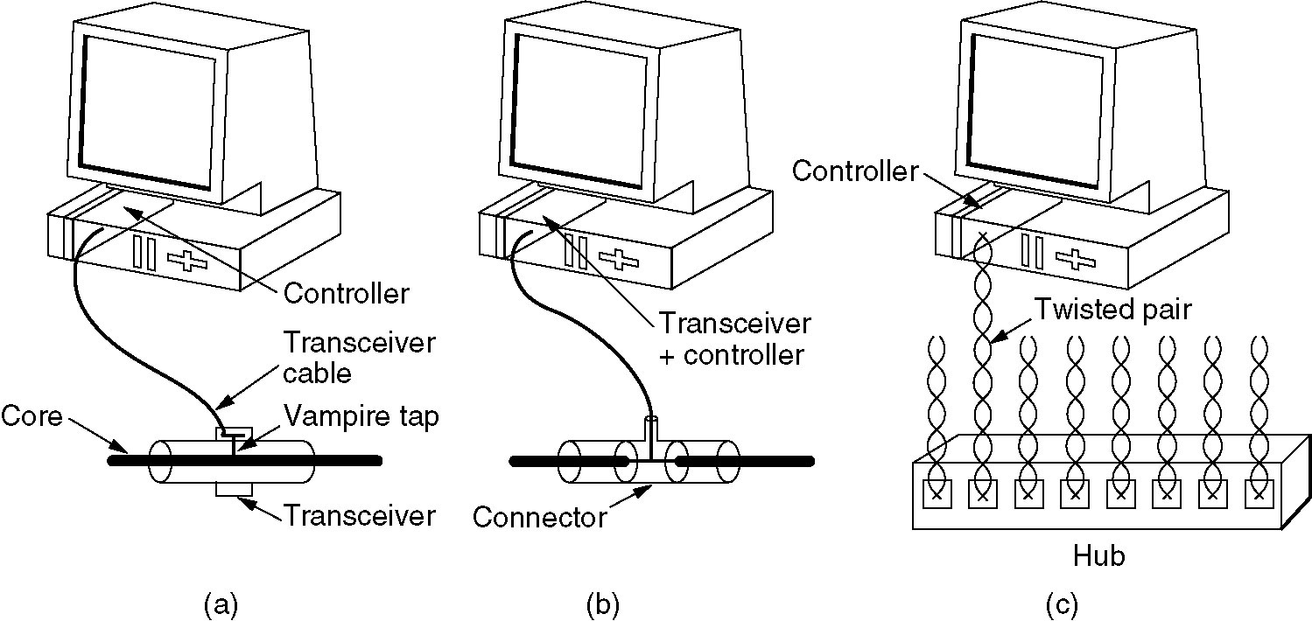
Ethernet cabling
*

Slide 6
Detecting problem in thick or thin coax
Detecting cable breaks, excessive length (超长), bad taps， or loose connector can be a major problem with thick coax or thin coax.
time domain reflectometry （时间域反射计）
  Send pusle
  Timing the interval between sending and receiving the echo
  Localize the origin of the echo
*

Slide 7
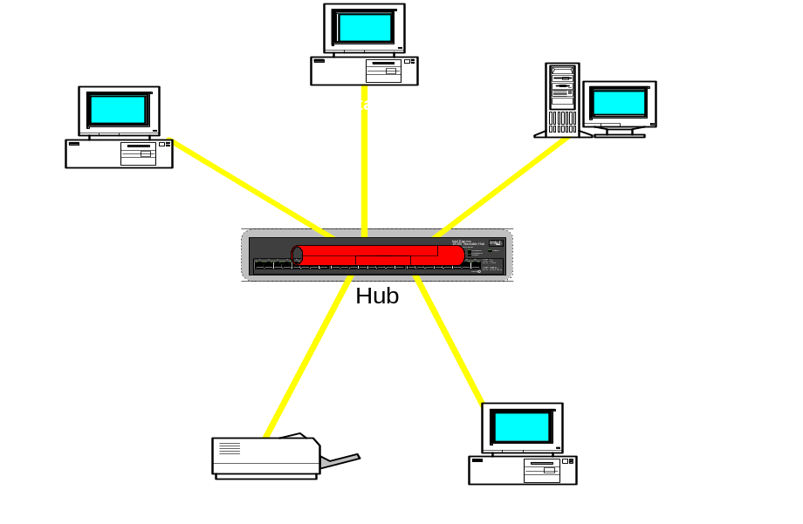
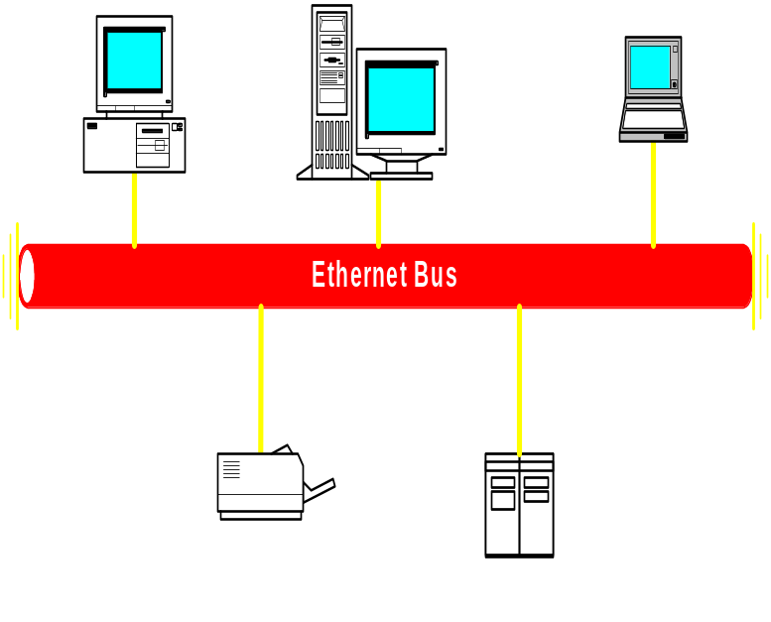
Topology of 10Base-T
Physical topology
Logical topology
Physical topology is star
Logical topology is bus（compete the bus）
*
Notes:
*

Slide 8
Characteristics of 10Base-T
Advantage
  Installation-cost is lower than coax
  Plug and play, constructing network is flexible
  Star topology, easy to separate trouble
  open
Problem
  Many users share a 10M bus (channel)
*
Notes:
*

Slide 9
Ethernet encoding
None of the Ethernet versions use straight binary encoding with 0 volts for a 0 bit and 5 volts for a 1 bit since it leads to ambiguities: it cannot tell the difference between an idle sender (0 volts) and a 0 bit (0 volts).
We can use -1 volts for a 0 and +1 volts for a 1, but this also runs into trouble if the receiver samples the line at a slightly different rate than the sender is sending the data.
What is needed is a way for receivers to unambiguously determine the start, end, or middle of each bit without reference to an external clock.
*

Slide 10
Ethernet encoding(cont’d)
Do not use binary encoding
All Ethernet do use Manchester encoding
  Each bit period is divided into two equal intervals.
  A binary 1 bit is sent by having the voltage set high during the first interval and low in the second one.
  A binary 0 is just the reverse: first low and then high.
  Every bit period has a transition in the middle, making it easy for the receiver to synchronize with the sender.
  But requires twice as much bandwidth as straight binary encoding.
Differentia Manchester encoding
  802.5 does use
*

Slide 11
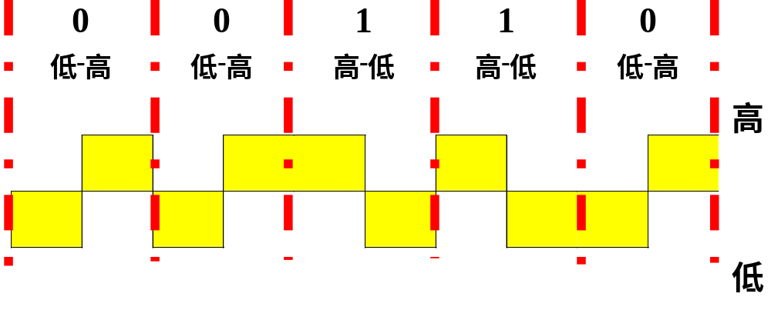
Manchester encoding
  +0.85 volt: high signal
  -0.85 volt: low signal
  0 volt: DC value
Bit rate: b = 10 Mbps
Baud: B = 20 MHz（信号的变化频率）
*

Slide 12
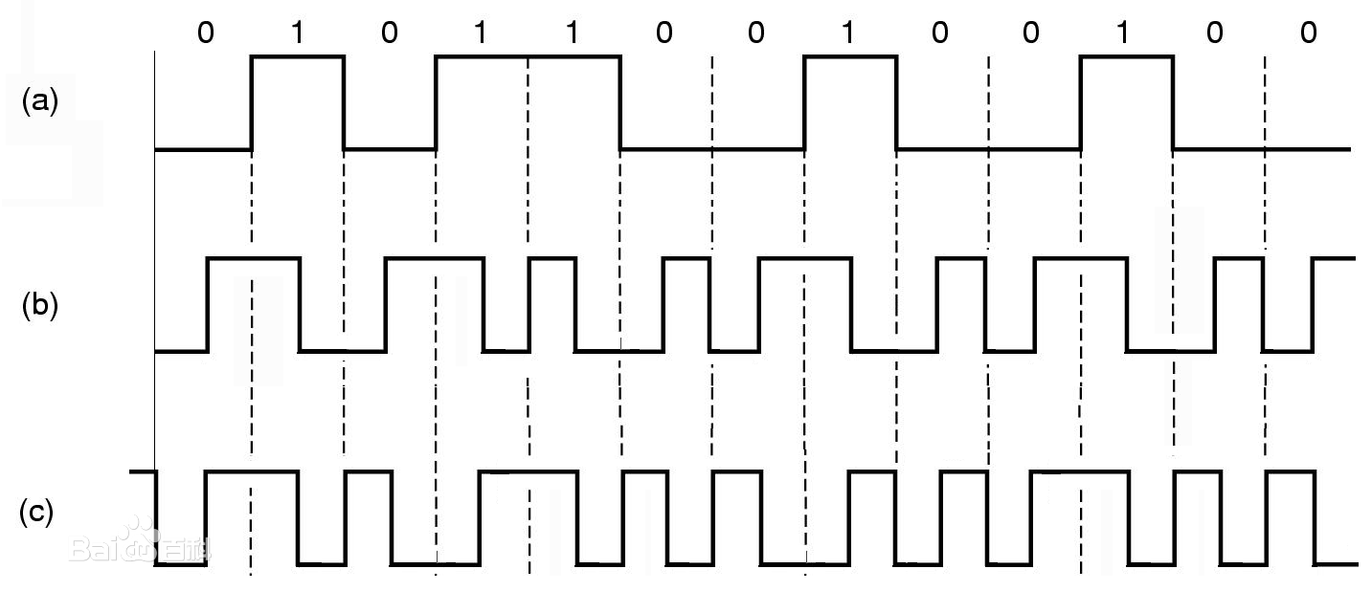
Manchester encoding
*

Slide 13
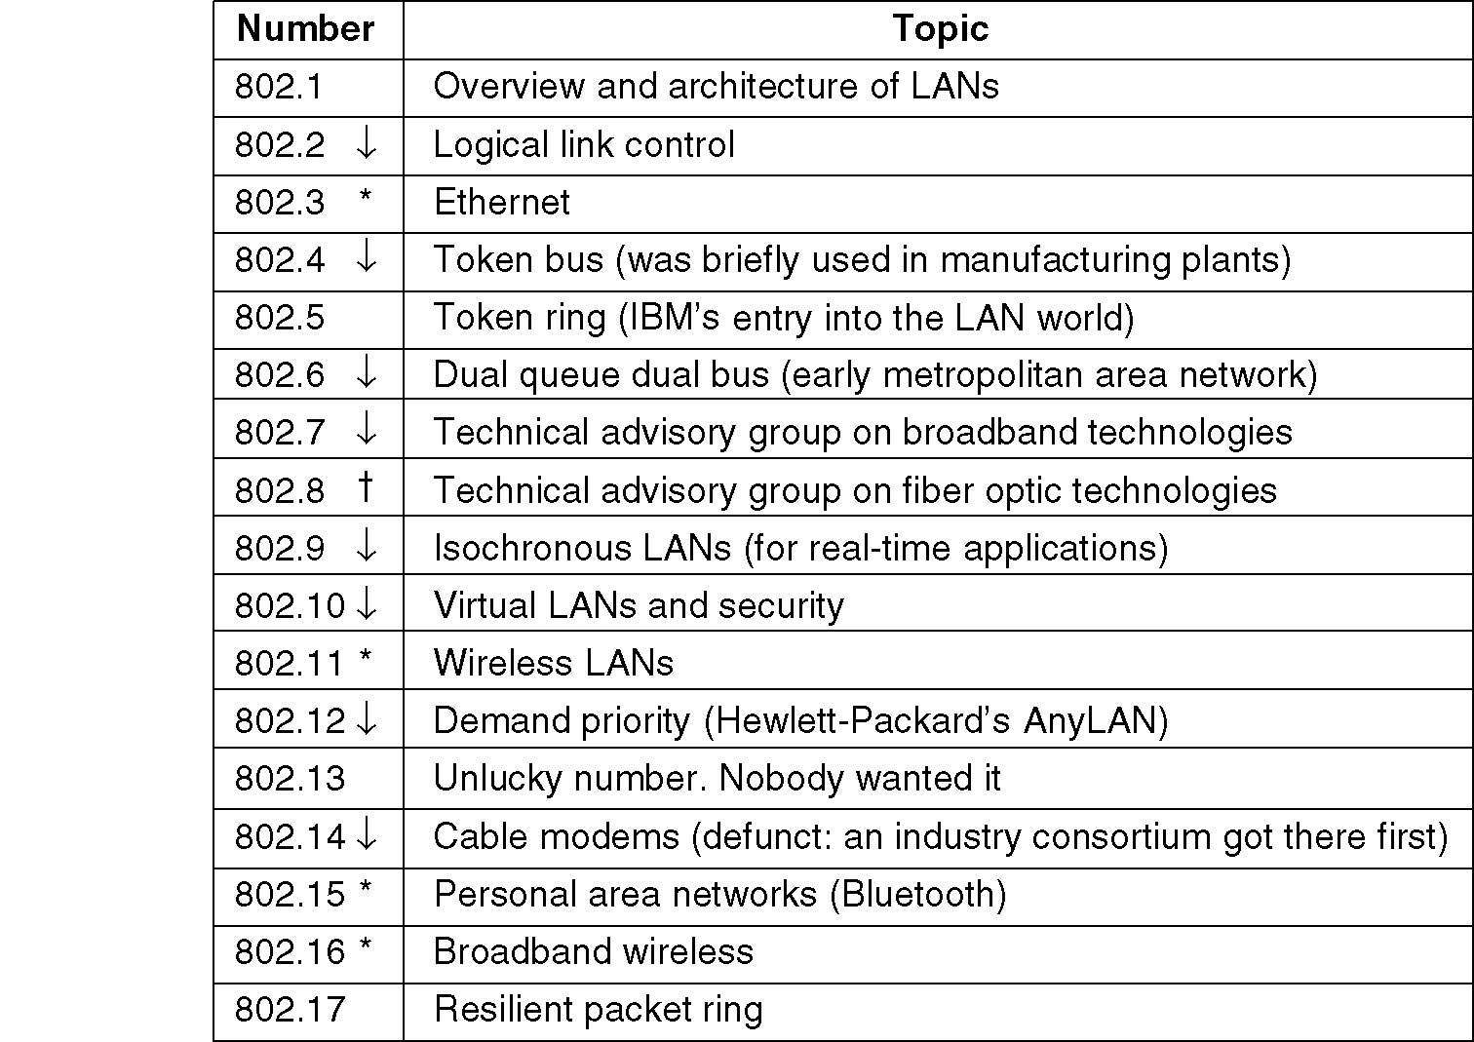
IEEE 802 standard (chapter 1)
*

Slide 14
Ethernet MAC sublayer protocol
There are two different MAC sublayer protocols:
  DIX (DEC, Intel, Xerox)
    was introduced first
    was most widely used
  IEEE 802.3
    was introduced later
    was not so widely used (due to the de facto DIX standard and abundance of available hardware)
  They are close enough that it makes little difference
事实标准
*

Slide 15
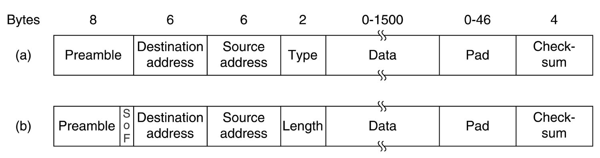
Comparison of IEEE 802.3 and Ethernet frame
(a) Preamble of 8 bytes, each with the bit pattern 10101010. For synchronization between the sender and the receiver.
(b) Preamble of 7 bytes and a Start of frame (SOF) byte containing 10101011 to denote the start of the frame, and it is useful for compatibility with 802.4 and 802.5.
Ethernet
802.3
*

Slide 16
Destination/Source address
10-Mbps baseband standard use only the 6-byte addresses.
  Ordinary address: the high-order bit value is 0.
  Multicast address: the high-order bit value is 1.
  Broadcast address: all bits have a value of 1.
  Local address: assigned by local network administrator, distinguished by the second high-order bit (46) value 0.
    For bit 47, 0 means single station address and 1 means group stations address
  Global address ( about 7 X 10¹³): assigned by IEEE to ensure world wide uniqueness, distinguished by the second high-order bit (46) value 1.
*

Slide 17
MAC address (physical address)
Ethernet MAC Address = Manufacture ID (OUI，Organizationally Unique Identifier ) + NIC ID=24bit + 24bit
First 24 bits：
Cisco 00-00-0c
Novell 00-00-1B、00-00-D8
3Com 00-20-AF、00-60-8C
IBM 08-00-5A
An example
00-60-8C-01-28-12
*

Slide 18
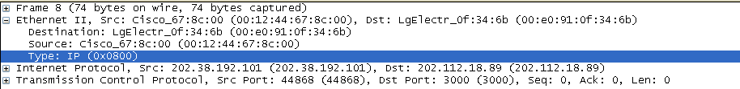
The Type/Length Field
In DIX, the type field specifies which network-layer process to give the frame to (for supporting multi-protocols at network-layer).
  But DIX is the format commonly used, and the field is often used as a type field.
In IEEE 802.3, the length field is the length of the data field.
How to distinguish this field?
  Any number in the field less than or equal to 1536(0x600) can be interpreted as Length, and any number greater than 1536 can be interpreted as Type.
*

Slide 19
Data field
Data field: <= 1500 bytes.
Ethernet requires that valid frames must be at least 64 bytes long.
  Keeping a minimum frame length will result in the sender being able to detect if a collision has occurred by forcing the transmission to take more than 2τ in time.
  where round trip time ~= 50 μsec (the line rate is 10Mbps and the maximum distance is 5km)
If the data portion of a frame is less than 36 bytes, the Pad field is used to fill out the frame to the minimum size.
*

Slide 20
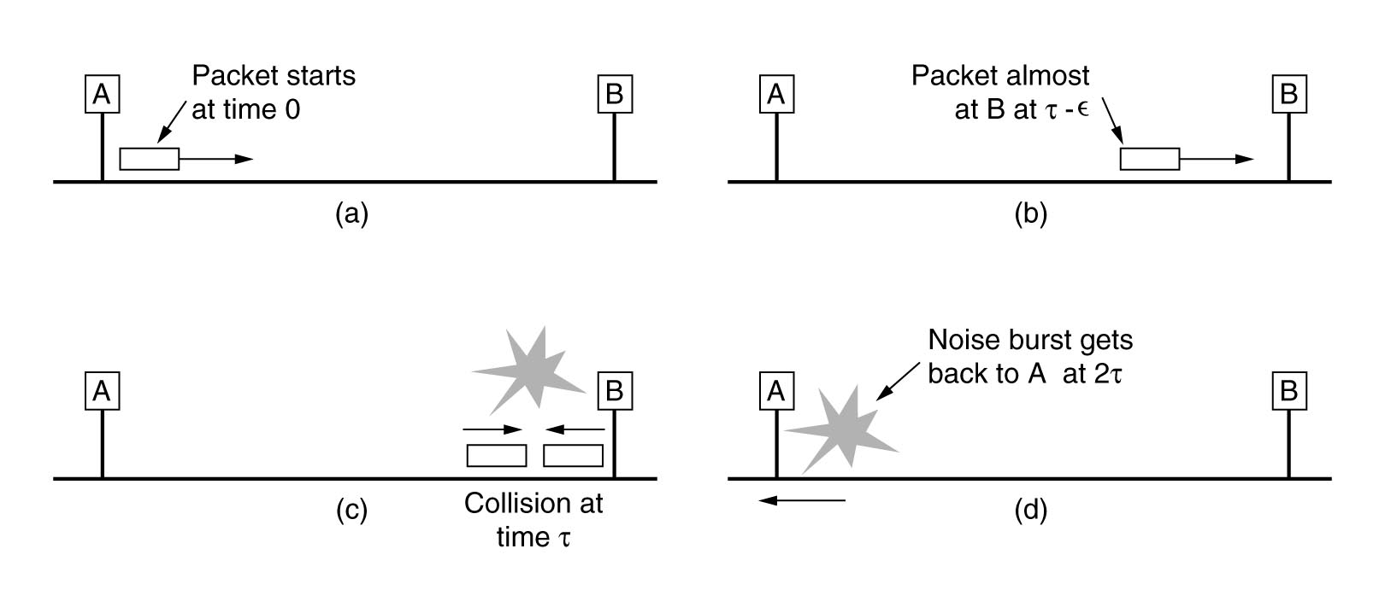
Why length≥ 64 Byte?
CSMA/CD require
  Sending time the frame need ≥ 2τ
Ethernet（802.3），10Mbps LAN
  Time slot：2τ = 51.2μs
  The shortest frame：10Mbps× 2τ/8 = 64 Byte
    或者：（51200/100ns）/8=64Byte
*
Notes:
*

Slide 21
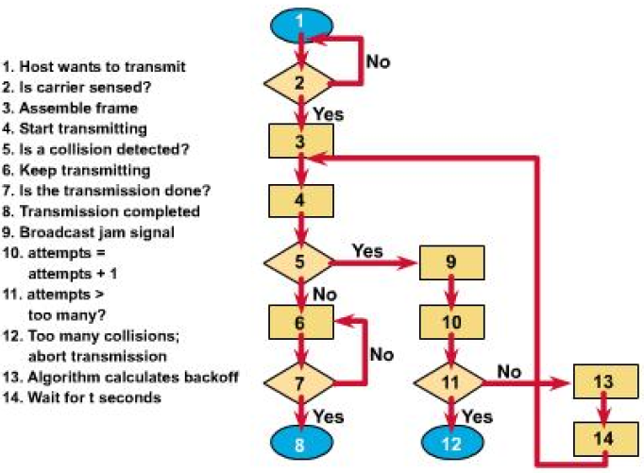
CSMA/CD
先听后发
边发边听
*

Slide 22
Binary Exponential Backoff
二进制指数回退算法
After a collision, the station waits for a random time and try again. How the randomization is done ?
Time is divided into discrete slots whose length is equal to the worst case round trip propagation time (2τ).
  After the first collision, each station waits either 0 or 1 slot time at random.
  After the second collision, each station waits either 0, 1, 2, or 3 slot times at random.
  After i collisions, a random number between 0 and 2^{i} – 1 is chosen, and that number of slots is skipped.
  After 10 collisions have been reached, the randomization interval is frozen at 1023 slots.
  After 16 collisions, the controller gives up and reports failure.
*

Slide 23
Random time
Retry Random Time Range
1 2¹-1 = 0....1 x 51.2_{μsec}
2 2²-1 = 0....3 x 51.2 _{μsec}
3 2³-1 = 0....7 x 51.2 _{μsec}
4 2⁴-1 = 0....15 x 51.2 _{μsec}
5 2⁵-1 = 0....31 x 51.2 _{μsec}
6 2⁶-1 = 0....63 x 51.2 _{μsec}
7 2⁷ -1= 0....127 x 51.2 _{μsec}
8 2⁸ -1= 0...255 x 51.2 _{μsec}
Retry Random Time Range
9 2⁹-1 = 0...511 x 51.2 _{μsec}
10 2¹⁰-1 = 0....1023 x 51.2 _{μsec}
11 2¹¹-1 = 0....1023 x 51.2 _{μsec}
12 2¹²-1 = 0....1023 x 51.2 _{μsec}
13 2¹³-1 = 0....1023 x 51.2 _{μsec}
14 2¹⁴-1 = 0....1023 x 51.2 _{μsec}
15 2¹⁵-1 = 0....1023 x 51.2 _{μsec}
16 2¹⁶-1 = 0....1023 x 51.2 _{μsec}
*

Slide 24
Pay attention
After ith collision：
  When 0 < i ≦10 ，wait ( 0～2^{i}－1) ×2τ
  When 10 < i < 16 ，wait（0~1023） ×2τ
  When i > 16 ，give up sending
*

Slide 25
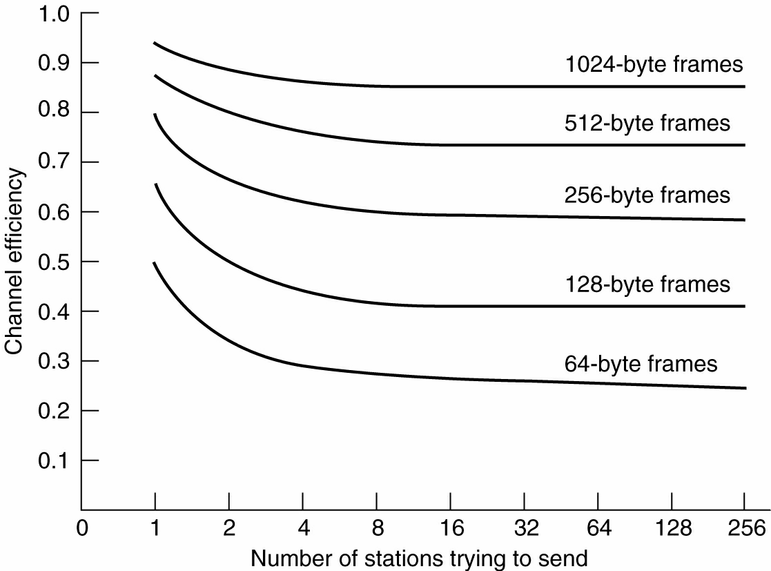
Ethernet performance
*

Slide 26
Typical Ethernet
10base2
10base5
10base-T
Improve performance
  Up to 100Mbps
  Switched network
*

Slide 27
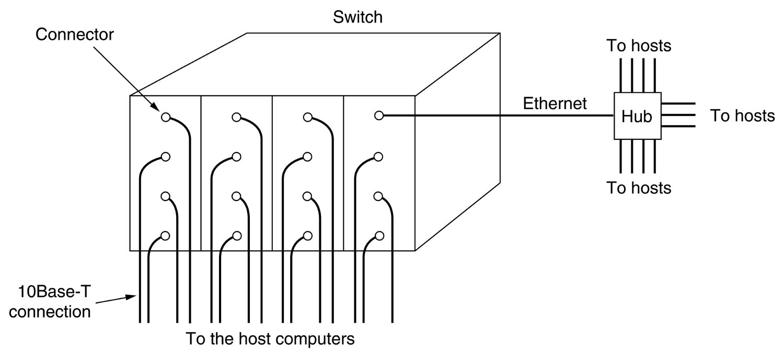
Switched Ethernet
The heart of the system is a switch containing a high-speed (typically over 1 Gbps) backplane and room for multiple plug-in cards (typically 4 to 32)
The plug-in card checks to see if the frame is destined for one of the other stations connected to the same card.
  If so, the frame is copied to the destination station.
  If not, the frame is sent over the high-speed backplane to the destination station's card.
*

Slide 28
Switched Ethernet (cont’d)
What happens if two machines attached to the same plug-in card transmit frames at the same time ?
Case 1: all the ports on the card are wired together to form a local on-card LAN:
  At any instant, only one transmission per card is permitted, but all the cards can be transmitting in parallel.
  Each card forms its own collision domain, independent of the others.
Case 2: each input port can buffer incoming frames in the card's on-board RAM.
  All input ports can receive (and transmit) frames at the same time - parallel and full-duplex.
  Each port is a separate collision domain, so collisions do not occur.
*

Slide 29
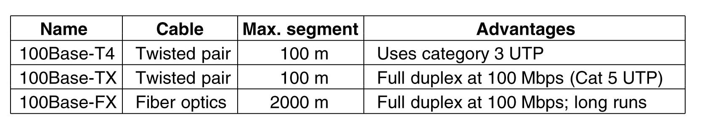
100Mbps Ethernet—802.3u
Fast Ethernet (IEEE 802.3u) was officially approved by IEEE in June 1995.
  backward compatible
    The old packet formats, interfaces, and procedural rules are kept
  Faster
    The bit time is reduced from 100 (10 Mbps) nsec to 10 nsec (100 Mbps).
Fast Ethernet uses hubs or switches to wire up computers, just like 10Base-T wiring.
Fast Ethernet allows the following three types of wire.
*
Notes:
*

Slide 30
Gigabit Ethernet（吉比特以太网）
Gigabit Ethernet (IEEE 802.3z) was ratified by IEEE in 1998.
  backward compatible
  faster than the existing 802.3 and 802.3u standards.
All configurations of Gigabit Ethernet are point-to-point rather than multidrop.
Gigabit Ethernet supports two different modes of operation
  full-duplex: switch-based connection
  half-duplex: hub-based connection
Gigabit Ethernet supports flow control: one end can send a special control frame to the other end telling it to pause for some period of time
*

Slide 31
How to solve？
carrier extension（载荷扩充）
  padding the frame to 512 bytes (8)
  So，the maximum distance can be 200m=25*8
  disadvantage：line utility is low ，just 9%（46/512）
frame bursting （帧串）
  transmit multiple frames in a single transmission
  Improve line utility
*
Notes:
*
被

Slide 32
IEEE802.2
LLC run on top of Ethernet and the other 802 protocols.
LLC hides the differences between the various kinds of 802 networks by providing a single format and interface to the network layer.
LLC provides three service options:
  unreliable datagram service,
  acknowledged datagram service
  reliable connection-oriented service.
The LLC header contains three fields:
  a destination access point
  a source access point
  a control field.
*

Slide 33
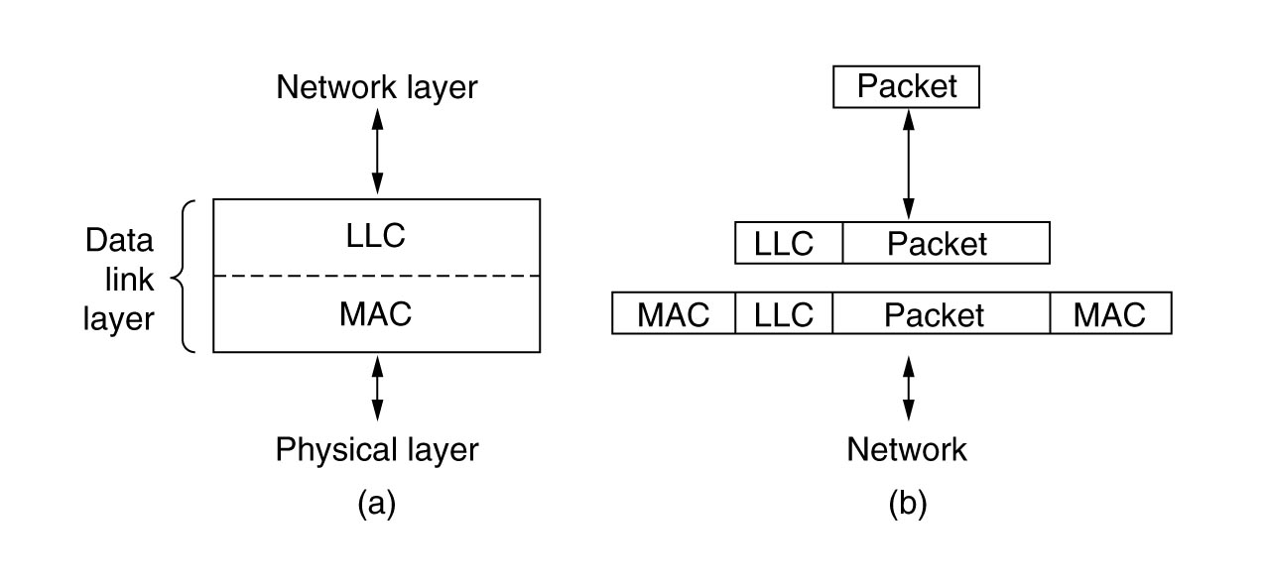
Logical Link Control
*

Slide 34
Summary
Learn IEEE802 standard
Master Ethernet/IEEE802.3 MAC principle
  Binary exponential backoff
Master Ethernet/IEEE802.3 frame format
  Difference
  64byte~1518byte
Learn characteristics of Ethernet
  10Base-T
  Faster Ethernet
*

Slide 35

Thanks！
*

