Slide 1
COMPUTER NETWORKS
- Chapter 4 Medium Access Control Sublayer 3
王昊翔
WANG Haoxiang
hxwang@scut.edu.cn
School of Computer Science & Engineering
国家双语教学试点项目 广东省精品课

Slide 2
Contents of this lecture
Learn basic idea of frame switch (L2 switching)
Master basic principle of L2 switch
Learn bridge
Learn switch

Slide 3
Why are there multiple LANs？
Goal of each department may be different
May be geographically spread over several building
May be necessary to split into separate LANs to accommodate the load
Physical distance between the most distant machines may be too great
In order to improve performance
Bridges can contribute to organization’s security

Slide 4
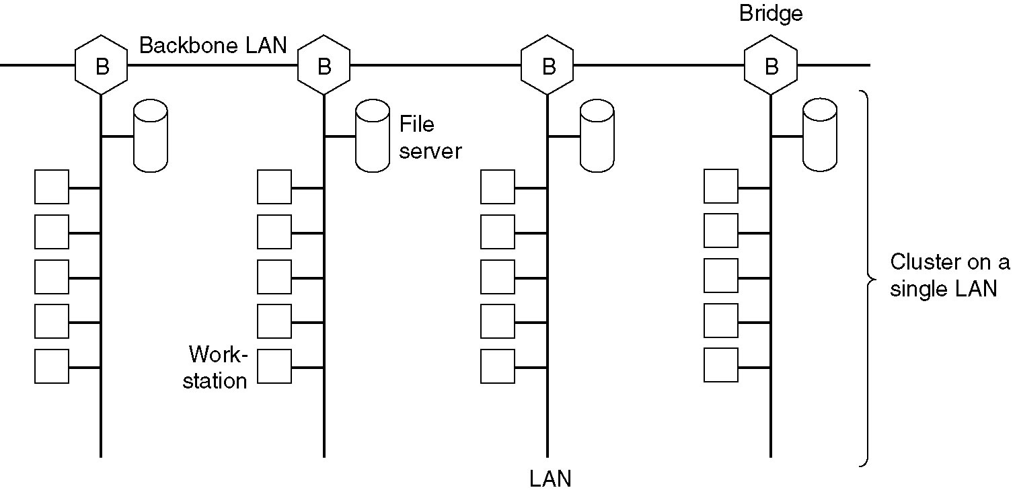
Provide a higher load

Slide 5
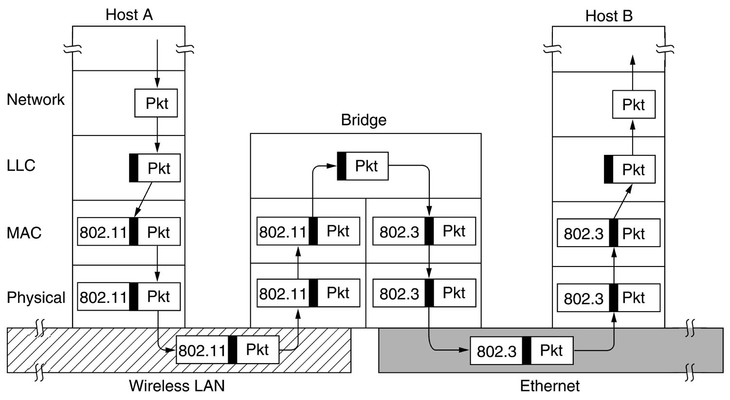
Bridge-operation from 802.11 to 802.3

Slide 6
Bridge from 802.X to 802.Y
Problem：
  Different frame format – re-encapsulation
  Different transmission speed - Buffering.
  Different the most frame length （如， 802.3 1526 字节, 802.11 2346 字节）
  Different security policy
  Different QoS policy

Slide 7
Local internetworking
Multiple LANs connected by transparent bridges do not need any change on their hardware and software.
Transparent bridges operate in promiscuous mode (混杂模式), accepting every frame transmitted on all the LANs to which it is attached.
When a frame arrives, a bridge must decide whether to discard or forward it, and if the latter, on which LAN to put the frame.
The decision is made by looking up the destination address in a big (hash) table inside the bridge.

Slide 8
Local internetworking(cont’d)
A bridge maintains a table of destination addresses and the corresponding output line as follows:
Initially all the hash tables are empty.
flooding algorithm:(泛洪)
  Every incoming frame for an unknown destination is output on all the LANs to which the bridge is connected except the one it arrived on.
backward learning （逆向学习）
  By looking at the incoming frame's source address, a bridge is able to know which machine is accessible on which LAN, so it make an entry in its hash table linking the source machine with the incoming LAN.
How to handle dynamic topologies?
  Whenever a hash table entry is made, the arrival time of the frame is noted in the entry.
  The entry time is updated whenever a frame from the address in that entry arrives.
  Periodically, a process in the bridge scans the hash table and purges(清除) all entries more than a few minutes old.

Slide 9
Principle of bridge
Routing procedure for an incoming frame:
  If destination and source LANs are the same, discard the frame.
  If the destination and source LANs are different, forward the frame.
  If the destination LAN is unknown, use flooding.
As each frame arrives, the above algorithm must be applied.
Special purpose VLSI chips exist to do the lookup and update the table entry, all in a few microsecond.

Slide 10
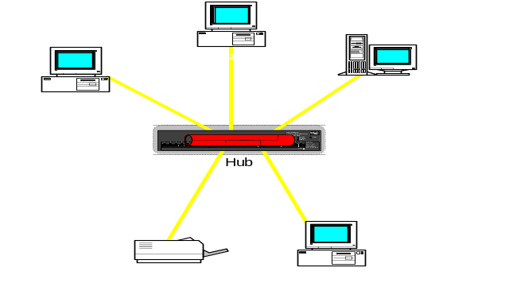
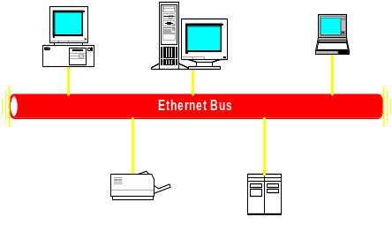

Bridge can segment collision-domain
LAN2
LAN1
网桥
Notes:
*

Slide 11
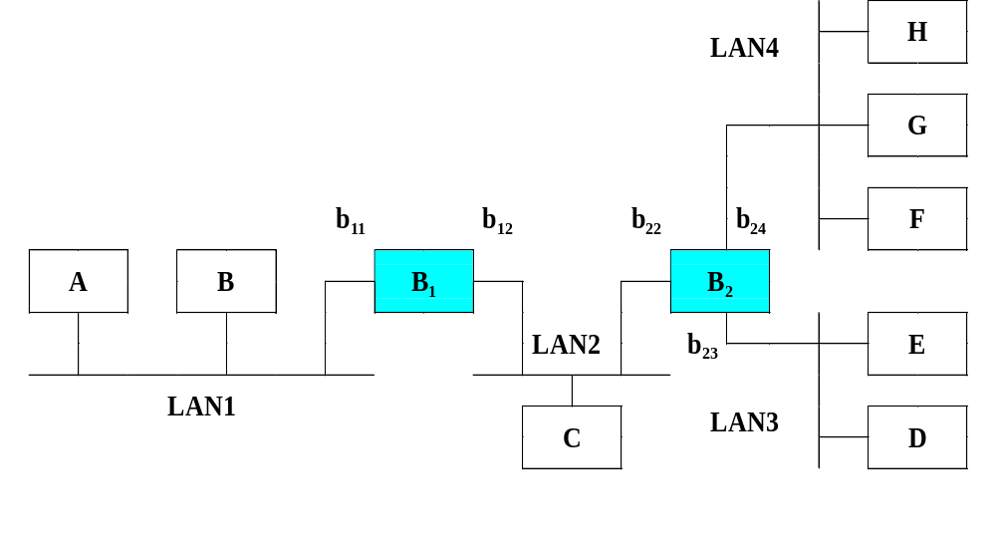
Transparent bridge
Notes:
*
Instructors Notes:

Slide 12
Flooding（扩散、泛洪）

Slide 13
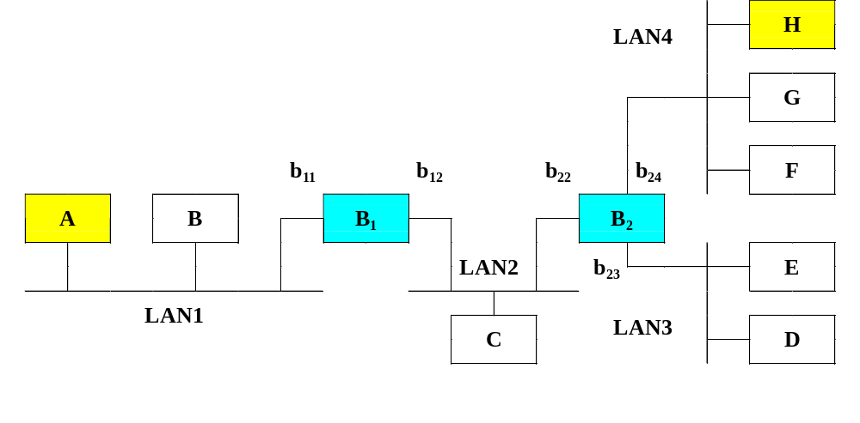
Step 1： A send Fa to H
DA
SA
Frame：Fa
Notes:
*

Slide 14
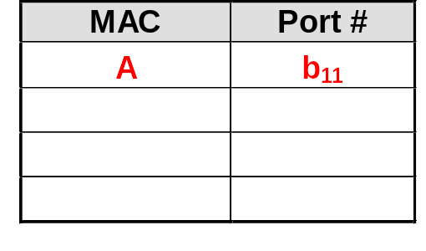
Step 2：bridge B1
B1 receives Fa from b11，flooding Fa to b12（LAN2）
B1 learns source addr. of Fa
Notes:
*
Instructors Notes:

Slide 15
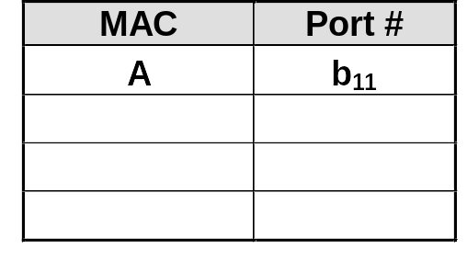
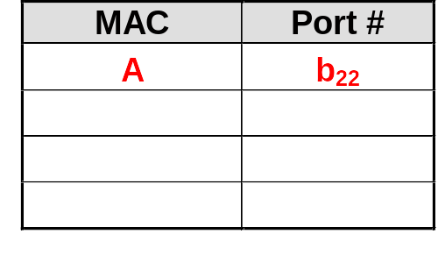
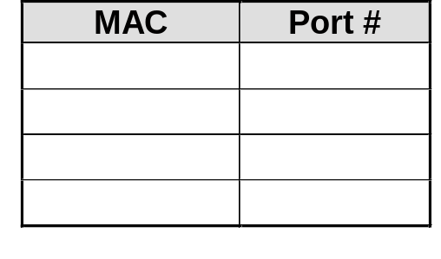
Step 3：Bridge B2
B₁
B₂
Notes:
*

Slide 16
Step4： H send F_{h} back to A
DA
SA
Frame: F_{h}
Notes:
*

Slide 17
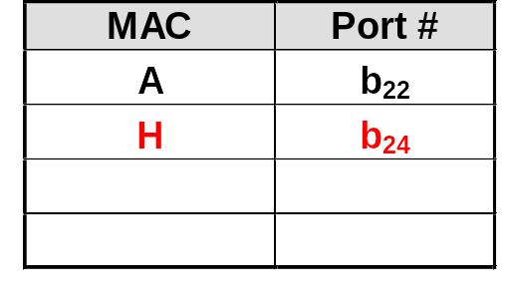
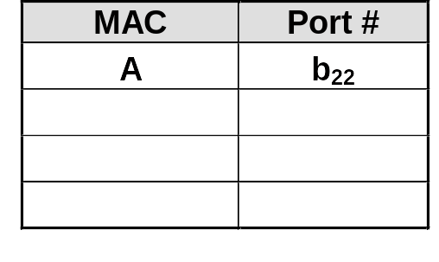
Step 5：Bridge B2 (forword F_{h})
B₁
B₂
Notes:
*

Slide 18
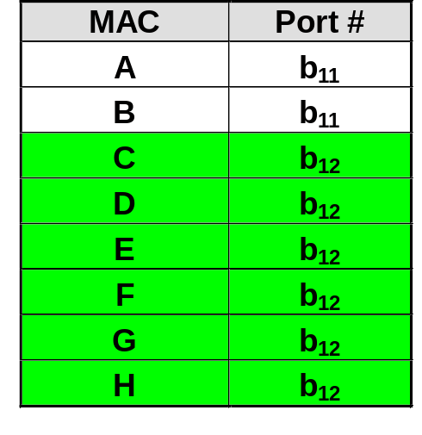
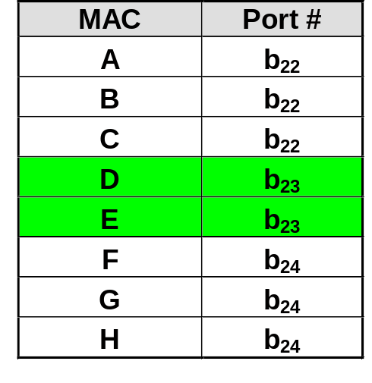
Table show
Notes:
*

Slide 19
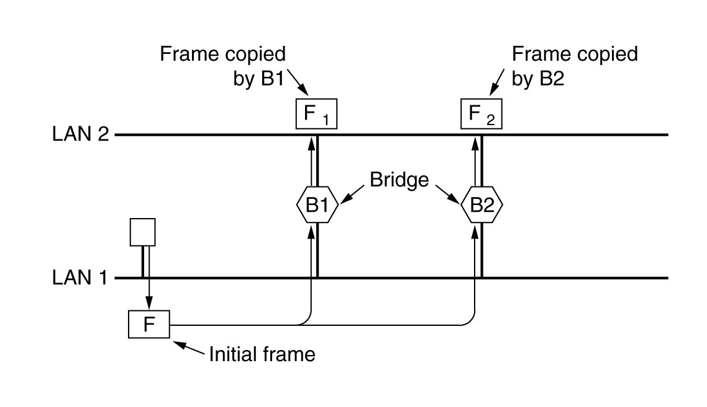
Spanning tree bridge
To increase reliability, some sites use two or more bridges in parallel between pairs of LANs. This arrangement creates loops in the topology.
What happens if a frame with an unknown destination arrives ?

Slide 20
Spanning Tree Bridges (cont’d)
The solution is for the bridges to communicate with each other and overlay the actual topology with a spanning tree that reaches every LAN.
In a spanning tree, there is a unique path from each source to each destination, loops are impossible.
To build the spanning tree
  Choose one bridge to be the root of the tree
    The bridge with the lowest serial number becomes the root.
  A tree of shortest paths from the root to every bridge and LAN is constructed.
  If a bridge or LAN fails, a new spanning tree is computed.
Notes:
overlay覆盖

Slide 21
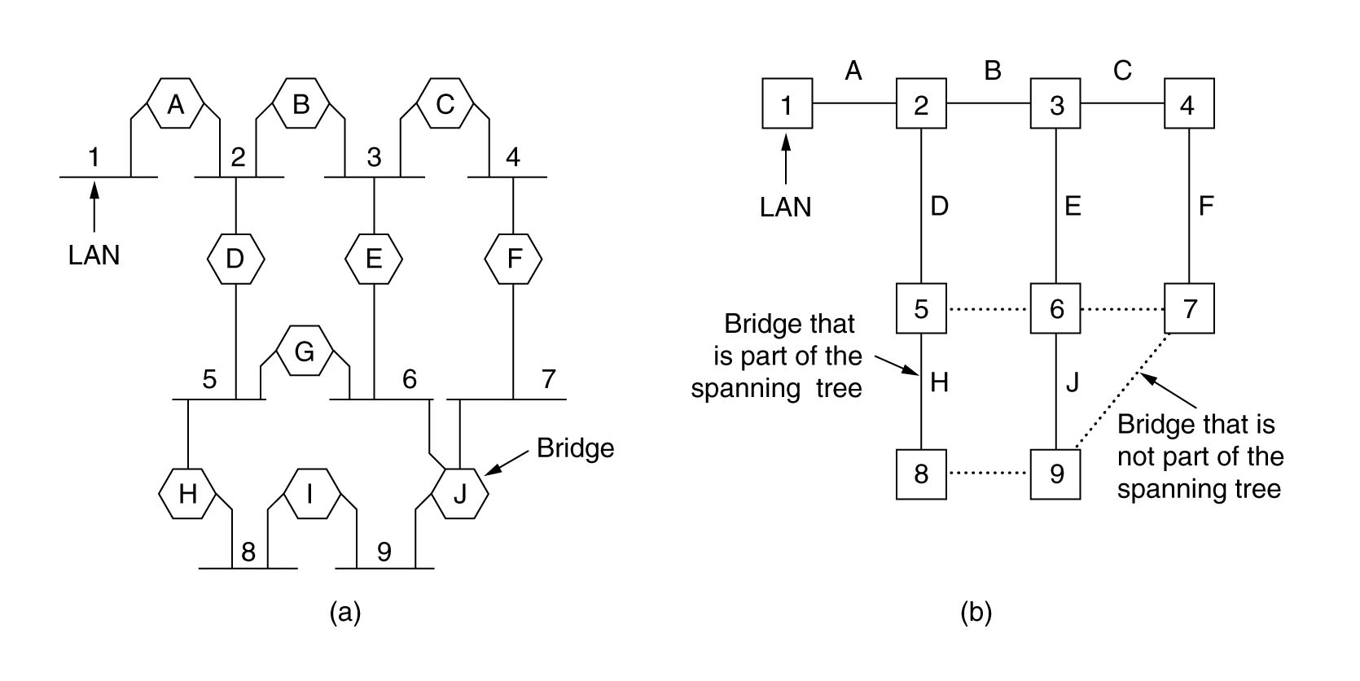
Spanning Tree Bridges (cont’d)

Slide 22
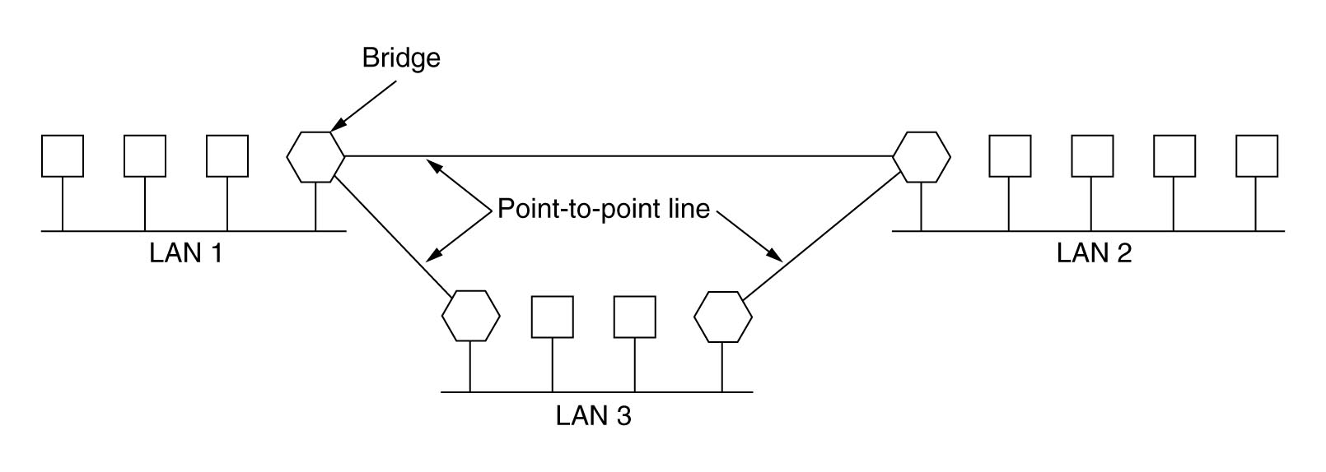
Remote Bridges
Remote bridges can be used to interconnect distant LANs.
  Putting a bridge on each LAN
  Connecting the bridges pairwise with point-to-point lines.

Slide 23
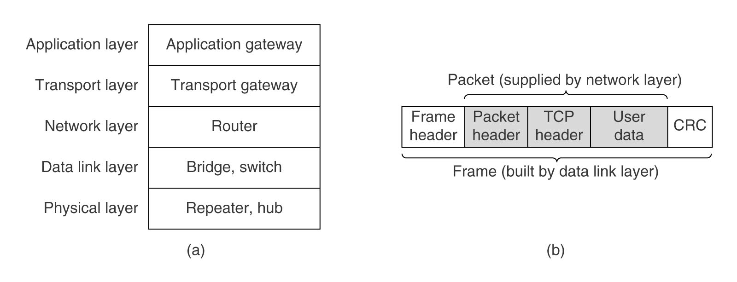
Network Devices

Slide 24
Network Devices (cont’d)
Repeaters
  Are analog devices to connect two cable segments.
  A signal appearing on one segment is amplified and put out on the other segment.
  Can not understand frames, packets, or headers, but understand volts.
Hubs
  Frames arriving on any of the lines are sent out on all the others.
  The entire hub forms a single collision domain.
  All the lines coming into a hub must operate at the same speed.
  Do not amplify the incoming signals and are designed to hold multiple line cards each with multiple inputs (one collision domain).
  Do not examine the 802 addresses or use them in any way.
Bridge.
  A bridge connects two or more LANs.
  When a frame arrives, software in the bridge extracts the destination address from the frame header and looks it up in a table to see where to send the frame.
  A bridge may have line cards (like a hub) for different network types and speeds.
  Each line forms its own collision domain.

Slide 25
Network Devices (cont’d)
Switches
  A switch is similar to bridge in its routing on frame addresses.
  Switches are often used to connect individual computers (no collision).
  Switches must have space for many more line cards.
  Each line card provides buffer space for frames arriving on its ports.
  Each port forms its own collision domain.
Routers
  When a packet comes into a router, the frame header and trailer are stripped off and the packet located in the frame's payload field is passed to the routing software.
  The routing software uses the packet header to choose an output line.
  For an IP packet, the packet header will contain a 32-bit (IPv4) or 128-bit (IPv6) address, but not a 48-bit 802 address.
Gateways
  Transport gateway
    Connect two computers that use different connection-oriented transport protocols
    Copy the packets from one connection to the other, reformatting them as need be.
  Application gateway
    understand the format and contents of the data
    translate messages from one format to another.

Slide 26
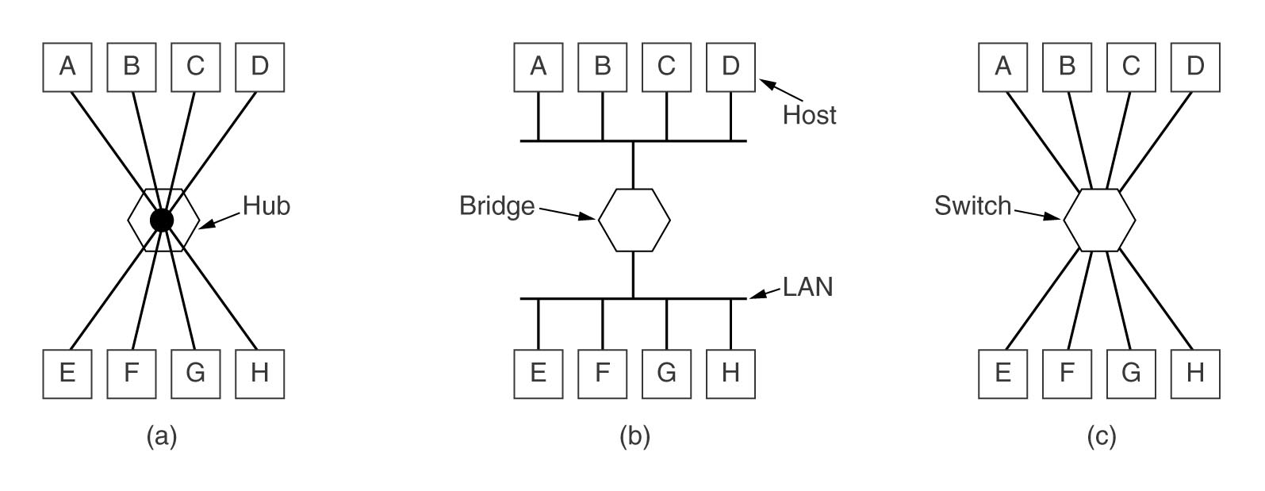
Network Devices (cont’d)

Slide 27
L2 (data link layer) devices
Network interface card (NIC)
Bridge
Switch

Slide 28
Summary
Learn basic idea of frame switch (L2 switching)
Master basic principle of L2 switch
Learn bridge
Learn switch

