Slide 1
Chapter5 Network Layer(2)
王昊翔：hxwang@scut.edu.cn
School of Computer Science & Engineering ,SCUT

Slide 2
Review
Network Layer Outline
  VC/Datagram subnet
Routing Algorithms
  Static
  Dynamic
Shortest Path
  Sink tree
Flooding

Slide 3
Outline
Dynamic routing algorithm
Distance-vector algorithm
  An example：Rip
Problem of DV and solution

Slide 4
Dynamic Routing algorithm
Distance vector routing algorithm
  For example: RIP
Link state routing algorithm
  For example: OSPF
Hybrid routing
  For example: IGRP

Slide 5
How is dynamic property realized？
  If routers need to communication, they must say same language, that is same routing protocol
  A new router must introduce itself in it’s own initiative (say hello)
  Send hello packets periodically to learn other’s health (keep alive)

Slide 6
Distance Vector Routing
距离矢量路由选择:operate by having each router maintain a table (i.e, a vector) giving the best known distance to each destination and which line to use to get there .
D-V algorithm is dynamic and distributed. It is common used in small network, RIP is a typical example of DV
RIP：Routing information protocol，路由选择信息协议，1988，RFC1058

Slide 7
Working principle of DV
Each router use two vectors, D_{i} and S_{i} ,to denote the distance from a node to all other nodes and next node (hop)
Exchange path-information among Neighbor routers
Each node update it’s routing table according to path information

Slide 8
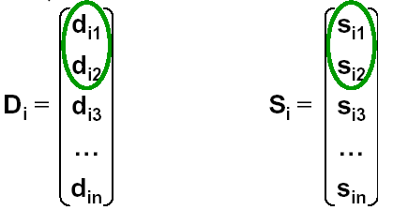
Working principle of DV(cont’d)
d_{i1}：the distance (f.g. delay) from node i to node 1
S_{i1} ：the next node along the best way from node i to node 1
n ：node
number of network

Slide 9
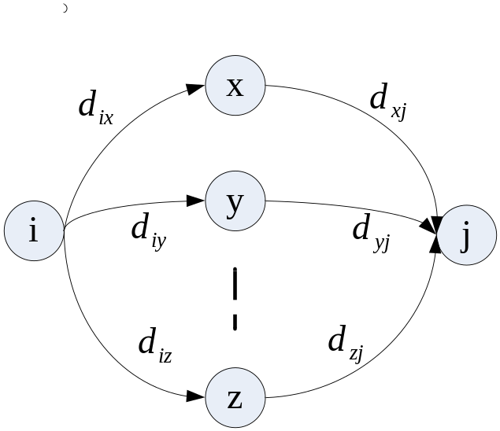
Update routing table
After exchange vector:
  Update distance : d_{ij}= Min[d_{ix}+ d_{xj}] ( x ∈A )
    A—collection of neighbors of node I;
    d_{ij}—the shortest distance from i to j;
    d_{ix}—the shortest distance from i to x;
    d_{xj}—the shortest distance from x to j
  Update next node: S_{ij}= x

Slide 10
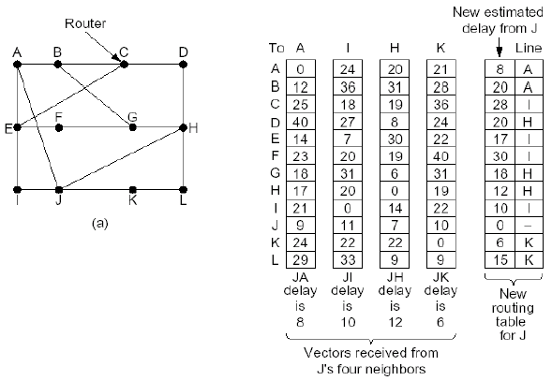

Slide 11
Do exercise
Topology is following, router C receive three routing delay vectors from router B,D,and E
  A B C D E F
  From router B：（ 5， 0，8，12，6， 2）
  From router D: （16，12，6， 0，9，10）
  From router E: （ 7， 6，3， 9，0， 4）
Now, delay between Router C and router B,D,and E is measured respectively, is 6,3, and 5，try to answer the routing vector of router C after update.
B
C
A
D
E
F

Slide 12
topology
B
C
A
D
E
F

Slide 13
Reference key
Analysis: via router B,D, and E, the vector of router C is：
  Via router B：（11， 6， 14， 18，12 ，8）
  Via router D: （19，15， 9， 3，12，13）
  Via router E: （12 ，11， 8， 14， 5， 9）
So, update routing table of router C as following:
  （11，6，0，3，5，8）
  （ B，B，-，D，E，B）

Slide 14


Characteristic of D-V algorithm
advantage
  Algorithm is simple
Disadvantage
  Exchanged information is too big
  Path information propagates slowly and path information may be different
  Convergence speed is slow, leads to infinite count issue。
  Not fit for big network

Slide 15
Main features of RIP
RIP is a D-V routing protocol
RIP uses hop (跳数) as metric
When metric is bigger than 15, the destination is deemed to unreachable
Default sending period is 30 seconds

Slide 16
Disadvantage of RIP
Unable to reach when a destination-network’s metric is bigger than 15 ( so small)
RIP’s metric is hop，that is router’s number all the way，It’s not so reasonable
In practice, it’s common to count to infinite, and convergence slowly

Slide 17
The problems induced by DV
Representation
  routing loop（路由环路）
  Count to infinite（计数到无穷问题）
  slow Convergence （收敛慢的问题）
Cause
  Trust wrong routing information

Slide 18
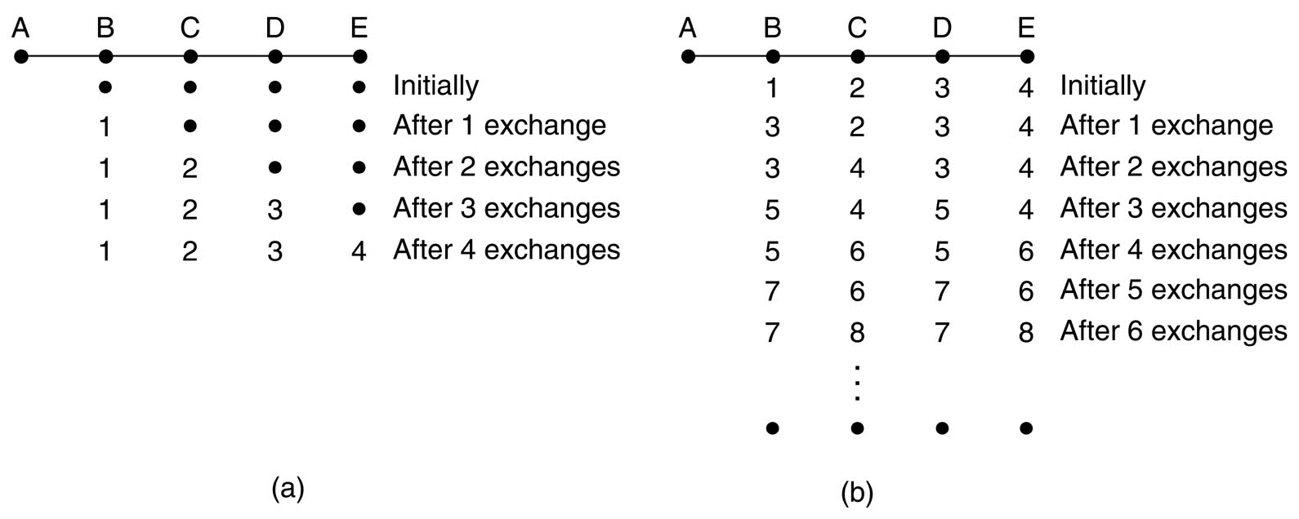
Main problem of DV
It reacts rapidly to good news, but leisurely to bad news(好消息跑得快，坏消息传得慢)

Slide 19

Summary
Principle of DV-algorithm
  A typical example: RIP
Problem of DV

