Slide 1
Chapter5 Network Layer(6)
王昊翔 hxwang@scut.edu.cn
School of Computer Science & Engineering ,SCUT
Communication & Computer Network key-Lab of GD

Slide 2
Content of the second part
Internet protocol
  Packet
  IP address
Other protocol
  Arp
  Dhcp
  Rarp
  ICMP
  CIDR

Slide 3
Outline
Main function of router
Learn IP
  IP packet format
  IP address and it’s classification
Reserved IPv4 address
Subnet and subnetting

Slide 4
Network Layer in the Internet
Design Principles for Internet (RFC 1958)
  Make sure it works.
  Keep it simple.
  Make clear choices.
  Exploit modularity.
  Expect heterogeneity.
  Avoid static options and parameters.
  Look for a good design; it need not be perfect.
  Be strict when sending and tolerant when receiving.
  Think about scalability.
  Consider performance and cost.

Slide 5
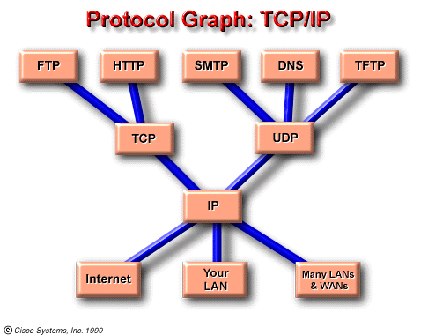
Internet and Its Network Layer
The Internet can be viewed as a collection of subnetworks or Autonomous Systems (ASes) that are interconnected.
The glue that holds the whole Internet together is the network layer protocol, IP (Internet Protocol).
Its job is to provide a best-efforts (i.e., not guaranteed) way to transport datagrams from source to destination.

Slide 6
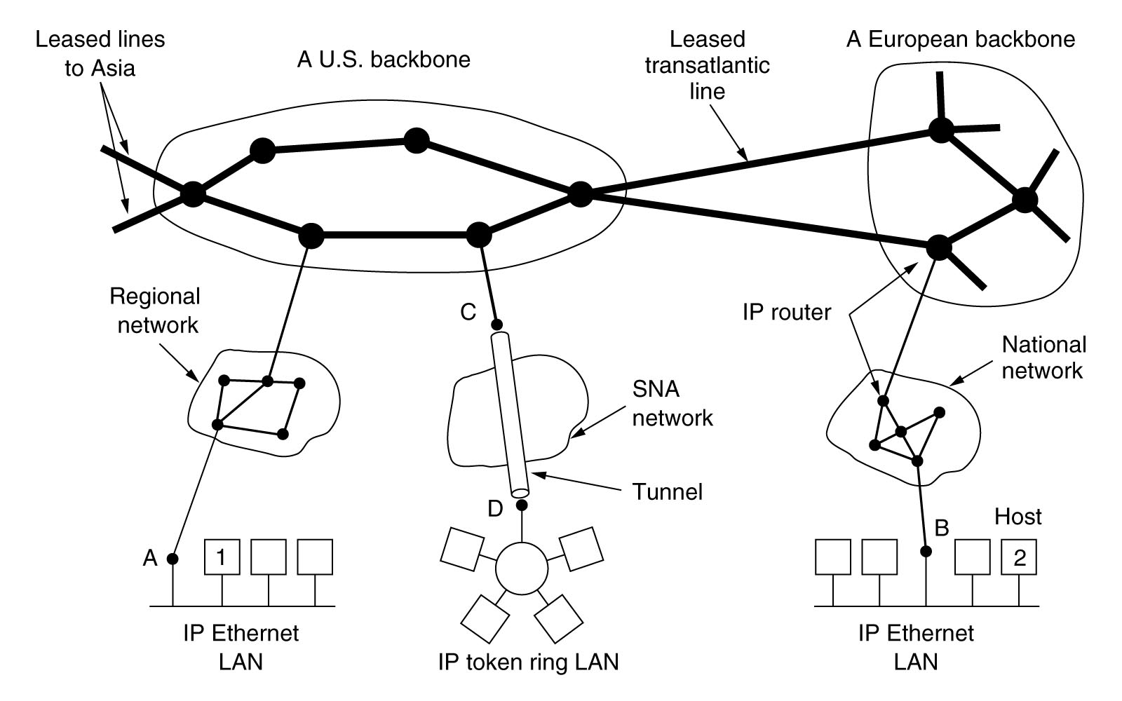
Internet - Collection of Subnetworks

Slide 7
Addressing(寻址)
寻址：连网的目的是共享资源、与远端节点通信，要做到这一点，首先必须找到目的节点，寻找目的节点（设备）的过程叫做寻址。
Two type of addressing
  MAC addressing：locate destination according to MAC address
  IP addressing： locate destination according to IP address

Slide 8
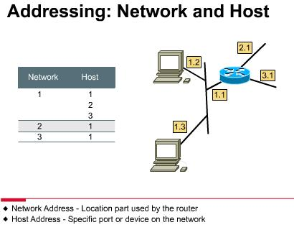
IP addressing
Step
  Packet arrive a router
  The router forward the packet
  Locate the destination
Analogy: mailing

Slide 9
Main function of router
Process of router
  Open packet（de-encapsulation）
  Decide destination network
  Main function
  Routing
  Forward
  other
Notes:
*
1。Ttl
2。是否需要分段
3。目的MAC地址
4。校验和

Slide 10
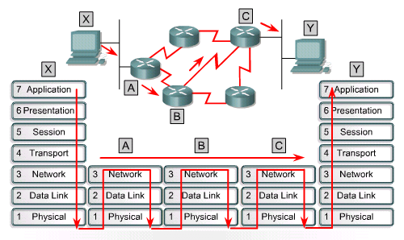
Data go through routers

Slide 11
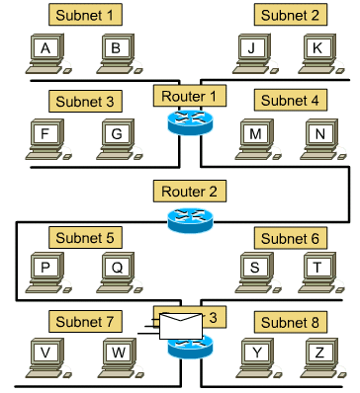

How a packet go from A to Z ?

Slide 12
Routing table
Including network address, interface, metric (f.g. hop), subnet mask 帮助router找到目的地，类比邮政地址, gateway, and so on。
Besides IP and MAC address of connected-devices, router has IP and MAC address of it’s neighbor router（arp table）
May be somewhat different, because of different factory

Slide 13
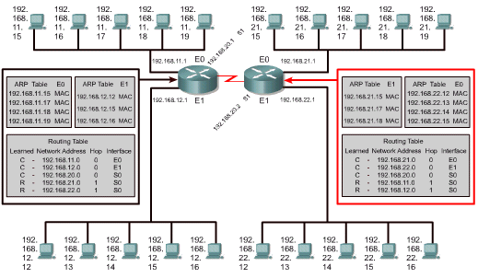
ARP table and routing table

Slide 14
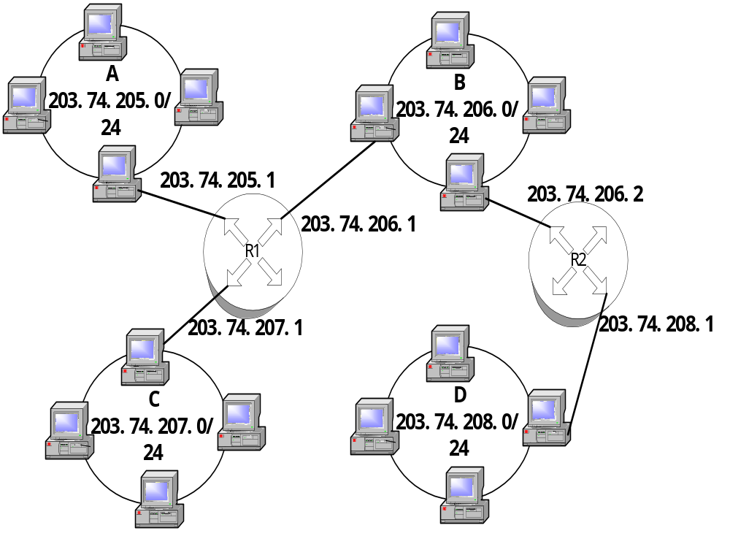

Slide 15
Routing of router R1
网络 | 网络地址 | 网络掩码 | 网关 | 接口 | 跳数
A | 203.74.205.0 | 255.255.255.0 | 203.74.205.1 | 203.74.205.1 | 0
B | 203.74.206.0 | 255.255.255.0 | 203.74.206.1 | 203.74.206.1 | 0
C | 203.74.207.0 | 255.255.255.0 | 203.74.207.1 | 203.74.207.1 | 0
D | 203.74.208.0 | 255.255.255.0 | 203.74.206.2 | 203.74.206.1 | 1

Slide 16
Internet protocol
IP is to provide a best-efforts (i.e., not guaranteed) way to transport datagrams (packet) from source to destination
  A routed protocol
Internet protocol
  Packet format
  Addressing

Slide 17
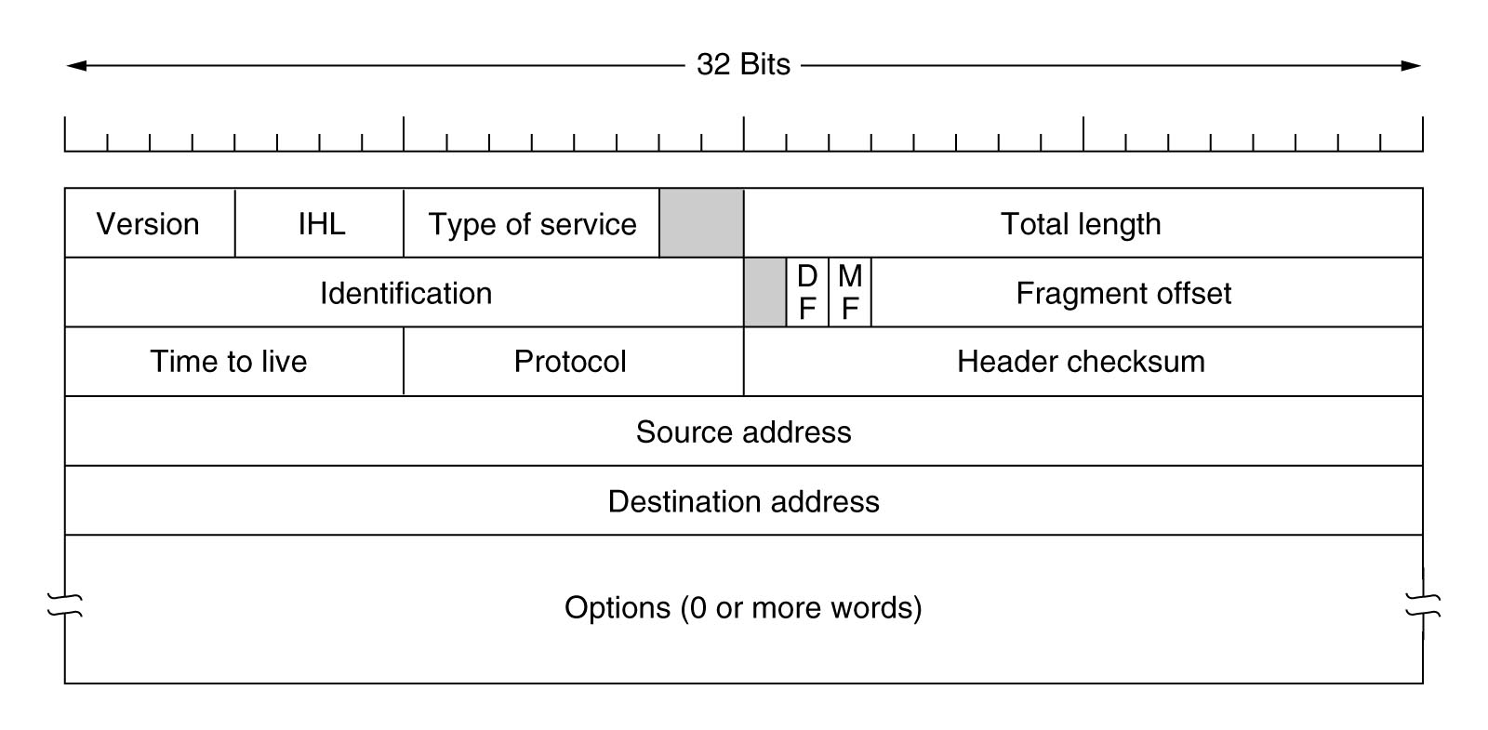
IP packet format
4 bits.
Indicates the version of IP currently used.
  IPv4 : 0100
  IPv6 : 0110

Slide 18
IP packet format
4 bits.
IP Head lenght：32bits a unit

Slide 19
IP packet format
8 bits.
Specifies the level of importance that has been assigned by a particular upper-layer protocol.
  Precedence.
  Reliability.
  Speed.

Slide 20
IP packet format ··
16 bits.
Including head and data，unit byte

Slide 21
IP packet format
16 bits.
Sequence number

Slide 22

IP packet format
Ipv6就没有这个字段了
Don’t fragment
More fragments

Slide 23
IP packet format
8 bits.
Time-to-Live(TTL)

Slide 24
IP packet format ··
8 bits.
Transport layerProtocol .17(UDP) or 6(TCP)

Slide 25
IP packet format
16 bits.
A checksum on the header only, helps ensure IP header integrity.

Slide 26
IP packet format
32bit（IPv4）

Slide 27
IP packet format
Allows IP to support various options, such as security, route, error report ...

Slide 28
IP packet format
Padding ...
32bit x n

Slide 29

IP address
IP address：network number and host number
Binary figure of IP address
Disadvantage: difficult to remember

Slide 30
Dotted decimal notation of IP address
Binary IP is difficult to remember
Dotted decimal notation：
  32 bits is parted into 4 8-bits group
  “.” is used to separate the 8-bits groups
  Each 8-bits group is written in decimal, from 0 to 255

Slide 31
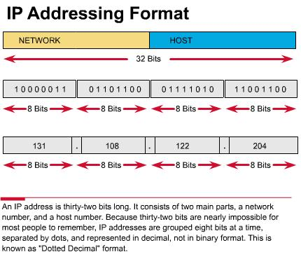

Slide 32
Hierachical property of IP addr.
Internet
130.1.0.0
网络1
网络n
130.n.0.0
子网1
子网m
主机
主机
130.1.m.0
130.n.*.*
主机
主机
主机
主机
130.1.m.11
130.1.1.1

Slide 33
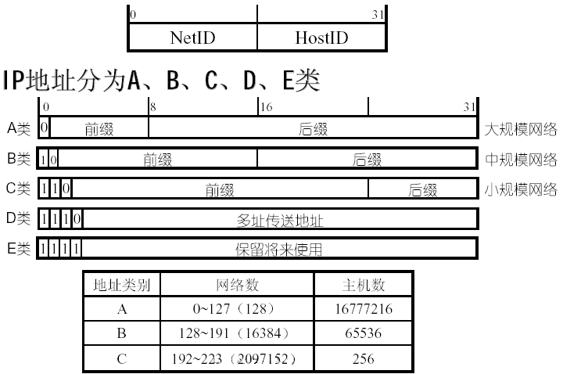
Classification of IP address
不能全0 或者 全1， 全0表示网络地址， 全1代表广播地址， 所以个数为 2^24 - 2

Slide 34
A class
31 30 29 28 27 26 25 24 23 22 21 20 19 18 17 16 15 14 13 12 11 10 9 8 7 6 5 4 3 2 1 0
The first byte is identified to network，the last three bytes are identified to host
Each net can include （2²⁴ -2）host at most
The highest bit is “0”
The first byte range “0－127” , so number of net is 128
0
network
host
0 - 127 0 - 255 0 - 255 0 - 255

Slide 35
B class
31 30 29 28 27 26 25 24 23 22 21 20 19 18 17 16 15 14 13 12 11 10 9 8 7 6 5 4 3 2 1 0
The first two bytes are network bits, the last two bytes are host bits.
Each net can include（2¹⁶-2）host at most
The highest two bits are “10”
The first byte range “128－191”
Number of net is 2¹⁴
1 0
network
host
128 -191 0 - 255 0 - 255 0 - 255

Slide 36
C class
31 30 29 28 27 26 25 24 23 22 21 20 19 18 17 16 15 14 13 12 11 10 9 8 7 6 5 4 3 2 1 0
The first three bytes are network bits, the last byte is host bits
Each net can include 254 host at most
The highest three bits are“110”
The first byte range “192－223”
number of net is 2²¹
1 1 0
network
host
192 - 223 0 - 255 0 - 255 0 - 255

Slide 37
Special IP address
32 bit all 0，0.0.0.0 Cisco default routing
32 all 1，255.255.255.255 Flood Broadcast
Host id all 0，network address 172.16.0.0
Host id all 1，172.16.255.255 Direct Broadcast
127.0.0.0 Lookback Network
127.0.0.1 Lookback test

Slide 38


Flood Broadcast = Local Broadcast
STOP
255.255.255.255

Slide 39
Direct Broadcast
192.168.20.0
192.168.20.255

Slide 40
Example: analyze 172.16.20.200
172.16.20.200 is Class B address
Network portion: 172.16
Host portion: 20.200
Network address: 172.16.0.0
Broadcast address: 172.16.255.255

Slide 41
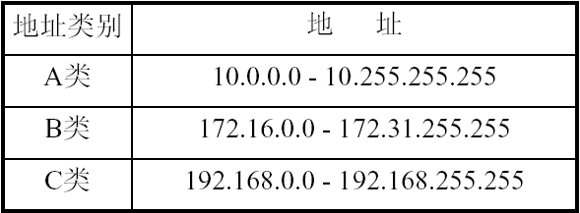
Public and private address
Global IP
IP地址枯竭
  CIDR
  IPv6
  subnetting
  private
    A: 10.0.0.0- 10.0.255.255（1个A）
    B: 172.16.0.0-172.31.255.255（16个B）,
    C: 192.168.0.0- 192.168.255.255（256个C）

Slide 42
Subnet(子网)
A LAN may grow to be too large to handle and must be split into subnets.
Subsets allow a network to be split into several parts for internal use but still act like a single network (i.e., a single routing table entry) to the outside world.
This allows different subnets to be connected within an organization.

Slide 43
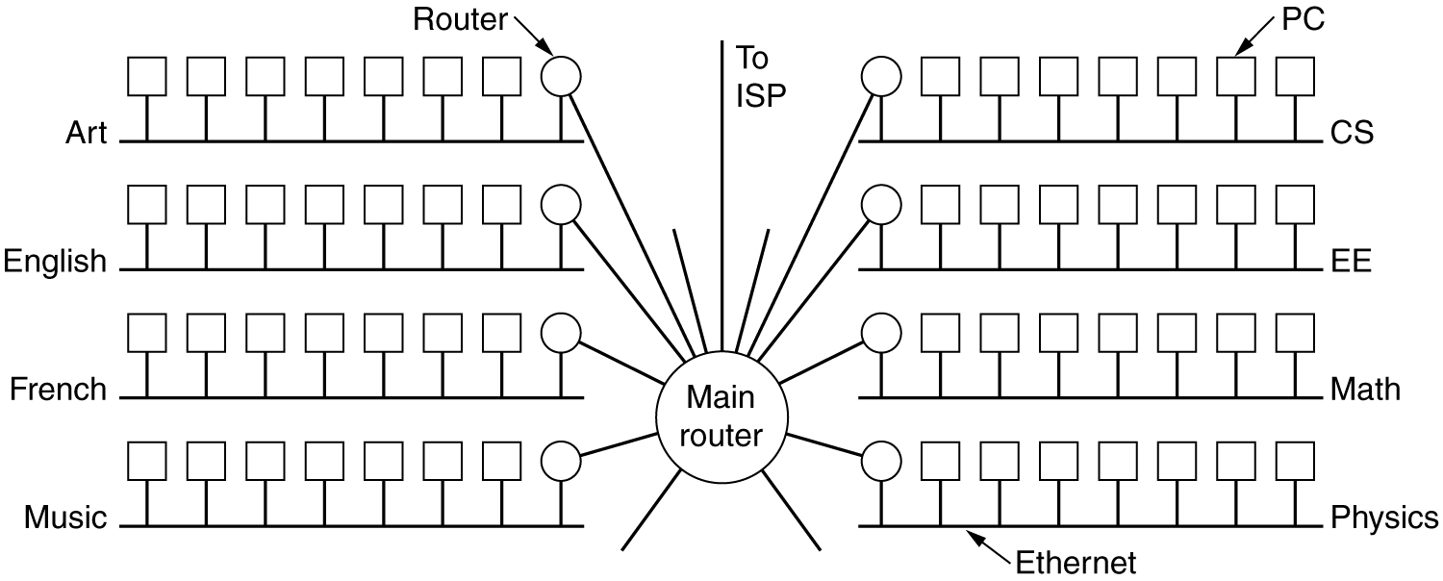
A Subnet Examples

Slide 44
What function of main router？
Communication with outside
Main router forwards packets from outside, but how to know inside intranet structure？
  A table？
  A mechanism, subnet mask

Slide 45
Subnet Masks
A mask is used by the router to determine which subnet the packet should travel to.
Subnet masks can be specified in dotted decimal notation, with the addition of a slash followed by the number of bits in the network + subnet part.
  255.255.255.224
  202.10.23.102/27
Routers will AND the destination address with the subnet mask in order to get the address of the router where the packet should go.
Using this method reduces the number of individual addresses that each router must store, resulting in smaller router tables.

Slide 46
Subnet Masks
Default subnet mask
  A：255.0.0.0 /8
  B：255.255.0.0 /16
  C：255.255.255.0 /24

Slide 47
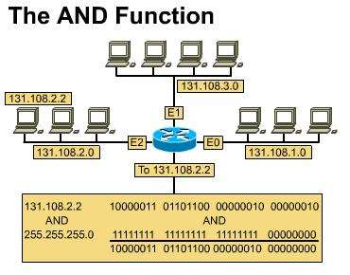
Main router

Slide 48
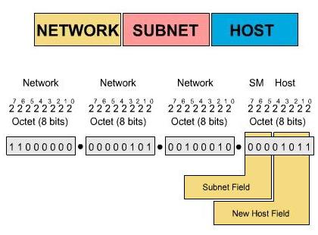
Addr. Of subnet

Slide 49
Using subnet to show network addr.
A network addr.：10.0.0.0 10/8
broadcast addr.：10.255.255.255
host addr.：10.0.0.1～10.255.255.254
B network addr.：166.111.0.0 166.111/16
broadcast adr.：166.111.255.255
host addr.：166.111.0.1～166.111.255.254
C network addr.：212.111.1.0 212.111.1/24
broadcast addr.：212.111.1.255
host addr.：212.111.1.1～212.111.1.254

Slide 50
How to subnet? An example
Borrowed bits
8 7 6 5 4 3 2 1
Network addr.
reserved
0 0 0 0 0 0
0 0 0 0 0 1
…………
0 1 1 1 1 1
1 1 1 1 1 1
0 0
0 1
1 0
1 1
reserved
Broadcast addr.

Slide 51
Subnet address space
Subnet is construct via borrowing bits from host part of a IP address
Subnetting results in loss of IP address space
  For example：C class IP 202.38.197.0，256 Ipaddresses，254valid IP.
  4 subnets，total IP addresses，2*62=124。

Slide 52

subnetting
subnetting：divide a big network into small subnet
Borrowing rule

Slide 53
summary
Router’s main function
Internetprotocol
  Packet fromat
  IP address
IPv4 address reserved space
Subnetting

Slide 54

Thank you！

