Slide 1
Chapter5 Network Layer(7)
王昊翔 hxwang@scut.edu.cn
School of Computer Science & Engineering ,SCUT
Communication & Computer Network key-Lab of GD

Slide 2
Outline
The basic idea of CIDR
The principle of NAT/PAT
ICMP and it’s application
Principle Address resolution protocol
  ARP
  RARP
Learn assignment of IP address (RARP\Boot\pDHCP)

Slide 3
IP address problem
IP is rapidly becoming a victim of its popularity: it is running out of addresses.
In principle, over 4 billion addresses exist, but the practice of organizing the address space by classes wastes millions of them.
For most organizations:
  a class A network, with 16 M addresses is too big
  a class C network, with 256 addresses is too small
  a class B network, with 65,536 addresses, seems just right (so many organizations ask for B networks).
In reality, more than half of all class B networks have fewer than 50 hosts !
How about providing more (and smaller) class B addresses? Or class C networks use 10 bits instead of eight for the host number?
Routing table explosion

Slide 4
CIDR –Classless InterDomain Routing
The solution to the routing table problem and addr. problem is CIDR.
The basic idea behind CIDR is described in RFC 1519.
  Allocate IP addresses in variable-sized blocks as opposed to allocating them based on class.
    F.g. need 2000 address
CIDR can use prefix 13~27.

Slide 5
Routing With CIDR
Each routing table entry is extended by giving a 32-bit mask.
Each routing table consists of an array of (IP address, subnet mask, outgoing line) triples.
When a packet comes in,
  Its destination IP address is first extracted.
  Masking the destination address and comparing it to the table entry looking for a match.
  If multiple entries (with different subnet mask lengths) match, the longest mask is used.

Slide 6
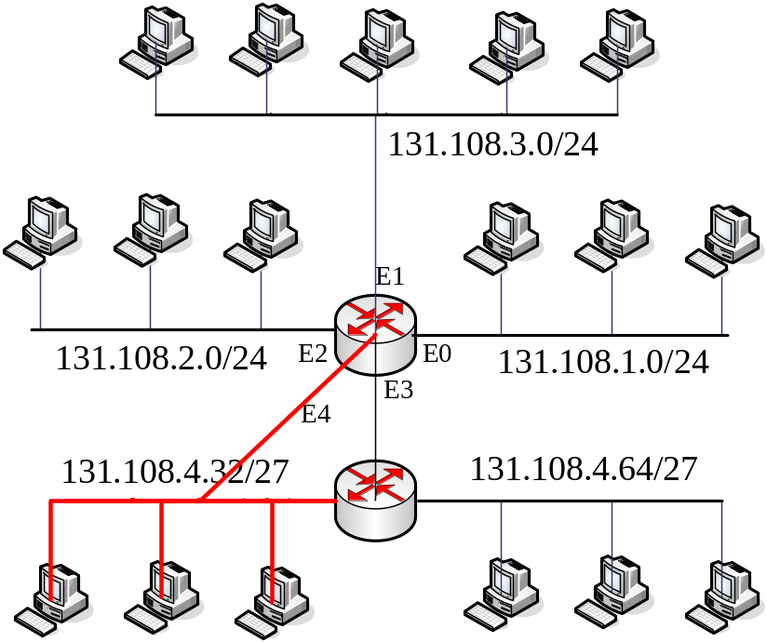
The longest mask is used
An example: a packet with destination IP addr. is 131.108.4.33
destination | intf
131.108.4.0/24 | E3
131.108.4.32/27 | E4
131.108.1.0/24 | E0
131.108.2.0/24 | E2

Slide 7
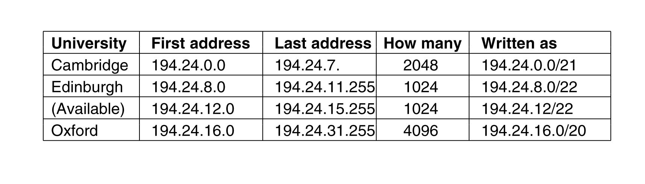


IP Address Assignment Example

Slide 8
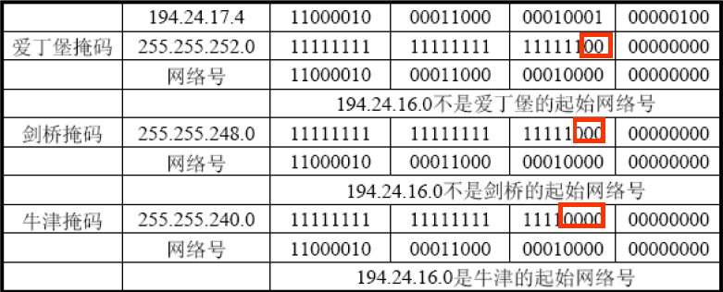
CIDR example (2/2)
A packet addressed to: 194.24.17.4
Binary presentation: 11000010 00011000 00010001 00000100

Slide 9
How to compute available IP addr. ？
IP address is 194.24.6.112，it’s mask is 255.255.248.0；equal to 194.24.6.112/21
Corresponding host-bits 32-21=11，so host has：2048
from: 00000000.00000000=0.0
to: 00000111.11111111=7.255

Slide 10
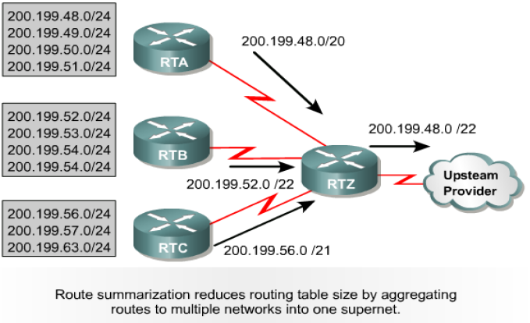
Routing cluster(路由聚合)
Reduce routing table
Separate up-down(隔离路由翻动)
200.199.48.0/22
200.199.48.0/20

Slide 11
How to Cluster
200.199.48.0/24
200.199.49.0/24
200.199.50.0/24
200.199.51.0/24
Cluster into：200.199.48.0/22
00110000
00110001
00110010
00110011
Bits unchanged：8+8+6=22，= mask or network length
第三个8位组

Slide 12
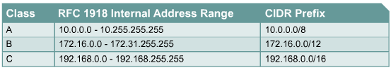
NAT outline
NAT：net address translate NAT
  Translation between private IP Addr.(私人地址) and global IP Addr.(公有地址)
PAT：port address translate
  Map many IP addr. to one IP addr. with different port
Private IP addr.：non-routed Addr.

Slide 13
NAT—Network Address Translation
A quick fix was needed to deal with the problem of running out of IP addresses.
NAT (Network Address Translation) is described in RFC 3022.
The process involves using private internal IP addresses and then translating those IP addresses to a valid IP address when leaving the LAN.
This translation is done by a NAT box. The NAT box is able to translate and keep track of addresses by using a large translation table.
As incoming packets arrive at the NAT box, it looks up the source port field which was used as an index to the internal IP address in the NAT table.

Slide 14
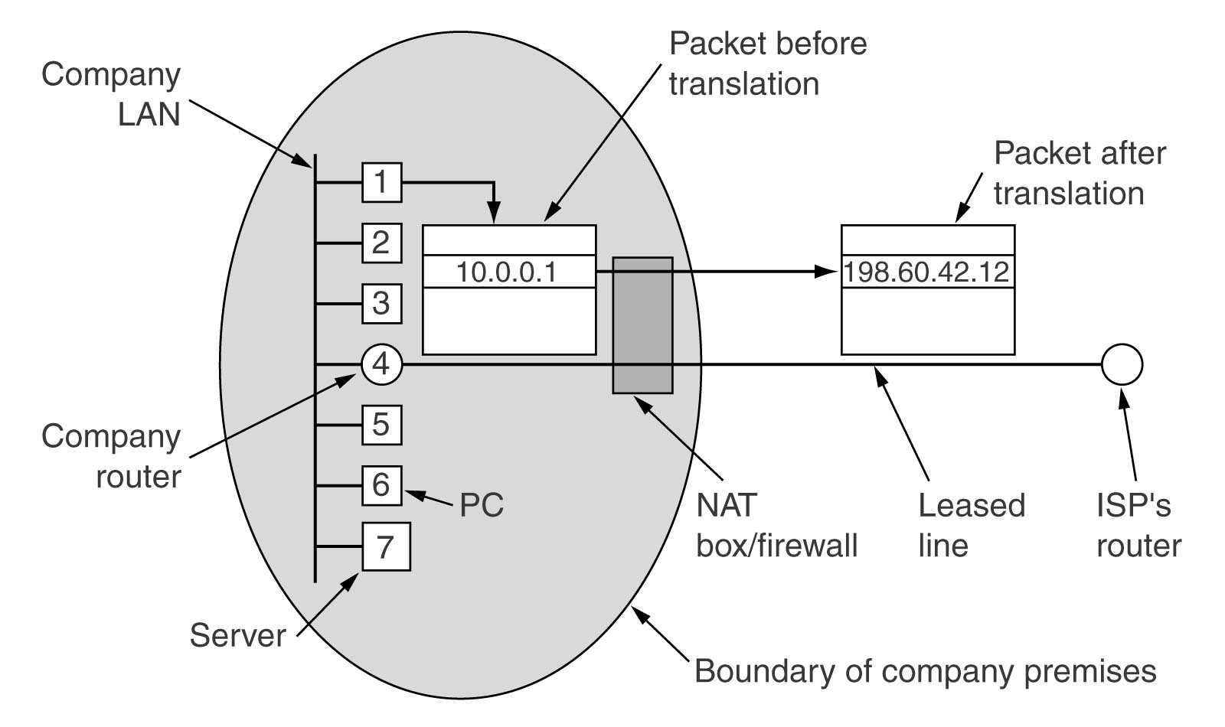
Placement and operation of a NAT Box

Slide 15
NAT Operation
10.0.0.3
Web server
140.203.8.22
140.203.8.22
5503
80
Payload
(request)
host
10.0.0.3
10.0.0.3
140.203.14.66
140.203.14.66
140.203.8.22
NAT
140.203.8.22
140.203.8.22
10.0.0.0
5503
80
5001
80
5001
80
140.203.8.22
Payload
(request)
Payload
(request)
Payload
(request)
10.0.0.3
80
5503
Payload
(response)
NAT translation table
140.203.14.66
10.0.0.1
Index
Orig Source Port
Orig IP Address
5001
5503
10.0.0.3
…
…
…
140.203.8.22
NAT
140.203.8.22
140.203.8.22
10.0.0.3
140.203.14.66
140.203.14.66
80
5503
80
5001
80
5001
Payload
(response)
Payload
(response)
Payload
(response)
host
10.0.0.4
NAT box
Inside LAN
outside WAN

Slide 16
NAT Issues
NAT violates the architectural model of IP - every IP address uniquely identifies a single machine worldwide.
It changes the Internet into a “connection-oriented” network. The NAT box maintains the state of the connection, and if it crashes, so does the link.
Protocol layer k makes assumptions about what protocol layer k+1 has put in the payload, violating layer independence.

Slide 17
NAT Issues (cont’d)
NAT may fail if some protocols other than TCP or UDP are used.
If IP addresses are inserted into the payload data (i.e. text of the message), then the NAT table will not translate that information and trouble could occur.
The limit of a NAT machine is 61,440 （65536-4096）machines.

Slide 18
Internet network-layer protocol
Besides internet protocol, there are some other accessorial protocols
  ICMP (Group Talk)
  ARP
  RARP
  BOOTP
  DHCP
Get a IP Addr. dynamically

Slide 19
Address mapping ( 地址映射)
ARP （地址解析协议）：
    Address Resolution Protocol
    IP addr. → MAC addr.
RARP （逆向地址解析协议）
    Reserve Address Resolution Protocol
    MAC addr. → IP addr.

Slide 20
ARP — Address Resolution Protocol
ARP solves the problem of finding out which physical address corresponds to a given IP address.
ARP is defined in RFC 826.

Slide 21
Assignment way of IP addr.
Static assignment
Dynamic assignment
  Given an Ethernet address, what is the corresponding IP address?
    RARP (Reverse Address Resolution Protocol) is defined in RFC 903. It uses a destination address of all 1s (limited broadcasting) to reach the RARP server and the RARP server sends back the corresponding IP address.
    BOOTP is defined in RFCs 951, 1048 and 1084. It uses UDP messages, which are forwarded over routers. It can provides more information. （disadv. :manual configuration）
    DHCP (Dynamic Host Configuration Protocol) is described in RFCs 2131 and 2132. RARP

Slide 22
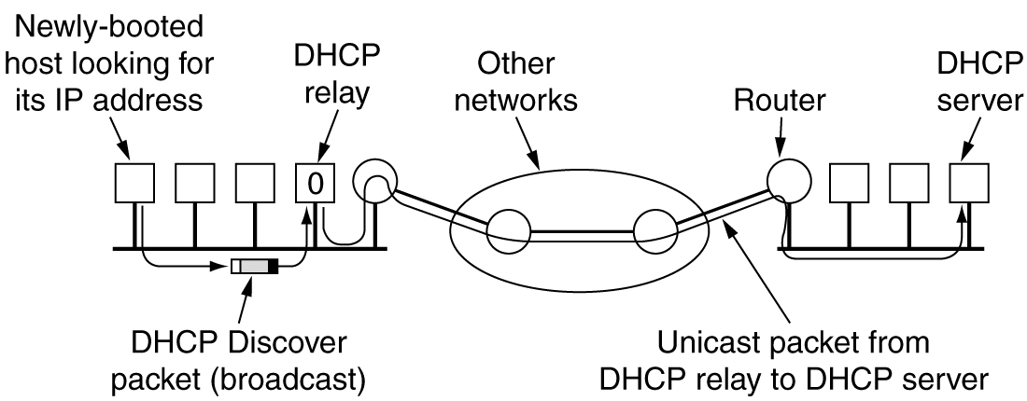
DHCP：动态主机配置协议
Dynamic host configure protocol
可以灵活分配IP地址，节约IP地址的使用

Slide 23
Summary
The idea of CIDR
The principle of NAT/PAT
ICMP and it’s application
Principle Address resolution protocol
  ARP
  RARP
Learn assignment of IP address(RARP\Boot\pDHCP)

Slide 24

Thank you！

