Slide 1
Chapter7 Application Layer
王昊翔：hxwang@scut.edu.cn
School of Computer Science & Engineering ,SCUT
Communication & Computer Network key-Lab of GD

Slide 2
Review
Transport layer
  Functionalities/services provided
  Distinguish from network layer
UDP and TCP
  Segment headers
  Socket
  Three-way hank shake
  Two-army problem

Slide 3
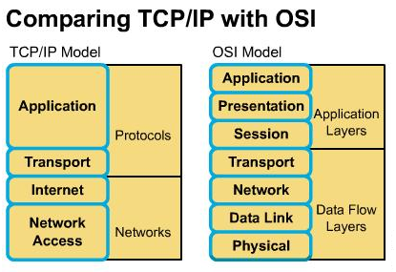
Outline
Overview of application layer
Domain Name System
Important application
  E-mail
  World wide web
  ftp
  telnet
  Multimedia

Slide 4
Main function of application layer
Be nearest to user, provide application program the network communication.
Telnet
HTTP
NFS
APP L
FTP
XWin
TFTP
SMTP
SNMP
REXEC
DNS
RPC
Tran L
TCP
UDP
Netw L
ICMP
IP
IGMP
ARP
RARP
DLL
Ethernet, Token Ring, FDDI, PPP/SLIP, X.25

Slide 5
Property of application layer
No application layer, no network communication support；
The only layer does not provide service to it’s upper layer；
It provide service to application outside reference-model.
Application program can be divided into:
  Direct：Browser , e-mail ,FTP , Telnet
  Indirect：Word , resource manager , (via redirector)

Slide 6

Domain Name System
Already have IP and port number
  Socket can identify a process on a particular host
WHY still need DNS

Slide 7
Domain Name System
Using IP addresses as absolute machine addresses on the Internet is not very practical, three reasons:
  Computers can frequently change IPs, rendering using an IP address to access the machine useless.
  Be not easy to remember IP
  Multiple servers doing the same thing
A system of using a name to access the machine was devised to overcome this problem.

Slide 8
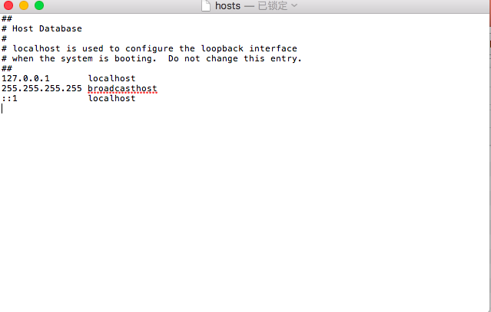
Domain Name System
Hosts file /etc/hosts/ or "%WINDIR%\System32\drivers\etc"
In the ARPANET, there was simply a file, hosts, that listed all the hosts and their IP addresses
small network

Slide 9
Domain Name System (cont’d)
DNS is a hierarchical, domain-based naming scheme and a distributed database system for implementing this naming scheme
Usage:
  Map name onto an IP address, an application program calls an library procedure, called resolver, passing it the name as a parameter (i.e. gethostbyname() is an resolver)
  The resolver sends UDP packet to a local DNS server which looks up the name and returns the IP address to the resolver
  The resolver returns the IP address to the application

Slide 10
DNS Name Space
Internet is divided into over 200 top level domains.
  Each domain is divided into sub-domains, which are further partitioned, etc..
  All domains can be represented by a tree.
    The leaves of the tree represent domains that have no sub-domains (but contain machines)
    A leaf domain may contain a single host or represent a company and contain thousands of hosts
Top level domains could be generic and country domains.

Slide 11
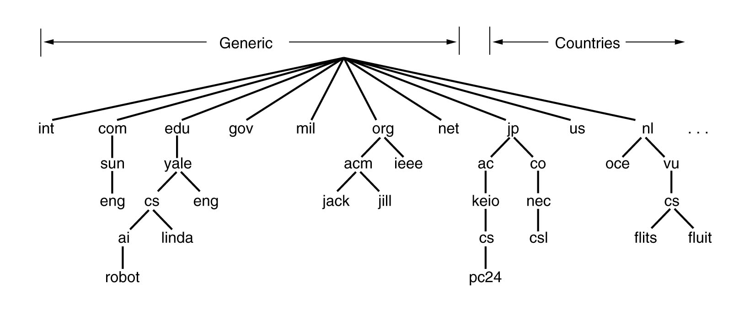
DNS Name Space (cont’d)

Slide 12
Domain Names
Each domain is named by the path upward from it to the (unnamed) root. The components are separated by periods (pronounced ''dot'').
Can be either absolute (ends with a period i.e. eng.sun.com.) or relative (it doesn’t end with a dot)
  Relative ones have to be interpreted in a context to find the true meaning
  Both of them refers to a specific node in the tree and all the nodes under it
Are case insensitive (edu, Edu, EDU are same thing)
Components names can be up to 63 characters and full names should not exceed 255 characters.
http://www.llanfairpwllgwyngyllgogerychwyrndrobwllllantysiliogogogoch.co.uk/

Slide 13
Domain Names (cont’d)
Each domain controls how it allocates the domains under it (full control it’s sub domain)
  i.e. Japan makes a domains ac.jp and co.jp
  Our country？
To create a new domain, permission is required from the domain that will include it; once created, it can create sub-domains without having to ask permission from the higher up domains.
Naming follows organizational boundaries, not physical networks.

Slide 14
Resource Records
Every domain, either single host or a top level domain, should have a set of resource records
When a resolver gives a domain name to DNS, what it gets back are the resource records associated with that name; thus the primary function of DNS is to map domain names onto resource records
A resource record has five parts:
  Domain name
  Time to Live
  Class
  Type
  Value

Slide 15
Resource Records (cont’d)
Domain_name - tells the domain to which this record applies
  Normally many records exist for each domain and each copy of the database holds info about multiple domains
  This field is the primary search key used to satisfy queries
  The order of the records in the database is not important
Time_to_live - gives an indication of how stable the record is
  Info that is highly stable, is assigned a large value, such as 86400 (number of seconds in a day)
  Info that is highly volatile is assigned a small value, such as 60 (1 minute)
Class field - always IN for Internet information.

Slide 16
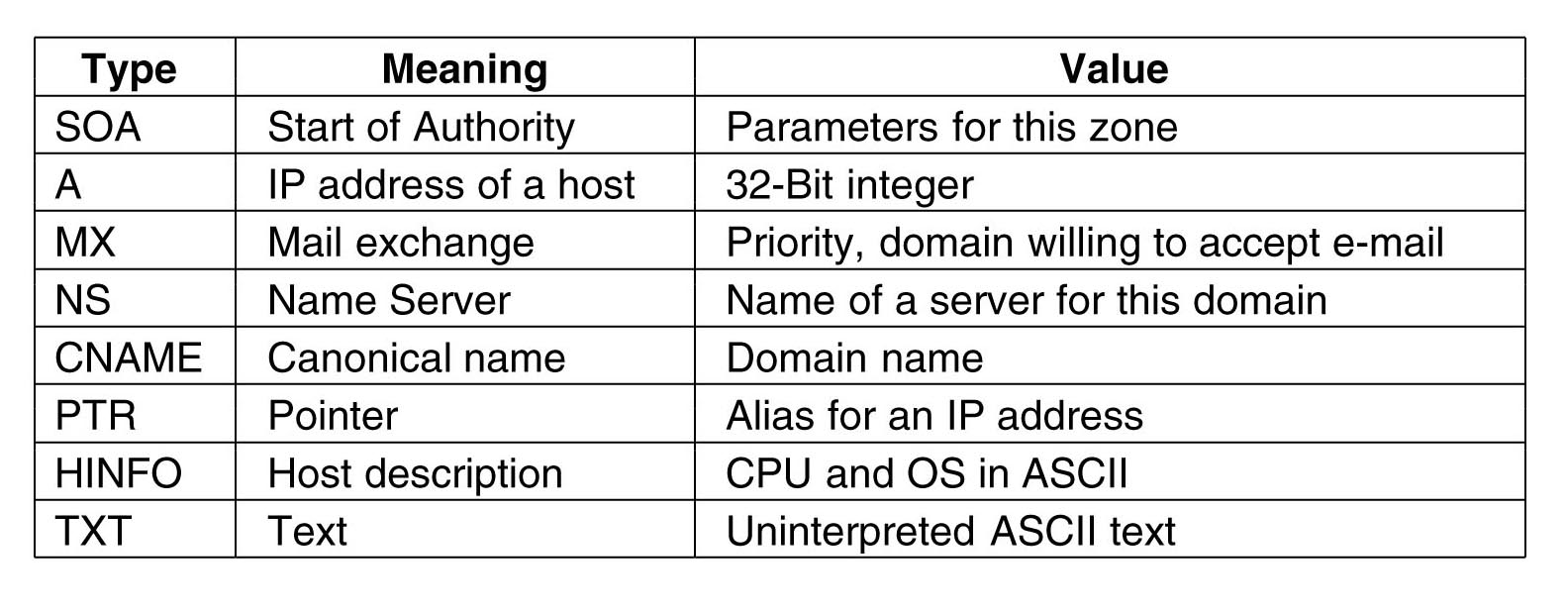
Resource Records (cont’d)
Type - tells what kind of record this is.

Slide 17
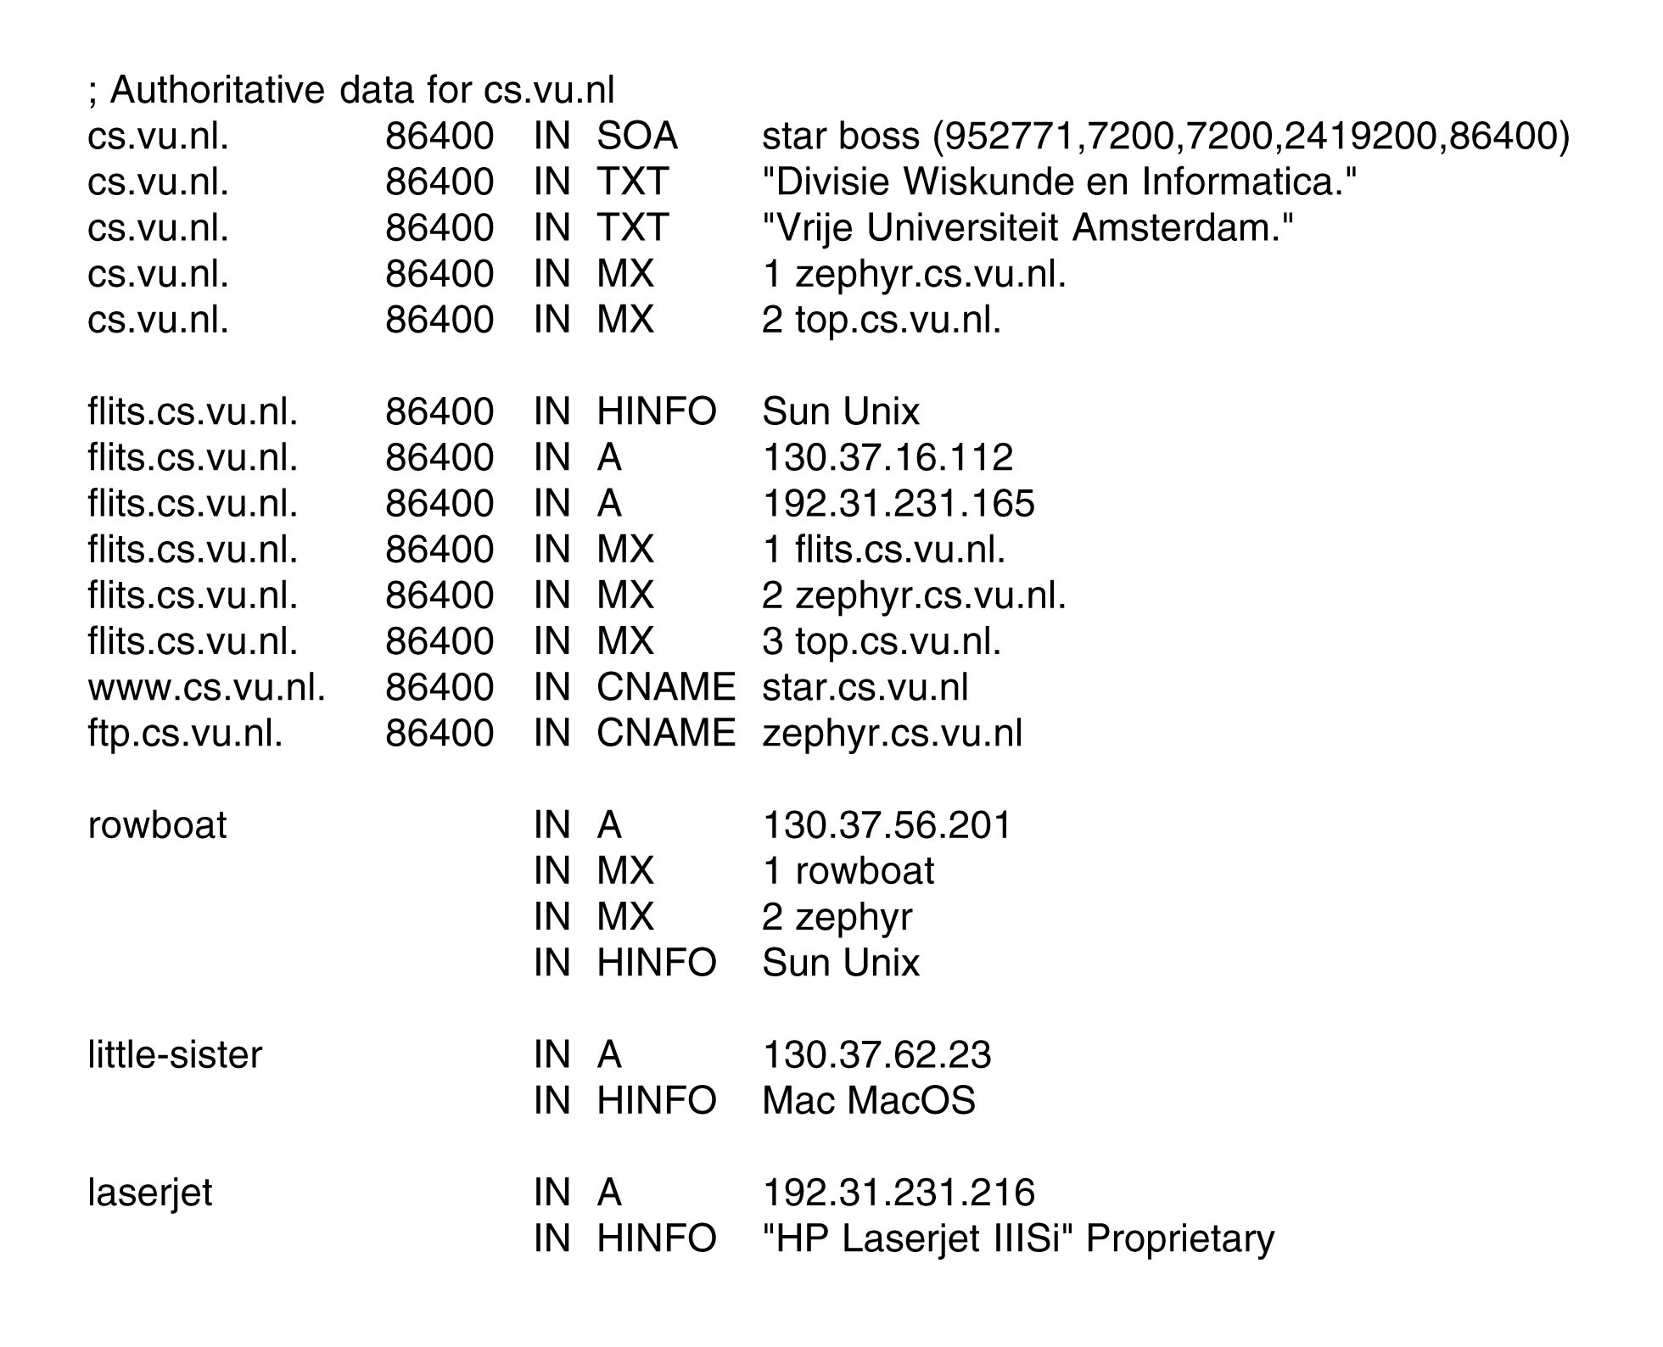
Resource Records Example

Slide 18
Resource Records (cont’d)
Questions for you
  How these records generated and synchronized
  SOA and NS
  DNS hijack and DNS (cache) pollution
Discussion topics for next time

Slide 19
Name Servers
We need more than just one name server for the whole Internet.
The DNS name space is split into non-overlapping zones, each of which has a primary name server.
The primary name server gets its information off of disk, and shares that information with secondary name servers.
Some name servers for a zone can be located outside of the zone to improve reliability.
Where the zone boundaries are placed within a zone it is up to the zone’s administrator. This decision is made based on how many name servers are needed and where.

Slide 20
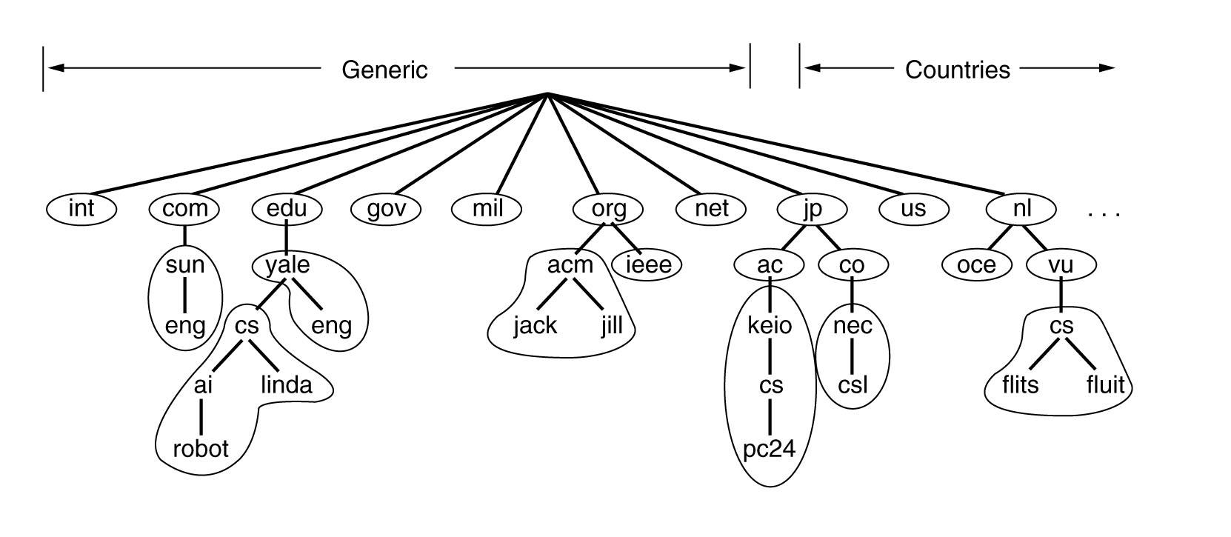
Part of the DNS Name Space Showing the Division Into Zones

Slide 21
Resolving Domain Names
When a resolver has a query about a domain name, it passes the query to one of the local name servers.
If the domain being sought falls under the jurisdiction (权限)of the name server, it returns the authoritative resource records.
  An authoritative record is one that comes from the authority that manages the record and is thus always correct. But cached records may be out of date.
If the domain is remote and no information about the requested domain is available locally, the name server sends a query message to the top-level name server for the domain requested.

Slide 22
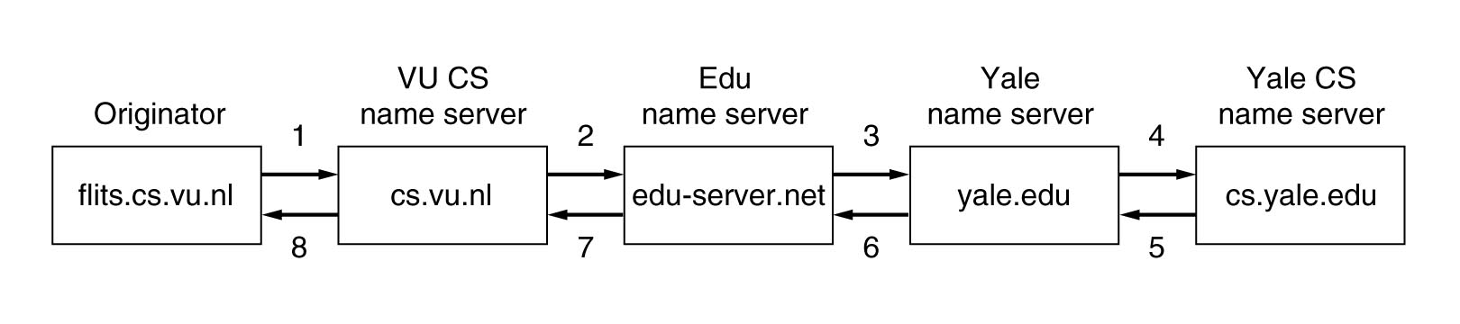
How a Resolver Looks Up a Remote Name in Eight Steps
Recursive query (递归查询、递归解析)
Flits.cs.vu.nl wants to know IP of linda.cs.yale.edu
recursive query（迭代查询）
  Return IP or the name of the next server to try.

Slide 23
Electronic Mail
E-mail system consists of two parts
  User agents(UA), which allow people to read and send email
    Local programs that provide a command based or graphical method for interacting with e-mail system
  Message transfer agents (MTA), which move the messages from source to destination
    Are typically system daemons or processes that run in background, having the job to move messages.

Slide 24
E-mail Message Format
Basic ASCII e-mail message using RFC 822
  Messages consists of a primitive envelope (described in RFC821), some number of header fields, a blank line and then the message body
  Each header field (logically) consists of a single line of ASCII text, a colon（：） and, for most fields, a value
  RFC822 was designed long ago and doesn’t clearly distinguish between the envelope fields and the header fields
    This was revised in RFC 2822, however, wasn’t possible to completely redo it due to the widespread usage
  Users are allowed to invent new headers for their own private use, provided that these headers start with the string X-.

Slide 25
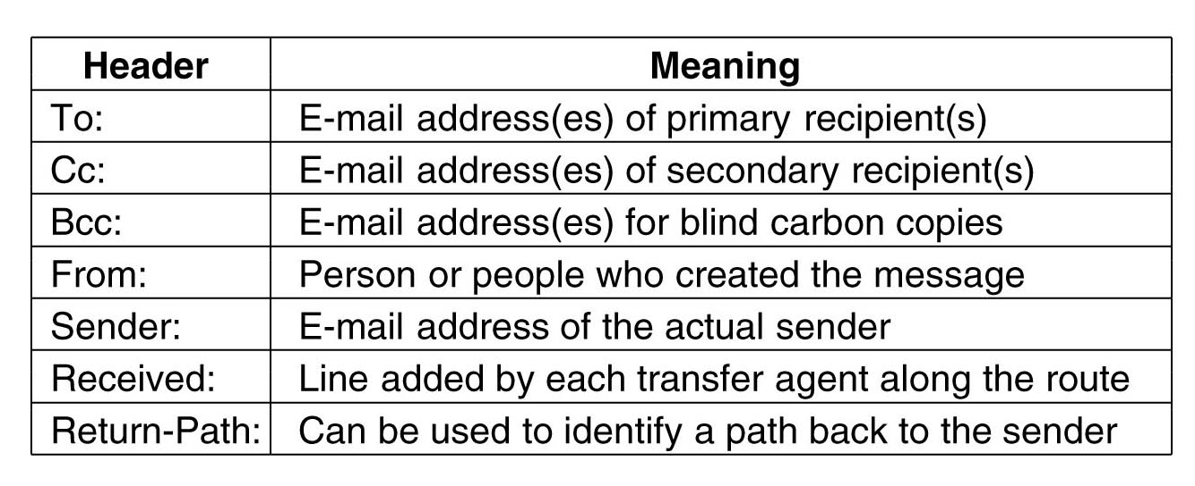
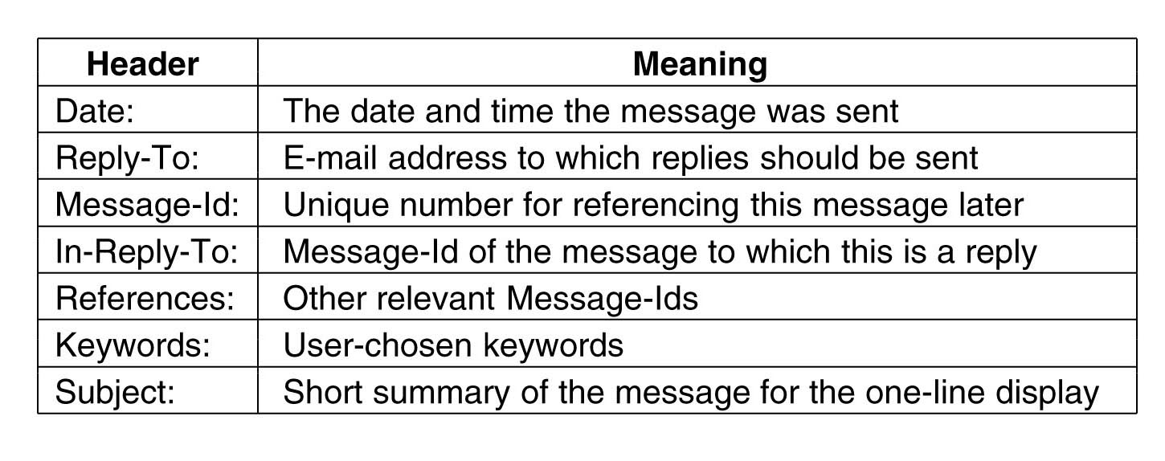
RFC 822 Message Header

Slide 26
E-mail Message Format (cont’d)
MIME – the Multipurpose Internet Mail Extensions
  Solves problems related to send and receive of messages in non Latin alphabets, languages with no alphabets (Chinese or Japanese), messages not containing text at all (video or audio)
  RFC1341 and updated in RFCs 2045-2049.
The basic idea of MIME is to continue to use RFC 822 format, but to add structure to the message body and define encoding rules for non-ASCII messages
  By not deviating the RFC822, MIME messages can be sent using the existing mail programs and protocols
  All it has to be changed is the receiving and sending programs, which each user can do it.

Slide 27
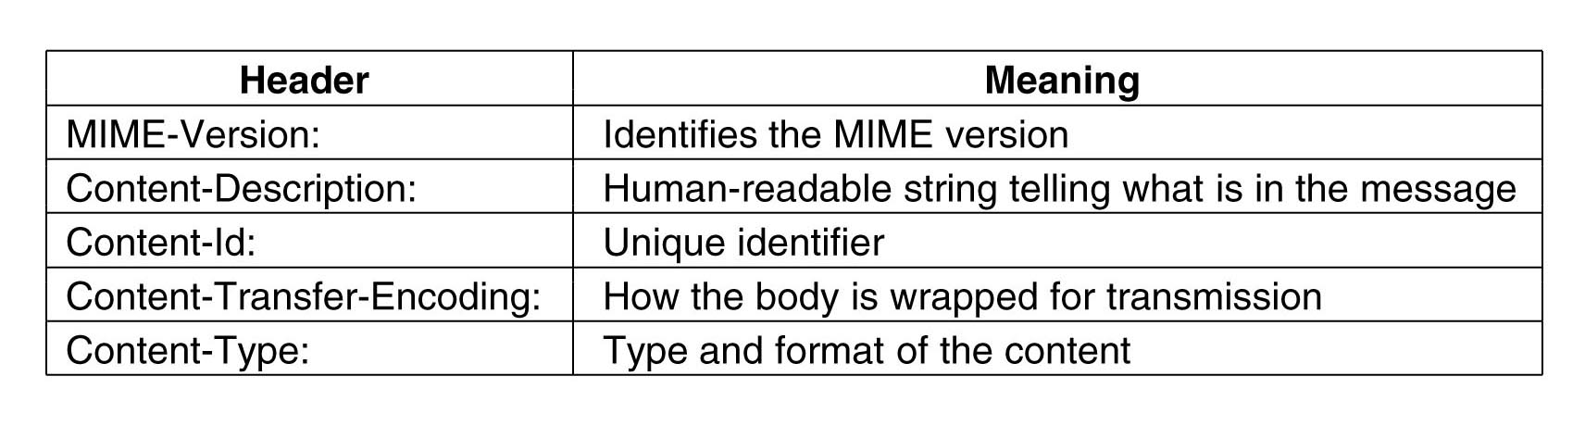
RFC 822 headers added by MIME
Content-Transfer-Encoding
  tells how the body is wrapped for transmission through a network that may object to most characters other than letters, numbers, and punctuation marks.

Slide 28
Email Message Transfer
Message transfer mechanism is concerned with relaying messages from the originator to the destination
  This can be done by establishing an transport level connection between the source and the destination and then just transfer the message
SMTP – Simple Mail Transfer Protocol
  Source machine establishes a TCP connection on port 25 on destination machine, where SMTP daemon listens.
  If a message can’t be delivered, an error report containing the first part of the undeliverable message is returned to the sender

Slide 29
SMTP Protocol （three steps）
Connection establishment (on port 25)
Data exchange
  the client machine (operating as a client) waits for the destination machine (operating as a server) to talk first;
  the server begins by sending a line of text giving its identity and telling whether is prepared to receive mail;
    if it is not, then the client releases the connection and tries again latter
  If the server is willing to accept mail, then the client announces whom the e-mail is coming from and whom it is going to
  If such recipient exists at the server end, then the client get the go-ahead to send the message
  The client sends the message, server acknowledges it
Connection is released

Slide 30
Final Delivery
Assuming that all machines can send and receive mail all the time, the e-mail model so far works
This model breaks for people accessing Internet over a dialup connection
  What happens when John wants to send Mary e-mail and Mary is not currently online?
One solution is to have a message transfer agent on ISP machine; since this transfer agent can be online all the time, e-mail can be sent 24 hours a day
  This solution creates another problem: how does the user gets e-mail from ISP’s message transfer agent
    Solution: create another protocol that allows user transfer agents (on client PCs) to contact the message transfer agent (on ISP’s machine) and allow e-mail to be copied from ISP to the user
    One such protocol is POP3 (Post Office Protocol Version 3), RFC 1939

Slide 31
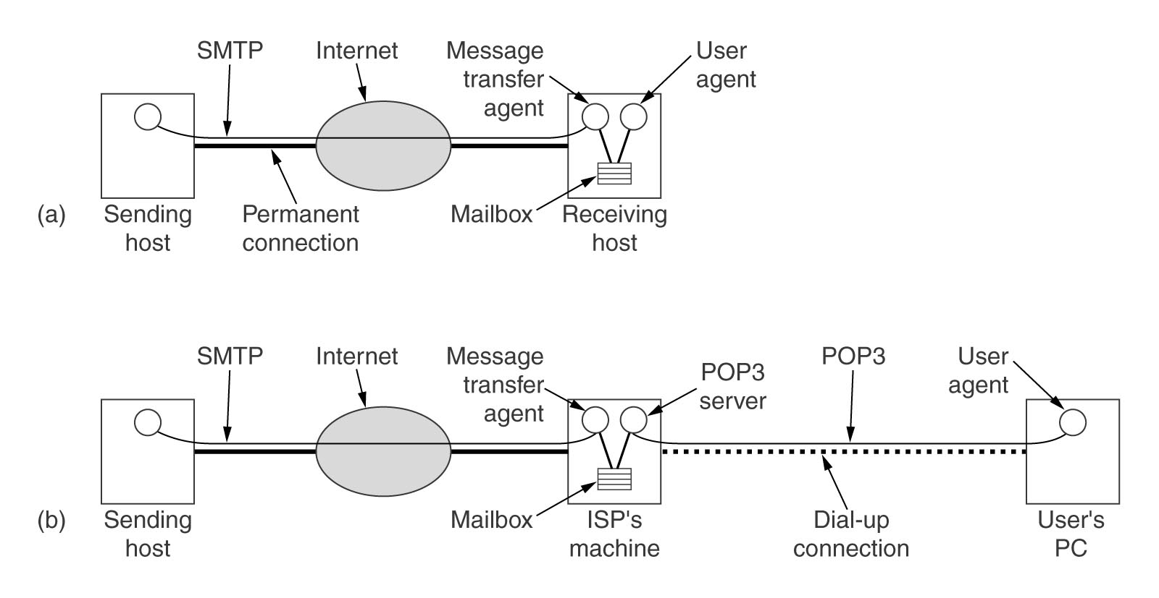
Final Delivery (cont’d)

Slide 32
POP3
Starts when the user starts the mail reader
Mail reader calls up the ISP (if there is no connection) and establishes a TCP connection with the message transfer agent on port 110;
The POP3 protocol goes through three states in sequence:
  Authorization
    Having user logged in by sending its username and password
  Transactions
    User collecting the e-mails and marking them for deletion
  Update
    Causes the e-mails to be deleted

Slide 33
POP3 (cont’d)
USER userid
  This must be the first command after the connect. Supply your e-mail userid (not the full e-mail address). Example: USER john.smith
PASS password
  This must be the next command after USER. Supply your e-mail password. The password may be case sensitive.
STAT
  The response to this is: +OK #msgs #bytes Where #msgs is the number of messages in the mail box and #bytes is the total bytes used by all messages. Sample response: +OK 3 345910
LIST
  The response to this lists a line for each message with its number and size in bytes, ending with a period on a line by itself.
RETR msg#
  This sends message number msg# to you (displays on the Telnet screen). You probably don't want to do this in Telnet (unless you have turned on Telnet logging). Example: RETR 2

Slide 34
POP3 (cont’d)
TOP msg# #lines
  This is an optional POP3 command. Not all POP3 servers support it. It lists the header for msg# and the first #lines of the message text. For example, TOP 1 0 would list just the headers for message 1, where as TOP 1 5 would list the headers and first 5 lines of the message text.
DELE msg#
  This marks message number msg# for deletion from the server. This is the way to get rid a problem causing message. It is not actually deleted until the QUIT command is issued. If you lose the connection to the mail server before issuing the QUIT command, the server should not delete any messages. Example: DELE 3
RSET
  This resets (unmarks) any messages previously marked for deletion in this session so that the QUIT command will not delete them.
QUIT
  This deletes any messages marked for deletion, and then logs you off of the mail server. This is the last command to use. This does not disconnect you from the ISP, just the mailbox.

Slide 35
summary
Function of application layer
DNS
Application
  E-mail

