Slide 1
COMPUTER NETWORKS
- Review
王昊翔
WANG Haoxiang
hxwang@scut.edu.cn
School of Computer Science & Engineering
国家双语教学试点项目 广东省精品课

Slide 2
Chapter 1 Introduction
What is computer network?
Network category
Reference model
  TCP/IP VS. OSI
  Benefits of layered structure
  PDU names
Service VS. Protocol

Slide 3

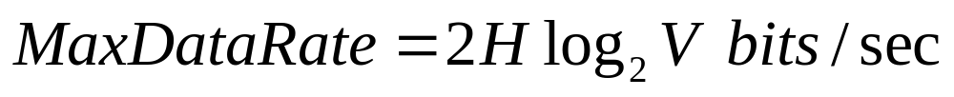
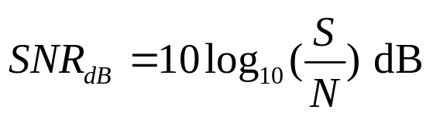

Chapter 2 Physical Layer
Bandwidth – Fourier Series
  Hz and bps
Nyquist theorem
Shannon theory

Slide 4
Chapter 2 Physical Layer(cont’d)
UTP
Copper wires and Optical fiber
Understand modem
  Amplitude modulation(AM)
  Frequency modulation(FM)
  Phase modulation(PM)
  Quadrature Phrase shift keying (QPSK)

Slide 5
Chapter 2 Physical Layer(cont’d)
Master trunk multiplex technology
  Frequency Division Multiplexing
  Time Division Multiplexing
Master circuit-switching ,message switching and packet switching
understand mobile-phone system
  Code division multiple Access (CDMA)

Slide 6
Chapter 3 data link layer
Master framing
  Character count(字符计数法)
  Flag bytes with byte stuffing(带字符填充的首尾界符法)
  Starting and ending flags, with bit stuffing(带位填充的首尾标志法)
  Physical layer coding violations(物理层编码违例法)

Slide 7
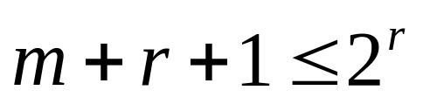
Chapter 3 data link layer(cont’d)
Master error detection and correction
  Haimming distance (definition)
  Error correction: hamming code
    Correct one bit error:
  Error detection:CRC
The error-detecting and error-correcting properties of a code depend on its Hamming distance.
  In order to detect d errors, we need a distance of d+1.
  In order to correct d errors, we need a distance of 2d+1

Slide 8
Error correcting and detecting
Hamming code
CRC

Slide 9
Chapter 3 data link layer(cont’d)
Master 6 dll’s basic protocol
  Utopia
  Stop and wait
  PAR (positive acknowledgement with retransmission ) or ARQ (automatic repeat request)
  One-bit sliding window
  Go back n
  Selective repeat
  Max window sizes!

Slide 10
Chapter 4 MAC sublayer(cont’d)
Multiple Access Protocols
  ALOHA
    Pure ALOHA
    Slotted ALOHA
  Carrier Sense Multiple Access Protocols
    1-persistent CSMA
    Non-persistent CSMA
    p-persistent CSMA
    CSMA/CD (CSMA with Collision Detection)(“先听后发、边发边听”)
  Ethernet and IEEE802.3
  Min frame length！

Slide 11
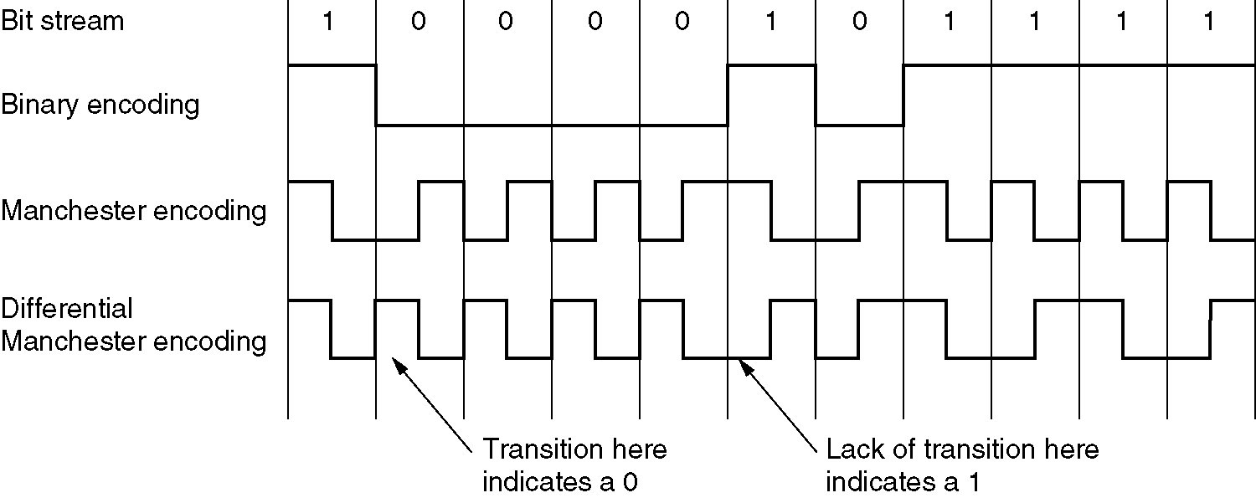
Chapter 4 MAC sublayer(cont’d)
Bit stream encoding methods
  Manchester Encoding
  Differential Manchester Encoding
  Question - Bit stream is 1001101001, sketch three waves:

Slide 12
MAC sublayer
MAC address
Ethernet & IEEE802.3

Slide 13
Working principle of switching
Flooding
Backward learning

Slide 14
Chapter 5 network layer
Routing Protocol
  IGP
    DV:RIP
    LS:OSPF
Routed Protocol
  IPv4
  IPv6
BGP

Slide 15
Routing algorithm
Routing algorithm
  Static routing algorithm
    Dijkstra
    flooding
  Dynamic routing algorithms
    DV
    LS
    Comparisons

Slide 16
IPv4
Main function of router
Learn IP
  IP packet format
  IP address and it’s classification
Reserved IPv4 address

Slide 17
Other protocol and technology
Subnet and subnetting
The idea of CIDR
The principle of NAT/PAT

Slide 18
Sup. :IPv6
Advantage of IPv6
Differences with IPv4

Slide 19
Chapter 6 transport layer
UDP (segment)
TCP (segment)
Pseudo header. (why?)
Socket
Transport layer and network layer (why?)
Comparation

Slide 20
Chapter 7 Application layer
DNS
  Working principle
  Using UDP(why?)

Slide 21
Lab sessions
Router operations
Networking
Socket

Slide 22
THANKS!
BEST of LUCK!
hxwang@scut.edu.cn

