Slide 1
COMPUTER NETWORKS 2022: Fall
- Chapter1.2: Architecture
王昊翔
WANG Haoxiang
hxwang@scut.edu.cn
School of Computer Science & Engineering
国家双语教学试点项目 广东省精品课

Slide 2
Contents
How to design
Layered Model
OSI
TCP/IP of Internet
Standardization

Slide 3
Design Issues for the Networks
Addressing
Error control
flow control
routing
multiplexing and de-multiplexing

Slide 4
Network Architecture
Layered Network Model
What is the Protocol
What is the Service, Service Primitives
Relationship of Services and Protocols
Software、Soften and Programmable

Slide 5
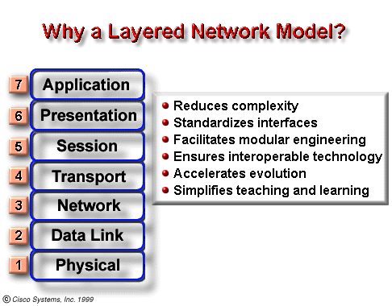
Layered Network Model (OSI)
Support varieties

Slide 6
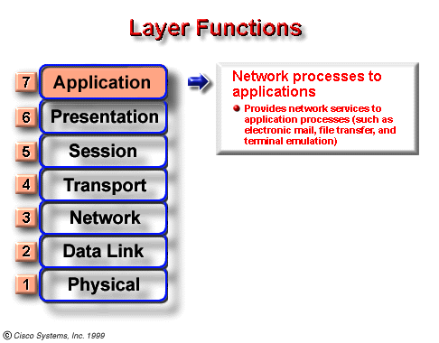
OSI Model Application Layer

Slide 7
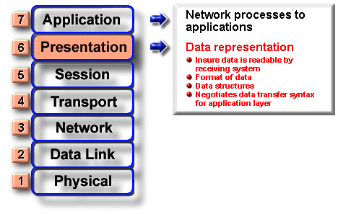
OSI Model Presentation Layer

Slide 8
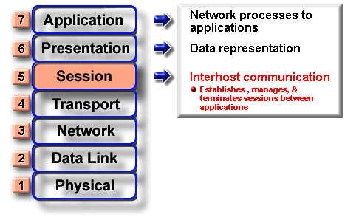
OSI Model Session Layer

Slide 9
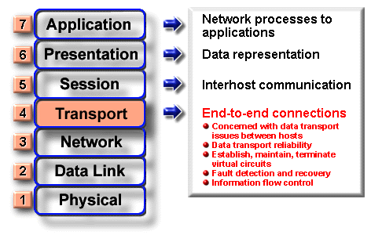
OSI Model Transport Layer

Slide 10
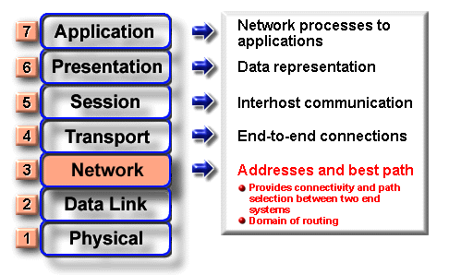
OSI Model Network Layer

Slide 11
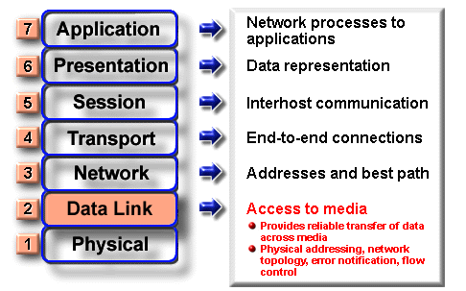
OSI Model Data Link Layer

Slide 12
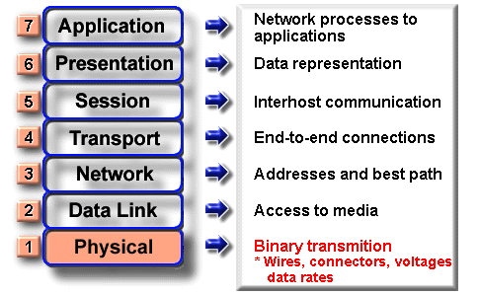
OSI Model Physical Layer

Slide 13
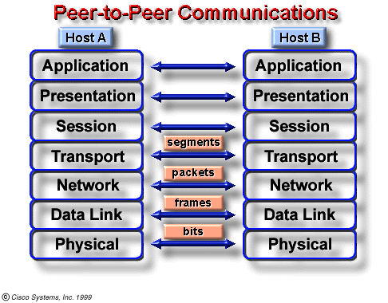
Peer-to-Peer Communications
Protocol is the most important !

Slide 14
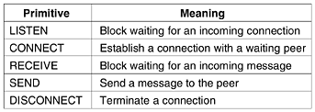
Service Primitives

Slide 15
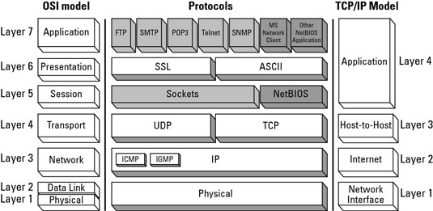
Discussion (3)
OSI v.s. TCP/IP?

Slide 16
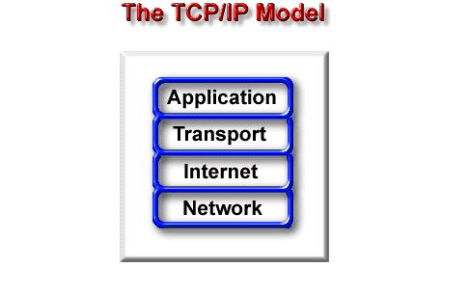
OSI: XNS, Novell-IPX, MS-NetBEUI
network itf
itf layer
Physical + DataLink Layers :Ethernet

Slide 17

Discussion (4)
Services v.s. Protocols?

Slide 18
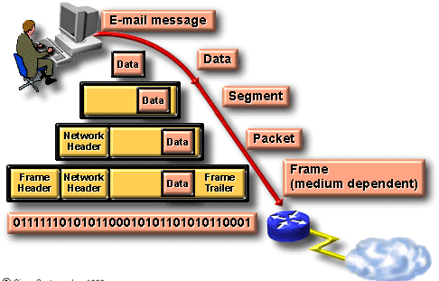
Information Encapsulation Exp.

Slide 19
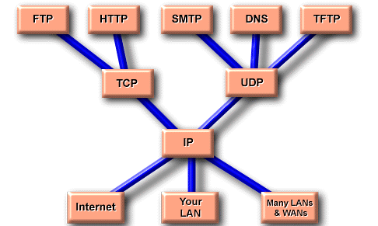
Protocol Graph: TCP/IP
file transport protocol
hypertext transfer protocol
simple mail transport protocol
domain name service
trivial file transport protocol
You can add more and more applications

Slide 20
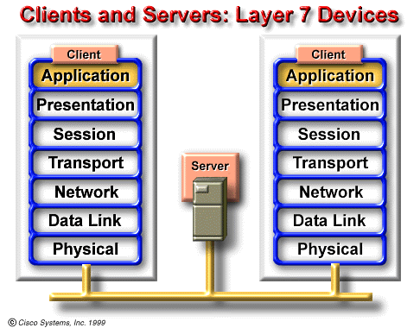
Example: Client/Server
They operate at all 7 layers of the OSI model. They perform the entire process of encapsulation and decapsulation to do their job of sending e-mails, printing reports, scanning pictures, or accessing database.

Slide 21
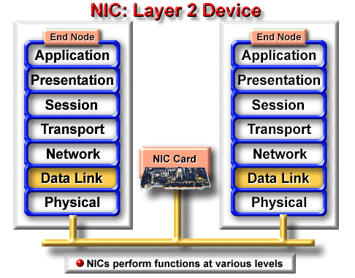
Example: NIC
.
A network interface card (NIC card or NIC) is a small printed circuit board that fits into the expansion slot of a bus on a computer’s motherboard or peripheral device network adapter.

Slide 22
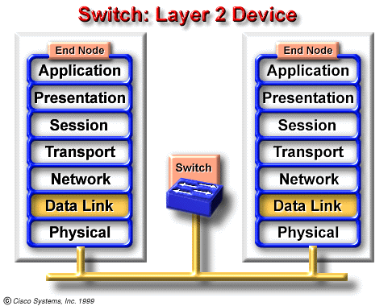
Example: Switch
It switches packets from incoming ports (interfaces) to outgoing ports, while providing each port with full bandwidth

Slide 23
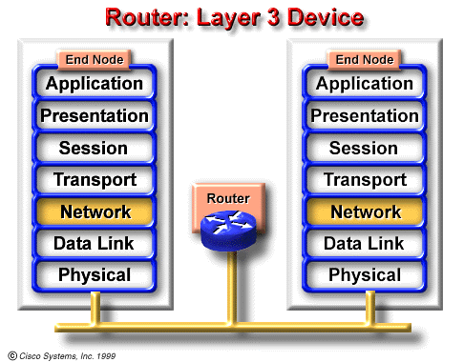
Example: Router
The symbol for a router is suggestive of its two primary purposes path selection, and switching of router routes, and packets.

Slide 24
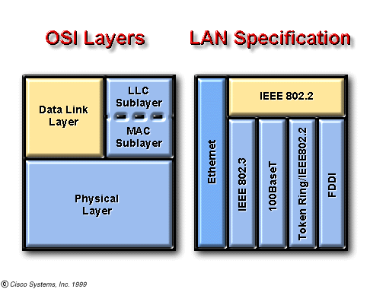
TCP/IP protocols’ friend
Notes:
Logical Link Control. Higher of the two data link layer sublayers defined by the IEEE. The LLC sublayer handles error control, flow control, framing, and MAC-sublayer addressing. The most prevalent LLC protocol is IEEE 802.2, which includes both connectionless and connection-oriented variants. See also data link layer and MAC.

Slide 25
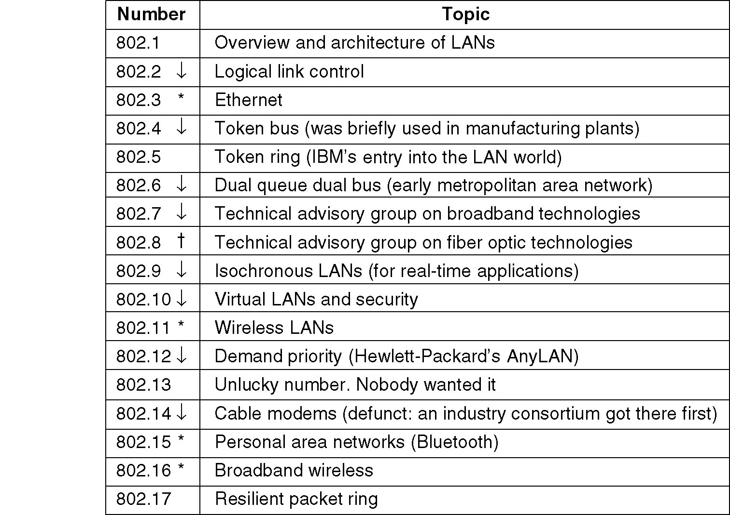
The IEEE 802 working groups

Slide 26
Network Standardization
ITU (International Telecommunication Union)
ISO (International Standards Organization )
ANSI (American National Standards Institute)
NIST (National Institute of Standards and Technology)
IEEE (Institute of Electrical and Electronics Engineers)
RFCs (Request For Comments).
IRTF (Internet Research Task Force)

Slide 27
Presentation 1
For a good talk
Orgonization: Structure, acknowledge or refs.
Presentation：Visually; orally; body language...
Timing: ~20mins(15-20 min?)
Q&A

Slide 28
Many thanks:
Cisco Academy.
Your task:
Yuketang &
Layered Structure ？&
Compare TCP/IP and OSI ?

