Slide 1
COMPUTER NETWORKS 2023 Fall
- Chapter 2. The Physical Layer 2
王昊翔
WANG Haoxiang
hxwang@scut.edu.cn
School of Computer Science & Engineering
国家双语教学试点项目 广东省精品课

Slide 2
Outline
Structure of the Telephone System
The Local Loop: Modems, ADSL and Wireless
Trunks and Multiplexing
Switching

Slide 3
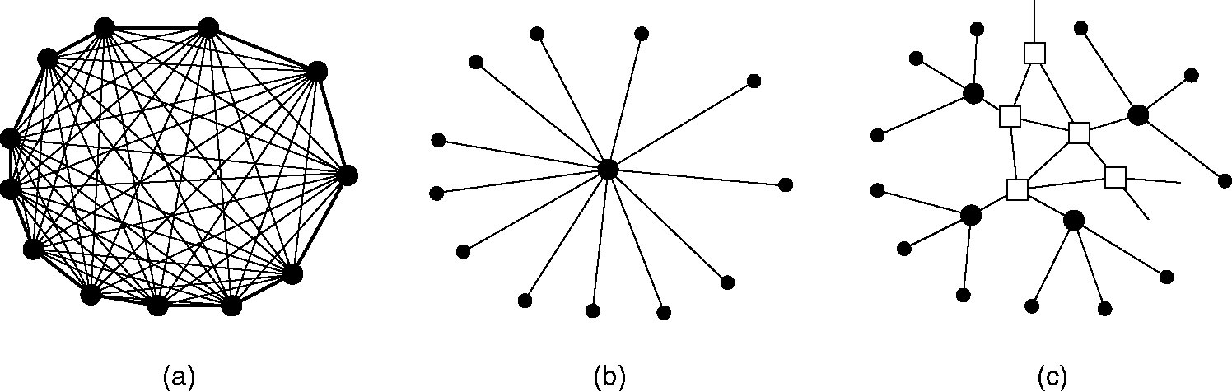
Structure of the Telephone System
The PSTN (Public Switched Telephone Network) is the world's collection of interconnected voice-oriented public telephone networks. It's also referred to as the POTS (Plain Old Telephone Service).
(a) Fully-interconnected network.
(b) Centralized switch.
(c) Two-level hierarchy.

Slide 4
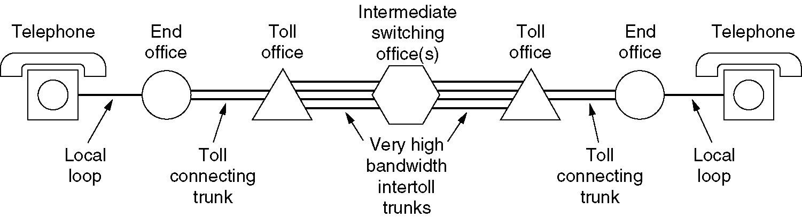
Structure of the Telephone System
A typical circuit route for a medium-distance call.

Slide 5
Components of the Telephone System
Local loops
Analog twisted pairs going to houses and businesses
Trunks
Digital fiber optics connecting the switching offices
Switching offices
Where calls are moved from one trunk to another

Slide 6
The Local Loop
Transmission lines suffer from three major problems:
Attenuation
Delay distortion
Noise
The square waves used in digital signals have a wide frequency spectrum (usually, high frequency) and thus are subject to strong attenuation and delay distortion.

Slide 7
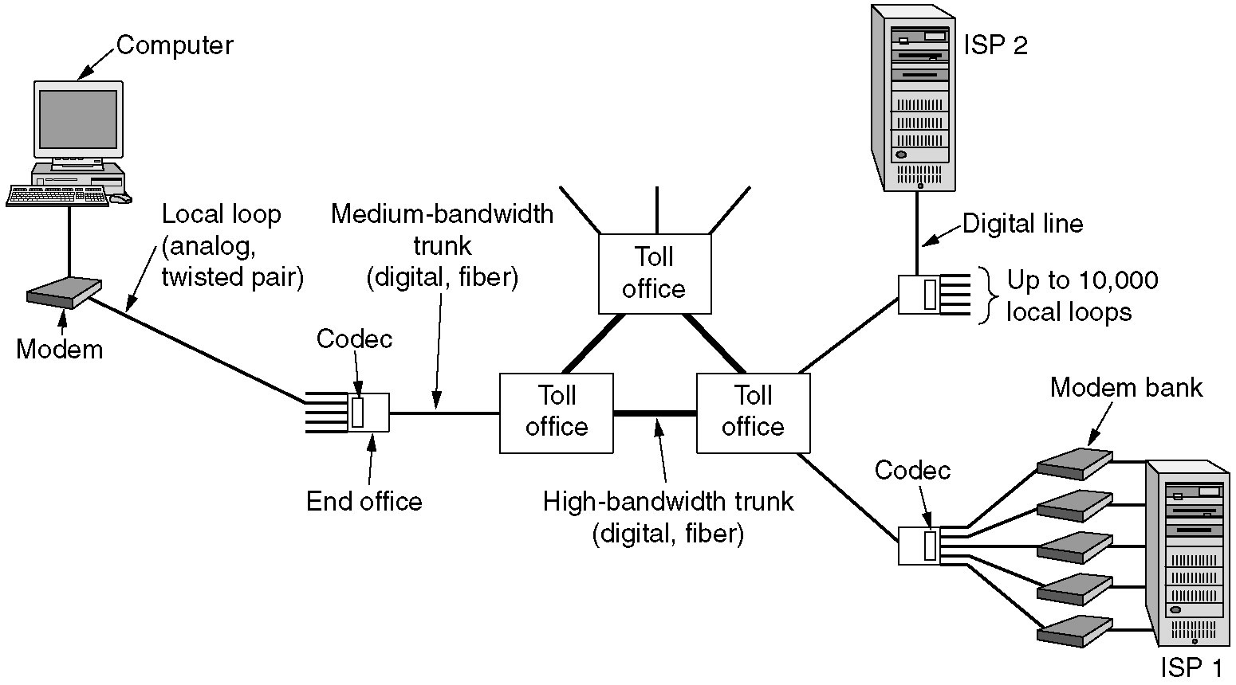
Modems
The use of both analog and digital transmissions for a computer to computer call. Conversion is done by the modems and codecs.

Slide 8
Modems
The modulation is introduced to solve this problem.
Amplitude: two different amplitudes are used to represent 0 and 1.
Frequency: different tones are used.
Phase: the wave is systematically shifted (45, 135, 225, or 315º).
A modem (modulator-demodulator) is a device that modulates outgoing digital signals to analog signals.

Slide 9
Terms
Data element, bits, a signal binary 0 or 1
Data rate, bits per second, the rate at which data elements are transmitted.
Signal elements/Symbol
Signal rate or modulation rate, signal elements per second (baud), the rate at which signal elements are transmitted.
Notes:
A digital signal is a sequence of discrete, discontinuous voltage pulses. Each pulse is a signal element. Binary data are transmitted by encoding each data bit into signal elements. One-to-one correspondence between data bit and signal elements. Similarly, a digital bit stream can be encoded onto an analog signal as a sequence of signal elements. Each signal element is pulse of constant frequency, phase and amplitude.
The duration of a bit is the amount of time it takes for the transmitter to emit the bit. At which the signal level is changed.

Slide 10
Basic Encoding Techniques
Digital data to analog signal
Amplitude-shift keying (ASK)
Amplitude difference of carrier frequency
Frequency-shift keying (FSK)
Frequency difference near carrier frequency
Phase-shift keying (PSK)
Phase of carrier signal shifted
Notes:
The case of transmitting digital data using analog signals. Public telephone network is designed to receive, switch and transmit analog signal in the voice-frequency range 300-3400Hz. Some digital devices attached to the telephone network via a modem (modulator-demodulator), which converts digital data to analog signals, vice verse.
Three encoding or modulation techniques.

Slide 11
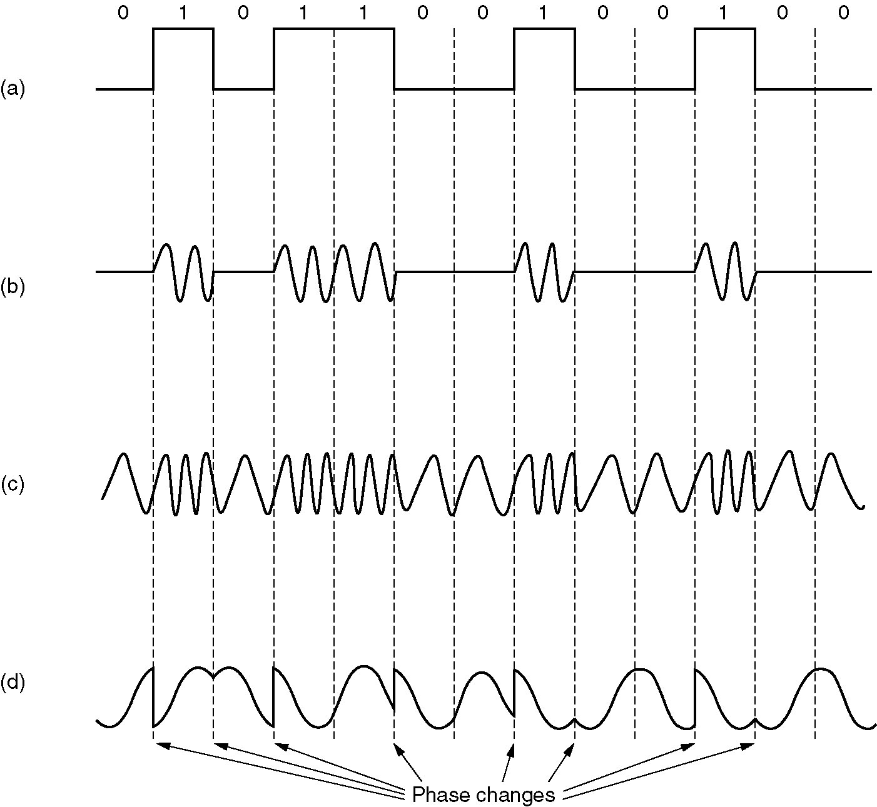
Modulation of analog signals
(a) A binary signal
(b) Amplitude modulation
(c) Frequency modulation
(d) Phase modulation

Slide 12
Modems
The number of samples/symbols per second is measured in baud.
In quadrature phase-shift keying (QPSK四相/正交相移键控), the four angles, usually out of phase by 90°, are used to transmit 2 bits/symbol. The bit rate is twice the baud rate.
QAM-64 (Quadratrue Amplitude Modulation正交幅度调制-64) allows 64 different combinations, so 6 bits can be transmitted per symbol.

Slide 13
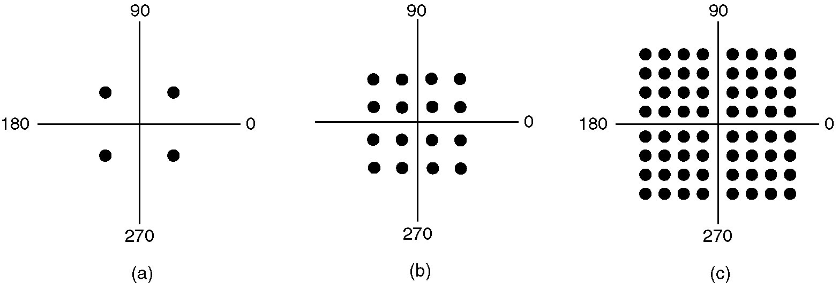
Modems
Constellation Diagrams:
(a) QPSK.
(b) QAM-16.
(c) QAM-64.

Slide 14
Modems
A connection that allows traffic in both directions simultaneously is called full duplex.
A connection that allows traffic either way, but only one way at a time is called half duplex.
A connection that allows traffic only one way is called simplex.

Slide 15
Trunks and Multiplexing
Two categories of multiplexing schemes are used to multiplex many conversations over a single physical trunk:
In FDM (Frequency Division multiplexing), the frequency spectrum is divided into frequency bands. For fiber optic channels, WDM (Wavelength Division Multiplexing) is used.
In TDM (Time Division Multiplexing), the entire bandwidth is used for a chunk of time period.

Slide 16
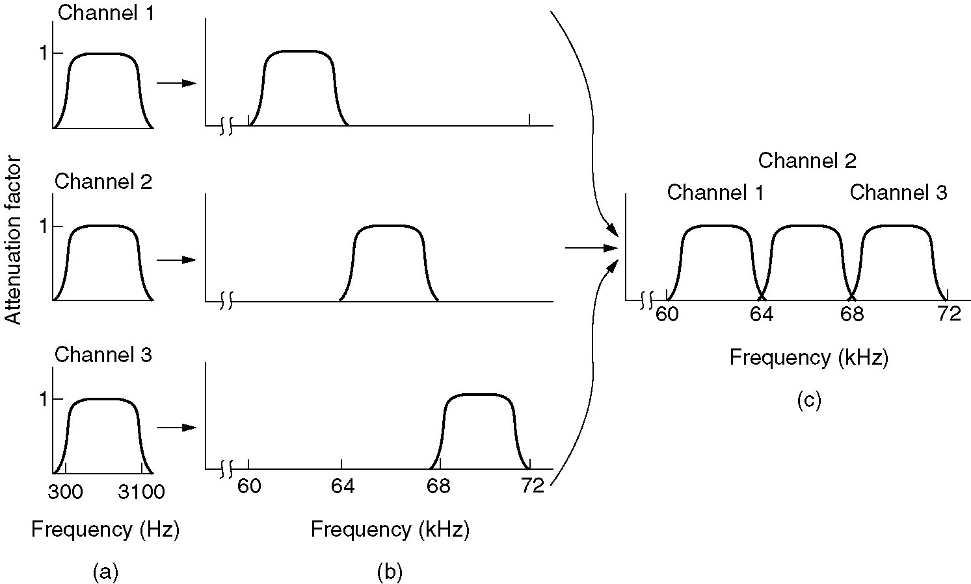
Frequency Division Multiplexing
(a) The original bandwidths.
(b) The bandwidths raised in frequency.
(b) The multiplexed channel.

Slide 17
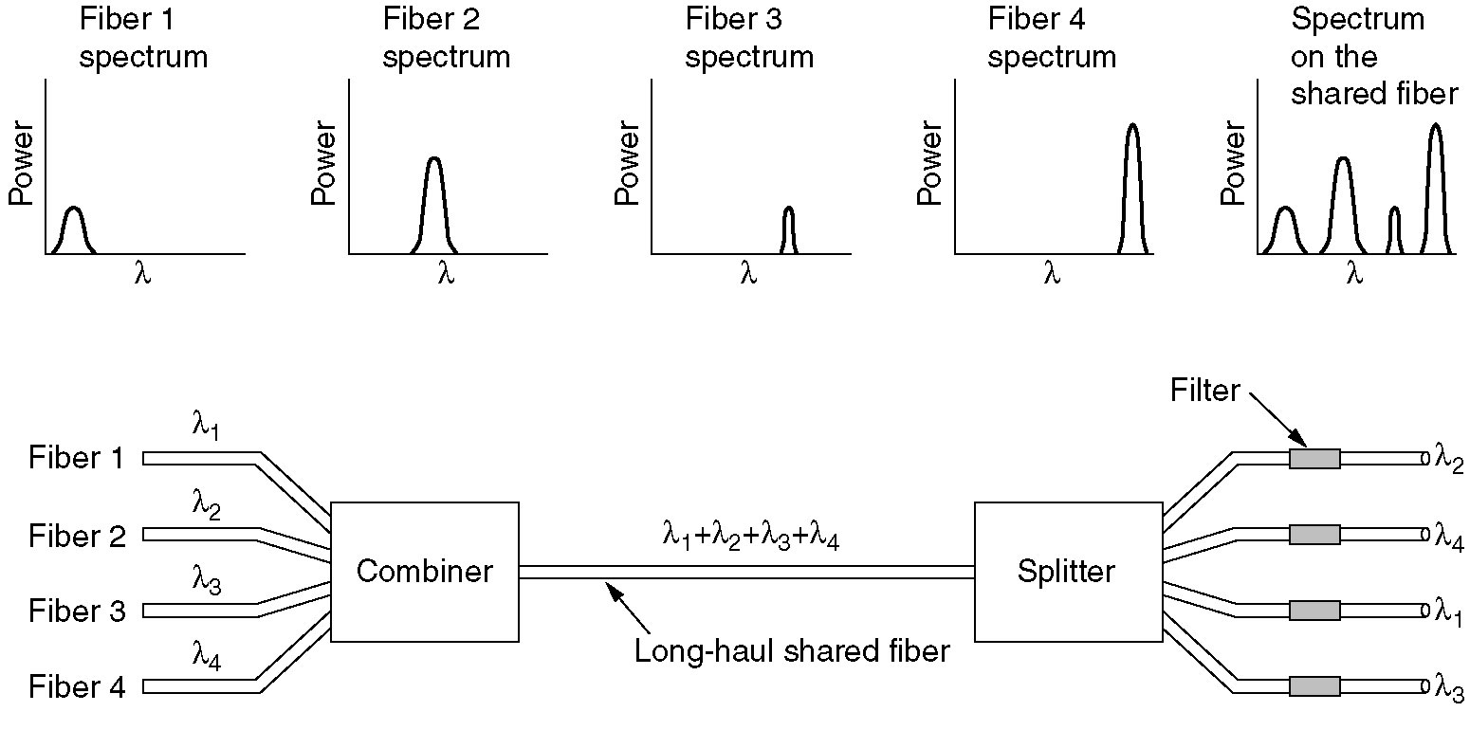
Wavelength Division Multiplexing
Wavelength division multiplexing.

Slide 18
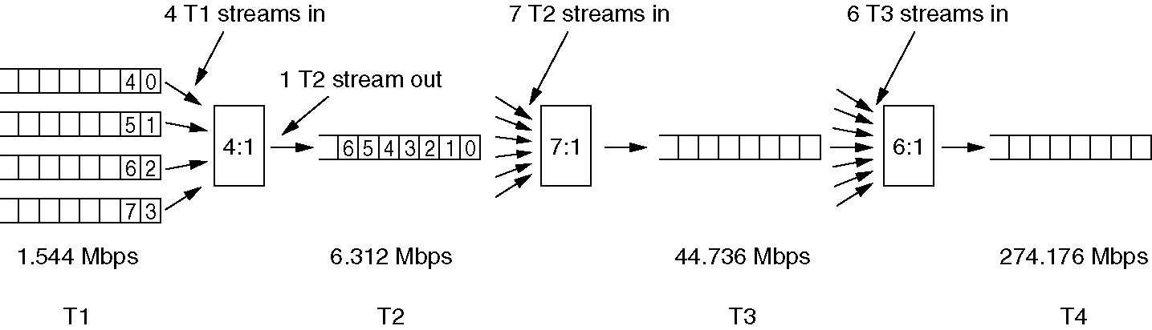
Time Division Multiplexing
Multiplexing T1 streams into higher carriers.

Slide 19
Switching
Circuit switching – seek out a physical path from sender to receiver. An end-to-end path must be (conceptually) established before data is sent.
Message switching – no path is established in advance. The message is stored in the first switching office and forwarded later one hop at a time.
Example: store-and-forward network
Problem: No restriction of block size
Packet switching – place a restriction on block size, to allow packets to be buffered in main memory at the switching office.
Advantages:
Well-suited for interactive traffic
Improved response time and throughput

Slide 20
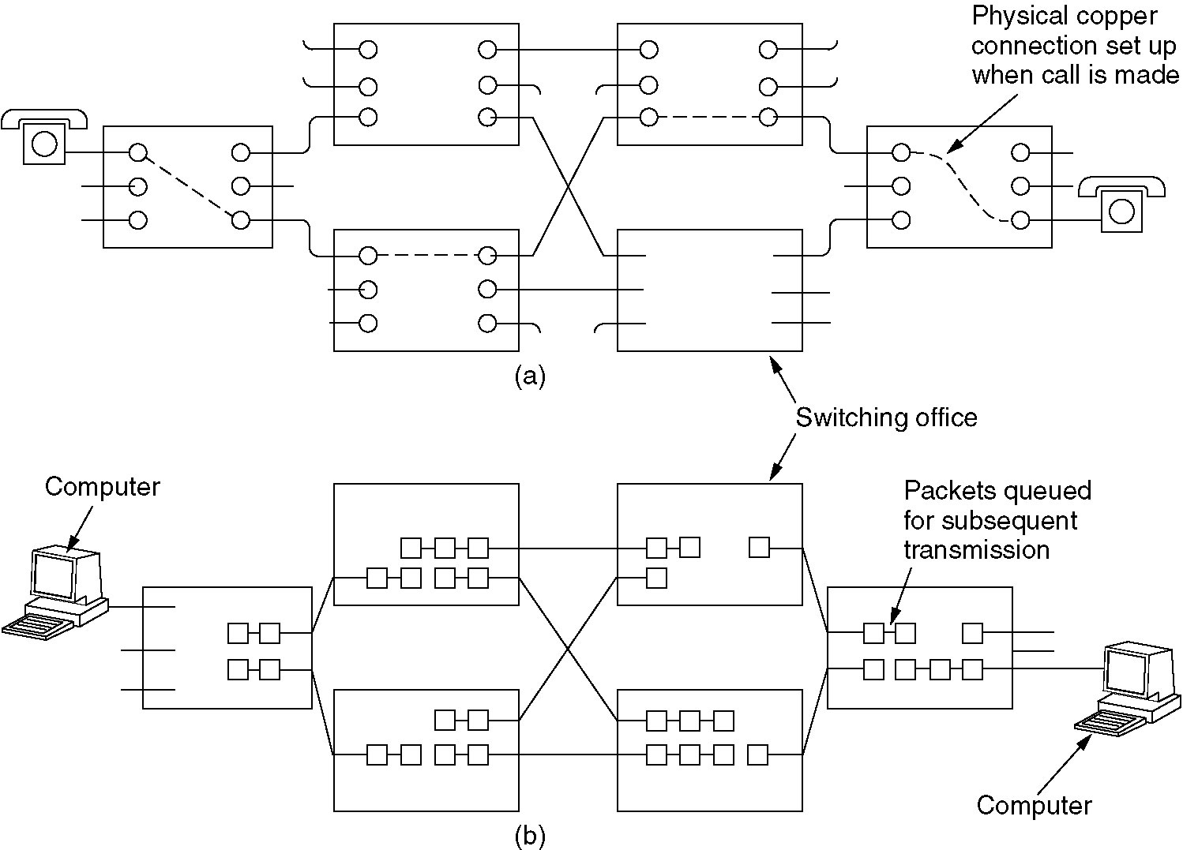
Circuit Switching
(a) Circuit switching.
(b) Packet switching.

Slide 21
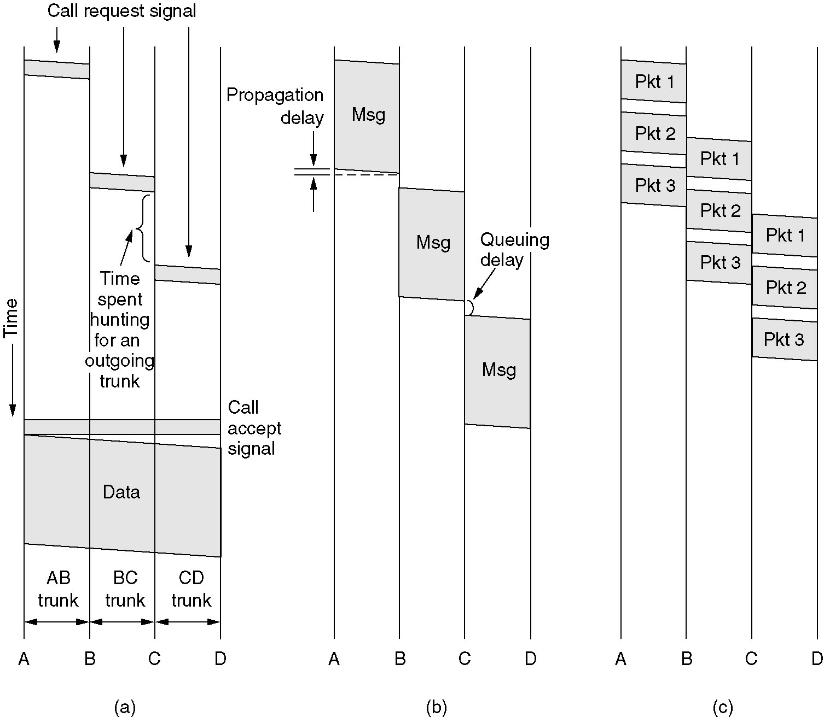
Message Switching
(a) Circuit switching (b) Message switching (c) Packet switching

Slide 22
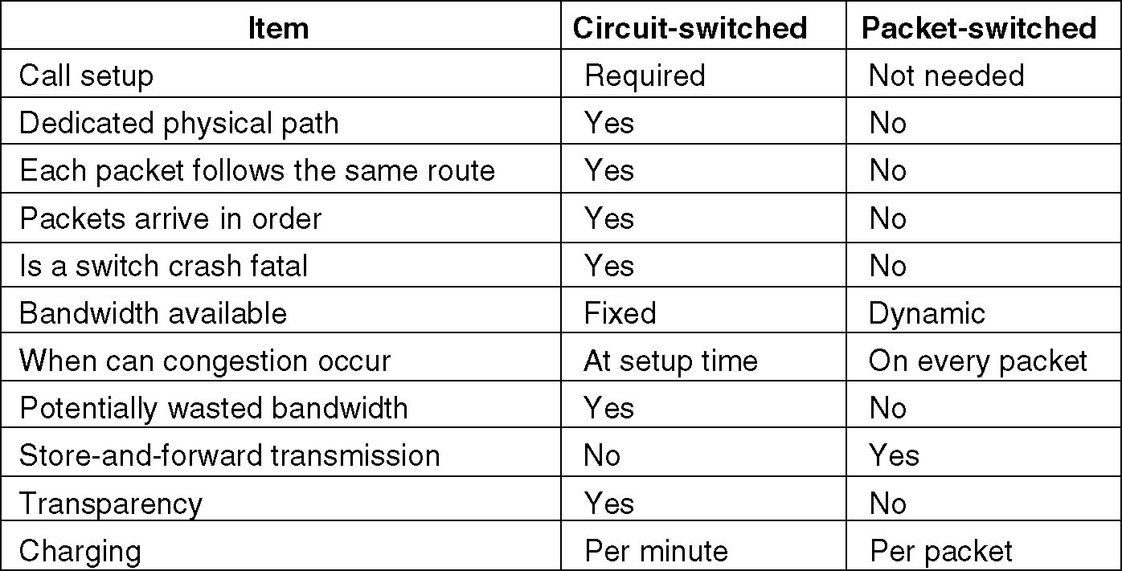
Packet Switching
A comparison of circuit switched and packet-switched networks.

Slide 23
Presentations
Wireless Transmission
Mobile telephone system

Slide 24
Presentation

