Slide 1
COMPUTER NETWORKS 2023 Fall
- Chapter 2. The Physical Layer 3
王昊翔
WANG Haoxiang
hxwang@scut.edu.cn
School of Computer Science & Engineering
国家双语教学试点项目 广东省精品课

Slide 2
Second Generation Mobile Phones: Digital Voice
CDMA: Code Division Multiple Access
In an airport lounge with many pairs of people conversing:
TDMA: take turns speaking
FDMA: people in widely separated clumps, each clump holding its own conversation
CDMA: all talking at once, but with each pair in a different language
The key to the CDMA is to be able to extract the desired signal while rejecting everything else as random noise.

Slide 3
Second Generation Mobile Phones: Digital Voice
CDMA: Code Division Multiple Access
In CDMA, each bit time is subdivided into m short intervals called chips. Typically, there are 64 or 128 chips per bit.
Each station is assigned a unique m-bit code called a chip sequence. To transmit a 1 bit, it sends its chip sequence. To transmit a 0 bit, it sends the 1’s complement of its chip sequence.

Slide 4
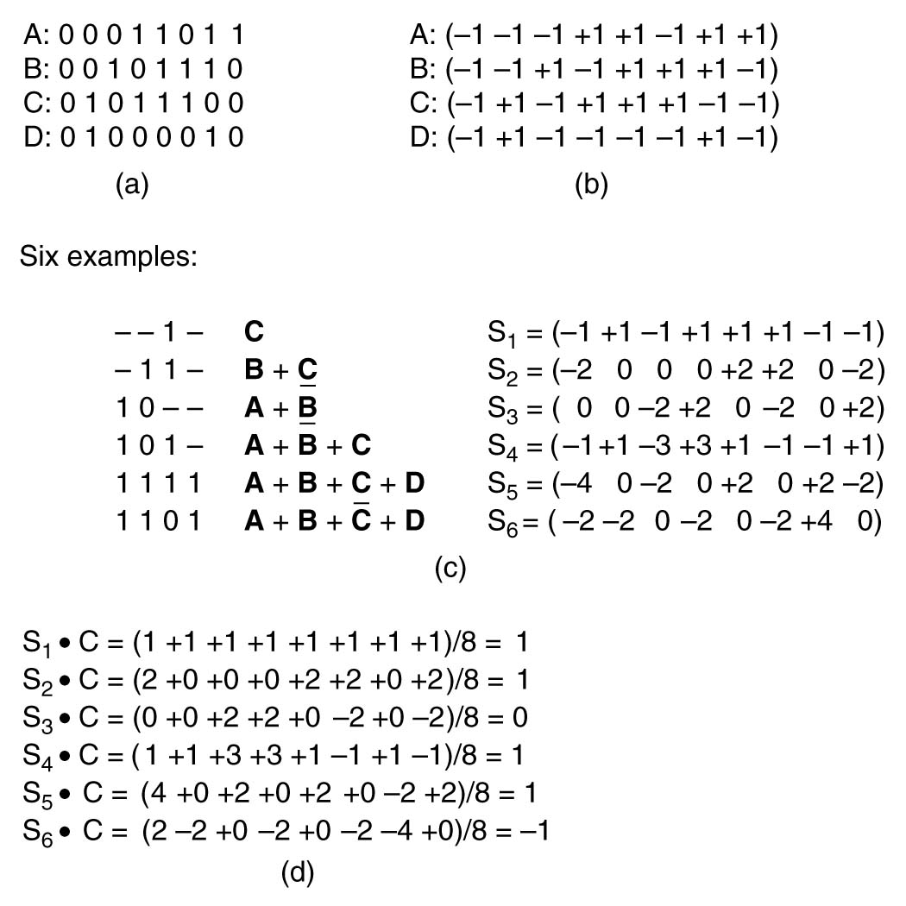
Second Generation Mobile Phones: Digital Voice
CDMA: Code Division Multiple Access
(a) Binary chip sequences for four stations
(b) Bipolar chip sequences
(c) Six examples of transmissions
(d) Recovery of station C’s signal

