Slide 1
Chapter5 Network Layer(1)
2023 Fall
王昊翔：hxwang@scut.edu.cn
School of Computer Science & Engineering ,SCUT
Communication & Computer Network key-Lab of GD

Slide 2

Main object of the chapter5
How packets transport from source to destination?
How to select a path?
  Routing protocol, Router
  Routed protocol: IPv4,IPv6
  Others

Slide 3
Contents of the first part(5.1~5.3 )
Outline of network layer
Outline of Routing algorithm
Learn Dijkstra algorithm
Distance-vector algorithm ：Rip
Link state routing algorithm ：OSPF
Multi-level routing, broadcast routing, mobile routing, adhoc routing, p2p, and et al.

Slide 4
Outline of the lecture
Main function of network layer
Routing algorithm
  Static routing algorithm
    Dijkstra
    flooding
  Dynamic routing algorithm
    DV
    LS
Learn Dijkstra algorithm

Slide 5
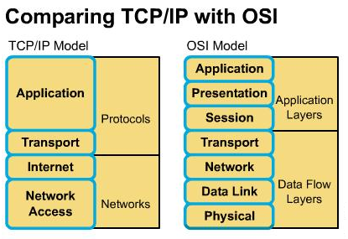
Position of network layer

Slide 6
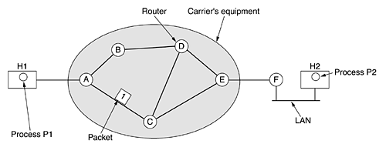
Main function of network layer
Main function is: transport packet from source to destination all the way.

Slide 7
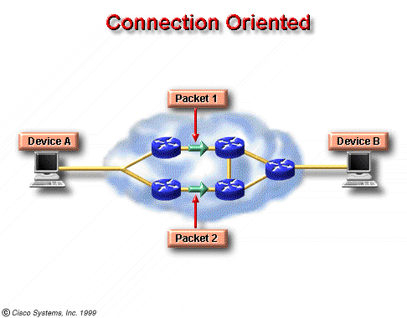
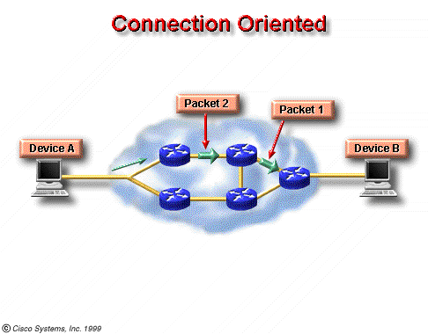
Service types provided by network layer
Connection oriented service：X.25, ATM
Connectionless service：IP
Connectionless

Slide 8
Structure of communication subnet
Virtual-circuit subnet
  Select a path when connection is established
  Each packet has a connection-number
  Connection is removed when communication is over
Datagram subnet
  Each datagram has destination-address
  Each datagram look for path independently

Slide 9
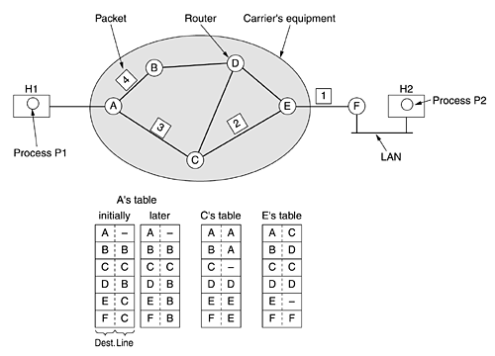
Connectionless service—datagram subnet
jam

Slide 10
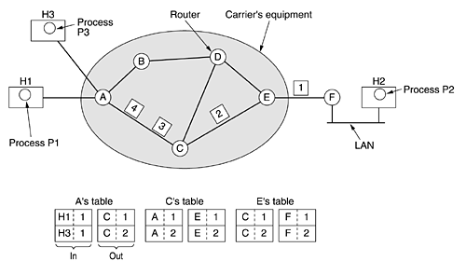
Connection-oriented Serv.-virtual circuit Subnet

Slide 11


Slide 12

Question
Does virtual-circuit subnet not need path-select (routing algorithm)?
(是否虚电路子网不需要路由选择算法？)

Slide 13
How is routing table set up?
Static routing
  Configured by administrator: ip route
Dynamic routing
  Routing algorithm
    Distance vector routing（D-V）
    Link state routing（L-S）

Slide 14
Static routing and dynamic routing
Routing table entry that is configured by administrator is called static routing
  Fit for small, stable network，cost less
  Default routing：both of destination network address and subnet mask is 0.0.0.0，as:
  Can use Windows route print, check routing table
Routing table entry that is obtained by routing protocol is called dynamic routing
  Fit for big, variational network，cost more
网络 | 网络地址 | 网络掩码 | 网关 | 接口 | 跳数
 | 0.0.0.0 | 0.0.0.0 | 203.74.205.1 | 203.74.205.1 | 1

Slide 15
Routing protocol classification
Routed protocol
  example：IP、IPX
Routing protocol
  Distance vector routing
  Link state routing
  Hybrid routing

Slide 16
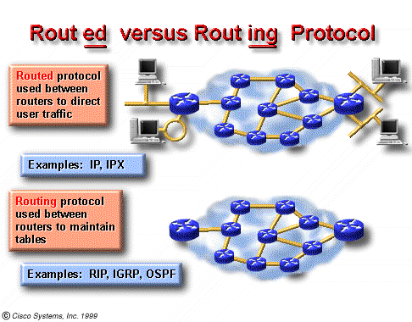
Routed protocol VS. routing protocol

Slide 17
Routing algorithm
What is routing algorithm?
Routing algorithm design must consider following issue:
  Correctness, simplicity, robustness, stability, fairness, and optimality (contradictory、trade-off)
Classification of routing algorithm
  Static algorithm（not self-adaptive）
  Dynamic algorithm（ self-adaptive ）

Slide 18
Metric in routing algorithm
Alias：cost，量度、代价、开销、成本
Common metric
  Path length：hop (跳数)
  reliability：error rate on line
  delay
  bandwidth
  Load of router
  Communication cost

Slide 19

Optimization principle（最优化原理）
if router J is on the optimal path from router I to router K, then the optimal path from J to K also falls along the same route
the set of optimal routes from all sources to a given destination form a tree (called sink tree) rooted at the destination

Slide 20
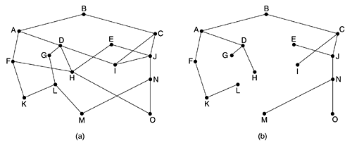
Sink tree(汇集树)
a sink tree is not necessarily unique
The goal of all routing algorithms is to discover and use the sink trees for all routers

Slide 21
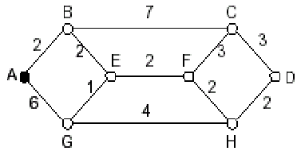
Shortest path routing
Dijkstra algorithm（1959）：compute shortest path using weight on communication-line
Pay attention：
  path with lest line may not be shortest path
  The shortest path may be the fastest one

Slide 22
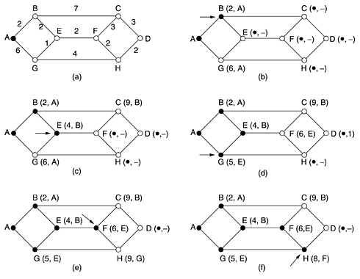
原理
Working node
update
10,H

Slide 23
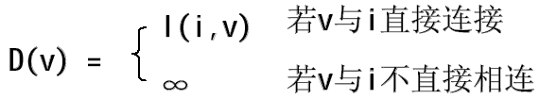
Dijkstra algorithm steps（1/2）
1. Initialization
Suppose node i is source node, N = {i}，for all nodes which is not included in collection:
“∞” can be replaced by “any number bigger more than path ”, such as 10⁹

Slide 24
Dijkstra algorithm steps（1/2）
2. look for a node w which is not included in collection N，whose D(w) is lest，and put w into N; Then for all nodes which are not included in N, using min[D(v)，D(w) + l(w,v)] to replace D(v):
3.repeat step 2，until all nodes are included in collection N

Slide 25
Do exercise
According to following figure，try to select a shortest path from A to J using Dijkstra algorithm：
  Write each working node in turn
  Answer the shortest path from A to J and cost (metric)
  Lable each node after the finish

Slide 26
7
C
I
4
4
1
5
1
A
D
2
E
2
G
J
S.
D.
2
4
4
1
8
8
B
4
F
3
H

Slide 27
Reference key
Working node:
  A、C、D、BE、EB、G、IH、HI、F、J
Shortest path and cost:
  ACDEGIJ，and cost is 15
Labels are following:

Slide 28
(4,A)
(10,G)
C
7
I
4
4
1
1
5
(15,I)
A
D
2
E
2
G
J
(9,E)
S.
(5,C)
(7,D)
D.
2
1
8
4
4
8
B
4
F
3
H
(7,D)
(11,B)
(10,G)

Slide 29
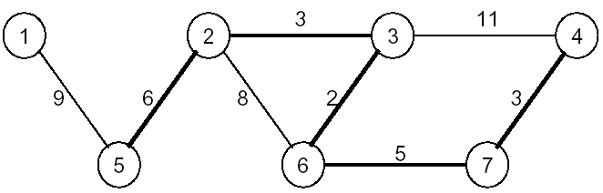
Flooding(1/2)
Every incoming packet is sent out on every outgoing line except the one it arrived on(不计算路径，有路就走)
For example, from 5 to 4：packet from 5→1,2；2→3,6；3→6,4；6→3,7；7→4
problem：duplicate packets，such as 3，6

Slide 30
Flooding(2/2)
Resolution:
  Add a counter in packet-header ，reduce 1 when pass a node， packet is discarded when counter is zero
  Each node set up a register table, packet is discarded when it arrives a node again
  Flooding selectively
disadvantage：duplicate packets are two many，waste bandwidth
advantage：reliability high，path short，use in military affairs frequently

Slide 31
Summary of the lecture
Main function of network layer
  Transport packets (path selection)
  Service provide to transport-layer
Routing protocol
  Routing-table
Static routing algorithm
  Dijkstra algorithm
  flooding

Slide 32

Thank you all！

