Slide 1
Chapter5 Network Layer(3)
2023 Fall
王昊翔 hxwang@scut.edu.cn
School of Computer Science & Engineering ,SCUT
Communication & Computer Network key-Lab of GD

Slide 2
Contents of the lecture
Review of last lecture
  DV
  Problem
Link state routing algorithm
  An example：OSPF
BGP

Slide 3
Link State Routing
Distance vector routing was used in the ARPANET until 1979, when it was replaced by link state routing.
Variants of link state routing are now widely used.
The idea behind link state routing consists of five parts:
  Discover its neighbors and learn their network addresses.
  Measure the delay or cost to each of its neighbors.
  Construct a packet telling all it has just learned.
  Send this packet to all other routers.
  Compute the shortest path to every other router.

Slide 4
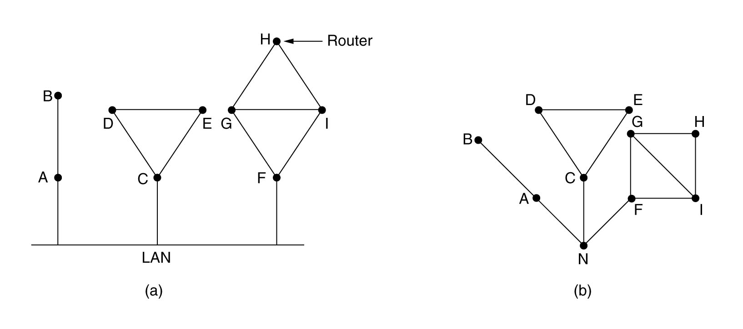
Learning about the Neighbors
When a router is booted, it sends a special HELLO packet on each point-to-point line.
The router on the other end is expected to send back a reply telling who it is (using a globally unique name).
When two or more routers are connected by a LAN, the LAN can be modeled as a node.

Slide 5
Measuring Line Cost
To determine the cost for a line, a router sends a special ECHO packet ,and that the other side is required to send back immediately.
By measuring the round-trip time, the sending router can get a reasonable estimate of the delay.
  For even better results, the test can be conducted several times, and the average used.
To factor the load in, the round-trip timer must be started when the ECHO packet is queued.
To ignore the load, the timer should be started when the ECHO packet reaches the front of the queue.

Slide 6
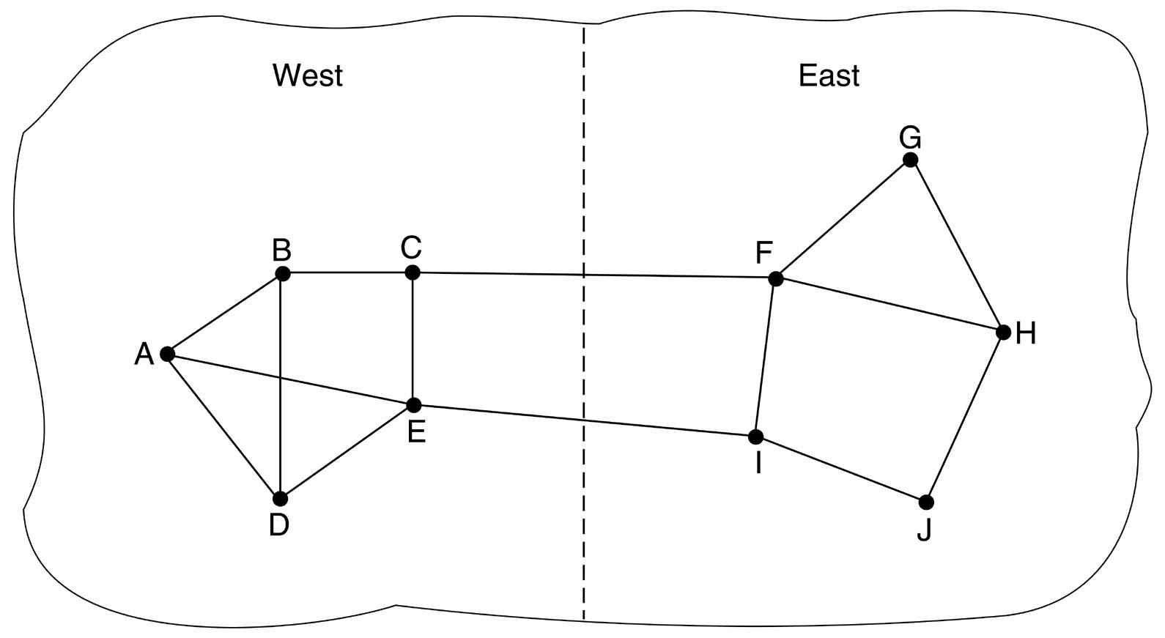
Measuring Line Cost (cont’d)
Should the load be taken into account when measuring the delay ?
  Arguments can be made both ways.
Should be
distribute load

Slide 7
Building Link State Packets
A Link State Packet is constructed to send to other routers. Information contained in the packet is:
  ID of the sender
  sequence number
  age
  list of neighbors
  delay to each neighbor
when to build?
  State packets may be built periodically, or when some significant event occurs, such as a line or neighbor going down or coming back up again.
Link state information

Slide 8
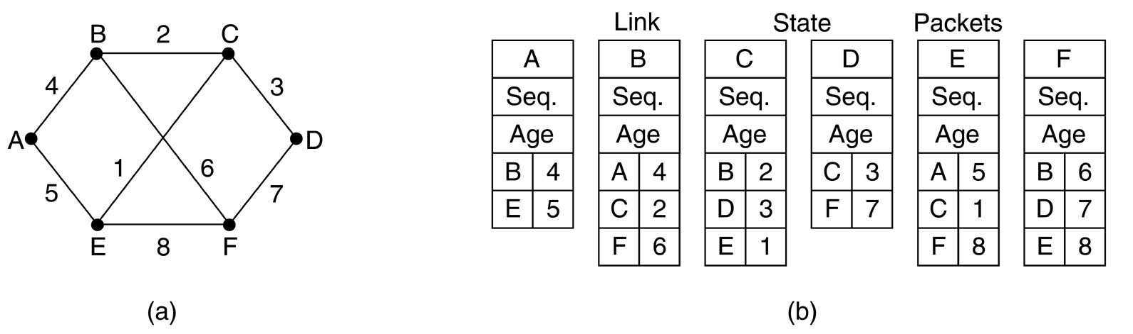
Building Link State Packets (cont’d)
(a) A subnet. (b) The link state packets for this subnet.

Slide 9
Distributing The Link State Packets
The basic algorithm:
  Each state packet contains a sequence number that is incremented for each new packet sent.
  Routers keep track of all the (source router, sequence) pairs they see.
  When a new link state packet comes in, it is checked against the list of packets already seen.
    If it is new, it is forwarded on all lines except the one it arrived on (i.e., flooding).
    If it is a duplicate, it is discarded.
    If a packet with a sequence number lower than the highest one seen so far ever arrives, it is rejected as being obsolete.

Slide 10
Distributing The Link State Packets (cont’d)
Problems with the basic algorithm:
  The sequence numbers may wrap around, causing confusion.
    Solution: using a 32-bit sequence number. With one packet per second, it would take 137 years to wrap around.
  If a router ever crashes, it will lose track of its own sequence number. If it starts again at the sequence number 0, new packets will be rejected as obsolete/duplicate by other routers.
  If a sequence number is ever corrupted and 65,540 is received instead of 4 (a 1-bit error), packets 5 -- 65540 will be rejected as obsolete.
00000000000000100
10000000000000100

Slide 11
Distributing The Link State Packets (cont’d)
The solution to router crashes and sequence number corruption is to associate an age (e.g., 60) with each state packet from any router and decrement the age once per second.
When the age hits zero, the information from that router is discarded.
Normally a new packet comes in every 10 seconds, so router information only times out when a router is down (or 6 consecutive packets have been lost, an unlikely event).

Slide 12
Distributing The Link State Packets (cont’d)
Some refinements to the basic algorithm make it more robust.
  When a state packet comes in to a router for flooding, it is put in a holding area (保留区)to wait a short while first.
  If another state packet from the same source comes in before it is transferred, their sequence numbers are compared.
    If they are equal, the duplicate is discared.
    If they are different, the older one is thrown out.
  To guard against errors on the lines, all state packets are acknowledged.
  When a line goes idle(空闲), the holding area is scanned in round robin to select a packet or acknowledgement to send.

Slide 13
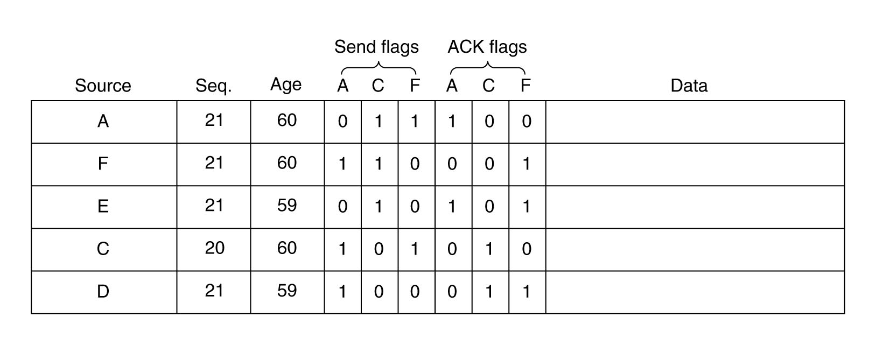
Distributing The Link State Packets (cont’d)
C’s LSP arriv.
From F
1 0 0 0 1 1
B’s holding area

Slide 14
Computing the New Routes
A full set of link state packets allows a router to construct a graph of the entire subnet.
We can now use Dijkstra’s algorithm to figure out the shortest paths between routers.
We can install this information in the routers to direct the packets. (set up routing-table)

Slide 15


Characteristics of L-S routing algorithm
Advantages
  Consistency of every router is good
  Convergence is good
  Fit for big network
Disadvantages
  Each router requires bigger storage-space
  Computing workload is great

Slide 16
Example of L-S routing protocol—OSPF
Group talk
Open shortest path first
Use graph to replace real network
  Every router is a node
  Measure cost（metric）
  May have a few graphs
Computing shortest path

Slide 17
Example of L-S routing protocol—OSPF
Open shortest path first
Use graph to replace real network
  Every router is a node
  Measure cost（metric）
  May have a few graphs
Computing shortest path

Slide 18
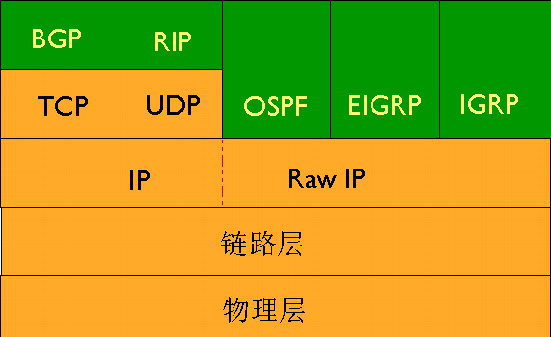
Position of OSPF

Slide 19
OSPF outline
OSPF is a routing protocol based on open standards，is most common and best protocol among IGPs( within autonomic system)
Can be used by large network
No routing-loop(无路由自环)
Support VLSM
Use bandwidth as metric（10⁸/BW）
Convergence is fast
。。。。。

Slide 20

Single-area OSPF
Generally, large OSPF network is divided into subarea， Area0 （区域0 ）is backbone area.
RouterID：a unsigned 32bits integer, is a only identifier of a router, and is exclusive in AS.
Protocol number: 89, in the head of IP packet.
TTL=1：as a rule, OSPF packet can not be transmitted ，but virtual link is a exception.

Slide 21
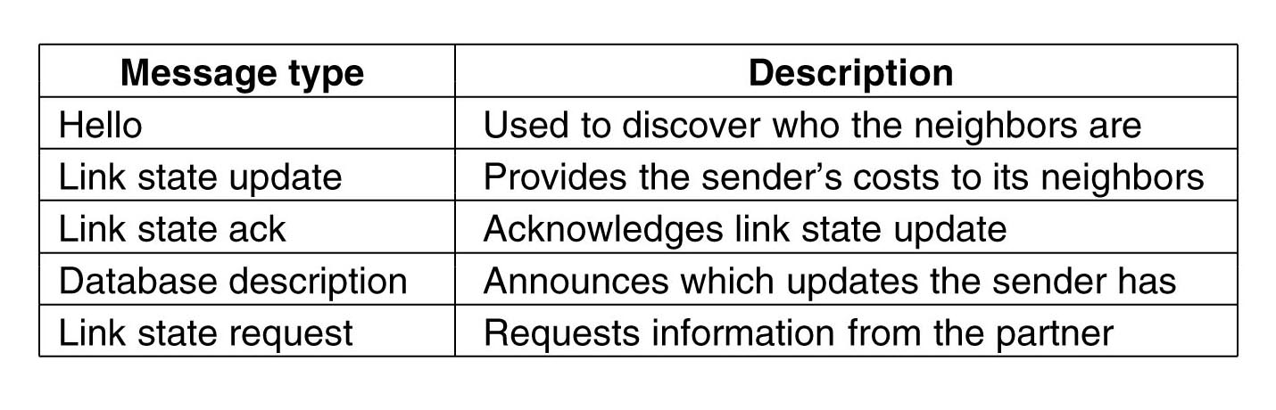
OSPF Message types
LSU
LSA
DD
LSR

Slide 22
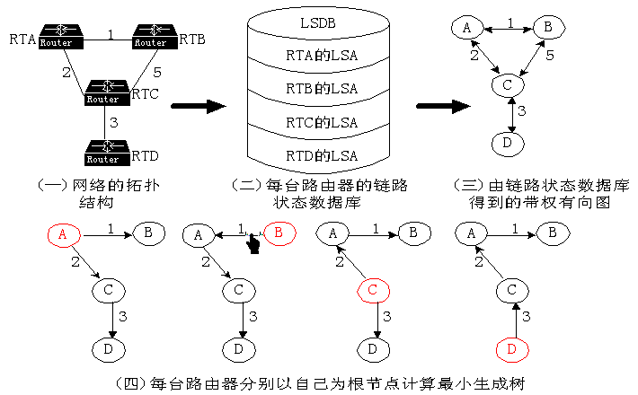
OSPF Operation Steps
Construct Full-adjacency relationship（建立路由器毗邻关系）
Select DR and BDR(选举DR指定路由器和BDR)
Discover routing(发现路由)
Select best routing(选择最佳路由)
Maintain routing info

Slide 23
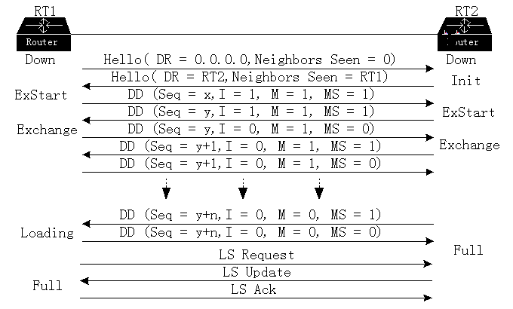
Construct Router adjacency relationship
Full adjacency

Slide 24

OSPF Problems in a Large Network
LSDB is very huge, need many storage space.
Computing the lest spanning tree needs more time, CPU’s load is very heavy.
  A few changes can result in computing again
Network topology changes frequently, so network is often in “turbulence(动荡)”
  Interface is up or down
  Router add or delete
  Just like a lake

Slide 25
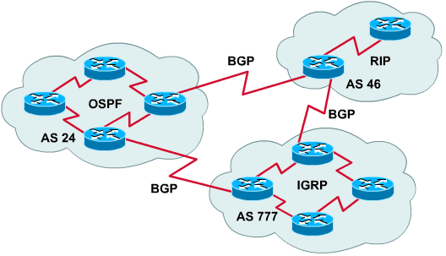
BGP（border gateway protocol）（边界网关协议）
different protocol - BGP (Border Gateway Protocol) is needed between ASes because the goals of an interior gateway protocol and an exterior gateway protocol are not the same.
The definition of BGP is in RFCs 1771 to 1774.

Slide 26
BGP Principle（1/2）
The typical policies of exterior gateway protocol routers involve political, security, or economic considerations.
Given BGP's special interest in transit traffic, networks are grouped into one of three categories.
  stub networks
  multiconnected networks
  transit networks

Slide 27
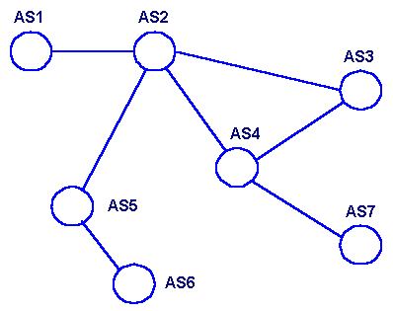

Slide 28
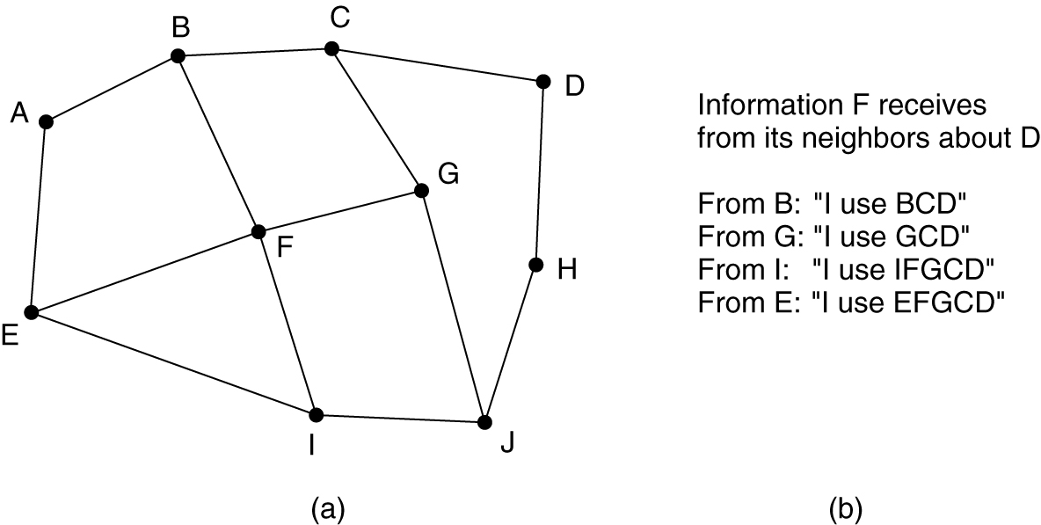
BGP原理（2/2）P459~461
Pairs of BGP routers communicate with each other by establishing TCP connections.
BGP is fundamentally a distance vector protocol, but quite different from most others such as RIP.
  BGP router keeps track of the exact path.

Slide 29
Summary
Link state algorithm
  Five steps
  Problems and their resolution
OSPF
  Five message types
  DR selection
  OSPF operation process(status)
BGP

Slide 30

Thank you all！

