Slide 1
Intro to TCP - working principles and examples

Slide 2
Contents
TCP service and buffer
TCP‘s Establishment & Release
Reliable transmission
TCP Flow Control
Congestion control of TCP
Application of TCP

Slide 3
Crew Member
202130430379 杜喆
202130561134 周楠钧
202130430409 许琪祥
202130430096 乐沛琳
202130190990 黎志枫
202130461601 王简

Slide 4
TCP service and buffer

Slide 5
Service types
Data block segmentation: The application data is divided into data blocks that TCP thinks the most suitable for sending.
Re -sorting: Since the TCP message segment is transmitted as an IP datagram, the arrival of the IP datagram may be disorderly, so the arrival of the TCP message segment may also be lost. If necessary, TCP will re -sort the received data, and hand over the data received to the application layer in a correct order
Full duplex communication: also known as two -way communication at the same time, that is, both parties to communicate can send and receive information information interaction methods at the same time.
Reliable transmission: Reliable transmission is performed through verification, serial numbers, confirmation and re -transmission.
Flow control: Set the size of the receiving window by sliding the window algorithm for traffic control.
Congee control: Slowly start & congestion avoidance, fast re -transmission & fast recovery algorithm for congestion control.

Slide 6
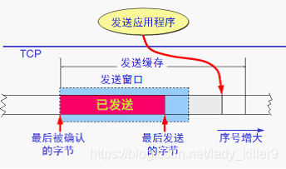
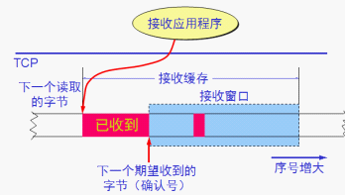
buffer
Send buffer: The data prepared and sent but not received by confirmed data
Receive buffer: Data read in order but do not accept applications and data that does not arrive in order

Slide 7
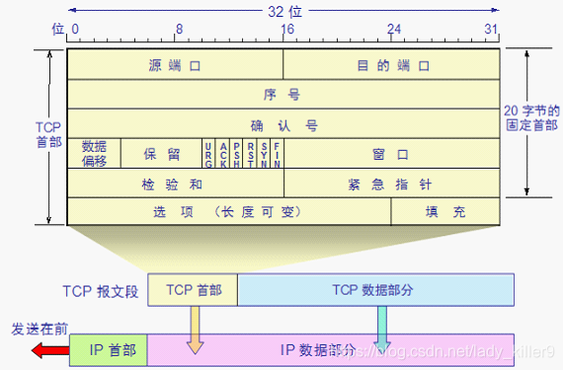
TCP header
Source port and destination port: each accounts for 2 bytes. The port is the service interface of the transmission layer and the application layer. The reuse and split function of the transmission layer must be achieved through the port
Serial number SEQ: occupy 4 bytes. The serial number of the first byte in the data in the cache.
Confirm the serial number ACK: occupy 4 bytes. When N-1 and the previous packet segments were received for n, the packet segment with a serial number n is expected to receive the serial number N.
The first length/data offset: occupy 4 bits. It pointed out that the beginning of the data of the TCP message segment is far from the beginning of the starting point of the TCP packet segment. The unit of "data offset" is 32 -bit (4 bytes as the calculation unit).
Emergency level URG: At 1, emergency pointers are effective, emergency data is higher priority, and priority is sent.

Slide 8
TCP‘s Establishment & Release

Slide 9


Connection Principle
A TCP connection is established using a client/server approach, where the application process that actively initiates the connection establishment is called the client, and the application process that passively waits for the connection to be established is called the server.
Transport connections have three phases: connection establishment, data transfer, and connection release.
Transport connection management is the control of the connection establishment and connection release process, so that it can operate normally, to achieve these purposes: letting the two sides of the communication can be sure of each other's existence, allowing the two sides of the communication to negotiate a number of, and allocating to the transportation of physical resources (buffer size, etc.).
Three-way Handshake , Four-way Wavehand.

Slide 10
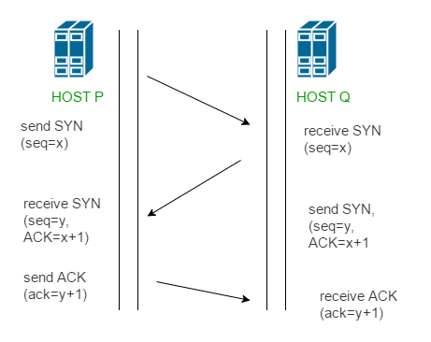
Three-way Handshake
First handshake: The client's application process opens on its own initiative and sends a request message segment to the server. In its header: SYN = 1, seq = x.
Second handshake: The server application process is opened passively. If it agrees to the client's request, it sends back an acknowledgement message with the following in its header: SYN=1,ACK=1,ack=x+1,seq=y.
Third handshake: After the client receives the acknowledgement message, it informs the upper application process that the connection has been established. Then it sends an acknowledgement message to the server with its header: ACK=1,ack=y+1.

Slide 11
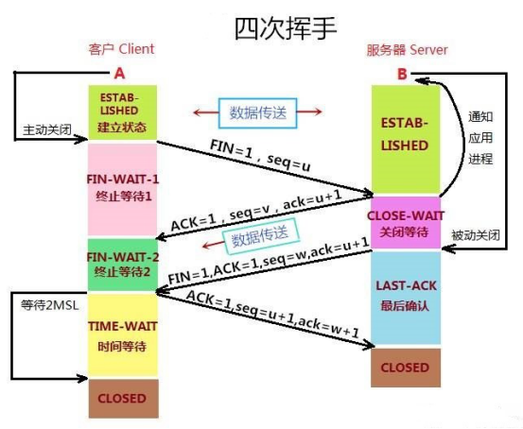
Four-way Wavehand
First wave: After the end of data transmission, the client application process sends out a connection release message segment and stops sending data, with its header: FIN=1, seq=u.
The second wave: After the server receives the connection release message segment, it sends out an acknowledgement message with its header: ack=u+1,seq=v. At this point, the connection enters a nearly-closed state.
Third wave: If the server no longer has data to send to the client, its application process notifies the server to release the TCP connection. The header of the last message sent by the server at this stage should be: FIN=1,ACK=1,seq=w, ack=u+1.
Fourth wave: After the client receives the connection release message segment, it must send an acknowledgement: ACK=1,seq=u+1,ack=w+1. After 2MSL (maximum message-side lifetime), this TCP connection is over.

Slide 12
Reliable transmission

Slide 13
TCP (Transmission Control Protocol) was specifically designed to provide a reliable end-to-end byte stream over an unreliable internetwork，which means the byte stream received by the receiver is identical to the byte stream sent by the sender.

Slide 14
How to ensure the reliability of transmission?
Checksum
Serial number and confirmation response
Retransmission
Flow Control (Sliding Window Protocol)
Congestion control

Slide 15
Checksum
When calculating the checksum, TCP needs to add a 12 byte pseudo header, includes:
Source IP Address
Destination IP address
Reserved Bytes (Set to 0)
Transport layer protocol number (TCP is 6)
TCP message length (header+data)

Slide 16
Checksum
Purpose of the pseudo header:
Increase the error detection capability of TCP checksum, such as checking whether TCP packet was sent to correct object based on the destination IP address, and checking whether the transport layer protocol is selected correctly based on the transport layer protocol number.
The pseudo header is only used during verification.

Slide 17
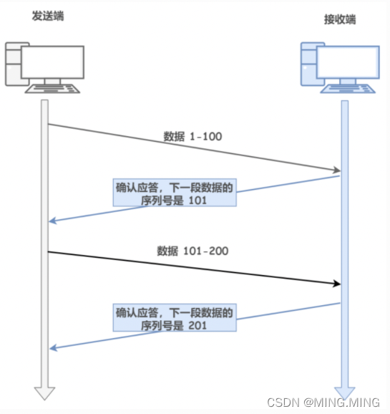
Serial number and confirmation response

Slide 18
Retransmission-Timeout Retransmission
When sending a message, the TCP sender sets a timer. If no ACK confirmation message is received from the receiver within the specified time, the sender will retransmit the already sent message segment.

Slide 19
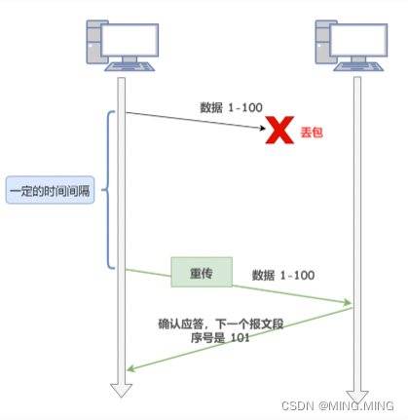
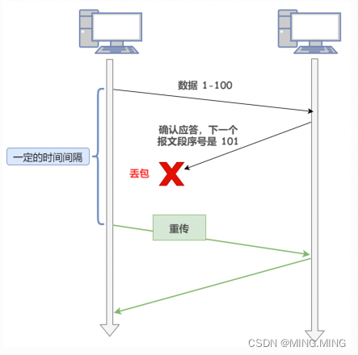
Retransmission-Timeout Retransmission
Message segment loss
ACK confirmation message lost
Problem: The timeout period is relatively long!

Slide 20
Retransmission-Fast Retransmission
Fast retransmission is not time-driven, but data-driven
Principle: Whenever the receiver receives an out of sequence message segment larger than the expected sequence number, it sends a redundant ACK to the sender, indicating the sequence number of the next expected byte.When the TCP sender receives redundant confirmation from the receiver (three duplicates) before reaching the retransmission time, it must retransmit the already sent message segment

Slide 21
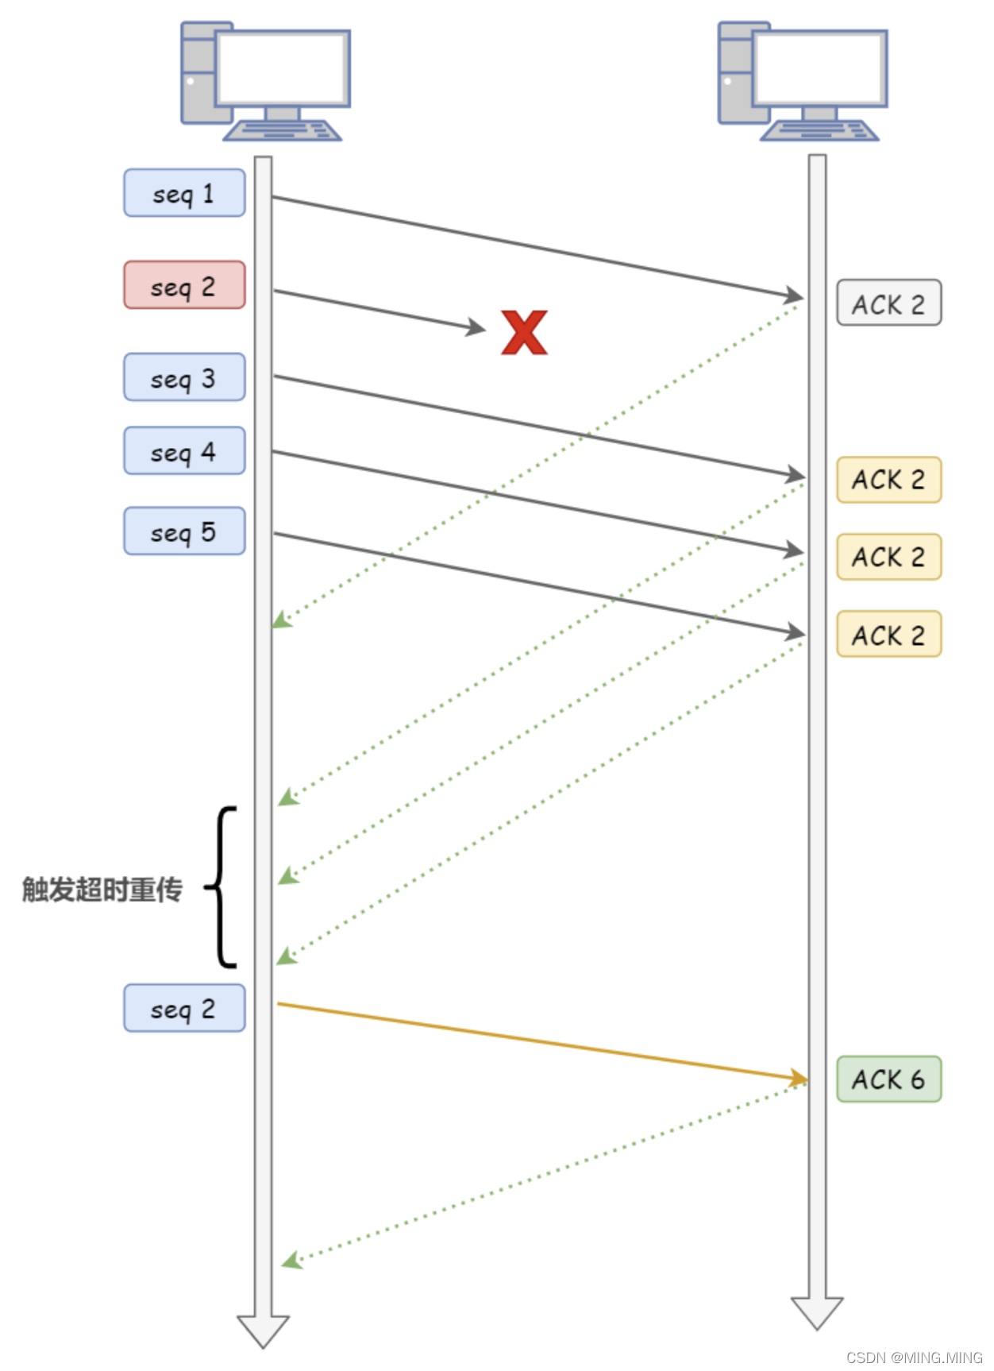
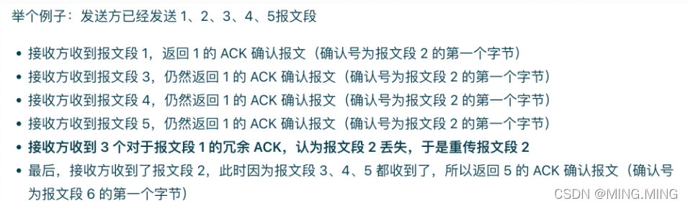
Retransmission-Fast Retransmission

Slide 22
TCP Flow Control

Slide 23
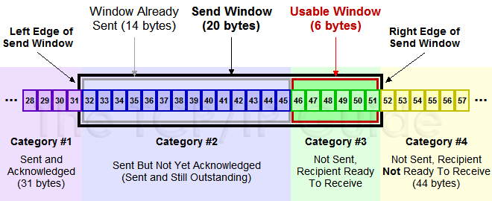
Sliding window
Sending Window

Slide 24
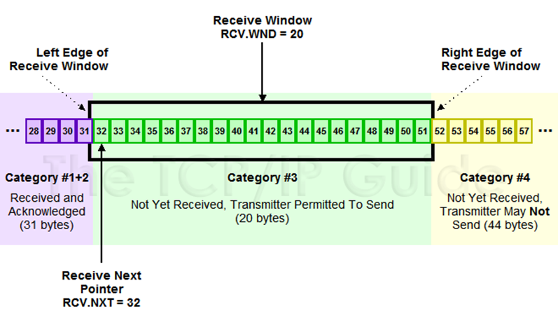
Sliding window
Receiving Window

Slide 25
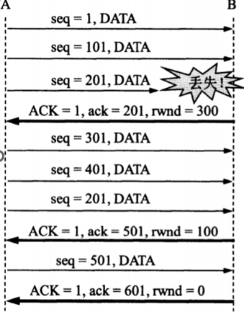
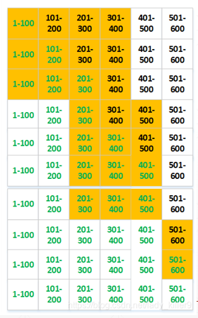
Flow Control
During the communication process, the receiver dynamically adjusts the size of the sender's sending window according to the size of its own receiving buffer, and the sender's sending window takes the smallest value of the receiving window rwnd and the congestion window cwnd.

Slide 26
Congestion control of TCP

Slide 27
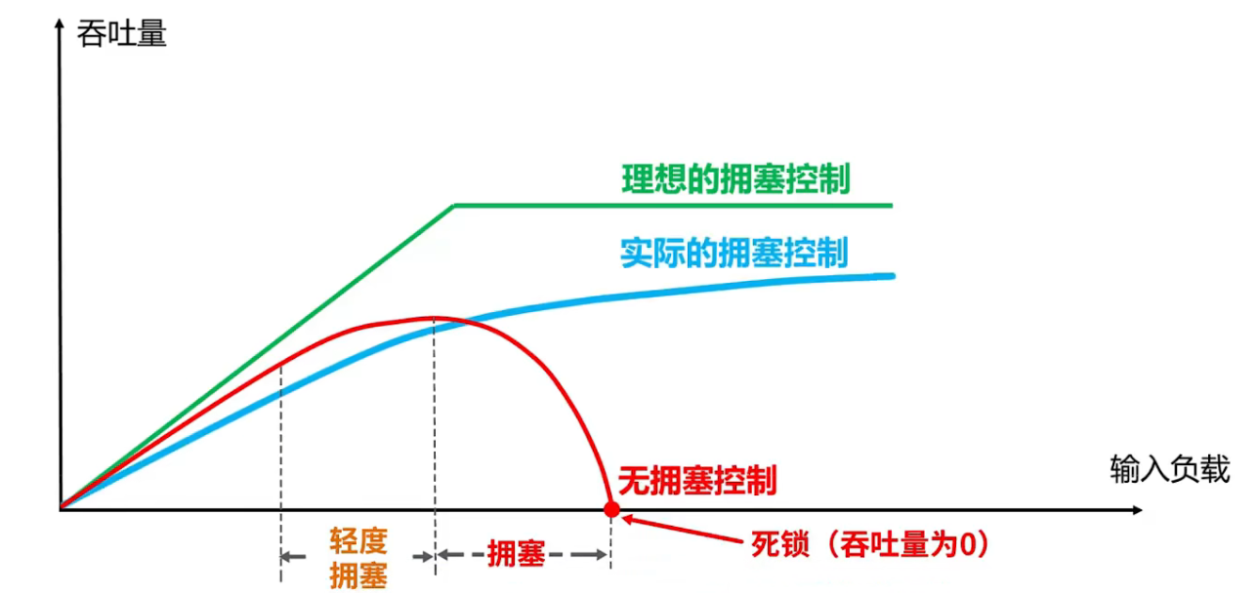
Congestion control of TCP
During a certain period of time, if the demand for a resource in the network exceeds the available portion of the resource, the network performance will deteriorate. This situation is called congestion.
If congestion occurs without control, the throughput of the whole network will decrease with the increase of input load.

Slide 28
Four Congestion Control Algorithms
The following describes the basic principles of these four congestion control algorithms, assuming the following conditions:
1.Data is transmitted in one direction, while only confirmation is transmitted in the other direction.
2.There is always enough cache space on the receiver, so the size of the sender's sending window is determined by the congestion of the network.
3.The number of MSS in the maximum packet segment is used as the unit for discussing problems, not in bytes.
Slow-start
Congestion avoidance
Fast retransmit
Fast recovery

Slide 29
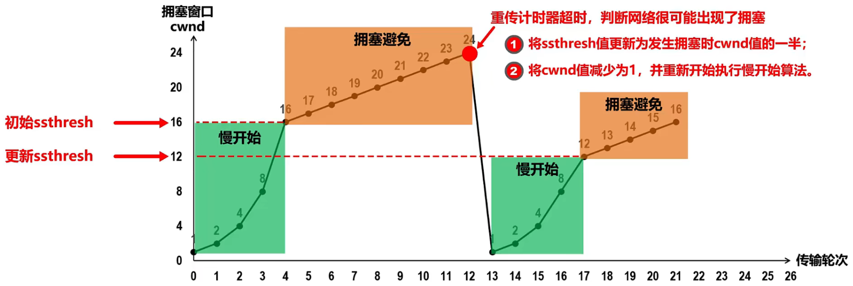
Slow-start
Congestion avoidance
The core idea of slow start is to gradually increase the congestion window size exponentially from small to large, and reduce the congestion window if the network is congested.
The basis for determining network congestion is that the acknowledgement packets that should arrive are not received on time.
The congestion avoidance algorithm allows the congestion window to grow slowly. After each round trip time , the congestion window of the sender is increased by 1 instead of doubling, and the congestion window grows slowly according to a linear law.
Whether during the slow start period or the congestion avoidance period, as long as the network is congested, ssthresh is set to half the size of the current sending window, and then restart the slow start algorithm.

Slide 30
Fast retransmit
Fast recovery
Fast retransmission requires the receiver to send a duplicate acknowledgement immediately after receiving an out-of-order packet segment, so that the sender knows that a packet is lost.
The fast retransmission algorithm stipulates that as long as the sender receives three consecutive duplicate acknowledgements, it should immediately retransmit the packet segment that has not been received by the other party, without waiting for the retransmission timer to expire.
The fast recovery algorithm is suitable for the combination of fast retransmission algorithm
(1) When the sender receives three consecutive duplicate acknowledgments, perform the "multiplication reduction" algorithm to halve the Slow start threshold, but then do not perform the slow start algorithm, because if the network is congested, it will not receive several duplicate acknowledgments, so the sender now thinks that the network may not be congested.
(2) At this time, the slow start algorithm is not executed, but the congestion window cwnd is set to the value after ssthresh is halved, and then the congestion avoidance algorithm is executed to make the congestion window slow larger

Slide 31
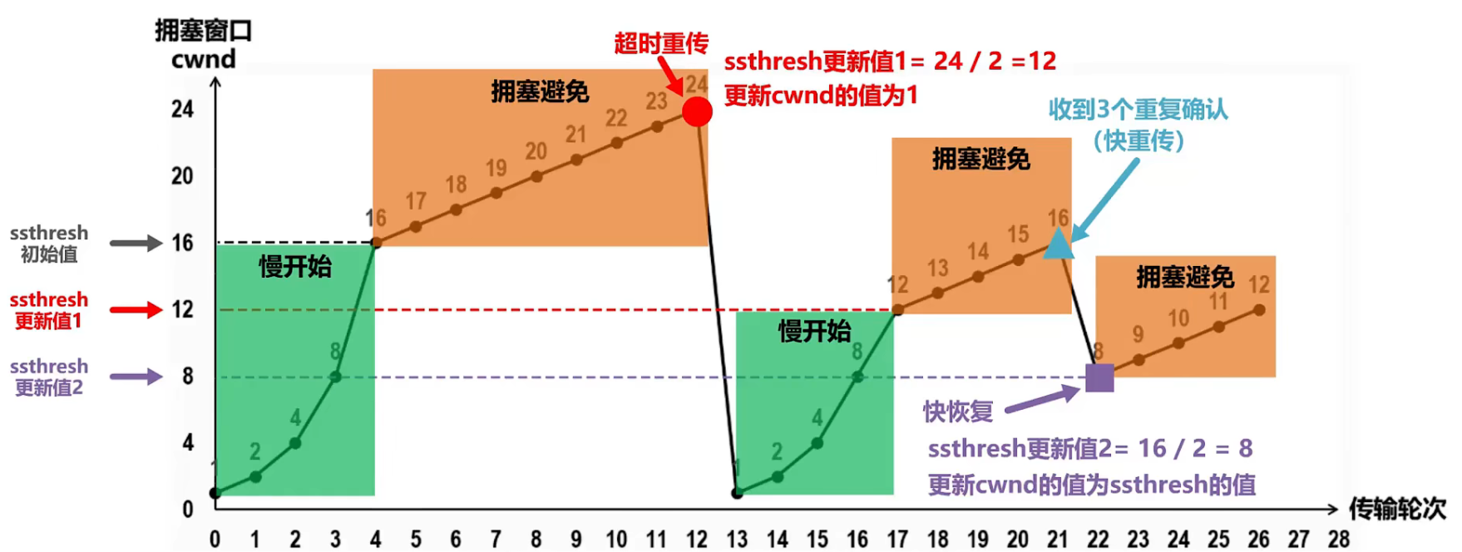
Inclusion

Slide 32
Application of TCP

Slide 33
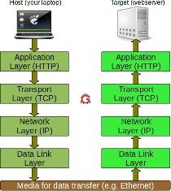
Web Browsing
When you open a web browser and enter a URL, such as "https://www.example.com," the browser initiates a TCP connection with the web server that hosts the website. TCP ensures that the data packets containing the web page content are reliably and accurately transmitted between the client (your browser) and the server. The browser sends an HTTP request over the TCP connection, and the server responds with the requested web page data, which is then displayed in your browser.
Instant Message
TCP is utilized by various instant messaging applications for reliable message delivery and real-time communication. IRC (Internet Relay Chat) is a chat protocol that uses TCP connections to enable multiple users to join chat rooms and exchange messages. XMPP (Extensible Messaging and Presence Protocol) is another protocol commonly used for instant messaging and presence information. It relies on TCP to establish connections between users and enable real-time messaging.

Slide 34
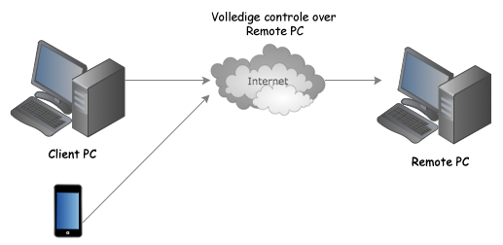
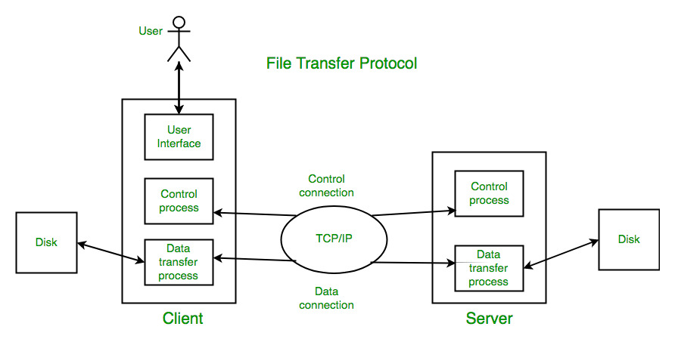
Remote Desktop
TCP can be employed in remote desktop applications like VNC and RDP. These application allow users to access and control their PC over a network. TCP serves as a bridge between the local and remote systems, enabling the transmission of screen updates, mouse movements, and keyboard inputs. TCP ensures reliable and accurate transmission of these interactions, providing a seamless remote desktop experience.
File Transfer
FTP (File Transfer Protocol) is a widely used protocol for transferring files over networks. It provides a convenient and reliable way to upload and download files between a client and a server. FTP relies on TCP as its underlying transport protocol to ensure the secure and ordered delivery of file data.

Slide 35
[Example] A TCP connection has been established between host A and host B. The TCP maximum segment length is 1000 bytes. If the current congestion window of host A is 4000 bytes, after host A sends two consecutive maximum segments to host B, it successfully receives the acknowledgement segment of the first segment sent by host B. The size of the receive window notified in the acknowledgement segment is 2000 bytes, then the maximum number of bytes that host A can still send to host B at this time is
a.1000 b.2000
c.3000 d.4000

