Slide 1

Intro to UDP, and
comparisons with TCP
Group Member：钱鹏 黄逸民 夏鑫杭 杨晨鹤

Slide 2
1.
Introduction
Catalogue
Brief reviews
2.
Implementation
Flowchart and Code
3.
Application
Adoption of UDP
4.
Difference
Between TCP and UDP

Slide 3
01.
Introduction

Slide 4
User Datagram Protocol (UDP)
Definition：
The second protocol in the transport layer is the User Datagram Protocol.
Function：
A method of sending encapsulated IP datagrams.
Provided an interface with the IP protocol.
Added the function of reusing multiple processes through port numbers on this interface.
Optional end-to-end error detection function.
Notes:
51PPT模板网 www.51pptmoban.com

Slide 5
Characteristic of UDP
Point one
UDP is connectionless and there is no need to release the link after communication ends.
Point two
UDP is an unreliable protocol.
Point three
UDP is oriented to package.
Point four
UDP does not have congestion control.
Point five
UDP supports one-to-one, one-to-many, many-to-many, and many-to-one communication.
Point six
The overhead of the UDP header is relatively small, only 8 bytes.
Point seven
The protocol using UDP typically runs in user space.

Slide 6

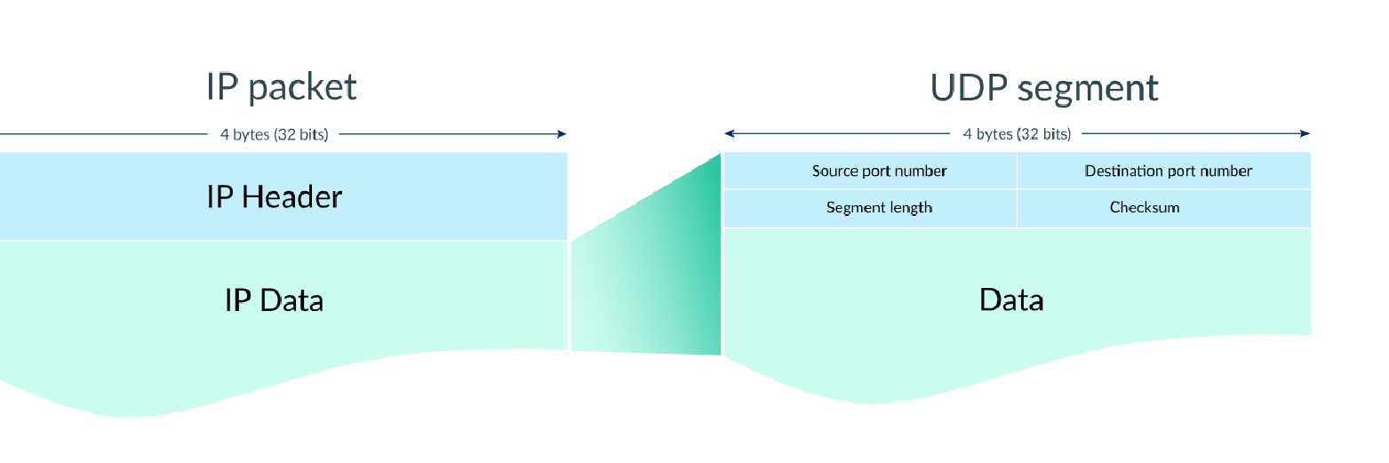
UDP Header
Structure of UDP Header:、
Source port number(who send)
Destination port number(send to whom)
Segment length(the length of data)
Checksum(Check if it is wrong)
Port numbers:The first four bytes of the UDP header store the port numbers for the source and destination.
Segment:The next two bytes of the UDP header store the length (in bytes) of the segment (including the header).
The length can be high as：65535.
Checksum:The final two bytes of the UDP header is the checksum, a field that's used by the sender and receiver to check for data corruption.
Optional in IPV4, mandatory in IPv6 (because IPV6 does not have checksum), if checksum is not used, all additions are 0.

Slide 7
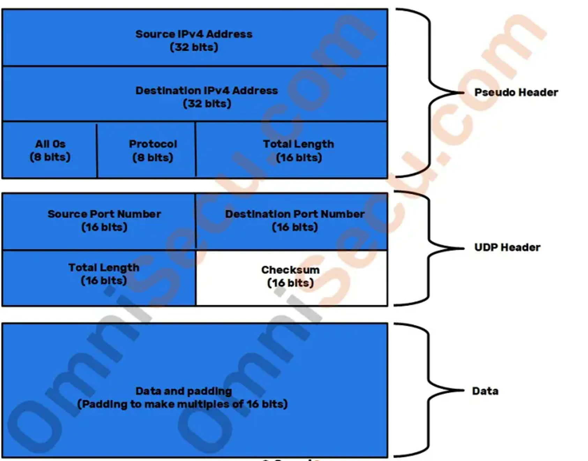
Pseudo header of UDP
Background: When UDP is running on IPv4, a "pseudo header" needs to be added before the UDP packet.
Content:The pseudo header includes some information in the IPv4 header, but it is not the header of the IP packet used when sending IP packets.
Function: Pseudo header is used only for calculating the checksum value. It is not a part of actual UDP packet and it is never sent over network.

Slide 8
Pseudo header of UDP
Structure:
Source and Destination IP addresses:
Contains the Source and Destination IPv4 addresses of IPv4 header.
Protocol field:
Contains the IPv4 protocol type code (17 for UDP).
Total Length field：
Contains the length of the UDP datagram (excluding the pseudo header).

Slide 9
Pseudo header of UDP(cont’d)
Background：
We already know that IPV4 will calculate checksum. Why we need Pseudo header？
Reason：
In short, this is a historical reason. Initially, TCP/IP was a single overall protocol (referred to as TCP) . When they decided to divide it into TCP and IP (among others), they did not completely separate this two part.
It provides you with a little extra protection against random errors, but we would have been better off without it.

Slide 10
Analysis about UDP
Advantage:
Fast transmission speed.
Slightly safer than TCP.
Broadcast support: UDP supports broadcasting to multiple recipients, making it useful for applications such as video streaming and online gaming.
Disadvantage:
Unreliable and unstable.（There is no flow control, congestion control, or retransmission mechanism after receiving a bad segment.）
If the network quality is poor, it is easy to lose packets.
Notes:
51PPT模板网 www.51pptmoban.com

Slide 11
02.
Implementation

Slide 12
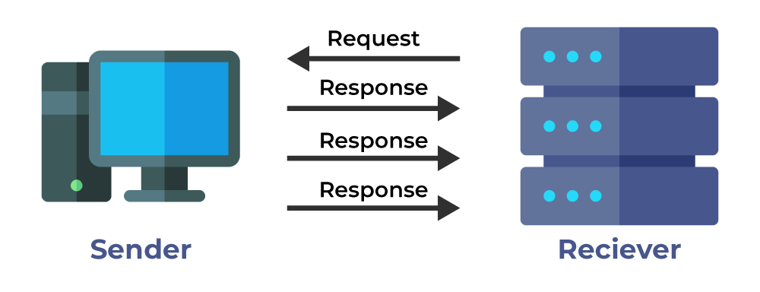
Implementation
As we know, UDP provides a type of low-latency, relatively simple, relatively unreliable data transmission mechanism
内容智能流转
数字资产管理
全员营销获客
So it’s implementation is relatively simple
The basic principle includes data package encapsulation and unencapsulation

Slide 13
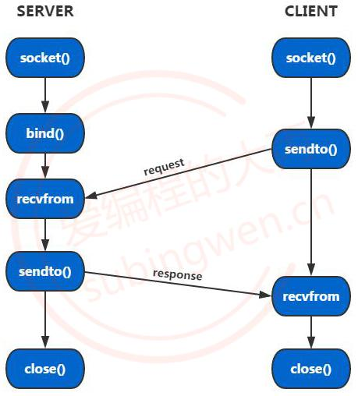
Implementation
There are generally three parts for the implementation:
1. Create a UDP socket;
2. SEND data (UDP send process)
3. Receive data (UDP's receive process)

Slide 14
Implementation
1.Create a UDP Socket
2. Send Data (UDP's send process)
UDP Communication begins with the creation of a Socket. Sockets are communication endpoints that allow applications to send and receive data over a network.
Sending data involves building a datagram segment, specifying a destination address and port,
and sending a datagram segment to a destination using the SENDTO () function
3. receive data (UDP's receive process)
Receiving data is another important aspect of UDP communication.
This includes listening for specific ports and receiving data packets using the recvfrom () function.

Slide 15
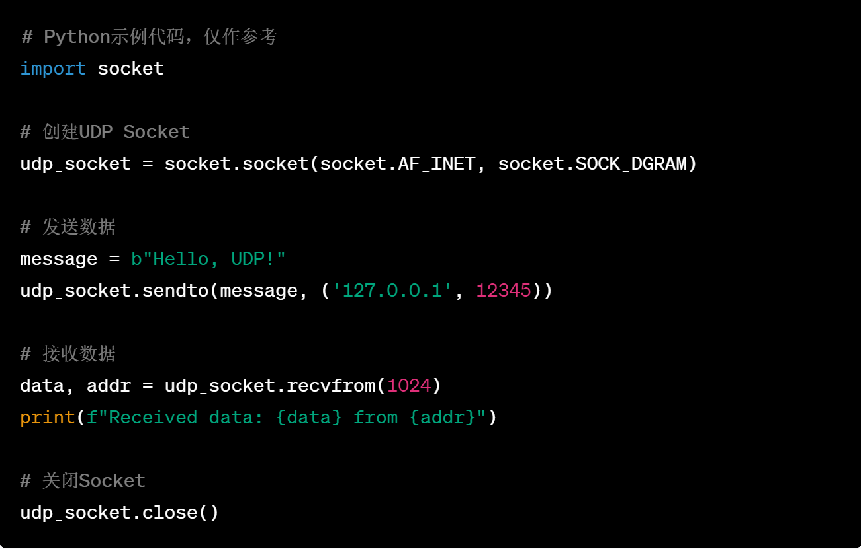
Code demonstration
Create a UDP Socket
1. Import the Socket library
In most programming languages, to use UDP,
we first need to import the appropriate Socket library.
For example, in Python, we can use the socket library.
2. Create a UDP Socket
Create a UDP Socket using the Socket () function.
Specifies the address family and socket type (typically AF
for the address family and SOCK for the socket type for UDP) .

Slide 16
Code demonstration
Send Data (UDP's send process)
1.Build the datagram segment
Prepares the data to be sent, usually in the form of byte streams .
2.Specify the destination address and port
Determine the destination address and port number to send to.
Send data through the SENDTO () function
3.Use the SENDTO () function to send the datagram segment to the destination address and port.

Slide 17
Code demonstration
Receive data (UDP's receive process)
1. On the receiving end, you need to bind the socket to a specific port using the bind () function. This enables the socket to listen for data on the specified port.
2. Use the recvfrom () function to receive data packets
By calling the recvfrom () function, the socket waits and receives the datagram.

Slide 18
03.
Application

Slide 19
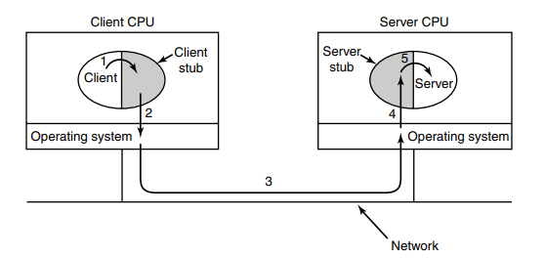
Remote Procedure Call
It is a computer communication protocol used to allow one computer program to request the execution of a procedure or function on another computer, as if calling a local function, without knowing the details of the underlying network communication.
It represents the server procedure in the client’s address space
These procedures hide the fact that the procedure call from the client to the server is not local

Slide 20
UDP in RPC
In terms of transport layer protocols, UDP is a good base on which to implement RPC. Both requests and replies may be sent as a single UDP packet in the simplest case and the operation can be fast.
But in some cases, it may be necessary to set up a TCP connection and send the request over it rather than using UDP.

Slide 21
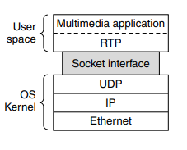
Real-time Transport Protocol
The protocol is designed to handle real-time traffic (like audio and video) of the Internet.
The basic function of RTP is to multiplex several real-time data streams onto a single stream of UDP packets. The UDP stream can be sent to a single destination or to multiple destinations.
RTP normally runs in user space over UDP (in the operating system).
The position of RTP in the protocol stack

Slide 22
Operation in RTP
On the operating system side of the socket, UDP packets are generated to wrap the RTP packets and handed to IP for transmission over a link such as Ethernet. The reverse process happens at the receiver. The multimedia application eventually receives multimedia data from the RTP library. It is responsible for playing out the media.
The multimedia application consists of multiple audio, video, text, and possibly other streams. These are fed into the RTP library, which is in user space along with the application. This library multiplexes the streams and encodes them in RTP packets, which it stuffs into a socket.

Slide 23
Application layer protocol based on UDP
01
DNS
02
TFTP
It maps human-readable domain names to IP addresses in computer networks
A protocol used for simple file transfer between clients and servers.
03
SNMP
04
NTP
A network management protocol used to collect and organize management information in computer network.
A protocol used to synchronize the clocks of computers and network.

Slide 24
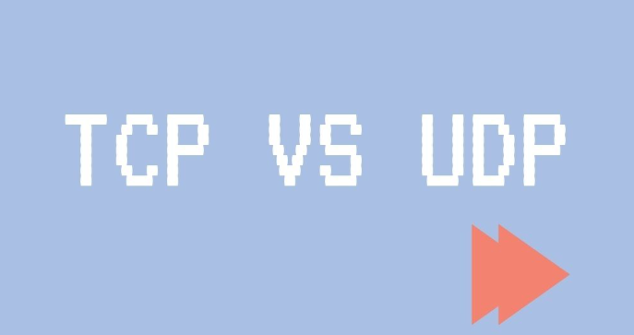
04.
Difference between TCP and UDP

Slide 25
Contrast
 | TCP | UDP
Connection | Connection-oriented | Connectionless
Transmission method | Point to point | n to n
Reliability | Yes | No
Flow control | Yes | No
Congestion control | Yes | No
Retransmission | Timeout retransmission | Only send
Delivery mode | Stream | Datagram
Transmission speed | Slow | Fast
Header overhead | 20 bytes | 8bytes
Notes:
51PPT模板网 www.51pptmoban.com

Slide 26
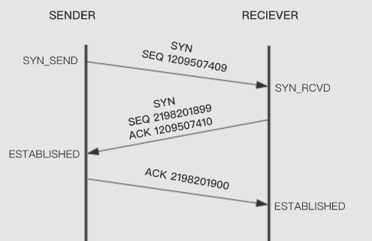
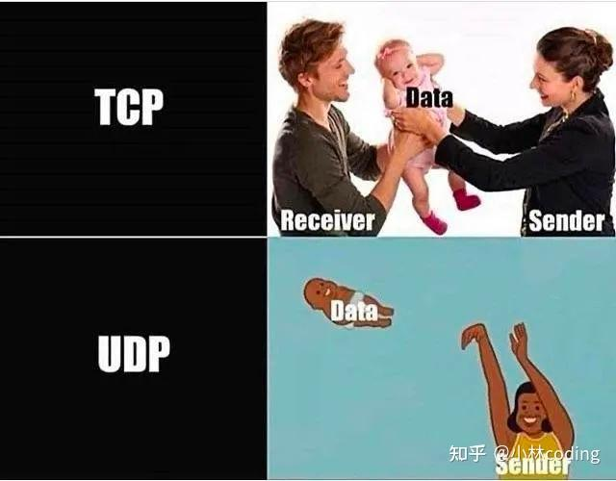
Connection
TCP: Connection-oriented
UDP: Connectionless
The connection is established before network communication.
There is no connection setup, so UDP can be delivered one-to-one, one-to-many, many-to-one, and many-to-many, whereas TCP is delivered point-to-point
Notes:
51PPT模板网 www.51pptmoban.com

Slide 27
Reliability
TCP has sophisticated mechanisms to ensure the reliability of the transmission. UDP is unreliable and cannot guarantee that every datagram will be delivered.
Three methods:
Two mechanisms:
A sliding window in bytes
Flow control
Timeout retransmission
Congestion control
Select Confirm
Notes:
51PPT模板网 www.51pptmoban.com

Slide 28
Delivery method
TCP: Byte stream
Data is sent in bytes, and a packet can be split into multiple packets in bytes for easy delivery.
TCP can store data in a send buffer and either wait for a certain size to be sent, or send it directly; there is no fixed size.
UDP: Datagram
UDP needs to send a fixed length of data packet each time. If it is too long, the application layer protocol needs to actively cut it to a suitable length.
Notes:
51PPT模板网 www.51pptmoban.com

Slide 29
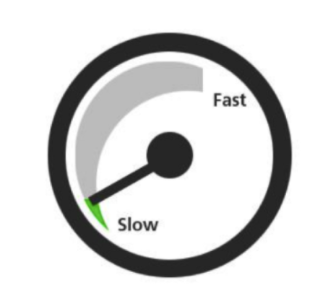
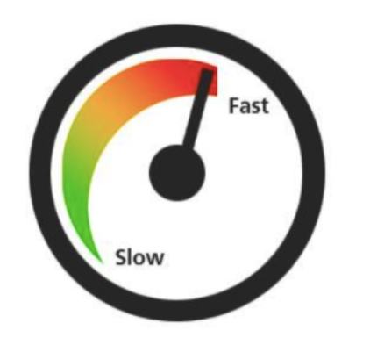
Real-time
TCP transmission needs to establish a connection and ensure the reliability of the transmission, so the overhead is higher and the real-time is lower.
UDP has high real-time performance, which is suitable for communication or broadcast communication with high speed transmission and real-time requirements.
Notes:
51PPT模板网 www.51pptmoban.com

Slide 30
Problem
What are the aspects of the unreliability of the UDP protocol?
Notes:
51PPT模板网 www.51pptmoban.com

Slide 31
Problem
What are the aspects of the unreliability of the UDP protocol?
The unreliability of UDP is manifested in the possibility of packet loss, duplicate or out-of-order arrival.
When the network is congested or a packet is lost during transmission, UDP does not resend the packet, but directly sends the next packet out, which may cause the loss of the packet.
In addition, since UDP does not maintain connection state, packets may arrive repeatedly, or out of order, and the receiver needs to deal with these problems on its own.
Notes:
51PPT模板网 www.51pptmoban.com

Slide 32
Thank you
Thank you very much for your attention
Notes:
51PPT模板网 www.51pptmoban.com

