Slide 1
Mobile Telephone System
翁伟钊 202130430256 庄多懋 202130430423 李宇龙 202130430126蔡希迪 202130430010 卢本涛 202130430188 葛苏杭 202130430041

Slide 2
01
Cellular Network
翁伟钊 202130430256

Slide 3
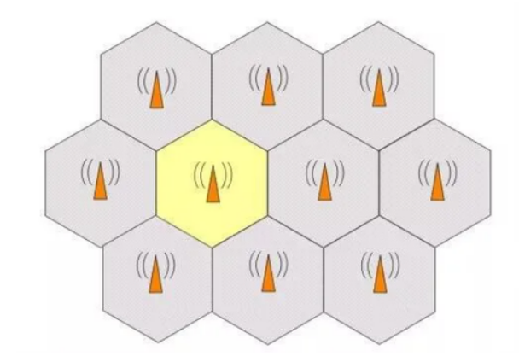
Cellular Network
Initially designed for mobile terminals inside vehicles with antennas mounted on the vehicle roof
Support lightweight handheld mobile terminals operating inside and outside buildings at both pedestrian and vehicle speeds

Slide 4
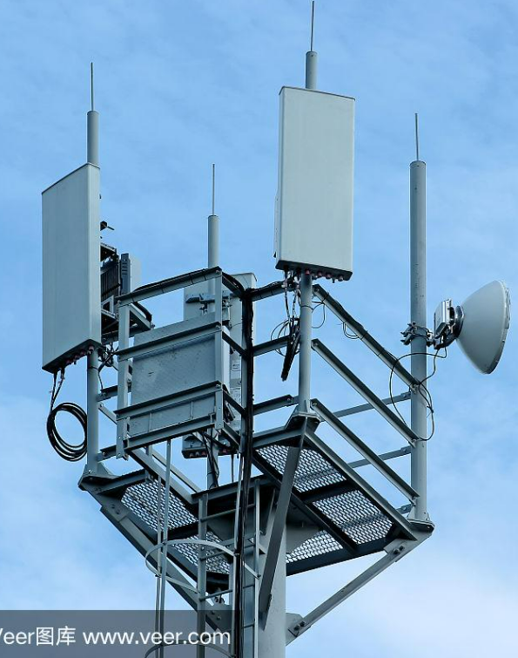
Cellular Network
Base Station:
A relatively small number of cells to cover an entire city or region.
Base Stations are placed on tall buildings or mountains and transmitted at very high power with cell coverage areas of several square miles.
Signals propagated out from base stations uniformly in all directions.

Slide 5
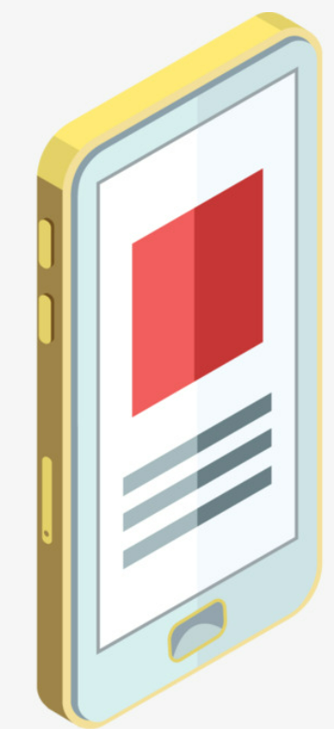
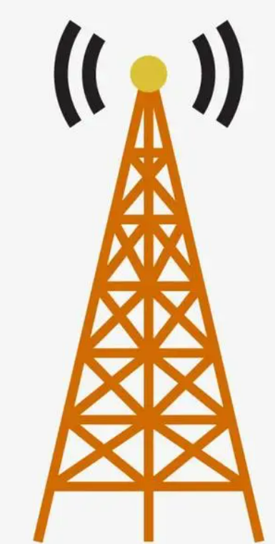
Communication Process of mobile phone
Turn on mobile phone, it searches for the nearest available cell tower (base station).
The phone sends a signal to the tower to register on the network, providing its unique identifier, the International Mobile Subscriber Identity (IMSI).
The network determines the best cell tower for your phone's current location and signal strength.

Slide 6
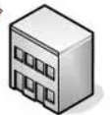
Communication Process of mobile phone
Make a call or send data, phone encodes the voice or data into packets.
These packets are transmitted as radio waves to the nearest cell tower.
The cell tower receives the signal and forwards it to the Mobile Switching Center (MSC) in the core network.

Slide 7
Communication Process of mobile phone
The MSC routes the call to the destination number, which may be another mobile phone, a landline, or an Internet-based service.
The MSC communicates with the appropriate cell tower near the recipient's location.

Slide 8
Communication Process of mobile phone
The recipient's phone receives the signal, decodes it, and plays back the voice or displays the data.
The recipient's phone may also send back acknowledgment signals to confirm the successful reception of data.
signal

Slide 9
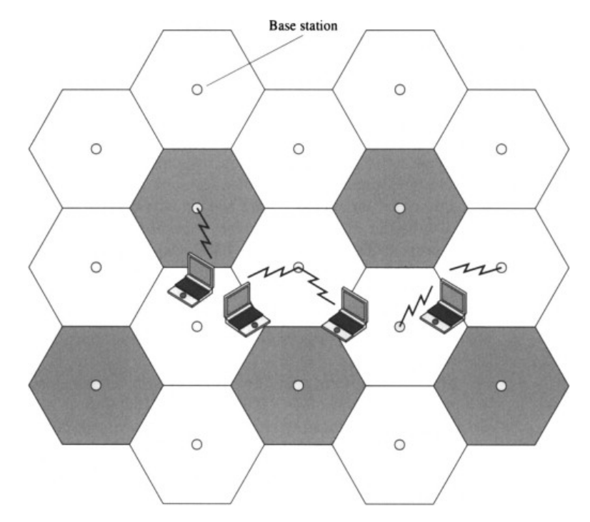
Frequency reuse
Exploits path loss to reuse the same frequency spectrum at spatially separated locations
Some set of channels is assigned to each cell, the same channel set is used in another cell some distance away
The shaded cells use the same channel set

Slide 10
Frequency reuse
Intercell interference: The interference caused by users in different cells operating on the same channel set
Reuse distance: The spatial separation of cells that reuse the same channel set
Reuse distance should be as small as possible to maximize the spectral efficiency obtained by frequency reuse
Cannot be infinitely decreased. why?

Slide 11
02
First Generation Mobile Phones
庄多懋 202130430423

Slide 12
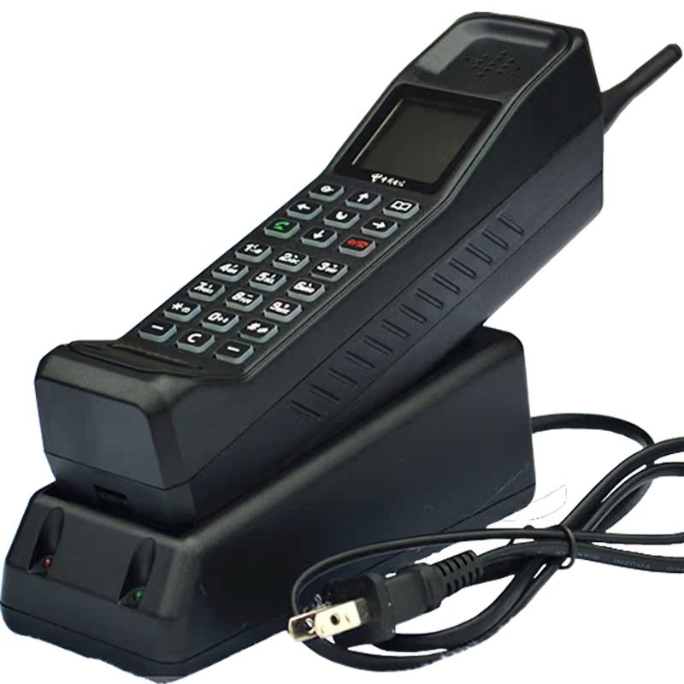
1G
The technology used in the first generation of mobile phones is analog voice technology, refers to the original analog, voice only cellular telephone standard.
The electrical or electromagnetic signals used to represent and transmit information often directly simulate the information itself.

Slide 13
Development
In the early decades of the 20th century
In 1946
In the 1960s
In 1982
Mobile wireless telephone occasionally appear in military communication.
St. Louis established the first telephone system available in cars, the push to talk system.
The Improved Mobile Telephone System (IMTS) began to be installed and used.
Advanced Mobile Phone System (AMPS) is being installed and deployed for the first time in the United States.

Slide 14
Channels
AMPS uses FDM to separate the channels.
The AMPS system uses 832 full-duplex channels, each consisting of a pair of simplex channels. This arrangement is called Frequency Division Duplex (FDD).
The 832 channels are divided into four categories:
1. Control (base to mobile) to manage the system.
2. Paging (base to mobile) to alert mobile users to calls for them.
3. Access (bidirectional) for call setup and channel assignment.
4. Data (bidirectional) for voice, fax, or data.

Slide 15
Call Management
Each mobile telephone in AMPS has a 32-bit serial number and a 10-digit telephone number in its PROM.
The telephone number is represented as a 3-digit area code in 10 bits, and a 7-digit subscriber number in 24 bits.
Scans the 21 control channels to find the most powerful signal .
Broadcasts its serial number and telephone number.
The base station receive signal and inform MTSO.
MTSO records the existence of its new customer and also informs the customer's home MTSO of his current location.

Slide 16
Call Management
Caller
MTSO
Callee
Send the signal and if there is a collision, try again.
Receive the signal and inform MTSO.
Find an idle channel and sent it back on the control channel.
Transmit signal
The base station
The base station

Slide 17
03
Second Generation Mobile Phones
李宇龙 202130430126

Slide 18
2G
GSM(Global System for Mobile communications) is a dominant 2G system, its techniques are mainly the mixture of FDM(Frequency Division Multiplexing) and TDM(Time Division Multiplexing).
D-AMPS(Digital Advanced Mobile Phone System) is the digital version of AMPS and is compatible with AMPS. D-AMPS also adopts TDM technique.
CDMA(Code Division Multiple Access) is distinct from the former two. Neither FDM nor TDM is it based on. However, 3G is based on CDMA.

Slide 19
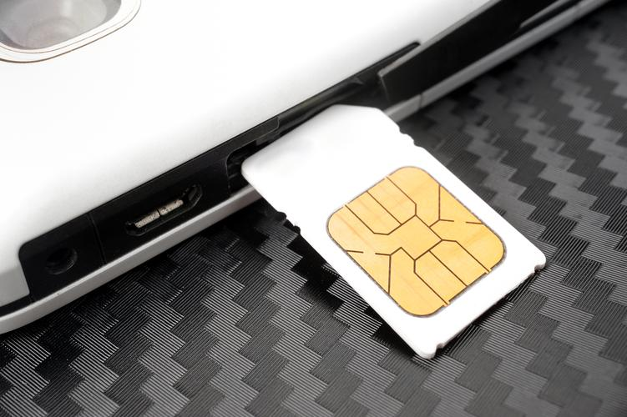
2G: GSM
The greatest distinction between 1G and 2G is that 2G transmits digital signals while 1G transmits analog signals.
The compression and the encryption of signals bring the gain of capacity, safety and interference immunity.
The SIM(Subscriber Identity Module) card is utilized to encrypt calls.

Slide 20
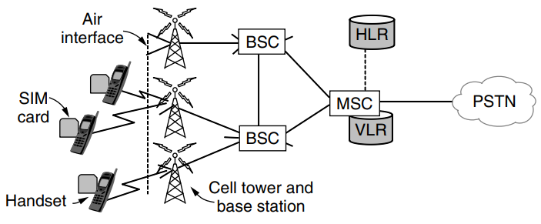
2G: GSM
Air interface specifies the norm of wireless transmission between mobile phone and base station.
GSM is also a frequency division duplex cellular system. Each pair of mobile phones corresponds a pair of frequencies with a constant frequency difference, one for sending and one for receiving.
TDM technique makes the frequency pair shared by multiple mobile phones.
GSM mobile network architecture

Slide 21
2G: GSM
Every base station connects to a BSC(Base Station Controller).
BSC allocates wireless resources and deals with switching.
Every BSC connects to a MSC. MSC is responsible for routing calls and connects to PSTN(Public Switching Telephone Network).
A database named VLR(Visitor Location Register) records all mobile phone nearby every base station.
HLR(Home Location Register) records the latest location of every nearby mobile phone.
These two databases must update as any mobile phone moves from a cell to the other cell.
GSM mobile network architecture

Slide 22
04
Third Generation Mobile Phones
蔡希迪 202130430010

Slide 23
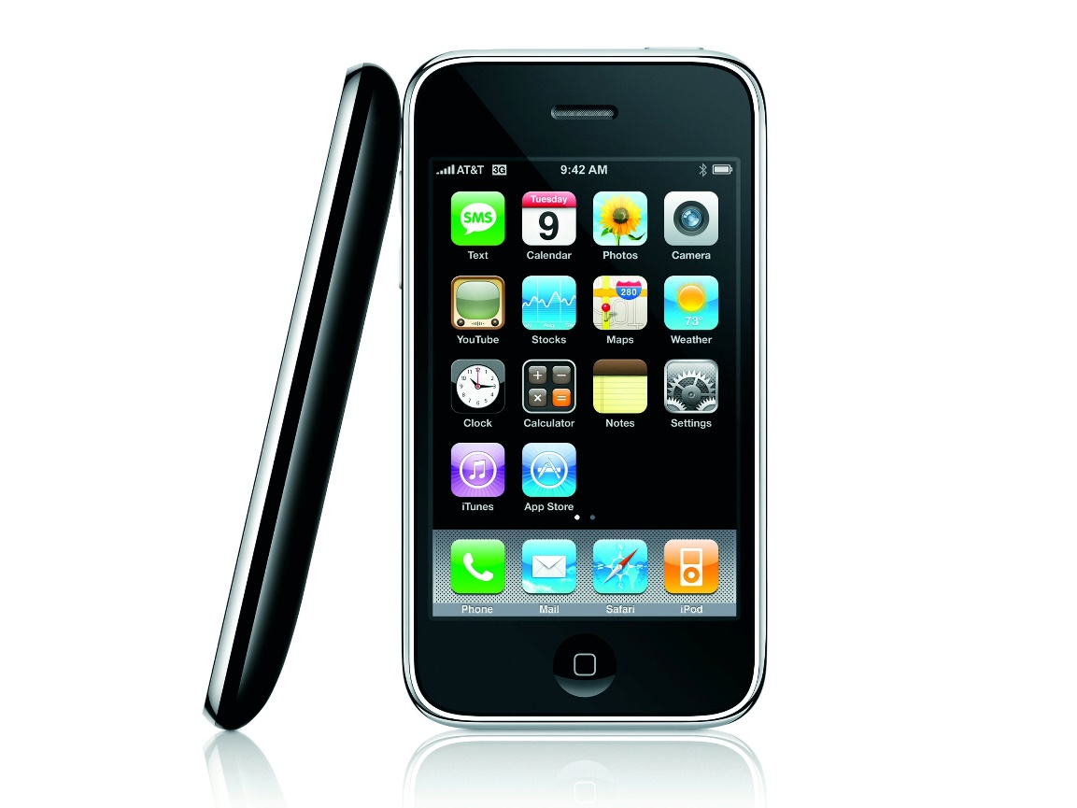
3G
During the development of 3G, data traffic on fixed networks began to surpass voice traffic, and a similar trend beginning to emerge on mobile devices as well.
The iPhone users with a strong demand for data accelerated the transition to 3G technology.

Slide 24


CDMA
CDMA allows each device to transmit over the entire frequency spectrum all the time.
Each bit time is divided into $m$ short intervals called chips.
To transmit a 1 bit, a device sends its chip sequence. To transmit a 0 bit, it sends the one's complement of its chip sequence.
All chip sequences must be pairwise orthogonal.
The chips of a device $(m=6)$
A (-1 -1 -1 +1 +1 -1 +1 +1)
To transmit a 1 bit, transmit:
(-1 -1 -1 +1 +1 -1 +1 +1)
To transmit a 0 bit, transmit:
(+1 +1 +1 -1 -1 +1 -1 -1)

Slide 25
CDMA
All devices should have the same power level at the receiver minimize interference between competing signals.
CDMA use an effective heuristic to balance received power.
The base station also provides feedback to each mobile station to increase, decrease, or maintain transmit power.
Weak signals from base station
Strong signals from devices
Strong signals from base station
Weak signals from device

Slide 26
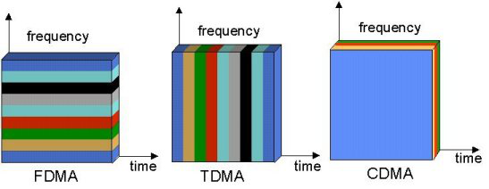
CDMA
CDMA can increase the system capacity. It does not need to use FDM to differentiate transmissions from different devices.
CDMA can make use of the short period of silence. It can simply not send signals to one device to minimize interference to other devices.
In CDMA, devices in a cell use the same frequency

Slide 27
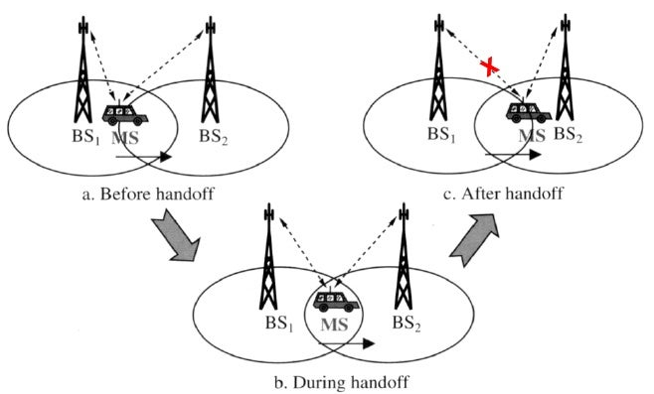
CDMA
CDMA can achieve soft hand off.
This means that the mobile phone is taken over by new base stations before the connection with the original base station is completely interrupted.
Another switching approach is hard handoff, where the original base station disconnects the call before the new base station takes over. If the new base station cannot take over the call the call is abruptly interrupted.

Slide 28
05
4G: OFDM
卢本涛 202130430188

Slide 29
4G: OFDM
Orthogonal Frequency-Division Multiplexing
FDMA
OFDM
Amplitude
Amplitude
Frequency
Frequency
Guard Gap
Guard Gap
Reduced Interference, Low Utilization Rate
No contribution of others at peek

Slide 30
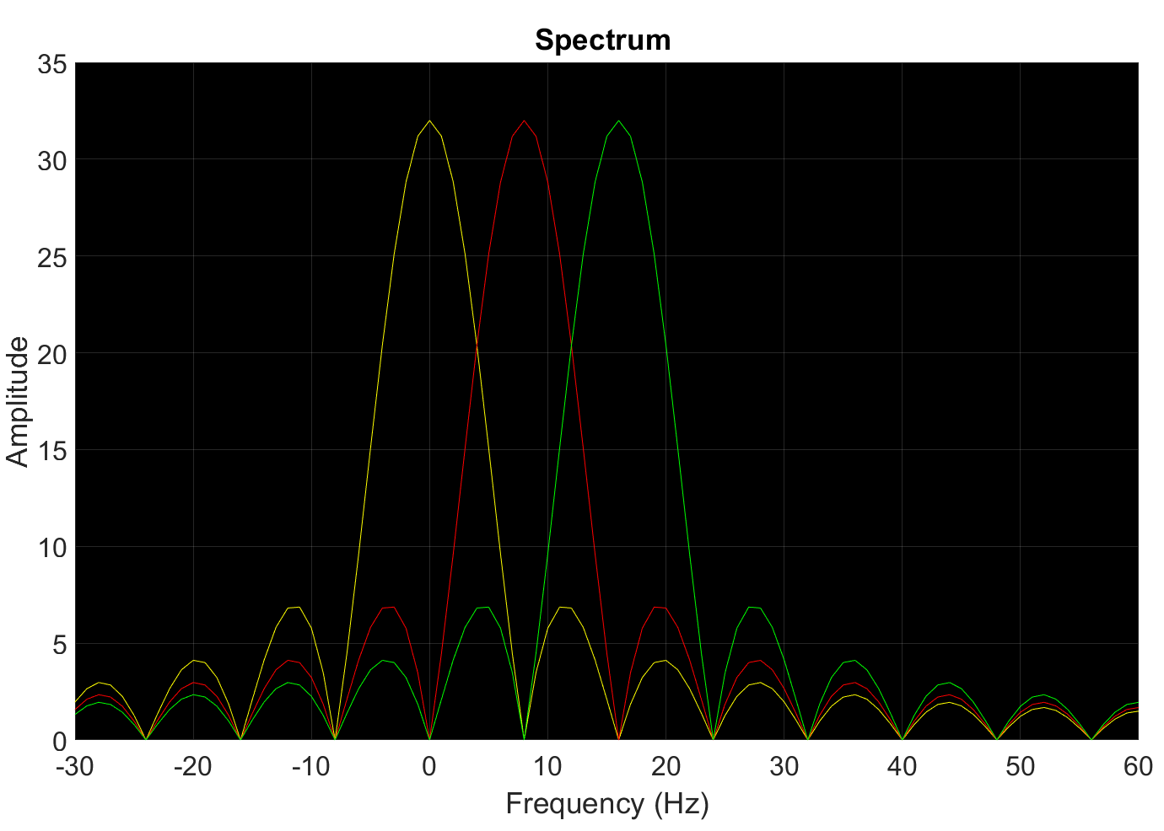
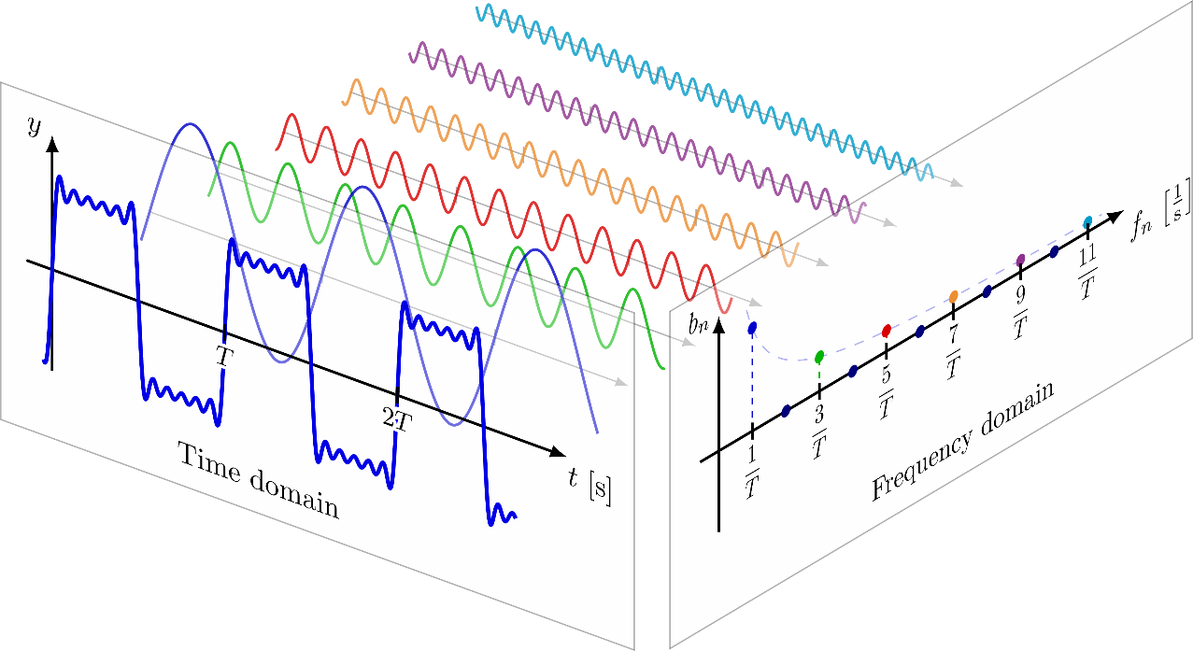
4G: OFDM
DSP (Digital Signal Processor) can easily decompose this orthogonal signal into original signals using FFT
Interfered?

Slide 31
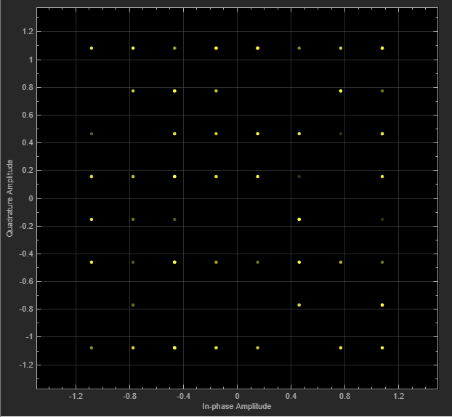
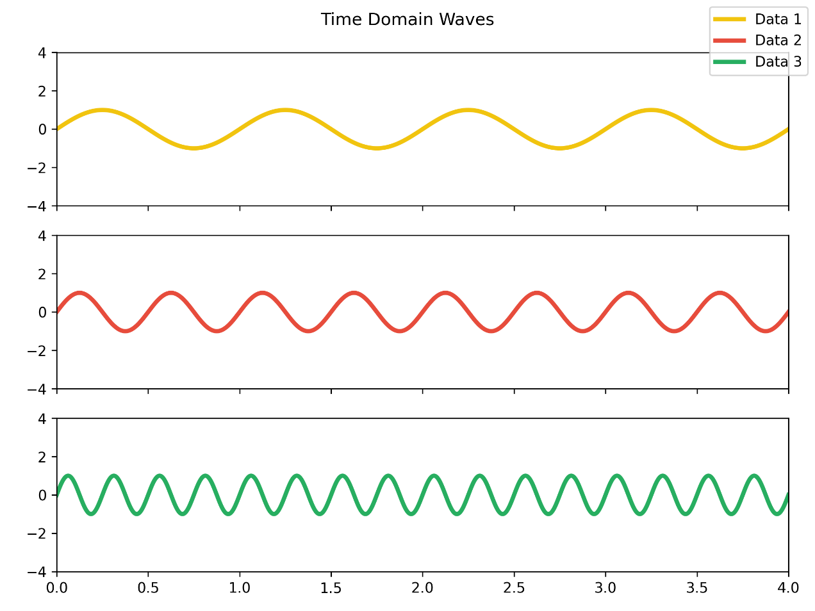
4G: OFDM
Let’s see how it actually works…
…|101011|100110|010101
QAM-64
Time Domain
Amplitude
Sum
Frequency

Slide 32
4G: OFDM
Let’s see how it actually works…
Arrange OFDM symbols in time slots and send them one by one
…|101011|100110|010101
Serial Data
QAM-64
Sub-carriers
…|101011|
…|100110|
…|010101|
Parallel Data
Each line (different frequency)
is called a sub-carrier
Sum of line signals form a OFDM symbol
OFDM symbol

Slide 33
4G: OFDM
Typical 4G LTE (Long-Term Evolution) supports 1200 sub-carriers.
High Flexibility and Efficiency

Slide 34
06
5G: NOMA
卢本涛 202130430188

Slide 35
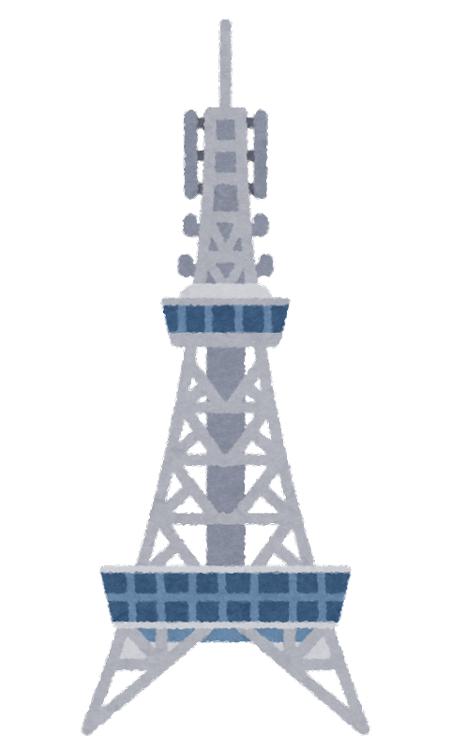


5G: NOMA
Non-Orthogonal Multiple Access (Power Domain)
R2
Receivers at different distance enjoy different signal strength
R1
A
B

Slide 36
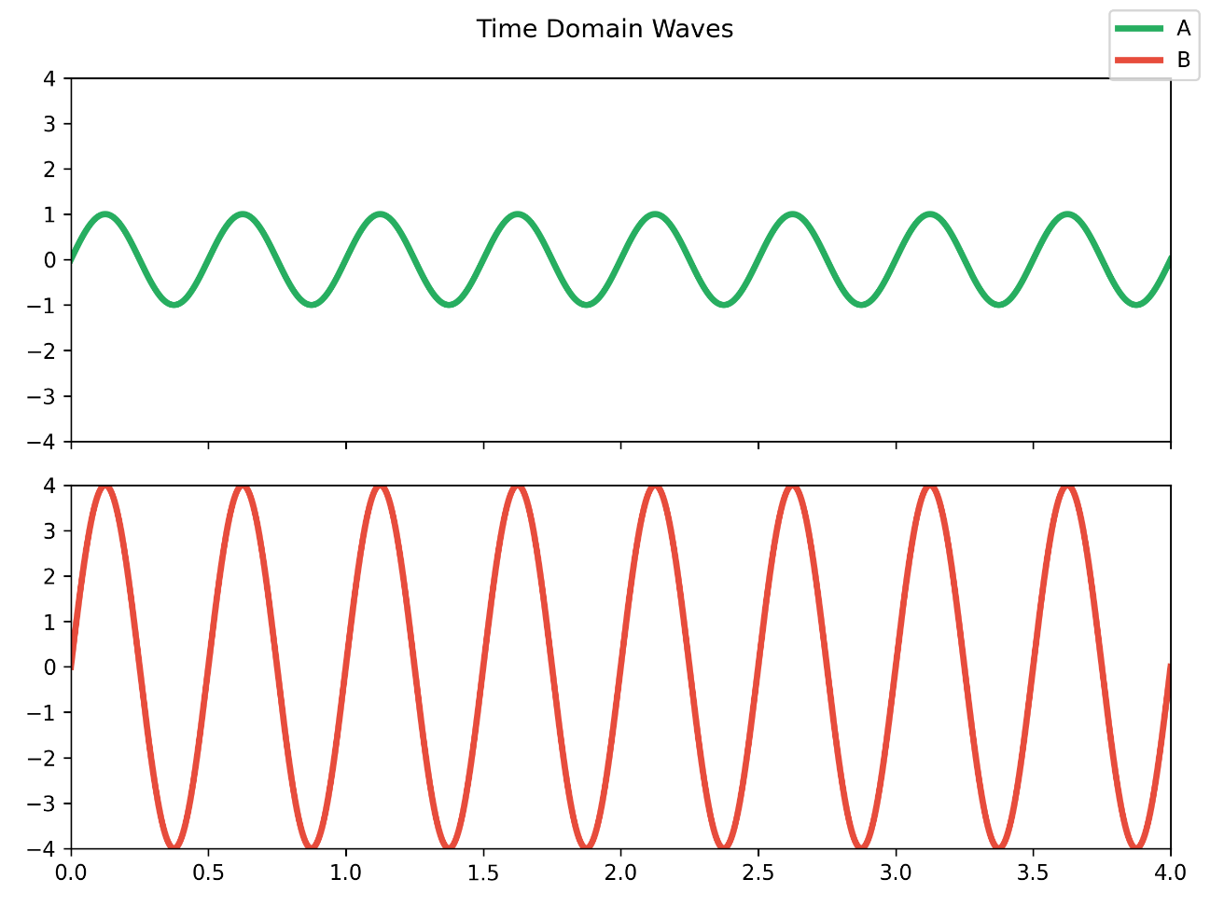
5G: NOMA
Non-Orthogonal Multiple Access (Power Domain)
Allocate more power to “weak” (far) users
A
B

Slide 37
5G: NOMA
Non-Orthogonal Multiple Access (Power Domain)
Data
Data
A’s Signal
A’s Signal
Noise
B’s Signal
B’s Signal
Signal Strength
Signal Strength
A
B

Slide 38
5G: NOMA
Non-Orthogonal Multiple Access (Power Domain)
Data
A’s Signal
B’s Signal
Decode B’s Signal
Signal Strength
SIC
(Successive Interference Cancellation)
Subtract from received signal
Retrieve A’s Data
A

Slide 39
5G: NOMA
Non-Orthogonal Multiple Access (Power Domain)
R2
A, B can use the same frequency
Further enlarge capacity
R1
A
B

Slide 40
07
WeChat Call vs. Traditional Call
葛苏杭 202130430041

Slide 41
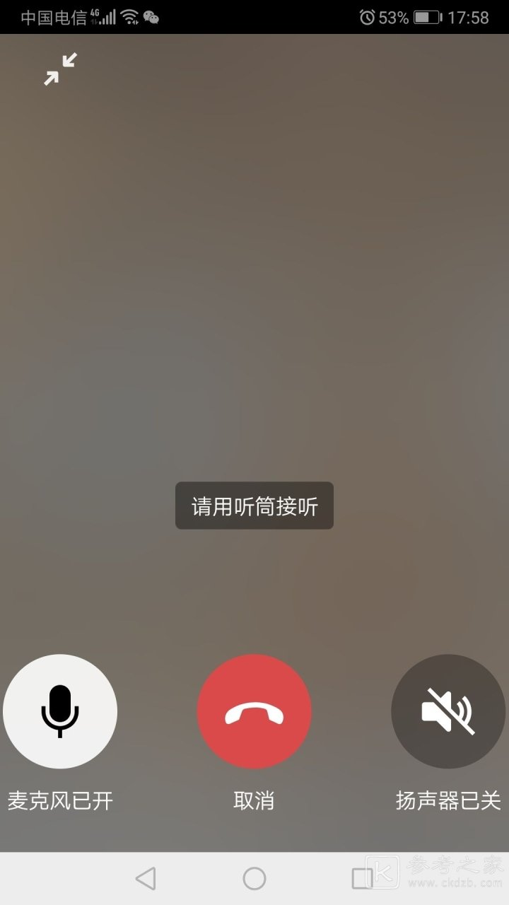
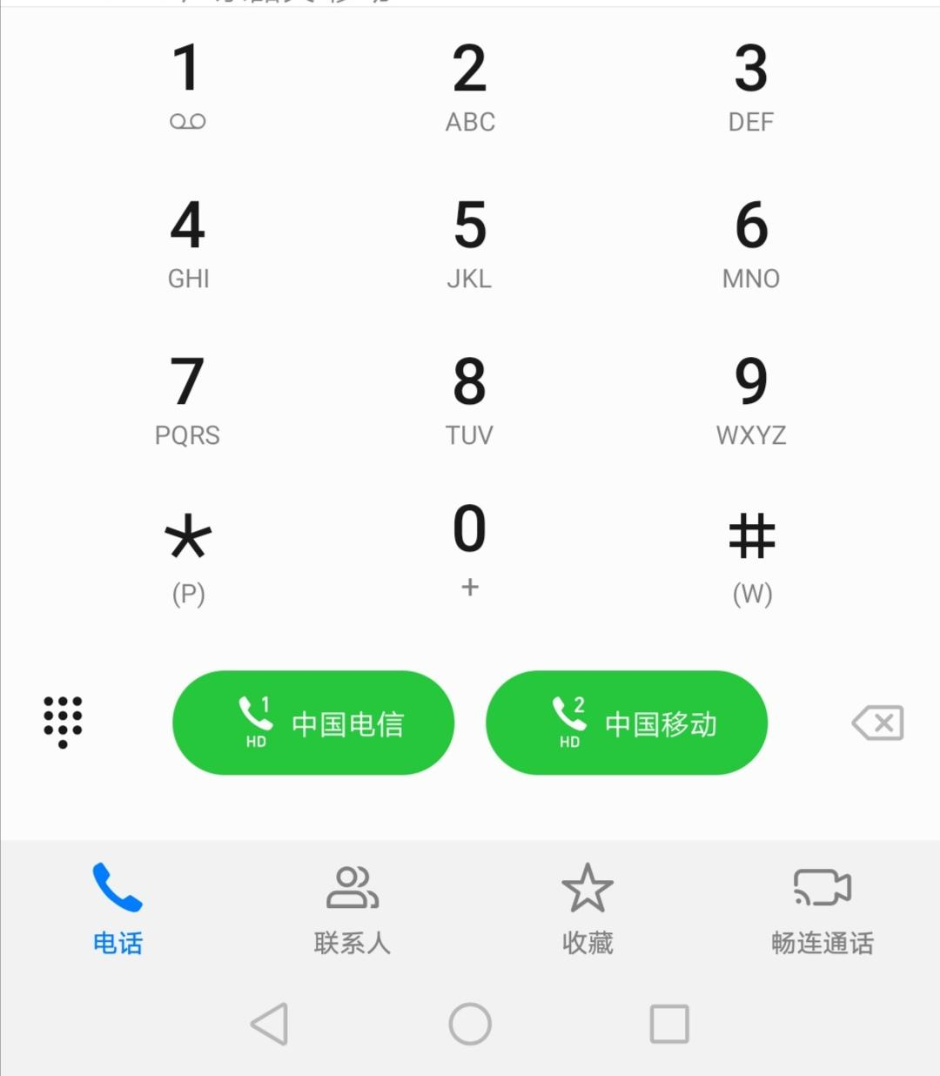
VS

Slide 42
Distinguish
1.. In the case of data and wifi, making WeChat calls does not generate costs, while mobile phone calls directly consume phone bills
2. WeChat calls are transmitted through mobile phone data traffic, and mobile phone calls can only be made when the data signal and WiFi signal are better, While mobile phone calls use communication networks, and the call quality is relatively better

Slide 43
Distinguish
3. Mobile phone calls is more secure than WeChat calls(WeChat calls belong to VOIP, VoLTE and VONER are "carrier-grade" calls with dedicated bearers on the network), but it does not have the function of talking to multiple people at the same time.
4. Mobile phone calls are very convenient for recording, WeChat calls can also be recorded, such as the tape recorder that comes with the MIUI system of Xiaomi mobile phones, you can directly choose to open WeChat, QQ, etc. in "Application Call Recording"; But for some mobile phones, it is not as convenient as system call recording.
5. Mobile phone calls has a dedicated bearer channel, and there is billing that can be used as legal evidence. There are also many services in the telephone, including call forwarding, three-way calling, video conferencing, and voice mail

Slide 44
08
Q & A

Slide 45
Reference
[1] Y. Cai, Z. Qin, F. Cui, G. Y. Li and J. A. McCann, "Modulation and Multiple Access for 5G Networks," in IEEE Communications Surveys & Tutorials, vol. 20, no. 1, pp. 629-646, Firstquarter 2018, doi: 10.1109/COMST.2017.2766698.
[2] MathWorks,“What Is OFDM?”, https://www.mathworks.com/discovery/ofdm.html
[3] Keysight Technologies, Inc., Concepts of Orthogonal Frequency Division Multiplexing (OFDM) and 802.11 WLAN, https://rfmw.em.keysight.com/wireless/helpfiles/89600B/WebHelp/Subsystems/wlan-ofdm/Content/ofdm_basicprinciplesoverview.htm
[4] Tanenbaum, A. S. (2003). Computer networks. Pearson Education India.

Slide 46
Thank you
翁伟钊 202130430256 庄多懋 202130430423 李宇龙 202130430126
蔡希迪 202130430010 卢本涛 202130430188 葛苏杭 202130430041

