Slide 1
Ethernet and IEEE 802.3
Group 6: 姚一阳 王瑞林 梁誉瀚
叶昊林 谈世翔
2023/9/25

Slide 2
Academic report
presentation
CONTENTES
#01
History And Classic Ethernet
#02
Classic Ethernet MAC Sublayer Protocol
#03
Ethernet Performance
#04
Switched Ethernet
#05
Further Development

Slide 3
#01
History And Classic
Ethernet
September·25th

Slide 4
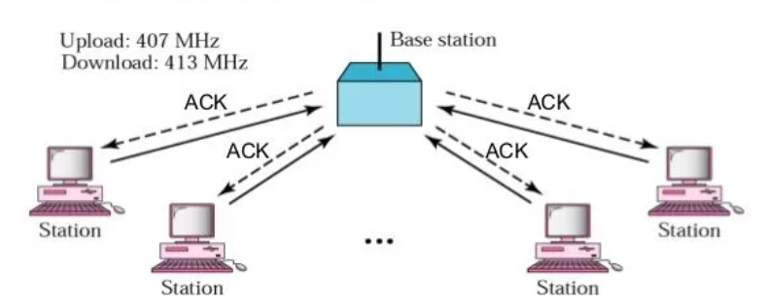
1.1 History of Ethernet: Start From ALOHA Network
Developed by Norm Abramson at the Univ. of Hawaii in 1968
Mountainous islands land-based network difficult to install
Earlist wireless transmission protocol

Slide 5
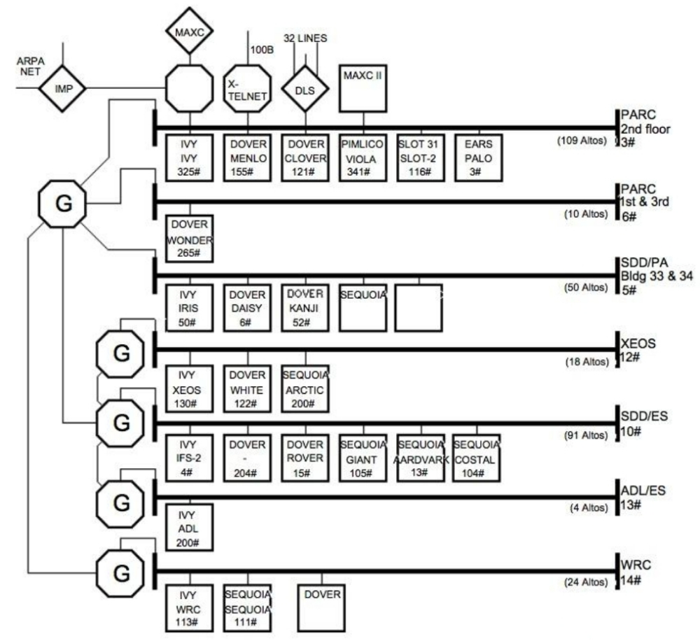
1.2 History of Ethernet: Birth of Ethernet
In 1976, using the knowledge of Abramson's work, Bob Metcalfe and David Boggs, who worked at Xerox, designed and implemented the first local area network, it was called Ethernet I after the luminiferous ether, it ran at 3 Mbps.
Ethernet I Network

Slide 6

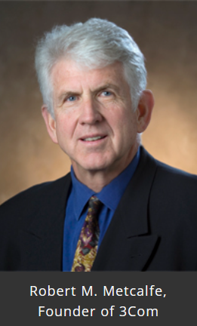
1.3 History of Ethernet: Development
In 1978, DEC, Intel and Xerox drew up a standard for a 10-Mbps Ethernet, called the DIX standard.
In 1983, with a minor change, the DIX standard became Ethernet II, it was later named IEEE 802.3 by IEEE.
In 1979, Metcalfe formed his own company, 3Com, which went on the market 5 tears later.

Slide 7
1.4 Classic Ethernet
Thick
Ethernet
More efficient
Classic
Ethernet
Thin
Ethernet
Cheaper and easier to install
Ethernet
Switched
Ethernet
devices called switches are used to connect different computers

Slide 8
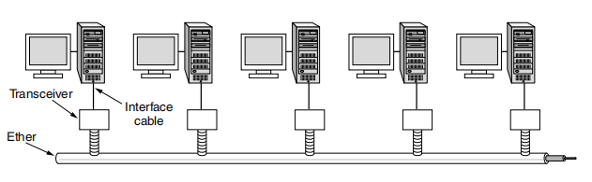
1.4 Classic Ethernet
Multiple cables are connected by repeaters to allow larger networks.
No two transceivers could be more than 2.5 km apart, no path between any two transceivers could traverse more than four repeaters. (We will see the reasons later)
Architecture of classic Ethernet

Slide 9
#02
Classic Ethernet MAC Sublayer Protocol
September·25th

Slide 10
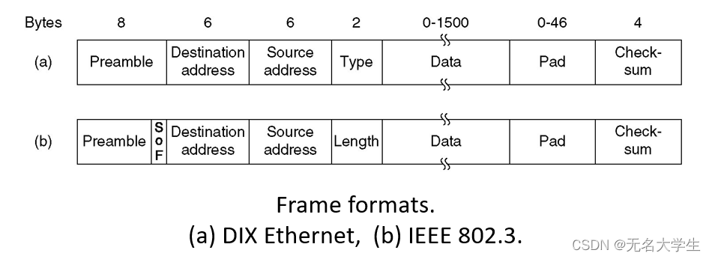
2.1The Ethernet MAC Sublayer Protocol:frame
The Ethernet protocol provides a pause time between each frame, beginning with the leading domain and ending with the CRC checksum. When sending a frame, it should be composed of high and low levels, and the pause time level is directly 0. This framing is different from the usual network.
请在此输入具体的内容，T内容应当精炼简洁，便于读者快速把握信息。
提高材料转化率
提高成品率
提高废物利用率
提高产能
52
64
37
75
%
%
%
%
相比于传统方法，可有效提高材料转化的效率
相比于传统方法，可有效提高成品产出的效率
相比于传统方法，可有效提高废物利用的效率
相比于传统方法，可有效提高工业化产能
请在此输入具体的内容，内容应当精炼简洁，便于读者快速把握信息。
请在此输入具体的内容，内容应当精炼简洁，便于读者快速把握信息。
请在此输入具体的内容，内容应当精炼简洁，便于读者快速把握信息。
适当对内容进行分段，可增加信息的可阅读性。
适当对内容进行分段，可增加信息的可阅读性。
适当对内容进行分段，可增加信息的可阅读性。
适当对内容进行分段，可增加信息的可阅读性。

Slide 11
2.1The Ethernet MAC Sublayer Protocol:frame
The first is the 8-byte Preamble (the leading field) , each byte containing the bit mode 10101010(except the last 2 bits of the last byte being 11) , which is called the 802.3 Frame Start of Frame (SOF) delimiter. This bit mode is manchester-encoded to facilitate clock synchronization between the receiver and the sender. Header contains Destination and Source Addresses and a Type field trailer is CRC checksum.The Destination and Source Addresses are both 6 byte MAC Addresses (physical Addresses). Each computer will have a unique MAC address (address of the network card) , global uniqueness.
请在此输入具体的内容，T内容应当精炼简洁，便于读者快速把握信息。
提高材料转化率
提高成品率
提高废物利用率
提高产能
52
64
37
75
%
%
%
%
相比于传统方法，可有效提高材料转化的效率
相比于传统方法，可有效提高成品产出的效率
相比于传统方法，可有效提高废物利用的效率
相比于传统方法，可有效提高工业化产能
请在此输入具体的内容，内容应当精炼简洁，便于读者快速把握信息。
请在此输入具体的内容，内容应当精炼简洁，便于读者快速把握信息。
请在此输入具体的内容，内容应当精炼简洁，便于读者快速把握信息。
适当对内容进行分段，可增加信息的可阅读性。
适当对内容进行分段，可增加信息的可阅读性。
适当对内容进行分段，可增加信息的可阅读性。
适当对内容进行分段，可增加信息的可阅读性。

Slide 12
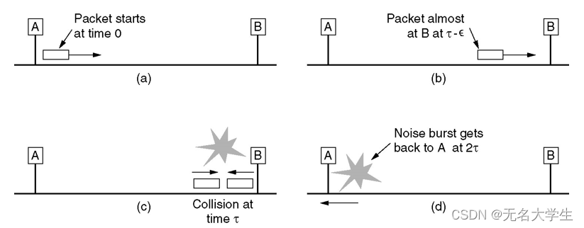
2.2The Ethernet MAC Sublayer Protocol:field
Tpye (Type) field, which tells the receiver what to do with the frame. It is possible to have multiple network layer protocols in use on the same computer, so when an Ethernet frame arrives, the kernel must know which network layer protocol to hand it over to, the type field specifies which process this frame should be handed over to.
Data fields, up to 1500 bytes, should be sufficient memory -RAM-RAM) for the transceiver to store a frame. The minimum data portion of a frame is also specified and is related to data transfer speed, mainly due to transmission conflicts in Ethernet, as shown below.
请在此输入具体的内容，T内容应当精炼简洁，便于读者快速把握信息。
提高材料转化率
提高成品率
提高废物利用率
提高产能
52
64
37
75
%
%
%
%
相比于传统方法，可有效提高材料转化的效率
相比于传统方法，可有效提高成品产出的效率
相比于传统方法，可有效提高废物利用的效率
相比于传统方法，可有效提高工业化产能
请在此输入具体的内容，内容应当精炼简洁，便于读者快速把握信息。
请在此输入具体的内容，内容应当精炼简洁，便于读者快速把握信息。
请在此输入具体的内容，内容应当精炼简洁，便于读者快速把握信息。
适当对内容进行分段，可增加信息的可阅读性。
适当对内容进行分段，可增加信息的可阅读性。
适当对内容进行分段，可增加信息的可阅读性。
适当对内容进行分段，可增加信息的可阅读性。

Slide 13
2.3The Ethernet MAC Sublayer Protocol:transmission
请在此输入具体的内容，T内容应当精炼简洁，便于读者快速把握信息。
提高材料转化率
提高成品率
提高废物利用率
提高产能
52
64
37
75
%
%
%
%
相比于传统方法，可有效提高材料转化的效率
相比于传统方法，可有效提高成品产出的效率
相比于传统方法，可有效提高废物利用的效率
相比于传统方法，可有效提高工业化产能
请在此输入具体的内容，内容应当精炼简洁，便于读者快速把握信息。
请在此输入具体的内容，内容应当精炼简洁，便于读者快速把握信息。
请在此输入具体的内容，内容应当精炼简洁，便于读者快速把握信息。
If a station attempts to transmit a very short frame, the transmission is completed before the conflicting noise returns to the sender (2 Tau) , although a collision occurs. In this case, the sender assumes that the frame has been successfully sent. Therefore, all frames take at least 2 Tau to send (one round trip so 2 Tau) , typically 64 bytes.
适当对内容进行分段，可增加信息的可阅读性。
适当对内容进行分段，可增加信息的可阅读性。
适当对内容进行分段，可增加信息的可阅读性。
适当对内容进行分段，可增加信息的可阅读性。

Slide 14
2.4CSMA/CD with Binary Exponential Backoff：
Step·02
Step·03
2 is called Slot time, after the first collision, each station waits for 0 or 1 Slot before sending again. If the same time is chosen, that is, a second collision occurs, each station randomly selects 0,1,2,3, and then waits for so many slots to send again. And so on, choosing a number at random between 0 and waiting for so many slots. After 10 conflicts, the selection interval of the random number is fixed on the maximum value of 1023, and will not increase in the future. After 16 collisions, the controller gives up and sends a failure report back to the computer.
请在此输入具体的内容，内容应当精炼简洁，便于读者快速把握信息。
请在此输入具体的内容，内容应当精炼简洁，便于读者快速把握信息。
请在此输入具体的内容，内容应当精炼简洁，便于读者快速把握信息。
适当地对文案内容进行断句和分段，可以增加信息的可阅读性。
适当地对文案内容进行断句和分段，可以增加信息的可阅读性。
适当地对文案内容进行断句和分段，可以增加信息的可阅读性。

Slide 15
#03
Ethernet Performance
September·25th

Slide 16

1.Probability A
preconditions:
1. with k stations always ready to transmit
2. each station transmits during a contention slot with probability p
probability A that some station acquires the channel in that slot:

Slide 17
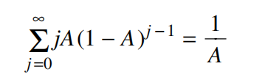
mean number of slots per contention:

Slide 18

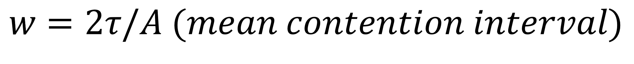


slot duration
mean number of slots per contention

Slide 19
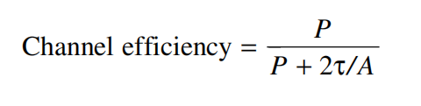
2.Channel Efficiency
If the mean frame takes P sec to transmit, when many stations have frames to send, then:
indicates that why Ethernet standard specifies a maximum cable length
cable length
contention interval

Slide 20
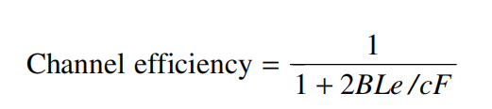
variables declaration:
1.frame length F
2.network bandwidth B
3.cable length L
4.speed of signal propagation c
5.P = F / B
indicates that increasing network bandwidth or distance (the BL product) reduces efficiency for a given frame size

Slide 21
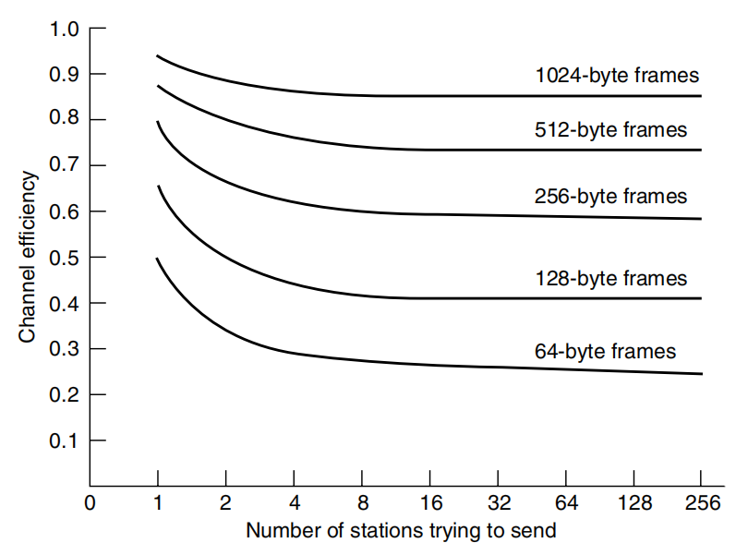
3.Efficiency Example
conclusions:
1.with a 64byte slot time, 64byte frames are not efficient
2.with 1024byte frames and an asymptotic value of e 64byte
slots per contention interval, the contention period is 174 bytes and
the efficiency is 85%

Slide 22
#04
Switched Ethernet
September·25th

Slide 23
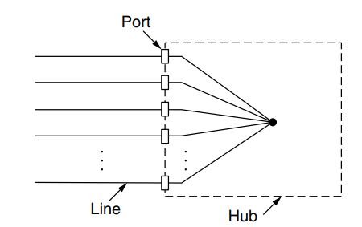
1. Shortages of classic Ethernet
请在此输入具体的内容，T内容应当精炼简洁，便于读者快速把握信息。
To deal with problems about finding breaks or loose connections, Ethernet turned to a new pattern in which each station has a dedicated cable running to a central hub, and it can connects all the attached wires electrically, as if they were soldered together.
提高材料转化率
提高成品率
提高废物利用率
提高产能
52
64
37
75
%
%
%
%
相比于传统方法，可有效提高材料转化的效率
相比于传统方法，可有效提高成品产出的效率
相比于传统方法，可有效提高废物利用的效率
相比于传统方法，可有效提高工业化产能
请在此输入具体的内容，内容应当精炼简洁，便于读者快速把握信息。
请在此输入具体的内容，内容应当精炼简洁，便于读者快速把握信息。
请在此输入具体的内容，内容应当精炼简洁，便于读者快速把握信息。
However, hubs do not increase capacity because they are logically equivalent to the single long cable of classic Ethernet. As more and more stations are added, each station gets a decreasing share of the fixed capacity. Eventually, the LAN will saturate.
适当对内容进行分段，可增加信息的可阅读性。
适当对内容进行分段，可增加信息的可阅读性。
适当对内容进行分段，可增加信息的可阅读性。
适当对内容进行分段，可增加信息的可阅读性。

Slide 24
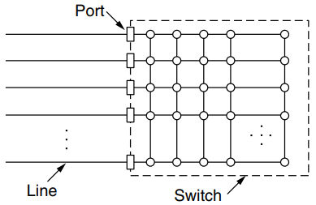
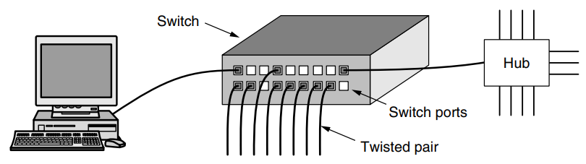
2. How swithed Ethernet works
The heart of this system is a switch containing a high-speed backplane that connects all of the ports
请在此输入具体的内容，T内容应当精炼简洁，便于读者快速把握信息。
A switch has the same advantages as a hub, too. It is easy to add or remove a new station by plugging or unplugging a wire, and it is easy to find most faults since a flaky cable or port will usually affect just one station.

Slide 25
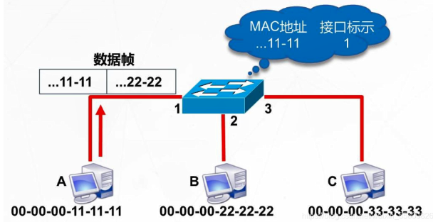
When a switch port receives an Ethernet frame from a station, the switch checks the Ethernet addresses to see which port the frame is destined for.
请在此输入具体的内容，T内容应当精炼简洁，便于读者快速把握信息。
The switch then forwards the frame over its high-speed backplane to the destination port. The destination port then transmits the frame on the wire so that it reaches the intended station

Slide 26
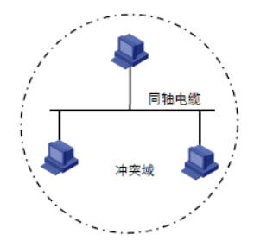
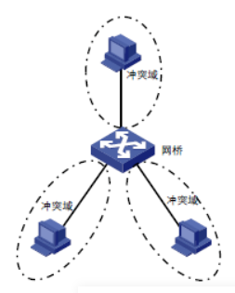
In a hub, all stations are in the same collision domain. They must use the CSMA/CD algorithm to schedule their transmissions.
请在此输入具体的内容，T内容应当精炼简洁，便于读者快速把握信息。
In a switch, each port is its own independent collision domain. In the common case that the cable is full duplex, both the station and the port can send a frame on the cable at the same time. Collisions are now impossible and CSMA/CD is not needed.

Slide 27
3. Improvement Over Hub
请在此输入具体的内容，T内容应当精炼简洁，便于读者快速把握信息。
1. Since there are no collisions, the capacity is used more efficiently
2. With a switch multiple frames can be sent at the same time(by different stations). These frames will reach the switch ports and travel over the switch’s backplane to be output on the proper ports

Slide 28
#05
Further Development
September·25th

Slide 29
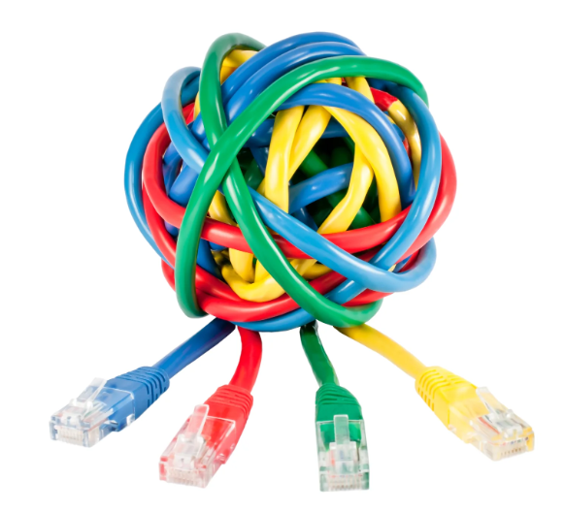
5.1 Fast Ethernet
"Work expands to fill the time available for its completion..."
请在此输入具体的内容，T内容应当精炼简洁，便于读者快速把握信息。
----Parkinson's Law
Data expanded to fill the bandwidth available for their transmission
The novelty of 10 Mbps wore off quickly, more and more installations needed more bandwicth, making the 10-Mbps LANs connected by a maze of repeaters, hubs and switches.
Advanced cabels and transmission techniques were needed

Slide 30
5.1 Fast Ethernet
请在此输入具体的内容，T内容应当精炼简洁，便于读者快速把握信息。
Keep all old frame formats, interfaces and procedueal rules
IEEE 802.3u
100 Mbps
Upgrade the cables
IEEE 802.3
10 Mbps
1995
Technically reduce the bit time from 100nsec to 10 nsec
1983

Slide 31
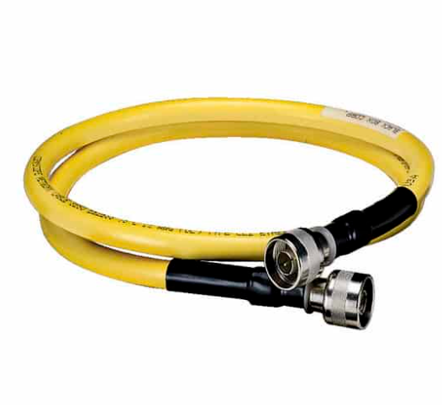
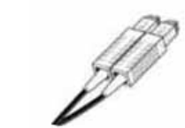
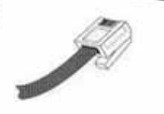
5.1 Fast Ethernet
Advenced Cabel:
请在此输入具体的内容，T内容应当精炼简洁，便于读者快速把握信息。
10BASE-5
IEEE 802.3
100BASE-FX
IEE 802.3u
100BASE-TX
IEEE 802.3u
Coaxical Pair
Twited Pair
Fiber Pair
500 m
100 m
2000 m

Slide 32
5.2 Gigabit Ethernet and 10-Gigabit Ethernet
IEEE 802.3ae
10 Gbps
请在此输入具体的内容，T内容应当精炼简洁，便于读者快速把握信息。
IEEE 802.3ab
2002
1 Gbps
10GBase-LR: 10 km
IEEE 802.3u
100 Mbps
10GBase-ER: 40 km
1999
1000Base-LX: 5 km
IEEE 802.3
10 Mbps
1995
1000Base-SX: 550 m
1983

Slide 33
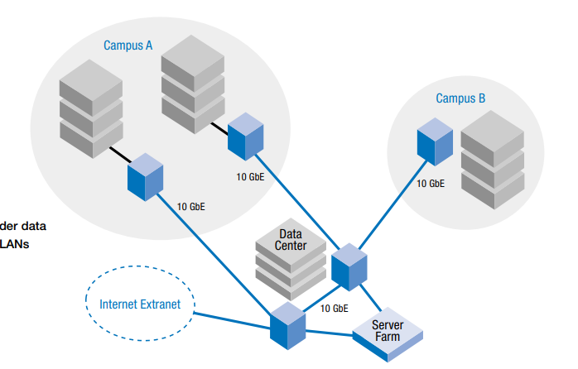
5.3 Applications of 10-Gigabit Ethernet
With 10 GE，LANs can provide better support the rising number of bandwidth-hungry applications and reach greater distance, such as 40 km, which means companies and schools can choose their data center and server farm
in a more strategic way.
请在此输入具体的内容，T内容应当精炼简洁，便于读者快速把握信息。

Slide 34
Q&A
September·25th

Slide 35
Q&A
1.How does Ethernet handle collisions and ensure efficient data transmission?
请在此输入具体的内容，T内容应当精炼简洁，便于读者快速把握信息。

Slide 36
Q&A
1.How does Ethernet handle collisions and ensure efficient data transmission?
请在此输入具体的内容，T内容应当精炼简洁，便于读者快速把握信息。
Ans: Ethernet uses the Carrier Sense Multiple Access with Collision Detection (CSMA/CD) access method. It listens for ongoing transmissions and waits for a clear channel before transmitting data. If collisions occur, the devices involved detect them and retransmit after a random delay.

Slide 37
Q&A
2.Can you think of any challenges or limitations associated with Ethernet networks?
请在此输入具体的内容，T内容应当精炼简洁，便于读者快速把握信息。

Slide 38
Q&A
2.Can you think of any challenges or limitations associated with Ethernet networks?
请在此输入具体的内容，T内容应当精炼简洁，便于读者快速把握信息。
Ans: Ethernet networks may face challenges like network congestion, distance limitations (with copper cables), and potential security vulnerabilities that need to be addressed to ensure optimal performance and security.

Slide 39
Reference Page
https://www.optcore.net/100base-tx-vs-100base-fx/
https://en.wikipedia.org/wiki/10_Gigabit_Ethernet
IEEE SA - IEEE 802.3-2018
https://www.cse.ohio-state.edu/~panda/788/papers/1h_pro10gbe_lr_sa_wp.pdf
https://www.cablinginstall.com/home/article/16466796/100basesx-provides-a-path-to-the-future
https://en.wikipedia.org/wiki/Fast_Ethernet
Switched Ethernet (Data Communications and Networking)http://what-when-how.com/data-communications-and-networking/switched-ethernet-data-communications-and-networking/
https://zhuanlan.zhihu.com/p/62417/0199
Aloha Network - NETWORK ENCYCLOPEDIA
Ethernet Performance (tutorialspoint.com)
请在此输入具体的内容，T内容应当精炼简洁，便于读者快速把握信息。

Slide 40
Thanks
September·25th

