Slide 1


Error correction &
Hamming encoding
Group 4: 詹迪佳，甘轩，林晓金，王文俊 ，王震 ，王侯

Slide 2

Contents
01
Introduction to Errors
04
02
Error Detection
BCH Code
05
03
Hamming Code
Summary

Slide 3
01
Introduction to Errors
Speaker: 詹迪佳

Slide 4
Introduction to Errors
Why errors happen ?
Thermal Noise: inherent to the channel
Main reason: Noise
Impulse Noise: caused by external electromagnetic interference
Solution: increase signal-to-noise ratio.
Notes:
建议添加图像

Slide 5
Introduction to Errors
Features of Errors：
Errors have higher probability happen on useful bits.
Errors are usually concentrated rather than discrete.
Correcting error in bits is better than transmit the whole frame.

Slide 6
Introduction to Errors
Two Kinds of Error：
Bit Error
Frame error
Some bits that are wrong in a frame during transforma-tion.
Some frames are lost, repe-ated, or disordered during transformation.
A
111
……
101
B
A
111 | 101
……
111
B

Slide 7
02
Error Detection
Speaker: 甘轩

Slide 8
Parity Check
01 Introduction
Parity check is a simple method of error detection. The sender and receiver count the parity bits in the data to judge whether there is an error.

Slide 9
Parity Check
02 Encoding principle
The encoding rule of the parity check is to decide odd or even parity, then add a check bit at the end of each group, making the total number of 1 in the code is odd or even.
Parity bit examples ：
Sequence of seven bits | With even parity bit | With odd parity bit
0100010 | 0100010 0 | 0100010 1

Slide 10
Parity Check
Odd parity example
Data bits
Parity bit
Original data
0111000110101011 | 0
The total number of 1 is odd
Error data
0111000110111011 | 0
The total number of 1 become even, error!

Slide 11

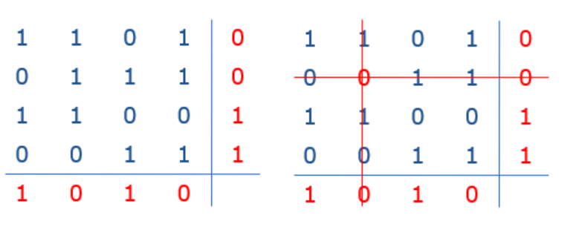
Two Dimension Parity Check
2D parity check can also be used to correct the error!
02
2D parity check

Slide 12
Parity Check Features
Error correction ability
Single-dimensional parity check can only detect errors with an odd number of incorrect bits, for example, it cannot detect errors when two bits are incorrect.
Simple algorithm and high calculation speed.
Efficiency
The efficiency of multi-dimension parity check is decided by the length and dimension of original data.
02

Slide 13


03
Hamming Code
Speaker: 王文俊、林晓金

Slide 14
Two concepts
CodeWord
A frame consists of m data bits(i.e., message) and r check bits.
The total length is n (i.e., n = m + r)

Slide 15
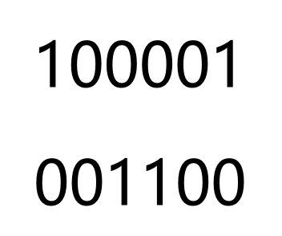

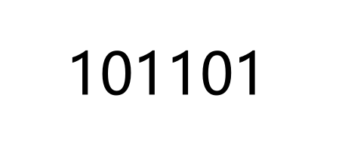
Two concepts
Hamming distance
Given two codewords, we can determine the “difference” between the two codewords based on the number of bit difference which called as Hamming distance.

Slide 16
Characteristic
The error-detecting and error-correcting properties of a code depend on its Hamming distance.
In order to detect d errors, we need a distance of d+1.
In order to correct d errors, we need a distance of 2d+1.
The coding efficiency of Hamming Code is: R = m / ( m + r )

Slide 17
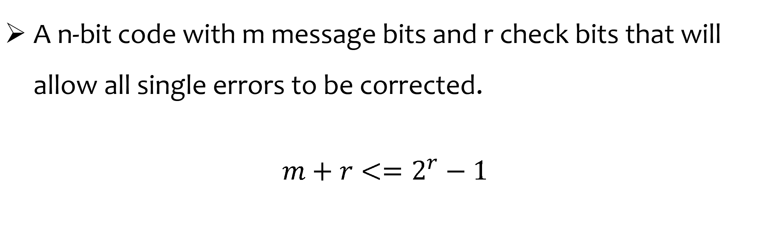
1 bit Hamming Error-correcting codes
A n-bit code with m message bits and r check bits that will allow all single errors to be corrected.
$$m+r<=2^{r}−1$$

Slide 18
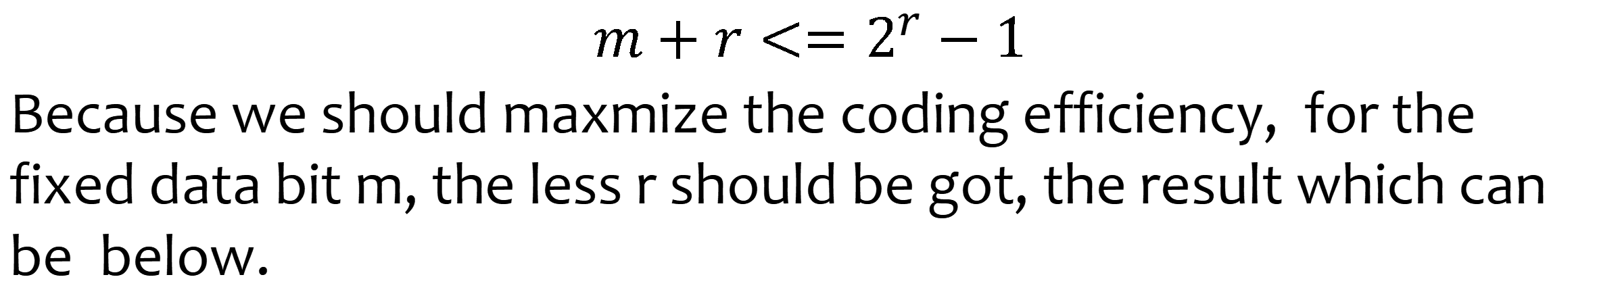
1 bit Hamming Error-correcting codes
$$m+r<=2^{r}−1$$
Because we should maxmize the coding efficiency, for the fixed data bit m, the less r should be got, the result which can be below.

Slide 19
1 bit Hamming Error-correcting codes
The bits of the codeword are numbered consecutively, starting with bit 1 at the left end, bit 2 to its immediate right, and so on.
The bits that are powers of 2 are check bits.
The rest (3, 5, 6, 7, 9, etc.) are filled up with the m data bits.
Each check bit’s value is the parity of every data bits
The parity of each check bit comes from the parity of the number of 1 of all data bits in the check bit’s position.

Slide 20
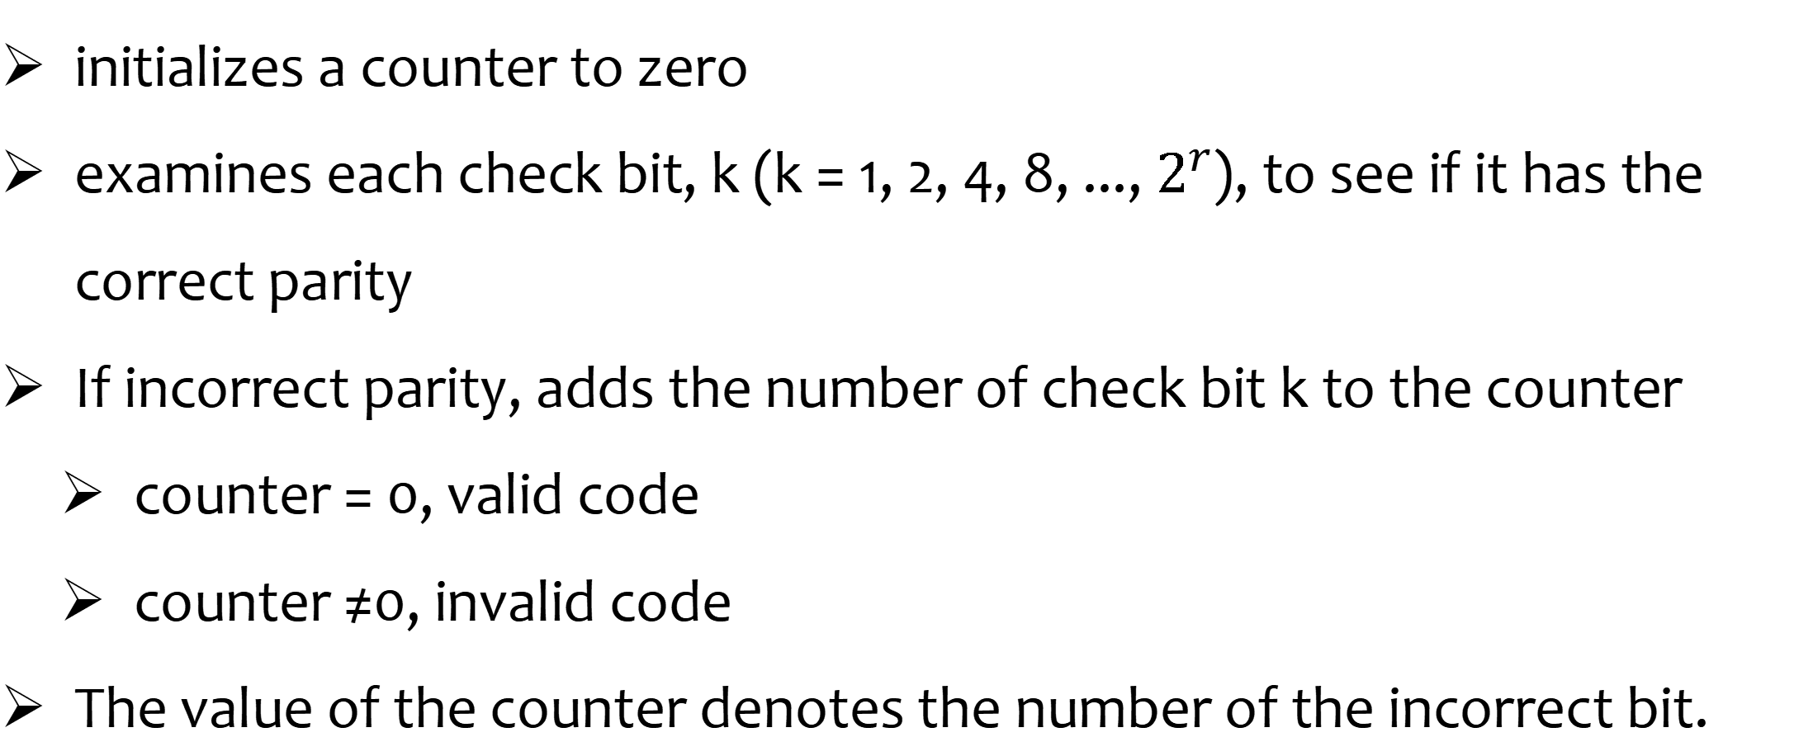
Hamming correct-error (receiver)
initializes a counter to zero
examines each check bit, k (k = 1, 2, 4, 8, ..., $2^{r}$), to see if it has the correct parity
If incorrect parity, adds the number of check bit k to the counter
counter = 0, valid code
counter ≠0, invalid code
The value of the counter denotes the number of the incorrect bit.

Slide 21
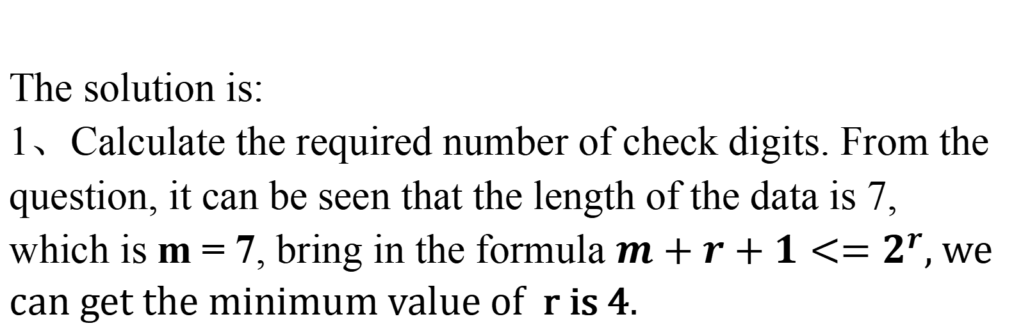
An Example
Q: Given that the original data is 1101001, after using Hamming Code encoding, calculate the actual data sent? If the receiving end receives data 11001101101, find the error position.
The solution is:
1、Calculate the required number of check digits. From the question, it can be seen that the length of the data is 7, which is m = 7, bring in the formula $m+r+1<=2^{r}$, we can get the minimum value of r is 4.

Slide 22
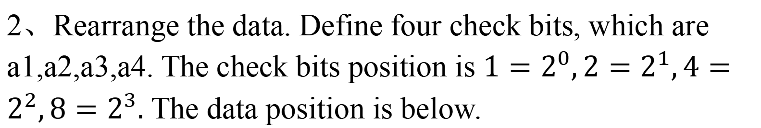
An Example
Q: Given that the original data is 1101001, after using Hamming Code encoding, calculate the actual data sent? If the receiving end receives data 11001101101, find the error position.
2、Rearrange the data. Define four check bits, which are a1,a2,a3,a4. The check bits position is $1=2^{0},2=2^{1},4=2^{2},8=2^{3}.$ The data position is below.
data | a1 | a2 | 1 | a3 | 0 | 0 | 1 | a4 | 0 | 1 | 1
index | 1 | 2 | 3 | 4 | 5 | 6 | 7 | 8 | 9 | 10 | 11

Slide 23
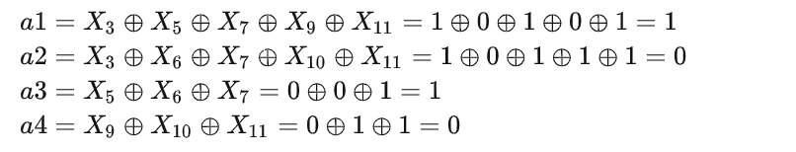

An Example
3、According the formula below, we can get the a1,a2,a3,a4.
(${ X}_{i} is the i^{th}$ bit of the send 𝑑𝑎𝑡𝑎)
4、The send data is 11001001101
data | a1 | a2 | 1 | a3 | 0 | 0 | 1 | a4 | 0 | 1 | 1
index | 1 | 2 | 3 | 4 | 5 | 6 | 7 | 8 | 9 | 10 | 11

Slide 24
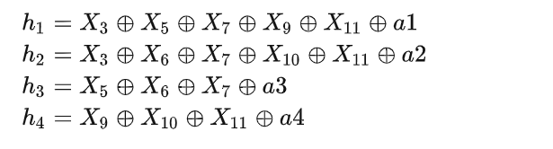
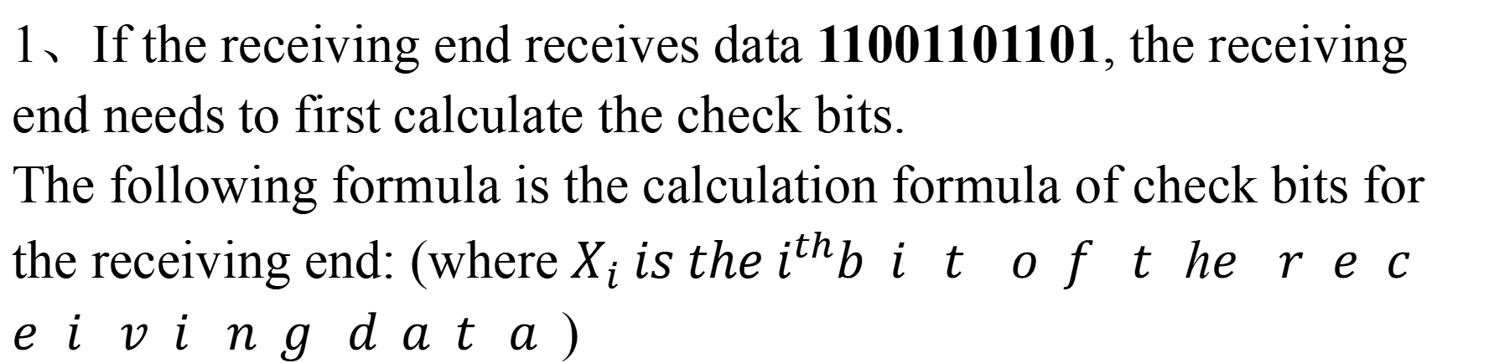
An Example
1、If the receiving end receives data 11001101101, the receiving end needs to first calculate the check bits.
The following formula is the calculation formula of check bits for the receiving end: (where${ X}_{i} is the i^{th}$𝑏𝑖𝑡 𝑜𝑓 𝑡ℎ𝑒 𝑟𝑒𝑐𝑒𝑖𝑣𝑖𝑛𝑔 𝑑𝑎𝑡𝑎)
data | 1 | 0 | 1 | 1 | 0 | 1 | 1 | 0 | 0 | 1 | 1
index | 1 | 2 | 3 | 4 | 5 | 6 | 7 | 8 | 9 | 10 | 11

Slide 25
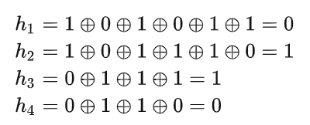
An Example
2、The result is
So the error position is 6, so we only need to modify the sixth position, that is:
11001101101
11001001101

Slide 26
04
Bose-Chaudhuri-Hocquenghem Code
Speaker: 王震

Slide 27
01 What is BCH code？
The BCH code (Bose-Chaudhuri-Hocquenghem code) is an error-correcting code independently invented by R. C. Bose and S. K. Chaudhuri in the early 1960s, and later discovered by A. Hocquenghem in the same year.
The BCH code is a binary code capable of detecting and correcting multiple bit errors.

Slide 28
02 Common types of BCH codes
At present, BCH code has been derived from a variety of types, mainly BCH code, extended BCH code (EBCH), double cyclic redundancy check BCH code (BCH-BCH code), RS-BCH code.
Among them, BCH code is the most basic type, and other types are to expand and improve it to adapt to different application needs.
演示文稿是实用工具，可以是演示、演讲、报告等等。他们有各种各样的目的，使他们成为令人信服和教学的有力工具。大多数时候，他们都是在观众面前。

Slide 29
03 BCH code coding principle
The coding principle of BCH code is to combine information bits according to specific laws to form a group of coding bits.
When sending data, by transmitting this set of coded bits, the receiver checks whether the data has errors according to the identification rules when receiving, and carries out error correction processing.
演示文稿是实用工具，可以是演示、演讲、报告等等。他们有各种各样的目的，使他们成为令人信服和教学的有力工具。大多数时候，他们都是在观众面前。

Slide 30



02 RS-BCH code
RS code is a kind of linear error correcting code with strong error correcting performance, which can correct random error and burst error. RS code is a multi-base BCH code that can correct multiple element errors simultaneously.

Slide 31
05
Summary
Speaker: 王侯

Slide 32



Summary
Error detection & Hamming encoding
Error Detection: identifying errors or corruptions in data that occur during network transmission, like Checksum technique.
Hamming Code: not only detects errors but also allows for their correction in the case of a limited number of errors by adding redundancy in the form of parity bits.
They play a vital role in ensuring the accuracy and reliability of data transmission in computer network.
Notes:
建议添加图像

Slide 33
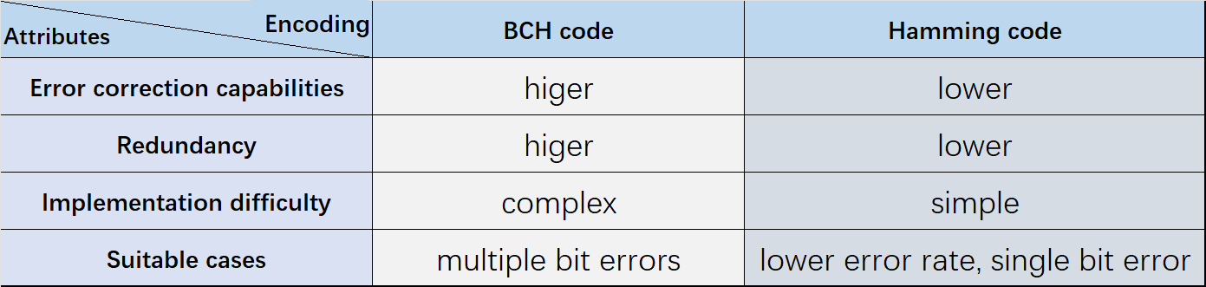
Summary
Hamming code VS. BCH code
Both of them are error-correcting codes used in data transmission.
Notes:
建议添加图像

Slide 34
Q&A

Slide 35
Q: Which layer in the OSI model does error correction happen?

Slide 36
Q: Which layer in the OSI model does error correction happen?
A: Error correction is typically employed in the Data link layer(DLL) in the OSI model. DLL is responsible for transmitting data reliably and avoiding errors within the local network segment.

Slide 37
References
Error Correction https://blog.csdn.net/qq_39583450/article/details/113848573
2. Hamming Code: https://zhuanlan.zhihu.com/p/278326197
3. BCH code detailed analysis: https://blog.csdn.net/qq_29788741/article/details/125410641
Attention: part of pictures and texts is derived from the Internet and ChatGPT respectively.

Slide 38
Thanks for Listening

