Slide 1
IPv6 and comparisons with IPv4
Team members:
张航铭 庄镇裕 郭欢
邱梓钊 赵涵 张宝樑

Slide 2
CONTENTS
01
IPv6 and comparisons with IPv4
Why we need IPv6?
04
Type of IPv6 address
The format of the
IPv6 datagram
02
05
Comparisons with IPv4
Notation of
IPv6 address
IPv6 routing and methods of transition
from IPv6 to IPv4
03
06

Slide 3
01
Why we need IPv6?

Slide 4
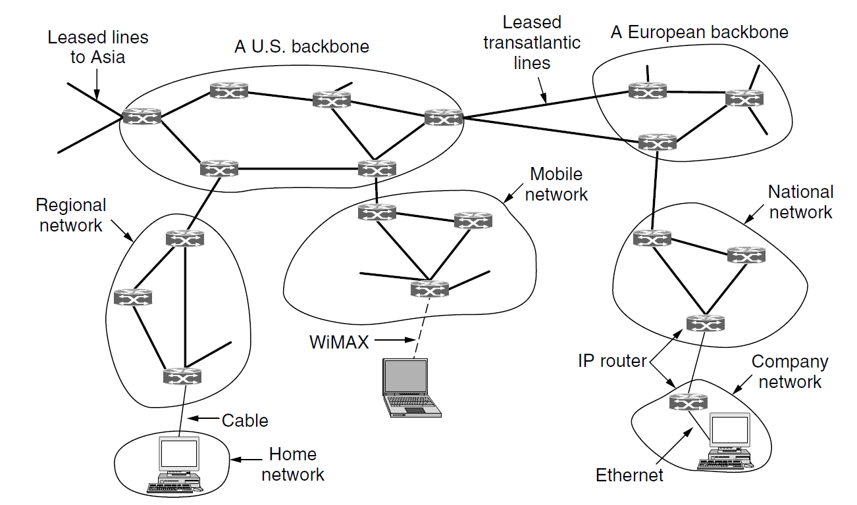
Internet’s network layer
In the network layer, the Internet can be viewed as a collection of networks or Autonomous Systems that are interconnected.
There is no real structure, but several major backbones exist
Tier 1 networks
I
S
P

Slide 5
Internet’s network layer
nternet
ervice
rovider
I
S
P
Connect to backbone
Provide Internet access to homes and businesses

Slide 6
Internet’s network layer
What holds the whole Internet together?
nternet
rotocol
I
P

Slide 7
I
P
Provide a best-effort (i.e., not guaranteed) way to transport packets from source to destination.
No matter whether these machines are on the same network or whether there are other networks in between them.
A computer in US
A computer
in UK

Slide 8
I
v6
P
Provide a best-effort (i.e., not guaranteed) way to transport packets from source to destination.
No matter whether these machines are on the same network or whether there are other networks in between them.
A computer in US
A computer
in UK

Slide 9
Why we needs IPv6?
IPv4 does not satisfy our requirements…
Address space is not enough
This has led to the use of NATs that map multiple private addresses to a public IP address. The problems are processing overhead and lack of end-to-end connectivity.
Lack of hierarchy support
Because of its predefined class organization, IPv4 lacks true hierarchical support. This design creates the need for large routing tables to deliver IPv4 packets to any location on the Internet.

Slide 10
Why we needs IPv6?
IPv4 does not satisfy our requirements…
IPv6
solves these problems fundamentally
Complex network configuration
With IPv4, addresses must be assigned statically or using a configuration protocol such as DHCP. In an ideal situation, hosts can configure themselves based on the network segment.
Lack of built-in authentication
IPv4 does not require support for any mechanism that provides authentication or encryption of the exchanged data. This changes with IPv6. Internet Protocol security (IPSec) is an IPv6 support requirement.

Slide 11
02
The format of
the IPv6 datagram

Slide 12
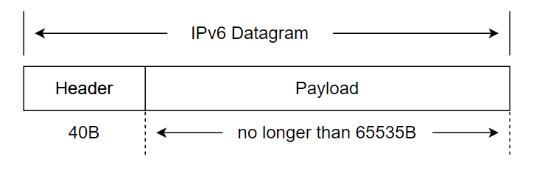
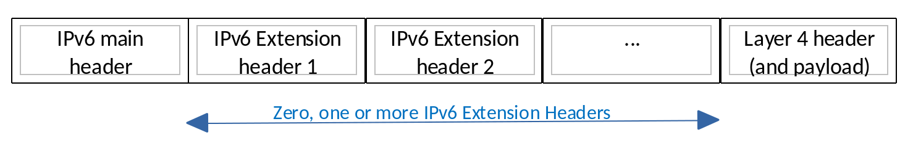
The format of the IPv6 datagram
Send out
Data

Slide 13
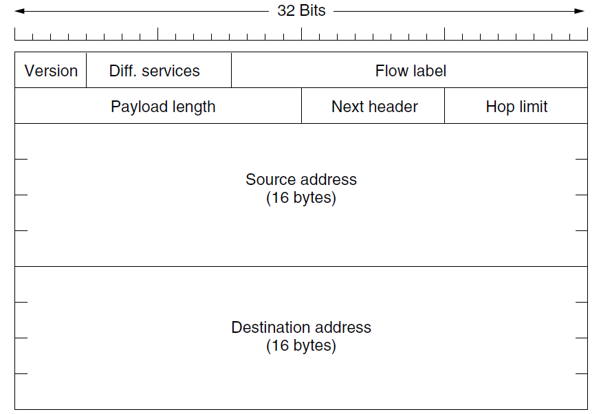
The format of the IPv6 datagram
The IPv6 fixed header (required).

Slide 14
The format of the IPv6 datagram
The Version field(4 bits) is always 6 for IPv6 (and 4 for IPv4).
The router determines the type of the packet by checking this field. To make the transmission faster, some routers may skip this step.

Slide 15
The format of the IPv6 datagram
The Differentiated services field(8 bits) is used to distinguish the class of service for packets with different real-time delivery requirements.
(Live streaming)
The low-order 2 bits are used to signal explicit congestion indications.

Slide 16
The format of the IPv6 datagram
The field(20 bits) provides a way for a source and destination to mark groups of packets that have the same requirements and should be treated in the same way by the network, forming a pseudoconnection.
It contains source address,
destination address, and flow number. Ensure that different flows can be distinguished smoothly.
Flow label

Slide 17

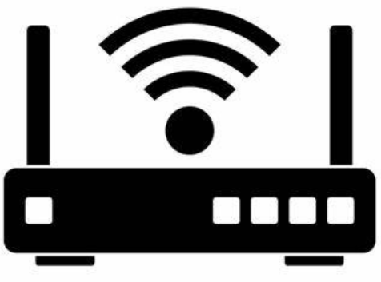


Flow label
Live stream
Server
Routers
Your computer
Identifier: 1
In this case, these packets have strict delay requirements and thus need reserved bandwidth.
The flow can be set up in advance and given an identifier. When a packet with a nonzero Flow label shows up, all the routers can look it up in internal tables to see what kind of special treatment it requires.
An attempt to combine the flexibility of a datagram network and the guarantees of a virtual-circuit network.

Slide 18
The format of the IPv6 datagram
The Payload length field(16 bits) tells how many bytes follow the fixed 40-byte header.

Slide 19
The format of the IPv6 datagram
The field(8 bits) lets the cat out of the bag.
For example, if this header is the last IP header, it tells which transport protocol
handler (e.g., TCP, UDP) to pass the packet to.
Next header

Slide 20
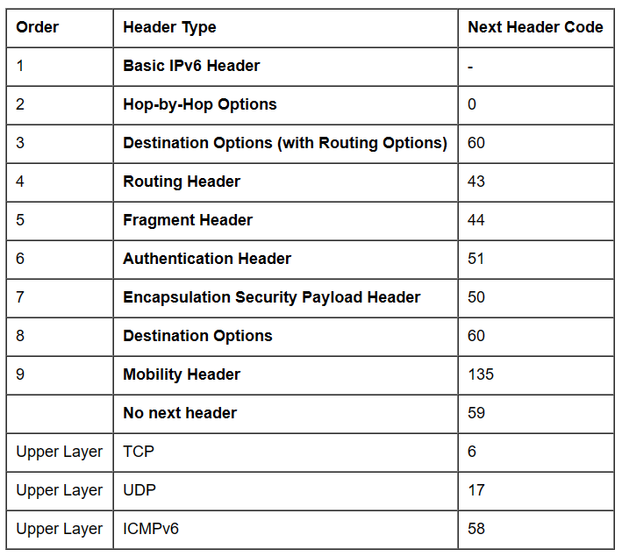
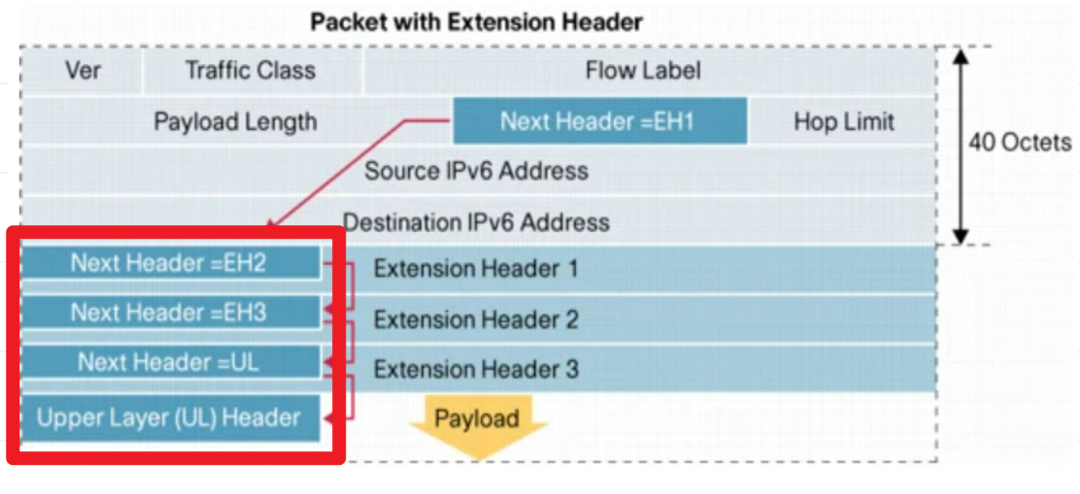
Next header
:
Extension header
Each of these extension headers is optional, but if more than one appears, they must follow the fixed headers directly, preferably in the order listed in the table.

Slide 21
Next header
Extension header
Fixed format
Variable number of variable length
Format: (Type, Length, Value)
Type
Value

Slide 22
Next header
Extension header
Fixed format
Variable number of variable length
Format: (Type, Length, Value)
Length
Value
Type
1-byte field telling which option this is.

Slide 23
Next header
Extension header
Fixed format
Variable number of variable length
Format: (Type, Length, Value)
Value
Value
Type
1-byte field telling which option this is.
Length
Indicates how long the Value segment is (from 0 to 255 bytes).

Slide 24
Next header
Extension header
Fixed format
Variable number of variable length
Format: (Type, Length, Value)
Value
Type
1-byte field telling which option this is.
Length
Indicates how long the Value segment is (from 0 to 255 bytes).
Value
Any information needed to the extension header

Slide 25
Next header
:
Extension header
Fixed format
Variable number of variable length
Format: (Type, Length, Value)
Value
Some kinds of extension header: Destination options header, Hop-by-hop header, Routing header, Fragment header, Authentication header(See textbook for details)

Slide 26
The format of the IPv6 datagram
The Hop limit field(8 bits) is used to keep packets from living forever.
If the value in this field reaches 0, the router dismisses the datagram and returns an ICMP error report message.

Slide 27
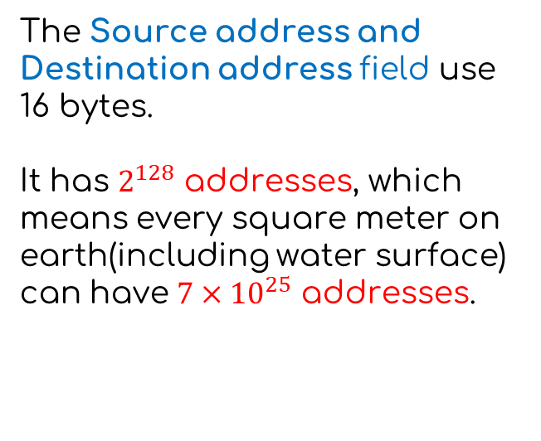
The format of the IPv6 datagram
The Source address and Destination address field use 16 bytes.
It has $2^{128}$ addresses, which means every square meter on earth(including water surface) can have $7×{10}^{25}$ addresses.

Slide 28
03
Notation of
IPv6 address

Slide 29
Notation of IPv6 address
They are written as eight groups of four hexadecimal digits with colons between the groups, like this:
8000:0000:0000:0000:0123:4567:89AB:CDEF
8000:0000:0000:0000:0123:4567:89AB:CDEF

Slide 30
Notation of IPv6 address
They are written as eight groups of four hexadecimal digits with colons between the groups, like this:
8000:0000:0000:0000:0123:4567:89AB:CDEF
Delete the leading 0s
8000:0000:0000:0000:0123:4567:89AB:CDEF

Slide 31
Notation of IPv6 address
They are written as eight groups of four hexadecimal digits with colons between the groups, like this:
8000:0000:0000:0000:0123:4567:89AB:CDEF
Delete the leading 0s
8000:0:0:0:123:4567:89AB:CDEF

Slide 32
Notation of IPv6 address
They are written as eight groups of four hexadecimal digits with colons between the groups, like this:
8000:0000:0000:0000:0123:4567:89AB:CDEF
Delete the leading 0s
8000:0:0:0:123:4567:89AB:CDEF
Replace groups of 0s by “::”
8000:0:0:0:123:4567:89AB:CDEF

Slide 33
Notation of IPv6 address
They are written as eight groups of four hexadecimal digits with colons between the groups, like this:
8000:0000:0000:0000:0123:4567:89AB:CDEF
Delete the leading 0s
8000:0:0:0:123:4567:89AB:CDEF
Replace groups of 0s by “::”
8000::123:4567:89AB:CDEF

Slide 34
Notation of IPv6 address Summary
Leading zeros within a group can be omitted
8000:0000:0000:0000:0000:0000:89AB:CDEF can be rewritten as 8000:0:0:0:0:0:89AB:CDEF
One or more groups of zeros can be replaced by a pair of colons
8000:0:0:0:0:0:89AB:CDEF can be rewritten as 8000::89AB:CDEF
Notice 1: Double colons(::) can occur only once
Address 8000::89AB::CDEF cannot be restored to the original address.
Notice 2: Double colons(::) replaces the most consecutive zeros
FFFF:0:0:89AB:0:0:0:CDEF can be rewritten as FFFF:0:0:89AB::CDEF
Notice 3: There are the same number of zeros in different positions, and double colons replace the one that comes first (leftmost).
FFFF:0:0:89AB:0123:0:0:CDEF can be rewritten as FFFF::89AB:0123:0:0:CDEF

Slide 35
04
Type of
IPv6 address

Slide 36


Type of IPv6 address
Unicast
Describe the communication where a piece
of information is sent from one point to
another point. It can be both Source address
and Destination address.

Slide 37
Type of IPv6 address
Multicast
Describe communication where a piece of information is sent from one or more points to a set of other points.

Slide 38
Type of IPv6 address
Anycast
Describe communication where a piece of information is sent from one point to a group of points. But as soon as the source node sends the data to any node in the group, the transmission process is completed. Therefore, the node with the lowest transmission cost is generally selected.
Anyone

Slide 39
Type of IPv6 address
Anycast
Describe communication where a piece of information is sent from one point to a group of points. But as soon as the source node sends the data to any node in the group, the transmission process is completed. Therefore, the node with the lowest transmission cost is generally selected.
Lowest cost

Slide 40
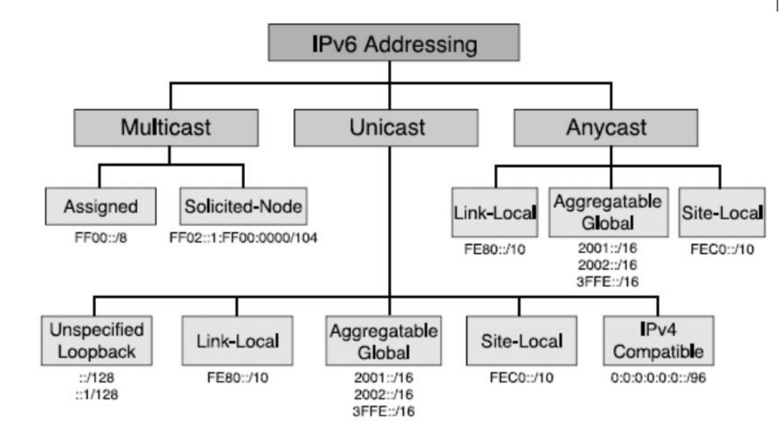
Type of IPv6 address
Summary

Slide 41
05
Comparisons with IPv4

Slide 42
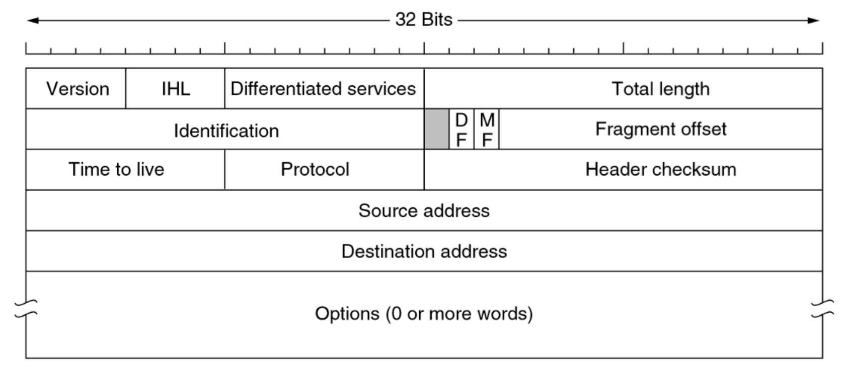
Difference: The length of the IPv6 header must be an integer multiple of 8B, while the length of the IPv4 header must be an integer multiple of 4B.
Comparisons with IPv4
Header length
IPv4
IPv6
VS

Slide 43
Difference: IPv6 expands addresses from 32 bits (4B) to 128 bits (16B).
Comparisons with IPv4
Address length
IPv4
IPv6
VS
Advantage: more addresses

Slide 44
Comparisons with IPv4
Checksum field
IPv4
IPv6
VS
Difference: IPv6 removes the checksum fields of IPv4
Advantage: reduce the processing time per hop

Slide 45
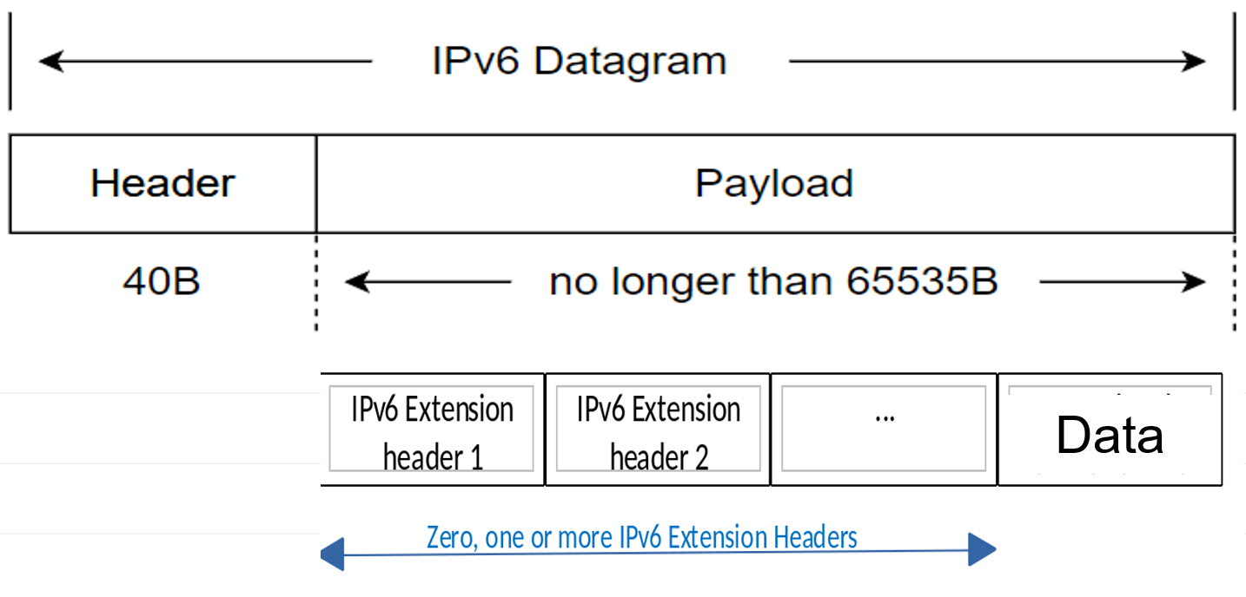
Comparisons with IPv4
Options field
IPv4
IPv6
VS
Difference: IPv6 removes the option field and add the extension header.
Advantage: flexibility and improve the processing efficiency of the router

Slide 46
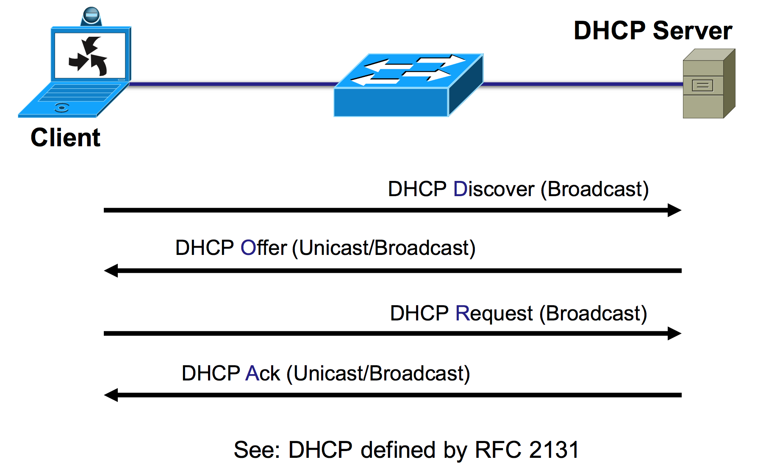

Comparisons with IPv4
Get IP address
IPv4
IPv6
VS
Difference: IPv6 supports plug and play (automatic configuration) and does not require the DHCP protocol.
Advantage: easy to use

Slide 47
Fragment can be done by routers and hosts.
Comparisons with IPv4
Fragment
IPv4
IPv6
Fragment can be done only by hosts.
VS
Packet may be too big message.
ICMPv6 adds a new type: Packet Too Big message

Slide 48
Protocol field
Comparisons with IPv4
IPv4
IPv6
Next header field
Total length field
Improvement
Payload field
Differentiated services field
Remove this field

Slide 49
06
IPv6 routing and methods of transition
from IPv6 to IPv4

Slide 50
IPv6 routing
Flexible routing mechanism
IPv6 allows flexible addressing and reduces the size of routing tables. Intermediate routers must keep track only of the local portion of their network to forward the messages appropriately.
Neighbor Discovery
Router discovery: This allows hosts to identify local routers.
Address resolution: This allows nodes to resolve a link-layer address for a corresponding next-hop address.
Address auto-configuration: This allows hosts to automatically configure site-local and global addresses.
ICMPv6 for Neighbor Discovery
Router advertisement, Router solicitation, Neighbor solicitation, Neighbor advertisement, Redirect

Slide 51
Tunneling
Methods of transition
from IPv6 to IPv4
Dual Stack

Slide 52
Methods of transition from IPv6 to IPv4
Dual Stack
IPv4
IPv6
IPv4 and IPv6 protocol stacks are enabled on one device. It has two IP addresses and communicate with both IPv4 and IPv6 network.

Slide 53
Methods of transition from IPv6 to IPv4
Tunneling
IPv6
IPv4
IPv4
IPv6
The data (or payload) passed using tunnels can be frames or packets of different protocols.
The tunnel protocol re-encapsulates the data frames or packets of other protocols and sends them through the tunnel.

Slide 54
QA
Please list the type of IPv6 address.
?

Slide 55
Please list the type of IPv6 address.
Unicast: 1 to 1
Multicast: 1 to many
Anycast: 1 to many (Actually, it sends the data to the one with lowest cost)
Lowest cost

Slide 56
Reference
Textbook: Computer Networks (Andrew S. Tanenbaum)
https://cloud.tsinghua.edu.cn/d/4b12b05d30dc435688c3/
https://learn.microsoft.com/en-us/dotnet/fundamentals/networking/ipv6-overview
https://www.cisco.com/en/US/technologies/tk648/tk872/technologies_white_paper0900aecd8054d37d.html
https://en.wikipedia.org/wiki/IPv6
https://info.support.huawei.com/info-finder/encyclopedia/en/QoS.html
https://support.huawei.com/enterprise/en/doc/EDOC1100278265/508ecec2
https://www.bilibili.com/video/BV19E411D78Q/?p=55
https://bithachi.blog.csdn.net/article/details/105297642
https://blog.csdn.net/dshf_1/article/details/102403592

Slide 57
Thanks for listening!
Team members:
张航铭 庄镇裕 郭欢
邱梓钊 赵涵 张宝樑

