Slide 1
COMPUTER NETWORKS
王昊翔
WANG Haoxiang
hxwang@scut.edu.cn
School of Computer Science & Engineering

Slide 2
Chapter 2. The Physical Layer
Part 1

Slide 3
Contents
Theoretical basis for data communication
Fourier analysis
Bandwidth-Limited Signals
The Maximum data rate of a channel
Guided transmission media
Magnetic media
Twisted pair
Coaxial cable
Wireless Transmission
Electromagnetic spectrum
Radio transmission
Microwave transmission
Infrared and millimeter waves
Light wave transmission

Slide 4
The physical layer
defines the mechanical, electrical, and timing interfaces to the network, provides the means to transmit bits from sender to receiver, that is, involves a lot on how to use (analog) signals for digital information.

Slide 5
Theoretical Basis
Information can be transmitted on wires by varying some physical property such as voltage or current. By representing the value of this voltage or current as a single-valued function of time, f(t), we can model the behavior of the signal and analyze it mathematically. This analysis is the subject of the following sections.

Slide 6
Fourier Series (Not required, but…)
Any reasonably behaved periodic function, g(t), with period T can be constructed by summing a (possibly infinite) number of sines and cosines:
where f=1/T is the fundamental frequency and a_{n} and b_{n} are the sine and cosine amplitudes of the nth harmonics (terms).

Slide 7
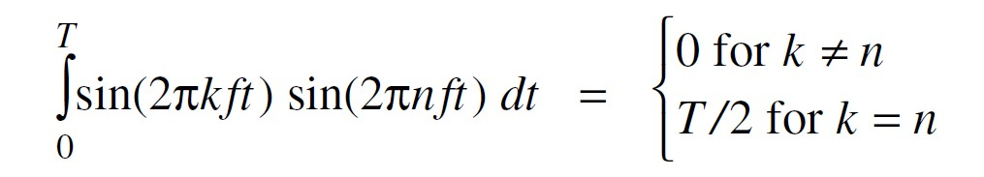
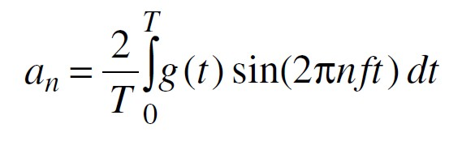
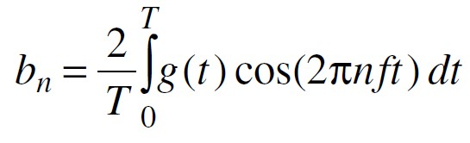
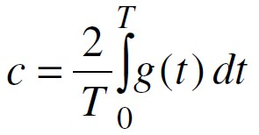
Fourier Series(Not required, but…)

Slide 8
An example(Not required)
Consider 01100010, 8 bit for ASCII character 'b':
a_{n} =1/πn[cos(πn/4) -cos(3πn/4) + cos(6πn/4) -cos(7πn/4)]
b_{n} = 1/πn[sin(3πn/4) -sin(πn/4) + sin(7πn/4) -sin(6πn/4)]
c_{n} = ¾
The root mean square amplitudes is

Slide 9
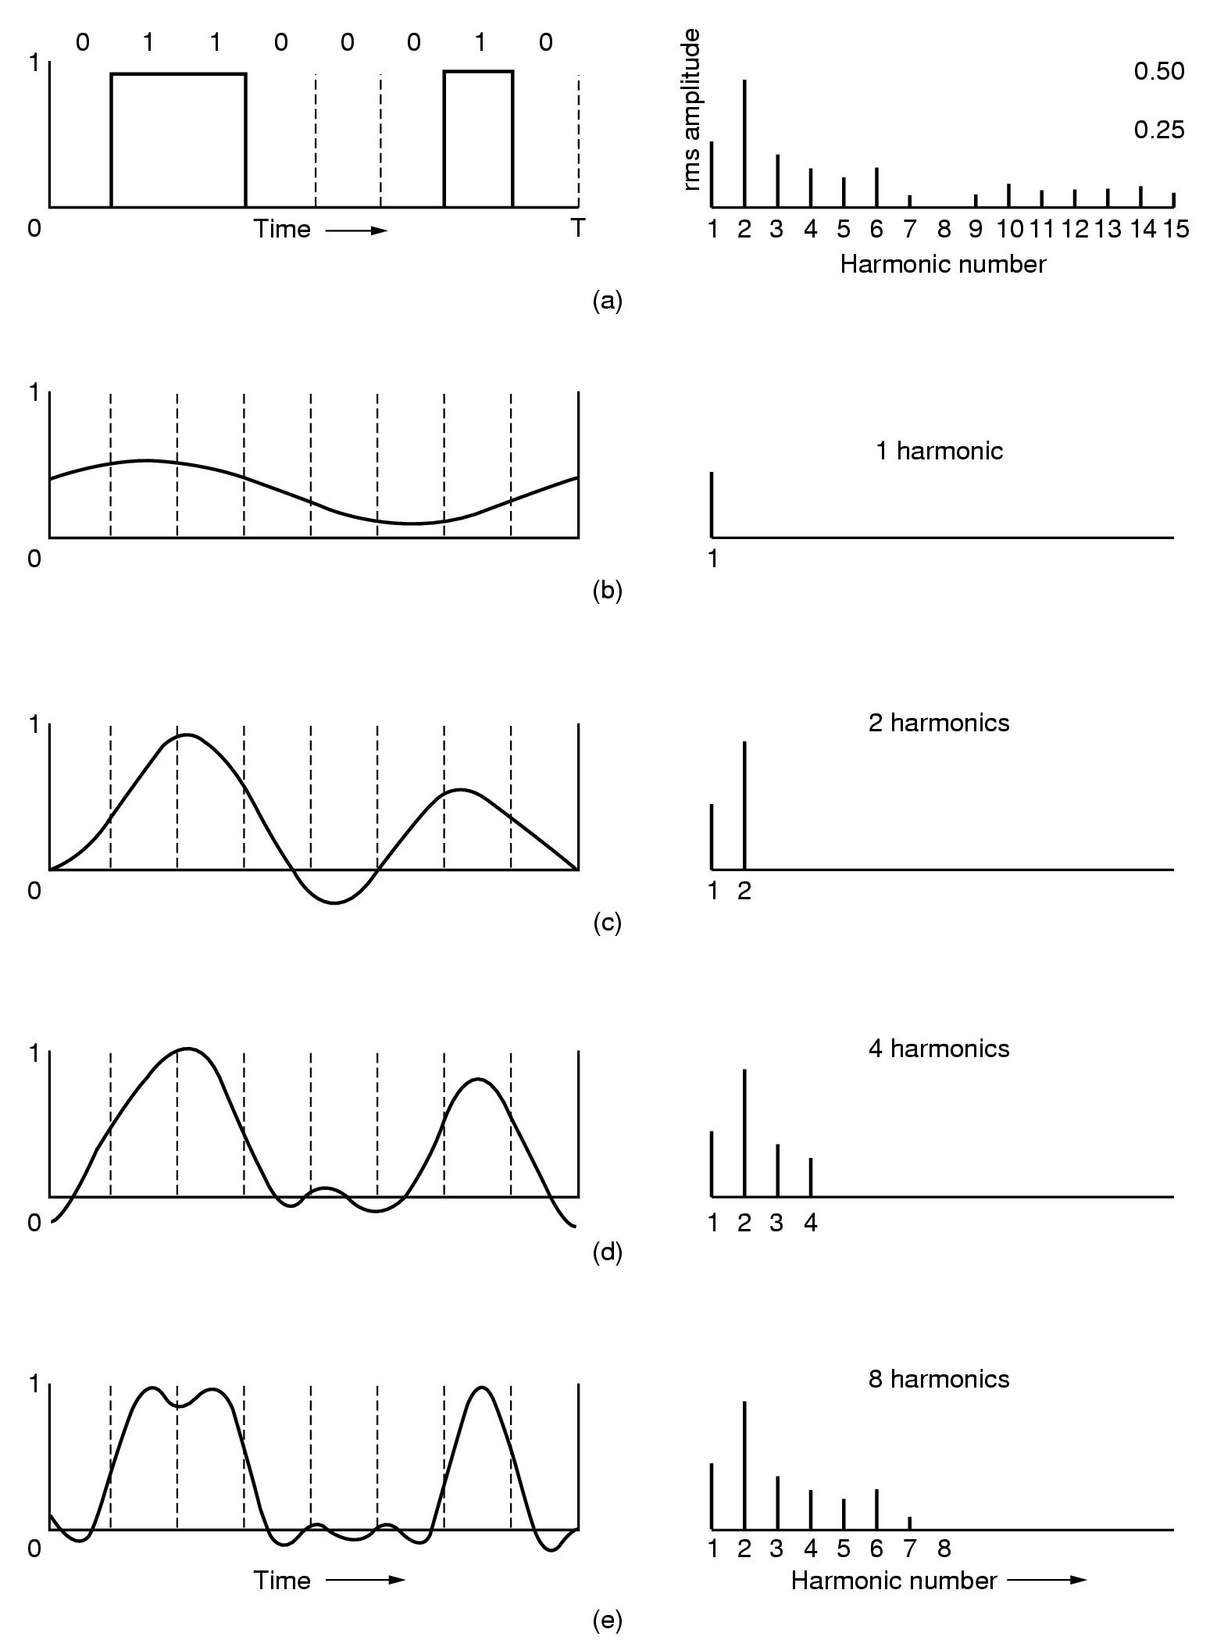
Note: root mean squares (on the right) reflect the dispersed
energy at the given frequency.

Slide 10
Bandwidth
Digital signal transmission is subject to attenuation, distortion, etc. This is partly caused by disallowing high-frequency components to pass through.
The range of frequency or the number of bits of a transmission medium is called bandwidth.

Slide 11
Bandwidth-Limited Signals
The larger n is, the higher the frequency nf of the nth harmonic.
All transmission facilities diminish different Fourier components by different amounts, thus introducing distortion.
Usually, the amplitudes are transmitted undiminished from 0 up to some frequency f_{c} (in Hertz, Hz) with all frequencies above this cutoff frequency截止频率 strongly attenuated.

Slide 12
Signal-to-Noise Ratio
S/N
S: signal power
N: noise power
dB
10 log₁₀ S/N
an S/N ratio of 1000 is 30 dB

Slide 13
Max. Data Rate of a Channel
Nyquist’s Theorem (noiseless channel)
H: bandwidth
V: discrete levels
Maximum data rate: 2H log₂ V bits/sec
Shannon’s Theorem (noise channel)
H: bandwidth
S/N: signal to noise ratio
Maximum number of bits/sec: H log₂ (1 + S/N)

Slide 14
Exercise
Suppose that the bandwidth of a channel is between 3MHz and 4MHz and SN = 24dB.
(1) what is the capacity of this channel?
(2) Being able to achieve capacity, how many signaling levels are required?

Slide 15
Exercise solution
Suppose that the bandwidth of a channel is between 3MHz and 4MHz and SN = 24dB.
(1) what is the maximum data rate?
H = 1MHz
S/N = 251
C = 10⁶xlog₂(1+251)=8Mbps
(2) Being able to achieve capacity, how many signaling levels are required?
C=2H log₂ V
V=16

Slide 16
Guided Transmission Media
Magnetic media
Twisted pair
Coaxial cable
Fiber optics

Slide 17
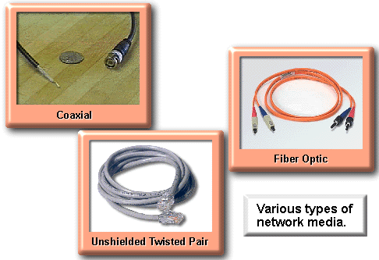
Various Types of Network Media

Slide 18
Magnetic media
Never underestimate the bandwidth of a station wagon full of tapes hurtling down the highway
Take a standard videotape that can carry about 200 gigabytes of data.
A box of 60 x 60 x 60 cm can hold about 1000 tapes, which corresponds to 200TB, or 1600Tb.
Sending such a box can be done within 24 hours, worldwide, 19Gbps; or 400Gbps within one hour.
Costs: roughly $5000 to ship 200TB, 3 cents for 1GB
So, why not just tape?

Slide 19
Twisted pair
UTP (Unshielded Twisted Pair)
STP (Shielded Twisted Pair)
10Base-T: 10Mbps, 100 meters
100Base-T: 100Mbps, 100 meters
1000Base-T: 1Gbps, 100 meters
Category 3: not to use anymore
Category 5/Super Category 5
Category 6/7: for Gigabit transmission

Slide 20
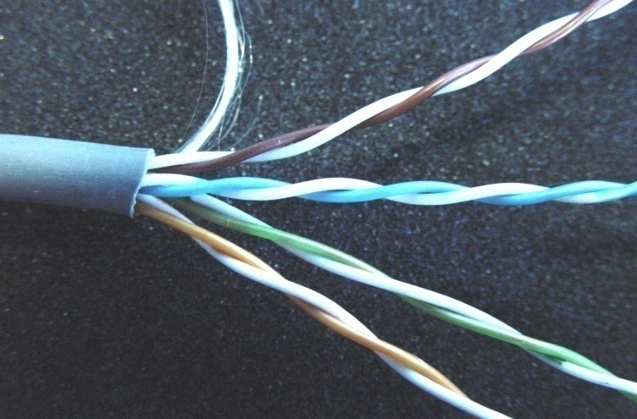
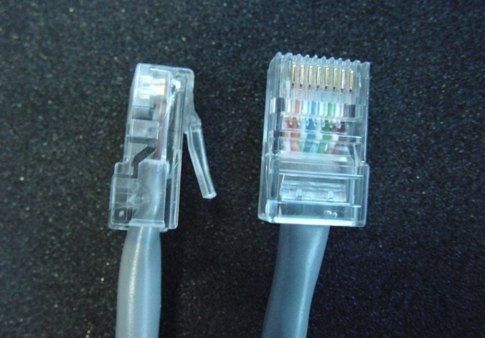
Twisted pair (cont.)
8
7
6
5
4
3
2
1
Brown
White/Brown
Green
White/Blue
Blue
White/Green
Orange
White/Orange
8
7
6
5
4
3
2
1
棕
白棕
绿
白兰
兰
白绿
橙
白橙

Slide 21
UTP in actions
Telephone line serve 3KM-5KM
One pair only
Data Cable serve 100M, Four pairs
Category 3 : 16MHz
Category 5 : 100MHz
Category 6 : 250MHz
Category 7 : 600MHz
Data rate: 10Mbps, 100Mbps, 1000Mbps

Slide 22
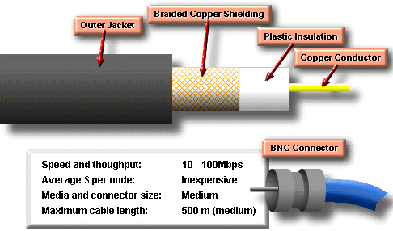
Coaxial cable (50/75ohm:1GHz)
Coaxial cable consists of a hollow outer cylindrical conductor that surrounds a single inner wire made of two conducting elements.
It can be run, without as many boosts from repeaters, for longer distances between network nodes than either shielded or unshielded twisted-pair cable

Slide 23
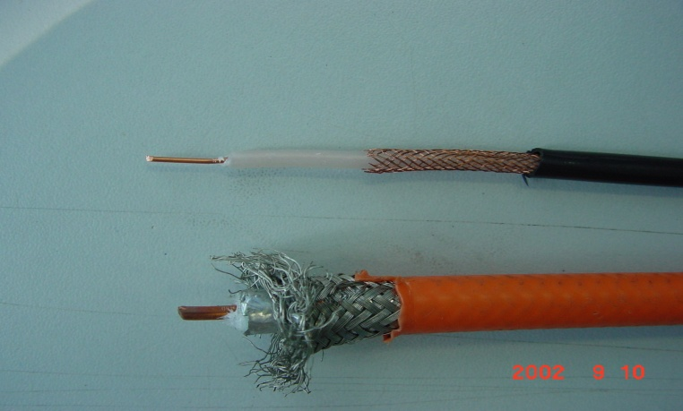
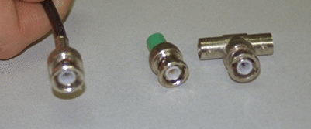
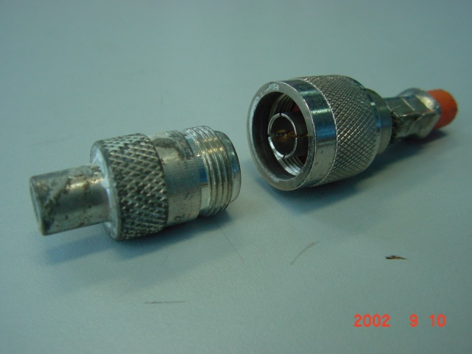
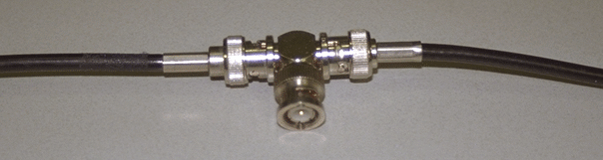
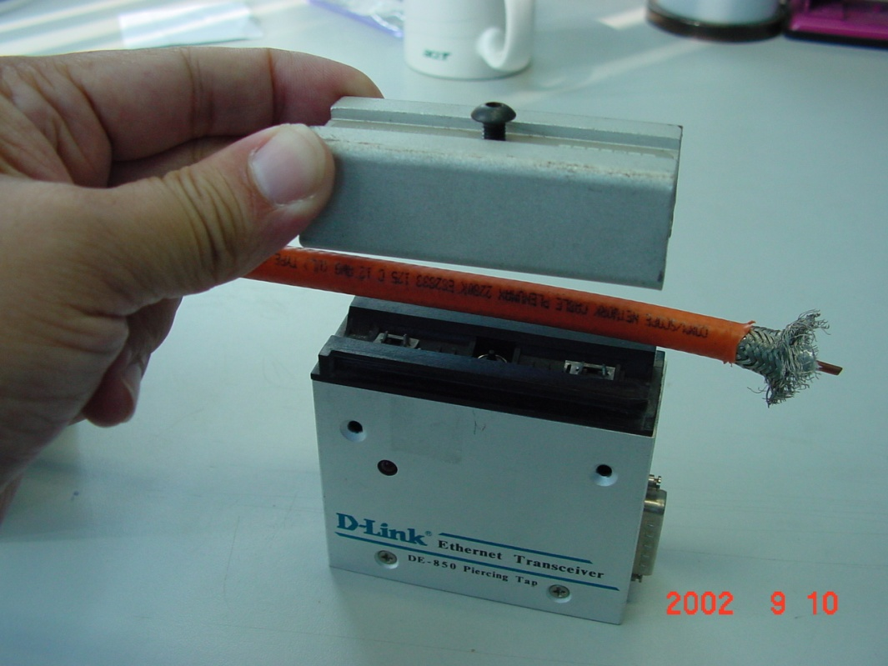
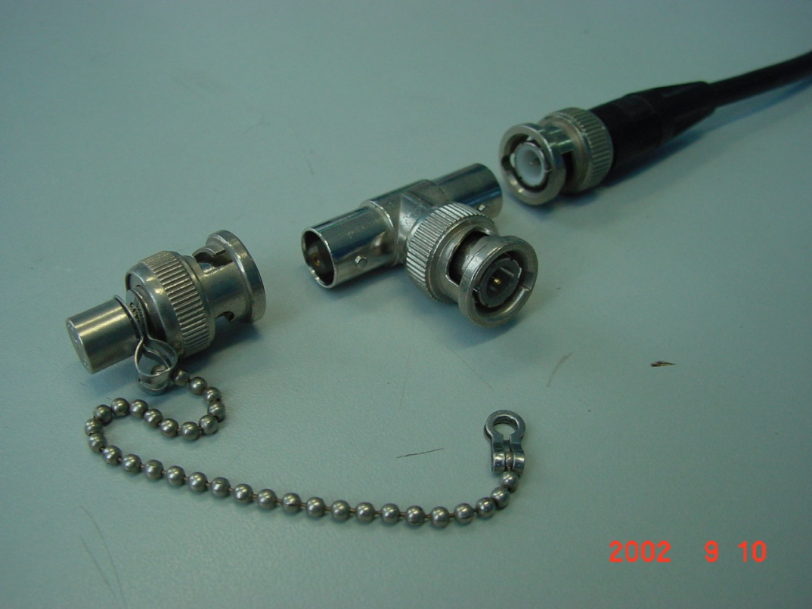

Slide 24
UTP vs. STP and COAX
advantages.
It is easy to install
is less expensive
its real advantage is its size.
disadvantages
is more prone to electrical noise and interference
once considered slower at transmitting data than other types of cable.
today, UTP is considered the fastest copper-based media.
The distance between signal boosts is shorter for unshielded twisted-pair than it is for coaxial cable.

Slide 25
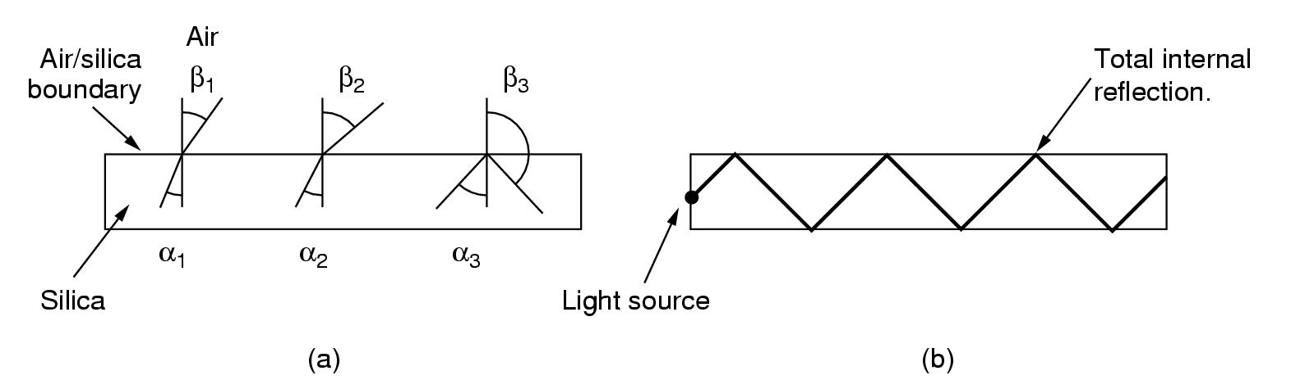
Fiber optics
Based on light refraction:
Three examples of a light ray from inside a silica fiber impinging on the air/silica boundary at different angles.
Light trapped by total internal reflection.

Slide 26
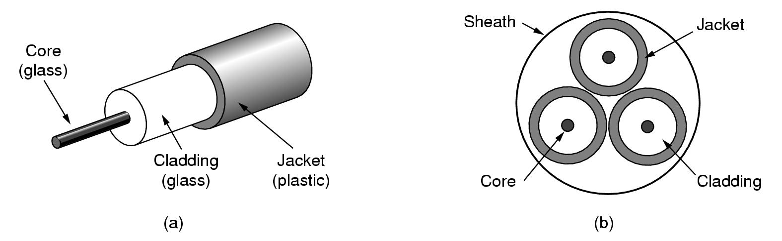
As it turns out, attenuation is extremely well in optical fiber. This means that they can be used for long distances. In addition, the bandwidth is enormous.
Item | LED | Semiconductor Laser
Data rate | Low | High
Mode | Multimode | Multimode or single mode
Distance | Short | Long
Lifetime | Long life | Short life
Temperature sensitivity | Minor | Substantial
Cost | Low cost | Expensive

Slide 27
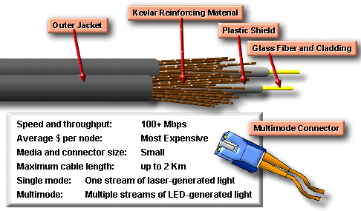
Fiber optics
MM: multi-mode
SM: single-mode
LED-Light Emitting Diode
Semiconductor Laser
Fiber-optic cable is a networking medium capable of conducting modulated light transmissions. It is not susceptible to electromagnetic interference and is capable of higher data rates than any of the other types of networking media discussed here. Fiber-optic cable does not carry electrical impulses, signals that represent bits, are converted into beams of light. light in fibers is not considered wireless because the electromagnetic waves are guided in the optical fiber.

Slide 28
Fiber Connections
Observation: An interface consists of a receiver (photodiode) which transforms light into electrical signals, and/or a transmitter (LED or laser-diode)
Passive interface: A computer is directly connected to the optical fiber
Active interface: There’s an ordinary electrical repeater connected to two fiber segments and the computer:

Slide 29
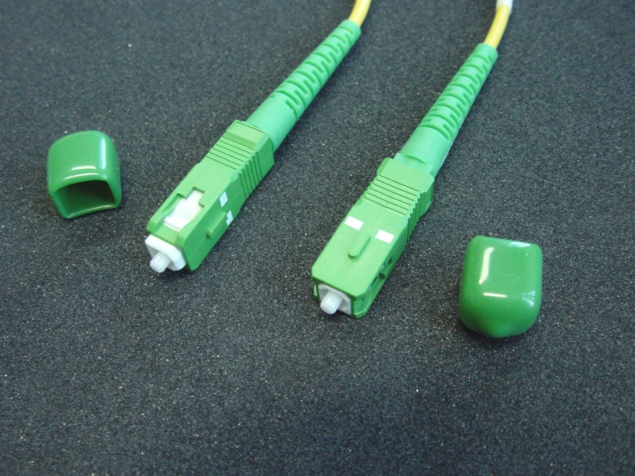
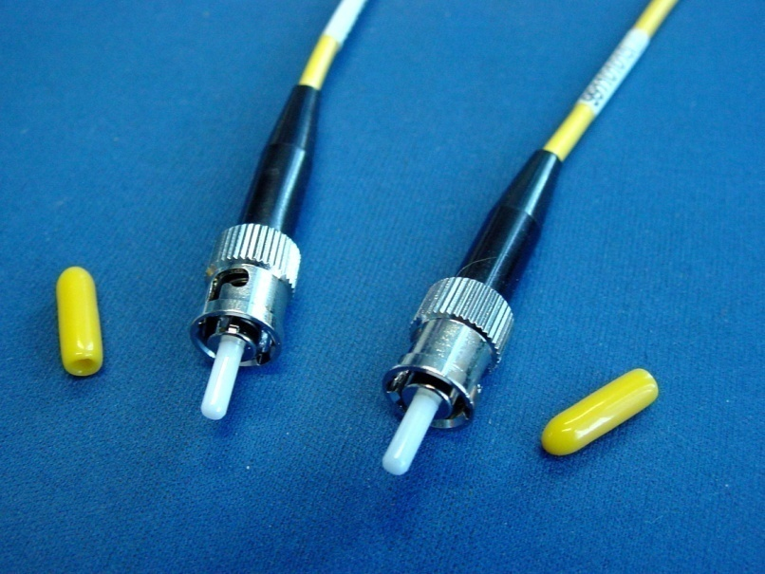
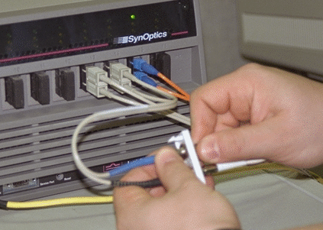
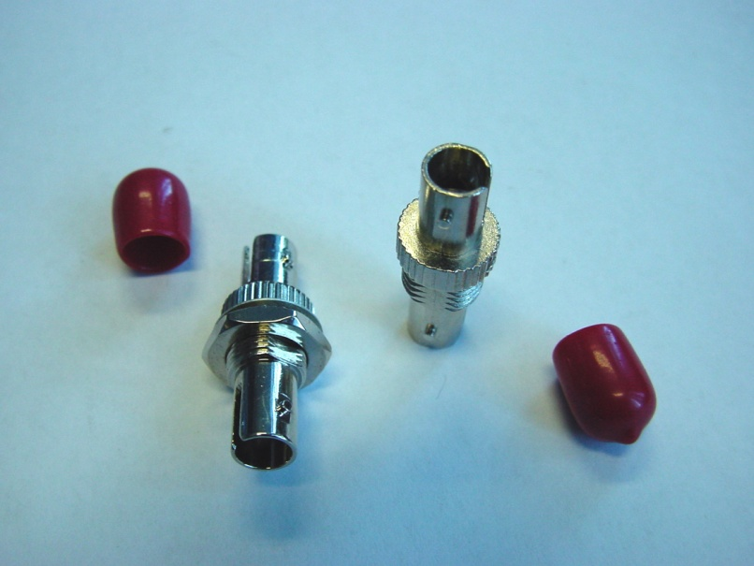
SC：568A标准，方形，插入锁定
ST：插入锁定
光耦合器（ST）

Slide 30
Optical Fiber vs. Copper Wire (1)
Bandwidth: Fiber can support enormous bandwidths, exactly what we need with upcoming image-based applications (video-on-demand).
Attenuation: Because the attenuation in fiber is less than in copper (can you imagine why?), we don’t need to boost the signal as often. In practice, fiber requires an active repeater every 30 km, copper every 5 km.

Slide 31
Optical Fiber vs. Copper Wire (2)
External influences: That’s right, no more interference from other cables, radios, power failures, etc.
Weight: Fiber simply doesn’t weigh as much. Good for backbones, and the use of heavy maintenance equipment.

Slide 32
Wireless Transmission
The Electromagnetic Spectrum
Radio Transmission
Microwave Transmission
Infrared and Millimeter Waves
Lightwave Transmission

Slide 33
The Electromagnetic Spectrum
f (Hz) 10⁰ 10² 10⁴ 10⁶ 10⁸ 10¹⁰ 10¹² 10¹⁴ 10¹⁶ 10¹⁸ 10²⁰ 10²² 10²⁴
Radio
Microwave
Infrared
UV
X-ray
Gamma Ray
Visible
Light
f (Hz) 10⁴ 10⁵ 10⁶ 10⁷ 10⁸ 10⁹ 10¹⁰ 10¹¹ 10¹² 10¹³ 10¹⁴ 10¹⁵ 10¹⁶
Twisted Pair
Satellite
V: very
U: ultra
S: super
E: extremely
T: tremendously
Fiber
Optics
L: low
M: medium
H: high
Coax
Terrestrial
Microwave
AM
Radio
FM
Radio
Maritine
TV
Band
LF
MF
HF
VHF
UHF
SHF
EHF
THF

Slide 34
Wave Properties
Radio, Microwaves, Infrared, and Visible Light
can all be used for transmitting information
AM, FM, or PM
UV, X-rays, and Gamma Rays
would be even better due to their higher frequencies
hard to produce and modulate
do not propagate well through buildings
dangerous to living things

Slide 35
Radio Transmission
Radio waves
easy to generate
can travel long distances
penetrate buildings easily
omnidirectional
at low frequencies, the power falls off sharply with distance from the source
at high frequencies, radio waves tend to travel in straight lines and bounce off obstacles

Slide 36
Propagation of Radio Waves
VLF, LF, and MF bands
HF and VHF bands
Earth
Earth
Radio waves follow
the ground
Ionosphere

Slide 37
Microwave Transmission
Microwaves
travel in straight lines
can be narrowly focused (by a dish)
the transmitting and receiving antennas must be accurately aligned with each other.
do not pass through buildings well.
can be absorbed by water/rain
widely used for long-distance telephone communication, cellular telephones, TV distribution

Slide 38
Infrared and Millimeter Waves
widely used for short-range communication.
TV remote controller
do not pass through solid objects.
Bad: limited distance
Good: security
candidate for indoor wireless LAN
cannot be used outdoors (due to sun shines)

Slide 39
Lightwave Transmission
Each side needs its own laser and its own photodetector.
The laser’s strength, a very narrow beam, is its weakness.
Difficult aiming at far distance
offers high bandwidth
easy to install

Slide 40
Summary
Data communication and computer networking have solid theorectical background.
Three major transmission media are widely used today: twisted pair, coaxial cable and optical fiber.
Wireless transmission becomes more and more important in today's networking.

