Slide 1
COMPUTER NETWORKS 2023 Fall
- Chapter 3. Data Link Layer pter 3. Data Link Layer 2
王昊翔
WANG Haoxiang
hxwang@scut.edu.cn
School of Computer Science & Engineering
国家双语教学试点项目 广东省精品课

Slide 2
Contents of this lecture
Learn protocol verification
Finite state machine models
Petri net models
Learn Example DLL protocol
HDLC
PPP

Slide 3
Protocol verification
Due to the complexity of various protocols, it is important that they are properly verified for correctness.
The verification should also determine if it is possible for deadlocks or other problems to occur in the protocol.
There are several different methods of protocol verification.
Finite state machine models
Petri net models

Slide 4
Finite State Machine Models
Each protocol machine (i.e., sender or receiver) is always in a specific state at every instant of time.
All the states are denoted as nodes.
The state of the complete system is the combination of all the states of the two protocol machines and the channel.
From each state, there are zero or more possible transitions to other states. Transitions occur when some event happens.
All the transitions are denoted as directed arcs.
Initial state corresponds to the description of the system when it starts running, or at some convenient starting place shortly thereafter.
Reachability analysis
which states are reachable and which are not
detect a variety of errors in the protocol specification

Slide 5
An Example Of A Finite State Machine Model
Protocol 3: 2 protocol machine and channel, total 16 states
Each state is labeled by three characters, SRC
S is
0: frame 0 is sent
1: frame 1 is sent
R is
0: frame 0 is expected
1: frame 1 is expected
C is
0: frame 0 is on the channel
1: frame 1 is on the channel
A: ack frame is on the channel
-: the channel is empty

Slide 6
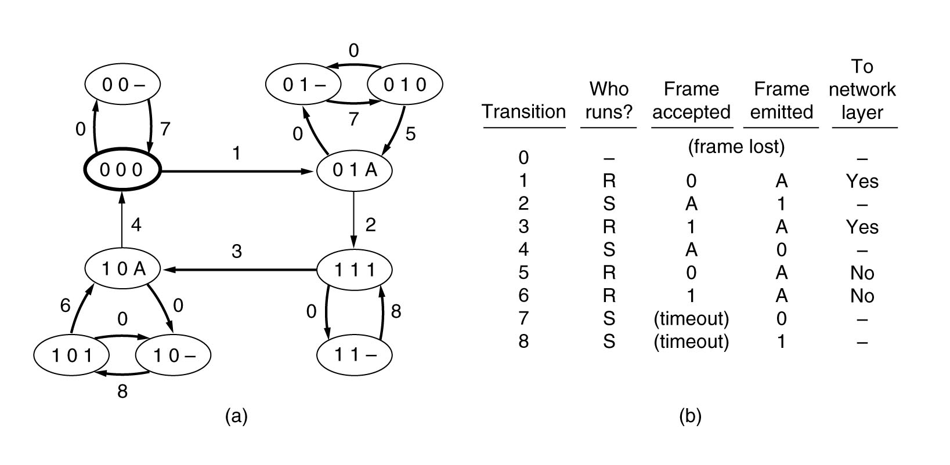
An Example Of A Finite State Machine Model (cont’d)
(a) State diagram for protocol 3. (b) Transmissions.

Slide 7
Petri Net Models
A Petri net has four basic elements: places(库所), transitions（变迁）, arcs（弧）, and tokens（标记）.
A place represents a state which (part of) the system may be in. (circle)
The current state indicated by the token (heavy dot)
A transition is indicated by a horizontal or vertical bar.
Each transition has zero or more input arcs coming from its input places, and zero or more output arcs, going to its output places.

Slide 8
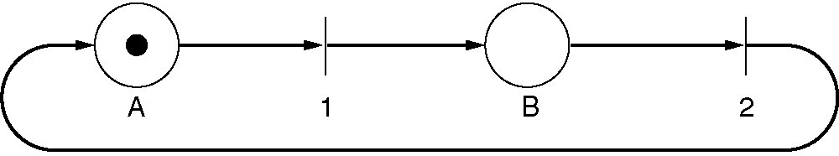
Petri Net Models (cont’d)
A transition is enabled （激活的）if there is at least one input token in each of its input places.
Any enabled transition may fire （激发）at will, removing one token from each input place and depositing a token in each output place.
Petri net can be used to detect protocol failures in a way similar to the use of finite state machines.
Petri net can be represented in convenient algebraic form（代数形式） resembling a grammar.
A Petri net with two places and two transitions.

Slide 9
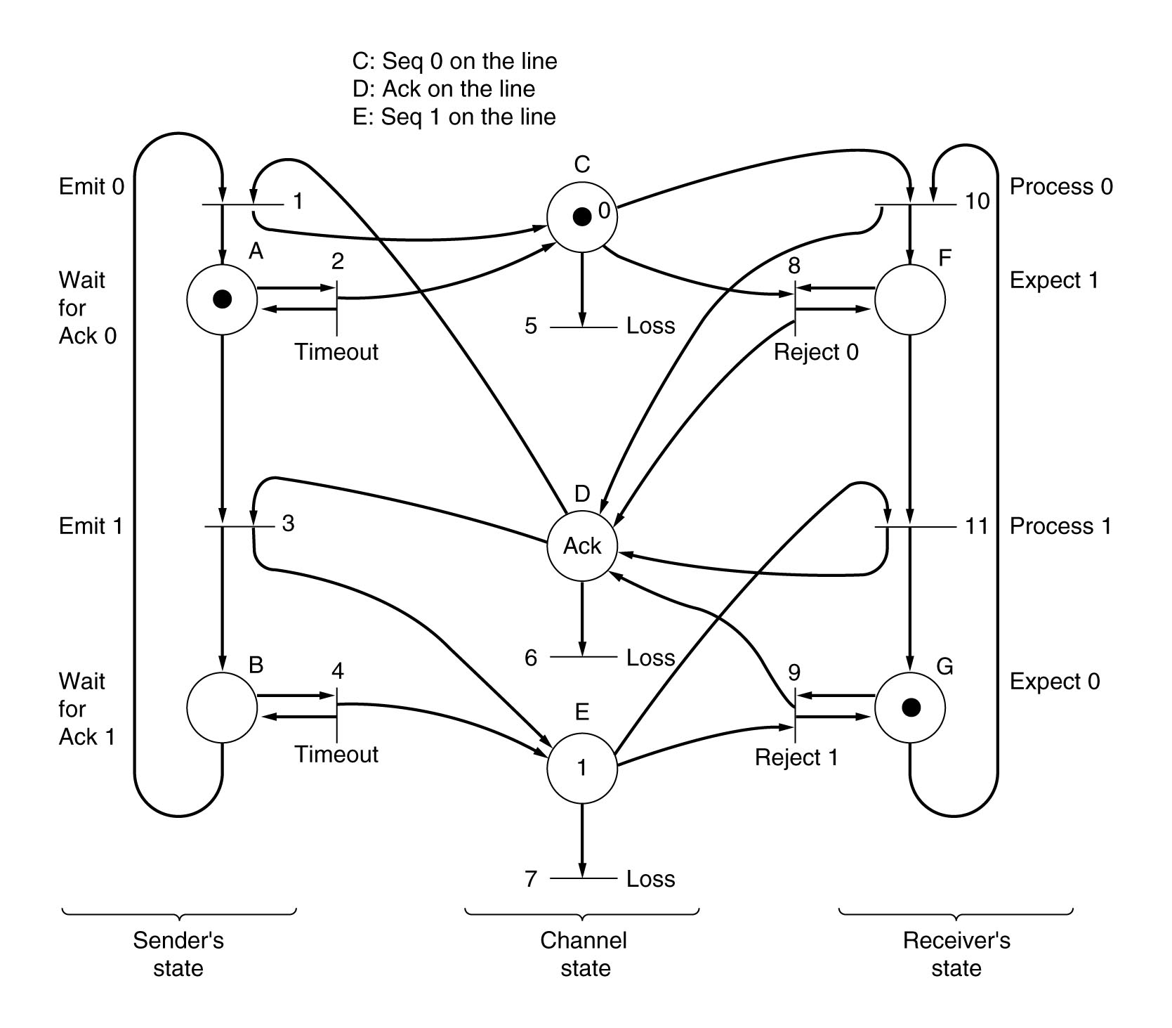
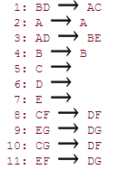
A Petri Net Model For Protocol 3

Slide 10
Example DLL protocol
HDLC
High-Level Data Link Control
PPP
The Point-to-Point Protocol

Slide 11
History of HDLC
IBM introduced SDLC – Synchronous Data Link Control – and submitted it to ANSI and ISO for acceptance as US and International standards.
ANSI modified it to be ADCCP – Advanced Data Communication Control Procedure
ISO modified it to be HDLC – High-level Data Link Control.
CCITT modified HDLC for its LAP (Link Access Procedure) but later modified it again to LAPB.
They are all very similar, with only minor (but annoying) differences between them.

Slide 12
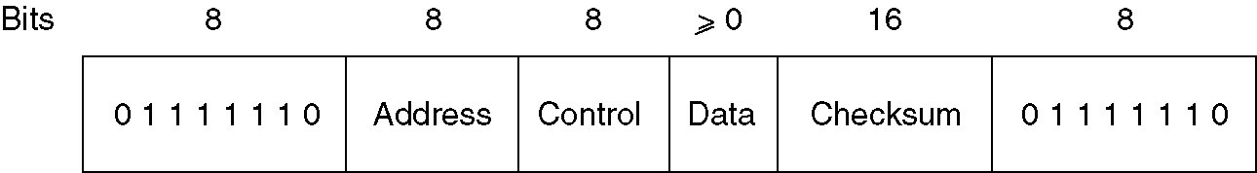
HDLC frame-structure
标志Flag
地址Addr
控制Con
信息Infor
帧校验序列FCS
标志F
帧校区间
透明传输区间

Slide 13
HDLC frame-structure(cont’d)
Flag sequence
Identify start or end of the frame
Bit stuffing for transparency.
Address field
Identify one of the terminals (on lines with multiple terminals)
Distinguish commands from response (for point-to-point lines)
Control field
For sequence numbers, acknowledgements, and other purposes

Slide 14
HDLC frame-structure(cont’d)
Control field
For sequence numbers, acknowledgements, and other purposes
Flag
Flag
Address
Control
Fame Check Seq.
Flag
Address
Control
Information
Fame Check Seq.
Flag
Flag
Address
Control
Fame Check Seq.
Flag
Bit Seq. No.
1
2
3
4
5
6
7
8
I frame
0
N（S）
P/F
N（R）
S frame
1
0
S
P/F
N（R）
U frame
1
1
M
P/F
M

Slide 15
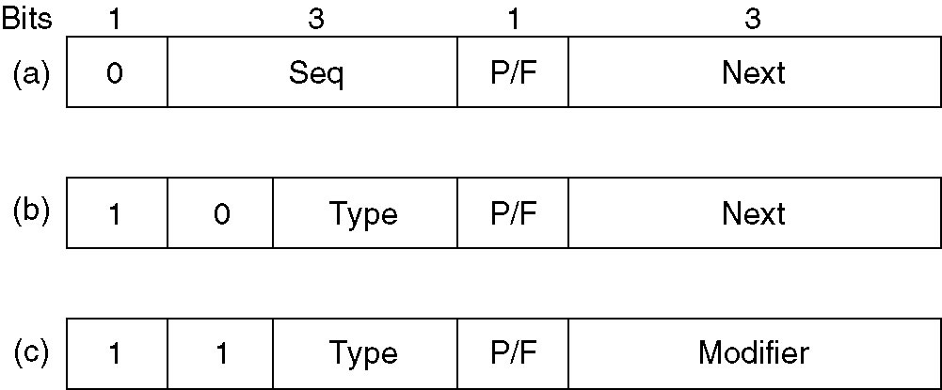
HDLC – Frame Type
Frame Types
Information Frame(信息帧)
Supervisory Frame (监控帧)
Unnumbered Frame (无编号帧)
The contents of the Control field for three kind frames
Figure 3-25 Control field of
(a) An Information frame.
(b) A Supervisory frame.
(c) An Unnumbered frame.

Slide 16
HDLC – Information Frame
Information Frame(信息帧)
Seq :N(S)
Sending frame sequence number
Next:N(R)
Piggybacked acknowledgement
Piggybacking the number of the first frame not yet received (i.e., the next frame expected), not the number of the last frame received correctly.
P/F
Poll/Final(查询/结束)
Used when a computer is polling a group of terminals

Slide 17
HDLC – Supervisory Frame
Supervisory Frame (监控帧)
Type 0 (bit3-4: 0 0) receive ready
RR frame= acknowledgement frame
Used when there is no reverse traffic to use for piggybacking
Type 1 (bit3-4: 0 1)，like protocol5
RNR=Negative acknowledgement frame
The Next field indicates the first frame in sequence not received correctly
Type 2 (bit3-4: 1 0):RECEIVE NOT READY
Acknowledges all frames up to but not including Next
Tells the sender to stop sending
Type 3 (bit3-4: 1 1):SELECTIVE REJECT
Calls for retransmission of only the frame specified

Slide 18
HDLC – Frame structure
Flag
Address
Control
Information
Fame Check Seq.
Flag
Frame Structure
Data field
Contain any information
May be arbitrarily long
The efficiency of the checksum falls off with increasing frame length
Checksum field
Cyclic redundancy code: 16bit – CRC: x¹⁶+x¹²+x⁵+1

Slide 19
Three Commands Provided By Protocols
DISC (DISConnect) - allows a machine to announce that it is going down (e.g., for preventive maintenance).
SNRM (Set Normal Response Mode) - allows a machine that has just come back on-line to announce its presence and force all the sequence numbers back to zero.
HDLC and LAPB have an additional command, SABM (Set Asynchronous Balanced Mode).
SABME and SNRME are the same as SABM and SNRM
FRMR (FRaMe Reject) - indicate that a frame with a correct checksum but impossible semantics arrived.

Slide 20
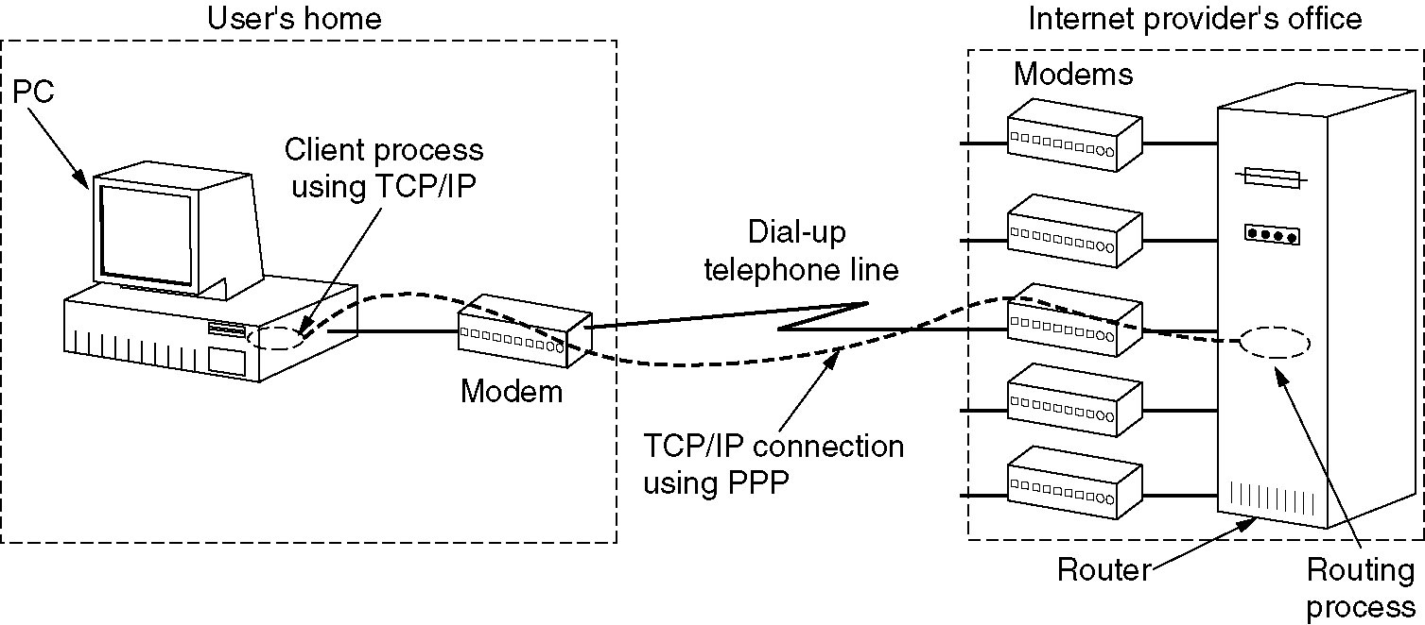
DLL in the internet
Point-to-Point Communication
Router-Router leased line connection
Dial-up host-router connection

Slide 21
Point-to-Point Protocol
Defined in RFC 1661 and further elaborated on in several other RFCs (e.g., RFCs 1662 and 1663).
PPP provides three features:
A framing method , The frame format also handles error detection.
A link control protocol for bringing lines up, testing them, negotiating options, and bringing them down.
This protocol is called LCP (Link Control Protocol).
A way to negotiate network-layer options in a way that is independent of the network layer protocol to be used. The method chosen is to have a different NCP (Network Control Protocol) for each network layer supported.

Slide 22
Typical Scenario: Connecting A Home PC To Internet Service Provider
Physical connection setup phase:
The PC calls the provider's router via a modem.
The router's modem answers the phone and establishes a physical connection.
Data link layer options negotiation phase:
The PC sends the router a series of LCP packets in the payload field of one or more PPP frames. These packets and their responses select the PPP parameters to be used.
Network layer options negotiation phase:
A series of NCP packets are sent to configure the network layer and to assign an IP address for the PC (if the PC wants to run a TCP/IP protocol stack).
Data communication phase:
The PC sends and receives IP packets over the established connection.
Connection release phase:
When the PC is finished, NCP is used to tear down the network layer connection and free up the IP address.
The LCP is used to shut down the data line layer connection.
The computer tells the modem to hang up the phone, releasing the physical connection.

Slide 23
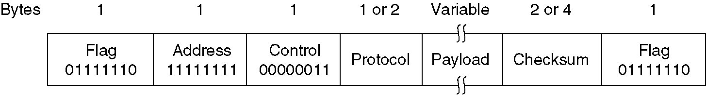
PPP Frame Format
Main differences
PPP is character-oriented while HDLC is bit oriented.
PPP uses byte stuffing on dial-up modem lines, so all frames are an integral number of bytes.
The PPP full frame format for unnumbered mode operation.

Slide 24
PPP Frame Format(cont’d)
Begin with a spcial byte-01111110 (same as HDLC)
若封装在PPP帧中的数据出现0x7E字节，则用2字节序列0x7D、0x5E取代；
若出现0x7D字节，则用2字节序列0x7D、0x5D取代；

Slide 25
PPP Frame Format(cont’d)
Address Fieled
always set to the binary value 11111111
Control field
default value is 00000011, which indicates an unnumbered frame.
Considering the address and the control field are constant in default, so the LCP can negotiate to leave those two fields out.
双方协商认同后，可省略
双方协商认同后，可省略

Slide 26
PPP Frame Format(cont’d)
Protocol - tell what kind of packet is in the Payload field
The default size of the Protocol field is 2 bytes, can be negotiated down to 1 byte using LCP.
When protocol=0x0021,the payload is IP packet.
When protocol= 0xc021,the payload is LCP packet.
When protocol= 0x8021, the payload is NCP packet.
Payload - variable length, up to some negotiated maximum, default is 1500 bytes.
Checksum - normally 2 bytes (but can be 4 bytes)
Closing flag – same as starting flag

Slide 27
Summary of this lecture
Learn protocol verification
Finite state machine models
Petri net models
Learn Example DDL protocol
HDLC
Frame format
PPP

Slide 28

Thanks！

