Slide 1
Software Engineering
Lesson 1
Use Rational Rose

Slide 2
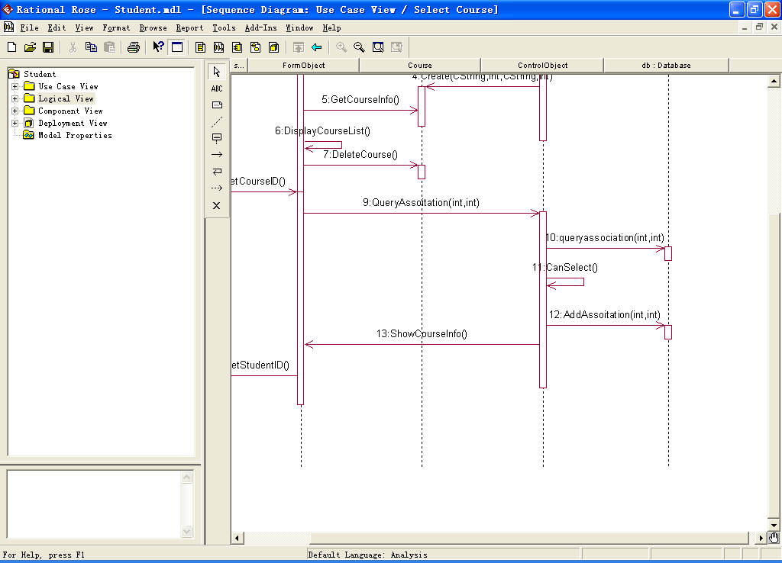
Rational Rose

Slide 3
Rational Rose
Use case view
Logic view
Component view
Deployment view

Slide 4
The UML Provides Standardized Diagrams
State
Diagrams
State
Diagrams
Class
Diagrams
Use Case
Diagrams
Use Case
Diagrams
State
Diagrams
Use Case
Diagrams
Use Case
Diagrams
State
Diagrams
Use Case
Diagrams
Object
Diagrams
Activity
Diagrams
Scenario
Diagrams
State
Diagrams
Scenario
Diagrams
State
Diagrams
Sequence
Diagrams
State
Diagrams
Model
Scenario
Diagrams
Component
Diagrams
Scenario
Diagrams
Component
Diagrams
Collaboration
Diagrams
Deployment
Diagram
Component
Diagrams
Notes:
In building a visual model of a system, many different diagrams are needed to represent different views of the system. The UML provides a rich notation for visualizing our models. This includes the following key diagrams:
Use Case diagrams to illustrate user interactions with the system.
Class diagrams to illustrate logical structure.
Object diagrams to illustrate objects and links.
State diagrams to illustrate behavior.
Component diagrams to illustrate physical structure of the software.
Deployment diagrams to show the mapping of software to hardware configurations.
Interaction diagrams (i.e., collaboration and sequence diagrams) to illustrate behavior.
Activity diagrams to illustrate the flow of events in a use case.

Slide 5
UML ----- OO Design
Requirements
Design
Architecture
Domain models
UML sequence diagrams
UML communication diagrams
UML use case diagrams
Scenarios
UML object diagrams
UML component diagrams
UML class diagrams
UML activity diagrams
UML package diagrams
UML deployment diagrams
UML activity diagrams
UML state diagrams

Slide 6
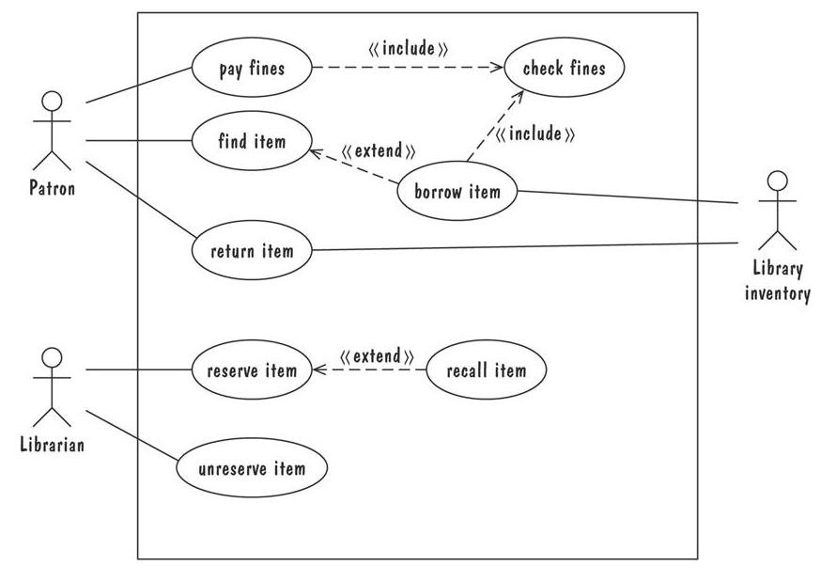
Use-case Diagram 用例图

Slide 7
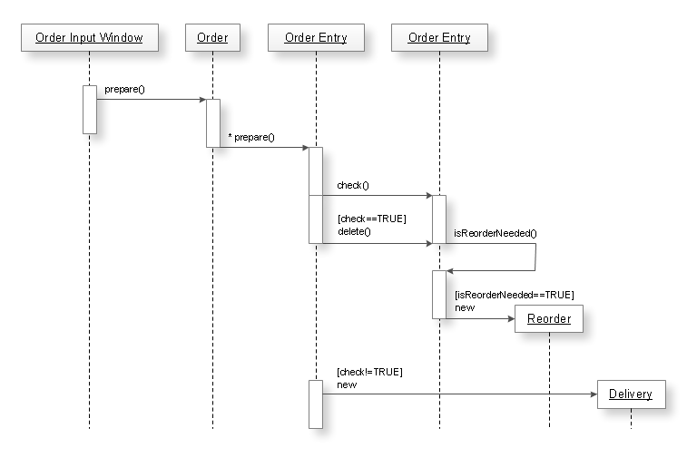
Sequence Diagram 顺序/时序图

Slide 8
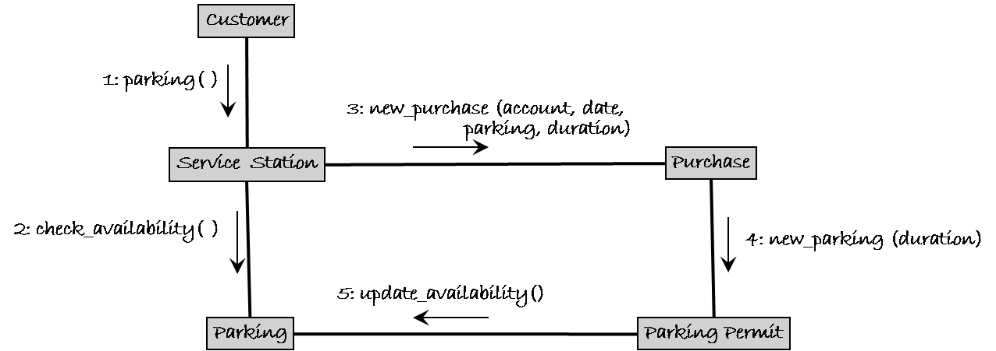
Collaboration Diagram 协作图

Slide 9
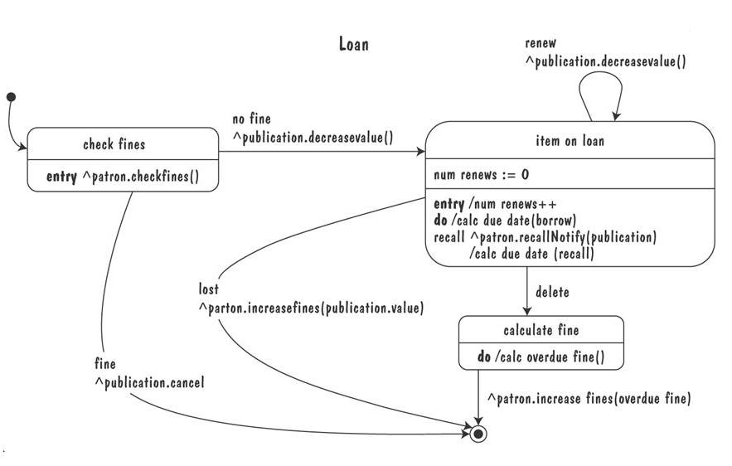
Statechart diagram 状态图

Slide 10
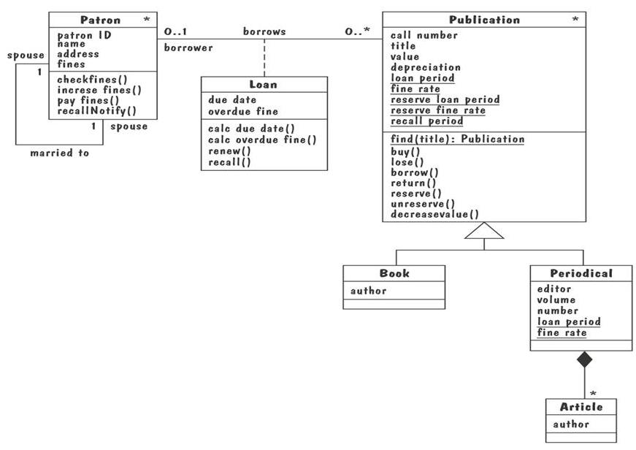
Class diagram 类图

Slide 11
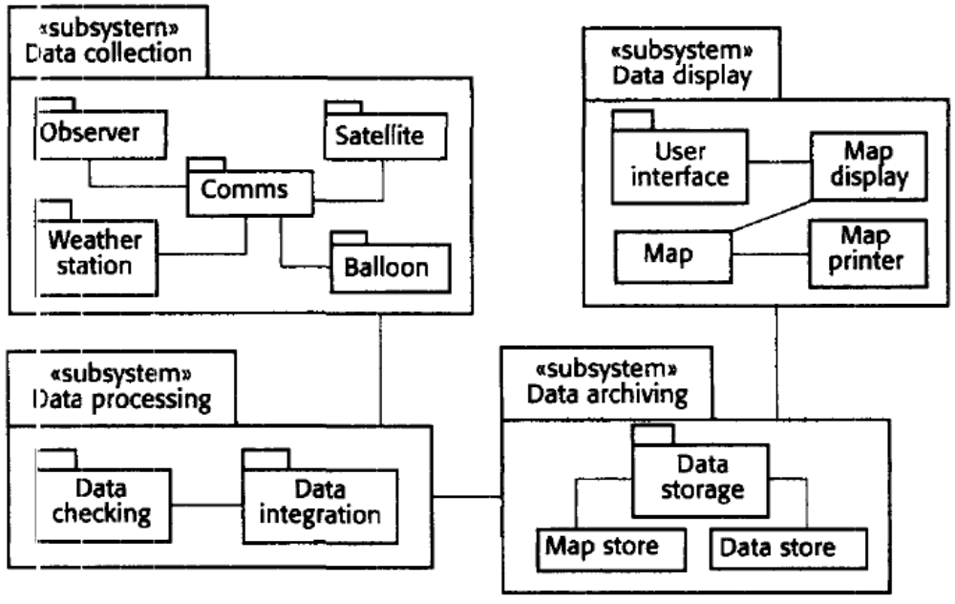
Package diagram 包图

Slide 12
部署图--Deployment Diagram
server:HostMachine
<<database>>
meetingsDB
Deployment diagram of a client-server system.
[Rumbaugh,99]
:Scheduler
reservations
<<direct channel>>
clientMachine:PC
:Planner
Software Design (UML)

