Slide 1
Software Engineering
Lesson 3
Exercise 2
Design and Development

Slide 2
Pothole tracking and repair system
The department of public works for a large city has decided to develop a on-line pothole tracking and repair system (PHTRS). A description follows:
  Citizens can log onto this system and report the location and severity of potholes. As potholes are reported they are logged within a “public works department repair system” and are assigned an identifying number, stored by street address, size (on a scale of 1 to 10), location (middle, curb, etc.), district (determined from street address), and repair priority (determined from the size of the pothole).

Slide 3
  Work order data are associated with each pothole and includes pothole location and size, repair crew identifying number, number of people on crew, equipment assigned, hours applied to repair, hole status (work in progress, repaired, temporary repair, not repaired), amount of filler material used and cost of repair (computed from hours applied, number of people, material and equipment used). Finally, a damage file is created to hold information about reported damage due to the pothole and includes citizen's name, address, phone number, type of damage, dollar amount of damage. PHTRS is an on-line system; all queries are to be made interactively.

Slide 4
Exercise 2.1
Development
  Implement a prototype of PHTRS system
    Include user interfaces and one function
    Implemented in Ruby(Rails) or other object-oriented programming languages (or Java, C++)
    Object-oriented
    MVC(Model-View-Controller) architecture pattern

Slide 5
Guide for exercise
Steps
  1. Install the VMware and Load the virtual machine rails to run the Ubuntu system
  2. Create a new Rails app
  3. Create the example scaffold
  4. Develop your program for PHTRS prototype system with Ruby-Rails develop framework

Slide 6
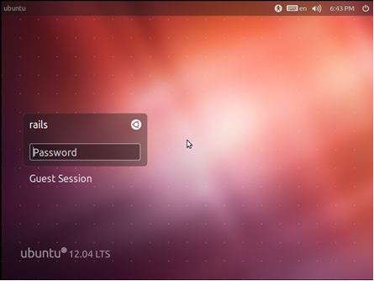
Load Ubuntu virtual machine
    Use VMware player open the “rails12.vmx” file in “Rails” folder and start this virtual machine
    All passwords:
    rails

Slide 7
Creating a New Rails App
Create your Rails application:
    rails new demo_app --skip_bundle
CD the project folder:
    cd demo_app
Create the database
    rake db:create

Slide 8
Starting Your Application
Start Puma, the built-in webserver:
    rails server or rails s
Working locally
  Open up your favorite browser and view the app on localhost with port 3000
    http://0.0.0.0:3000/

Slide 9
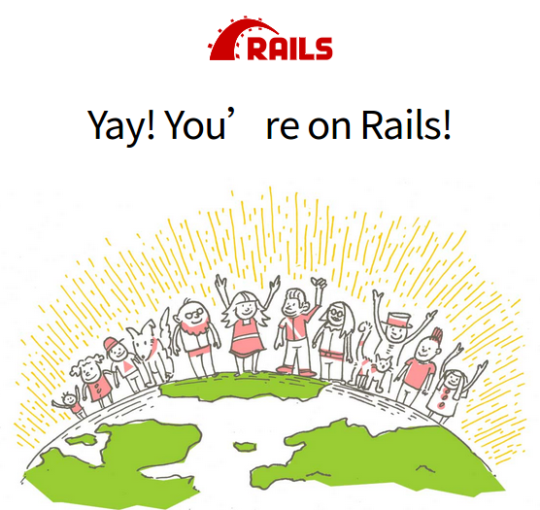
Viewing Your Application
A new application (Rails version 5.0.0)

Slide 10

Create a demo scaffold
Let’s create a demo app with Rails(ruby)
Using Scaffold to create a Post resource that represents a single blog post:
rails generate scaffold Post name:string title:string content:text rake db:migrate

Slide 11
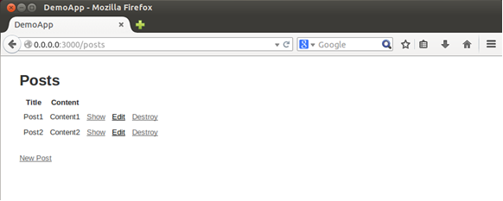
Viewing this demo
  Then startup the project web server to run and test the demo project with web browser(URL: http://0.0.0.0:3000/posts)

Slide 12
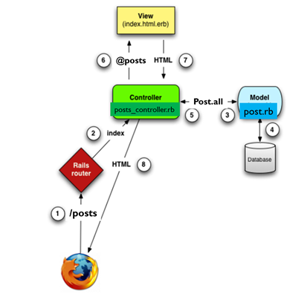
Prototype Implementation
    MVC
    (Model-View-Controller)

Slide 13
Exercise 2.2(cont’d)
Test
  Draw a graph to show the structure (execution) of a selected procedure in your program（or your Ruby program）.
  Compute the complexity of this procedure according to the structure graph

Slide 14
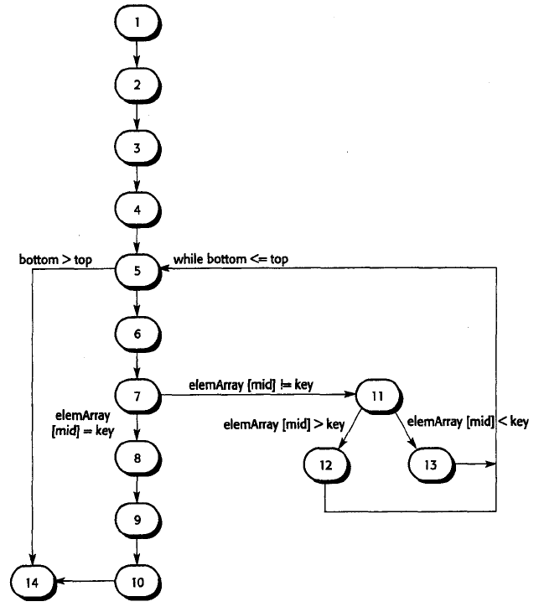
Example:

Slide 15
Exercise 3.2 (cont’d)
Test case design
  Test case design for the selected procedure
    Should cover all statements (or methods) of the procedure
    Every branch should been exercised for true and false conditions
    List inputs and corresponding execution paths

