Slide 1
PROJECT PRESENTATION • DATA SCIENCE
Predicting Vehicle Maintenance Needs Using Machine Learning
ML
PREDICTIVE
MAINTENANCE
Haaniya Asiya KP • Aikhya • Likitha
PG Dept. of SIST AIMIT
St Aloysius (Deemed to be University), Mangaluru
2026

Slide 2
Abstract
A concise summary of the project
PROBLEM
APPROACH
RESULT
Maintenance needs can be difficult to classify consistently using manual assessment alone.
A 50,000-record dataset was preprocessed and used to train a class-weighted Logistic Regression classifier.
On 10,000 test records, the model reported 95.95% accuracy and 97.34% balanced accuracy.
Results are dataset-specific. The strong relationship between Reported_Issues and the target requires further validation.
2

Slide 3
Problem Statement
Why this project is needed
THE CHALLENGE
OUR RESEARCH QUESTION
Determining whether a vehicle requires maintenance can be challenging when relying only on manual assessment.
QUESTION
Can a machine learning model classify records into maintenance-required and maintenance-not-required categories using the available vehicle data?
Scope: a dataset-based research prototype—not a deployed diagnostic system.
3

Slide 4
Objectives
What the project aims to achieve
• Analyse and preprocess the vehicle maintenance dataset.
• Develop a classification model using Logistic Regression.
• Evaluate performance using accuracy, balanced accuracy, precision, recall, F1-score and a confusion matrix.
• Examine the influence of Reported_Issues on model performance.
• Identify limitations affecting interpretation and real-world use.
4

Slide 5
Introduction
Background and motivation
TRADITIONAL PRACTICE
MACHINE LEARNING
PROJECT FOCUS
Fixed service schedules, manual inspection and technician experience may not always identify maintenance needs at the right time.
Classification models can learn patterns from vehicle attributes and historical records to estimate a maintenance category.
Build and evaluate a structured preprocessing and classification workflow, while checking for class imbalance and feature-related risks.
Predictions reflect patterns in the supplied labels; they do not confirm mechanical faults.
5

Slide 6
Literature Review
Selected foundational work and predictive-maintenance research
Paper / year | Author(s) | Method / focus | Accuracy | Gap / limitation
Random Forests (2001) | Leo Breiman | Ensemble of decision trees for classification and regression. | Not reported in this reference | General method; performance depends on data and setup.
Scikit-learn: Machine Learning in Python (2011) | Pedregosa et al. | Software library for preprocessing, model training and evaluation. | Not applicable — library paper | Provides tools, not a vehicle-maintenance benchmark.
Predictive Maintenance Enabled by ML (2021) | Theissler et al. | Review of automotive predictive-maintenance use cases and challenges. | Not a single model accuracy | Highlights practical challenges and validation needs.
Accuracy is marked as not reported/not applicable where the cited source is not a directly comparable experiment.
6

Slide 7
Research Gap
How this project is positioned
WHAT PRIOR WORK OFFERS
PROJECT CONTRIBUTION
REMAINING GAP
• Classification and ensemble-learning methods
• Software tools for reproducible ML workflows
• Reviews of predictive-maintenance challenges
• A structured vehicle-data preprocessing pipeline
• Class-weighted Logistic Regression
• Evaluation on a held-out test subset
• Verify target-label generation
• Investigate Reported_Issues association
• Validate using independently collected data
7

Slide 8
Proposed Methodology
Workflow used in the study
Dataset
Split
Preprocess
Train
Evaluate
Interpret
50,000 records
30k train • 10k validation • 10k test
Impute • scale • one-hot encode
Class-weighted Logistic Regression
Metrics + confusion matrix
Feature risk + validation needs
Preprocessing was fitted on training data and applied to validation/test data. Raw Last_Service_Date and Warranty_Expiry_Date columns were excluded.
Target: Need_Maintenance (0 = no maintenance required; 1 = maintenance required).
8

Slide 9
Algorithm Outline
High-level pseudocode for the implemented workflow
INPUT: vehicle maintenance dataset D
1. Separate features X and target y = Need_Maintenance
2. Split D into stratified train, validation and test sets
3. Fit preprocessing on training data:
• numerical: median imputation + standardisation
• categorical: most-frequent imputation + one-hot encoding
4. Train class-weighted Logistic Regression
5. Use validation data during model development
6. Predict labels for the independent test set
7. Calculate evaluation metrics and confusion matrix
OUTPUT: predictions and test-set evaluation
9

Slide 10
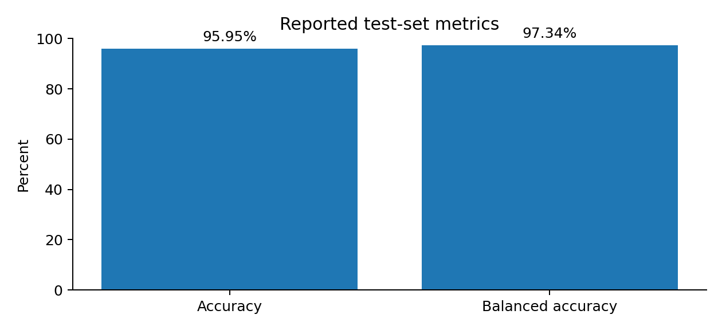
Results and Findings
Reported performance on the independent test set (10,000 records)
ACCURACY
BALANCED ACCURACY
CORRECT PREDICTIONS
95.95%
97.34%
9,595 / 10,000
These figures are reported in the paper and should be reproduced from the implementation before final deployment.
10

Slide 11
Confusion Matrix
How the model classified the 10,000 test records
PREDICTED CLASS
No maintenance (0)
Maintenance needed (1)
INTERPRETATION
1,892
8
Actual 0
True negatives
False positives
• 9,595 records correctly classified
• 397 maintenance-labelled records were missed
• False negatives need careful review
397
7,703
Actual 1
False negatives
True positives
Class 0 = no maintenance required. Class 1 = maintenance required.
11

Slide 12
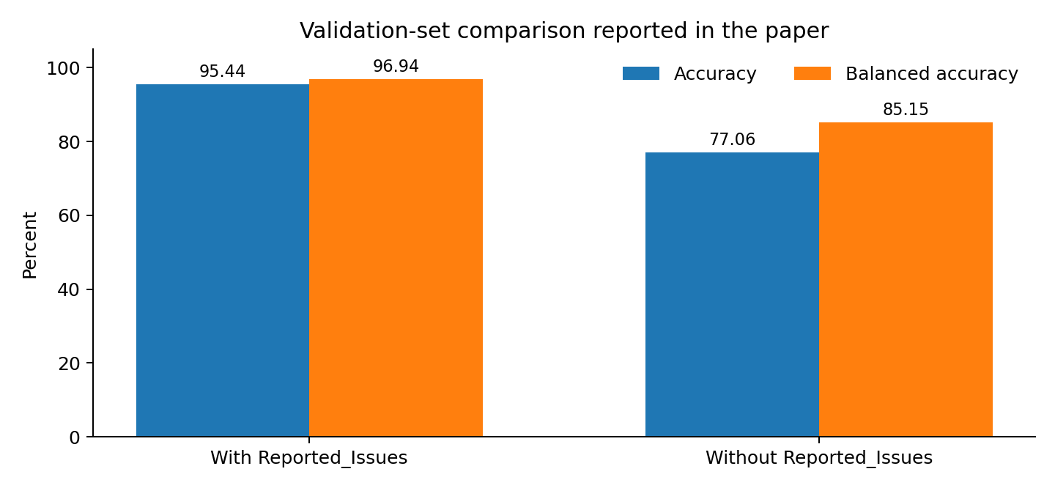
Feature Comparison
Validation accuracy comparison reported in the paper
Including Reported_Issues substantially increased the reported scores; this relationship needs further investigation.
The paper notes that all records with four or five reported issues were labelled as needing maintenance in the analysed data.
12

Slide 13
Conclusion
Key takeaway
WHAT WAS ACHIEVED
MAIN RESULT
WHAT COMES NEXT
A structured preprocessing workflow and class-weighted Logistic Regression model were evaluated on a held-out test set.
95.95% accuracy and 97.34% balanced accuracy were reported on 10,000 test records.
Verify label generation, investigate feature relationships, compare classifiers and validate on independent data.
This is a research prototype; predictions do not replace inspection by a qualified technician.
13

Slide 14
References
References listed in the project paper
• Breiman, L. (2001). Random forests. Machine Learning, 45, 5–32. https://doi.org/10.1023/A:1010933404324
• Pedregosa, F., Varoquaux, G., Gramfort, A., Michel, V., Thirion, B., Grisel, O., Blondel, M., Prettenhofer, P., Weiss, R., Dubourg, V., Vanderplas, J., Passos, A., Cournapeau, D., Brucher, M., Perrot, M., & Duchesnay, É. (2011). Scikit-learn: Machine learning in Python. Journal of Machine Learning Research, 12, 2825–2830.
• Theissler, A., Pérez-Velázquez, J., Kettelgerdes, M., & Elger, G. (2021). Predictive maintenance enabled by machine learning: Use cases and challenges in the automotive industry. Reliability Engineering & System Safety, 215, Article 107864. https://doi.org/10.1016/j.ress.2021.107864
• Chavindu Dulaj. (n.d.). Vehicle maintenance data [Data set]. Kaggle. https://www.kaggle.com/datasets/chavindudulaj/vehicle-maintenance-data
14

