Slide 1
Understanding demographic shifts:
Impact on disease diagnoses
SAS Capstone Project
Final Presentation
Team 1
Balaji Srungarapu
Haardik Sharma
Qi Li
Suresh Shanmugam
Venkat Jagannath

Slide 2
Executive Summary
Motivation for this project:
Planning for population and demographic shifts
By 2029, the entire ‘baby boomers’ cohort will be 65 or older
Approach & Results
Data from Census Bureau and Centers for Disease Control and Prevention
Models to predict hospitalization rates of 5 diseases (Septicemia, Cancer, Osteoarthritis, Asthma & Dementia)
Models to forecast the impact of vaccination on Septicemia incidence
Derived total cost savings from the vaccination program over the next 50 years

Slide 3
Agenda
Problem Statement
Conclusions 1,2,3
Initial Hypothesis from secondary research
Data Refinement Approach
Modeling Approach
Future Course of Action

Slide 4
Research focus is on ‘Hospitalizations’
Problem statement:
What are the peak years for each disease?
Which diseases are projected to increase, or decrease consistently over the time interval of the study?
How does a vaccination program impact septicemia incidence and associated costs?
* Five diseases focus - Septicemia, Cancer, Osteoarthritis, Asthma & Dementia
Specific questions asked by Census Bureau:
Determine the Incidence rate (Hospitalizations) of the diseases
by Age & Gender.
Estimate the medical costs associated with Septicemia.
Gauge potential savings from Septicemia vaccination.
Reference 1. SAS Analytics Shootout 2016 – Problem statement.

Slide 5
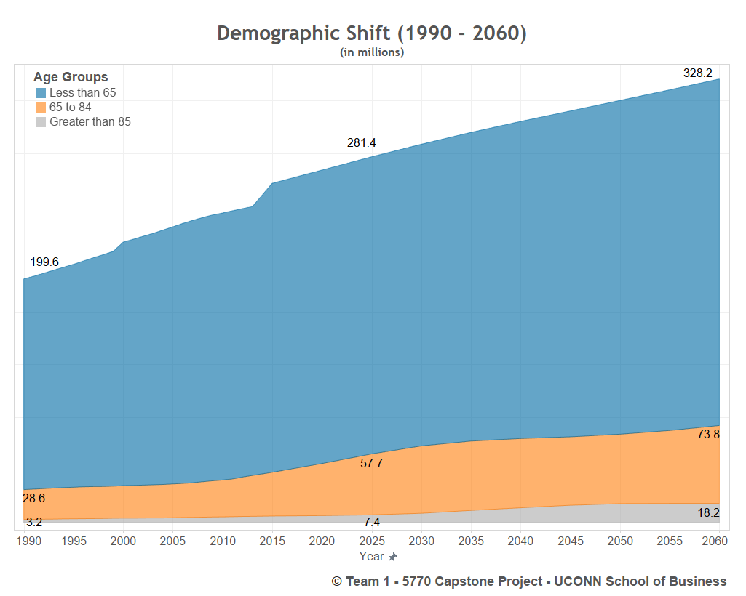
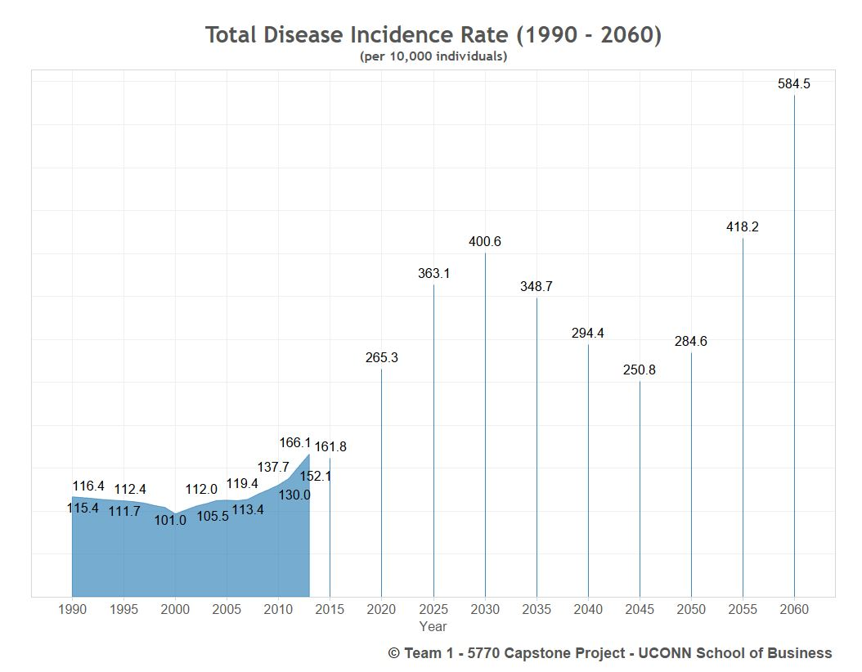
Conclusion 1 – Total Diseases
A demographic shift in the age groups can be observed.
From 1990 to 2060, the population older than 65 years has doubled
The total disease incidence rate has increased five fold from 1990 to 2060.

Slide 6
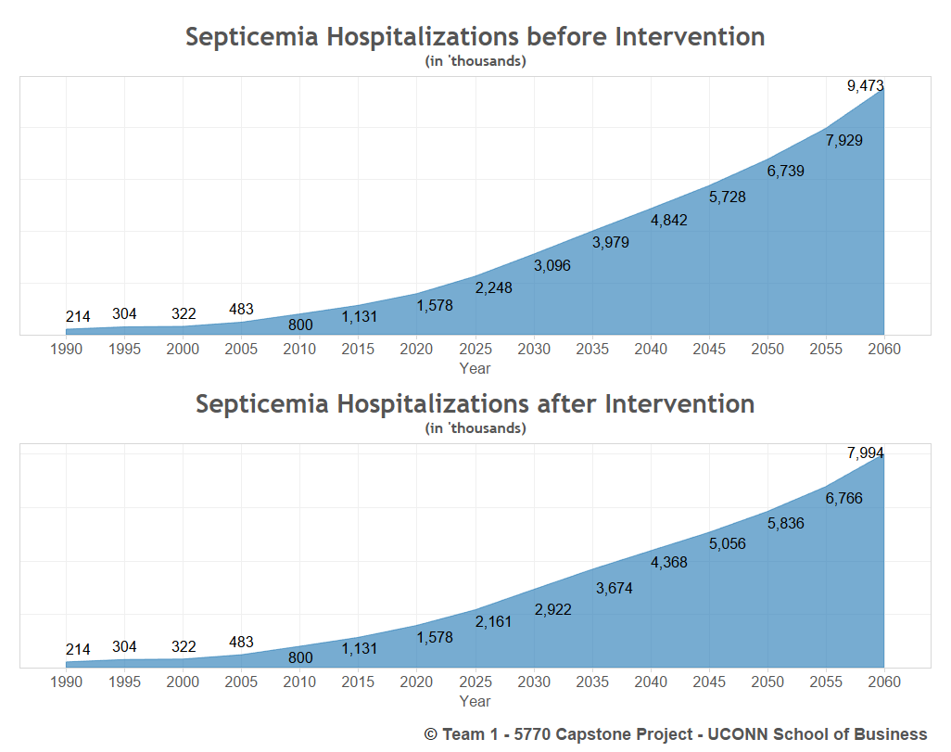
Conclusion 2 – Vaccination Program Impact

Slide 7
Conclusion 3 – Septicemia Financial Model
Baseline assumptions –
Cost of treatment - $18600
Inflation(Healthcare) – 6%
CPI Inflation – 3%
Intervention begins 2025.
Vaccine is expected to reduce incidence rate by 20% and cost of treatment by 25%.
NPV of cost savings expected to be ~ $ 75 billion
Reference 1. SAS Analytics Shootout 2016 – Problem statement.

Slide 8
Data Details
Data Source
Three dataset from Census Data Center, including Census_population, Projected_population, and Disease_cases
1. Census_population Dataset:
Variables | Type | Details
Year | Numerical | 1990 till 2010 (per year interval)
Gender | Categorical | Male | Female | Both
Age Group | Categorical | 31 Age Groups
Population | Numerical | Population in Thousands

Slide 9
Data Details
Data Source
Three dataset from Census Data Center, including Census_population, Projected_population, and Disease_cases
2. Projected_population Dataset:
Variables | Type | Details
Year | Numerical | 2015 till 2060 (at 5 year interval)
Gender | Categorical | Male | Female | Both
Age Group | Categorical | 15 Age Groups
Population | Numerical | Population in Thousands

Slide 10
Data Details
Data Source
Three dataset from Census Data Center, including Census_population, Projected_population, and Disease_cases
3. Disease_cases Dataset:
Variables | Type | Details
Year | Numerical | 1990 till 2010 (per year interval)
Gender | Categorical | Male | Female | Both
Age Group | Categorical | 8 Age Groups
Diseases | Categorical | 5 Types (Asthma, Cancer, Dementia, Arthritis, Septicemia)
Incidences | Numerical | Cases in Thousands

Slide 11
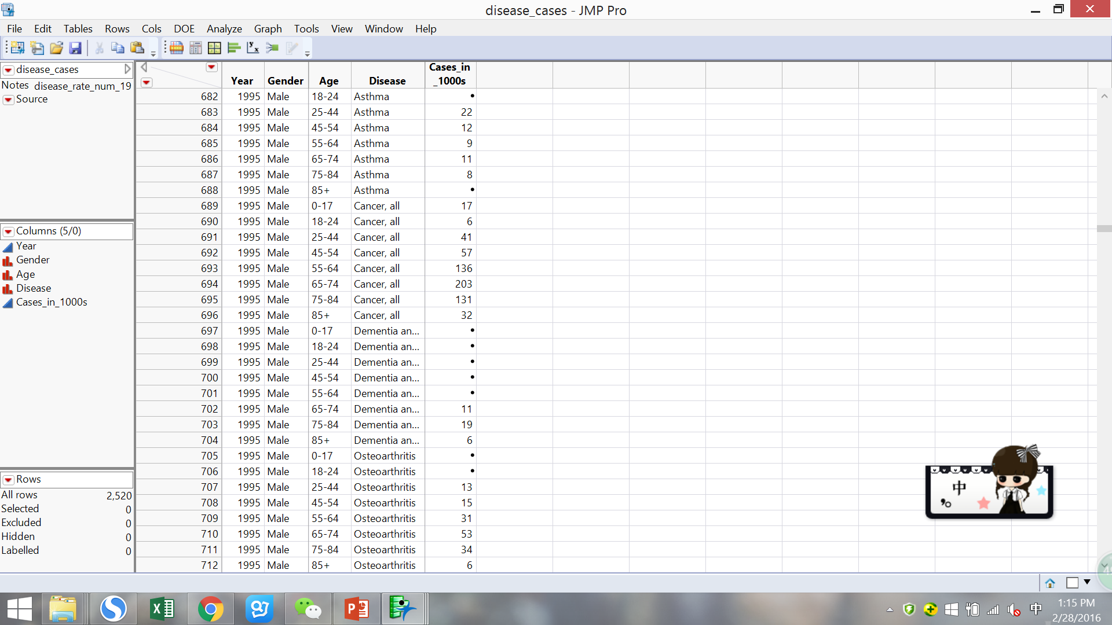
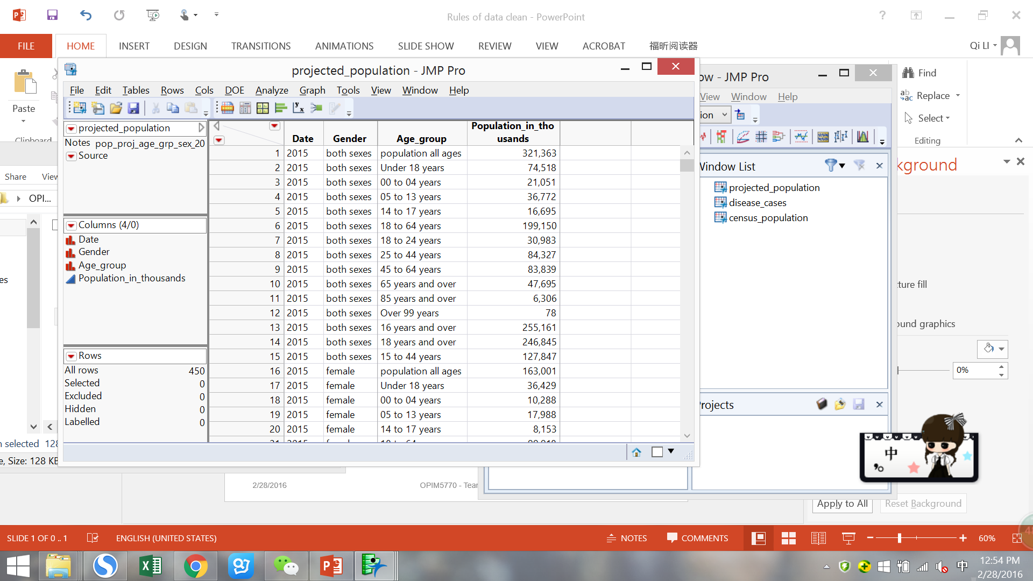
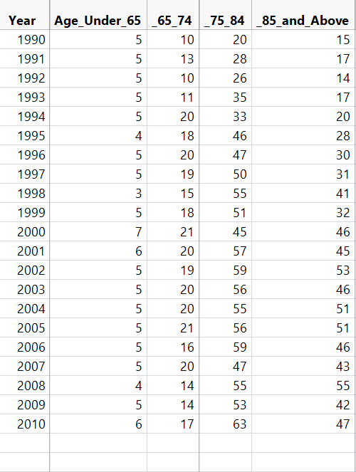
Data Refinement Approach
Before
After
1
Data Group
Combine the Age data and arrange them into four groups: under 65, 65-74, 75-84, above 85.
Disease case Dementia and Alzheimer
2
Data Clean
Specify several rules of dealing with missing values.
3
Data Reshape
Make “year” as row and “age group” as column, which is clean and easier to analyze
Sample
Sample

Slide 12
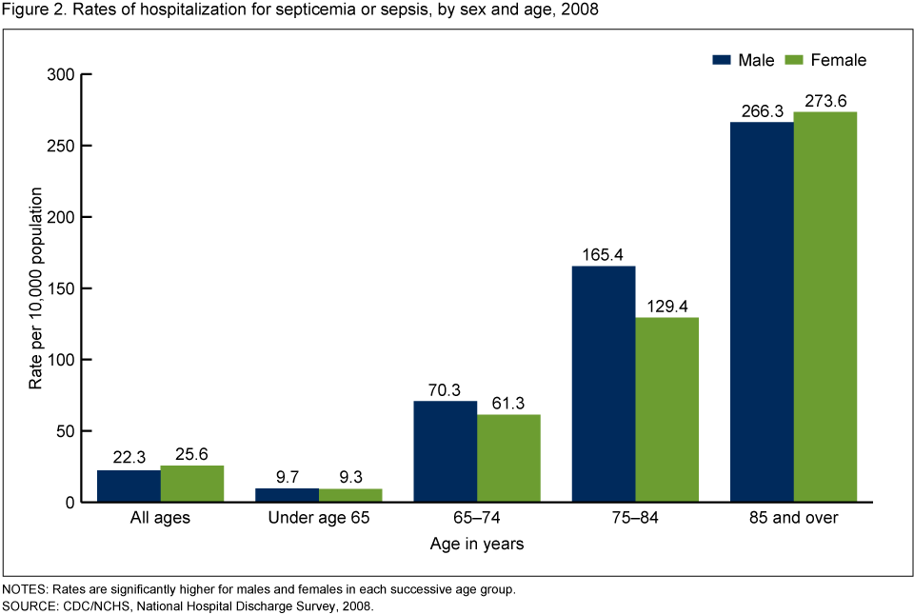
Initial Hypothesis for modeling Septicemia
The Risk of Septicemia increases with Age. Four age groups are crucial.
.
Crucial Age Groups
Reference - Hall MJ, Williams SN, DeFrances CJ, Golosinskiy A. Inpatient care for septicemia or sepsis: A challenge for patients and hospitals. NCHS data brief, no 62. Hyattsville, MD: National Center for Health Statistics. 2011.

Slide 13
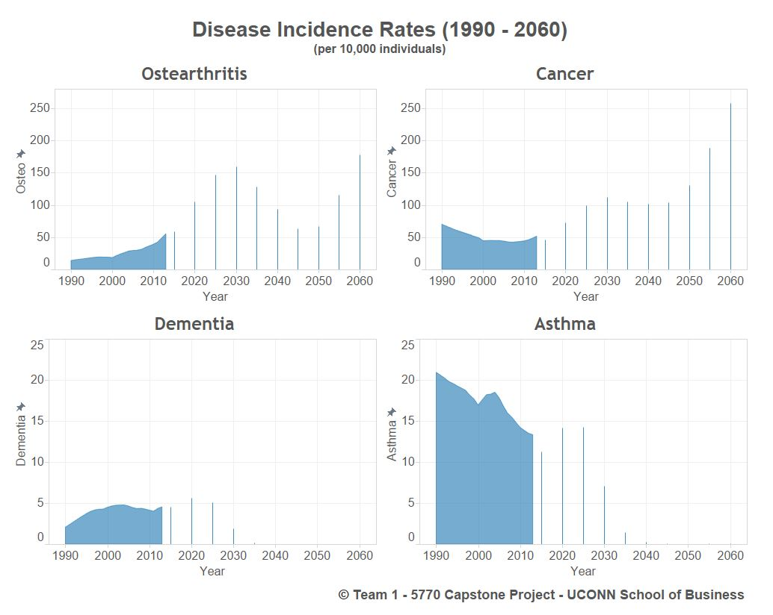
Modeling Approach 1: Time Series Panel Regression
No statistical difference between male/female groups
Data for all the age groups and gender is merged and reshaped
‘Hospitalization rate’ as a Target variable
Time Series Panel Regression’ model is used to fit the data
Holdout of 4 years (20% of data) for validating models
Other forecasting methods for time series were also tried.

Slide 14
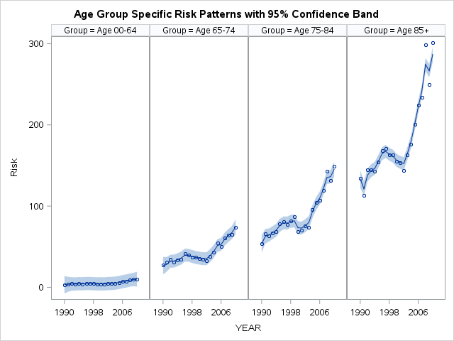
Modelling Approach 2: State-space model for Transitions between age groups
State-space models allowed a very flexible framework for incorporating dynamics of diseases
Unobserved or latent state process that causes diseases Xt
Observations are hospital admits Yt
Assumption: observation process Yt is independent of the past given Xt
Incorporated vaccination and measurement error in model

Slide 15
Future Course of Action
Causes for Septicemia not clearly understood¹. Possible causes are infection during hospitalization, infection due to antibiotic resistance & lower immunity levels due to aging.
Septicemia related costs largest contributor to US healthcare costs².
Vaccine program’s biggest beneficiaries would be Medicare & Medicaid program ($45 Billion/60%).
Improve patient experience in hospital & reduce the incidence of Septicemia
Incentives for doctors/healthcare professionals
Adoption rate of Septicemia vaccine drives cost savings
Develop strategies to quickly achieve adoption
Reference 1. SAS Analytics Shootout 2016 – Problem statement.
2. Healthcare cost and Utilization project - Septicemia in U.S. Hospitals, 2009

Slide 16
Questions?

Slide 17
Appendix – Modeling Approach 1 – Panel Regression
Disease | MSE | RMSE | MAPE | R²
Osteoarthritis | 0.6587 | 0.8116 | 2.2899 | 0.988
Cancer | 1.9818 | 1.4077 | 2.1942 | 0.975
Asthma | 0.9749 | 0.9873 | 4.2935 | 0.764
Dementia | 0.0603 | 0.2457 | 5.8958 | 0.910
Septicemia | 0.9138 | 0.9559 | 5.2339 | 0.962

Slide 18
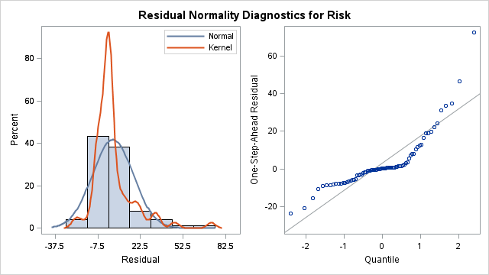
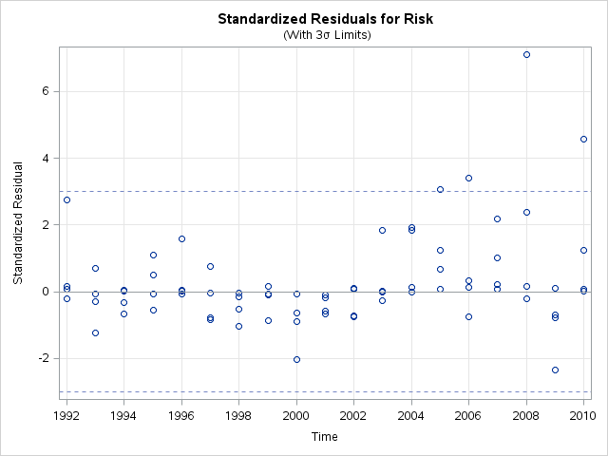
Appendix – Factor model for Septicemia Model statistics and residuals shows ‘good fit’
Model Parameter Estimates
Component | Type | Parameter | Estimate | Standard Error | t Value
IrwTrend | DLL Trend | Slope Variance | 50.173 | 12.4306 | 4.04
IrwTrend | DLL Trend | Phi | 0.959 | 0.0407 | 23.55
wn | Irregular | Variance | 31.409 | 8.3668 | 3.75
Regression Parameter Estimates
Response Variable | Regression Variable | Estimate | Standard Error | t Value | Pr > |t|
Risk | log_Population | 23.3 | 2.45 | 9.55 | <.0001

Slide 19
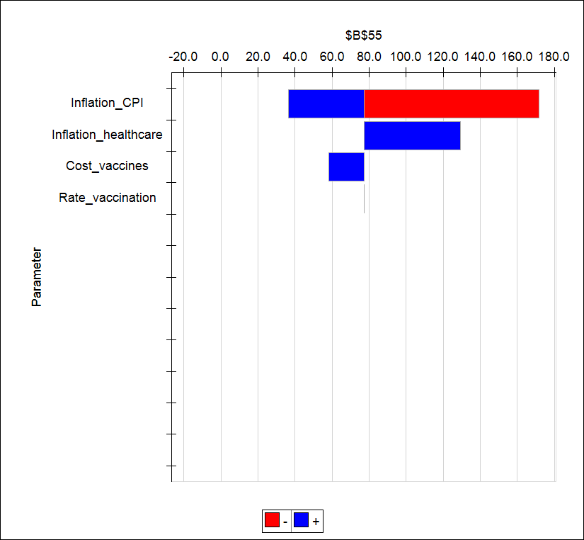
Appendix – Septicemia Financial Model
Cost Saving Sensitivity

