Slide 1

TEAM SENKU
Team Members:
Jampala Srija (22WJ1A6644)
Esprit EL (22WJ1A6627)
Aquib Ahmed (22WJ1A6608)
Haard Shah (22WJ1A6643)
From CSM-1, 2yr, GNITC
Sustainable Development Goal: Quality Education

Slide 2
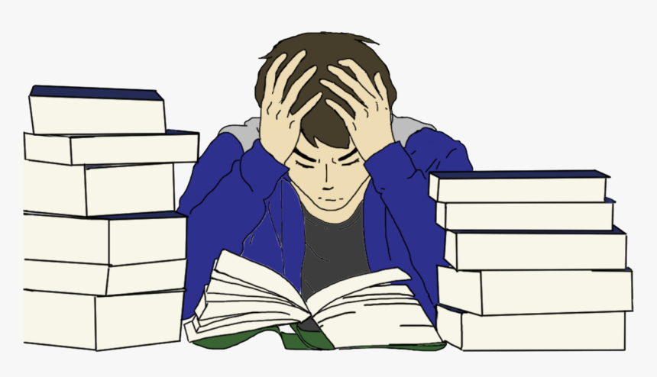


The Problem:
I’m sure all of us have been here, especially during Intermediate Schooling. Remember Rotational Motion from Physics? It still stresses me out to even think about JEE Physics.

Slide 3
The Problem:
Just listening to lectures or reading textbooks, or even both, are not always sufficient enough to make the students understand their concepts, especially in subjects like Physics and Biology. The simple reason for this is that the student cannot understand the concepts if he/she is not able to visualize it. This is true irrespective of the IQ level of the student or his/her marks. Unless the student visualizes the concept, they can neither answer the questions confidently, nor accurately.

Slide 4
The Solution We Propose:
We propose to create a free, multi-platform app that contains interactive simulators with both 2D and 3D spaces that allow students to enter their own parametric values (like gravity constant, mass of an object, radius of a sphere, charge on a ring etc. for Physics; highlighted muscle groups, movements of tendons, ligaments at joints etc. in Biology and more) depending upon the topic and play the simulation animation. We aim on making modules mainly on the topics used in High School and Intermediate level topic and questions.

Slide 5
The Competition:
You might argue, that there are many other simulators online as well like
OPhysics
Desmos
PhET
Biology Simulations
CK-12

Slide 6
Uniqueness:
How does our software stand out?
Our software will be available at multiple platforms.
Our software will be free of cost and subscriptions. Ads and Donations will be the primary form of income.
Our Software will cover multiple subjects like Phy, Chem, Bio +
Our Software will have an option to toggle advanced details
Our software will provide every minute concept from the syllabus of the students and not highly advanced Masters or PHD level concepts that will instead make students feel dumb

Slide 7
Potential Problems We’d Face:
Requires a big team and a lot of effort
Hard to maintain
Software may crash easily
New simulations must be made constantly as syllabus changes
Software file will be Huge and Probably Cloud servers might be needed
It will take a lot of time to bring awareness about this product

Slide 8
Future Scope:
Students can scan their question and get the simulation
Better UI and UX with bright and vibrant colours to prevent a boring study environment
AI doubt solving chatbot
Improved efficiency with newer versions of the software

Slide 9
Thank You
Hope you liked the idea

