Slide 1
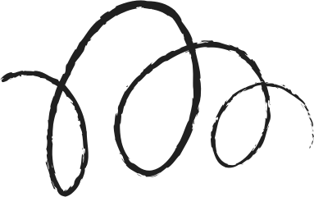




Self-RAG
Learning to Retrieve, Generate, and Critique through Self-Reflection
Akari Asai, Zeqiu Wu, Yizhong Wang, Avirup Sil, Hannaneh Hajishirzi
University of Washington · Allen Institute for AI · IBM Research AI
ICLR 2024 · arXiv 2310.11511
CS613 · Paper Presentation
Presented by: [Team member names]
Notes:
[~30 s] Good morning. We are presenting Self-RAG: Learning to Retrieve, Generate and Critique through Self-Reflection, by Akari Asai and colleagues from the University of Washington, the Allen Institute for AI and IBM, published at ICLR 2024.
In one sentence: Self-RAG is a single language model that decides for itself when to look something up, judges whether what it found is relevant, and checks whether its own sentences are supported. It does all of this by writing special tokens, so judging costs no more than writing a word.

Slide 2




LLMs make things up
Knowledge lives in the weights. It is fixed after training, has no source and is hard to update.
Rare facts are the worst. Few training examples, so probability spreads over plausible but wrong answers.
Users cannot verify an answer that comes with no evidence.
The standard fix is Retrieval-Augmented Generation (RAG): look up passages, then answer. But RAG brings problems of its own.
no retrieval
with retrieval
14.7%
45.7%
Llama2-13B accuracy on rare-entity questions (PopQA long-tail: entities with fewer than 100 Wikipedia views a month)
Why not just trust the model?
Notes:
[~45 s] Let's start with the problem. A language model stores its knowledge in its weights. That knowledge is frozen after training, comes with no source, and is hard to update.
Rare facts are the worst case. The model saw few training examples, so its probability is spread over answers that sound plausible but are wrong.
The numbers on the right come from the paper's Table 2. On PopQA's long-tail questions, Llama2-13B scores 14.7 percent without retrieval and 45.7 percent with it. So retrieval clearly matters, and the standard fix is retrieval-augmented generation, RAG. But as we'll see, RAG brings problems of its own.

Slide 3

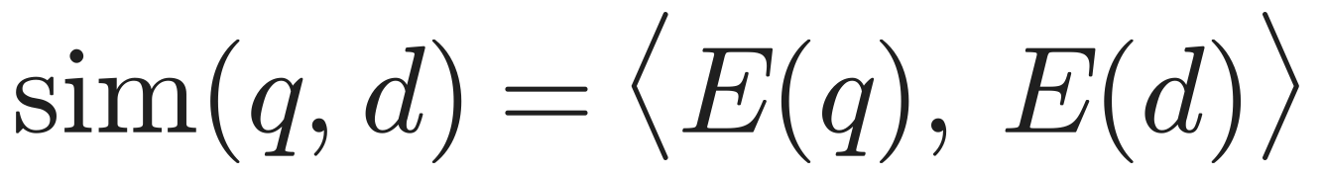
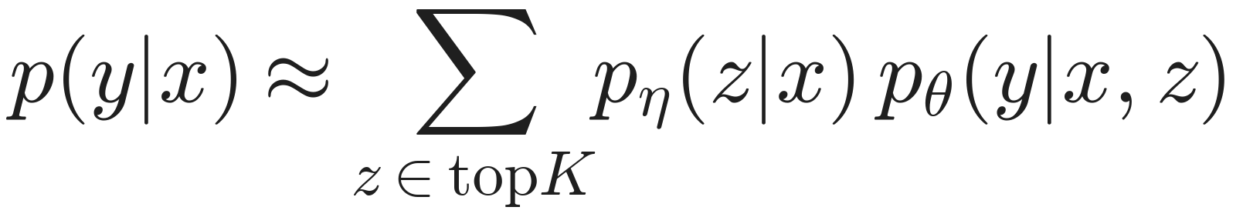
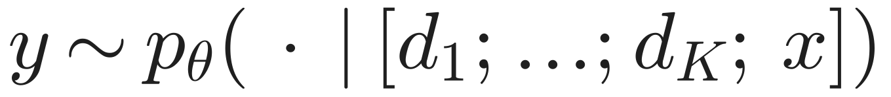

RAG in one slide
Query x
Retriever R
Top-K passages
Language model
Answer y
dense search over
~21M Wikipedia passages
d1 … dK
(K = 5 here)
Dense retrieval
Classic RAG (Lewis 2020)
In-context RAG (common)
Embed query and passage separately, rank by dot product. Contriever is trained with a contrastive loss; Self-RAG keeps it frozen.
The passage is a latent variable: average the answer over passages, weighted by the retriever. Always retrieves.
Paste all K passages in front of the prompt. No training needed. This is the 'Ret-ChatGPT' baseline.
Notes:
[~45 s] Here is RAG in one picture. The retriever embeds the query and every passage separately and ranks passages by dot product. Self-RAG uses Contriever-MS MARCO and keeps it frozen. The top-K passages then go to the language model.
There are two classic ways to use them. Lewis et al. treat the passage as a latent variable and average the answer over passages, weighted by the retriever. In practice, most systems just paste all K passages into the prompt; that is the 'Ret-ChatGPT' baseline you will see later.
Both versions retrieve every single time, and neither checks the answer against the evidence.

Slide 4



Why plain RAG falls short
Always retrieves
Irrelevant passages
No grounding check
Top-K passages for every prompt, even 'write an essay about your summer'. Wastes compute and derails creative or reasoning tasks.
The retriever's top hit can be off-topic, and LMs are easily distracted by irrelevant context (Shi et al. 2023).
Nothing makes the output follow the passages, and nothing checks it afterwards, so citations are unreliable.
Ret-ChatGPT on PubHealth:
70.1 → 54.7
Alpaca-13B on PubHealth:
55.5 → 51.1 with retrieval
Open RAG models on ASQA:
2–8% citation precision
Earlier fixes each cover one part: FLARE retrieves when confidence is low, SAIL always prepends passages, Toolformer learns API calls, RLHF needs expensive PPO, and self-refine needs many prompt calls.
Notes:
[~50 s] That gives three failure modes. One: RAG always retrieves, even for 'write an essay about your summer'. Two: the top passage can be off-topic, and models are easily distracted by irrelevant context. Three: nothing forces the answer to follow the passages, and nothing checks it afterwards.
The paper's own numbers show the damage. ChatGPT with retrieval drops from 70.1 to 54.7 on PubHealth. Alpaca-13B drops from 55.5 to 51.1. And open RAG models get only 2 to 8 percent citation precision on ASQA.
Earlier work fixes one piece each: FLARE retrieves when confidence is low, SAIL always prepends passages, Toolformer learns API calls, and RLHF needs expensive PPO training.

Slide 5
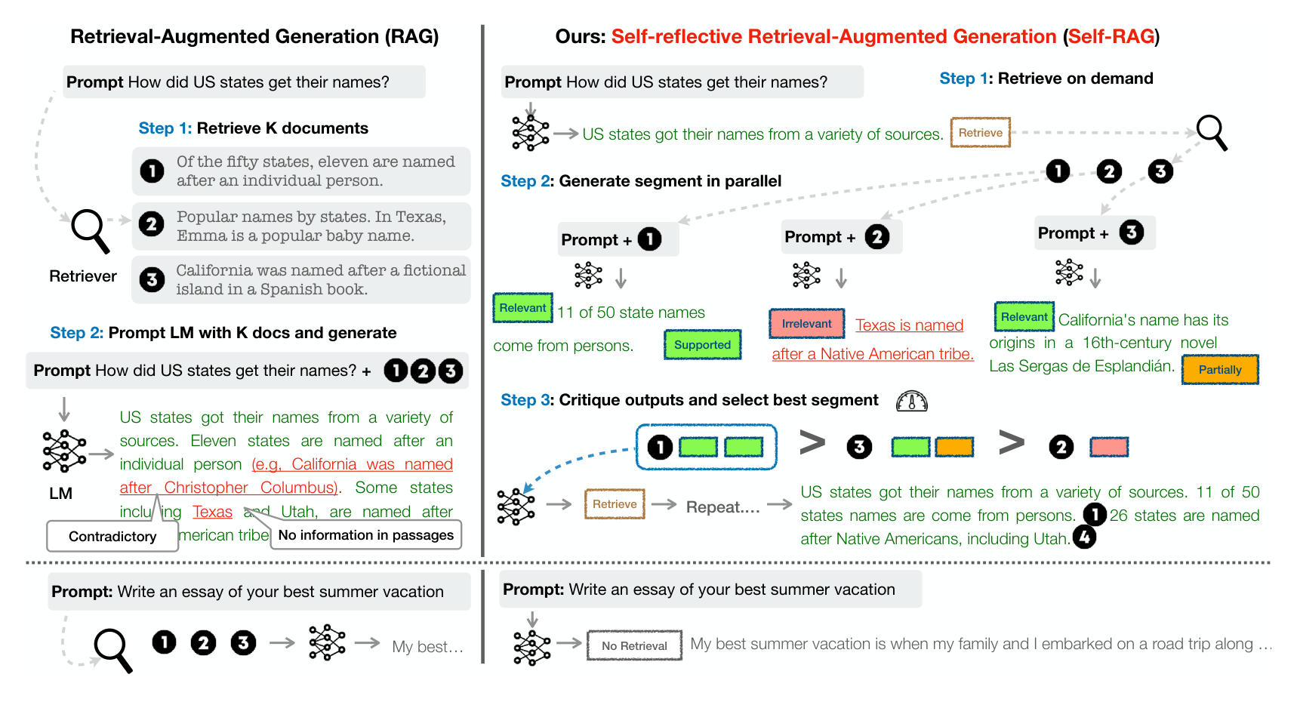
RAG vs Self-RAG: the paper's picture
Plain RAG (left)
Always fetches K = 3 passages and pastes them all into one prompt. The answer mixes them: one claim is contradicted, one has no support.
Self-RAG (right)
Step 1: retrieve only when needed
Step 2: one draft per passage, in parallel
Step 3: critique, keep the best, repeat
Essay prompt (bottom)
Paper Figure 1. Left: standard RAG. Right: Self-RAG on the same prompt. Bottom: a creative prompt.
Self-RAG writes [No Retrieval] and answers directly. Plain RAG still retrieves.
Notes:
[~60 s] This is the paper's Figure 1, and it summarises the whole method.
On the left, plain RAG retrieves three passages for 'How did US states get their names?', pastes them all in, and the answer mixes them up: one claim is contradicted by the passages and another has no support at all.
On the right, Self-RAG. Step 1: it writes a first sentence, then decides it needs evidence and emits Retrieve. Step 2: it writes one continuation per passage, in parallel, and labels each passage Relevant or Irrelevant. Step 3: it critiques each continuation, Supported or Partially supported, and keeps the best one. Here passage 1 beats passage 3, which beats passage 2. Then it repeats for the next sentence.
The bottom row: for an essay prompt, Self-RAG writes 'No Retrieval' and simply answers, while plain RAG still retrieves.

Slide 6
Core idea: reflection tokens
Add special tokens to the vocabulary and train ONE model, with ordinary next-token prediction, to write them between its own sentences. Critique becomes next-token prediction.
Retrieve
IsRel
IsSup
IsUse
Should I fetch evidence for the next sentence?
Is passage d relevant to the question x?
Is every claim in my sentence backed by d?
Is the whole answer useful? (not about truth)
Yes · No · Continue
Relevant (best) · Irrelevant
Fully (best) · Partially · No support
5 (best) · 4 · 3 · 2 · 1
sees: x and y<t
before each sentence
sees: x, d
after the passage
sees: x, d, yt
after the sentence
sees: x, y
once, at the end
Notes:
[~60 s] This is the central idea: reflection tokens. We add special tokens to the vocabulary and train one model, with ordinary next-token prediction, to write them between its own sentences. Critique becomes next-token prediction.
There are four types, from the paper's Table 1. Retrieve: should I fetch evidence for the next sentence? It can say Yes, No, or Continue, meaning reuse the passage I already have. IsRel: is this passage relevant to the question? IsSup: is every claim in my sentence backed by the passage, fully, partially, or not at all? IsUse: is the whole answer useful, on a 1-to-5 scale, regardless of whether it is true.
The first three are written for every sentence; IsUse once at the end. The bottom row of each card shows what that token is allowed to see.

Slide 7
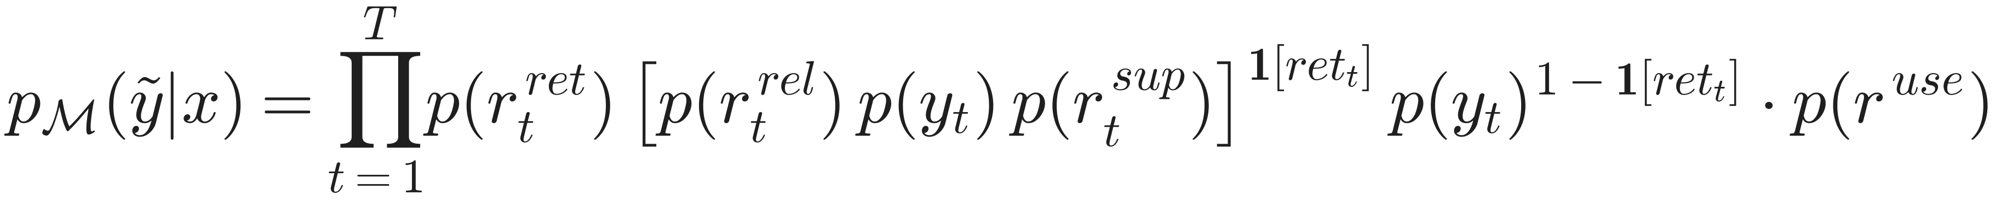
What the model actually writes
Q: when did Walking Dead season 7 come out?
[Retrieve=Yes] <p> …season 7 premiered on October 23, 2016… </p> [IsRel=Relevant] October 23, 2016 [IsSup=Fully] [IsUse=5]
Why this order?
Retrieve first: decide before writing
IsRel before the sentence: the judgment shapes the answer
IsSup after: check the finished sentence
IsUse last: a property of the whole answer
<p>…</p> passages come from the retriever, not the model
Q: write a poem about the sunset
[Retrieve=No] The stars begin to twinkle bright… [Retrieve=No] They flicker like a silent dance… [IsUse=5]
One token stream = chain rule
Notes:
[~45 s] Here is what the model actually writes, taken from the paper's training examples. For the Walking Dead question it writes Retrieve=Yes; the retriever inserts a passage; then the model writes IsRel, the answer, IsSup and IsUse. For the poem it never retrieves. Nobody hard-coded that; it is learned from the data.
The order matters because the model is autoregressive: earlier tokens condition later ones. Retrieve comes before writing. IsRel comes before the sentence, so the judgment shapes the answer. IsSup comes after, because you can only check a finished sentence. IsUse is last, because it is about the whole answer.
And remember: the passage itself comes from the retriever, not from the model.

Slide 8
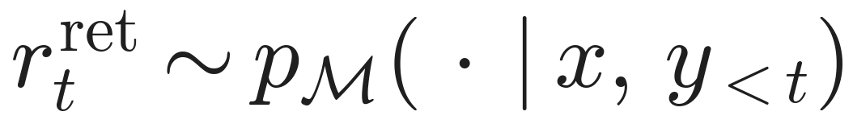
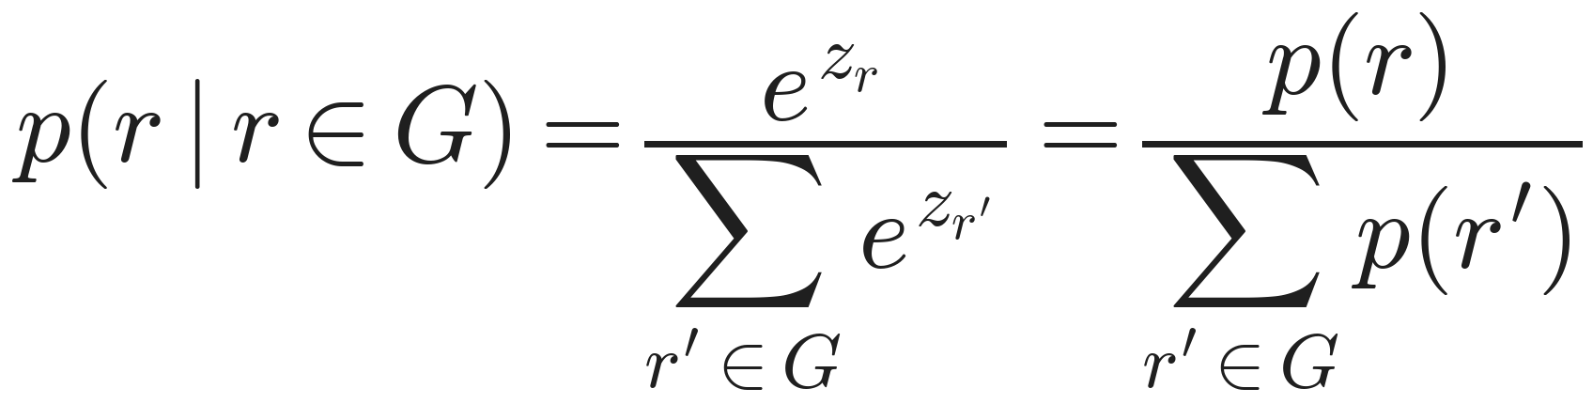
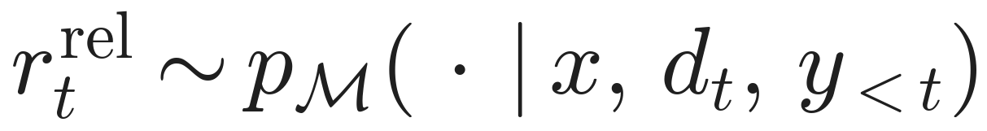
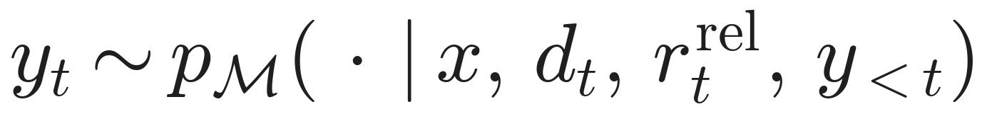
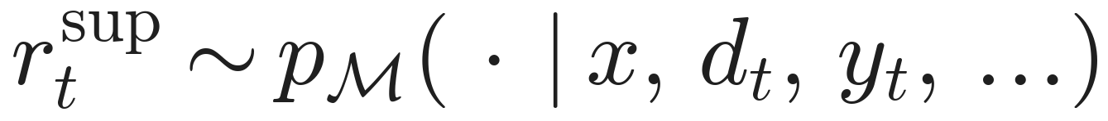
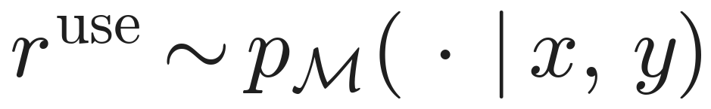
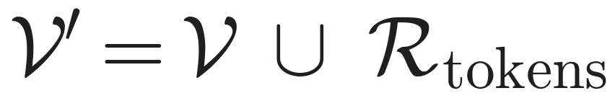
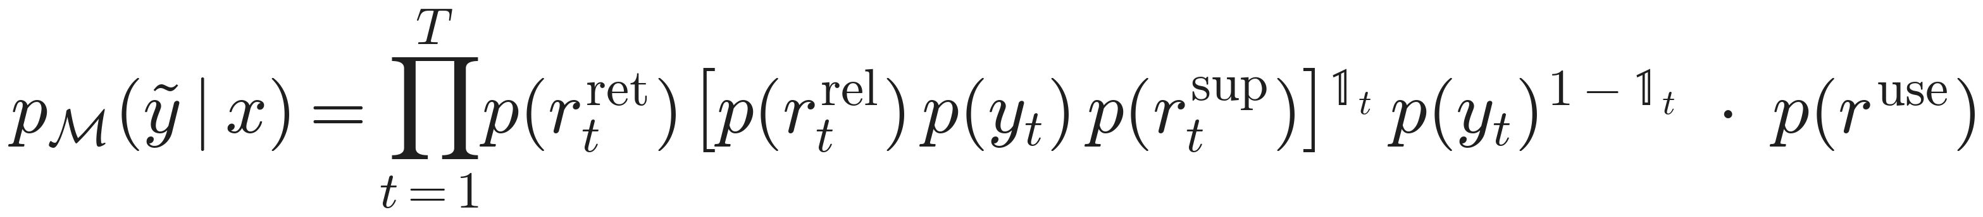
Reflection tokens, formally
Generative story of segment t
Reading a decision from logits
decide: retrieve?
external call, not modelled
judge the passage
Each token type G is a small group (Yes / No, Relevant / Irrelevant, ...). Renormalising inside the group removes the ~32,000 ordinary tokens: the global softmax denominator cancels. This is how the threshold δ and the critique scores are computed.
write the sentence
check the sentence
after the last segment
New vocabulary
One token stream = chain rule
New rows in the embedding table and output layer, trained like any other word. A segment = one sentence (split with spaCy).
Passages are inputs from the retriever R, not outputs of M, so they are not in the product.
Notes:
[~60 s] Now the same thing formally. For each segment t, the model first samples the Retrieve token, given the question and everything written so far. Only if it says Yes do we call the retriever; that is an external step, not part of the model. Then the model writes IsRel, the sentence, and IsSup, each conditioned on everything before it. After the last segment it writes IsUse.
Because it is all one token stream, the probability of the output factorises by the chain rule, shown at the bottom. The indicator switches the critique factors on only for segments where we retrieved. Passages are not in the product, because the model does not produce them.
On the right is the trick used everywhere at inference. To read a decision, we renormalise the probability inside the token group. The softmax denominator over 32,000 normal tokens cancels, so we get a clean probability for Yes versus No. The new tokens are just extra rows in the embedding and output layers.

Slide 9

Training: distil a critic, then teach the generator
GPT-4 labels
Critic C
Annotate 150k
Generator M
Few-shot prompts per token type: 12.6k Retrieve, 19.3k IsRel, 11.2k IsSup, 3.8k IsUse
Llama2-7B fine-tuned on those labels. Agrees with GPT-4: 94% Retrieve, 94% IsSup, 80% IsRel, 74% IsUse
For each sentence: C decides retrieval, R fetches, C labels IsRel / IsSup, keeps one passage. Text unchanged
Llama2 7B / 13B + new tokens, plain next-token training (3 epochs, 4×A100)
At inference: only M + the retriever
C and GPT-4 are only used to build the training data. M has learned to be its own critic.
Notes:
[~45 s] How do we get training data with these tokens? Nobody has it, so the authors build it in two stages.
Stage one: GPT-4 labels a sample using few-shot prompts, one prompt per token type, and a Llama2-7B critic is fine-tuned to imitate those labels.
Stage two: the critic and the retriever annotate 150 thousand ordinary instruction and QA examples, inserting passages and reflection tokens. The generator is then trained on that with plain next-token prediction.
GPT-4 and the critic are only used to build the data. At inference, only the generator and the retriever run. The generator has learned to be its own critic.

Slide 10
Stage 1: GPT-4 teaches the critic
Is GPT-4 itself right?
Settings
Authors hand-checked 20 labels per type: agreement 95% Retrieve, 95% IsRel, 90% IsSup, 80% IsUse (errors mostly 4 vs 5 or 1 vs 2).
One instruction + few-shot demos per token type (App. D) · temperature 1 · max 200 tokens · wrong formats dropped · about 47k labels in total · critic trained with Eq. 1
Notes:
[~50 s] Stage one in numbers. On the left, the GPT-4 labels collected: about 12.6 thousand for Retrieve, 19.3 thousand for IsRel, 11.2 thousand for IsSup and 3.8 thousand for IsUse; about 47 thousand in total.
Is GPT-4 right? The authors checked 20 labels per type by hand: 95 percent agreement for Retrieve and IsRel, 90 for IsSup, 80 for IsUse.
On the right, how well the critic imitates GPT-4 on held-out labels. The Llama2-7B critic reaches about 94 percent on Retrieve and IsSup, 80 on IsRel and 73.5 on IsUse. A smaller FLAN-3B critic is clearly worse on IsSup, 73 versus 93.5. IsUse is the hardest for both; most errors are 4-versus-5 confusions, where humans disagree too.

Slide 11
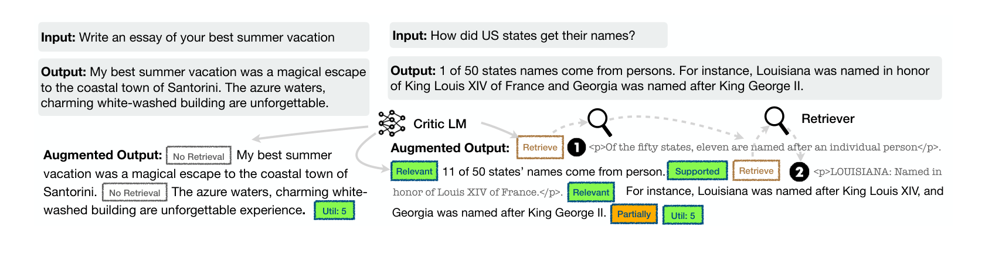
Stage 2: the critic labels 145k examples
Paper Figure 2: two training targets. Left: no retrieval needed. Right: the critic inserts Retrieve, passages, IsRel, IsSup and IsUse.
STEP 01
STEP 02
STEP 03
STEP 04
STEP 05
C predicts Retrieve for (x, y). No: add only IsUse, done.
Yes: retrieve with (x, y) as the query; split y into sentences (spaCy).
Per sentence: C says Yes / No / Continue. Yes: retrieve with (x, that sentence).
Per passage: C labels IsRel and IsSup. Keep the best relevant + supported one; if none, a random one.
C adds IsUse at the end. The answer text itself is never rewritten.
Notes:
[~60 s] Stage two, from the paper's Figure 2 and Algorithm 3. On the left, a creative prompt: the critic says No Retrieval, and only a utility token is added. On the right, a factual answer: the critic says Retrieve, the retriever finds passages, and the critic labels them Relevant and Supported, or Partially.
The five steps below are the full procedure. Two details matter. First, step 4: if no passage is both relevant and supported, a random passage is inserted anyway. So the generator also sees Irrelevant and No-support examples, and learns to say so honestly. Second, step 5: the answer text is never rewritten. The critic only inserts tokens and passages around the original answer. The generator learns how to annotate good answers, not new answer content.

Slide 12
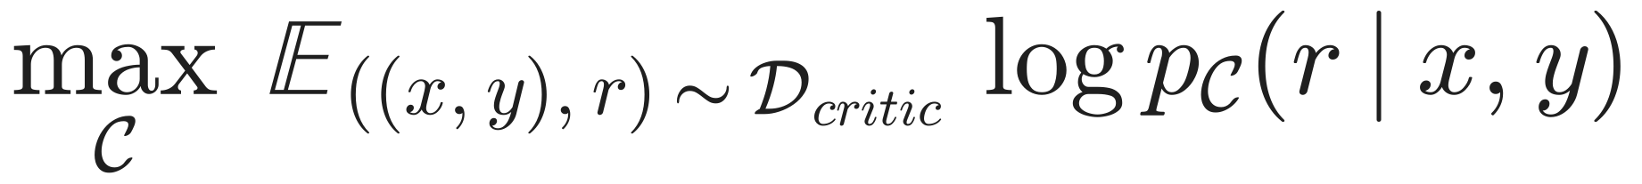
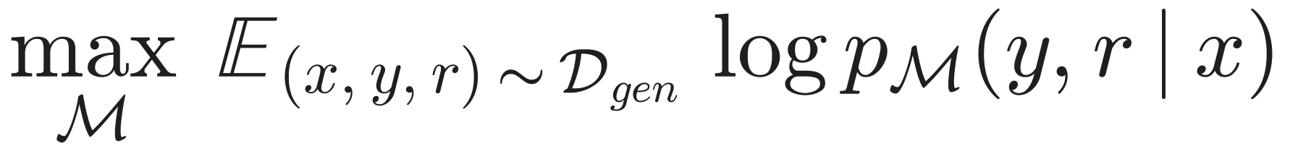
The two training objectives
Critic · Eq. 1
Generator · Eq. 2
A classifier written as language modelling: predict GPT-4's label r as text.
Writes the answer AND its critique, interleaved.
Why mask the passages?
They are inputs from the retriever, not model output
Predicting them would teach memorising Wikipedia, or making up passages
The model still attends to them, so it learns to use them
Why not RLHF / PPO?
PPO: about 4 models in memory and on-policy sampling
Self-RAG: 1 model, static corpus, cross-entropy loss
Behaviour is changed later at inference, without retraining
Notes:
[~45 s] These are the two objectives. Equation 1, the critic: maximise the log-probability of GPT-4's label given the input and output. It is a classifier written as language modelling.
Equation 2, the generator: maximise the log-probability of the answer and the reflection tokens together, interleaved, given the input.
Why not RLHF? PPO needs about four models in memory and fresh samples during training. Here we have one model, a fixed dataset, and cross-entropy. And behaviour can still be changed later, at inference, without retraining.

Slide 13
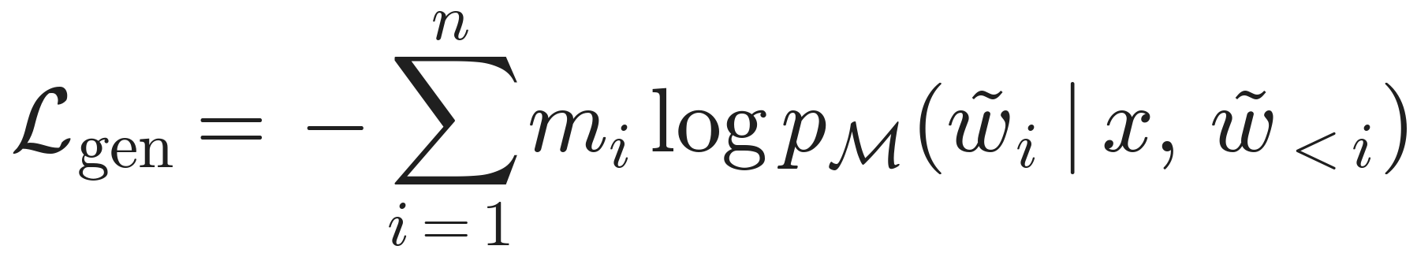
The generator loss, token by token
Ordinary next-token cross-entropy. The only change: tokens inside a retrieved passage get no loss.
One training sequence
[Retrieval]
<paragraph> The Walking Dead (season 7) ... premiered on October 23, 2016 ... </paragraph>
[Relevant]
October 23, 2016.
[Fully supported]
[Utility:5]
loss (m = 1)
masked (m = 0)
loss (m = 1)
loss (m = 1)
loss (m = 1)
loss (m = 1)
What changes in the model
Training recipe (App. A.2)
The vocabulary grows by the reflection tokens: new rows in the embedding and output matrices. The model still reads passages through attention; it just never learns to write them.
Llama2 7B / 13B, 3 epochs, batch size 128
Peak LR 2e-5, 3% warm-up, linear decay
Max length 2,048 (7B) / 1,524 (13B)
4× A100 80GB, DeepSpeed ZeRO-3, bf16, FlashAttention
Notes:
[~45 s] Equation 2 at the token level. It is the normal next-token loss with a mask: m equals zero for every token inside the retrieved passage and one otherwise.
The strip in the middle is one real training sequence. Green tokens get loss; the grey passage is masked.
Why mask the passage? The retriever supplies it at test time, so the model never needs to write it. Training on it would teach the model to memorise Wikipedia, or to invent passage-like text, which is exactly hallucination. The model still reads the passage through attention, so it learns to use it without learning to produce it.
The only architectural change is the bigger vocabulary. The training recipe on the right is from Appendix A.2.

Slide 14

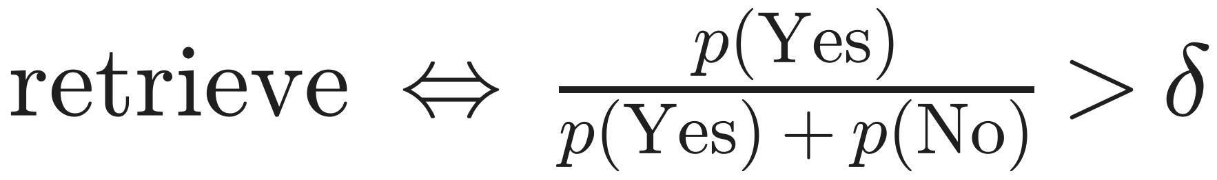
Inference, one sentence at a time
Probability of 'Yes' within the Yes/No group. Default δ = 0.2: retrieve even when 'No' is more likely. δ = 0 for ASQA, where citations are required.
STAGE 01
STAGE 02
STAGE 03
STAGE 04
STAGE 05
Retrieve?
Fetch K
K drafts
Critique
Keep best B
Check the threshold above. If no: write the sentence like a normal LM
R returns the top 5 passages for (x, previous sentence)
One candidate sentence per passage, in parallel, each after its IsRel token
IsSup for each (d, sentence) pair; IsUse for usefulness
Segment-level beam search, B = 2, ranked by the score f
Notes:
[~45 s] Inference goes one sentence at a time. At each sentence boundary we read the Retrieve token as the probability of Yes within Yes and No, and retrieve if that is above delta.
The default delta is 0.2, so the model retrieves even when No is more likely. For ASQA it is 0, because citations are required.
If it retrieves, it fetches five passages, writes one candidate sentence per passage in parallel, critiques each candidate, and keeps the best two partial answers. That is a beam search over sentences, with greedy decoding inside each sentence.

Slide 15
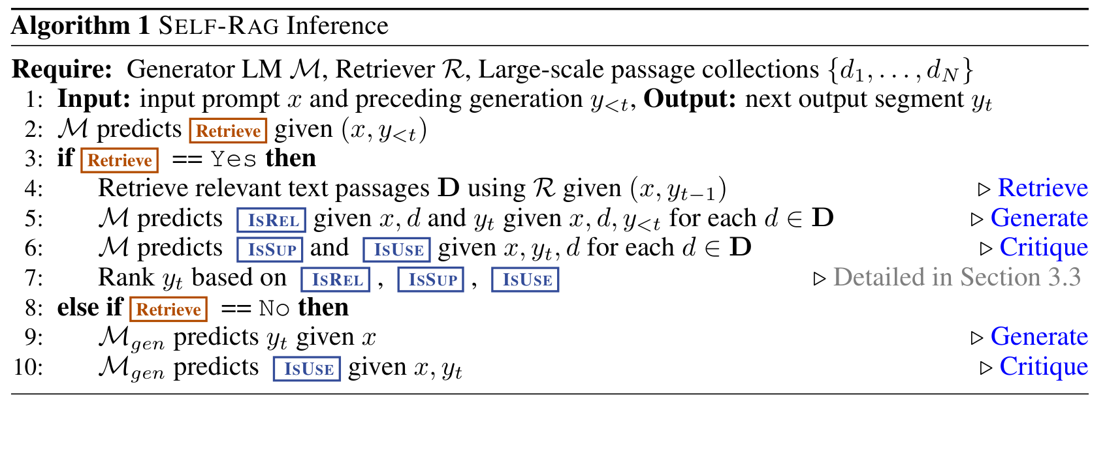
Algorithm 1, line by line
Lines 2–3: decide
Retrieve is read as P(Yes) / (P(Yes) + P(No)) > δ, not argmax. Default δ = 0.2.
Line 4: retrieve
Query = (x, previous segment). Top-5 passages from Contriever-MS MARCO.
Lines 5–7: draft, judge, rank
Cost and special cases
One draft per passage, in parallel. IsRel before the draft; IsSup and IsUse after. Rank by the score f.
Up to B × K = 2 × 5 = 10 segment drafts per retrieval step, run in parallel with vLLM
Greedy decoding inside a segment, beam search over segments
PubHealth / ARC: scores are summed per answer option; best option wins
The paper reports no wall-clock latency
Lines 8–10: no retrieval
Works like a normal LM; still predicts IsUse.
Notes:
[~45 s] This is the paper's Algorithm 1, so you can map each line. Lines 2 and 3: predict Retrieve; in practice the threshold from the previous slide, not the argmax. Line 4: retrieve passages using the question and the previous segment. Line 5: for each passage, predict IsRel, then the segment. Lines 6 and 7: predict IsSup and IsUse, and rank the candidates; the ranking formula is on the next slide. Lines 8 to 10: with no retrieval, it is just a normal language model.
The cost is real: up to two beams times five passages, so ten drafts per retrieval step. They run in parallel with vLLM, but the paper reports no latency numbers. For PubHealth and ARC, the scores are summed per answer option and the best option wins.

Slide 16
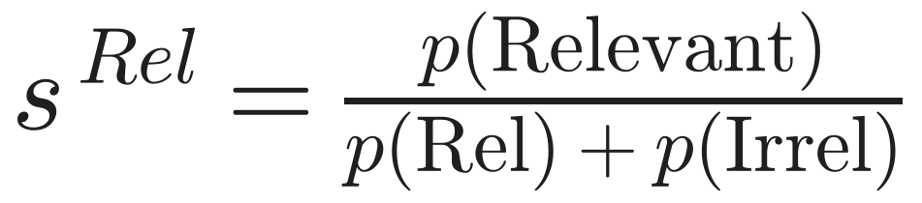
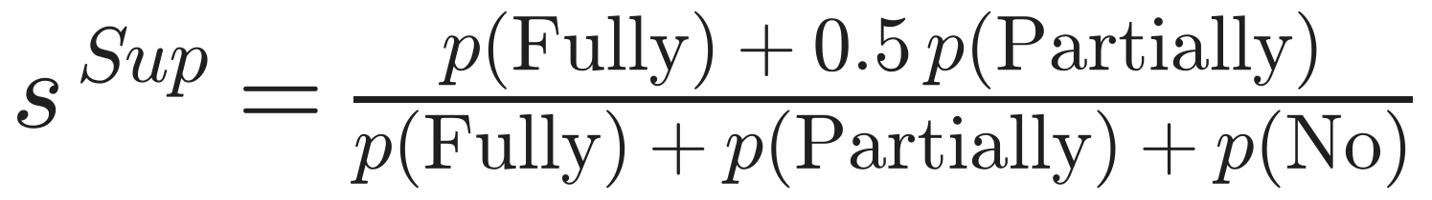
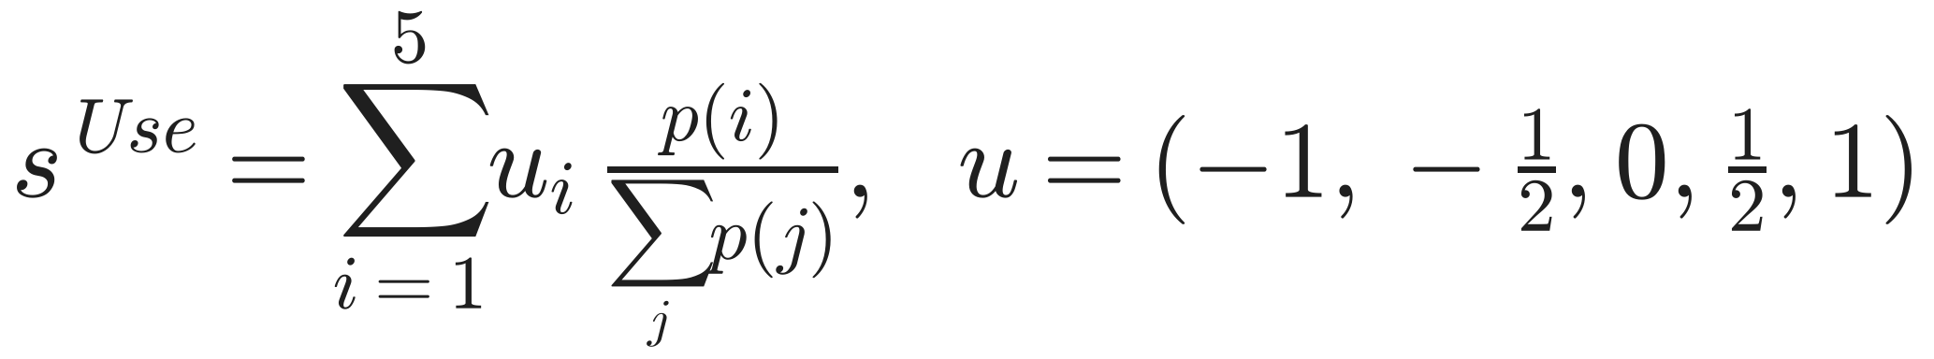
Scoring a candidate sentence
Worked example
(illustrative numbers)
 | d1: states named after people | d2: baby names in Texas
Fluency p(yt) | 0.60 | 0.70
s Rel | 0.90 | 0.20
s Sup | 0.80 | 0.25
s Use | 0.57 | 0.33
Score f | 2.59 (chosen) | 1.31
Defaults: w = (1, 1, 0.5)
Expected value of each critique, in a fixed range
Hard mode: drop any candidate with IsSup = No support
Likelihood alone would pick d2, a fluent sentence built on an off-topic passage. The critique terms pick the grounded d1.
Notes:
[~60 s] This is how a candidate sentence is scored: Equations 3 and 4. The first term is the sentence's own probability, how fluent it is. Then we add a weighted sum of critique scores.
Each score is an expected value under the renormalised token distribution. s-Rel is the probability of Relevant. s-Sup gives Fully 1, Partially a half and No 0. s-Use maps the 1-to-5 rating onto minus 1 to plus 1. Default weights are 1, 1 and 0.5.
The worked example uses the US-states prompt from Figure 1, with illustrative probabilities. Passage d2, about baby names, gives a slightly more fluent sentence: 0.70 versus 0.60. But after the critique terms, d1 scores 2.59 against 1.31. Likelihood alone would pick the off-topic sentence; the critique terms pick the grounded one. With all weights at zero, we are back to plain likelihood ranking.

Slide 17

Decomposition
Retrieve if useful
4 small, separately supervised decisions instead of one hard one
Essays and maths stay a normal LM, so versatility is kept
Why it
works
Generate + verify
Cheap critique
Checking a sentence against one passage is easier than writing a correct one
Learned offline with SFT: no RL, no reward model at test time
One passage each
RLHF in disguise
No mixing of noisy passages: bad ones are scored down
Like π* = π_ref · exp(reward / β) / Z: changing w changes the reward, no retraining
Notes:
[~45 s] Why does this work? First, decomposition: four small, separately supervised decisions instead of one hard one. Second, verifying is easier than generating: checking a sentence against one passage is easier than writing a correct one. Third, one passage per candidate, so noisy passages are never mixed and bad ones are scored down. Fourth, retrieval only when useful, so essays and maths stay normal. Fifth, the critique is cheap: learned offline with supervised learning, with no reward model at test time.
Sixth, mathematically it resembles RLHF. The optimal RLHF policy is the reference policy reweighted by exp of the reward. Self-RAG reranks candidates by likelihood plus a critique reward, so changing the weights is like choosing a different reward, without retraining.

Slide 18

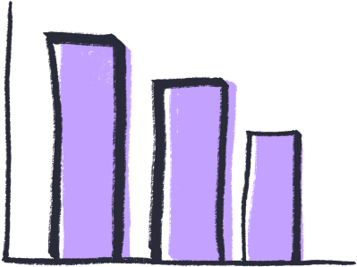

Experimental setup
Closed-set
Short-form QA
Long-form
PubHealth: health-claim fact check
ARC-Challenge: science multiple choice
Metric: accuracy
PopQA long-tail: 1,399 rare-entity questions
TriviaQA: 11,313 questions
Metric: gold answer appears in the output
Biographies: FactScore (% of atomic facts supported)
ASQA: correctness, fluency (MAUVE), citation precision and recall
Baselines No retrieval: Llama2, Alpaca, Llama2-chat, ChatGPT, CoVE-65B · Standard RAG: the same models + the same passages · Same data, no reflection: Llama2-FT · Retrieval-trained: SAIL, Toolformer
Settings Llama2 7B / 13B · 150k training pairs · Contriever-MS MARCO top-5 (+5 web results for Bio and QA) · zero-shot · δ = 0.2, B = 2, w = (1, 1, 0.5)
Notes:
[~40 s] Now the experiments. Six tasks in three families, all zero-shot. Closed-set: PubHealth and ARC-Challenge. Short-form QA: PopQA's rare entities and TriviaQA. Long-form: biographies, and ASQA, which needs citations.
The baselines come in four groups. The two that matter most are standard RAG, which is the same models with the same passages, and Llama2-FT, which is trained on the same 150 thousand examples but without reflection tokens. Llama2-FT tells us whether the gains come from the data or from the method.

Slide 19
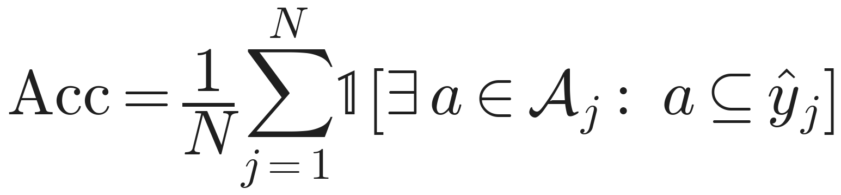
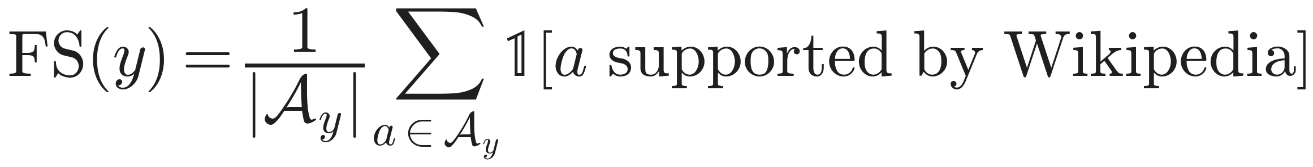
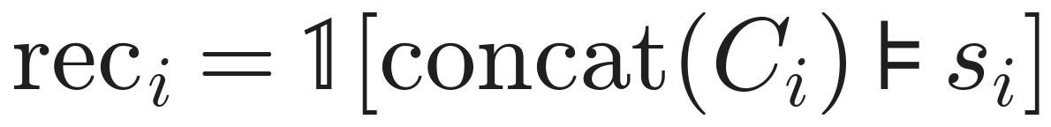
What each metric measures
PopQA, TriviaQA: match accuracy
Bio: FactScore
Correct if any gold alias appears in the output. Caveat: a long answer can match by luck.
Split the bio into atomic facts; check each against Wikipedia. Precision, not coverage: short bios score well.
ASQA: citation recall, precision
ASQA: fluency and correctness
Judged by an NLI model (TRUE, T5-11B). Recall: is the claim backed? Precision: is every citation needed?
MAUVE: how close model text is to human text (1 = same). str-em: share of short gold answers found in the output.
Notes:
[~50 s] Before the results, here is what each number means. PopQA and TriviaQA count an answer correct if any gold alias appears in the output; a long answer can get lucky.
FactScore splits a biography into atomic facts and checks each against Wikipedia. It measures precision, so short bios do well.
ASQA citations are judged by an NLI model. Recall asks whether a statement is entailed by its citations. Precision asks whether each citation is actually needed: a citation is irrelevant if it does not support the statement alone and removing it changes nothing.
MAUVE compares the distribution of model text with human text; 1 means identical. str-em is the share of short gold answers that appear in the output.

Slide 20
Main results
Best open model on all six tasks
Beats ChatGPT on PopQA, PubHealth, Bio and citation precision
Not everywhere: ChatGPT without retrieval still wins TriviaQA (74.3) and ARC (75.3)
Same data is not enough: Llama2-FT trails, so the gain comes from the framework
Source: Table 2. Ret-ChatGPT has no Bio score.
Notes:
[~50 s] The headline results. Self-RAG 13B is the best open model on all six tasks.
Against ChatGPT the picture is mixed. Self-RAG wins on PopQA, PubHealth, biographies and citation precision, but loses on TriviaQA, ARC and ASQA correctness. We want to be precise here, because the abstract is a little generous.
The key control is Llama2-FT: same data, same retrieval at test time, and it is far behind: 64.3 versus 72.4 on PubHealth, and 5 versus 67 on citation precision. So the gain comes from the framework, not the data.

Slide 21
Table 2 in full
Model | Size | PopQA | TQA | PubHealth | ARC-C | Bio FS | ASQA em | rouge | MAUVE | prec | rec
LMs with proprietary data
Llama2-chat | 13B | 20.0 | 59.3 | 49.4 | 38.4 | 55.9 | 22.4 | 29.6 | 28.6 | – | –
Ret-Llama2-chat | 13B | 51.8 | 59.8 | 52.1 | 37.9 | 79.9 | 32.8 | 34.8 | 43.8 | 19.8 | 36.1
ChatGPT |  | 29.3 | 74.3 | 70.1 | 75.3 | 71.8 | 35.3 | 36.2 | 68.8 | – | –
Ret-ChatGPT |  | 50.8 | 65.7 | 54.7 | 75.3 | – | 40.7 | 39.9 | 79.7 | 65.1 | 76.6
Perplexity.ai |  | – | – | – | – | 71.2 | – | – | – | – | –
Baselines without retrieval
Llama2 | 7B | 14.7 | 30.5 | 34.2 | 21.8 | 44.5 | 7.9 | 15.3 | 19.0 | – | –
Alpaca | 7B | 23.6 | 54.5 | 49.8 | 45.0 | 45.8 | 18.8 | 29.4 | 61.7 | – | –
Llama2 | 13B | 14.7 | 38.5 | 29.4 | 29.4 | 53.4 | 7.2 | 12.4 | 16.0 | – | –
Alpaca | 13B | 24.4 | 61.3 | 55.5 | 54.9 | 50.2 | 22.9 | 32.0 | 70.6 | – | –
CoVE* | 65B | – | – | – | – | 71.2 | – | – | – | – | –
Baselines with retrieval
Toolformer* | 6B | – | 48.8 | – | – | – | – | – | – | – | –
Llama2 | 7B | 38.2 | 42.5 | 30.0 | 48.0 | 78.0 | 15.2 | 22.1 | 32.0 | 2.9 | 4.0
Alpaca | 7B | 46.7 | 64.1 | 40.2 | 48.0 | 76.6 | 30.9 | 33.3 | 57.9 | 5.5 | 7.2
Llama2-FT | 7B | 48.7 | 57.3 | 64.3 | 65.8 | 78.2 | 31.0 | 35.8 | 51.2 | 5.0 | 7.5
SAIL* | 7B | – | – | 69.2 | 48.4 | – | – | – | – | – | –
Llama2 | 13B | 45.7 | 47.0 | 30.2 | 26.0 | 77.5 | 16.3 | 20.5 | 24.7 | 2.3 | 3.6
Alpaca | 13B | 46.1 | 66.9 | 51.1 | 57.6 | 77.7 | 34.8 | 36.7 | 56.6 | 2.0 | 3.8
Ours
Self-RAG | 7B | 54.9 | 66.4 | 72.4 | 67.3 | 81.2 | 30.0 | 35.7 | 74.3 | 66.9 | 67.8
Self-RAG | 13B | 55.8 | 69.3 | 74.5 | 73.1 | 80.2 | 31.7 | 37.0 | 71.6 | 70.3 | 71.3
Yellow = best non-proprietary score per column. Green = Self-RAG. * = number copied from the original paper.
Notes:
[~40 s] This is the full Table 2 for reference; we won't read it out. Yellow marks the best non-proprietary score in each column, and the Self-RAG rows are green.
Three things to take from it. One: Self-RAG has the best open score in every column except ASQA exact match, where Alpaca-13B with retrieval is higher, 34.8 versus 31.7. Two: retrieval helps the baselines a lot on PopQA and Bio, but not on PubHealth. Three: look at the last two columns. Every open RAG baseline has citation precision and recall below 8 percent, except Llama2-chat at 20 and 36. Self-RAG is at 67 to 71, in ChatGPT's range.

Slide 22
Retrieval helps some tasks, hurts others
+31.8
Llama2-chat-13B on PopQA: rare facts can be copied from a passage
-15.4
ChatGPT on PubHealth: claim checking needs reasoning, and passages distract
So: decide per query
That is the Retrieve token. Self-RAG never retrieving: PopQA 45.5 → 24.7, but PubHealth 73.5 → 73.0 (Fig. 3a).
Notes:
[~45 s] This chart takes Table 2 and computes how many points retrieval adds for each baseline. On PopQA every model gains 20 to 30 points, because the answer can be copied straight out of a passage.
On PubHealth the gains vanish or turn negative: ChatGPT loses 15.4 points and Alpaca-7B loses 9.6. ARC is mixed and mostly small. These tasks need reasoning, and irrelevant passages distract. ChatGPT even loses 8.6 points on TriviaQA.
This is the paper's argument for deciding retrieval per query. Self-RAG's own ablation agrees: switching retrieval off costs 21 points on PopQA but only half a point on PubHealth.

Slide 23
Citations and grounding
Answers from memory
Of the correct PopQA / TriviaQA answers, how many are NOT in the retrieved passages? (App. C.1)
2%
15–20%
Self-RAG
Alpaca, Llama2-chat
Short but precise
Bio FactScore: 7B (81.2) beats 13B (80.2) because it writes shorter, fully grounded bios. With an irrelevant passage, Self-RAG says IsRel = Irrelevant instead of bluffing.
Notes:
[~45 s] Two views of grounding. On the left, ASQA citation precision and recall. Every open RAG baseline sits between 2 and 8 percent. Llama2-chat with retrieval reaches 20 and 36. Self-RAG reaches 67 to 71: comparable to ChatGPT with retrieval, and above it on precision, though below it on recall.
On the right, from Appendix C.1: among correct answers on PopQA and TriviaQA, how many are not found in the retrieved passages, so they came from memory? About 2 percent for Self-RAG, versus 15 to 20 percent for Alpaca and Llama2-chat. Self-RAG's correct answers are traceable to evidence.
One more detail: on biographies the 7B model beats 13B, because it writes shorter but fully grounded bios.

Slide 24
Ablations: every piece matters
7B, 50k training examples | PopQA | PubHealth | ASQA em
Self-RAG (full) | 45.5 | 73.5 | 32.1
Train: no retriever | 43.6 | 67.8 | 31.0
Train: no critic | 42.6 | 72.0 | 18.1
Test: never retrieve | 24.7 | 73.0 | –
Test: hard threshold | 28.3 | 72.6 | –
Test: always top-1 passage | 41.8 | 73.1 | 28.6
Test: drop IsSup score | 44.1 | 73.2 | 30.6
Test-time knobs (no retraining)
w Sup 0 → 2
citation precision 69.7 → 70.5, but MAUVE fluency 96 → 86
δ up
fewer retrievals; costs PopQA much more than PubHealth
5k → 150k data
PopQA about 34 → 55 and still rising
No critic → ASQA collapses: reflection tokens are the core
No retrieval hurts PopQA, not PubHealth: needs differ by task
Hard threshold retrieves too rarely: δ is a crucial knob
Human check
IsRel judged correct 90–95%, IsSup 85–90%
Notes:
[~60 s] Ablations, using a 7B model trained on 50 thousand examples for speed.
Training side: removing the critic, meaning always the top passage and no reflection tokens, similar to SAIL, collapses ASQA from 32.1 to 18.1. That is the single biggest drop, so the reflection tokens are the core of the method.
Test side: never retrieving costs 21 points on PopQA and almost nothing on PubHealth. Hard constraints, retrieving only when Yes is the argmax, retrieves too rarely and drops PopQA to 28.3, so the soft threshold matters. Always using the top-1 passage, which is standard RAG, loses about 3.5 points. Dropping IsSup mainly hurts long-form ASQA.

Slide 25
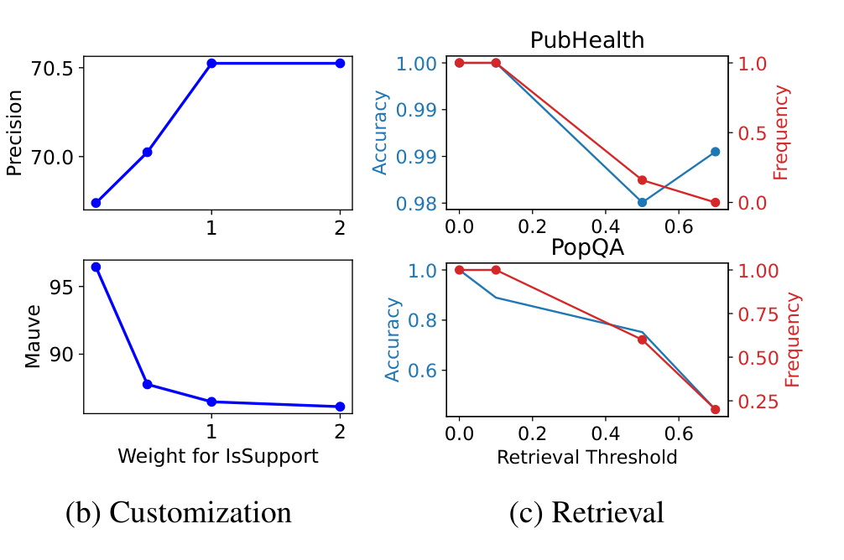
Test-time knobs (Figure 3b, 3c)
3b: weight on IsSup
w Sup 0 → 2: citation precision about 69.7 → 70.5, MAUVE fluency about 96 → 86.
More weight on support = safer citations but less fluent text. You pick the point at inference.
3c: retrieval threshold δ
Higher δ = fewer retrievals.
PubHealth: accuracy barely moves even at 0% retrieval. PopQA: accuracy falls with retrieval frequency.
So cost can be traded for accuracy per task.
Paper Figure 3 (b) and (c). In (c), accuracy is normalised to the best setting.
Notes:
[~45 s] The paper's Figure 3b and 3c show the test-time knobs.
In 3b, raising the weight on IsSup from 0 to 2 raises citation precision from about 69.7 to 70.5, but MAUVE fluency falls from about 96 to 86. Longer, more fluent text contains more claims that are not fully backed. It is a precision-versus-fluency trade-off, and you choose the point at inference time.
In 3c, raising delta lowers how often the model retrieves. On PubHealth, accuracy barely moves even when retrieval drops to zero. On PopQA, accuracy falls together with retrieval. So you can trade cost for accuracy per task, without retraining.

Slide 26
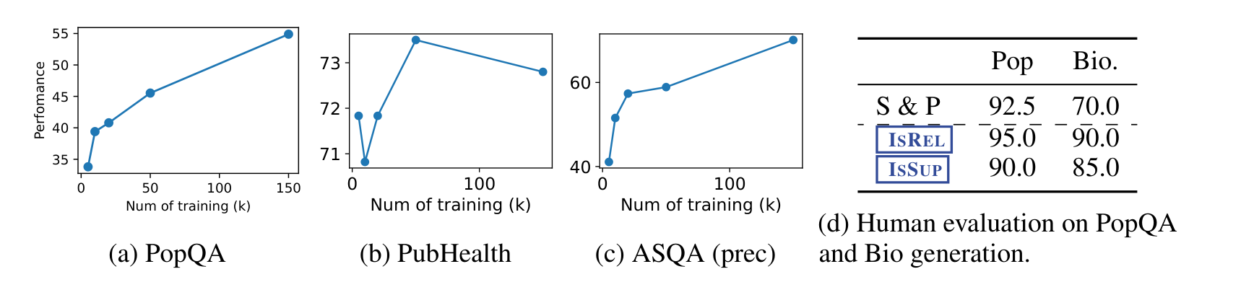
More data, and a human check (Figure 4)
(a) PopQA
(b) PubHealth
(c) ASQA precision
(d) Human check
About 34 → 55 from 5k to 150k examples, still rising.
Flat, about 71 to 73.5: this task needs little retrieval skill.
About 41 → 70, still rising. More data would likely help.
50 samples each. Supported and plausible: 92.5% PopQA, 70% Bio. IsRel right 95 / 90%, IsSup 90 / 85%.
The paper notes Llama2-FT shows no comparable gain from 50k to 150k examples: more data helps because of the reflection tokens.
Notes:
[~45 s] Figure 4. Panels a to c train the 7B model on 5 to 150 thousand examples. PopQA rises from about 34 to 55 and ASQA citation precision from about 41 to 70, both still rising, so more data would likely help. PubHealth stays roughly flat. The paper also notes that Llama2-FT does not improve comparably from 50k to 150k, which again points to the framework.
Panel d is a human check on 50 samples per dataset. 92.5 percent of PopQA outputs and 70 percent of biographies are supported and plausible, and humans agree with the model's own IsRel and IsSup labels 85 to 95 percent of the time. The caveat: 50 samples is small.

Slide 27
Critical analysis
Strengths
Limitations
Assumptions
Improvements
No RL: SFT + reranking
Tunable at test time (δ, w)
Per-sentence citations with self-labels
Strong controls: Llama2-FT, ablations
Every label traces back to GPT-4
Critic errors become training targets
Frozen retriever: detects bad passages, cannot fix them
Up to B·K = 10 drafts per step; latency not reported
One sentence ← one passage
GPT-4 judgments match human ones
The corpus contains the facts
Token probabilities can simply be added
Re-query when every IsRel is low
Learn or calibrate w on a dev set
Let a sentence use several passages
Preference training (DPO) on critique pairs
Notes:
[~60 s] Our critical view. Strengths: no reinforcement learning, just supervised training plus reranking; behaviour is tunable at test time; every sentence comes with a citation and a self-assessed support label; and the controls, Llama2-FT and the ablations, are strong.
Limitations: every label traces back to GPT-4, checked on only 20 examples per type. The critic's errors, 80 percent accuracy on IsRel and 73.5 on IsUse, become training targets. The retriever is frozen, so the model can detect a bad passage but cannot fix it by searching again. And cost: up to ten drafts per step, with no latency reported.
Assumptions: one sentence comes from one passage, and probabilities from different token groups can simply be added. Improvements we would suggest: re-query when every IsRel is low, learn the weights on a dev set, let a sentence use several passages, or use preference training on critique pairs.

Slide 28

Impact
2020
2023
2024
2024
2025
RAG
Self-RAG
CRAG, Adaptive-RAG
Agentic RAG
Search as a tool
Lewis et al.: retrieval as a latent variable, always on
Retrieval on demand + self-critique tokens (ICLR 2024)
Grade documents, fall back to web search; route queries by difficulty
LangGraph / LlamaIndex recipes: retrieval, hallucination and answer 'graders' = IsRel / IsSup / IsUse
Assistants decide when to search and cite; RL-trained search-and-reason models
Lasting idea: special tokens as an interface for control and self-evaluation, and test-time reranking instead of retraining.
Notes:
[~40 s] Impact. Self-RAG sits between the 2020 RAG paper, which always retrieves, and today's systems. Follow-ups such as Corrective RAG grade the retrieved documents and fall back to web search, which fixes the frozen-retriever limitation; Adaptive-RAG routes queries by difficulty.
LangGraph and LlamaIndex ship Self-RAG recipes in which an LLM plays retrieval, hallucination and answer 'graders': the same roles as IsRel, IsSup and IsUse. Modern assistants decide when to search and cite.
The lasting idea: special tokens as an interface for control and self-evaluation, and reranking at test time instead of retraining.

Slide 29

Team Contribution
Student | Contribution | Score | Main work
[Student A] | [Equal / Partial] | [1.0] | [e.g. problem & motivation, slides 2–5]
[Student B] | [Equal / Partial] | [1.0] | [e.g. method & equations, slides 6–17]
[Student C] | [Equal / Partial] | [1.0] | [e.g. experiments, slides 18–26]
[Student D] | [Equal / Partial] | [1.0] | [e.g. critique & impact, slides 27–28]
Scores reflect actual relative contribution (preparation, understanding, slides, presentation), as the rubric requires.
Notes:
[~15 s] This is our team contribution, as the rubric requires. [Each member says one sentence about what they did.]

Slide 30
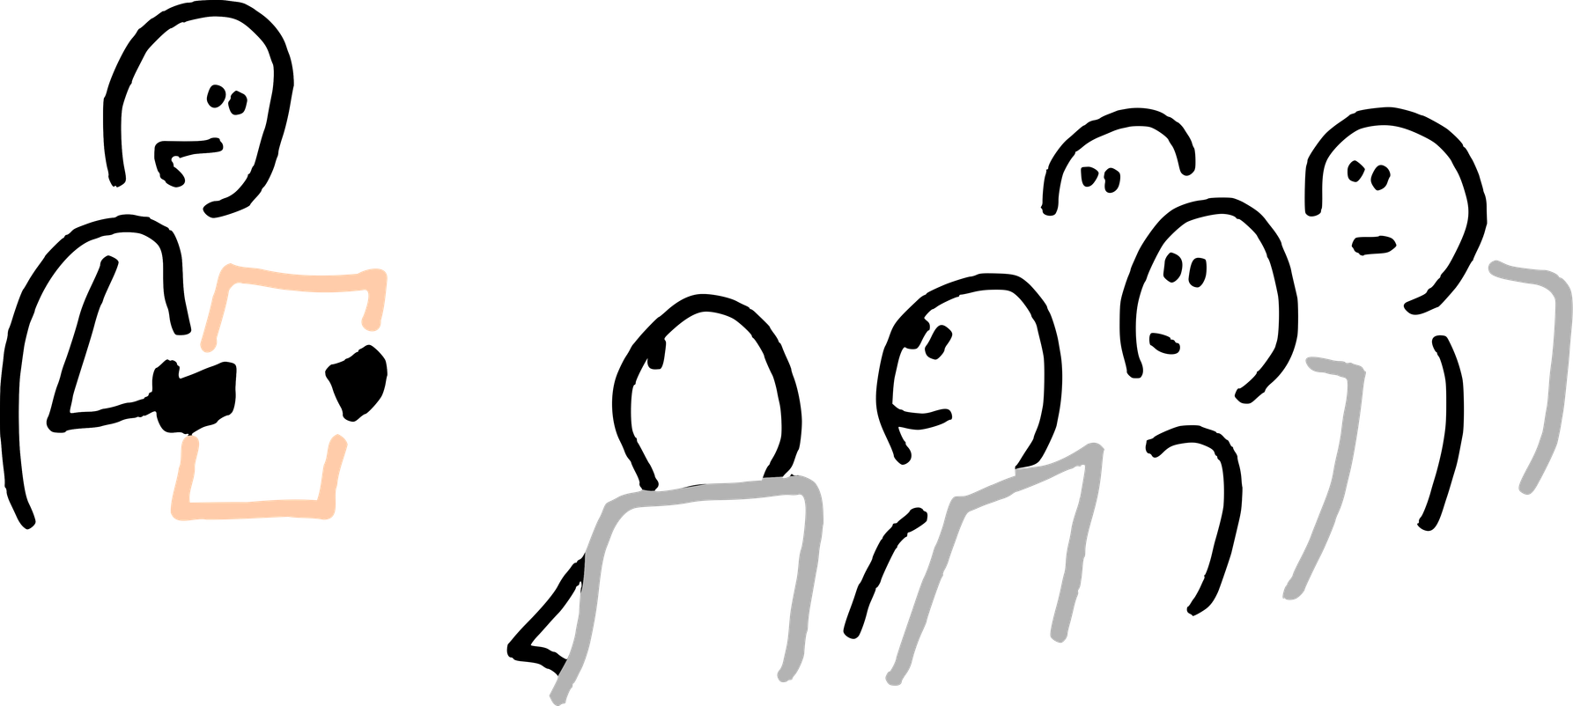
Thank you!
Questions?
Paper: arxiv.org/abs/2310.11511
Code and models: selfrag.github.io
Notes:
[~10 s] Thank you. We are happy to take questions.
[Prep, not to read aloud. Likely questions: Why mask the passages? Why a separate critic instead of GPT-4 directly? What do Equations 3 and 4 mean? Why delta = 0.2? What happens without the critic (ASQA 32.1 to 18.1)? Is the gain from data or framework (Llama2-FT)? Biggest limitation? How does this relate to modern LLMs? The two backup slides cover data and settings.]

Slide 31
Backup: the training data (Table 3)
145,619
examples in total (the paper rounds to 150k)
92,008 instruction-following
53,611 knowledge-intensive
Same pairs train Llama2-FT, minus tokens and passages
Fair Q&A point
ARC-Easy and ASQA training data are related to the ARC-Challenge and ASQA test sets, so these two tasks are not fully out-of-domain.
Notes:
[Backup] Backup for Q&A. This is Table 3, the generator's training data: 145,619 examples, which the paper rounds to 150 thousand. About 92 thousand are instruction-following, from Open-Instruct: GPT-4 Alpaca, Stanford Alpaca, FLAN-V2, ShareGPT and Open Assistant. About 54 thousand are knowledge-intensive: Wizard of Wikipedia, Natural Questions, FEVER, OpenBookQA, ARC-Easy and ASQA. The knowledge-intensive part is what teaches retrieval and citation.
A fair point if asked: ARC-Easy and ASQA training data are related to the ARC-Challenge and ASQA test sets, so those two tasks are not fully out-of-domain.

Slide 32
Backup: settings to know for Q&A
Setting | Value (paper §4.2, App. A.2, B.2)
Retriever | Contriever-MS MARCO, frozen. Top-5 Wikipedia passages (2018 dump; Dec 2020 for PopQA)
Extra evidence | +5 Google Programmable Search results for Bio and open QA; ASQA: GTR-XXL top-5 for every system
Retrieval threshold | δ = 0.2 by default; δ = 0 for ASQA (citations required)
Critique weights | w Rel = 1.0, w Sup = 1.0, w Use = 0.5
Decoding | Beam of 2 over segments, greedy inside a segment, vLLM
Max new tokens | 100 open QA, 50 closed-set, 200 per segment for Bio, 100 for ASQA baselines
Critic | Llama2-7B; GPT-4 labels at temperature 1, max 200 tokens
Training data creation | Up to 10 retrieved documents per input
Hardware | Training 4× A100 80GB; inference 1–2 Quadro RTX 6000 24GB
Notes:
[Backup] Backup for Q&A: the exact settings, from Section 4.2 and Appendices A.2 and B.2. Use this slide if someone asks how many passages, which thresholds or weights, or what hardware was used.

