Slide 1





Self-RAG
Learning to Retrieve, Generate, and Critique through Self-Reflection
Akari Asai, Zeqiu Wu, Yizhong Wang, Avirup Sil, Hannaneh Hajishirzi
University of Washington · Allen Institute for AI · IBM Research AI
ICLR 2024 · arXiv 2310.11511
CS613 · Paper Presentation
Presented by: [Team member names]

Slide 2

Roadmap
1 · Background & problem
5 · Critical analysis
LMs as distributions, retrieval, RAG, why plain RAG fails, prior work
Strengths, limitations, is the evidence sufficient?, improvements
2 · Core idea
6 · Impact
Reflection tokens, what is new, comparison with RAG variants
Follow-up work and modern LLM systems
3 · Method
7 · Wrap-up
Formalisation, critic + generator training, inference maths, cost, why it works
Takeaways, team contribution, references, Q&A
4 · Experiments
Backup
Tasks, metrics, baselines, full results, ablations, analyses
Q&A bank, GPT-4 prompts, evaluation details
Self-RAG · Introduction
2

Slide 3

01
Background & problem
Language models as probability distributions
Parametric vs non-parametric knowledge
Retrieval: sparse and dense
RAG formulations and their failure modes
Prior work and the gap Self-RAG fills
3

Slide 4
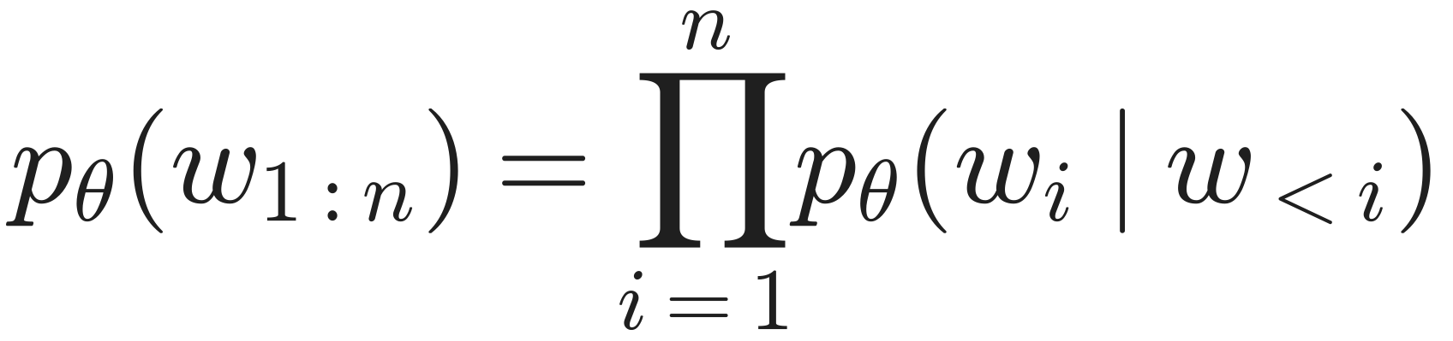
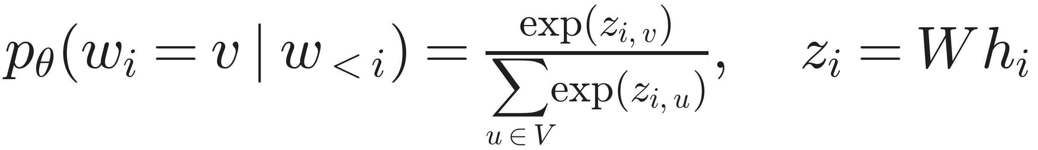
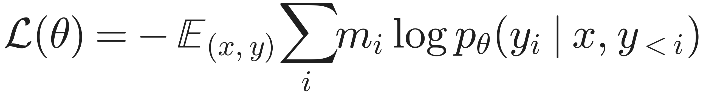
Language models are probability distributions
Chain rule (exact)
Teacher forcing: the model always conditions on the gold prefix, so one forward pass gives the loss at every position.
Pre-training: NLL on web text gives a text continuer (Llama2-7B).
Instruction tuning (SFT): NLL on (instruction, response) pairs gives an assistant (Alpaca). Self-RAG's generator is plain SFT on a special corpus.
RLHF: train a reward model r, then maximise E[r] − β·KL(π || π_ref) with PPO (ChatGPT, Llama2-chat). Self-RAG borrows the learned critic but avoids RL.
Prompt as prefix: conditional generation p(y | x) just treats x as the first part of the sequence.
Softmax over the vocabulary
Training: masked NLL
m_i (0 or 1) chooses which positions are trained. Instruction tuning masks the prompt; Self-RAG also masks retrieved passages.
Self-RAG · Background & problem
4

Slide 5



Where does an LM keep its knowledge?
Parametric memory: facts stored implicitly in θ. Fixed after training, no source, costly to update.
Non-parametric memory: an external corpus (e.g. Wikipedia split into ~100-word passages). Updatable, inspectable, citable.
Hallucination: fluent, confident, false output. The model samples what is plausible, not what is true.
Long tail: rare entities appear in few training examples, so probability spreads over plausible wrong answers (Mallen et al. 2023).
no retrieval
with retrieval
14.7%
45.7%
Llama2-13B on PopQA long-tail (1,399 questions about entities with <100 monthly Wikipedia views). Paper Table 2.
Retrieval matters most exactly where the model is weakest.
Self-RAG · Background & problem
5

Slide 6
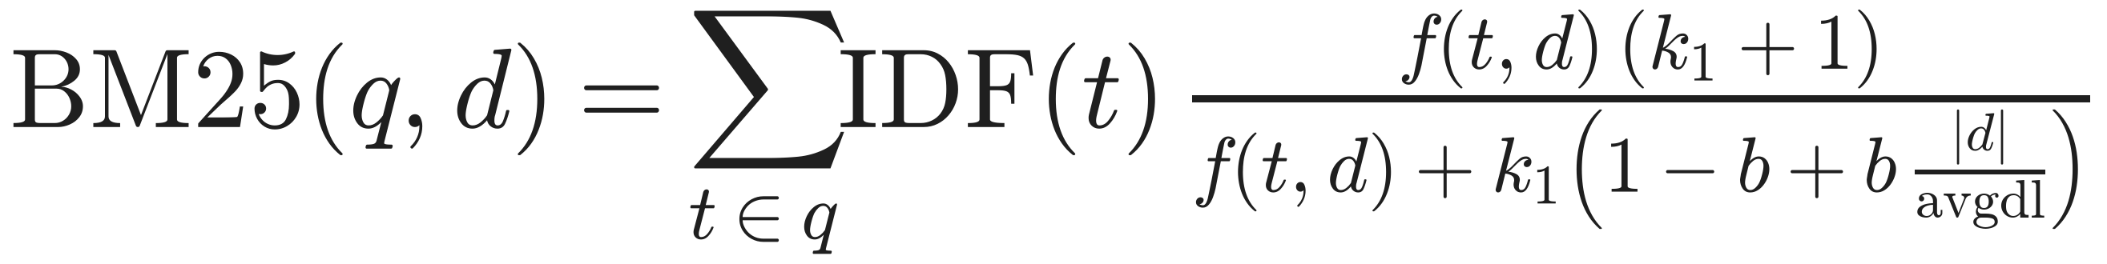
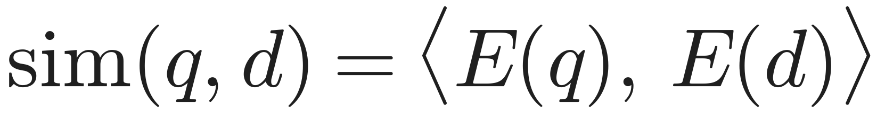
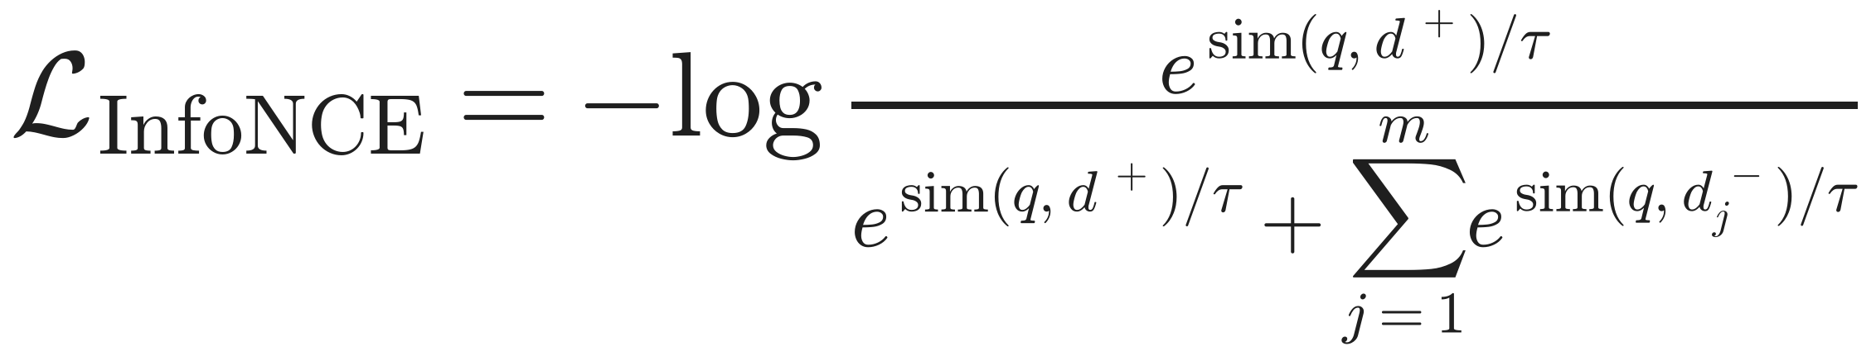
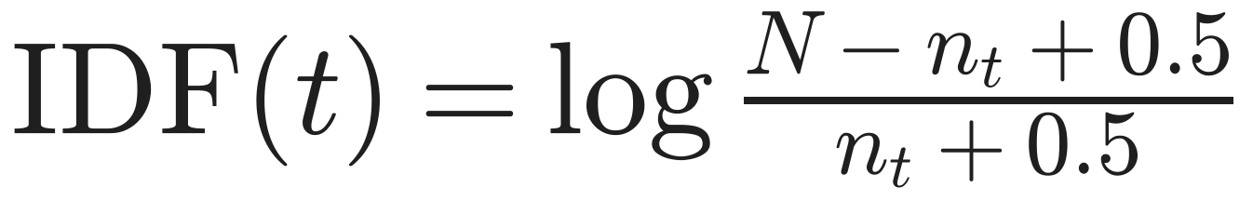
Retrieval: sparse vs dense
Sparse: BM25
Dense: bi-encoder (Contriever)
Exact word overlap; rare terms count more
k1 about 1.2 (saturation), b about 0.75 (length normalisation)
Misses synonyms and paraphrases
Passages embedded offline; search = maximum inner product search (FAISS) over ~21M passages
Contriever: contrastive pre-training on random crops (no labels), then MS MARCO fine-tuning
Self-RAG uses Contriever-MS MARCO, top-5 (up to 10 in training)
Key fact: Self-RAG never trains the retriever. R is frozen and off-the-shelf; all judgment of relevance happens inside the LM, after retrieval.
Self-RAG · Background & problem
6

Slide 7

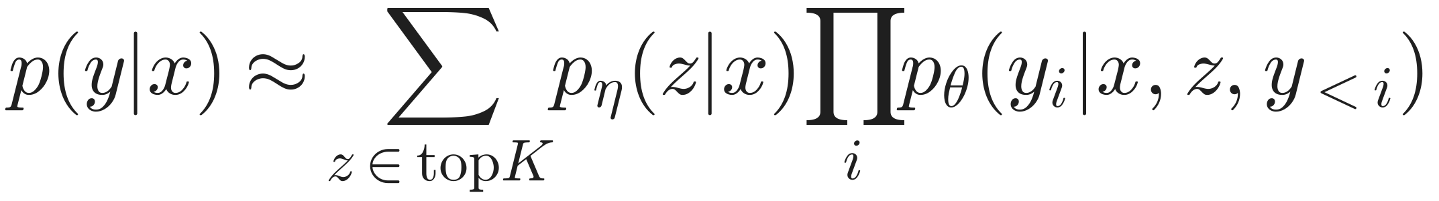
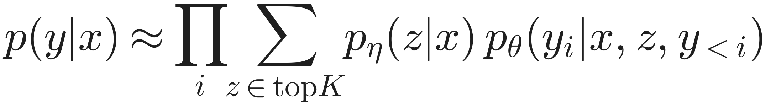
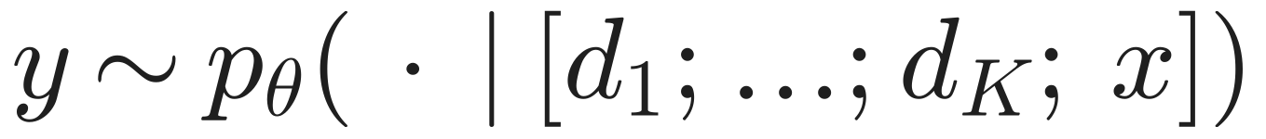
Retrieval-augmented generation: three formulations
Query x
Retriever R
Top-K passages
Language model
Answer y
p_η(z | x) ∝ exp⟨E(z), E(x)⟩ is the retriever's distribution over passages; p_θ is the generator.
RAG-Sequence (Lewis 2020)
RAG-Token (Lewis 2020)
In-context RALM (Ram 2023)
One passage explains the whole answer; marginalise over passages weighted by the retriever. Trained end-to-end.
Marginalise per token: different tokens can draw on different passages.
Concatenate the K passages before the prompt. No training. Used by the Ret-ChatGPT / Ret-Llama2-chat baselines.
Self-RAG · Background & problem
7

Slide 8



Why plain RAG falls short
Always retrieves
Irrelevant passages
No grounding check
Top-K passages for every prompt, even 'write an essay about your summer'. Wastes compute and derails creative or reasoning tasks.
The retriever's top hit can be off-topic; LMs are easily distracted by irrelevant context (Shi et al. 2023).
Nothing makes the output follow the passages and nothing checks it afterwards; models are not trained to use the evidence.
Ret-ChatGPT on PubHealth: 70.1 → 54.7
Alpaca-13B on PubHealth: 55.5 → 51.1 with retrieval
Open RAG models on ASQA: 2–8% citation precision
Formally: retrieval helps only if E[quality | retrieve] > E[quality | no retrieve], and that depends on x and on what has been written so far (y<t). A fixed 'always retrieve K' policy cannot capture this.
Self-RAG · Background & problem
8

Slide 9
Prior work (1/2): when and what to retrieve
Method | Idea | Gap that Self-RAG targets
FLARE / Active RAG (Jiang 2023) | Retrieve when the next sentence has low-probability tokens; prompts a proprietary LLM | Heuristic trigger; no relevance or support judgment
Toolformer (Schick 2023) | Self-supervised learning of API calls (e.g. Wikipedia search) | Learns to call tools, not to judge what comes back
SAIL (Luo 2023) | Instruction-tune with top retrieved passages prepended | Always retrieves; indiscriminate
RA-DIT (Lin 2023) | Dual instruction tuning of retriever and LM | Always retrieves; no self-critique
RECOMP (Xu 2023), NLI filter (Yoran 2023) | Compress or filter passages with an extra model | Extra model at inference; relevance only, not support
Atlas (Izacard 2022b) | Retriever and LM pre-trained jointly, then few-shot fine-tuned | Task-specific; fixed retrieval policy
Costs reported for such methods: runtime efficiency (Mallen 2023), robustness to irrelevant context (Shi 2023), lack of attribution (Liu 2023a; Gao 2023).
Self-RAG · Background & problem
9

Slide 10
Prior work (2/2): critics, control tokens, refinement
Method | Idea | Difference from Self-RAG
RLHF with PPO (Ouyang 2022) | Reward model from preferences, then PPO | Expensive online RL; behaviour fixed at training time
Fine-grained RLHF (Wu 2023) | Several fine-grained reward models | Still RL; no retrieval
CTRL, QUARK, Korbak 2023 | Control tokens that condition generation | Tokens steer the output; they do not evaluate it
Self-evaluation decoding (Xie 2023) | Value-guided decoding for reasoning | One evaluation dimension; no retrieval
Self-Refine, CoVE, REFINER | Generate, give feedback, revise, by prompting | Many inference calls per answer
LATS (Zhou 2023) | Tree search guided by LM value scores | Single overall score; prompting only
Self-RAG = adaptive retrieval + learned, fine-grained critique + controllable decoding, trained with plain SFT.
Self-RAG · Background & problem
10

Slide 11




What the authors set out to achieve
Retrieve only when useful
Judge every passage
Verify and cite
Decide per segment, from the input and what has been written
Say whether each retrieved passage is relevant
Check that each sentence is supported by its passage
Keep versatility
Control at test time
Train cheaply
Creative and reasoning prompts behave like a normal LM
Trade precision, fluency and cost without retraining
One model, standard next-token loss, no RL
Self-RAG · Background & problem
11

Slide 12
02
Core idea
Reflection tokens: retrieval and critique as vocabulary
Conventional RAG vs Self-RAG, step by step
Exact token definitions
What is new
12

Slide 13
Conventional RAG vs Self-RAG (paper Fig. 1)
Conventional RAG
Self-RAG
Step 1: retrieve K documents for the prompt, always
Step 2: prompt the LM with all K documents and generate
Q: How did US states get their names?
Output mixes in an error from an off-topic passage: 'California was named after Christopher Columbus'
Nothing re-checks the output against the passages
Q: Write an essay about your best summer vacation
Still retrieves, although no facts are needed
Step 1, retrieve on demand: the model emits [Retrieve] = Yes
Step 2, generate in parallel: one continuation per passage
d1 '11 of 50 state names come from persons': Relevant, Supported
d2 'Popular baby names in Texas': Irrelevant
d3 'California's name has its origins in a 16th-century novel': Relevant, Partially
Step 3, critique and select: keep the best segment, then repeat
Essay prompt: [Retrieve] = No, so it writes like a normal LM
Self-RAG · Core idea
13

Slide 14
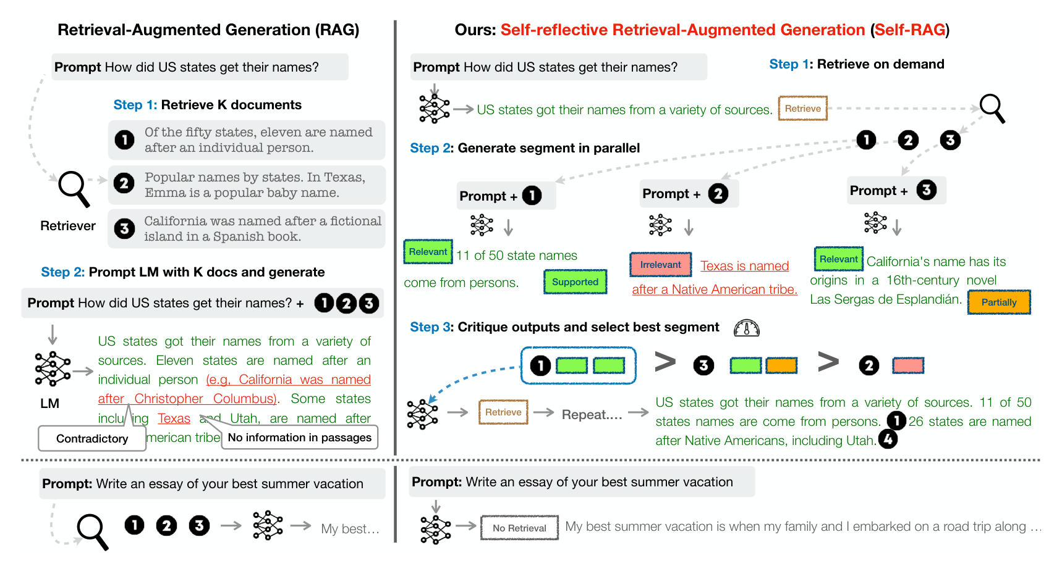
From the paper: Figure 1
Asai et al. 2024, Fig. 1
Left (RAG): always retrieves K = 3 documents and generates once; the answer contradicts a passage and the essay prompt still retrieves.
Right (Self-RAG): Retrieve → one candidate per passage tagged Relevant / Irrelevant and Supported / Partially → ranking 1 > 3 > 2 → repeat; the essay prompt gets No Retrieval.
Self-RAG · Core idea
14

Slide 15
Reflection tokens (paper Table 1)
Add special tokens to the vocabulary and train ONE model, with ordinary next-token prediction, to write them between its own sentences. Critique becomes next-token prediction.
Retrieve
IsRel
IsSup
IsUse
Should I fetch evidence for the next segment?
Does passage d give useful information for x?
Is every verification-worthy claim in yt backed by d?
Is y a useful response to x, regardless of truth?
Yes · No · Continue
Relevant (best) · Irrelevant
Fully (best) · Partially · No support
5 (best) · 4 · 3 · 2 · 1
input: x, y<t
before each segment
input: x, d
after the passage
input: x, d, yt
after the segment
input: x, y
once, at the end
Self-RAG · Core idea
15

Slide 16
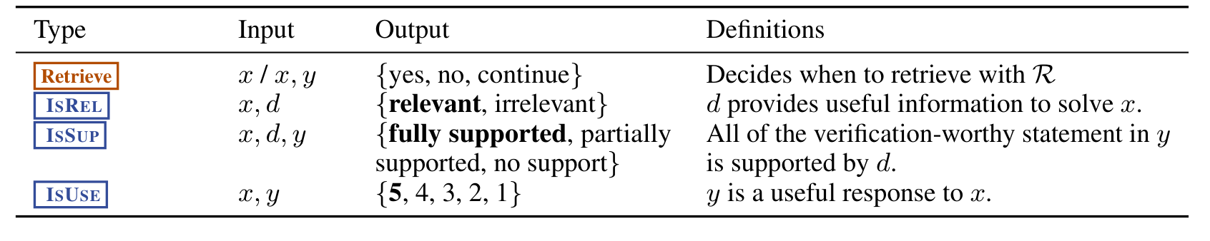
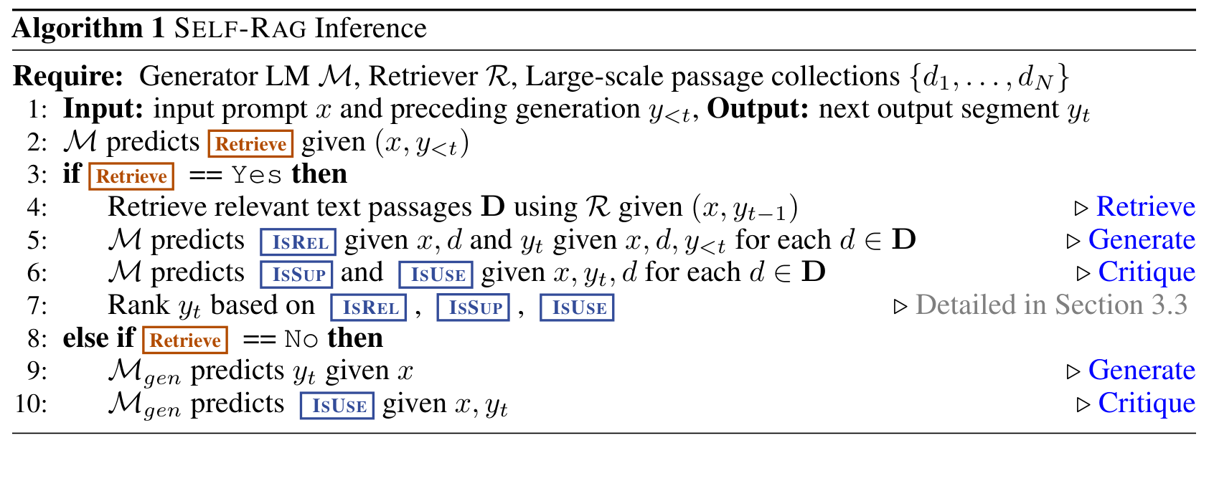
From the paper: Table 1 and Algorithm 1
Asai et al. 2024, Table 1 / Alg. 1
Self-RAG · Core idea
16

Slide 17
Token definitions in detail (App. A.1)
Retrieve
Yes: the continuation needs factual grounding. No: it does not, or retrieval would not help. Continue: keep using the passage already retrieved (e.g. several sentences from one Wikipedia intro).
IsRel
Relevant if the evidence provides useful information to solve x; otherwise Irrelevant.
IsSup
Attribution: how much of the output is entailed by the evidence (Menick 2022; Bohnet 2022). Three levels following Yue 2023 and Nakano 2021: Fully supported, Partially supported, No support / Contradictory.
IsUse
Perceived utility (Liu 2023a): is the response a helpful, informative answer, independent of whether it is factual. Also called plausibility (Menick 2022). Five-point scale, 1 lowest.
Self-RAG · Core idea
17

Slide 18

What is new
1
Retrieval on demand, per segment
The LM itself decides, mid-generation, using a learned token, not a confidence heuristic.
2
Self-critique as vocabulary
Relevance, support and utility are generated tokens, so judging costs one decoding step and needs no reward model at inference.
3
Critique learned offline, without RL
A critic labels the corpus once; the generator is trained with plain SFT.
4
Controllable decoding
Critique probabilities define a tunable score (weights w, threshold δ): one model, many behaviours, no retraining.
5
Fine-grained attribution
Every segment is generated from exactly one passage and carries its own support label: a built-in citation.
Self-RAG · Core idea
18

Slide 19
Self-RAG vs other RAG designs
 | Lewis-RAG | In-context RAG | Self-RAG
When to retrieve | Always, once | Always, once | Model decides, per segment
How passages are combined | Soft mixture (marginalise) | Concatenate all K | One passage per candidate, then select
Relevance check | Retriever score only | None | LM predicts IsRel
Grounding check | None | None | LM predicts IsSup
Citations | No | Depends on prompt | Built in: each segment tied to one d
Test-time control | No | No | Yes: weights w and threshold δ
Training | End-to-end (retriever + LM) | None | SFT of the LM only; retriever frozen
Self-RAG · Core idea
19

Slide 20

03
Method
Formalisation and token order
Training: GPT-4 → critic → annotated corpus → generator
Inference: threshold, critique scores, segment beam search
Worked example, cost, why it works
20

Slide 21
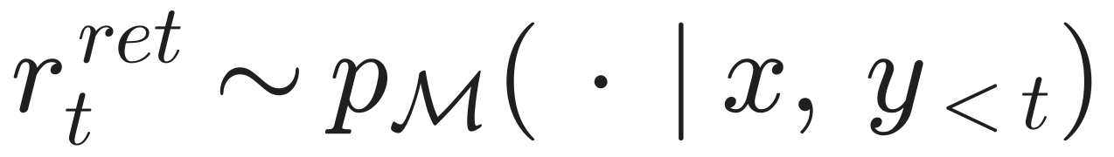
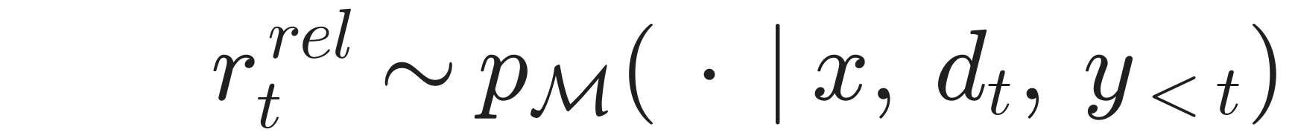
Problem formalisation (§3.1)
Input x; output y = [y1, …, yT] of T segments (one sentence each, split with spaCy). Each yt may contain words from V and reflection tokens from R; the model's vocabulary is V plus R.
Generative story of segment t
Notes
The retriever query at step t is (x, y_{t−1})
Passages d are inputs supplied by R, not tokens produced by M
Segment unit is a design choice; the framework also allows sub-sentences
One model plays three roles: retrieval policy, writer, critic
Self-RAG · Method
21

Slide 22
One token stream, so the chain rule applies
ỹ is the interleaved sequence; D (retrieved passages) is excluded from the product because R, not M, produces it. Each '·' means 'everything before it in the stream'.
Why this token order?
Retrieve before the segment
you must decide to look things up before writing
IsRel after the passage, before the sentence
the relevance judgment conditions what is written; the model learns to lean less on irrelevant passages
IsSup after the sentence
a post-hoc entailment check of yt against d; it cannot come earlier
IsUse at the very end
utility is a property of the whole answer
Self-RAG · Method
22

Slide 23
What the model writes (paper Fig. 2, Table 4)
Q: when did Walking Dead season 7 come out? (Natural Questions)
[Retrieve=Yes] <p> …season 7 premiered on October 23, 2016… </p> [IsRel=Relevant] October 23, 2016 [IsSup=Fully] [IsUse=5]
Q: Synthesize a poem: 'The sun is setting' (Stanford Alpaca)
[Retrieve=No] The stars begin to twinkle bright… [Retrieve=No] They flicker like a silent dance… [IsUse=5]
Q: Give an example of a situation where you delegate tasks (GPT-4 Alpaca)
[Retrieve=No] The manager realises… [Retrieve=Yes] <p>Delegation…</p> [IsRel=Relevant] This includes creating a guest list… [IsSup=Partially] … [Retrieve=Yes] <p>Joint application design…</p> [IsRel=Irrelevant] … [IsUse=5]
Self-RAG · Method
23

Slide 24
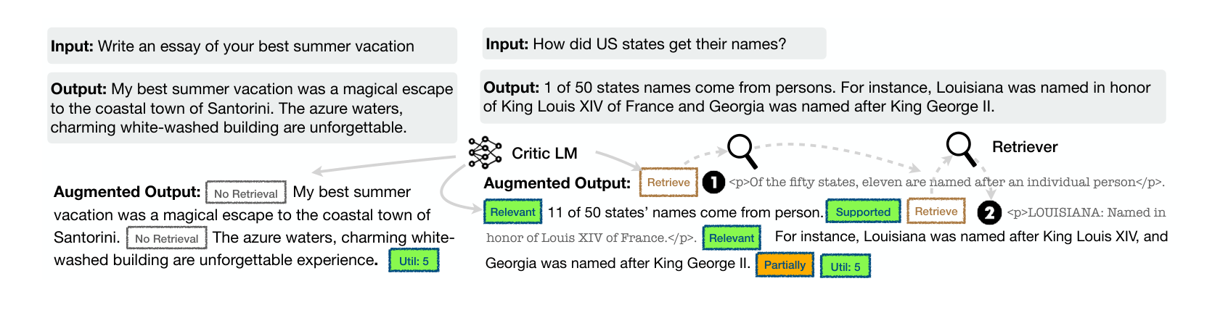
From the paper: Figure 2 (training examples)
Asai et al. 2024, Fig. 2
Left: no retrieval needed; only [No Retrieval] tokens and a final [Util: 5].
Right: the critic LM inserts [Retrieve], passages, [Relevant], [Supported] / [Partially] around the original output; the output text itself is unchanged.
Self-RAG · Method
24

Slide 25
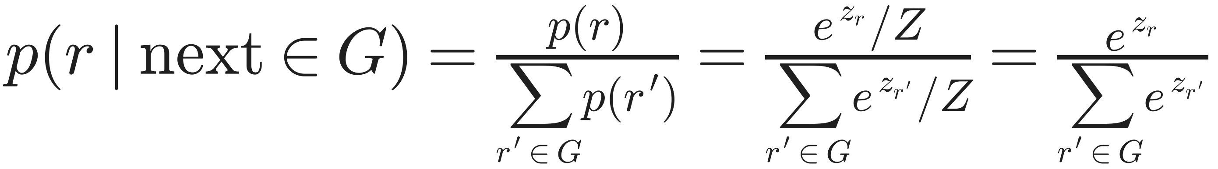
Vocabulary expansion and the restricted softmax
Adding reflection tokens R
E: input embedding table; W: output head. New rows are learned in fine-tuning; a reflection token is then emitted exactly like a word, through the same softmax.
Restricted softmax: the identity behind every score
Tokens in the released models
[Retrieval] · [No Retrieval] · [Continue to Use Evidence]
[Relevant] · [Irrelevant]
[Fully supported] · [Partially supported] · [No support / Contradictory]
[Utility:1] … [Utility:5]
<paragraph> … </paragraph>
Z (sum over all ~32k tokens) cancels. A group's probabilities can be read off the logits of that group alone, ignoring mass on unrelated words.
Self-RAG · Method
25

Slide 26
Training overview (Algorithm 2)
GPT-4 labels
Critic C
Annotate 150k
Generator M
Few-shot prompts per token type: 12.6k Retrieve, 19.3k IsRel, 11.2k IsSup, 3.8k IsUse
Llama2-7B fine-tuned on those labels (Eq. 1). Agrees with GPT-4 74–94% depending on type
For each sentence: C decides retrieval, R fetches, C labels IsRel / IsSup, keeps one passage; IsUse at the end
Llama2 7B / 13B with new tokens; next-token loss on the annotated corpus (Eq. 2)
At inference: only M + the retriever
C and GPT-4 are only used to build training data. Two distillation steps: GPT-4 → C → M. M ends up being its own critic.
Self-RAG · Method
26

Slide 27
Stage 1a: critic labels from GPT-4
Why not label everything with GPT-4? cost (sentences × passages × 4 aspects per example) and reproducibility (API drift).
Sampling: for each token type, sample (x, y) pairs from the training set.
Prompt: type-specific instruction + few-shot demonstrations; GPT-4 outputs the label as text, sampling r from p(r | I, x, y).
Decoding: temperature 1, ≤ 200 tokens, '##' separator; outputs in the wrong format are discarded.
Example prompt: Retrieve, input only (Table 8)
'Given an instruction, please make a judgment on whether finding some external documents from the web (e.g., Wikipedia) helps to generate a better response. Please answer [Yes] or [No] and write an explanation.'
Give three tips for staying healthy. [Yes] reliable sources can support the tips
Describe a time you made a difficult decision. [No] personal experience
Find the area of a circle, radius = 4. [No] maths; no document states the answer
Explain cellular respiration in plants. [Yes] detailed scientific concept
 | Retrieve | IsRel | IsSup | IsUse
Labels kept | 12,594 | 19,317 | 11,181 | 3,831
Author agreement (n = 20) | 95% | 95% | 90% | 80%
Self-RAG · Method
27

Slide 28
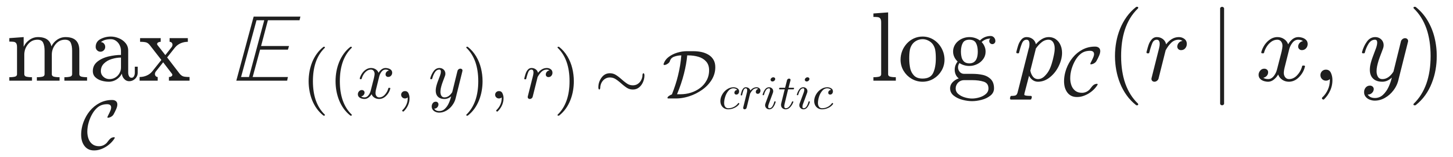
Stage 1b: training the critic (Eq. 1)
Meaning: make the critic put high probability on the label GPT-4 gave.
Equivalently: cross-entropy between C's distribution over label tokens and GPT-4's one-hot label; a classifier implemented as conditional LM.
Initialisation: Llama2-7B, the same base as the generator.
Inputs: (x, y) plus the passage d for IsRel / IsSup.
Agreement with GPT-4 on held-out labels (App. Table 5)
Base LM | Retrieve | IsSup | IsRel | IsUse
Llama2-7B | 93.8 | 93.5 | 80.2 | 73.5
FLAN-3B | 85.6 | 73.1 | 82.0 | 72.1
Bigger base model helps on most types. Both struggle most on IsUse, mainly confusing 4 and 5, where human annotators also disagree. These are agreement rates with GPT-4, not with humans.
Self-RAG · Method
28

Slide 29
Stage 2a: annotating the corpus (Alg. 3)
STEP 1
Retrieve?
C predicts Retrieve for (x, y). If No: only predict IsUse; done.
Passage selection rule
Keep d with IsRel = Relevant and IsSup = Fully or Partially
Several qualify: highest retrieval score
None qualify: pick one at random
Why random? It keeps negative examples, so M learns to emit Irrelevant / No support honestly.
The answer text y is never rewritten; only tokens and passages are inserted.
STEP 2
Initial retrieval
If Yes: retrieve with (x, whole y) as query; split y into sentences.
STEP 3
Per sentence
C decides Yes / No / Continue given x, y<t and the earlier passage; if Yes, query R with (x, yt).
STEP 4
Judge passages
For each retrieved d: C predicts IsRel, then IsSup.
STEP 5
Pick one passage
Rule on the right; insert it with its tokens.
STEP 6
Utility
At the end C predicts IsUse; add the sequence to D_gen.
Self-RAG · Method
29

Slide 30
Training data: 145,619 examples (App. Table 3)
Dataset | Category | Source | Instances
GPT-4 Alpaca | Instruction-following | Open-Instruct | 26,168
Stanford Alpaca | Instruction-following | Open-Instruct | 25,153
FLAN-V2 | Instruction-following | Open-Instruct | 17,817
ShareGPT | Instruction-following | Open-Instruct | 13,406
Open Assistant 1 | Instruction-following | Open-Instruct | 9,464
Wizard of Wikipedia | Knowledge-intensive | KILT | 17,367
Natural Questions | Knowledge-intensive | KILT | 15,535
FEVER | Knowledge-intensive | KILT | 9,966
OpenBookQA | Knowledge-intensive | HF Datasets | 4,699
ARC-Easy | Knowledge-intensive | HF Datasets | 2,147
ASQA | Knowledge-intensive | ASQA | 3,897
Mix
92,008
instruction-following (63%)
53,611
knowledge-intensive (37%)
Diverse instructions keep versatility; knowledge-intensive sets teach when retrieval pays off. Ablations later use a 50k random subset.
Self-RAG · Method
30

Slide 31
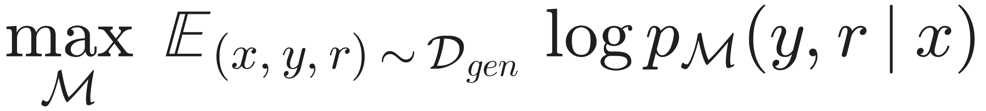
Stage 2b: training the generator (Eq. 2)
Versus Eq. 1
Why mask passages?
Effect
Critic predicts only r given (x, y)
Generator predicts y AND r, interleaved
Vocabulary expanded with all reflection tokens
They are inputs from R, not model output
Predicting them = memorising Wikipedia, or inventing passage-like text
Still attended to: the model learns to use them
M learns the retrieval policy, the critique and the writing in one model
At inference M's own token probabilities act as reward estimates
Self-RAG · Method
31

Slide 32
Why not RLHF? Cost, stability, control
 | PPO-based RLHF | Self-RAG
Models in GPU memory | policy, reference, reward, value (about 4) | 1 (generator)
Data | on-policy samples during training | static corpus, labelled once
Objective | policy gradient + KL penalty | cross-entropy
Reward model at inference | no (baked in) | no (M emits it)
Change behaviour later | retrain | change w, δ at inference
Training setup (App. B.1)
4 × A100 80GB; 3 epochs
Batch 128; peak LR 2e-5, 3% warm-up, linear decay
Max length 2,048 (7B) / 1,524 (13B)
DeepSpeed ZeRO-3, bf16, FlashAttention
Inference on 1–2 Quadro RTX 6000 (24GB) with vLLM
Trade-off: RLHF optimises the policy itself; Self-RAG only learns to predict critique and leaves selection to decoding. Cheaper and controllable, but the generator never directly improves from the reward.
Self-RAG · Method
32

Slide 33
Inference: Algorithm 1
Require: generator M, retriever R, passages {d1, …, dN}
Input: prompt x, previous segments y<t; output: segment yt
1 M predicts Retrieve given (x, y<t)
2 if Retrieve = Yes (or p_yes > δ):
3 D ← R(x, yt−1) retrieve K passages
4 for each d in D, in parallel:
5 M predicts IsRel given (x, d)
6 M predicts yt given (x, d, y<t)
7 M predicts IsSup, IsUse given (x, yt, d)
8 rank the K candidates by IsRel, IsSup, IsUse
9 else:
10 M predicts yt given (x, y<t), then IsUse
Defaults (§4.3)
K = 5 passages per retrieval
Beam width B = 2 over segments
Greedy decoding inside a segment
w = (1.0, 1.0, 0.5) for IsRel, IsSup, IsUse
δ = 0.2 (δ = 0 for ASQA)
vLLM for parallel branches
Self-RAG · Method
33

Slide 34
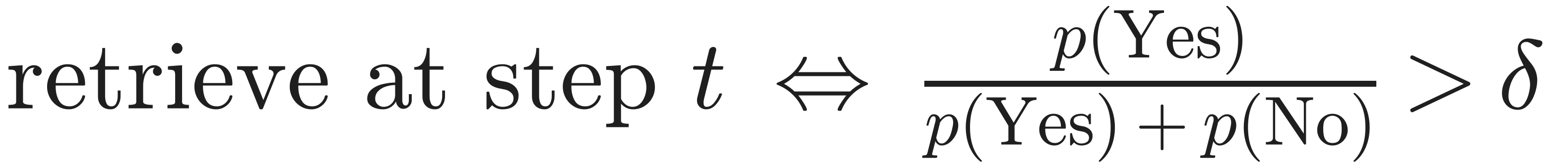
Adaptive retrieval threshold (App. A.3)
Restricted softmax: probability of Yes given the model is choosing between Yes and No.
δ → 0: retrieve almost always, like standard RAG. Used for ASQA, where citations are required.
δ → 1: almost never retrieve.
δ = 0.2 (default): retrieve even when No is more likely, as long as Yes keeps ≥ 20% of the Yes/No mass. Biased towards retrieving on factual tasks.
Hard constraint: retrieve only if Yes is the argmax, i.e. effectively δ = 0.5.
Worked example
p(Yes) = 0.12, p(No) = 0.40, p(Continue) = 0.03, the rest on other tokens
Hard constraint: argmax is No (0.40 > 0.12), so no retrieval. This is why 'hard constraints' retrieves less and loses 17 points on PopQA in the ablation (45.5 → 28.3).
Self-RAG · Method
34

Slide 35
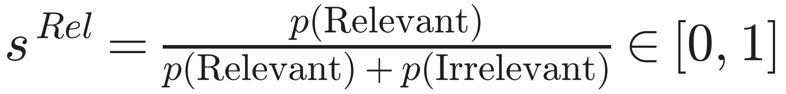
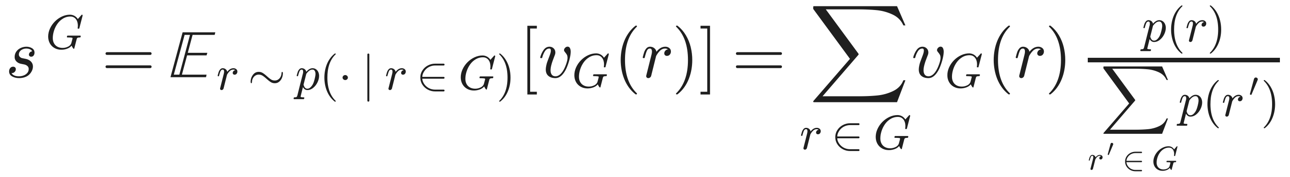
Turning critique tokens into scores
Unified view: expected value
Why normalise?
Raw p(Relevant) also competes with ~32k ordinary tokens
Renormalising removes that nuisance mass
Fixed ranges allow a weighted sum
v_Rel = (1, 0); v_Sup = (1, 0.5, 0); v_Use = (−1, −0.5, 0, 0.5, 1). The paper's generic formula p(r̂) / Σ p(r) is the special case where only the best value counts.
Self-RAG · Method
35

Slide 36
Segment score and beam search (Eqs. 3–4)
First term: how likely the segment is under the LM; in the released code a length-normalised probability exp(mean log p), so it lies in [0, 1].
Second term: weighted linear reward from self-critique. Defaults w = (1, 1, 0.5).
Hard alternative: drop any candidate whose IsSup is No support.
Closed-set tasks: scores are aggregated per answer option; the best option wins (App. B.2).
Segment-level beam search
Keep B = 2 partial answers
Expand each into K candidates when retrieving (one per passage), else one
Score candidates with f, accumulated along the path
Keep the top B; repeat until all beams finish; return the best
Tokens inside a segment are decoded greedily
Self-RAG · Method
36

Slide 37
Worked example: why the less fluent candidate wins
Query: 'How did US states get their names?' | d1: 11 of 50 states named after people | d2: popular baby names in Texas
Fluency p(yt | ·) | 0.60 | 0.70
p(Rel), p(Irr) → s Rel | 0.9, 0.1 → 0.90 | 0.2, 0.8 → 0.20
p(Full), p(Part), p(No) → s Sup | 0.7, 0.2, 0.1 → 0.80 | 0.1, 0.3, 0.6 → 0.25
p(Use = 1…5) → s Use | .01 .04 .15 .40 .40 → 0.57 | .05 .10 .25 .35 .25 → 0.325
f = p + s Rel + s Sup + 0.5 s Use | 2.585 (chosen) | 1.3125
Sensitivity to the weights
With w Sup = 1 and w Use = 0.5, d2 wins only if w Rel < −0.818, i.e. only if irrelevance is rewarded. Set all w = 0 and ranking reduces to likelihood, which picks d2.
Takeaway: critique terms move selection from 'most fluent' to 'most fluent and grounded'.
Illustrative numbers, not from the paper.
Self-RAG · Method
37

Slide 38
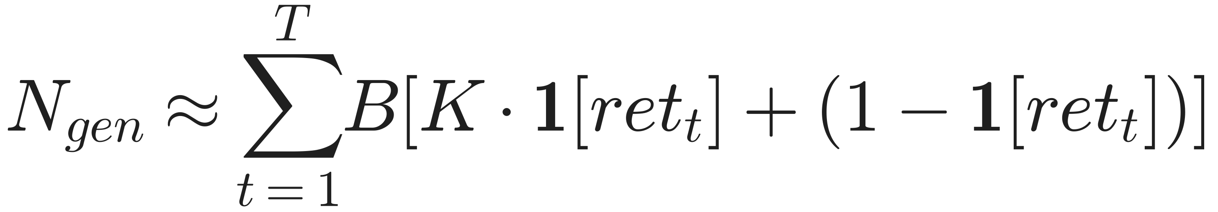
Inference cost
Number of segment generations. With B = 2 and K = 5, a retrieval step costs up to 10 drafts, each with its own passage prefill (~100 words), plus a few critique tokens.
What makes it expensive
What keeps it manageable
B · K branches per retrieval step
Prefill of a passage in each branch
Retrieval calls (dense search) per step
Latency and throughput are not reported in the paper
Branches are independent, so they batch well (vLLM)
Greedy decoding inside segments
No retrieval → a single branch (creative prompts)
δ trades accuracy for retrieval frequency (Fig. 3c)
Self-RAG · Method
38

Slide 39

Decomposition
Retrieve if useful
4 small, separately supervised decisions instead of one hard one
Essays and maths stay a normal LM, so versatility is kept
Why it
works
Generate + verify
Cheap critique
Checking a sentence against one passage is easier than writing a correct one
Learned offline with SFT; no RL, no reward model at test time
One passage each
RLHF in disguise
No mixing of noisy passages; bad ones are scored down
Ranking by likelihood + Σ w·s mimics a reward-tilted policy (next slide)
Self-RAG · Method
39

Slide 40
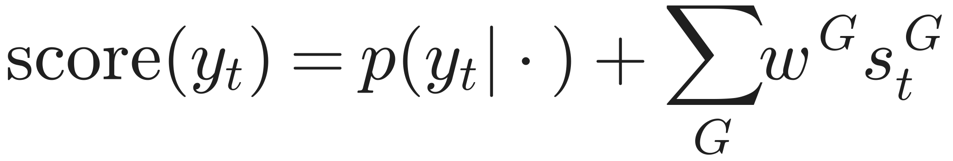
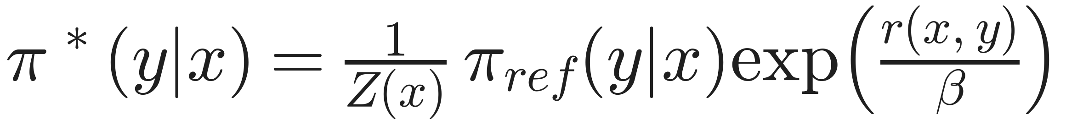
A closer look: test-time reward tilting
KL-regularised RLHF objective
Self-RAG ranking
Closed-form optimum
Same shape as log π* with reward r = Σ w·s and β = 1, over a finite candidate set
Changing w = choosing a different reward, with no retraining
Caveat: Self-RAG adds p, not log p, so this is an analogy, not an equivalence
Contrast with Lewis-RAG
Soft average weighted by the retriever vs hard selection weighted by the generator's own judgment.
Self-RAG · Method
40

Slide 41

04
Experiments
Six tasks, metrics with formulas
Baselines and fairness details
Full Table 2 and takeaways
Ablations, test-time control, efficiency, data scale
Human evaluation and qualitative examples
41

Slide 42
Tasks and datasets (§4.1), all zero-shot
Closed-set
Short-form QA
Long-form
PubHealth: public-health fact verification (Zhang 2023)
ARC-Challenge: science exam multiple choice (Clark 2018)
Metric: accuracy; answer-option probabilities aggregated
PopQA long-tail: 1,399 rare-entity questions (<100 monthly views)
TriviaQA-unfiltered: 11,313 test questions (Min 2019 split)
Metric: is a gold answer contained in the output
Biographies: 'Tell me a bio about X', FactScore (Min 2023)
ASQA (ALCE): ambiguous questions; long answers with citations
Metrics: str-em, ROUGE, MAUVE, citation precision and recall
Self-RAG · Experiments
42

Slide 43
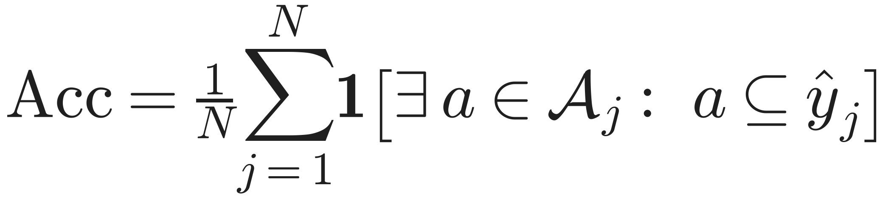
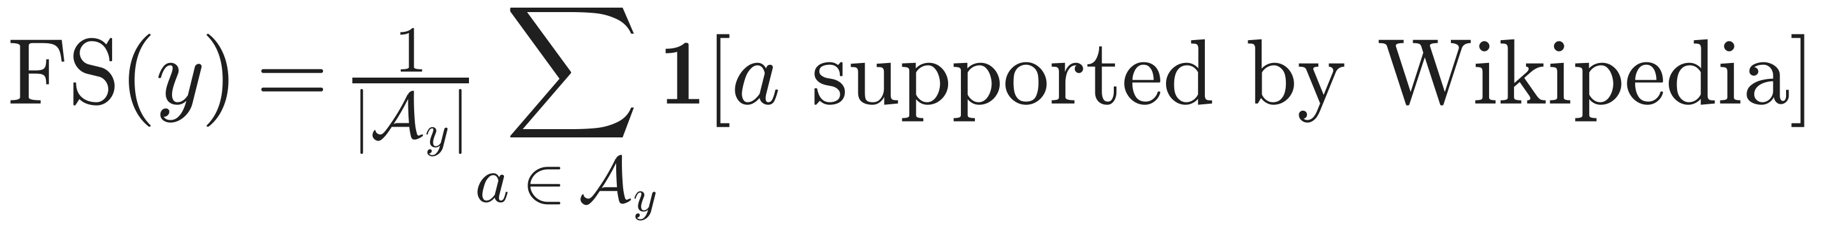
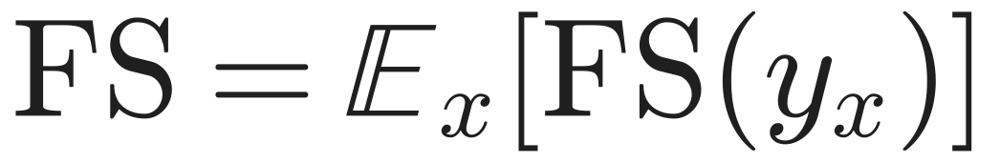
Metrics (1/2): accuracy, match, FactScore
Match accuracy (PopQA, TQA)
FactScore (Bio)
A_j: gold aliases. Lenient by design (Mallen 2023; Schick 2023). Caveat: a long answer listing many candidates can be 'correct' by accident.
A_y: atomic facts extracted by an LLM, each checked by retrieval + LM verification. Measures precision, not coverage.
Closed-set accuracy: for PubHealth and ARC, Self-RAG aggregates scores per option and picks the best option; predictions are lower-cased and string-matched to avoid format errors (App. B.2).
Why it matters: a 3-fact bio with 3 supported facts scores 1.0; a 10-fact bio with 8 supported scores 0.8. Shorter answers can win on FactScore.
Self-RAG · Experiments
43

Slide 44
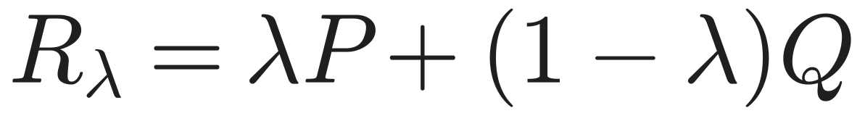
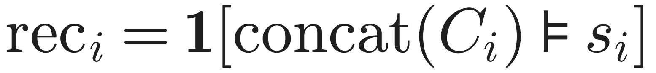
Metrics (2/2): ASQA correctness, fluency, citations
Correctness
Fluency: MAUVE
str-em: fraction of the disambiguated short answers that appear verbatim in the output
ROUGE-L: longest-common-subsequence overlap with reference long answers
MAUVE = area under C (P human, Q model text, quantised embeddings); 1 = identical.
Citations (ALCE; NLI judge TRUE, T5-11B)
Fairness fixes in the paper
All systems capped at 100 new tokens on ASQA (Llama2-chat's long outputs inflated str-em)
Same author-provided GTR-XXL top-5 passages for every system
Precision = share of citations that are not irrelevant. Recall: are claims backed? Precision: does each citation pull its weight?
Self-RAG · Experiments
44

Slide 45
Baselines (§4.2) and what each one controls for
Group | Models | Controls for
No retrieval, public | Llama2 7B/13B; Alpaca 7B/13B (Llama2 replication) | the effect of retrieval + reflection
No retrieval, RLHF / private data | ChatGPT; Llama2-chat-13B | is a 7B Self-RAG competitive with larger RLHF models?
Prompt engineering | CoVE-65B (chain-of-verification) | iterative self-verification by prompting vs learned reflection
Standard RAG | Llama2, Alpaca, Llama2-chat, ChatGPT + the same retrieved passages | the key comparison: same retriever, no reflection
Same data, no reflection | Llama2-FT-7B: trained on the 150k pairs without tokens or passages | is the gain from data or from the framework?
Trained with retrieval | SAIL-7B; Toolformer-6B (numbers from their papers) | other retrieval-aware training
Production system | Perplexity.ai (Bio only) | a deployed search-LLM product
Self-RAG · Experiments
45

Slide 46
Evaluation settings and fairness
Retrieval sources
Generation settings
Contriever-MS MARCO, top-5 from Wikipedia (official 2018 embeddings)
PopQA: Dec 2020 Wikipedia (Izacard 2022b), since 2018 lacks newer entities
Bio and open-domain QA: +5 documents from Google Programmable Search (intro paragraphs), following SAIL
ASQA: author-provided GTR-XXL top-5 for all baselines
Open QA: ≤ 100 new tokens; closed-set: ≤ 50
FactScore: ≤ 500 for baselines, ≤ 200 per segment for Self-RAG
ALCE capped at 100 tokens for all systems (baselines then output 30–60 tokens)
Official chat templates for instruction-tuned baselines
Fact-check labels lower-cased; MCQ formats string-matched
Self-RAG · Experiments
46

Slide 47
Table 2 (1/2): vs proprietary and no-retrieval models
Model | PopQA | TQA | Pub | ARC | Bio FS | ASQA em | rg | mau | prec | rec
Llama2-chat-13B | 20.0 | 59.3 | 49.4 | 38.4 | 55.9 | 22.4 | 29.6 | 28.6 | – | –
Ret-Llama2-chat-13B | 51.8 | 59.8 | 52.1 | 37.9 | 79.9 | 32.8 | 34.8 | 43.8 | 19.8 | 36.1
ChatGPT | 29.3 | 74.3 | 70.1 | 75.3 | 71.8 | 35.3 | 36.2 | 68.8 | – | –
Ret-ChatGPT | 50.8 | 65.7 | 54.7 | 75.3 | – | 40.7 | 39.9 | 79.7 | 65.1 | 76.6
Perplexity.ai | – | – | – | – | 71.2 | – | – | – | – | –
Llama2-7B | 14.7 | 30.5 | 34.2 | 21.8 | 44.5 | 7.9 | 15.3 | 19.0 | – | –
Alpaca-7B | 23.6 | 54.5 | 49.8 | 45.0 | 45.8 | 18.8 | 29.4 | 61.7 | – | –
Llama2-13B | 14.7 | 38.5 | 29.4 | 29.4 | 53.4 | 7.2 | 12.4 | 16.0 | – | –
Alpaca-13B | 24.4 | 61.3 | 55.5 | 54.9 | 50.2 | 22.9 | 32.0 | 70.6 | – | –
CoVE-65B * | – | – | – | – | 71.2 | – | – | – | – | –
Self-RAG 7B | 54.9 | 66.4 | 72.4 | 67.3 | 81.2 | 30.0 | 35.7 | 74.3 | 66.9 | 67.8
Self-RAG 13B | 55.8 | 69.3 | 74.5 | 73.1 | 80.2 | 31.7 | 37.0 | 71.6 | 70.3 | 71.3
Yellow: Self-RAG. Pink: a proprietary model beats Self-RAG 13B. * concurrent work. rg ROUGE, mau MAUVE, prec/rec citations.
Self-RAG · Experiments
47

Slide 48
Table 2 (2/2): vs retrieval-augmented baselines
Model | PopQA | TQA | Pub | ARC | Bio FS | ASQA em | rg | mau | prec | rec
Toolformer-6B * | – | 48.8 | – | – | – | – | – | – | – | –
Llama2-7B + RAG | 38.2 | 42.5 | 30.0 | 48.0 | 78.0 | 15.2 | 22.1 | 32.0 | 2.9 | 4.0
Alpaca-7B + RAG | 46.7 | 64.1 | 40.2 | 48.0 | 76.6 | 30.9 | 33.3 | 57.9 | 5.5 | 7.2
Llama2-FT-7B + RAG | 48.7 | 57.3 | 64.3 | 65.8 | 78.2 | 31.0 | 35.8 | 51.2 | 5.0 | 7.5
SAIL-7B * | – | – | 69.2 | 48.4 | – | – | – | – | – | –
Llama2-13B + RAG | 45.7 | 47.0 | 30.2 | 26.0 | 77.5 | 16.3 | 20.5 | 24.7 | 2.3 | 3.6
Alpaca-13B + RAG | 46.1 | 66.9 | 51.1 | 57.6 | 77.7 | 34.8 | 36.7 | 56.6 | 2.0 | 3.8
Self-RAG 7B | 54.9 | 66.4 | 72.4 | 67.3 | 81.2 | 30.0 | 35.7 | 74.3 | 66.9 | 67.8
Self-RAG 13B | 55.8 | 69.3 | 74.5 | 73.1 | 80.2 | 31.7 | 37.0 | 71.6 | 70.3 | 71.3
Bold: best among non-proprietary models. Teal: Llama2-FT, the same-data control. * numbers reported in the original papers (no implementation). Alpaca-13B + RAG has the best open str-em (34.8); Self-RAG leads every other column.
Self-RAG · Experiments
48

Slide 49
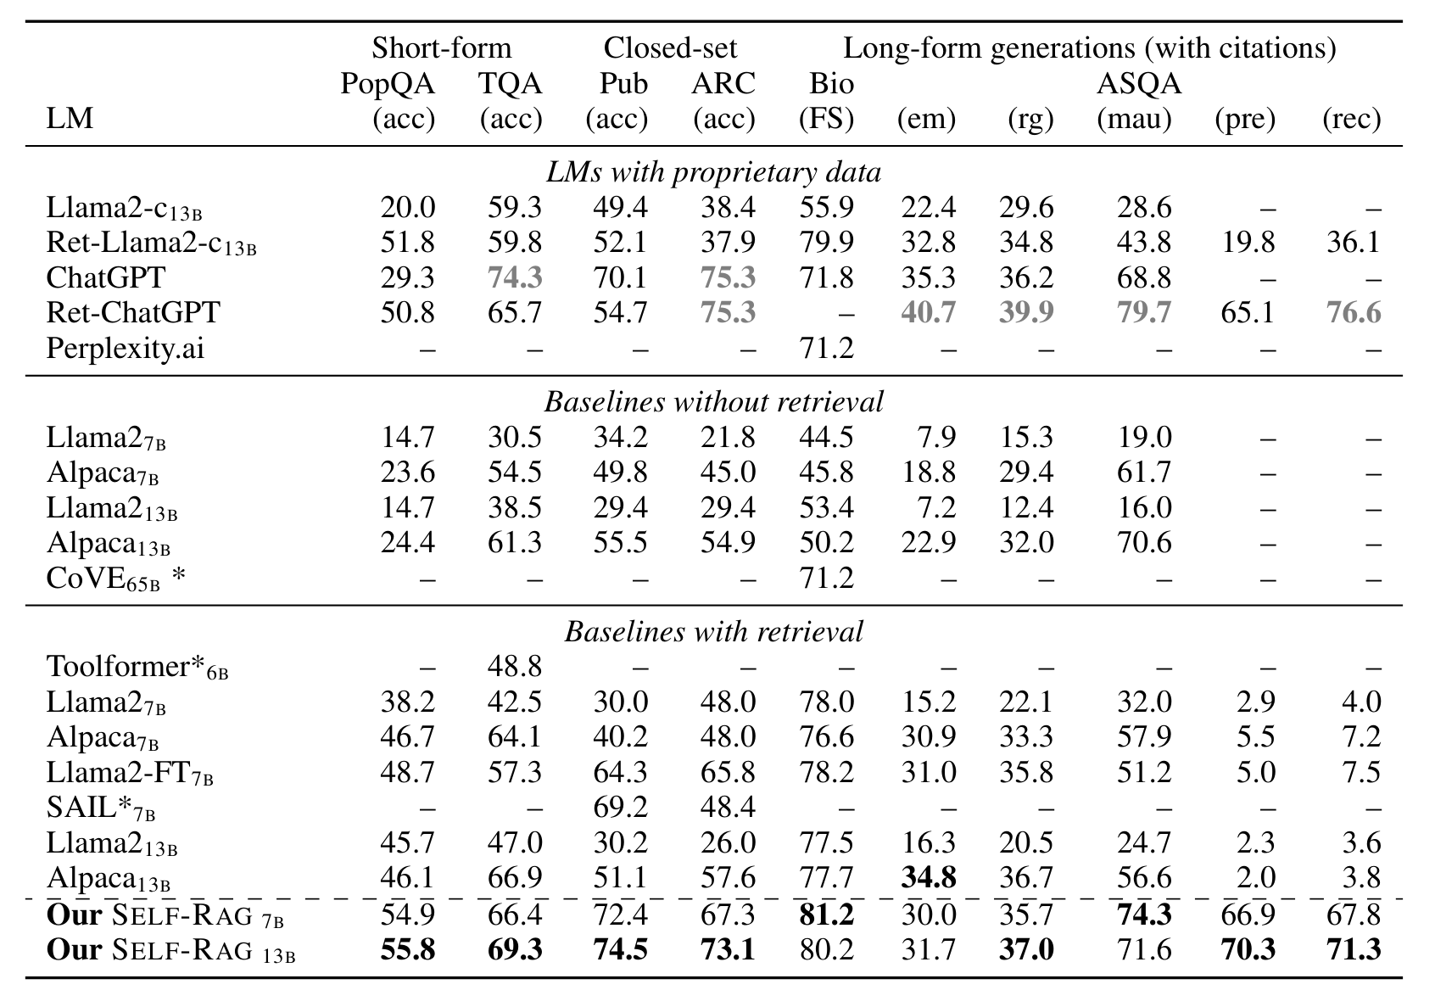
From the paper: Table 2
Asai et al. 2024, Table 2
Bold: best non-proprietary model; grey bold: proprietary model better than all open ones. * numbers from concurrent work.
Self-RAG · Experiments
49

Slide 50
Main results at a glance
Best open model on all six tasks
Beats ChatGPT on PopQA, PubHealth, Bio and citation precision
Not everywhere: ChatGPT without retrieval still wins TriviaQA (74.3) and ARC (75.3)
Same data is not enough: Llama2-FT trails, so the gain comes from the framework
Source: Table 2. Ret-ChatGPT has no Bio score.
Self-RAG · Experiments
50

Slide 51
Reading Table 2: five takeaways
1
Standard RAG can hurt
Ret-ChatGPT PubHealth 70.1 → 54.7; Alpaca-13B 55.5 → 51.1; ARC barely moves. Retrieval helps where answers can be copied (PopQA, Bio) but not for verification or reasoning.
2
Citations jump >10×
Open RAG models reach 2–8% citation precision/recall; Self-RAG 13B reaches 70.3 / 71.3, above Ret-ChatGPT on precision (65.1), below it on recall (76.6).
3
Framework, not data
Llama2-FT-7B (same 150k data): PubHealth 64.3 vs 72.4, citation precision 5.0 vs 66.9.
4
Small beats large
Self-RAG 7B/13B beats CoVE-65B on Bio (81.2 vs 71.2) and Llama2-chat-13B everywhere.
5
7B vs 13B
7B sometimes wins on factual precision (Bio 81.2 vs 80.2): it writes shorter, precisely grounded outputs.
Self-RAG · Experiments
51

Slide 52
Do answers come from the evidence? (App. C.1)
Among correct answers on PopQA and TriviaQA: how often is the gold answer NOT a substring of the retrieved passages, i.e. came from parametric memory?
2%
15%
18%
20%
Self-RAG 7B
Alpaca
Llama2-chat-13B
Alpaca (larger)
When passages are irrelevant, Self-RAG emits IsRel = Irrelevant, signalling that the following answer may not be grounded, while instruction-tuned baselines keep producing plausible answers. The paper's text names the largest baseline 'Alpaca 30B', which does not appear elsewhere; treat that label with care.
Self-RAG · Experiments
52

Slide 53
Ablations (Fig. 3a): every component matters
Variant (7B, 50k training examples) | PopQA | PubHealth | ASQA em | What it shows
Self-RAG (full) | 45.5 | 73.5 | 32.1 | reference
Train: no retriever (plain instruction tuning) | 43.6 | 67.8 | 31.0 | training with passages helps, most on PubHealth
Train: no critic (always top-1, no tokens; like SAIL) | 42.6 | 72.0 | 18.1 | reflection tokens are the core of long-form gains
Test: never retrieve | 24.7 | 73.0 | – | long-tail facts need retrieval; PubHealth does not
Test: hard constraint (argmax Retrieve) | 28.3 | 72.6 | – | retrieves too rarely: δ is a crucial knob
Test: always top-1 passage (standard RAG) | 41.8 | 73.1 | 28.6 | choosing among K by critique beats trusting R
Test: drop IsSup from the score | 44.1 | 73.2 | 30.6 | support scoring matters most for long-form
ASQA ablations use 150 sampled instances and exclude adaptive / no-retrieval variants. No variance or seeds are reported.
Self-RAG · Experiments
53

Slide 54
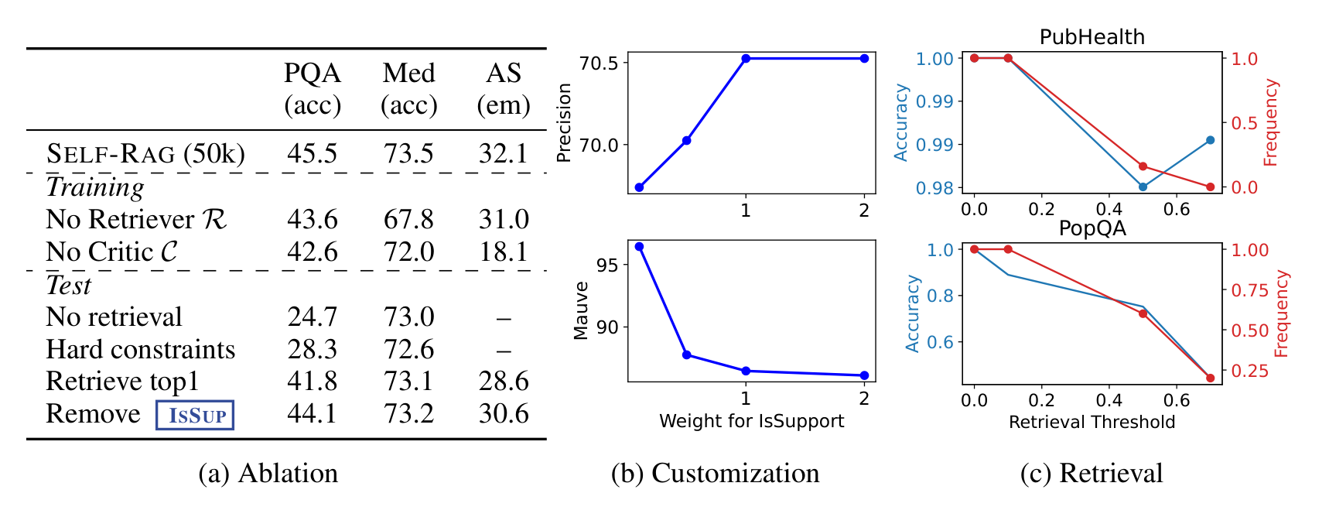
From the paper: Figure 3
Asai et al. 2024, Fig. 3
(a) Ablation: PQA = PopQA, Med = PubHealth, AS = ASQA (em); 7B model trained on 50k examples.
(b) Customisation: IsSup weight vs citation precision (top) and MAUVE (bottom) on ASQA.
(c) Retrieval: threshold δ vs normalised accuracy (blue) and retrieval frequency (red) on PubHealth and PopQA.
Self-RAG · Experiments
54

Slide 55
Test-time customisation (Fig. 3b, ASQA)
Raising w Sup favours well-supported, conservative output (precision up) at the cost of fluency (MAUVE down): chosen at inference, no retraining. Values read off the paper's figure (approximate).
Self-RAG · Experiments
55

Slide 56
Efficiency vs accuracy: the threshold δ (Fig. 3c)
Larger δ means fewer retrievals. PubHealth barely loses accuracy when retrieval stops; PopQA collapses. Values read off the paper's figure (approximate).
Self-RAG · Experiments
56

Slide 57
Training-data scale (Fig. 4a–c)
Self-RAG 7B fine-tuned on random subsets. PopQA and ASQA keep rising at 150k, so more data would likely help; Llama2-FT shows no comparable gain from 50k → 150k. Approximate values from the figure; 50k and 150k points from the ablation and Table 2.
Self-RAG · Experiments
57

Slide 58
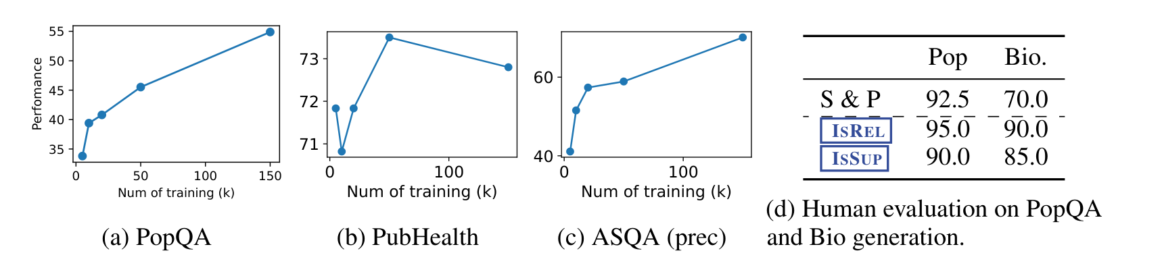
From the paper: Figure 4
Asai et al. 2024, Fig. 4
(a)–(c): Self-RAG 7B trained on 5k, 10k, 20k, 50k, 150k examples: PopQA accuracy, PubHealth accuracy, ASQA citation precision.
(d): human evaluation on 50 samples each: S&P and correctness of the IsRel / IsSup predictions.
Self-RAG · Experiments
58

Slide 59
Human evaluation (Fig. 4d, App. Table 6)
50 samples each | PopQA | Bio
S&P: supported and plausible | 92.5 | 70.0
IsRel judged correct | 95.0 | 90.0
IsSup judged correct | 90.0 | 85.0
Failure: 'Who is the author of The Lie?'
Output: 'The author of The Lie is Sam Harris' [IsRel=Relevant] [IsSup=Fully]
Passage is about Harris's book 'Lying', a different title
Both reflection tokens are wrong: plausible but not supported
S&P (Menick 2022): plausible = on-topic, reasonable answer; supported = evidence suffices to verify it. Cases where Self-RAG itself predicted Irrelevant / No support are excluded. Reflection tokens are mostly meaningful, not decorative.
Partial: 'Tell me a bio about Sergei Bodrov'
First sentence fully supported by the passage
Later 'Continue' sentences (born in Moscow; Guild president) are not in the evidence
Plausible, only partially supported
Self-RAG · Experiments
59

Slide 60
Qualitative examples (App. Table 7, Self-RAG 13B)
Sunday as the 7th day (ASQA)
Rory Tapner bio
G. Venugopal bio
Two retrievals, both Relevant and Fully supported
Cites Constantine's decree of AD 321 from two passages
Shows multi-segment, multi-citation answers
Claims CEO of Coutts 'since 2010'
Passage: stepped down in 2015
Model emits IsSup = Contradictory: the error is flagged, enabling hard filtering
'Sung over 300 songs in Malayalam, Tamil and Hindi'
Passage supports 300+ films, not the languages
Model emits Partially supported: a fine-grained, honest label
Self-RAG · Experiments
60

Slide 61

05
Critical analysis
Strengths
Limitations: supervision, method, evaluation
Is the evidence sufficient for the claims?
Assumptions and how to improve
61

Slide 62
Strengths
Simple mechanism
Controllable
Verifiable
Vocabulary expansion + SFT + reranking. No RL, no extra model at inference.
δ and w trade retrieval cost, precision and fluency at test time.
Per-segment citations with mostly correct self-labels (85–95% human agreement).
Strong controls
Broad evaluation
Open release
Llama2-FT isolates data from framework; training and inference ablations.
Six tasks, three formats; correctness, factuality, fluency and citations.
Code, models and data released; reproducible pipeline.
Self-RAG · Critical analysis
62

Slide 63
Limitations (1/3): supervision
All labels trace back to GPT-4: temperature 1, a single sample per item; any GPT-4 bias (e.g. towards verbose answers being 'useful') is distilled twice.
Tiny human validation: 20 items per token type checked by the authors themselves.
Error cascade: the critic agrees with GPT-4 only 80.2% on IsRel and 73.5% on IsUse; its mistakes become training targets for M.
Agreement is with GPT-4, not humans: critic accuracy measures imitation of the teacher.
Evidence of propagation: 'The Lie' example: Relevant + Fully supported on the wrong book.
Self-RAG · Critical analysis
63

Slide 64
Limitations (2/3): method
Frozen retriever: if the right passage is not in the top-K, reflection can only detect failure (IsRel = Irrelevant), not fix it; no query rewriting or re-retrieval loop.
One passage per segment: a sentence that needs two passages, or a claim spanning sentences, is handled poorly; no multi-hop synthesis within a segment.
Heuristic scoring: Eq. 3 adds a probability ([0,1]) to expected scores on different ranges ([0,1] and [−1,1]); the 0.5 credit, the utility scale and the default weights are hand-picked.
Little sensitivity analysis: only w Sup and δ are swept; w Rel and w Use are never ablated.
Inference cost unreported: up to B·K = 10 drafts per retrieval step plus prefills; no latency or throughput numbers.
Self-assessment is not verification: IsSup is the model grading itself; calibration of critique probabilities is not studied.
Self-RAG · Critical analysis
64

Slide 65
Limitations (3/3): evaluation
Retrieval sources differ by task: Self-RAG adds Google search results for Bio and open QA; shared retrieval is stated explicitly only for ASQA.
Copied baselines: SAIL, Toolformer and CoVE numbers come from their papers, with different setups.
Gameable metrics: match accuracy rewards long outputs; FactScore rewards short ones (the paper's own 7B > 13B note).
Ablation scale: 50k-example models, 150 ASQA samples, no seeds or variance.
Human evaluation: 50 examples per dataset; excludes cases the model flagged as irrelevant or unsupported.
Headline wording: 'outperforms ChatGPT' holds on 4 of 6 tasks, not all; recall and str-em on ASQA remain below ChatGPT.
Self-RAG · Critical analysis
65

Slide 66
Is the evidence sufficient for the claims?
Claim | Evidence | Verdict
Beats open LLMs and standard RAG | All six tasks, same retriever, Llama2-FT control | Strong
Gains come from the framework, not data | Llama2-FT with identical 150k data; no-critic ablation | Strong
Outperforms ChatGPT | Wins 4 of 6 tasks; loses TQA, ARC, ASQA recall / str-em | Partial
Improves factuality and citations | FactScore, citation precision, 2% vs 15–20% grounding analysis | Strong
Controllable without retraining | w Sup sweep (Fig. 3b), δ sweep (Fig. 3c) | Moderate (one weight swept)
Reflection tokens are reliable | Critic vs GPT-4 74–94%; humans 85–95% on 50 samples | Moderate
Efficient | No latency measurements | Not shown
Self-RAG · Critical analysis
66

Slide 67
Assumptions and how to improve
Hidden assumptions
Improvements
A good answer can be built sentence by sentence
Each sentence can be supported by a single passage
GPT-4 judgments of relevance, support and utility are a valid proxy for humans
Wikipedia (2018/2020) + web snippets contain the needed facts
Critique-token probabilities are calibrated enough to add linearly
Re-retrieve or rewrite the query when every IsRel is low (later done by CRAG)
Train or fine-tune the retriever jointly
Learn or calibrate w on a small dev set (temperature scaling)
Let a segment condition on a small set of passages chosen by IsRel
Preference optimisation (DPO) on critique-ranked pairs, so M also improves its outputs
Report latency; prune low-IsRel branches before generating
Self-RAG · Critical analysis
67

Slide 68

06
Impact
From always-on RAG to retrieval on demand
Follow-up research
Connections to modern LLM systems
68

Slide 69
Timeline
2020
2023
2024
2024
2025
RAG
Self-RAG
CRAG, Adaptive-RAG
Agentic RAG
Search as a tool
Lewis et al.: retrieval as a latent variable, always on
Retrieval on demand + self-critique tokens (ICLR 2024)
Grade documents, fall back to web search; route queries by difficulty
LangGraph / LlamaIndex recipes: retrieval, hallucination and answer 'graders'
Assistants decide when to search and cite; RL-trained search agents
Lasting idea: special tokens as an interface for control and self-evaluation, and test-time reranking instead of retraining.
Self-RAG · Impact
69

Slide 70
Follow-up work building on Self-RAG
Work | What it does | Relation to Self-RAG
CRAG (Yan et al. 2024) | Lightweight evaluator grades retrieved documents; triggers web search or knowledge refinement | Fixes the frozen-retriever gap (detect and correct)
Adaptive-RAG (Jeong et al. 2024) | Classifier routes queries: no retrieval / single-step / multi-step | Generalises 'retrieve only when needed'
RankRAG (Yu et al. 2024) | One LLM instruction-tuned to rank contexts and generate | Same single-model judge + writer philosophy
Search-R1 (Jin et al. 2025) | RL teaches an LLM to interleave reasoning and search calls | Replaces offline labels with outcome rewards
LangGraph / LlamaIndex recipes | Prompted graders as nodes in an agent graph | IsRel / IsSup / IsUse as prompts instead of tokens
Self-RAG · Impact
70

Slide 71
Self-RAG and modern LLM systems
Retrieve token → tool calls
Assistants decide when to call search, exactly the role of Retrieve, generalised to any tool.
IsSup → cited answers
Citation-grounded answers and 'is this claim supported?' checks in production search assistants.
Critique → LLM-as-judge
Graders for relevance, hallucination and helpfulness in RAG pipelines and evaluation.
Reranking → test-time compute
Best-of-N and verifier-guided search spend inference compute to raise quality without retraining.
Offline labels → RL with outcomes
Reasoning models trained with RL learn when to search from final-answer rewards.
Self-RAG · Impact
71

Slide 72
Key takeaways
1
Plain RAG retrieves indiscriminately and never checks its output.
2
Self-RAG trains one LM to emit reflection tokens: retrieve on demand, judge relevance, verify support, rate utility.
3
Critique is learned offline (GPT-4 → critic → corpus) and trained with plain next-token loss: no RL.
4
At inference, critique probabilities form a tunable score for segment-level beam search: controllable without retraining.
5
Best open model on six tasks, large citation gains; the Llama2-FT control shows the framework, not the data, drives it.
6
Limits: GPT-4-derived supervision, frozen retriever, heuristic scoring, unreported cost.
Self-RAG · Wrap-up
72

Slide 73

Team Contribution
Student | Contribution | Score | Main work
[Student A] | [Equal / Partial] | [1.0] | [e.g. background & problem]
[Student B] | [Equal / Partial] | [1.0] | [e.g. method & equations]
[Student C] | [Equal / Partial] | [1.0] | [e.g. experiments & analysis]
[Student D] | [Equal / Partial] | [1.0] | [e.g. critique, impact, references]
Scores reflect actual relative contribution (preparation, understanding, slides, presentation), as the rubric requires.
Self-RAG · Wrap-up
73

Slide 74
References (1/3)
[1] Asai, A., Wu, Z., Wang, Y., Sil, A., Hajishirzi, H. (2024). Self-RAG: Learning to Retrieve, Generate, and Critique through Self-Reflection. ICLR 2024. arXiv:2310.11511.
[2] Lewis, P. et al. (2020). Retrieval-Augmented Generation for Knowledge-Intensive NLP Tasks. NeurIPS 2020.
[3] Guu, K. et al. (2020). REALM: Retrieval-Augmented Language Model Pre-Training. ICML 2020.
[4] Ram, O. et al. (2023). In-Context Retrieval-Augmented Language Models. TACL.
[5] Izacard, G. et al. (2022a). Unsupervised Dense Information Retrieval with Contrastive Learning (Contriever). TMLR.
[6] Izacard, G. et al. (2022b). Few-shot Learning with Retrieval Augmented Language Models (Atlas). arXiv:2208.03299.
[7] Ni, J. et al. (2022). Large Dual Encoders Are Generalizable Retrievers (GTR). EMNLP 2022.
[8] Robertson, S., Zaragoza, H. (2009). The Probabilistic Relevance Framework: BM25 and Beyond. Found. Trends IR.
[9] Mallen, A. et al. (2023). When Not to Trust Language Models (PopQA). ACL 2023.
[10] Shi, F. et al. (2023). Large Language Models Can Be Easily Distracted by Irrelevant Context. ICML 2023.
[11] Gao, T., Yen, H., Yu, J., Chen, D. (2023). Enabling Large Language Models to Generate Text with Citations (ALCE). EMNLP 2023.
[12] Min, S. et al. (2023). FActScore: Fine-grained Atomic Evaluation of Factual Precision. EMNLP 2023.
[13] Pillutla, K. et al. (2021). MAUVE: Measuring the Gap between Neural Text and Human Text. NeurIPS 2021.
[14] Stelmakh, I. et al. (2022). ASQA: Factoid Questions Meet Long-Form Answers. EMNLP 2022.
[15] Joshi, M. et al. (2017). TriviaQA. ACL 2017. Clark, P. et al. (2018). ARC. arXiv:1803.05457.
Self-RAG · Wrap-up
74

Slide 75
References (2/3)
[16] Zhang, T. et al. (2023). Interpretable Unified Language Checking (PubHealth). arXiv:2304.03728.
[17] Jiang, Z. et al. (2023). Active Retrieval Augmented Generation (FLARE). EMNLP 2023.
[18] Schick, T. et al. (2023). Toolformer: Language Models Can Teach Themselves to Use Tools. NeurIPS 2023.
[19] Luo, H. et al. (2023). SAIL: Search-Augmented Instruction Learning. arXiv:2305.15225.
[20] Lin, X. V. et al. (2023). RA-DIT: Retrieval-Augmented Dual Instruction Tuning. arXiv:2310.01352.
[21] Xu, F., Shi, W., Choi, E. (2023). RECOMP: Improving Retrieval-Augmented LMs with Compression. arXiv:2310.04408.
[22] Yoran, O. et al. (2023). Making Retrieval-Augmented LMs Robust to Irrelevant Context. arXiv:2310.01558.
[23] Ouyang, L. et al. (2022). Training Language Models to Follow Instructions with Human Feedback. NeurIPS 2022.
[24] Schulman, J. et al. (2017). Proximal Policy Optimization Algorithms. arXiv:1707.06347.
[25] Ziegler, D. M. et al. (2019). Fine-Tuning Language Models from Human Preferences. arXiv:1909.08593.
[26] Wu, Z. et al. (2023). Fine-Grained Human Feedback Gives Better Rewards for LM Training. NeurIPS 2023.
[27] Keskar, N. S. et al. (2019). CTRL: A Conditional Transformer Language Model. arXiv:1909.05858.
[28] Lu, X. et al. (2022). QUARK: Controllable Text Generation with Reinforced Unlearning. NeurIPS 2022.
[29] Madaan, A. et al. (2023). Self-Refine: Iterative Refinement with Self-Feedback. NeurIPS 2023.
[30] Dhuliawala, S. et al. (2023). Chain-of-Verification Reduces Hallucination in LLMs. arXiv:2309.11495.
Self-RAG · Wrap-up
75

Slide 76
References (3/3)
[31] Xie, Y. et al. (2023). Self-Evaluation Guided Decoding. arXiv:2305.00633. Zhou, A. et al. (2023). LATS. arXiv:2310.04406.
[32] Menick, J. et al. (2022). Teaching Language Models to Support Answers with Verified Quotes. arXiv:2203.11147.
[33] Liu, N. F., Zhang, T., Liang, P. (2023a). Evaluating Verifiability in Generative Search Engines. Findings of EMNLP 2023.
[34] Touvron, H. et al. (2023). Llama 2: Open Foundation and Fine-Tuned Chat Models. arXiv:2307.09288.
[35] Dubois, Y. et al. (2023). AlpacaFarm. NeurIPS 2023. Wang, Y. et al. (2023). How Far Can Camels Go? (Open-Instruct). NeurIPS 2023.
[36] Petroni, F. et al. (2021). KILT: A Benchmark for Knowledge Intensive Language Tasks. NAACL 2021.
[37] Kwon, W. et al. (2023). Efficient Memory Management for LLM Serving with PagedAttention (vLLM). SOSP 2023.
[38] Rafailov, R. et al. (2023). Direct Preference Optimization. NeurIPS 2023.
[39] Yan, S.-Q. et al. (2024). Corrective Retrieval Augmented Generation (CRAG). arXiv:2401.15884.
[40] Jeong, S. et al. (2024). Adaptive-RAG: Learning to Adapt RAG through Question Complexity. NAACL 2024.
[41] Yu, Y. et al. (2024). RankRAG: Unifying Context Ranking with RAG in LLMs. NeurIPS 2024. arXiv:2407.02485.
[42] Jin, B. et al. (2025). Search-R1: Training LLMs to Reason and Leverage Search Engines with RL. arXiv:2503.09516.
Self-RAG · Wrap-up
76

Slide 77

Thank you!
Questions?
Paper: arxiv.org/abs/2310.11511
Code and models: selfrag.github.io
77

Slide 78

B
Backup slides
Q&A bank with short answers
GPT-4 prompt scales for IsSup and IsUse
Evaluation instructions
78

Slide 79
Q&A bank (1/2)
Why not always retrieve?
Why mask retrieved passages?
Hurts versatility and adds distractors: Ret-ChatGPT PubHealth 70.1 → 54.7; never-retrieve costs PopQA 20.8 but PubHealth 0.5.
They are inputs from R; predicting them teaches memorisation or invented passages. They are still attended to.
Why a separate critic?
Why not PPO?
Labelling 150k examples × sentences × passages × aspects with GPT-4 is costly and not reproducible; a 7B critic reaches 74–94% agreement.
About 4 models in memory, on-policy sampling, unstable; and behaviour is then fixed. SFT + test-time weights is cheaper and tunable.
What does Eq. 3/4 mean?
Why δ = 0.2?
Segment probability + weighted expected critique values; the grounded candidate beats the fluent one (2.585 vs 1.31).
Biases towards retrieval on factual tasks; argmax (δ about 0.5) retrieves too rarely: PopQA 45.5 → 28.3.
Self-RAG · Backup slides
79

Slide 80
Q&A bank (2/2)
Is the gain from data?
Why does 7B beat 13B on Bio?
No: Llama2-FT with the same 150k data trails (PubHealth 64.3 vs 72.4; citation precision 5.0 vs 66.9).
FactScore measures precision; 7B writes shorter, precisely grounded outputs.
Biggest limitation?
How would you improve it?
GPT-4-derived labels distilled twice with tiny human checks; or the frozen retriever; or unreported B·K cost.
Re-retrieval when IsRel is low; learned / calibrated weights; multi-passage segments; DPO on critique pairs.
Why the 'Continue' value?
Why weight IsUse by 0.5?
One passage can support several sentences (biographies); avoids redundant retrieval calls.
It ignores factuality and has the lowest critic accuracy (73.5%); down-weighting stops fluent but unsupported answers winning.
Self-RAG · Backup slides
80

Slide 81
GPT-4 prompt scales (App. D, Tables 11–12)
IsSup: entailment scale
IsUse: perceived utility
Fully supported: all information in the output is supported by the evidence (almost identical to part of it)
Partially supported: supported to some extent, but major information is not in the evidence
No support / Contradictory: ignores, is unrelated to, or contradicts the evidence
Judge only against the evidence; no external knowledge
5: complete, highly detailed, fully satisfies the need
4: mostly fulfils it; minor improvements possible
3: acceptable; major additions needed
2: addresses the main request but incomplete or not relevant
1: barely on-topic or irrelevant
Example: 'UK PM as of 2023?' → 'Boris Johnson was PM 2019–2022' rated 2
Self-RAG · Backup slides
81

Slide 82
Evaluation instructions (App. Table 5)
Dataset | Zero-shot instruction (paraphrased)
ARC-Challenge | Given four answer candidates A–D, choose the best; answer with the capital letter only
PubHealth | Is the statement correct? Say 'true' or 'false', lower-case, no period
Bio generation | Tell me a bio about [Person Name]
ASQA (baselines) | ALCE prompt: answer using only the search results, cite 1–3 documents per sentence with [1][2]…
ASQA (Self-RAG) | Answer the question; it may be ambiguous with several correct answers, so give a long answer covering all
PopQA, TriviaQA | No instruction; the question itself is the input
Self-RAG · Backup slides
82

