Slide 1





Self-RAG
Learning to Retrieve, Generate, and Critique through Self-Reflection
Akari Asai, Zeqiu Wu, Yizhong Wang, Avirup Sil, Hannaneh Hajishirzi
University of Washington · Allen Institute for AI · IBM Research AI
ICLR 2024 · arXiv 2310.11511
CS613 · Paper Presentation
Presented by: [Team member names]

Slide 2




LLMs make things up
Knowledge lives in the weights. It is fixed after training, has no source and is hard to update.
Rare facts are the worst. Few training examples, so probability spreads over plausible but wrong answers.
Users cannot verify an answer that comes with no evidence.
The standard fix is Retrieval-Augmented Generation (RAG): look up passages, then answer. But RAG brings problems of its own.
no retrieval
with retrieval
14.7%
45.7%
Llama2-13B accuracy on rare-entity questions (PopQA long-tail: entities with fewer than 100 Wikipedia views a month)
Why not just trust the model?

Slide 3

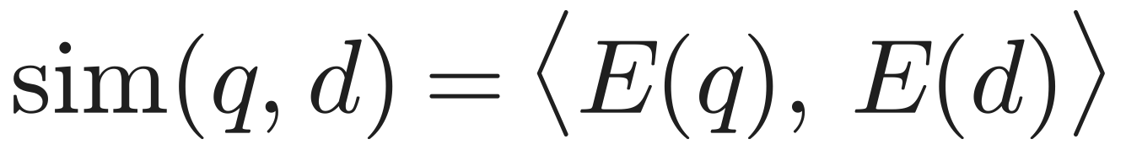
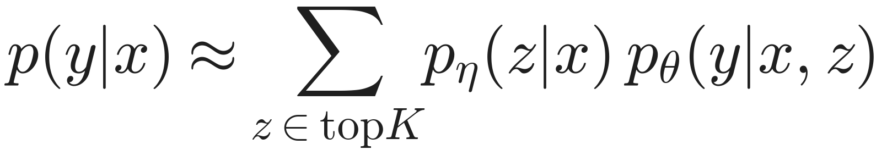
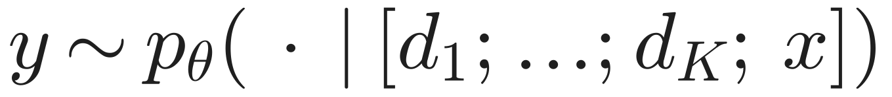

RAG in one slide
Query x
Retriever R
Top-K passages
Language model
Answer y
dense search over
~21M Wikipedia passages
d1 … dK
(K = 5 here)
Dense retrieval
Classic RAG (Lewis 2020)
In-context RAG (common)
Embed query and passage separately, rank by dot product. Contriever is trained with a contrastive loss; Self-RAG keeps it frozen.
The passage is a latent variable: average the answer over passages, weighted by the retriever. Always retrieves.
Paste all K passages in front of the prompt. No training needed. This is the 'Ret-ChatGPT' baseline.

Slide 4



Why plain RAG falls short
Always retrieves
Irrelevant passages
No grounding check
Top-K passages for every prompt, even 'write an essay about your summer'. Wastes compute and derails creative or reasoning tasks.
The retriever's top hit can be off-topic, and LMs are easily distracted by irrelevant context (Shi et al. 2023).
Nothing makes the output follow the passages, and nothing checks it afterwards, so citations are unreliable.
Ret-ChatGPT on PubHealth:
70.1 → 54.7
Alpaca-13B on PubHealth:
55.5 → 51.1 with retrieval
Open RAG models on ASQA:
2–8% citation precision
Earlier fixes each cover one part: FLARE retrieves when confidence is low, SAIL always prepends passages, Toolformer learns API calls, RLHF needs expensive PPO, and self-refine needs many prompt calls.

Slide 5
Core idea: reflection tokens
Add special tokens to the vocabulary and train ONE model, with ordinary next-token prediction, to write them between its own sentences. Critique becomes next-token prediction.
Retrieve
IsRel
IsSup
IsUse
Should I fetch evidence for the next sentence?
Is passage d relevant to the question x?
Is every claim in my sentence backed by d?
Is the whole answer useful? (not about truth)
Yes · No · Continue
Relevant (best) · Irrelevant
Fully (best) · Partially · No support
5 (best) · 4 · 3 · 2 · 1
sees: x and y<t
before each sentence
sees: x, d
after the passage
sees: x, d, yt
after the sentence
sees: x, y
once, at the end

Slide 6
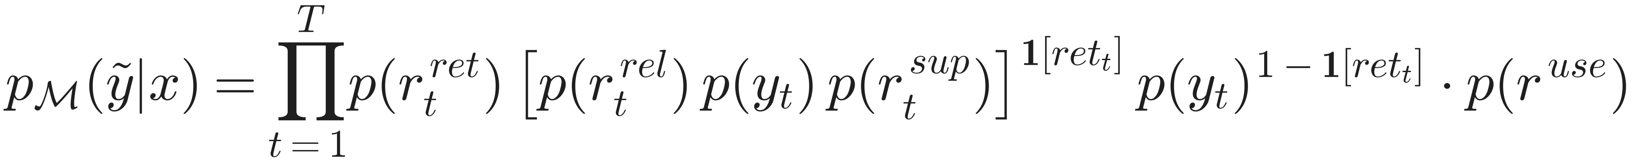
What the model actually writes
Q: when did Walking Dead season 7 come out?
[Retrieve=Yes] <p> …season 7 premiered on October 23, 2016… </p> [IsRel=Relevant] October 23, 2016 [IsSup=Fully] [IsUse=5]
Why this order?
Retrieve first: decide before writing
IsRel before the sentence: the judgment shapes the answer
IsSup after: check the finished sentence
IsUse last: a property of the whole answer
<p>…</p> passages come from the retriever, not the model
Q: write a poem about the sunset
[Retrieve=No] The stars begin to twinkle bright… [Retrieve=No] They flicker like a silent dance… [IsUse=5]
One token stream = chain rule

Slide 7

Training: distil a critic, then teach the generator
GPT-4 labels
Critic C
Annotate 150k
Generator M
Few-shot prompts per token type: 12.6k Retrieve, 19.3k IsRel, 11.2k IsSup, 3.8k IsUse
Llama2-7B fine-tuned on those labels. Agrees with GPT-4: 94% Retrieve, 94% IsSup, 80% IsRel, 74% IsUse
For each sentence: C decides retrieval, R fetches, C labels IsRel / IsSup, keeps one passage. Text unchanged
Llama2 7B / 13B + new tokens, plain next-token training (3 epochs, 4×A100)
At inference: only M + the retriever
C and GPT-4 are only used to build the training data. M has learned to be its own critic.

Slide 8
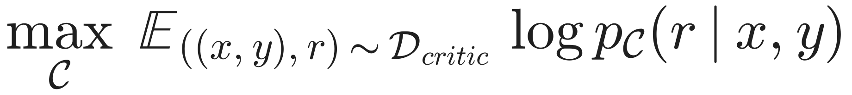
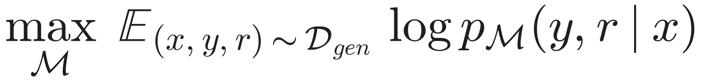
The two training objectives
Critic · Eq. 1
Generator · Eq. 2
A classifier written as language modelling: predict GPT-4's label r as text.
Writes the answer AND its critique, interleaved.
Why mask the passages?
They are inputs from the retriever, not model output
Predicting them would teach memorising Wikipedia, or making up passages
The model still attends to them, so it learns to use them
Why not RLHF / PPO?
PPO: about 4 models in memory and on-policy sampling
Self-RAG: 1 model, static corpus, cross-entropy loss
Behaviour is changed later at inference, without retraining

Slide 9

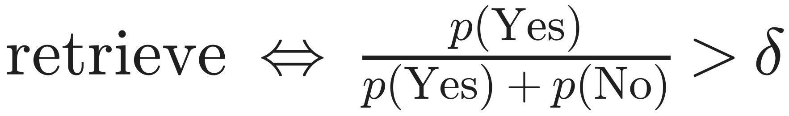
Inference, one sentence at a time
Probability of 'Yes' within the Yes/No group. Default δ = 0.2: retrieve even when 'No' is more likely. δ = 0 for ASQA, where citations are required.
STAGE 01
STAGE 02
STAGE 03
STAGE 04
STAGE 05
Retrieve?
Fetch K
K drafts
Critique
Keep best B
Check the threshold above. If no: write the sentence like a normal LM
R returns the top 5 passages for (x, previous sentence)
One candidate sentence per passage, in parallel, each after its IsRel token
IsSup for each (d, sentence) pair; IsUse for usefulness
Segment-level beam search, B = 2, ranked by the score f

Slide 10
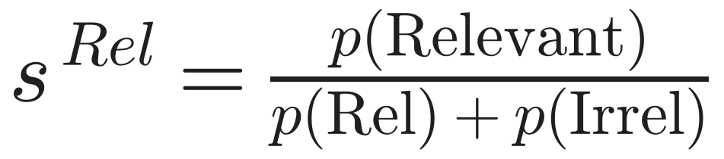
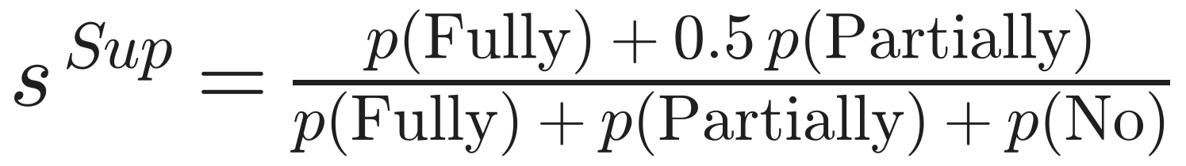
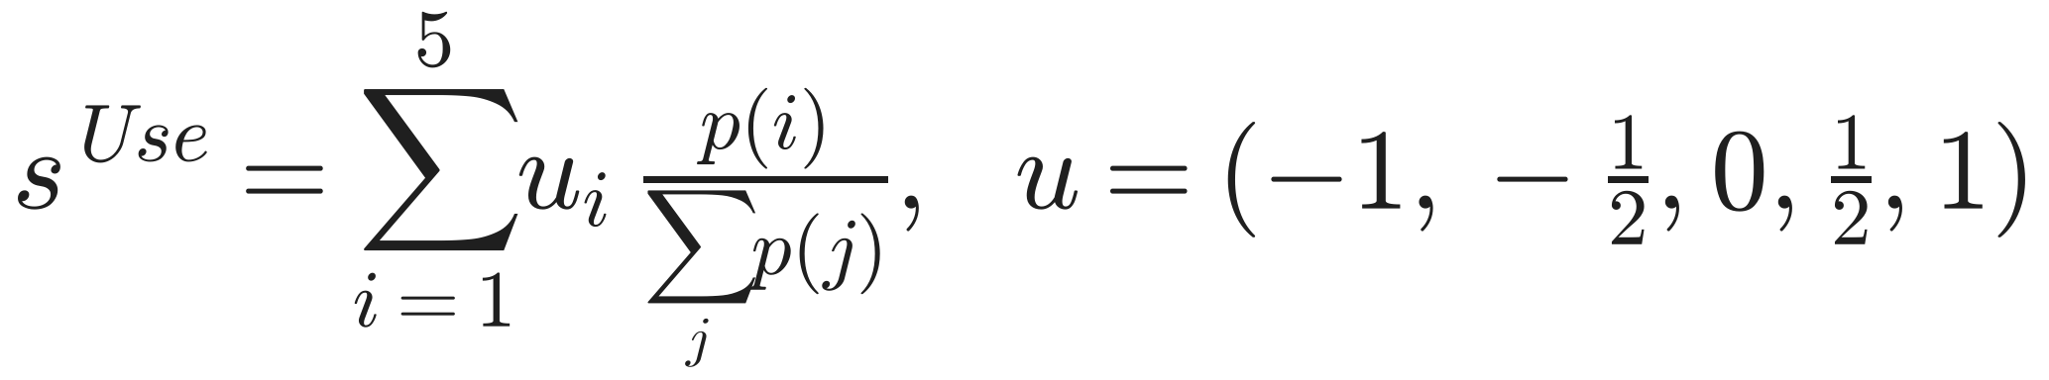
Scoring a candidate sentence
Worked example
(illustrative numbers)
 | d1: states named after people | d2: baby names in Texas
Fluency p(yt) | 0.60 | 0.70
s Rel | 0.90 | 0.20
s Sup | 0.80 | 0.25
s Use | 0.57 | 0.33
Score f | 2.59 (chosen) | 1.31
Defaults: w = (1, 1, 0.5)
Expected value of each critique, in a fixed range
Hard mode: drop any candidate with IsSup = No support
Likelihood alone would pick d2, a fluent sentence built on an off-topic passage. The critique terms pick the grounded d1.

Slide 11

Decomposition
Retrieve if useful
4 small, separately supervised decisions instead of one hard one
Essays and maths stay a normal LM, so versatility is kept
Why it
works
Generate + verify
Cheap critique
Checking a sentence against one passage is easier than writing a correct one
Learned offline with SFT: no RL, no reward model at test time
One passage each
RLHF in disguise
No mixing of noisy passages: bad ones are scored down
Like π* = π_ref · exp(reward / β) / Z: changing w changes the reward, no retraining

Slide 12

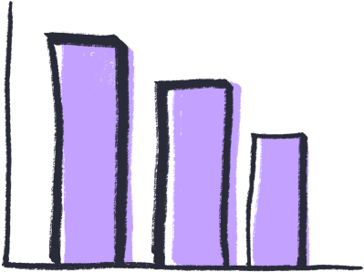

Experimental setup
Closed-set
Short-form QA
Long-form
PubHealth: health-claim fact check
ARC-Challenge: science multiple choice
Metric: accuracy
PopQA long-tail: 1,399 rare-entity questions
TriviaQA: 11,313 questions
Metric: gold answer appears in the output
Biographies: FactScore (% of atomic facts supported)
ASQA: correctness, fluency (MAUVE), citation precision and recall
Baselines No retrieval: Llama2, Alpaca, Llama2-chat, ChatGPT, CoVE-65B · Standard RAG: the same models + the same passages · Same data, no reflection: Llama2-FT · Retrieval-trained: SAIL, Toolformer
Settings Llama2 7B / 13B · 150k training pairs · Contriever-MS MARCO top-5 (+5 web results for Bio and QA) · zero-shot · δ = 0.2, B = 2, w = (1, 1, 0.5)

Slide 13
Main results
Best open model on all six tasks
Beats ChatGPT on PopQA, PubHealth, Bio and citation precision
Not everywhere: ChatGPT without retrieval still wins TriviaQA (74.3) and ARC (75.3)
Same data is not enough: Llama2-FT trails, so the gain comes from the framework
Source: Table 2. Ret-ChatGPT has no Bio score.

Slide 14
Ablations: every piece matters
7B, 50k training examples | PopQA | PubHealth | ASQA em
Self-RAG (full) | 45.5 | 73.5 | 32.1
Train: no retriever | 43.6 | 67.8 | 31.0
Train: no critic | 42.6 | 72.0 | 18.1
Test: never retrieve | 24.7 | 73.0 | –
Test: hard threshold | 28.3 | 72.6 | –
Test: always top-1 passage | 41.8 | 73.1 | 28.6
Test: drop IsSup score | 44.1 | 73.2 | 30.6
Test-time knobs (no retraining)
w Sup 0 → 2
citation precision 69.7 → 70.5, but MAUVE fluency 96 → 86
δ up
fewer retrievals; costs PopQA much more than PubHealth
5k → 150k data
PopQA about 34 → 55 and still rising
No critic → ASQA collapses: reflection tokens are the core
No retrieval hurts PopQA, not PubHealth: needs differ by task
Hard threshold retrieves too rarely: δ is a crucial knob
Human check
IsRel judged correct 90–95%, IsSup 85–90%

Slide 15
Critical analysis
Strengths
Limitations
Assumptions
Improvements
No RL: SFT + reranking
Tunable at test time (δ, w)
Per-sentence citations with self-labels
Strong controls: Llama2-FT, ablations
Every label traces back to GPT-4
Critic errors become training targets
Frozen retriever: detects bad passages, cannot fix them
Up to B·K = 10 drafts per step; latency not reported
One sentence ← one passage
GPT-4 judgments match human ones
The corpus contains the facts
Token probabilities can simply be added
Re-query when every IsRel is low
Learn or calibrate w on a dev set
Let a sentence use several passages
Preference training (DPO) on critique pairs

Slide 16

Impact
2020
2023
2024
2024
2025
RAG
Self-RAG
CRAG, Adaptive-RAG
Agentic RAG
Search as a tool
Lewis et al.: retrieval as a latent variable, always on
Retrieval on demand + self-critique tokens (ICLR 2024)
Grade documents, fall back to web search; route queries by difficulty
LangGraph / LlamaIndex recipes: retrieval, hallucination and answer 'graders' = IsRel / IsSup / IsUse
Assistants decide when to search and cite; RL-trained search-and-reason models
Lasting idea: special tokens as an interface for control and self-evaluation, and test-time reranking instead of retraining.

Slide 17

Team Contribution
Student | Contribution | Score | Main work
[Student A] | [Equal / Partial] | [1.0] | [e.g. problem & motivation, slides 2–4]
[Student B] | [Equal / Partial] | [1.0] | [e.g. method & equations, slides 5–11]
[Student C] | [Equal / Partial] | [1.0] | [e.g. experiments, slides 12–14]
[Student D] | [Equal / Partial] | [1.0] | [e.g. critique & impact, slides 15–16]
Scores reflect actual relative contribution (preparation, understanding, slides, presentation), as the rubric requires.

Slide 18

Thank you!
Questions?
Paper: arxiv.org/abs/2310.11511
Code and models: selfrag.github.io

