Slide 1

Don’t Panic
A Developer’s Guide To Security
Sebastiaan Zeeff
Ordina Pythoneers

Slide 2
Why are developers so important for security?
Notes:
Alright, you might not believe it, but this is the most important question that I going to try to answer in this talk.
"Why are developers so important for security?"
Now, I can already hear you thinking: Of course developers are very important for security! Are they not directly involved in developing the application or project that needs to be secure? If the codebase is insecure to begin with, chances are the entire project is going to be insecure.
This seems almost trivial, right?
And, yet, some don't seem think that developers are all that important.
Or, rather, they don't seem to think that developers take security all that seriously. They may even think that developers don't really care about security..
In fact, I was reading an article about security a few months ago that that contained this quote [NEXT]

Slide 3
"You know how it goes: mention 'security' to your typical developer, and you're likely to be met with an eye-roll at best, or puzzlement at worst. Generally, the whole security thing is seen as someone else's problem."
Notes:
[PAUZE] [HEAD SHAKE] [POINT]
"You know how it goes: mention 'security' to your typical developer,
and you're likely to be met with an eye-roll at best, or puzzlement at worst.
Generally, the whole security thing is seen as someone else's problem."
Now, that right there is a quote.
And I didn't make it up.
You can see the link here at the bottom, this is from an actual article I was reading.
So, what's going on here? Is this just from someone who hates developers?
Or is there more behind it?
While I think this quote is a bit harsh, the author actually does go on to make a few good points about it just below it.
And it made me think: Why does this particular security specialist think that developers don't care about security?
Why did they feel the need for such a hyperbole?
Because, if I consider myself, a developer, I do think that I care about security.
I do think that security is important and I do think it's part of my job to contribute to it
And, if I'm not mistaken, so do many of you here in this room.
Which is, I know, a bit easy to say because you are all here listening to talk about security, but still, it does make me think
In fact, if you make it past this quote in the article, the author does on to explain why they think this is.
They say that developers are typically focused on building software that is functional, that is brimming with innovative features, and that is delivered within a tight project timeline.
That security often just isn't a priority at the coding level.
And I do think the author is on to something; I just don't think it's because us developers don't care.
I think we do care.
Moreover, I think that we can learn something important if we dive into the question of why developers behave as-if they don't love security.
Or, that we behave in way that makes security specialists think we don't care about security.
I think that at the core of this

Slide 4
Why do developers behave as if they don't care about security?
Notes:
But I think that it's important we dive deeper into the question of why developers behave as-if they don't love security.
Or, that we behave in way that makes security specialists think we don't care about security.
I think that at the core of this

Slide 5
Safety Culture

Slide 6



Slide 7
Safety Culture
Security Culture

Slide 8
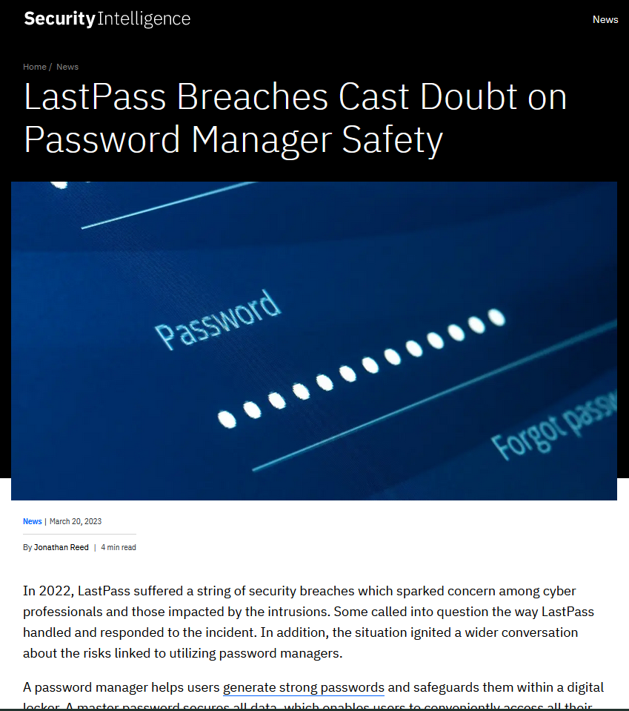

Slide 9
Why are developers so important for security?
Notes:
Alright, you might not believe it, but this is the most important question that I going to try to answer in this talk.
"Why are developers so important for security?"
Now, I can already hear you thinking: Of course developers are very important for security! Are they not directly involved in developing the application or project that needs to be secure? If the codebase is insecure to begin with, chances are the entire project is going to be insecure.
This seems almost trivial, right?
And, yet, some don't seem think that developers are all that important.
Or, rather, they don't seem to think that developers take security all that seriously. They may even think that developers don't really care about security..
In fact, I was reading an article about security a few months ago that that contained this quote [NEXT]

Slide 10
You don't have to be
a security expert
to contribute to security

Slide 11


Kelsey Hightower
@kelseyhightower
I think we are asking developers to do too much by shifting everything left including security. While it should be a collaborative effort, the idea that developers need to become security experts, in addition to everything else, just isn't sustainable.
7:13 PM · Jun 6, 2023 · 133.4K Views · 91 Retweets · 16 Quotes · 514 Likes · 69 Bookmarks

Slide 12
You don't have to be
a security expert
to contribute to security

Slide 13
You don't have to be
a security expert
to contribute to security

Slide 14
Shift Left

Slide 15
Start
Shift Left

Slide 16

Defence in depth

Slide 17
Swiss Cheese Model (James Reason, 1990)
Active Failures
Disaster
Latent Conditions

Slide 18
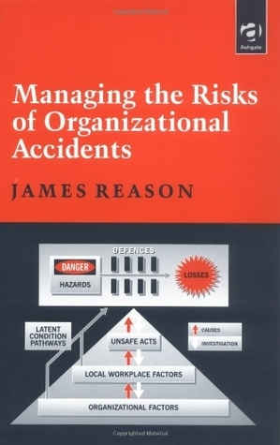

Slide 19
What can you
do to prevent holes
in your projects?
Notes:
Alright, you might not believe it, but this is the most important question that I going to try to answer in this talk.
"Why are developers so important for security?"
Now, I can already hear you thinking: Of course developers are very important for security! Are they not directly involved in developing the application or project that needs to be secure? If the codebase is insecure to begin with, chances are the entire project is going to be insecure.
This seems almost trivial, right?
And, yet, some don't seem think that developers are all that important.
Or, rather, they don't seem to think that developers take security all that seriously. They may even think that developers don't really care about security..
In fact, I was reading an article about security a few months ago that that contained this quote [NEXT]

Slide 20
1. Learn secure design principles
2. Adopt mature security practices
3. Know how to mitigate common vulnerabilities
Notes:
Alright, you might not believe it, but this is the most important question that I going to try to answer in this talk.
"Why are developers so important for security?"
Now, I can already hear you thinking: Of course developers are very important for security! Are they not directly involved in developing the application or project that needs to be secure? If the codebase is insecure to begin with, chances are the entire project is going to be insecure.
This seems almost trivial, right?
And, yet, some don't seem think that developers are all that important.
Or, rather, they don't seem to think that developers take security all that seriously. They may even think that developers don't really care about security..
In fact, I was reading an article about security a few months ago that that contained this quote [NEXT]

Slide 21
1. Learn secure design principles
Defence in Depth
Minimize your
attack surface
Keep it Simple,
Avoid Complexity
Secure data at rest
Avoid security
by obscurity
Least Privilege
No, unless...
Fail Securely
Validate inputs
Notes:
Alright, you might not believe it, but this is the most important question that I going to try to answer in this talk.
"Why are developers so important for security?"
Now, I can already hear you thinking: Of course developers are very important for security! Are they not directly involved in developing the application or project that needs to be secure? If the codebase is insecure to begin with, chances are the entire project is going to be insecure.
This seems almost trivial, right?
And, yet, some don't seem think that developers are all that important.
Or, rather, they don't seem to think that developers take security all that seriously. They may even think that developers don't really care about security..
In fact, I was reading an article about security a few months ago that that contained this quote [NEXT]

Slide 22
1. Learn secure design principles
Defence in Depth
Minimize your
attack surface
Keep it Simple,
Avoid Complexity
Secure data at rest
Avoid security
by obscurity
Least Privilege
No, unless...
Fail Securely
Validate inputs
Notes:
Alright, you might not believe it, but this is the most important question that I going to try to answer in this talk.
"Why are developers so important for security?"
Now, I can already hear you thinking: Of course developers are very important for security! Are they not directly involved in developing the application or project that needs to be secure? If the codebase is insecure to begin with, chances are the entire project is going to be insecure.
This seems almost trivial, right?
And, yet, some don't seem think that developers are all that important.
Or, rather, they don't seem to think that developers take security all that seriously. They may even think that developers don't really care about security..
In fact, I was reading an article about security a few months ago that that contained this quote [NEXT]

Slide 23
1. Learn secure design principles
Defence in Depth
Minimize your
attack surface
Keep it Simple,
Avoid Complexity
Secure data at rest
Avoid security
by obscurity
Least Privilege
No, unless...
Fail Securely
Validate inputs
Notes:
Alright, you might not believe it, but this is the most important question that I going to try to answer in this talk.
"Why are developers so important for security?"
Now, I can already hear you thinking: Of course developers are very important for security! Are they not directly involved in developing the application or project that needs to be secure? If the codebase is insecure to begin with, chances are the entire project is going to be insecure.
This seems almost trivial, right?
And, yet, some don't seem think that developers are all that important.
Or, rather, they don't seem to think that developers take security all that seriously. They may even think that developers don't really care about security..
In fact, I was reading an article about security a few months ago that that contained this quote [NEXT]

Slide 24


2. Mature Security Practices
High Level
Abstract
ISO 27001
OWASP Software Assurance Maturity Model (SAMM)
Create a formal definition of the build process so that it becomes consistent and repeatable.
OWASP DevSecOps
Maturity Model (DSOMM)
Pinning of artifacts
Low Level
Doing
Adapted with permission from a talk by Timo Pagel (OWASP DSOMM Lead)
Notes:
Alright, you might not believe it, but this is the most important question that I going to try to answer in this talk.
"Why are developers so important for security?"
Now, I can already hear you thinking: Of course developers are very important for security! Are they not directly involved in developing the application or project that needs to be secure? If the codebase is insecure to begin with, chances are the entire project is going to be insecure.
This seems almost trivial, right?
And, yet, some don't seem think that developers are all that important.
Or, rather, they don't seem to think that developers take security all that seriously. They may even think that developers don't really care about security..
In fact, I was reading an article about security a few months ago that that contained this quote [NEXT]

Slide 25
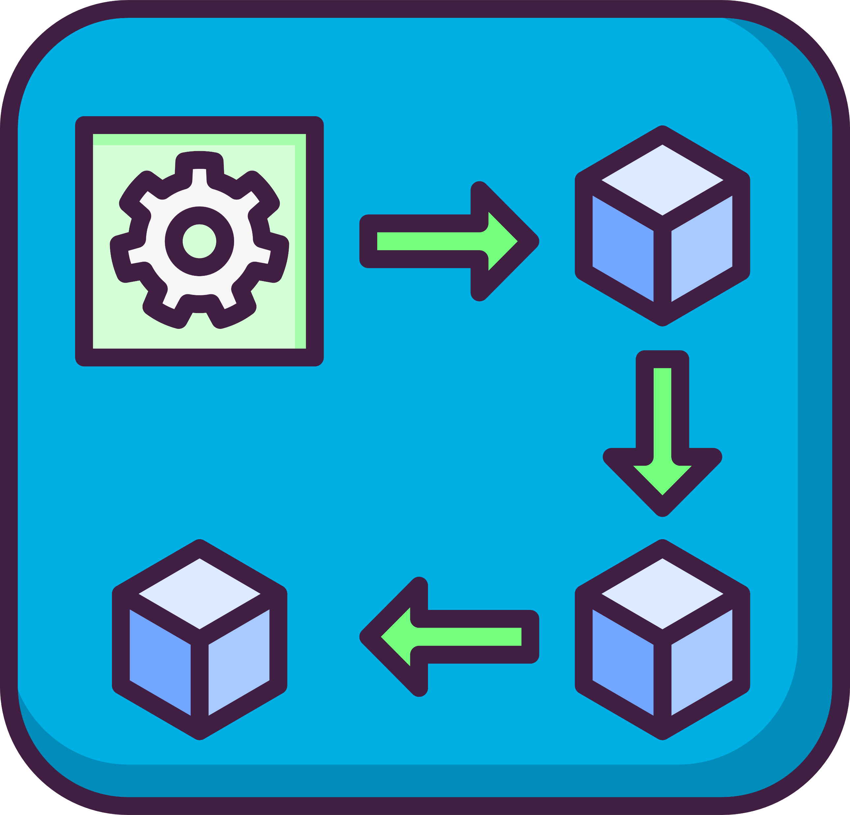




OWASP DSOMM Dimensions
Build and Deployment
Build
Culture & Organization
Deployment
Implementation
Patch Management
Information Gathering
Testing and Verification

Slide 26
OWASP DSOMM Dimensions
Build and Deployment
Build
Culture & Organization
Deployment
Implementation
Patch Management
Information Gathering
Testing and Verification

Slide 27
Maturity Levels with Activities
Level 5
Level 4
Usage of short maximum image lifetimes
Level 3
Level 2
Nightly Builds
Reduction of Attack Surface
Maximum Image Lifetime
Level 1
Patch Policy
Automated Patch PRs
Subdimension
Build and Deployment: Patch Management

Slide 28
Maturity Levels with Activities
Level 5
Advanced Abuse Stories
Level 4
Advanced Threat Modelling
Level 3
Threat Modelling (business level)
Simple Abuse Stories
Treat Modelling Processes + Standards
Level 2
Security Targets are communicated
Level 1
Simple Threat Modelling
Subdimension
Culture and Organization: Design

Slide 29
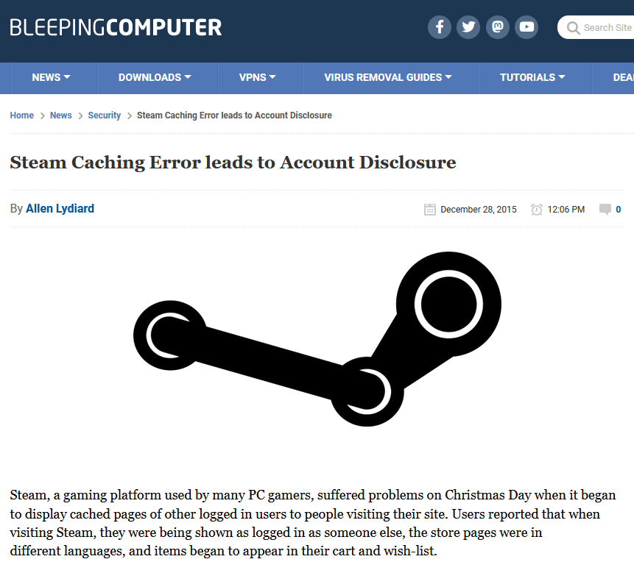

Slide 30
3. Know common vulnerabilities
Look at popular "top 10" lists (but don't forget to dive deeper)
Don't stay passive: Practice with exploitation challenges
Don't reinvent the wheel: Look up standard tools/techniques
Share identified vulnerabilities with your colleagues

Slide 31
Closing remarks
Take it slow: Don't try to do everything at once
Be pragmatic: Don't strive for perfection
Be vocal: We can only build a security culture together

Slide 32


Don't Panic! A Developer's Guide To Security Sebastiaan Zeeff https://sebastiaanzeeff.nl https://linkedin.com/in/sebastiaanzeeff Slides are available on Discord in the ”Talk Slides & Artifacts”
https://sebastiaanzeeff.nl/
https://www.linkedin.com/in/sebastiaanzeeff/
Notes:
Thank you so much for that introduction!
And, I'm really happy to be here. I do love Groningen, although I might just be a little bit biased because my ancestors used to live around here going back centuries.
Anyway, you're not here for my family history and neither am I.
Today, I'm going to talk about security. And this comes with a bit of a disclaimer.
If you've ever seen one of my previous talks, chances are that it was a highly technical talk. I talked about a lot of different topics, like the internals of the Python interpreter, or on some of the more advances language features of Python or an asynchronous ORM frameworks, but all of those talks had one thing in common: I was diving into technical details. And while I often simplify concepts to make them accessible, most of the points I made in those talks were technical facts and I typically do try to stay objective, if you believe in such a thing.
Well, not today. today I'm here to talk about security, and while I like to cite my sources, I am also going to share my opinions and experiences. This also means that it's perfectly to disagree with some of the things that I'm going to say or to have a different perspective on some of the topics. And, in fact, if you do have an interesting perspective or opinion to share, I invite all of you to come talk to me after my talk. I think it's best that we do it after, but do talk to me.
And one final disclaimer, I'm not a security expert.
I'm someone who's interested in security, I'm someone who's like to champion security, and raise awareness about security, but, ultimately, I'm a developer. That is my main job. So, this isn't only a guide for developers, it's also a guide by a developer. So, it's truly "A developer's guide to security".
Alright, I think I've mentioned enough disclaimers. Let's talk about security, yeah?

