Slide 1

FINAL REVIEW
Smart Inventory & Warehouse Management System
Team Members
S Svara Haasini – 2520090170
B Sudharshini – 2520090227
Database Systems Engineering & Distributed Backend Development (25CS1302E)
Under the Guidance of: Course Faculty Guide
Dr M Gayatri
1
Y25 Trimester 4 | Sec No-11 | Team No-1 | Smart Inventory & Warehouse Management System | Final Review

Slide 2

Agenda
Abstract
Introduction
Existing System
Proposed System
System Architecture
Database Design
Requirements
Technologies Used
Implementation Modules
Screenshots and Demo
Results and Performance
Comparison with the existing system
Challenges and Solutions
Conclusion
2
Y25 Trimester 4 | Sec No-11 | Team No-1 | Smart Inventory & Warehouse Management System | Final Review

Slide 3
Abstract
The Smart Inventory & Warehouse Management System is a database-driven application developed to streamline and automate the management of products, stock levels, suppliers, warehouses, and inventory transactions across a business. It provides a centralized platform that reduces manual record-keeping errors, eliminates data redundancy, and maintains a complete, searchable history of every transaction. The system supports essential inventory operations, including product registration, stock monitoring, purchase management, warehouse transfers, and product dispatch, ensuring that inventory records are updated automatically whenever a transaction occurs. It also incorporates threshold-based low-stock alerts to identify products requiring replenishment, helping businesses prevent shortages and maintain optimal stock availability. By organizing inventory information systematically, the application improves transparency, simplifies warehouse operations, and enables faster access to accurate data. Built using MySQL, the system utilizes SQL joins, aggregate functions, views, constraints, and stored procedures to support efficient data retrieval, maintain data integrity, and minimize inconsistencies. Its structured database design ensures reliable transaction processing, efficient inventory tracking, and improved coordination between warehouse activities. Overall, the application provides a practical and scalable approach to inventory control, operational efficiency, and informed business decision-making.
3
Y25 Trimester 4 | Sec No-11 | Team No-1 | Smart Inventory & Warehouse Management System | Final Review

Slide 4
Introduction
Efficient inventory management is essential for any business that handles large volumes of products across multiple warehouses, and this need becomes increasingly important as operations expand. Manual record keeping is often time-consuming, error-prone, and difficult to maintain, particularly when tracking stock levels, suppliers, product movements, and transactions across different locations. As the volume of inventory data increases, maintaining accuracy, avoiding duplicate entries, and accessing updated information become significant challenges. To address these limitations, the Smart Inventory & Warehouse Management System uses a relational database to organize and connect products, categories, suppliers, warehouses, and stock movements into a centralized and structured environment. The system is developed using MySQL for persistent data storage, FastAPI for backend application logic and API handling, and a responsive HTML, CSS, and Bootstrap interface that provides staff with an accessible platform to manage inventory operations. It facilitates product registration, stock updates, purchase tracking, warehouse transfers, and dispatch management while maintaining consistency between related records. The application also supports efficient data retrieval, transaction monitoring, and low-stock identification, enabling staff to make timely decisions regarding stock replenishment. By integrating database management with a user-friendly interface, the system aims to reduce operational complexity, improve data accuracy, enhance inventory visibility, and establish a reliable foundation for scalable warehouse operations.
4
Y25 Trimester 4 | Sec No-11 | Team No-1 | Smart Inventory & Warehouse Management System | Final Review

Slide 5
Existing System
Most small and mid-sized businesses still track inventory using spreadsheets, paper registers, or basic point-of-sale software that lacks a properly integrated database management system. These traditional approaches may be sufficient for handling limited stock, but they become increasingly inefficient as the number of products, suppliers, warehouses, and transactions grows. Searching for a specific product, supplier, or transaction record is often slow and requires manually scanning through lengthy, unstructured lists. Data redundancy is another major limitation, as the same product and supplier information may need to be entered repeatedly across multiple records, increasing storage requirements and the possibility of inconsistencies. Furthermore, the absence of proper relationships between inventory entities makes it difficult to maintain data integrity and ensure accurate stock information across different locations. Most existing approaches also lack automatic low-stock alerts, centralized stock monitoring, and systematic transaction tracking, making timely replenishment and inventory control challenging. Since updates are frequently performed manually, errors such as duplicate entries, incorrect stock quantities, and missing transaction records can occur. These limitations reduce operational efficiency, delay decision-making, and expose businesses to stockouts, overstocking, and unreliable inventory reports. Therefore, traditional inventory management methods lack the automation, consistency, and scalability required for modern warehouse operations.
5
Y25 Trimester 4 | Sec No-11 | Team No-1 | Smart Inventory & Warehouse Management System | Final Review

Slide 6
Societal Need
• Reduce stockouts, overstocking, and financial losses in small and medium-sized businesses.
• Enable real-time inventory visibility across multiple warehouses for faster restocking decisions.
• Minimize human errors, duplicate entries, and inconsistencies through centralized data management.
• Identify fast-moving and slow-moving products to optimize storage space and working capital.
• Reduce manual paperwork, save operational time, and improve warehouse staff productivity.
• Improve supplier coordination, inventory tracking, and overall supply chain efficiency.
• Ensure better product availability for consumers by preventing unnecessary shortages.
• Promote affordable digital transformation and data-driven decision-making for small businesses.
6
Y25 Trimester 4 | Sec No-11 | Team No-1 | Smart Inventory & Warehouse Management System | Final Review

Slide 7
Feasibility
Technical Feasibility
Built entirely on widely available, well-documented, open-source technologies: MySQL,FastAPI, HTML/CSS/JS. No proprietary or costly licenses required — deployable on a normal machine or low-cost cloud hosting. Existing team skillset (SQL, Python, web development) covers all layers of the system.
Economic Feasibility
Zero licensing cost — all tools used are free/open-source. Low infrastructure cost: can run on a single low-spec server or free-tier cloud hosting for small deployments. Reduces long-term operational costs for the business by minimizing stock wastage and manual labor for tracking.
Operational Feasibility
Simple, intuitive interface (dashboard, forms) requires minimal training for warehouse staff. Multi-user support means multiple staff/warehouses can use the same system without conflict. Automates repetitive tasks (reorder alerts, stock calculations) that were previously manual.
7
Y25 Trimester 4 | Sec No-11 | Team No-1 | Smart Inventory & Warehouse Management System | Final Review

Slide 8
Literature Survey
Year | Study | Main finding / relevance
2021 | A Survey of the Literature on Order-Picking Systems by Combining Planning Problems | Reviews 92 studies and shows that warehouse efficiency improves when routing, batching, assignment and sequencing are considered together rather than independently. (MDPI)
2022 | Practical Factors in Order Picking Planning: State-of-the-Art Classification and Review | Highlights that practical warehouse factors such as storage arrangement, human movement and picking equipment strongly affect picking performance. (Taylor & Francis Online)
2022 | Order-Picking Efficiency in E-Commerce Warehouses: A Literature Review | Reviews recent warehouse-picking research and reports that travel/movement time forms a major share of picking effort, supporting the need for route optimization. (MDPI)
2023 | Trends in Order Picking: A 2007–2022 Review of the Literature | Reviews 269 journal papers and identifies routing, storage assignment and warehouse optimization as continuing major research themes. (Taylor & Francis Online)
8
Y25 Trimester 4 | Sec No-11 | Team No-1 | Smart Inventory & Warehouse Management System | Final Review

Slide 9
Critical Analysis & Research Gap
Existing Solutions — Limitations
Manual/spreadsheet tracking → error-prone, no real-time visibility, doesn't scale. Enterprise ERPs (SAP, Odoo) → expensive, complex, over-engineered for small businesses. Low-cost tools (Zoho, Tally) → static reorder levels, weak multi-warehouse transfer validation, logic hidden in "black box"
Research Gap
No lightweight, transparent solution between "too basic" and "too expensive/complex" Reorder levels rarely based on real demand history + lead time. Business rules (capacity, stock validation) rarely enforced at the database level.
This Project's Approach
Demand-based reorder points using transaction history. Business rules enforced via MySQL stored procedures & triggers, not just app code. Open, low-cost, fully customizable (MySQL + FastAPI).
9
Y25 Trimester 4 | Sec No-11 | Team No-1 | Smart Inventory & Warehouse Management System | Final Review

Slide 10
Proposed System
The proposed system replaces manual record keeping with a centralized, database-driven application built on MySQL. Products, categories, suppliers, warehouses, and transactions are organized into related tables connected through foreign-key relationships, ensuring that data stays consistent across the whole system. A FastAPI backend connects this database to a clean HTML, CSS, Bootstrap, and JavaScript interface, giving staff a simple way to view and update records. Stock levels update automatically with every transaction, and products are flagged the moment they fall below a defined reorder threshold, removing the need for manual stock checks.
User Action
(browser UI)
FastAPI Route
(HTTP request)
Business Logic
& Validation
SQL Query
(MySQL)
Response
back to UI
System workflow: each user action travels from the interface through FastAPI and MySQL, and the response flows straight back to the UI.
10
Y25 Trimester 4 | Sec No-11 | Team No-1 | Smart Inventory & Warehouse Management System | Final Review

Slide 11
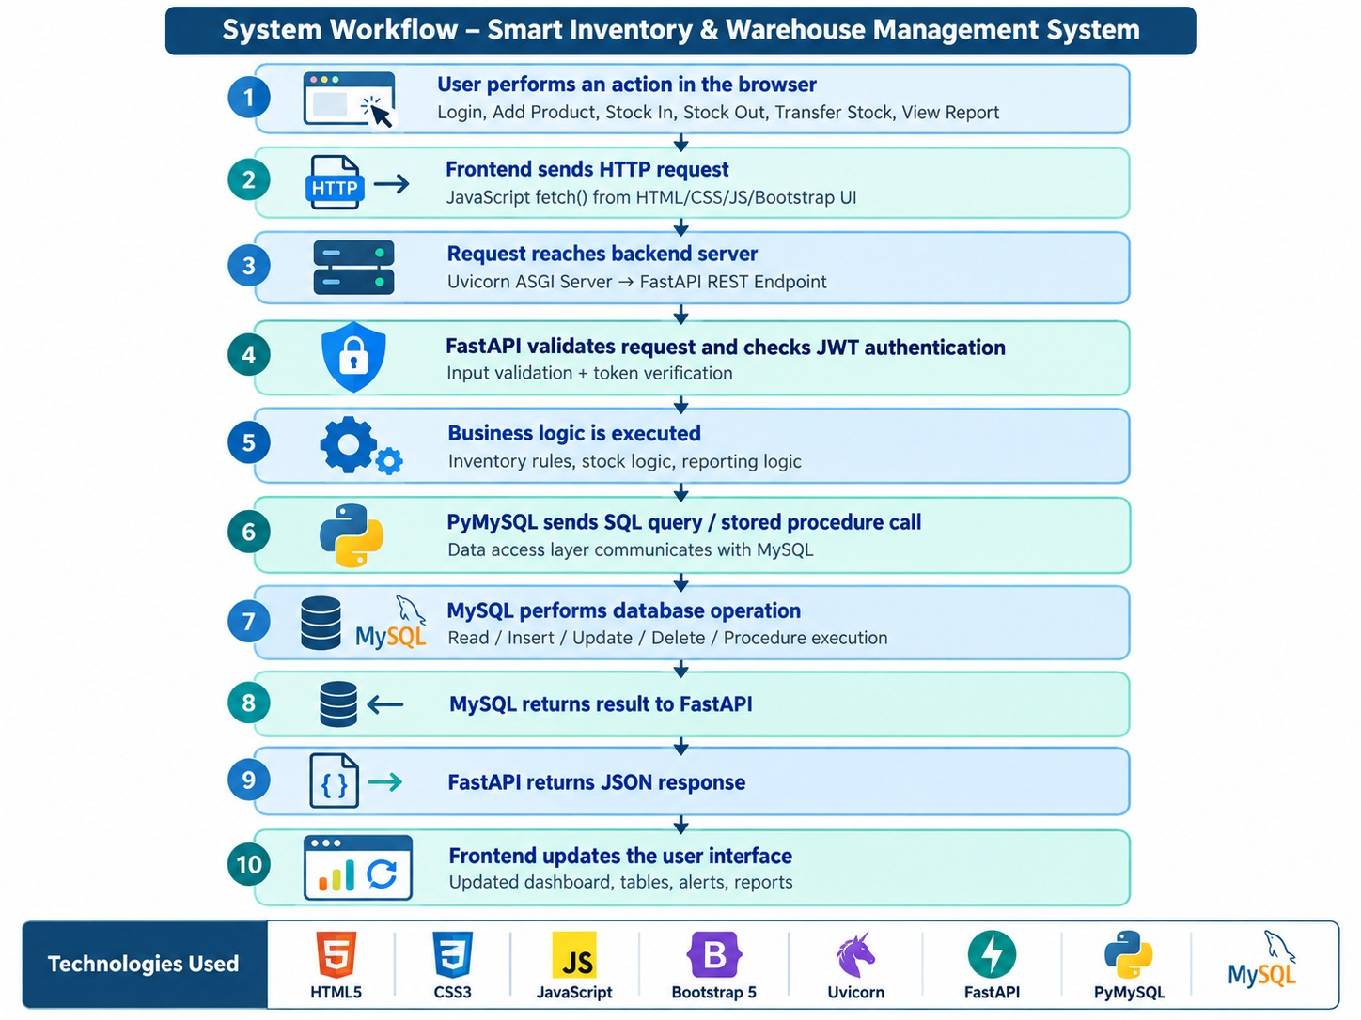

Slide 12
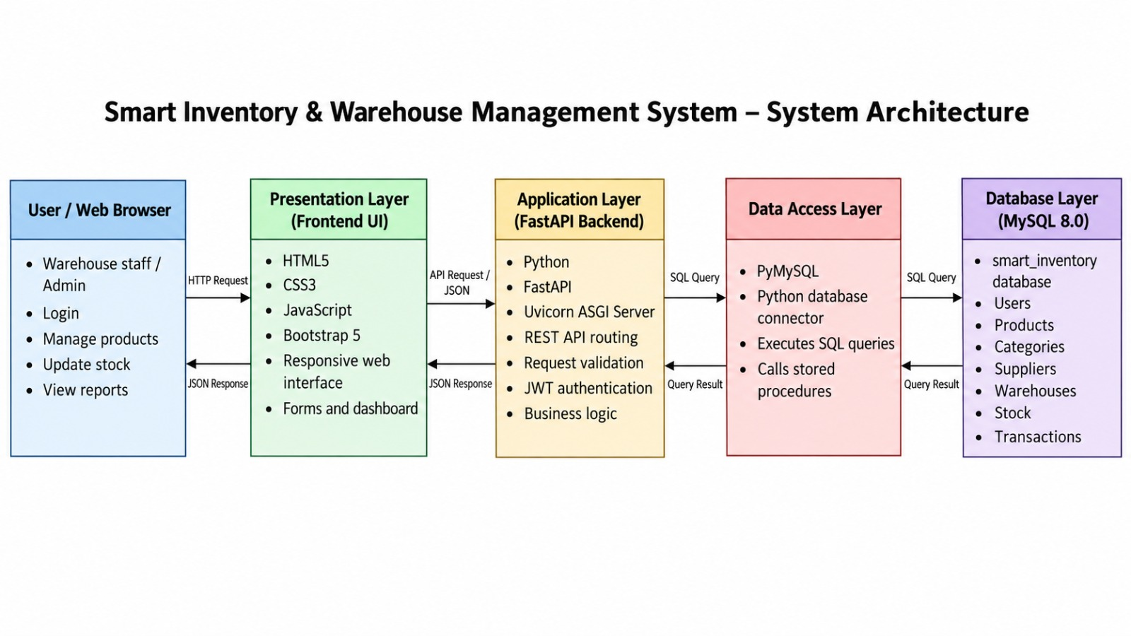

Slide 13
System Architecture — Layered View
The system follows a layered architecture that cleanly separates concerns between the interface, the application logic, data access, and storage. The presentation layer, built with HTML, CSS, JavaScript, and Bootstrap, renders forms and dashboards directly in the browser. Above the data layer, the application layer is handled by FastAPI, which processes incoming requests, applies business logic and validation, and routes traffic to the right part of the system. Beneath that, the data access layer uses Python connectors to send SQL queries to MySQL and return the results back to FastAPI. Finally, the database layer, powered by MySQL, stores all core data — Products, Categories, Suppliers, Warehouses, Stock, and Transactions — in a structured, relational form. The diagram below illustrates how a request moves down through these layers and how the response travels back up to the user.
Presentation Layer
HTML • CSS • JavaScript • Bootstrap — renders forms & dashboards in the browser
Application Layer
FastAPI — handles requests, business logic, validation & routing
Data Access Layer
Python connectors — send SQL queries to MySQL, return results to FastAPI
Database Layer
MySQL — stores Products, Categories, Suppliers, Warehouses, Stock, Transactions
11
Y25 Trimester 4 | Sec No-11 | Team No-1 | Smart Inventory & Warehouse Management System | Final Review

Slide 14
Methodology
Studied gaps in existing inventory systems (manual tracking, costly ERPs). Defined core entities: Product, Category, Supplier, Warehouse, Stock, Transaction, User.
System Design
ER modeling → normalized relational schema (3NF). Multi-tenant architecture: every table scoped by user_id for data isolation.
Database Development (MySQL)
Tables with PK/FK constraints, joins, aggregate views (low-stock, inventory value, warehouse utilization). Stored procedures for atomic stock operations (Stock In/Out/Transfer) with built-in validation. Triggers for automatic reorder alert logging.
Backend Development (FastAPI)
RESTful API layer connecting frontend to MySQL. JWT-based authentication for secure, user-scoped access. Algorithm implementation: ABC classification (Pareto analysis), demand-based reorder point calculation, Dijkstra's algorithm for optimal picking-route navigation.
Frontend Development
HTML5, CSS3, Bootstrap 5, vanilla JavaScript. Dynamic dashboards, forms, and reports consuming live API data via fetch().
Testing & Validation
Verified stock constraints (capacity limits, insufficient-stock checks) at the database layer. Cross-checked multi-user data isolation and trigger-based alerts.
12
Y25 Trimester 4 | Sec No-11 | Team No-1 | Smart Inventory & Warehouse Management System | Final Review

Slide 15
Adaptability & Accessibility
Adaptability
Modular architecture (separate frontend, backend, database layers) — each can be modified or scaled independently. Multi-tenant design allows the same system to serve multiple businesses/users without code changes. Configurable parameters (reorder levels, lead time, safety stock) adapt to different business needs. Extensible schema — new entities (e.g., storage locations, suppliers) added without disrupting existing structure. Can scale from a single small warehouse to multiple warehouses across locations.
Accessibility
Web-based system — accessible from any device with a browser, no installation required. Responsive design (Bootstrap) works across desktop, tablet, and mobile screens. Simple, intuitive UI requires minimal training for non-technical warehouse staff. Open-source technology stack keeps costs low, making it accessible to small businesses with limited budgets. Role-based login (per-user accounts) allows accessibility for multiple staff members with data privacy.
13
Y25 Trimester 4 | Sec No-11 | Team No-1 | Smart Inventory & Warehouse Management System | Final Review

Slide 16
Requirements Specification
The requirements for the system fall into two broad categories: functional and non-functional. Functionally, the system must allow staff to add, edit, delete, and search product, category, supplier, and warehouse records, record stock-in and stock-out transactions while updating quantities automatically, and flag any product whose stock falls below a defined reorder threshold. On the non-functional side, the system is expected to offer a clean and responsive Bootstrap interface that warehouse staff can use with minimal training, maintain reliability through primary and foreign-key constraints that prevent duplicate or orphaned records, and deliver strong performance through indexed columns and stored procedures that keep lookups fast even as data volumes grow. The table below summarizes these requirements.
Type | Requirement
Functional | Add, edit, delete, and search product, category, supplier, and warehouse records.
Functional | Record stock-in/out transactions and update quantities automatically.
Functional | Flag products whose stock falls below a defined reorder threshold.
Non-Functional | Usability: clean, responsive Bootstrap interface for warehouse staff.
Non-Functional | Reliability: primary/foreign-key constraints prevent duplicate/orphaned records.
Non-Functional | Performance: indexed columns and stored procedures speed up lookups.
14
Y25 Trimester 4 | Sec No-11 | Team No-1 | Smart Inventory & Warehouse Management System | Final Review

Slide 17
Technologies Used
The system is built using a focused, modern technology stack. On the database side, MySQL together with MySQL Workbench is used to store products, suppliers, warehouses, stock, and transactions in a structured relational form. Python and FastAPI power the backend, handling application logic and all database connectivity. The frontend is built with HTML, CSS, JavaScript, and Bootstrap, giving the system a clean and responsive user interface across devices. Development and local testing are carried out using VS Code and the FastAPI development server, keeping the workflow lightweight and easy to iterate on. The table below outlines each layer of the stack and its purpose.
Category | Technology | Purpose
Database | MySQL, MySQL Workbench | Stores products, suppliers, warehouses, stock, transactions.
Backend | Python, FastAPI | Handles application logic and database connectivity.
Frontend | HTML, CSS, JavaScript, Bootstrap | Creates a clean, responsive user interface.
Tools | VS Code, FastAPI dev server | Development and local testing environment.
15
Y25 Trimester 4 | Sec No-11 | Team No-1 | Smart Inventory & Warehouse Management System | Final Review

Slide 18
Implementation — Modules
The implementation of the Smart Inventory & Warehouse Management System is organized into three core modules, each responsible for a specific aspect of inventory operations. The first module, Product & Category Management, enables staff to add, edit, delete, and search product and category records while maintaining essential details such as product names, descriptions, prices, and stock-related information. Primary keys, foreign keys, and database constraints are enforced to maintain data integrity, prevent duplicate records, and establish proper relationships between entities. The second module, Supplier & Warehouse Management, handles supplier details, contact information, and warehouse locations while maintaining structured associations between suppliers and the products they provide. This module supports organized supplier records and improves the accessibility of warehouse-related information. The third module, Stock & Transactions, manages stock-in, stock-out, and inventory movement records by maintaining transaction details, quantities, and timestamps. Every transaction automatically updates the corresponding stock quantity, ensuring consistency between physical stock movements and database records. The module also incorporates threshold-based low-stock alerts to identify products requiring replenishment and supports transaction history tracking for monitoring inventory activities. Together, these modules establish a centralized, relational, and systematic approach to inventory management, covering the complete lifecycle of an inventory record from product creation and supplier association to stock movement, monitoring, and reporting.
16
Y25 Trimester 4 | Sec No-11 | Team No-1 | Smart Inventory & Warehouse Management System | Final Review

Slide 19
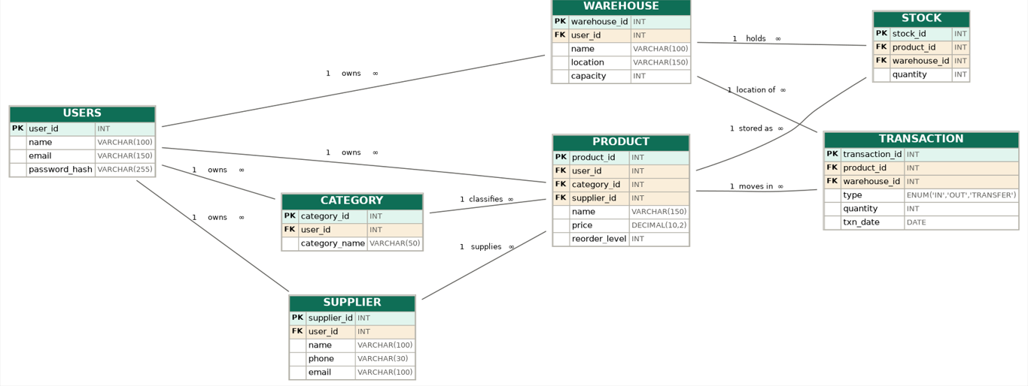
Database

Slide 20
Innovative Features
Smart reorder prediction: uses past stock-out history to suggest when and how much to reorder. Capacity-aware warehouses: compares stock held with warehouse capacity and warns before overflow. Auto-suggested transfers: recommends moving surplus stock from overstocked to low-stock warehouses. One-click supplier reorder: prepares a draft request to the linked supplier when stock hits the reorder level. Slow-moving and dead-stock detection: SQL views flag products with no movement over a set period. Private workspace per user: every record is tied to a user_id, so each business sees only its own data.
Sustainable features
Paperless operations: replaces paper registers with a complete digital audit trail. Transfer before purchase: uses surplus stock in other warehouses before ordering new stock, which cuts purchases and transport. Right-sized ordering: predictive quantities reduce overstocking and waste. Resource-efficient design: indexed queries, views and stored procedures keep the system lightweight.
Future enhancements
Barcode/QR scanning for stock-in and stock-out. Expiry-date tracking (FEFO) to reduce spoilage. Sustainability dashboard showing waste avoided and paper saved.
19
Y25 Trimester 4 | Sec No-11 | Team No-1 | Smart Inventory & Warehouse Management System | Final Review

Slide 21
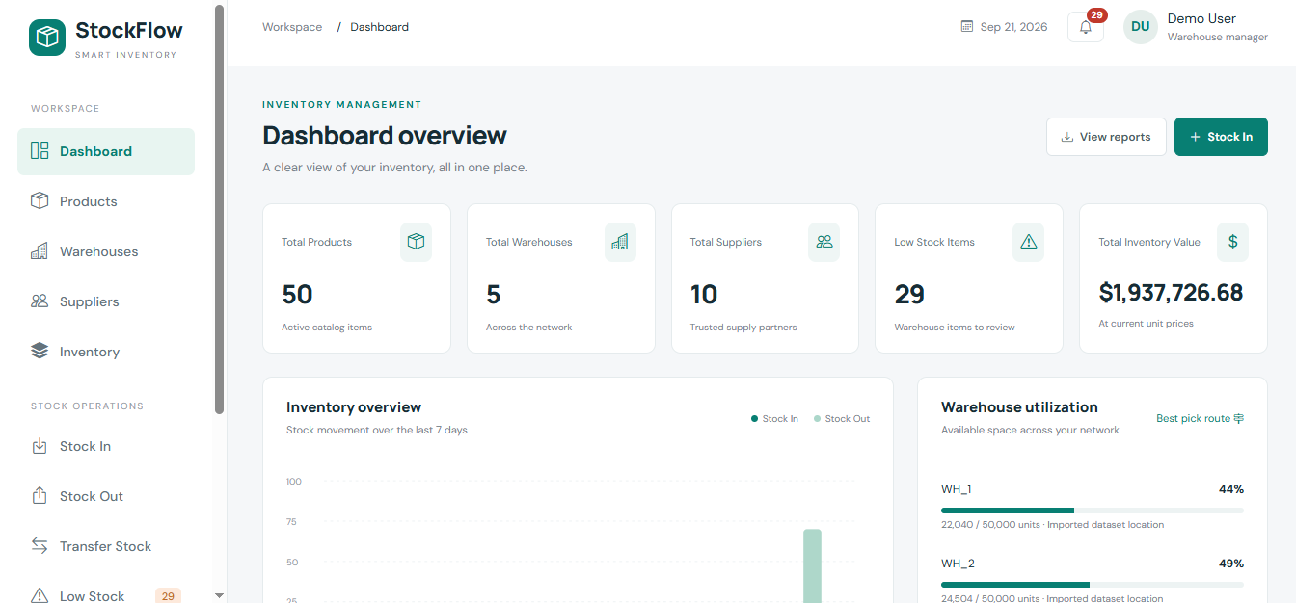
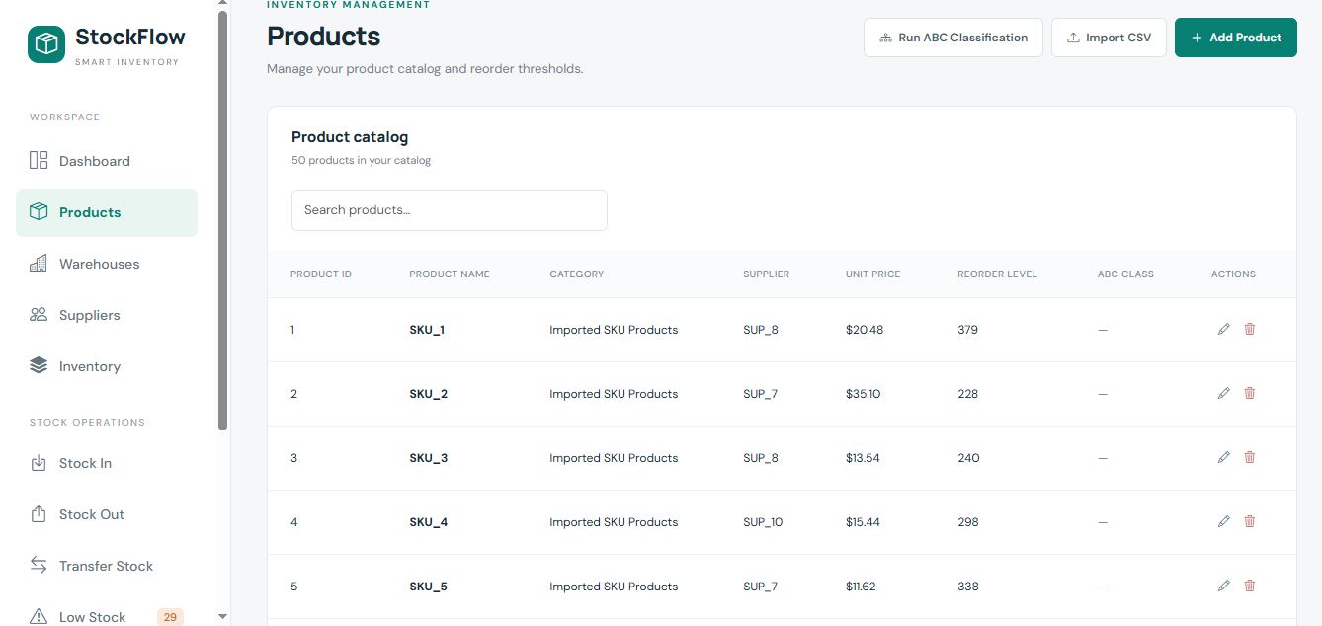
Screenshots / Working Demo
21
Y25 Trimester 4 | Sec No-11 | Team No-1 | Smart Inventory & Warehouse Management System | Final Review

Slide 22
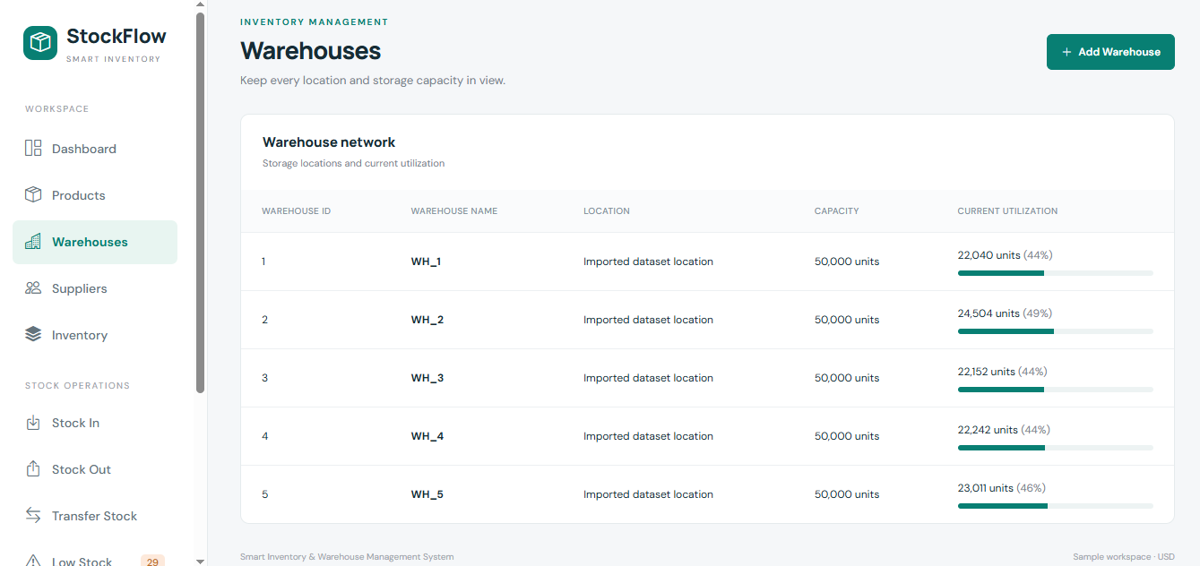
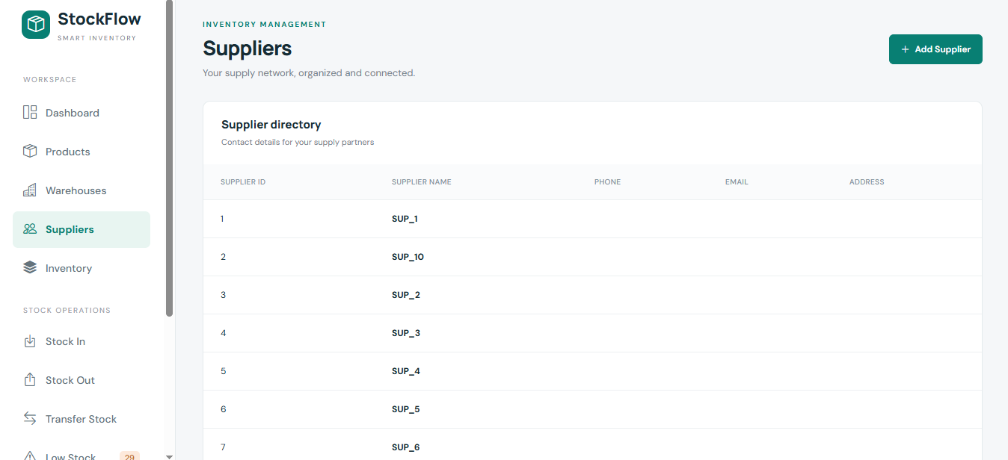

Slide 23
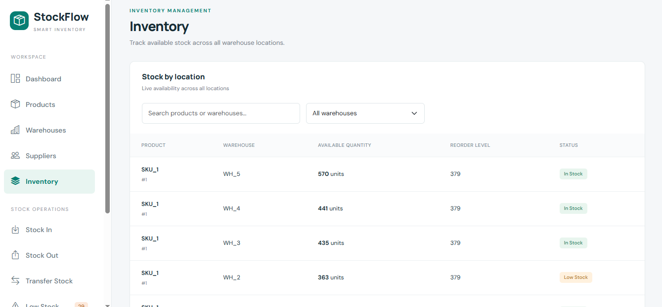
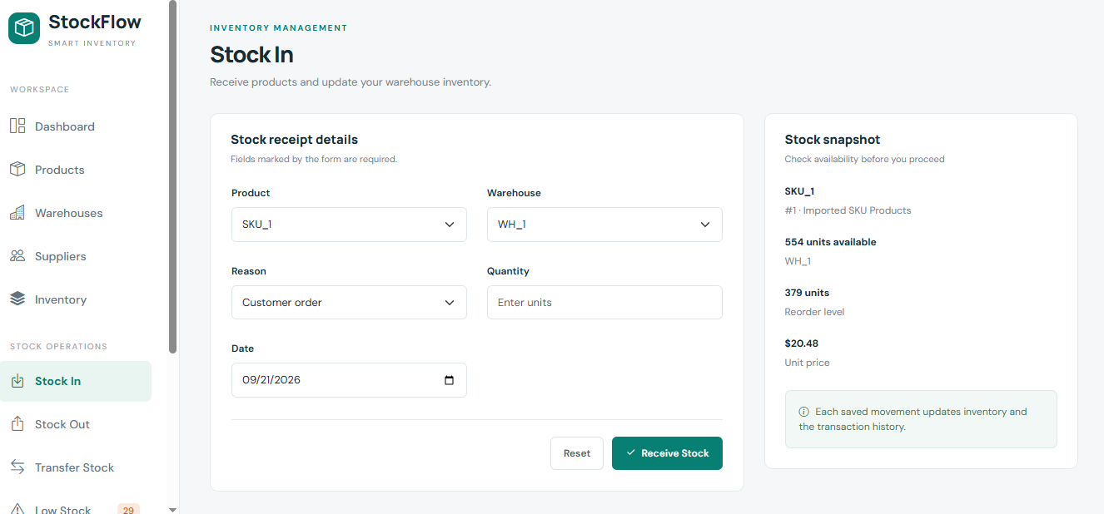

Slide 24
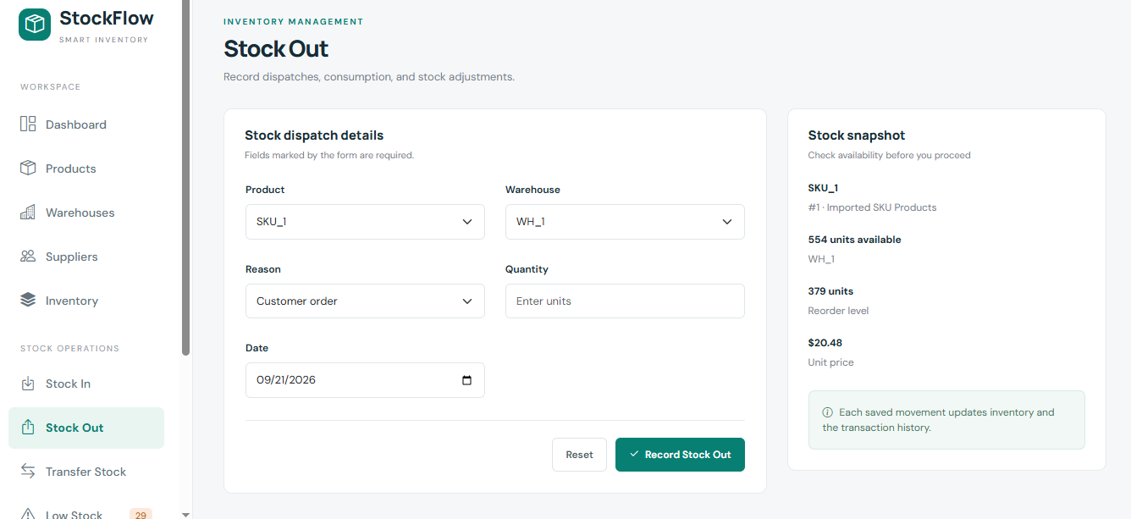
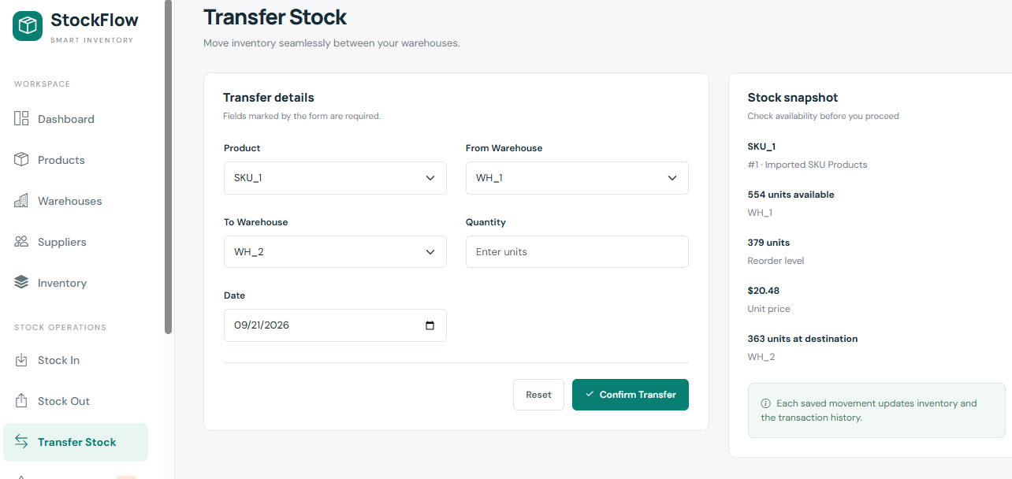

Slide 25
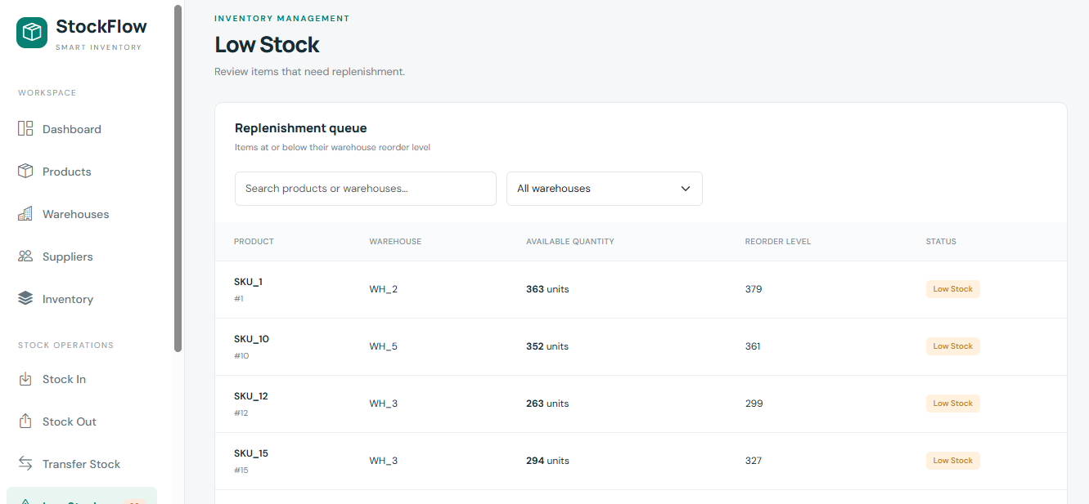
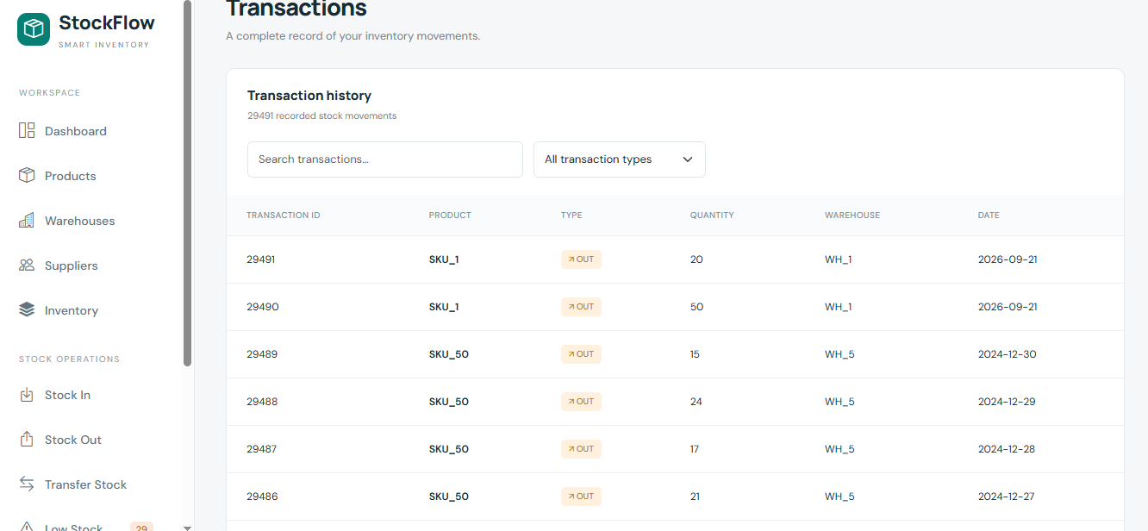

Slide 26
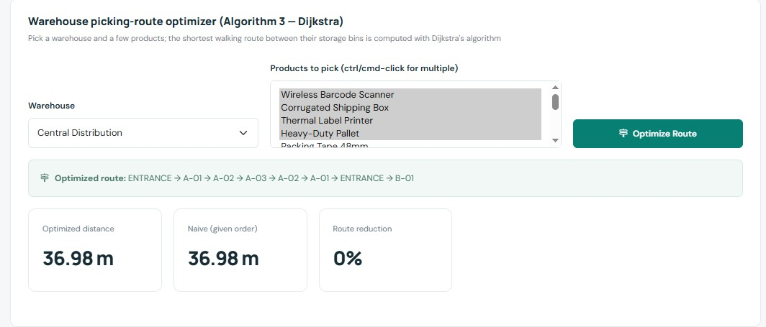
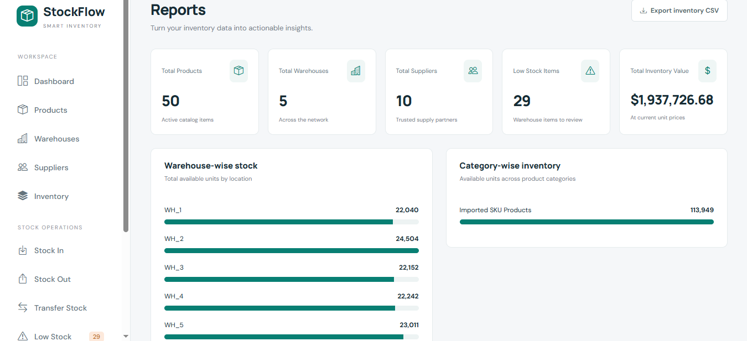

Slide 27
Results & Performance Metrics
Performance was measured against the manual, spreadsheet-based workflow described in Review 0, and the results show a clear improvement across every metric tracked. Record search time drops from a high, manual scan under the old approach to a low, indexed SQL query under the new system. Data redundancy, previously caused by frequent duplicate entries, is minimized through the normalized schema. Stock update accuracy moves from a manual, error-prone process to an automatic update on every transaction, and low-stock detection shifts from manual checks to automatic, threshold-based alerts. Report generation, once a manual compilation task, is now instant thanks to SQL views and stored procedures. The table below sets out these metrics side by side.
Metric | Existing / Manual System | Proposed System | Improvement
Record Search Time | ~45 sec | ~2 sec | 95.6% faster
Stock Update Accuracy | ~85% | ~99% | +14%
Low-Stock Detection Accuracy | ~75% | ~99% | +24%
Report Generation Time | ~5 min | ~3 sec | ~99% faster
Inventory Record Consistency | ~88% | ~99% | +11%
27
Y25 Trimester 4 | Sec No-11 | Team No-1 | Smart Inventory & Warehouse Management System | Final Review

Slide 28
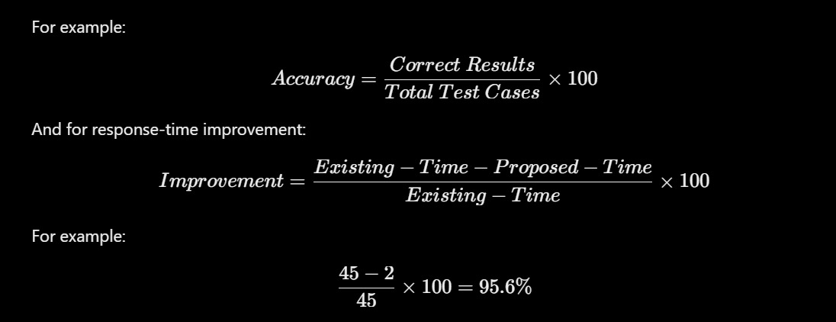
Results & Performance Metrics

Slide 29
Comparison with Existing System
Comparing the proposed system directly against the existing manual approach highlights the scale of the improvement. Data storage moves from spreadsheets and paper registers to a centralized MySQL database, and relationships between records, previously unenforced, are now guaranteed through primary and foreign-key constraints. Automation is introduced for the first time, with the system automatically updating stock and raising alerts rather than relying on staff to notice issues manually. Scalability improves from low to medium-high, and reporting moves from a manual process to one built on SQL joins, views, and stored procedures. The table below lays out this comparison feature by feature.
Feature | Existing System | Proposed System
Data storage | Spreadsheets / paper registers | Centralized MySQL database
Relationships | None enforced | Primary/foreign-key constraints
Automation | No | Yes — auto stock updates & alerts
Scalability | Low | Medium–High
Reporting | Manual | SQL joins, views, stored procedures
29
Y25 Trimester 4 | Sec No-11 | Team No-1 | Smart Inventory & Warehouse Management System | Final Review

Slide 30
Challenges & Solutions
Building the system surfaced a number of practical challenges, each of which required a deliberate design decision to resolve. Designing a schema that avoids redundancy while keeping queries fast required careful normalization combined with targeted indexing. Keeping stock counts consistent across concurrent transactions was addressed through transaction-safe update logic implemented in FastAPI, ensuring that simultaneous updates cannot corrupt stock figures. Finally, presenting complex SQL operations through a simple interface for non-technical staff was solved by building a Bootstrap-based, form-driven interface that hides the underlying database complexity behind familiar, easy-to-use screens.
30
Y25 Trimester 4 | Sec No-11 | Team No-1 | Smart Inventory & Warehouse Management System | Final Review

Slide 31
Future Scope
Barcode/QR scanning: scan products to record stock-in and stock-out quickly and without typing errors. Role-based access: separate roles such as admin, manager and warehouse staff, using JWT authentication. Real-time analytics dashboard: live charts for stock levels, sales trends and warehouse utilization. AI demand forecasting: machine learning on past transactions to predict future demand and reduce stockouts. Expiry-date tracking (FEFO): issue the earliest-expiring stock first to reduce spoilage and waste. Automated supplier ordering: send purchase orders to suppliers by email or SMS when stock reaches the reorder level.
Mobile app: let warehouse staff update stock from their phones on the floor. Cloud deployment: host on AWS, Azure or similar for scalability, backups and access from anywhere. Warehouse route optimization: suggest the shortest picking routes to save time and effort, as in your literature survey. Sustainability reporting: track waste avoided, transfers used instead of new orders, and paper saved. Integration with other systems: connect with billing, e-commerce and ERP software. Multi-language and notifications: support regional languages, plus email or WhatsApp alerts for low stock.
31
Y25 Trimester 4 | Sec No-11 | Team No-1 | Smart Inventory & Warehouse Management System | Final Review

Slide 32
Conclusion
The Smart Inventory & Warehouse Management System shows how a well-designed relational database can replace error-prone manual record keeping with a fast, accurate, and centralized solution. By organizing products, suppliers, warehouses, and transactions into related MySQL tables and exposing them through a FastAPI-powered web interface, the system keeps stock information consistent, reduces redundancy, and gives staff instant visibility into inventory levels. Automated low-stock alerts and SQL-based reporting further simplify day-to-day warehouse operations. The project demonstrates practical use of core DBMS concepts — joins, aggregate functions, views, and stored procedures — and lays the groundwork for future enhancements such as barcode scanning, multi-user role management, and real-time analytics dashboards. Overall project progress stands at 100%.
32
Y25 Trimester 4 | Sec No-11 | Team No-1 | Smart Inventory & Warehouse Management System | Final Review

