Slide 1
Operating system and system programming (25CS2104E)
Multithreaded Linux Application Using POSIX Threads and Mutexes
Review-I
Under the Esteemed Guidance of
Mr. M. Raghupathi
CSE Department
Team Members:
S Svara Haasini – 2520090170
B Sudharshini – 2520090227
Sumanjali – 2520090190

Slide 2
Abstract
Modern multi-core systems rely on concurrent execution for efficiency and responsiveness, but when multiple threads within a process access shared resources at the same time, it can cause race conditions and inconsistent results. This is a key challenge in Operating Systems, since threads share the same memory space and, without proper synchronization, can corrupt shared data. This project addresses this by developing a multithreaded Linux application using POSIX threads (Pthreads) for concurrent execution and mutex locks to synchronize access to critical sections, ensuring correctness and thread safety.

Slide 3
Problem Statement
Modern applications increasingly rely on concurrent execution to use multi-core processors efficiently and stay responsive.
When several threads within the same process access shared resources simultaneously, it can cause race conditions and data inconsistency.
Threads share the address space, memory and file descriptors of their parent process — a fundamental OS/Systems Programming challenge.
Without synchronization mechanisms such as mutexes, concurrent access to shared data can corrupt results and crash the application.
This project designs and implements a multithreaded Linux application using Pthreads for concurrency and mutex locks for synchronization.

Slide 4
Objectives
Understand and apply the concept of multithreading in a Linux environment using the POSIX Threads (Pthreads) library.
Design and implement a C program that creates multiple threads to perform concurrent tasks efficiently.
Identify critical sections in shared data access and use mutex locks to prevent race conditions and ensure data consistency.
Evaluate thread synchronization and thread joining, and demonstrate correct, thread-safe program execution on Linux.

Slide 5
Proposed Methodology
Developed in C on a Linux (Ubuntu) platform using the GCC compiler.
Main program creates a fixed number of worker threads via pthread_create(), each running a common thread function.
All threads share the process address space and access a common shared resource (e.g., shared counter or array).
A pthread_mutex_t protects the critical section — locked before and unlocked immediately after accessing shared data.
Main thread waits for all workers via pthread_join(), then verifies the final, consistent value of the shared resource.
Behaviour is tested and compared with and without mutex protection to demonstrate the effect of synchronization.

Slide 6
OS Concepts / Linux APIs Used
OS Concept / Linux API | Purpose in the Project
Process & Thread Management | Creating and managing multiple threads within a single Linux process using Pthreads.
pthread_create() | Creates new threads that execute a function concurrently with the main thread.
pthread_join() | Main thread waits for worker threads to finish, ensuring synchronized program flow.
Mutex (pthread_mutex_t) | Implements mutual exclusion so only one thread accesses a critical section at a time.
pthread_mutex_lock()/unlock() | Locks and unlocks the critical section around shared data, preventing race conditions.
Critical Section & Race Condition Handling | Shows how uncontrolled concurrent access corrupts results and how synchronization fixes it.

Slide 7
Tools, Platforms & Software Used
Tool / Platform / Software | Purpose
Linux / Ubuntu | Operating system platform on which the application is developed, compiled and executed.
C / C++ | Programming language used for thread creation, mutex synchronization and application logic.
POSIX Threads (Pthreads) Library | Provides the API (pthread_create, pthread_join, pthread_mutex_lock/unlock, etc.).
GCC Compiler | Compiles the C source into an executable, linked with the pthread library (-lpthread).
VS Code / GDB | Used as the code editor and debugger for writing, testing and debugging the application.

Slide 8
System Architecture
Main Thread (main())
pthread_create()
Worker Thread 1
Worker Thread 2
Worker Thread N
Mutex Lock – Critical Section (Shared Resource)
pthread_join()
Consistent, Thread-Safe Output

Slide 9
Individual Contribution
Roll Number | Student Name | Individual Responsibility
2520090170 | S Svara Haasini | Designed the overall program structure, implemented thread creation using pthread_create(), and prepared the project documentation.
2520090227 | B Sudharshini | Implemented the mutex locking mechanism (pthread_mutex_lock/unlock) to protect the critical section and tested for race conditions.
2520090190 | Sumanjali | Implemented thread joining logic using pthread_join(), verified output consistency, and handled debugging/testing on Linux.

Slide 10
Expected Outcome
A fully functional multithreaded Linux application that correctly creates, manages and synchronizes multiple POSIX threads.
Safe concurrent access to shared resources, with mutex locks successfully preventing race conditions.
Accurate and consistent final output verified across multiple program runs.
A clear comparison of inconsistent, unpredictable results without synchronization versus consistent, correct results with mutex-based synchronization.
Practical, hands-on understanding of thread creation, critical sections, mutual exclusion and safe resource sharing in Linux.

Slide 11
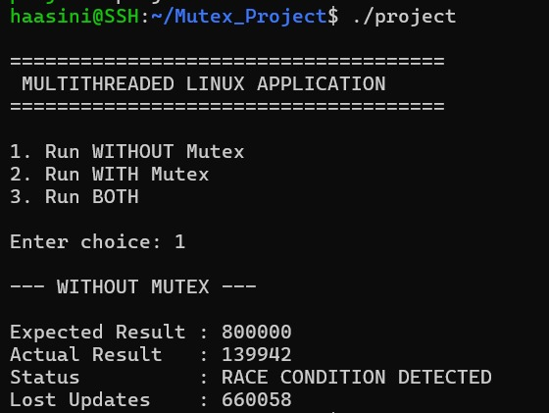
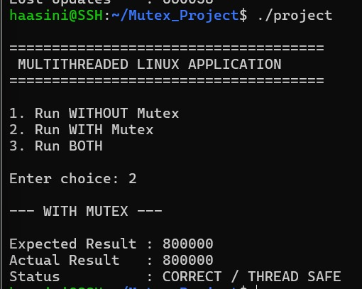

Slide 12
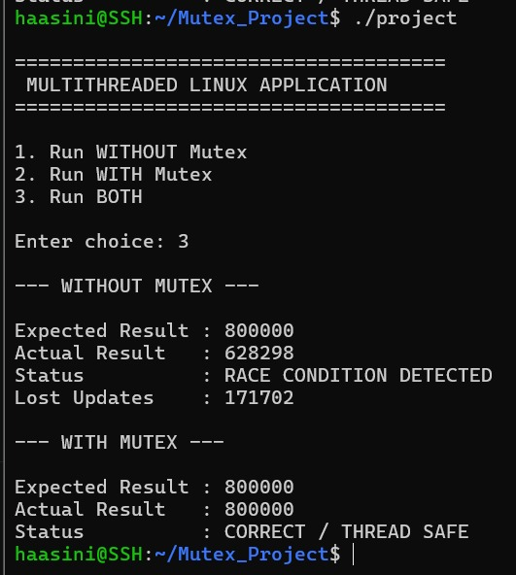

Slide 13
Conclusion
Multithreading improves performance and responsiveness on multi-core systems, but concurrent access to shared data introduces the risk of race conditions.
Using POSIX threads together with mutex locks effectively synchronizes access to critical sections and guarantees thread safety.
The project demonstrates core Operating Systems concepts – concurrency, critical sections and mutual exclusion – through a practical Linux implementation.
It builds a strong foundation for developing more advanced concurrent and parallel systems.

Slide 14
Thank you

