Slide 1
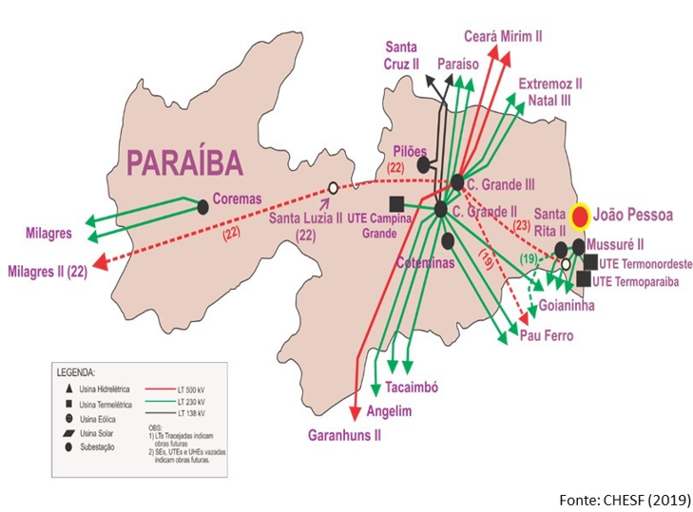
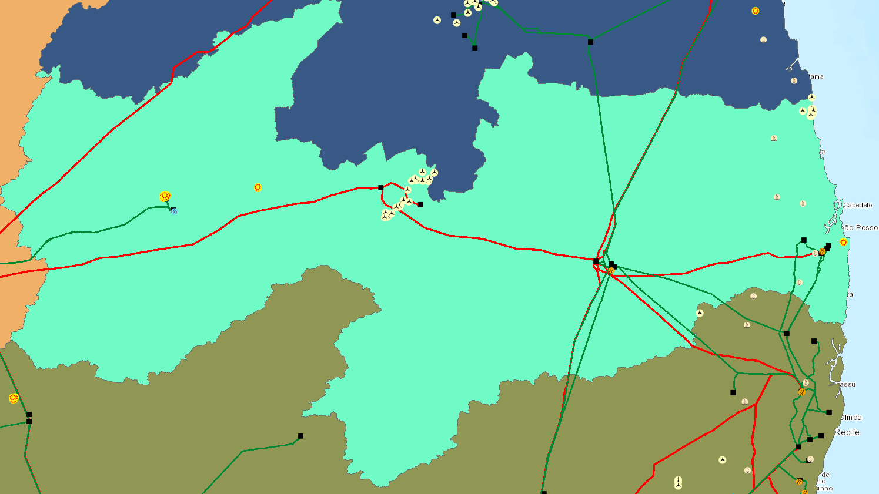
29 linhas de transmissão, sendo:
- 19 intraestaduais e 10 interestaduais
- 9 de 500kV e 20 de 230 kV
Parâmetros disponíveis das linhas de transmissão:
nome, SE de, SE para, comprimento, resistência, reatância, shunt,
Quantidade de SEs na Paraíba: 10

Slide 2
Presentation Template Instructions
Please use this template to prepare your presentation
Fill in Slide 2
Type in the title of the presentation
Specify the number of the preferential subject, name of the main speaker and country (replace the given example)
The logo of the company or affiliation may be added
Specify the Study Committee Number “SC XX”
Save the file with a new name, according to the following syntax:
A1_PS1_Name.ppt (Study Committee, number of the preferential subject, name of the main speaker)

Slide 3
Title of Your Presentation
Name (Country)
SC XX – PS Number
2022 CIGRE Session - Paris - Date
You may insert your country flag on the title slide, see on https://en.wikipedia.org/wiki/Gallery_of_sovereign_state_flags
(select PNG format, 200px).
Delete otherwise.
You may place the logo of your company on the first slide only, otherwise delete.

Slide 4
Table of contents
Introduction
Objective function
Restrictions
Decision parameters

Slide 6


For full-screen picture slide
This white logo can be used for a full-screen picture with a dark background (see example slide 13 on the presentation example document)
Copy and paste this PNG picture on your slide.
For a full-screen picture with a light background, use this PNG logo.

