Slide 1
CUSTOM FONTS & DOMAIN MANAGEMENT
CSCI 1210
Essentials of Web Development

Slide 2
Fonts
By now, hopefully, we all appreciate the fact that web browsers’ customary default font, Times New Roman, is pretty boring
We’ve seen how to change that font family using CSS
But we’re still pretty limited in our selection
TNR / Arial

Slide 3
Fonts
One catch to the font-family property
The display font must be present on the client machine to work
This is why we’ve been specifying a ‘fallback’ font when we use the font-family property - e.g.,
font-family: Arial, Helvetica, sans-serif
If Arial and Helvetica aren’t installed on the client’s computer (i.e., Mac & Linux), the browser will pick the first sans-serif font it finds that is

Slide 4
Fonts
There are a couple of ways to change this, however
CSS3 includes functionality to ‘serve up’ a custom font from the server, but, being CSS3 and not fully adopted yet, we can’t count on it working for all browsers
Google Fonts is another option
* If using the ‘custom font’ option, make sure it’s a (copyright) free font!

Slide 5
Google Fonts
Five steps:
Navigate to Google Fonts - https://www.google.com/fonts
Select the font(s) you want to use
Click on ‘Use’
Copy the link into your HTML document’s head element
Add the font name’s value to the font-family property in your CSS

Slide 6
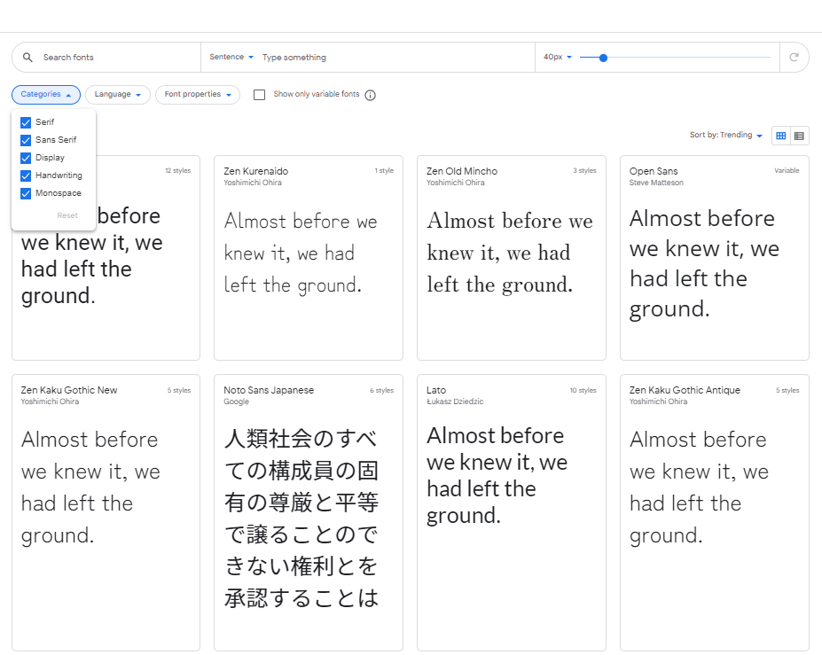
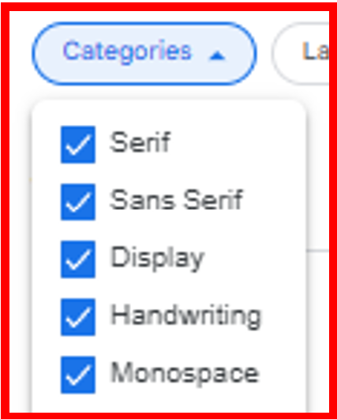

Slide 7
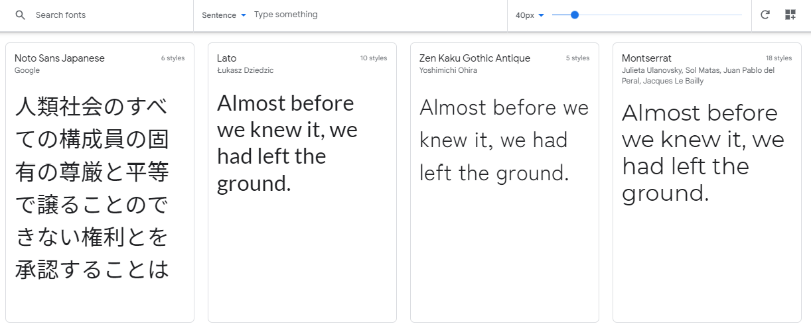
Pick a font. Any font

Slide 8
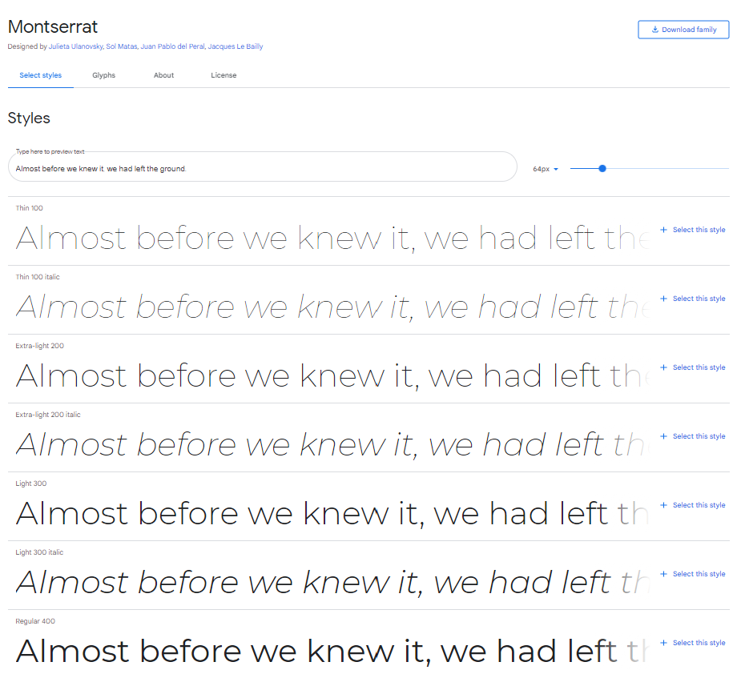
It is best to pick one or two from light, regular, and heavy
Too many options can have a negative effect on page download time

Slide 9
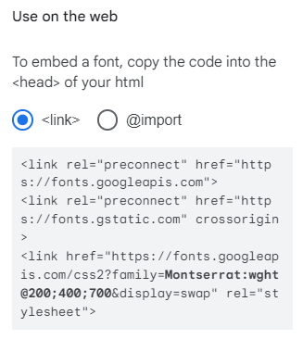
Copy/past into the <head> element of your document

Slide 10
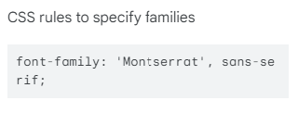
IF THE FONT’S NAME HAS SPACES IN IT, BE SURE TO ENCLOSE IT IN QUOTES, E.G., ‘Times New Roman’
Copy/past into the <head> element of your document

Slide 11
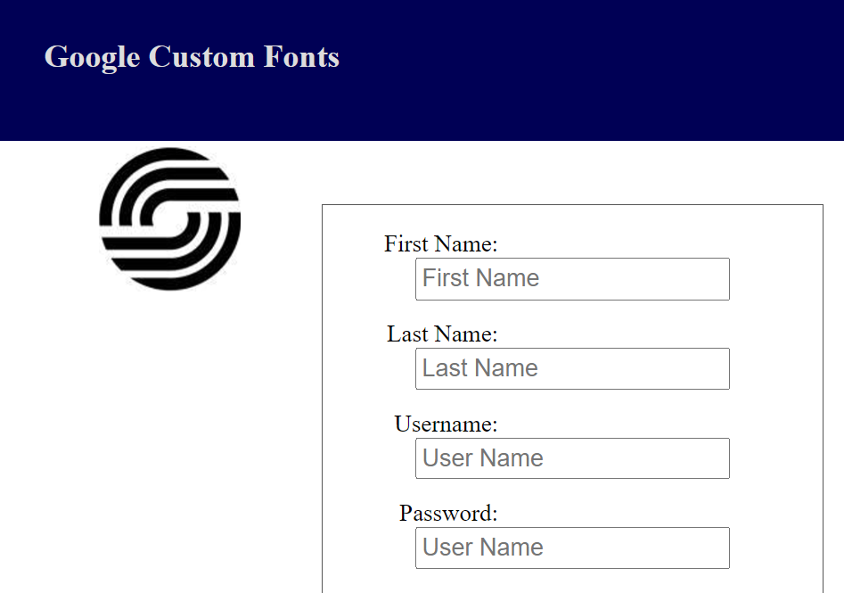
BEFORE

Slide 12
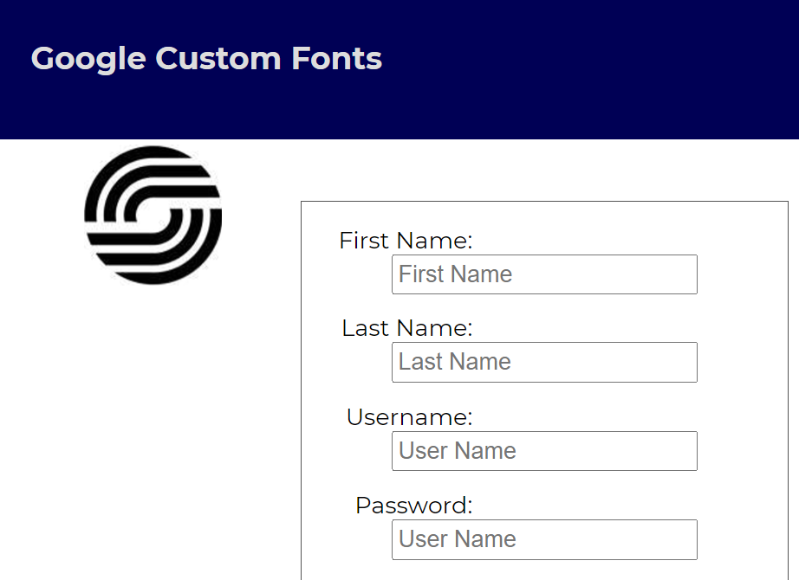
AFTER

Slide 13
A note of caution
You should use external fonts like this sparingly as they introduce performance overhead
The browser has to pull the font information from an external source
On a high-traffic site, this could become a noticeable issue

Slide 14
Domain Management
Your domain name is the core component of your online presence -- the address of a piece of online real estate that belongs only to you or your business
Choosing the right domain name and registering it are essential first steps for securing your company’s online home, but they’re not the only ones
To stay updated and secure, a domain needs ongoing management, whether it’s a single domain owned by a new entrepreneur or part of a large portfolio of domains owned by a large corporation

Slide 15
Domain Management
Domain management, or domain name management, refers to the ongoing tasks of keeping a personal or corporate domain (or domains) stable, secure, and able to support related websites
The domain name not only establishes its owner’s presence on the Internet, it also serves as a portal to a business or personal website designed to serve that owner’s unique needs
Site owners may be tempted to focus all their attention on setting up and maintaining the website itself, but managing the domain is a key factor in keeping the website live and accessible

Slide 16
How a domain name reaches your browser
You
register
Registrar
submits to
TLD Registry
ICANN
Domain owner
GoDaddy, Namecheap
Verisign (.com), IANA
Global oversight
Cloudflare, etc.
authoritative for TLD
of namespaces
set nameservers
You point your domain to nameservers, which hold DNS records
From registration to a live website
Authoritative DNS
A Record
Nameserver
DNS lookup
mysite.com →
Holds A, CNAME, MX
203.0.113.42
TXT records for your domain
TCP to IP:80/443
Your server listens on that IP — web software maps domain → files + TLS
Web server
TLS Certificate
Apache or Nginx
Let's Encrypt / CA
VirtualHost config maps
Issued to domain name
domain → /var/www/…
Enables HTTPS (port 443)
HTML / assets
encrypted
Browser
Renders the page at https://mysite.com

Slide 17
Domain Management
Securing a domain requires only a few steps
Finding the right domain name can take some time and thought, plus the help of online tools to perform a domain name search and check availability, but once a name has been picked, all that’s needed is to register it either with an independent registrar or a web hosting company for a term of one or multiple years
Once registered, the name is assigned to a host’s primary and secondary nameservers, which point the domain to a website

Slide 18
Domain Management
Individual users and small businesses might find that a single domain name is all that’s needed to establish an online presence and develop a brand
Larger corporations and those with a number of different business interests may need multiple domains
Many registrars recommend buying as many related domain names as possible to keep them from being used by competitors and to capture all possible variants that might be typed in during a search—including misspellings
That can result in a large portfolio of domain names, some of which may never be used
Whether a user buys one domain or many, though, ongoing management keeps them updated and working to support the websites they serve

Slide 19
Domain Management - How it Works
Domain management can take various forms, depending on a domain owner’s individual goals and needs
In general, a domain owner needs to be able to perform essential tasks such as renewing or terminating domain name registration, determining nameservers and hosting providers, and making changes to domain names if needed

Slide 20
Domain Management - How it Works
Because a domain establishes its owner’s online identity, managing that domain can also include checking for similar names that might be harmful to a brand’s reputation or authority, or tracking analytics to see how it performs in searches
Another key part of domain management involves security—validating IP addresses associated with the domain and checking for suspicious access to the domain

Slide 21
Domain Management - Tools & Options
Essential domain management tools are available either through the registrar, or they can be integrated into the control panel provided by a web hosting service
These tools offer a graphical, non-technical way to manage settings related to maintaining all the domains on a user’s account
These DIY management tools allow users to handle key tasks such as renewing or terminating domain registrations, validating IP addresses, and configuring nameservers

Slide 22
Domain Management - Tools & Options
A variety of paid and free domain management tools online can also handle essential tasks such as registering and renewing domains, managing multi-domain portfolios, and tracking domain performance
Some may also include domain name generators and other tools for managing multiple registrars and nameservers, and for keeping domains secure

Slide 23
Domain Management - Tools & Options
Available through the cloud or downloadable to a user’s own desktop, these tools allow users to control all aspects of domain management on their own
Domain management can also be outsourced—this is an appealing option for users with multiple domains or corporations with a large domain portfolio

Slide 24
Domain Management - Services
Because businesses of all sizes often buy multiple related domain names with different extensions, they can end up with a large portfolio of domains, some of which may lie dormant for long periods of time or never be used at all
Others may be associated with different nameservers or with hosting accounts that have varying terms of renewal
To manage a large and diverse collection of domains, corporate users may turn to domain management services, which offer a variety of service plans for tracking and maintaining all the active and inactive domains in the portfolio

Slide 25
Domain Management - Services
Domain management services use their own suite of domain management tools to handle domain registrations and renewals, review the portfolio and delete unused and unneeded domains, and maintain domain security
With sophisticated analytics for tracking unauthorized uses, site performance, and other key metrics, these services can work with clients to address issues and make changes to existing domains or the portfolio as a whole
While domain management services are widely used by larger businesses, they can also be a useful solution for busy domain owners running small- or medium-sized – businesses, or even individuals who don’t want to manage domains themselves

Slide 26
Purchasing Your Own Domain

Slide 27
Your Own Domain
There are many companies from whom you can purchase a domain
The Internet Corporation for Assigned Names and Numbers (ICANN) is the agency that is actually responsible for, among other things, domain registration
Other companies, such as GoDaddy, act as middlemen between their customers and ICANN

Slide 28
Your Own Domain
The following slides use illustrations from GoDaddy, but it is not, by far, the only company out there that will (for a fee) register an available domain name for its customers

Slide 29
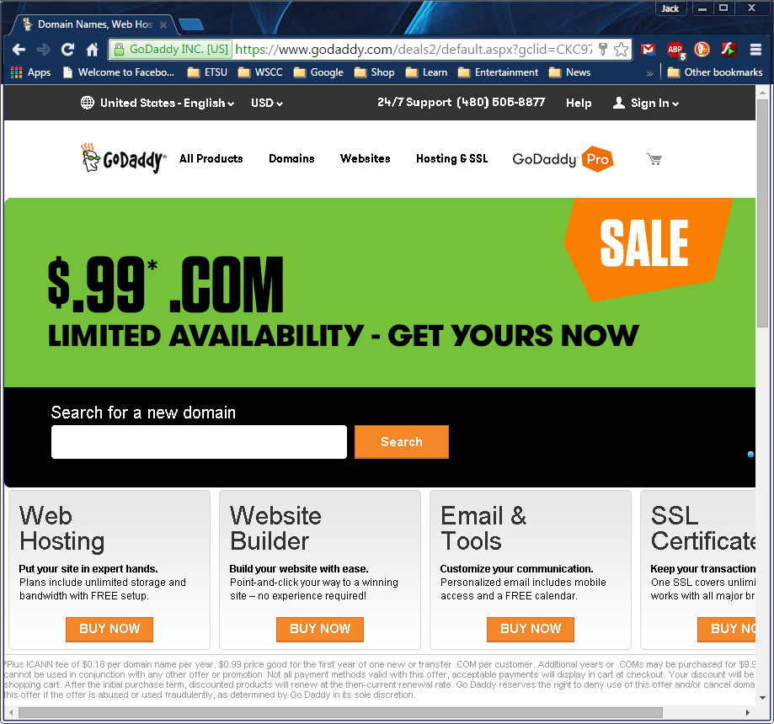
These screen shots are a little dated, but the links are still the same

Slide 30
These screen shots are a little dated, but the links are still the same

Slide 31
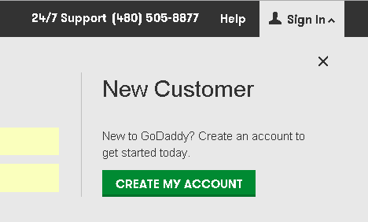

Slide 32
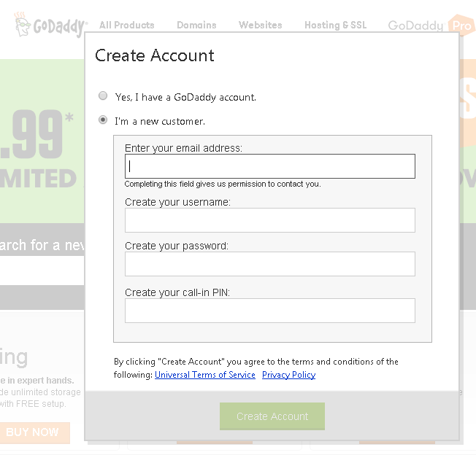

Slide 33
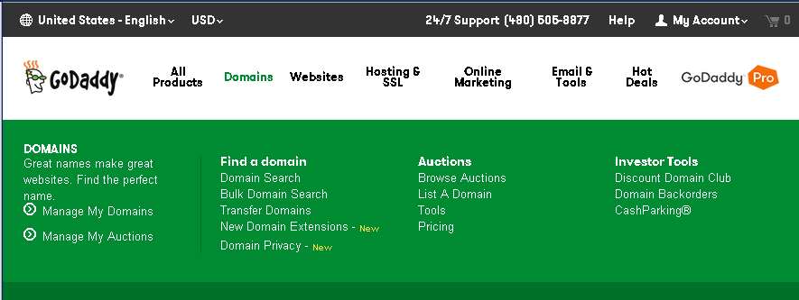
1
2
These screen shots are a little dated, but the links are still the same

Slide 34
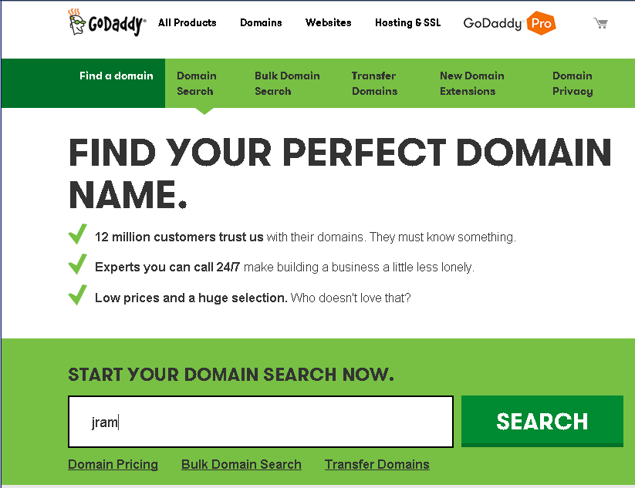

Slide 35
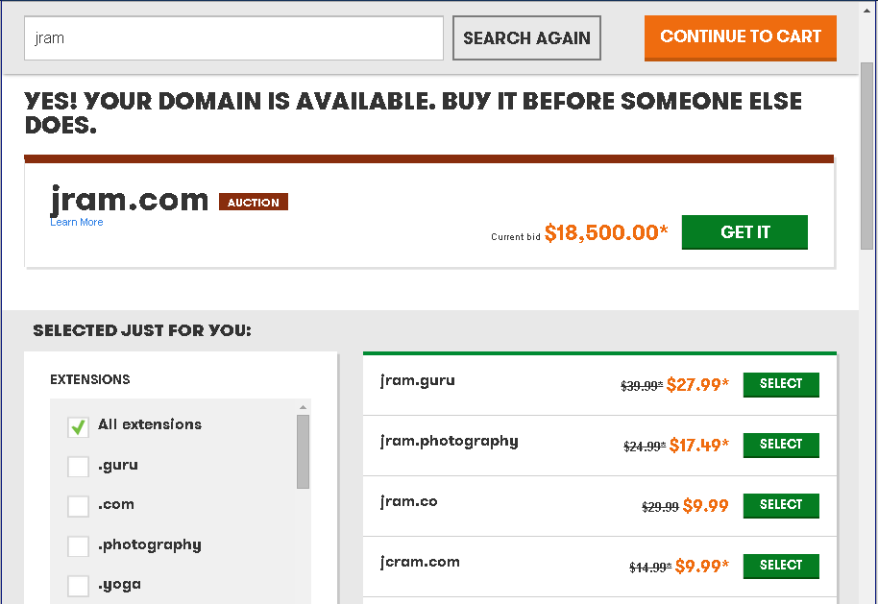

Slide 36
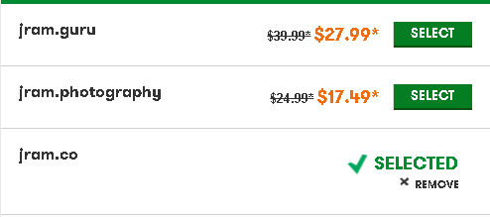

Slide 37
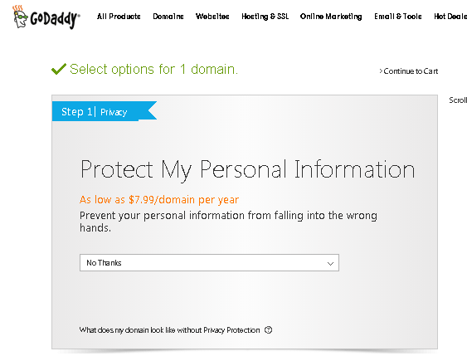
It’s a good idea to invest a little additional money into obscuring your personal information through a third party
Otherwise, your PII will be visible to anyone on the Internet!

Slide 38
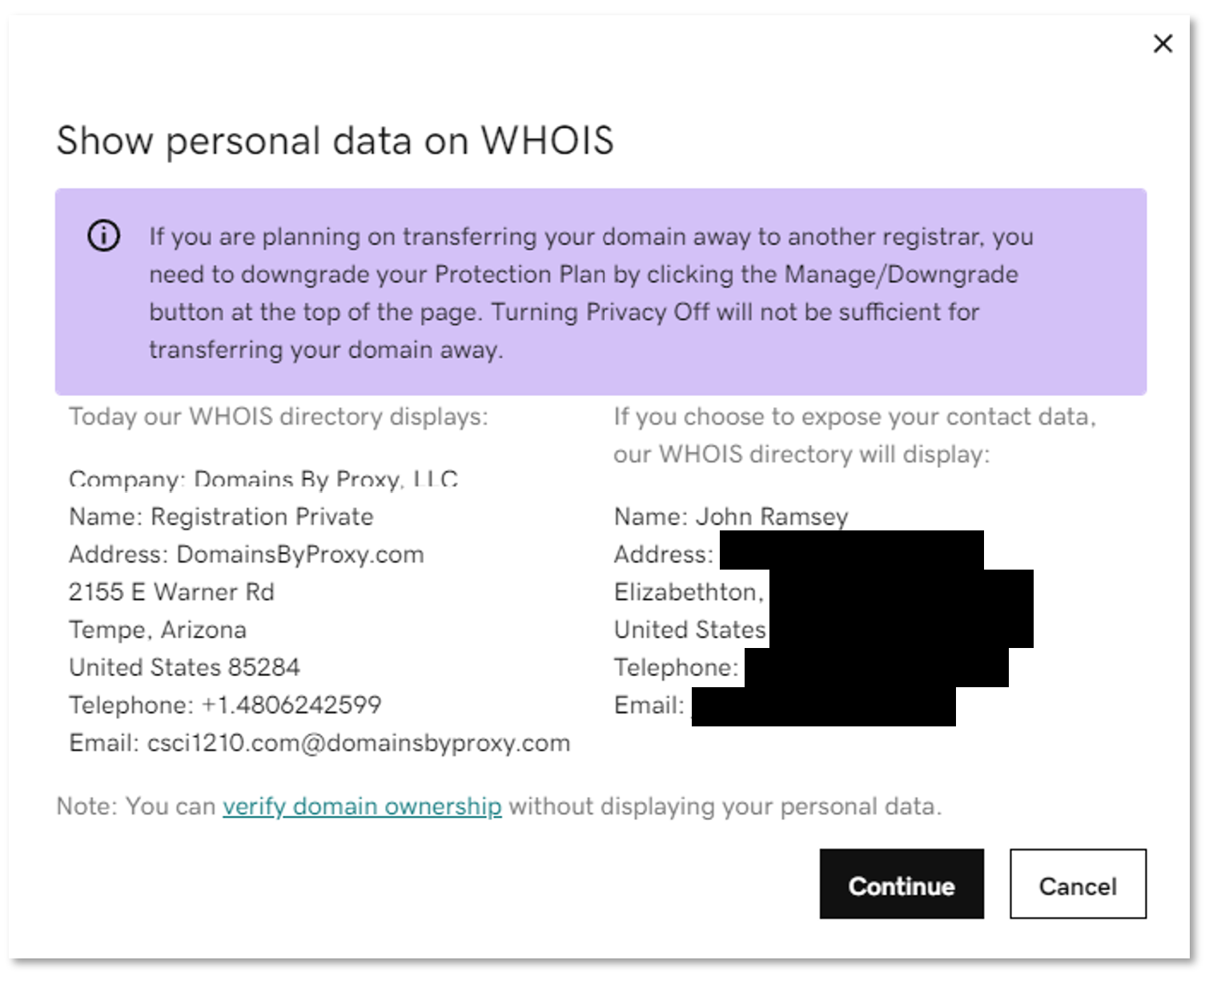
It’s a good idea to invest a little additional money into obscuring your personal information through a third party
Otherwise, your PII will be visible to anyone on the Internet!

Slide 39
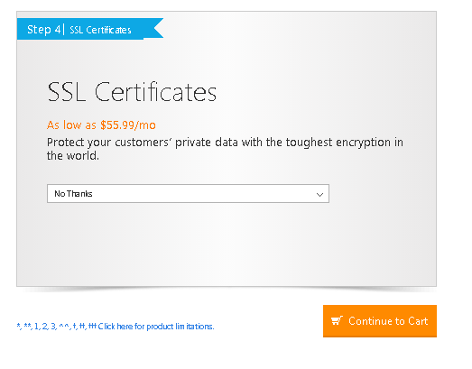
SSL Certificates secure your site
Providers like GoDaddy will add them for a fee
A system administrator can add them for free (LetsEncrypt.org)
Just about everybody is locking their sites, these days, thanks to LetsEncrypt

Slide 40
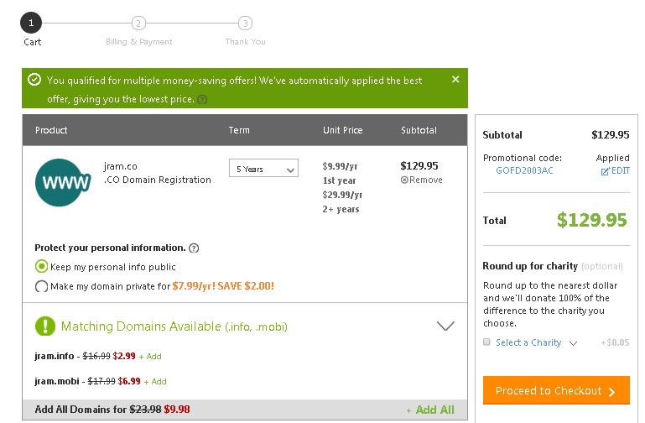

Slide 41
Managing Your Domain
(On GoDaddy)

Slide 42
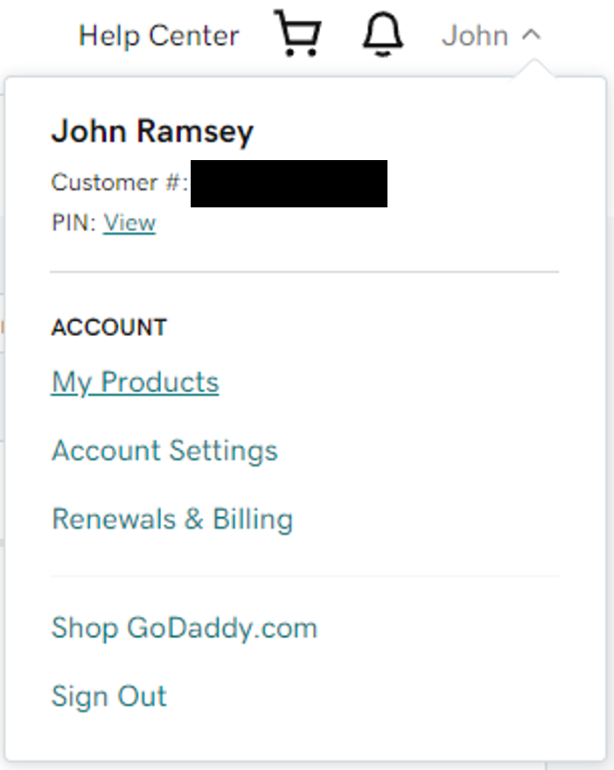

Slide 43
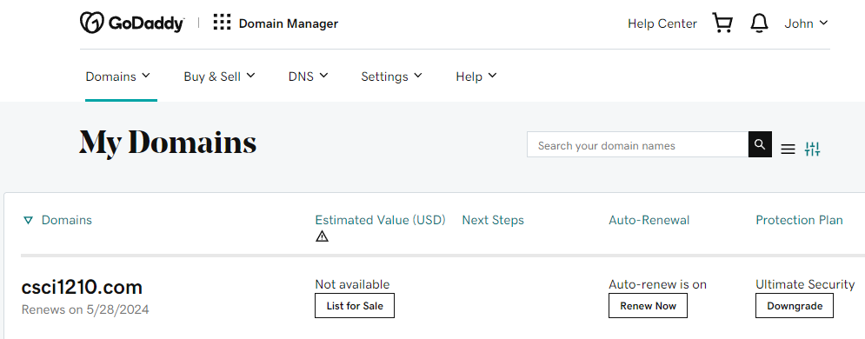

Slide 44
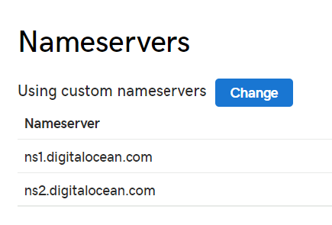
Here, we’re using a third party (DigitalOcean) as home to the actual servers that host the site So, GoDaddy provides the domain name-to-IP address mapping, but ‘points’ to DigitalOcean’s nameservers When someone looks up ‘csci1210.com,’ GoDaddy redirects the search to DigitalOcean, which resolves the IP address - 192.34.56.101

Slide 45
Services like GoDaddy are perfectly willing and able to provide a complete website solution, including design, deployment, SEO (Search Engine Optimization), and marketing
For $$
We prefer to do a lot of the above work ourselves and just use GoDaddy for my domain name (e.g., csci1210.com) registration only

Slide 46
Web Development
Important to Remember

Slide 47
Web Development
We’re spending a lot of our time this semester exploring the basics of web development
As such, we’re doing a lot of ‘one-off’ labs to illustrate and practice different concepts (e.g., elements, structure, styling, etc.)

Slide 48
Web Development
Beyond our class, however, it is important to remember that an effective, enterprise website includes a lot more
A web site can make (or break!) an organization
Creating an effective website requires a lot of different talents and skills
Not just Programming

Slide 49
Web Development
Web sites are usually a result of teams of people working together toward a common goal
This is the reason for our semester project - working as part of a team
Each team member brings his or her own set of education, experience, skills, and knowledge to the project
Here, we see the ‘Gestalt,’ the whole being greater than the sum of its parts, in action

Slide 50
Web Development
An effective web site is the result of a lot of different considerations, from
Concept, Requirements gathering, Design, Media, Coding, Testing, Marketing, Re-Design, all the way to Maintenance, …and more

Slide 51
Web Development
The Department of Computing presents other classes that continue with the basics we’re learning here, both directly and indirectly:
CSCI 1720 - Intermediate Web CSCI 2910 - Server Side CSCI 3110 - Advanced Web
CSCI 4250 - Software Engineering I CSCI 4350 - Software Engineering II CSCI 4417 - Introduction to System Administration CSCI 4927 - Human Computer Interaction

Slide 52
Conclusion
Learning how to craft a full-blown website must begin with basics - the ‘building blocks’
We can then use those to create more sophisticated solutions
Ultimately, we will possess the knowledge and skills to product effective, dynamic websites that fulfill our clients’ and users’ needs to make the web a productive part of clients’ business practices

Slide 53


Copyrights
Presentation prepared by and copyright of John Ramsey, East Tennessee State University, Department of Computing . (ramseyjw@etsu.edu)
Microsoft, Windows, Excel, Outlook, and PowerPoint are registered trademarks of Microsoft Corporation.
IBM, DB2, DB2 Universal Database, System i, System i5, System p, System p5, System x, System z, System z10, System z9, z10, z9, iSeries, pSeries, xSeries, zSeries, eServer, z/VM, z/OS, i5/OS, S/390, OS/390, OS/400, AS/400, S/390 Parallel Enterprise Server, PowerVM, Power Architecture, POWER6+, POWER6, POWER5+, POWER5, POWER, OpenPower, PowerPC, BatchPipes, BladeCenter, System Storage, GPFS, HACMP, RETAIN, DB2 Connect, RACF, Redbooks, OS/2, Parallel Sysplex, MVS/ESA, AIX, Intelligent Miner, WebSphere, Netfinity, Tivoli and Informix are trademarks or registered trademarks of IBM Corporation.
Linux is the registered trademark of Linus Torvalds in the U.S. and other countries.
Oracle is a registered trademark of Oracle Corporation.
HTML, XML, XHTML and W3C are trademarks or registered trademarks of W3C®, World Wide Web Consortium, Massachusetts Institute of Technology.
Java is a registered trademark of Sun Microsystems, Inc.
JavaScript is a registered trademark of Sun Microsystems, Inc., used under license for technology invented and implemented by Netscape.
SAP, R/3, SAP NetWeaver, Duet, PartnerEdge, ByDesign, SAP Business ByDesign, and other SAP products and services mentioned herein as well as their respective logos are trademarks or registered trademarks of SAP AG in Germany and other countries.
Business Objects and the Business Objects logo, BusinessObjects, Crystal Reports, Crystal Decisions, Web Intelligence, Xcelsius, and other Business Objects products and services mentioned herein as well as their respective logos are trademarks or registered trademarks of Business Objects S.A. in the United States and in other countries. Business Objects is an SAP company.
ERPsim is a registered copyright of ERPsim Labs, HEC Montreal.
Other products mentioned in this presentation are trademarks of their respective owners.

