Slide 1


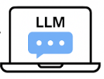
SANZI: LOCAL DEPLOYMENT OF TINY LANGUAGE MODELS ON AN APPLE M1
LOCAL LLM INFERENCE ON MACBOOK AIR (M1)
PROJECT AT A GLANCE
Move LLM inference from the cloud to the user’s own device for more privacy, control and independence from external services.
Motivation
Build SANZI, a chatbot using Llama-3.2-1B Instruct and Qwen1.5-0.5B Chat, with a configurable CLI and GUI.
Task
Make SANZI practical on an 8 GB Apple M1 using quantization, memory safeguards, OOM recovery and prompt engineering.
Challenge
Presented by:
Muhammad Hasan Al Banna
Matriculation no: 2951869
Project Supervisor: M.Sc. Jingcun Wang
30.06.2026
:, without using Ollama or llama.cpp.
:.
Notes:
Good afternoon everyone. I worked on a project ‘Local Deployment of Tiny Language Models on a Personal PC.’
The idea was to build a local AI system using small LLMs that run directly on user’s own device instead of relying on cloud services. This can give the user more privacy, more control and less dependence on external services.
For my project, I built a chatbot called SANZI using two tiny language models: Llama-3.2-Instruct with 1Billion parameter and Qwen1.5-Chat with half a billion parameter.
The main challenge was to make it work properly on my MacBook Air M1 with only 8 GB unified memory.

Slide 2
PRESENTATION ROADMAP
WHY
HOW
LEARN
Problem &
Objective
Architecture &
8 GB Strategy
Results &
Takeaways
Why local LLMs on
limited hardware?
Architecture • Quantization
• Memory • OOM handling
Performance • limits
• future work
1
2
3
4
5
→
WHAT
SHOW
What SANZI
Delivers
Live GUI
Demo
Models • CLI • GUI
• configurable controls
SANZI running locally
on MacBook Air M1
Notes:
This is the roadmap of my presentation.
First, I will explain the problem and objective. Then I will show what SANZI delivers and how the system is designed.
After that, I will show the live GUI(GuuEE) demo.
Finally, I will present the results, key takeaways and future work.

Slide 3

WHY running the model locally?
STANDARD CLOUD-BASED INFERENCE
→
→
→
AI
→
•••
User
Internet
External Provider
LLM / Model
Response
Prompts are sent off-device for processing
Network access is required and can add latency
Inference depends on an external service and may create API cost
Limited direct control over processing location and runtime
LOCAL LLM INFERENCE
Prompts and conversation stay on the user’s device
More direct control over model, precision and runtime
No external inference API or per-request API cost
for normal chat
No network round-trip for inference and less dependence on external providers
OUR APPROACH: Run LLM inference locally to give users more direct control and reduce dependence on external providers.
Notes:
So...why running model locally?
In typical cloud-based operation, the user sends a prompt through the internet to an external provider. So the prompt (maybe include important personal information or sofisticated data) leaves the user’s device, here is the conceren!!!! On top of that, Unintrurupt internet connection is required and the whole processing depends on third party service.
This can also add network delay, API cost and the user has less direct control over the runtime.
But if we use local models, the prompts and conversation stay on the user’s own device. No internet, no external API is needed for normal task. And the user has more direct control over the model, precision and runtime.
This is the main idea behind our local approach.

Slide 4
WHAT SANZI DELIVERS
Two Local Models
Two Interfaces
AI
• Llama-3.2-1B-Instruct
• Qwen1.5-0.5B-Chat
(One active model at a time)
>_
• Required Command-Line Interface(CLI) chatbot
• Final Vue 3 & Vite Graphical User Interface (GUI)
• Both run the models locally
User Controls
Precision & Memory Safeguards
• Max output tokens
• Temperature · top-p · seed
• Conversation history
• Clear / remove rounds / model switching
• FP16 · 8-bit Metal · 4-bit Metal
• 2500-token safe input budget
• Memory cleanup
• OOM detection and recovery
✓
From the required CLI chatbot to a complete local GUI system with configurable inference and memory safeguards.
Notes:
Here I will summarize what SANZI provides.
It supports two tiny language models: only one model active at a time.
I first implemented the CLI chatbot and then a Graphical user interface (GUI)usinng Vue 3 (view3)and Vite.
The user can control settings like maximum output tokens, temperature, top-p and seed and can also manage the conversation history.
For stable local operation, SANZI supports standard FP16 (16-bit Floating Point), as well as 8-bit and 4-bit quantization on Apple Silicon. It also includes a safe 2.5K-token input limit, memory cleanup, and Out of Memory (OOM) detection and recovery.

Slide 5
SANZI SYSTEM ARCHITECTURE
Two interaction paths, one on-device inference stack
01 CLI APPLICATION PATH
03 LOCAL EXECUTION
Command-Line
Interface (CLI)
CLI Python Processing
Prompt preparation + tokenizer
Supported Models
Llama-3.2-1B-Instruct
Qwen1.5-0.5B-Chat
One active model at a time
02 GUI / BACKEND APPLICATION PATH
USER
Local Python
Backend
ChatService
LocalLLMEngine
GUI Frontend
HTTP /
JSON
Vue 3 + Vite
PyTorch + Hugging Face Transformers
Conversation
History
Generation Settings
max output tokens
temperature · top-p · seed
Apple M1 / MPS
tested execution environment
Generated Response
CLI and GUI use different interaction paths but share the same local model execution environment.
Notes:
Here is the main architecture of SANZI.
There are two different application paths. The first one is the CLI path. The user interacts with the command-line interface using the terminal of the device, then the CLI python handles prompt preparation and tokenization , then sends the request to the selected local model.
The second path is the GUI path. Here, the user interect via the Frontend interface. The Vue 3 frontend communicates with the local Python backend using HTTP and JSON. The request then goes through ChatService and LocalLLMEngine. ChatService also manages the conversation history and generation settings, while LocalLLMEngine directly Control Local Models.
Both paths finally use the same supported local models.
The models run through PyTorch and Hugging Face Transformers. Hugging Face Transformers is used to load the tokenizer and the model and to handle the generation process. PyTorch performs the actual neural-network calculations. On the Apple M1, PyTorch uses MPS, or Metal Performance Shaders, to run those calculations on the Apple GPU. Then the generated response is returned to the user.

Slide 6
QUANTIZATION FOR MEMORY-EFFICIENT LOCAL INFERENCE
Quantization represents model weights with fewer bits, reducing the memory required to store them during local inference.
WHAT QUANTIZATION DOES
FP16
8-bit Metal
4-bit Metal
16 bits / weight
8 bits / weight
4 bits / weight
→
→
1× baseline
~½ theoretical
~¼ theoretical
SANZI MODES FP16 · 8-bit Metal · 4-bit Metal
THEORETICAL WEIGHT MEMORY IN SANZI
WHY IT MATTERS FOR SANZI
Precision | Llama 1B | Qwen 0.5B
FP16 (Baseline) | ~2.0 GB | ~1.0 GB
8-bit Metal | ~1.0 GB | ~0.5 GB
4-bit Metal | ~0.5 GB | ~0.25 GB
MacBook Air M1 with 8 GB unified memory
M1
8 GB
Lower-bit weights reduce pressure on limited shared memory
More memory remains for runtime and conversation context
Values show theoretical weight memory only; actual runtime memory also includes metadata, activations, context and framework overhead.
Notes:
Now I want to talk briefly about the quantization part.
If I remember correctly, during the mid-term presentation the professor asked me ‘how we can reduce memory usage while keeping the same number of model parameters.’
The answer is quantization.
We keep the same model structure and the same number of parameters, but we store each weight using fewer bits.
For example, instead of 16-bit precision, we can use 8-bit or 4-bit. The theoretical weight memory for Llama 1B is about 2 GB in FP16, around 1 GB in 8-bit and around 0.5 GB in 4-bit. For Qwen 0.5B, it is roughly half of these values.
That is why quantization is very useful for a limited-memory device like my MacBook Air M1 with 8 GB unified memory.
But lower precision does not always mean faster inference, which I will show in the results.
ewer bits.

Slide 7
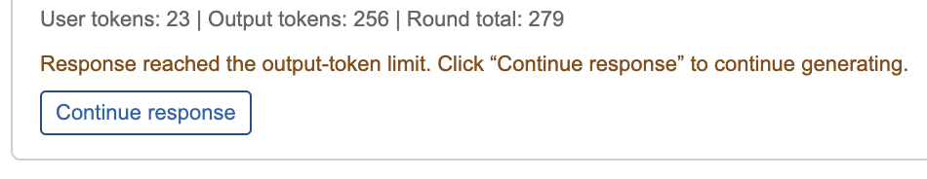
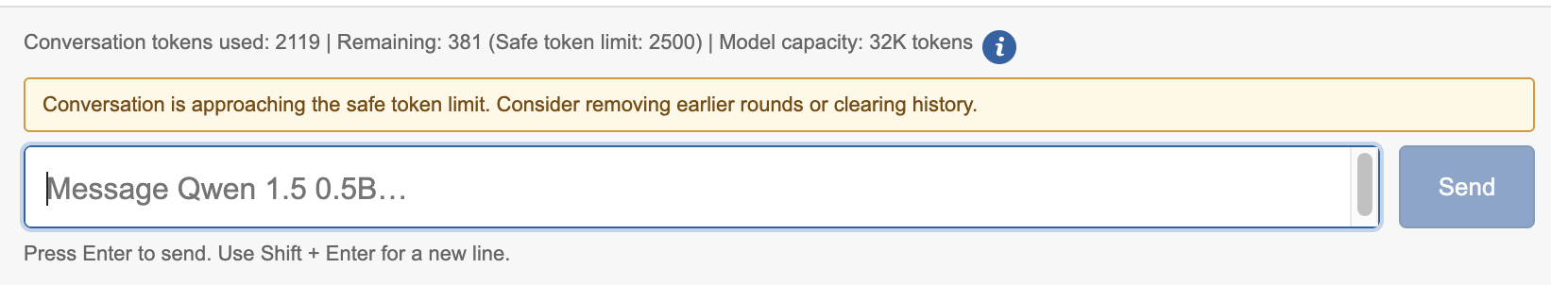
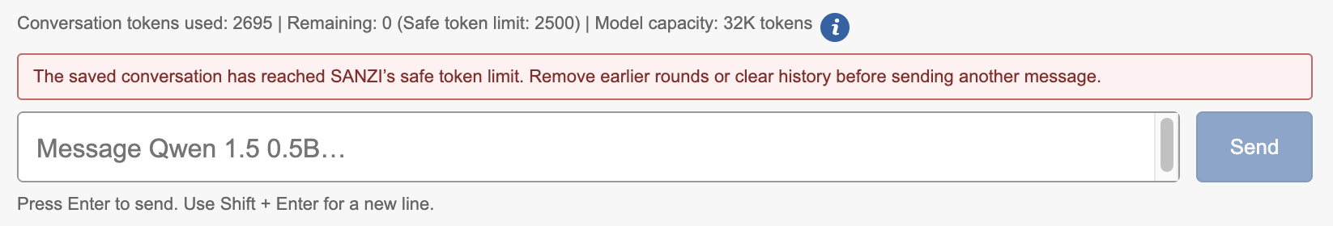
MAKING LOCAL INFERENCE WORK ON 8 GB
M1
8 GB
HARDWARE CONSTRAINT
Model weights, conversation context, runtime tensors and macOS share the same memory pool.
Apple M1 · 8 GB Unified Memory
PROACTIVE MEMORY SAFEGUARDS
Precision modes (Quantization)
Clean Model Switching
One active model at a time
1 Max output reached → generation stops safely → user can continue
2 Approaching safe token limit → warning asks user to clean history
3 Safe token limit reached → new input blocked until history is reduced
OOM RECOVERY
→
→
Application remains alive
OOM detected
Memory cleanup
Handled during model
loading and generation
loading or generation
SANZI prevents memory pressure early and uses OOM recovery as a final safety layer.
Notes:
Now I want to explain how I made the models run on my local device with limited resources.
Here, the 8 GB memory is shared by the model, conversation context, runtime tensors and macOS.
As I explained before, quantization helps reduce the memory needed for the model weights.
I also keep only one model active at a time and use clean model switching so the previous model does not stay in memory.
I also added safeguards for the conversation. The user can control the maximum output length.
When the conversation gets close to the 2500-token safe limit, SANZI gives a warning. If the limit is reached, new input is blocked until old conversation rounds are removed or the history is cleared.
And if an OOM error still happens during model loading or generation, SANZI cleans the memory and keeps the application alive.
So this is how I combined different techniques to make local inference practical on an 8 GB device.

Slide 8
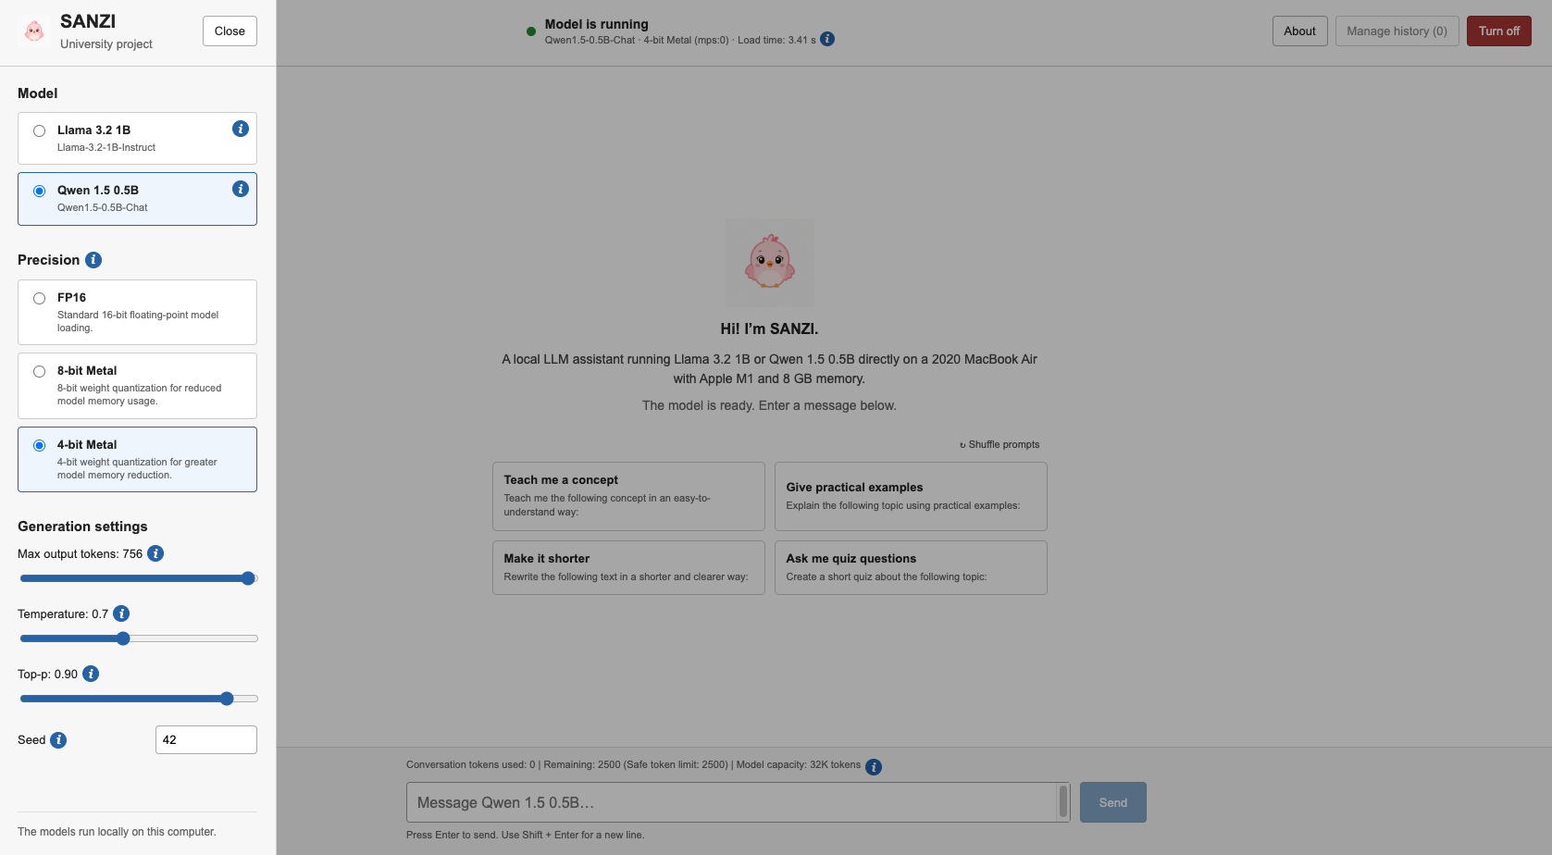
LIVE GUI DEMO
SANZI running locally on MacBook Air (M1)
DEMO FLOW:
1
Select model & precision
Llama / Qwen
FP16 / 8-bit / 4-bit Metal
2
Configure generation
Max output · Temperature
Top-p · Seed
3
Run a local prompt
Generate a response directly
on the device
4
Inspect runtime controls
Token information · History controls
Model switching
All normal chat inference runs locally — no external inference API is used.
CLI functionality was demonstrated during the mid-term presentation.
Notes:
[Sources]
- No external assets used on this slide.
- The right-side screenshot area is intentionally blank for the presenter to fill manually.

Slide 9
EXPERIMENTAL RESULTS
GENERATION THROUGHPUT · TOKENS / SECOND
Qwen-0.5B
Llama-1B
KEY FINDINGS
FASTEST AVERAGE CONFIGURATION Qwen 4-bit Metal — 24.22 tokens/s
QWEN
24.22
Highest throughput in all tested precision modes.
23.03 → 23.97 → 24.22 tokens/s
25
23.03
23.97
20
LLAMA
15
No clear throughput improvement with lower precision. 8.87 → 8.52 → 8.87 tokens/s
10
8.87
8.52
8.87
5
MAIN LESSON
0
Lower precision does not automatically mean higher throughput.
FP16
8-bit Metal
4-bit Metal
AVERAGEMODEL LOAD TIME · SECONDS
MODEL
FP16
8-BIT
4-BIT
In these repeated tests, the speed effect depended on the model and MPS execution path.
Qwen-0.5B
1.69 s
1.87 s
1.95 s
Llama-1B
4.58 s
5.47 s
6.54 s
✓ All 30 benchmark runs completed successfully
Apple M1 · 8 GB unified memory · MPS Seed 42 · Temperature 0.7 · Top-p 0.9 · Max output 150
Same prompt · 5 runs per configuration · mean reported
Notes:
Here are the experimental results.
I tested all six model and precision combinations five times and report the average values.
Based on results, I can summarise Qwen was faster than Llama in all three precision modes. This is not surprising because Qwen is the smaller model, with about 0.5 billion parameters, while Llama has about 1 billion parameters.
For Qwen, the throughput increased slightly from 23.03 tokens per second in FP16 to 24.22 tokens per second in 4-bit Metal, which was the fastest average configuration.
Llama behaved differently. Its throughput stayed almost the same across the three modes: 8.87, 8.52 and 8.87 tokens per second.
The load-time results also show that Qwen loaded faster than Llama in these tests.

Slide 10
KEY TAKEAWAYS & NEXT STEPS
WHAT SANZI ACHIEVED
KEY TAKEAWAY
✓
Local deployment of Llama-3.2-1B-Instruct and Qwen1.5-0.5B-Chat
“SANZI shows that practical local LLM deployment depends not only on model size, but also on precision, memory management and hardware-aware system design.”
✓
Functional CLI and GUI with configurable generation controls
✓
FP16, 8-bit Metal and 4-bit Metal execution on Apple M1
Memory safeguards and OOM recovery for limited hardware
Local inference can reduce dependence on external providers while giving the user more direct control over where prompts are processed.
✓
FUTURE WORK:
GPU
MEM
SLM
AI+
CROSS-PLATFORM
ACCELERATION
SMARTER LOCAL
PERSONALIZATION
BROADER MODEL
SUPPORT
TOWARDS A PERSONAL
AI SYSTEM
Extend optimized execution to NVIDIA CUDA and other hardware.
Add persistent local memory and user-specific context.
Support more efficient small language models and future quantization options.
Keep normal inference and personal context local while allowing controlled access to external tools when fresh information is needed.
“From a local Chatbot prototype toward a more capable, user-controlled personal AI System.”
Notes:
Finally, I want to summarize what I achieved and where this project can go next.
SANZI successfully runs two tiny language models locally through both a CLI and a GUI. I also implemented different precision modes, memory safeguards and OOM recovery to make local inference practical on limited hardware.
The main thing I learned is that local LLM deployment is not only about choosing a small model. Precision, memory management and hardware also play an important role.
For future work, I would like to support other hardware such as NVIDIA GPUs, add more tiny models and build smarter local personalization and memory.
I am optimistic that one day having a personal AI could become as normal as having a personal computer. It could understand our preferences and personal context while keeping more of that information under our own control with minimum privecy risk.
For me, SANZI is a small step in that direction.

